Slide 1

Experimental Challenges for Hypernuclear Physics at Panda
Patrick Achenbach
U Mainz
with contributions from the PANDA Hypernuclear groups
Sept. 2o11

Slide 2
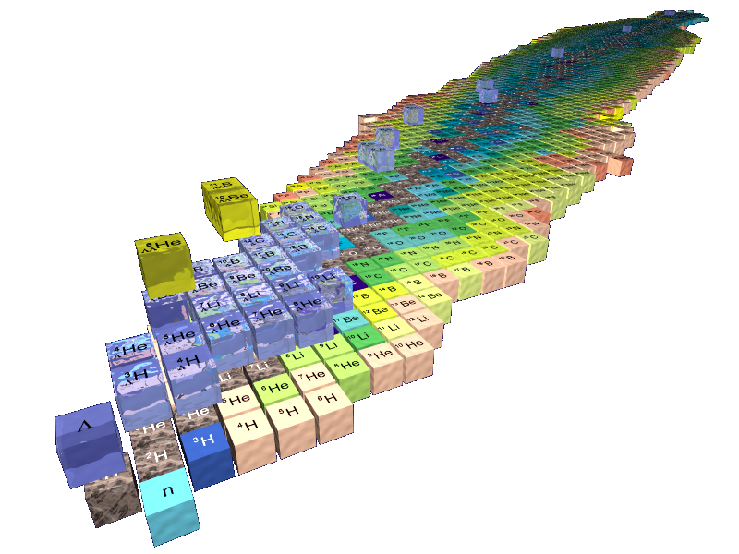
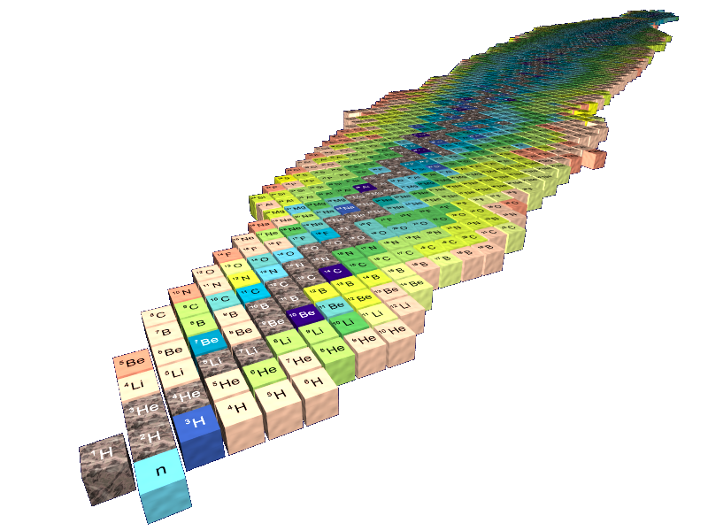
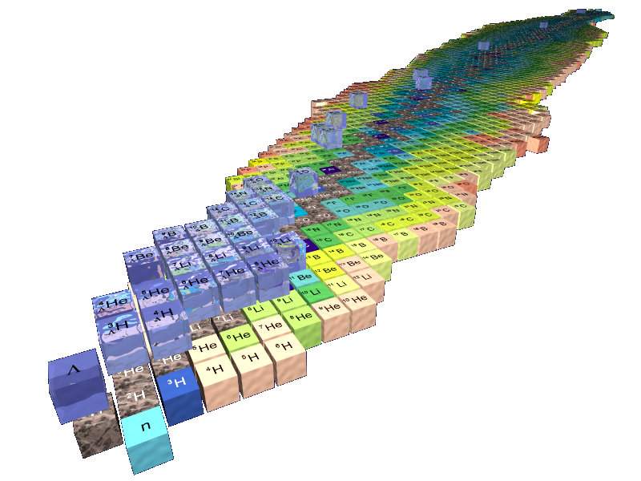
The hypernuclear landscape
number of baryons
N+Z+Y
element =
total charge
(not number of protons)
increasing strangeness
number of hyperons Y
Example:
⁷_{Λ}Li (⁶Li + Λ)
present limitations
only single Λ-hypernuclei close to valley of stability
only very few ΛΛ-hypernuclei events

Slide 3
Hypernuclear physics
Physics with single hypernuclei:
spectroscopy: nuclear structure and YN strong interaction, potential models …
life-time and mesonic/non-mesonic weak decay: weak interaction …
in-medium effects: change of Y-mass in nucleus, effects on magnetic moment ...
Physics with double hypernuclei:
spectroscopy: test of YY strong interaction
binding:
  ΔB_{ΛΛ}(^{A}_{ΛΛ}Z) = B_{ΛΛ}(^{A}_{ΛΛ}Z) - 2B_{Λ}(^{A-1}_{Λ}Z) accessible by emulsion experiments
  contribution of exchange mesons in YN and YY interaction
weak decay of double hypernuclei
atomic Ξ spectra (interplay of Coulomb and strong force)
increasing strangeness

Slide 4
Spectroscopy of ΛΛ-hypernuclei
[E. Hiyama, M. Kamimura, T.Motoba, T. Yamada and Y. Yamamoto, Phys. Rev. 66 (2002) , 024007]
many excited, particle stable states in double hypernuclei predicted
level structure reflects levels of core nucleus

Slide 5
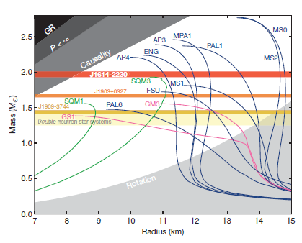
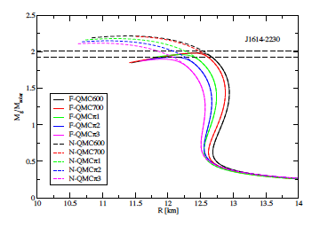

Excursion: strangeness in compact stars
→ equation-of-state (EOS) with/without strangeness
[J.R Stone, P.A.M. Guichon and A.W. Thomas]
→ experimental evidences of the 2M neutron star does not exclude hyperons in the EoS
[P. B. Demorest et al., A two-solar-mass neutron star measured using Shapiro delay, Nature 467, (2010) 1081]

Slide 6
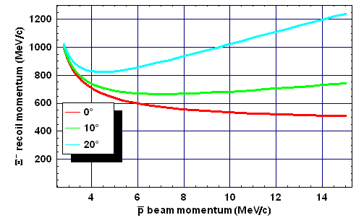
Formation of double hypernuclei from Xi particles
the hyperons may produce:
single hypernuclei: _{Λ}Z (_{Σ}Z)
twin hypernuclei: _{Λ}Z + _{Λ}Z‘
doubly strange hypernuclei: _{Ξ-}Z
double hypernuclei: _{ΛΛ}Z
H particle in a nucleus(?): ΛΛ
  dE(Ξ⁻)/dx → stop + capture
  hyperatom + atomic decay
  capture in nucleus (_{Ξ-}Z)
  conversion: Ξ⁻ + p → ΛΛ
  hypernuclei (_{ΛΛ}Z* or _{Λ}Z*+_{Λ}Z‘*)
strangeness production can only be tagged by the anti-hyperon or its decay products
forward detector
for trigger and particle ID
PANDA at FAIR

Slide 7
Production mechanism and detection strategy at PANDA
kaons
➀
hyperon- antihyperon production at threshold
trigger
_
p
3 GeV/c
Ξ⁻
➁
slowing down and capture of Ξ⁻ in secondary target nucleus
+28MeV
Λ
Λ
γ
Λ
Ξ⁻ atoms: x-rays
conversion:
  Ξ⁻ p → Λ Λ ‏
  ΔQ = 28 MeV
  conversion probability ~5-10%
☹
Λ
Λ
γ
Λ
➂
γ-spectroscopy of excited states
π
Λ
π
④
decay pion spectroscopy
[originally by J. Pochodzalla et al.]

Slide 8
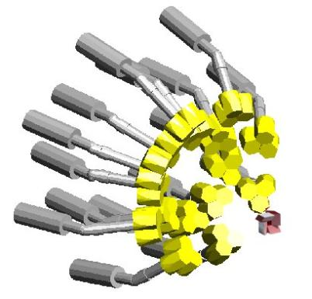
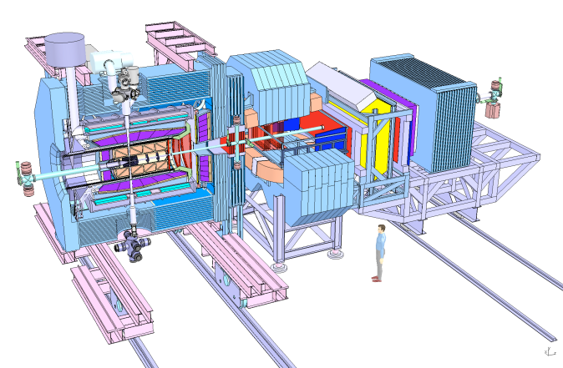
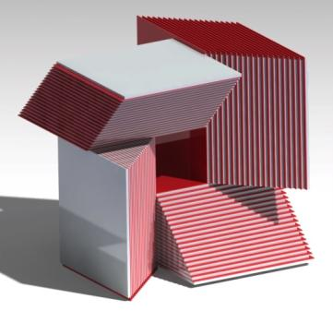
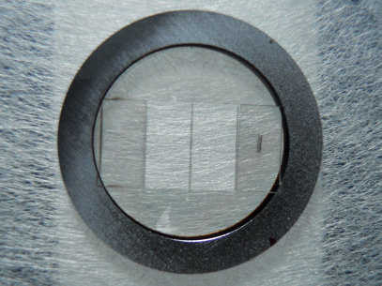
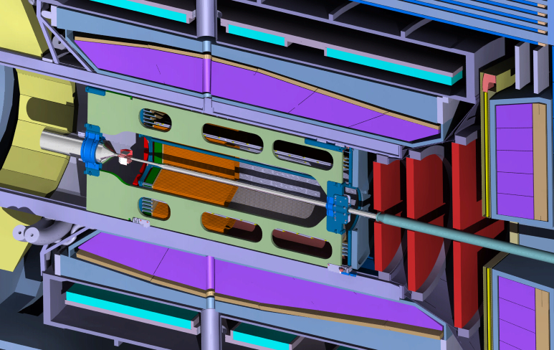

Instrumentation for hypernuclear physics at PANDA
Germanium detector array for hypernuclei spectroscopy
the Panda detector for forward angle particle identification
carbon wire primary target for Ξ production
secondary target for hypernuclei formation

Slide 9
Open issues being studied by the Panda Hypernuclear Groups
design and fabrication of the primary target
design and development of the secondary target
design and operation of the HPGe γ-array
electromechanical cooling of HPGe crystals
integration into the PANDA target spectrometer
simulation of the expected performance
technical
physics

Slide 10
Open issues being studied by the Panda Hypernuclear Groups
design and fabrication of the primary target
design and development of the secondary target
design and operation of the HPGe γ-array
electromechanical cooling of HPGe crystals
integration into the PANDA target spectrometer
simulation of the expected performance

Slide 11
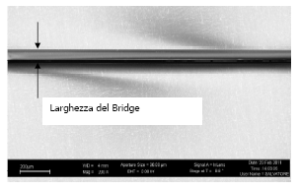

Prototype of the ¹²C thin wire target
Si ring
Wire
Diamond
Diamond
FESEM microscopy
wire width: 99.9 μm
Si ring outer φ=15 mm
Si ring inner φ=11 mm
Si ring thickness = 500 μm
diamond thickness = 3 μm
[F. Iazzi, PANDA Meeting 06 Sept. 2011.]

Slide 12
Open issues being studied by the Panda Hypernuclear Groups
design and fabrication of the primary target
design and development of the secondary target
design and operation of the HPGe γ-array
electromechanical cooling of HPGe crystals
integration into the PANDA target spectrometer
simulation of the expected performance

Slide 13
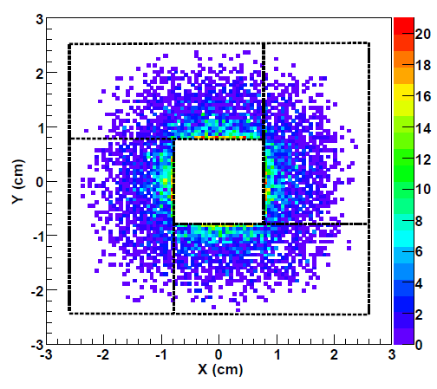
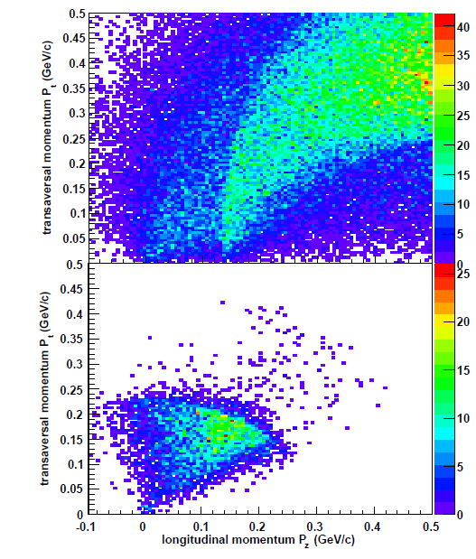
Stopping of the Xi particles
target geometry adjusted to stopping time and lifetime of Ξ-
[PANDA Physics Performance Report, 2009.]

Slide 14
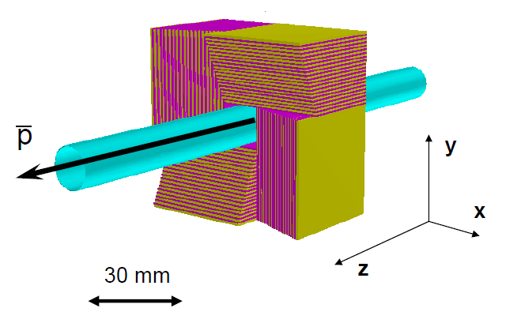
The secondary target design
four separated sections:
20 layers of double sided silicon strip detectors
(thickness 300 μm)
in each block
20 layers of absorbers
(thickness 1 mm)
different for each block
(Be, B and C)
boron
carbon
anti-Ξ and annihilation products
boron
[PANDA Physics Performance Report, 2009.]
beryllium
Notes:
Until now only the first part of the first step, the stop of the xi minus particles,
Were carried out. The production of the stopping points see in the figure
provides a first optimization of the secundary target.
The free angular range between 0 degree and 40 degree is sufficiently large for the detection of the associated kaons produced in the annihilation process and emitted mainly in the forward region.
The kaon trigger will be based on the detection of at least one K+ in the forward region Θ ≤ 40 degree not covered by the secondary target. We will use TOF and DIRC. To what extent the calorimter can be used is still open

Slide 15
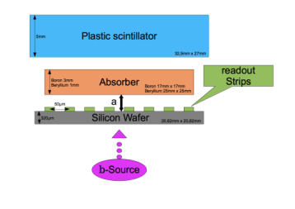
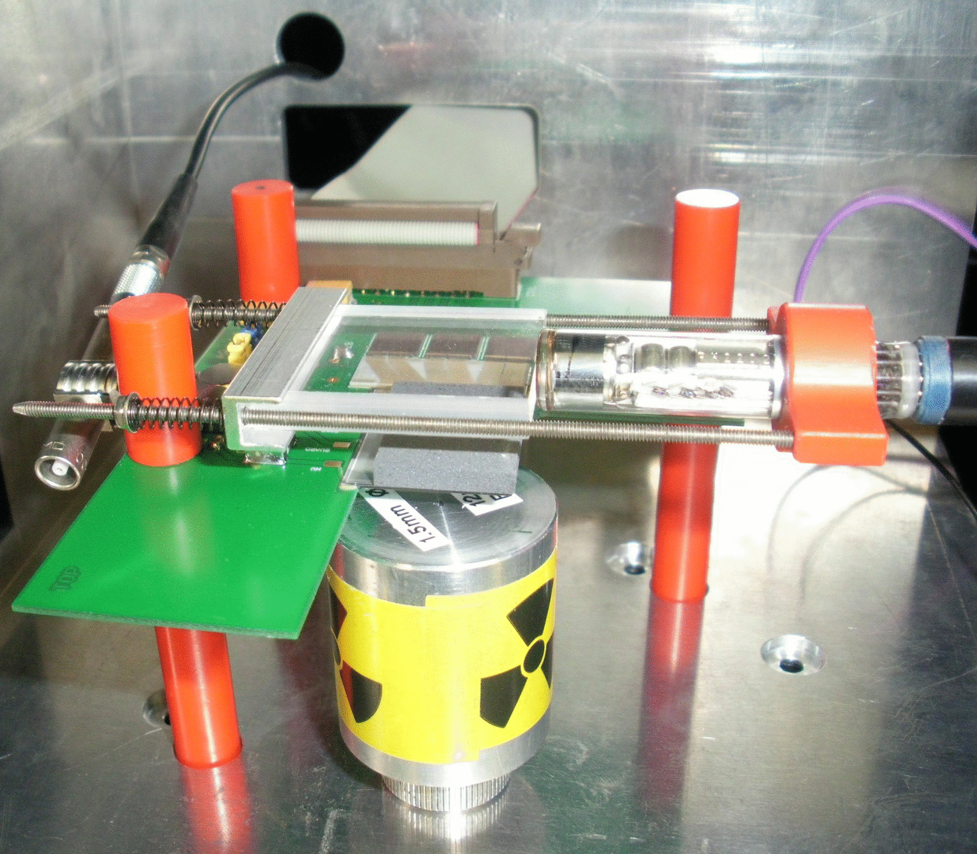
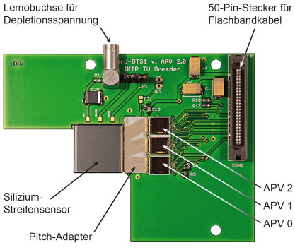
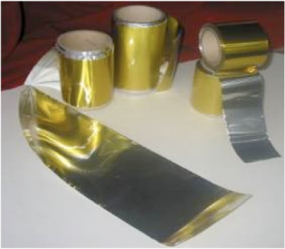
Prototype developments for the secondary target
  compact structure of detector and absorber:
    performance of silicon strip detector in direct contact with absorbers
  space required for frontend electronics:
    minimization of additional material masses
    on detecting volume:
    ultra-thin Al-Polyimide readout cables
      [J.M. Heuser et al., HadronPhysics2/JRA-ULISI]
[S. Bleser, U Mainz]
Notes:
To evaluate the feasibility of such detector structure
Effect of cable length on the signal transmission

Slide 16
Open issues being studied by the Panda Hypernuclear Groups
design and fabrication of the primary target
design and development of the secondary target
design and operation of the HPGe γ-array
electromechanical cooling of HPGe crystals
integration into the PANDA target spectrometer
simulation of the expected performance

Slide 17
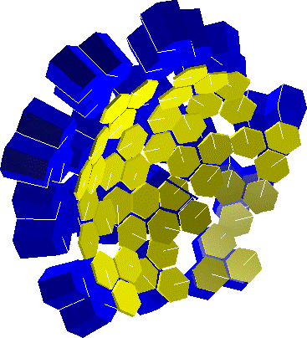
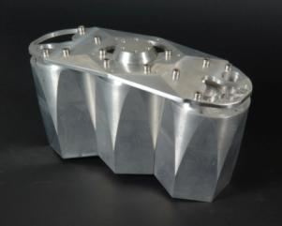
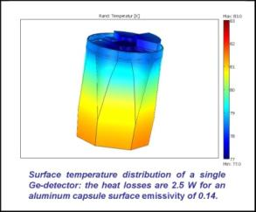
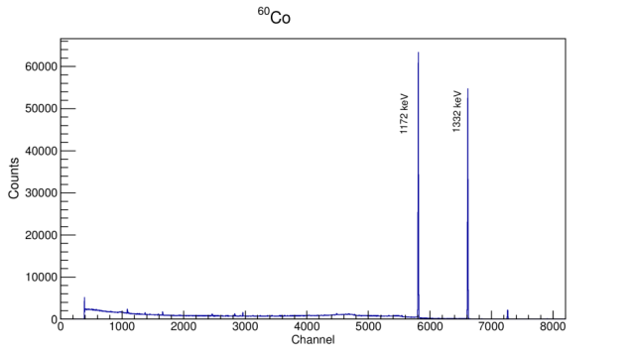

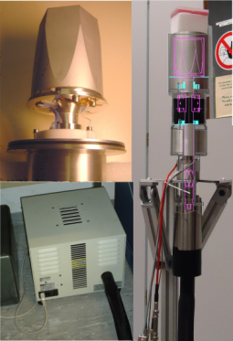

Towards a prototype of HPGe Cluster Array
  simulation of different multiplicity of crystals
  operation of double and triple cluster detector
  high rate environment:
    radiation damages
    pile-up effects
    electromagnetic background
  magnetic field environment:
    loss of resolution
Notes:
the major difficulty for the arrangement of the hypernclear setup is the limited space.
This point is soecially of big important for the arrangement of the germanium detectors array.
the performance of such mechanical cooling system together withe the influence on the energy resolution
has een tested sucessfully without any additional constarint on the enrgy resolution.
additionally to that, the deteftor has to be able to operate in a high rate environments. As a consequence, a dteail radiation damage study is
needed considering pile up effect, electromagnetic backround.

Slide 18
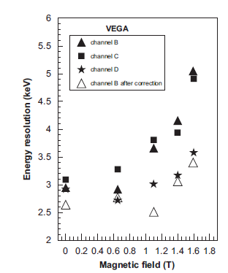
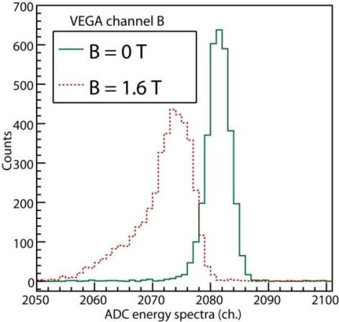
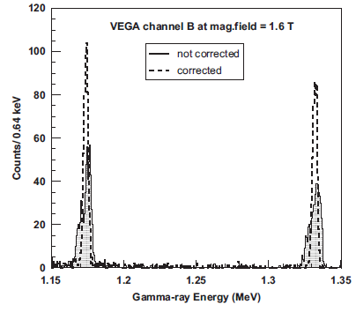
Performance of HPGe detectors in magnetic fields
  loss of resolution observed
  correction by rise-time correlation possible
[A. Sanchez Lorente et al., NIM A 573 (2007) 410.]

Slide 19
Open issues being studied by the Panda Hypernuclear Groups
design and fabrication of the primary target
design and development of the secondary target
design and operation of the HPGe γ-array
electromechanical cooling of HPGe crystals
integration into the PANDA target spectrometer
simulation of the expected performance

Slide 20
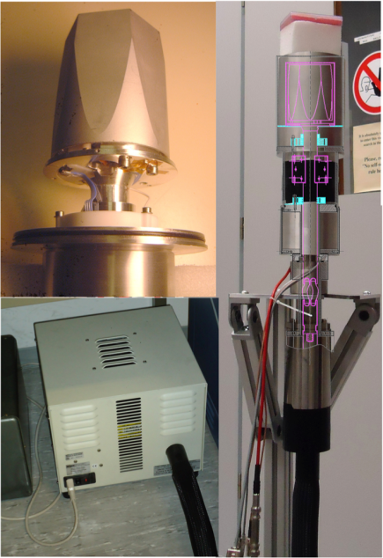

Towards a prototype of HPGe Cluster Array
HPGe encapsulated crystal
attached to electromechanical cooler
Flexible cold finger and flexible cold finger tube. Allows full use of the space available for detectors.
Detector Head fixing.
Electronics chamber
X-Cooler Head, partially hidden inside the electronics chamber
[M. Steinen, U Mainz, I. Kojouharov, GSI]
Notes:
the major difficulty for the arrangement of the hypernclear setup is the limited space.
This point is soecially of big important for the arrangement of the germanium detectors array.
the performance of such mechanical cooling system together withe the influence on the energy resolution
has een tested sucessfully without any additional constarint on the enrgy resolution.
additionally to that, the deteftor has to be able to operate in a high rate environments. As a consequence, a dteail radiation damage study is
needed considering pile up effect, electromagnetic backround.

Slide 21
Open issues being studied by the Panda Hypernuclear Groups
design and fabrication of the primary target
design and development of the secondary target
design and operation of the HPGe γ-array
electromechanical cooling of HPGe crystals
integration into the PANDA target spectrometer
simulation of the expected performance

Slide 22
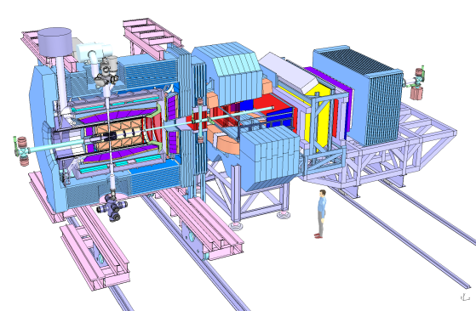
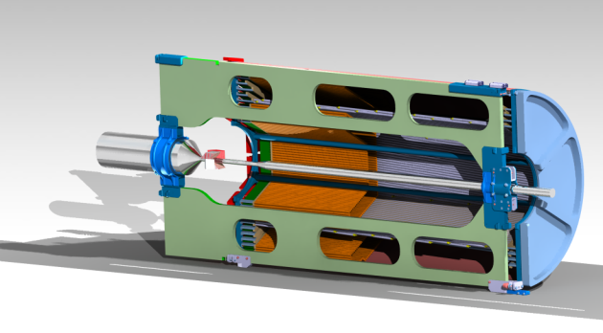
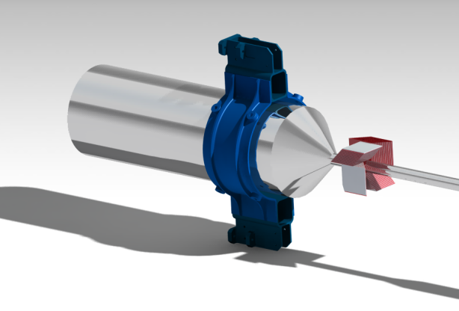
Target integration into the spectrometer
p
dedicated beam pipe going from 150 mm to 20 mm diameter
backward end cap calorimeter and MVD will not be used
modular structure
[from D. Rodriguez]

Slide 23

HPGe array integration into the spectrometer
p
[from D. Rodriguez]
[PANDA Technical Progress Report, 2005.]
θ_{lab}< 45°: Ξ-bar, K trigger and PID in PANDA spectrometer
θ_{lab}= 45°-90°: Ξ-capture and hypernuclei formation
θ_{lab}>90°: γ-detection with HPGe at backward angles
integration of electromechanical coolers for HPGe

Slide 24
Open issues being studied by the Panda Hypernuclear Groups
design and fabrication of the primary target
design and development of the secondary target
design and operation of the HPGe γ-array
electromechanical cooling of HPGe crystals
integration into the PANDA target spectrometer
simulation of the expected performance

Slide 25
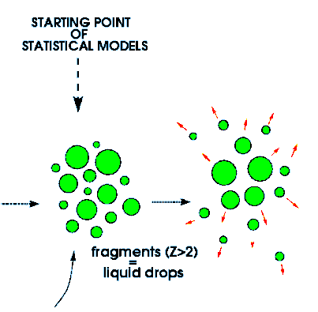
Statistical decay model for excited hypernuclei
example : Ξ⁻ + ¹²C ⇒ ^{A+Z+H}_{Ξ} Z ⇒ ¹³ _{ΛΛ} B*
What is the chance that individual excited, particle stable states of double hypernuclei are produced ?
conversion width Ξ + p ⇒ΛΛ about Г = 1MeV
precise Ξ⁻ binding energy not yet known (0.6 – 4 MeV)
typical excitation energy ~ a few MeV/nucleon
fragmentation of excited projectile remnants
are well understood in that regime
de-excitation of light nuclei via Fermi break-up process
  [A. Sanchez Lorente, A. Botvina et J.Pochodzalla, PLB 697 (2011) 222- 228)]
Notes:
In the following, the population of excited satets of a DHP hypernuclei have been vealuated
for different nuclear targets.

Slide 26
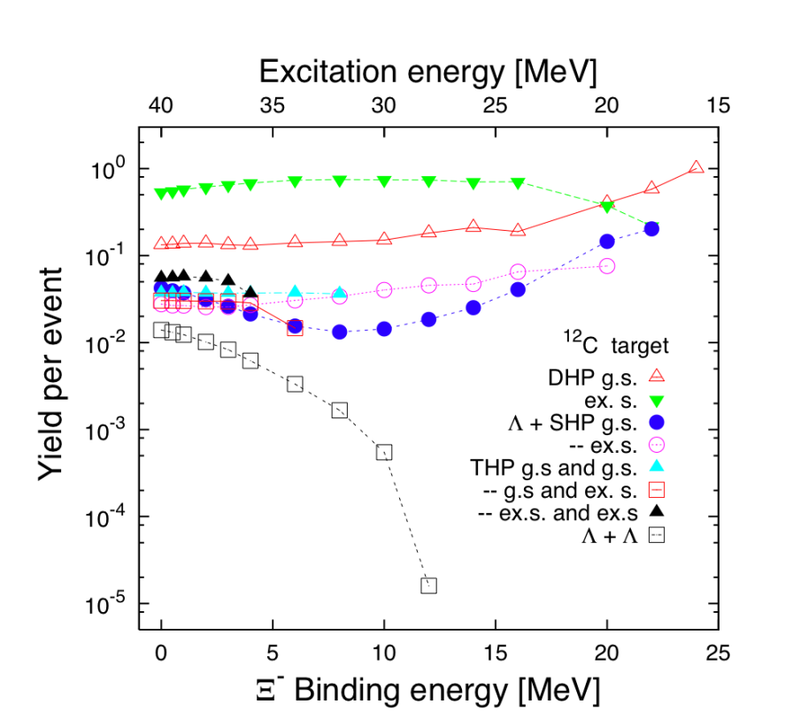
Population of excited double hypernuclear states
  Ξ⁻ + ¹²C ⇒ ¹³_{ΛΛ}B*
: double hypernuclei
: single hypernuclei
: twin hypernuclei
: ΛΛ
production of excited states of double hypernuclei is significant
  [A. Sanchez Lorente, A. Botvina et J.Pochodzalla, PLB 697 (2011) 222- 228]

Slide 27
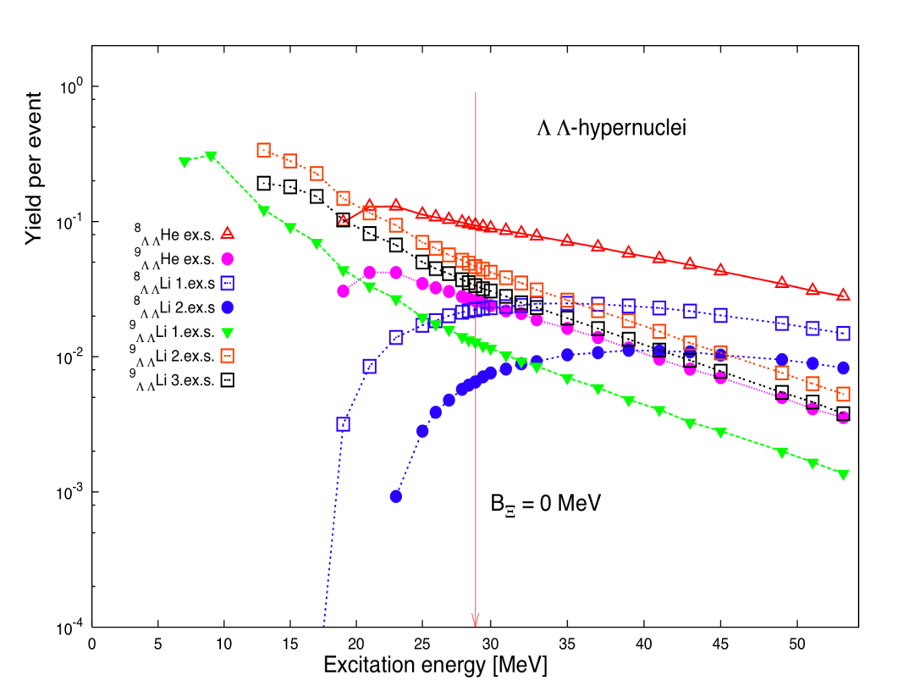
Population of excited double hypernuclear states
  Ξ⁻ + ⁹Be ⇒ ¹⁰_{ΛΛ}Li*
  [A. Sanchez Lorente, A. Botvina et J.Pochodzalla, PLB 697 (2011) 222- 228]

Slide 28
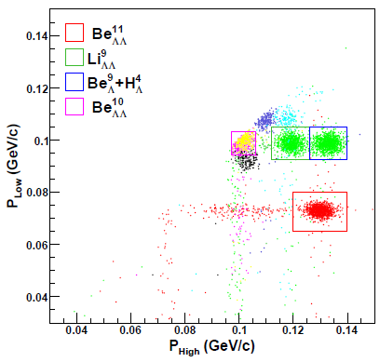
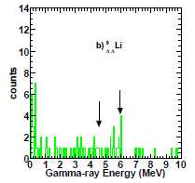
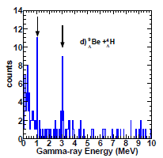
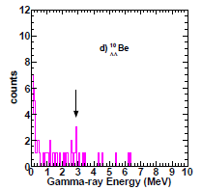
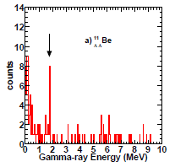

Background suppression by decay pion correlation
⁹_{ΛΛ}Li_{gs}
⁹_{Λ}Be_{gs}
p_{π} = 116 ΜeV
⁹B
p_{π} = 97 ΜeV
[PANDA Physics Performance Report, 2009. Simulations by A. Sanchez Lorente, U Mainz.]

Slide 29
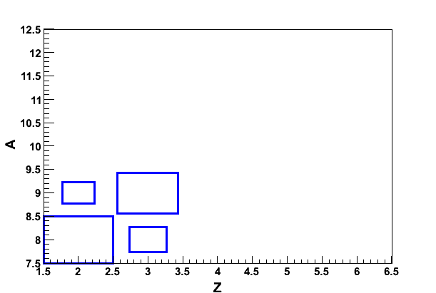
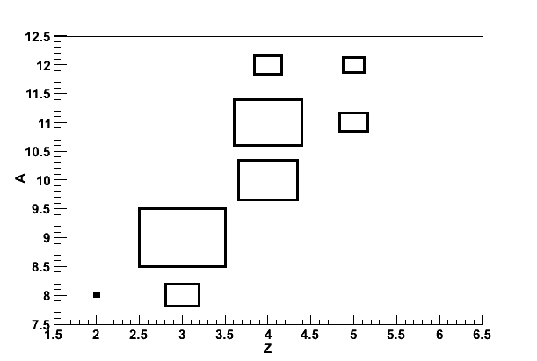
Identification of individual isotopes
PANDA will explore several targets: ⁹Be, ¹⁰B, ¹¹B, ¹²C, ¹³C
sum of excited states
B_{Ξ} = 0.5 MeV
sequential pionic decay prob. ≈ 0.45 - 0.03A
production probability · pionic decay probability
Li
B
B
C
¹¹_{ΛΛ}Be
Hypernuclei mass number
Hypernuclei mass number
⁹_{ΛΛ}Li
⁹Be target
⁹_{ΛΛ}Li
¹²C target
⁸_{ΛΛ}He
Hypernuclei charge
Hypernuclei charge
⇒ each target allows for the unique assignment of observable transitions by comparing the expected yields
Notes:
is based on the fact the use of different targets leads to the production of different hypernuclei species

Slide 30
Summary
Hypersystems provide a link between nuclear physics and QCD
to study basic properties of strongly interacting systems
antiproton collisions with nuclei are the ideal tool to produce exclusive Xi-antiXi pairs in nuclei at moderate momenta
many experimental challenges have to be overcome to realize such measurements
A statistical model predicts a large probability for the population of individual, excited states in double Λ hypernuclei
γ-spectroscopy of these double hypernuclei at PANDA is feasible

