Slide 1
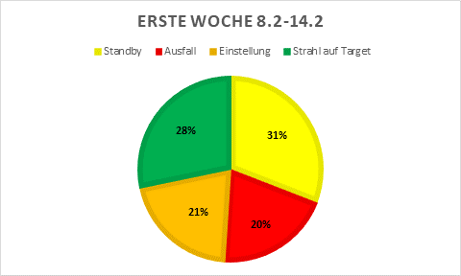
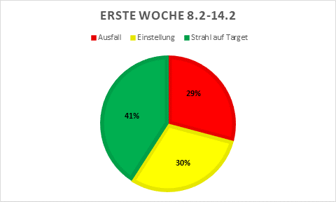
Accelerator Operations – 02.02.2021
Start of Beam Time 2021
we were 2 days behind the schedule with beam commissioning due to problems with A1 and A3, some commissioning was done during the OP Training phase
CH4 Ion source for Carbon and proton beams
Three experiments during the first week: PRIOR, HADES and ESR.
Many faults due to insufficient commissioning → Workshop next Monday

