Slide 1
Unilac – 2.2.2021
Important: Define date for pulsed gas stripper assembly (7th April?)
Clarify/confirm C3+ for ESR. When? (11.5.?) from EZR with (He1+)?
HLI beam for CW Cryostat commissioning (complete cryo module with 4 cavities) desired for end of June (parallel with Oxygen, from 21st June on)
Obligo shift 2020---2021….
HSI-RFQ “re-calibration” by software done. Successful Tantal beam tests on Thursday 28th January. (181Ta3+, A/q 60.5 > 59.5 U4+). RFQ Transmision 95% at 4 mA Ta3+, HIS transmission 75%. Working point at “85%”. Corresponding 7.4 Volt at RFQ (instead of 8.3 Volt).
Tunnel Septum UT2MUZ/MUX:
Installation finished incl. commissioning.
New coil spare part ordering started.
Leakage in Z-branch: re-assembled, pumping. But another turbo pump valve must be repaired.
Another new leakage: UXC, MU3 dipole baffle plate. Plates pumped extra, beam operation uncooled.
A4 / 10 Hz problem: new software version checked on Thursday 14th January. Okay!
RF Topics:
Commissioning ongoing
A1 Repair Senderwagen (pre amplifier stage), …

Slide 2
HSI RFQ Tantal Test 28th January 2021

Slide 3
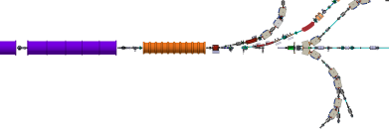
Leakage UXCMU3
Dipole Magnet MU3
Baffle Plate

