Slide 1
HEST – 02.02.2021
Legacy Optics for HEST in LSA are currently being replaced by verified versions: HHD, HHT, HTP, HADES, HTM, HTA already done.
Faraday cups in HEST have been installed and baked. Hardware commissioning in progress.
HEST clean-up campaign: Some equipment has been removed from HEST for storage after approval of radio protection. Waste material has still to stay in HEST, because approval of authorities could not be obtained in time.
Budget situation:
Costs for stepper motors (beam instrumentation) has been deducted from regular budget, although a budget transfer was agreed on last year. → It seems that request of additional needed budget was not properly communicated to management.
Prepayment still as obligo due to lost bank guarantee.

Slide 2
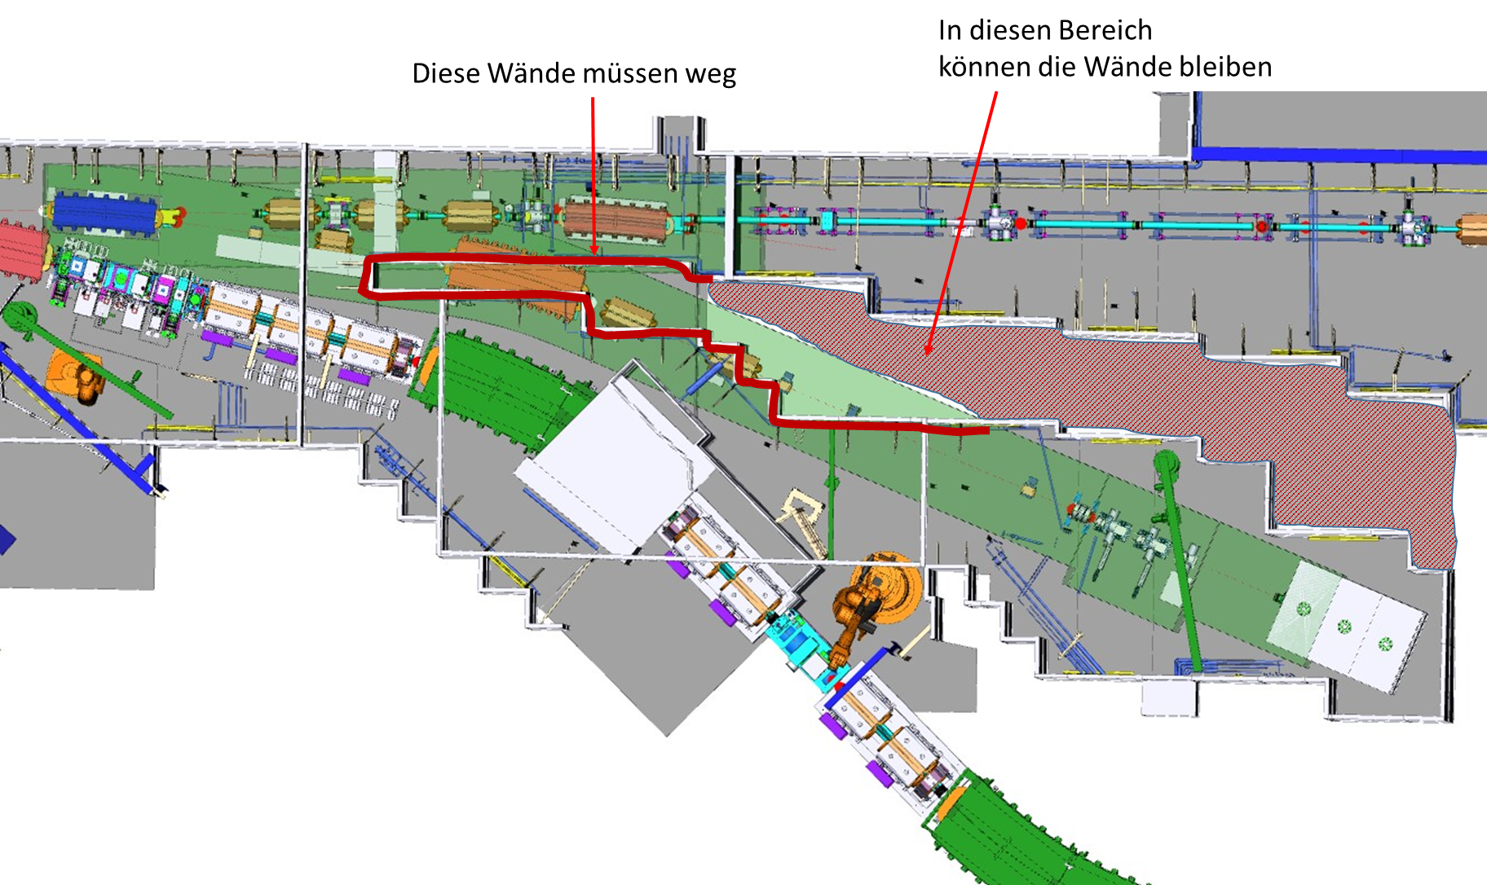
HEST – 02.02.2021
HHD project:
DIP16 issue still not yet solved.
3D modelling of new beam line is progressing well:
Figure courtesy E. Nickchen

