Slide 1
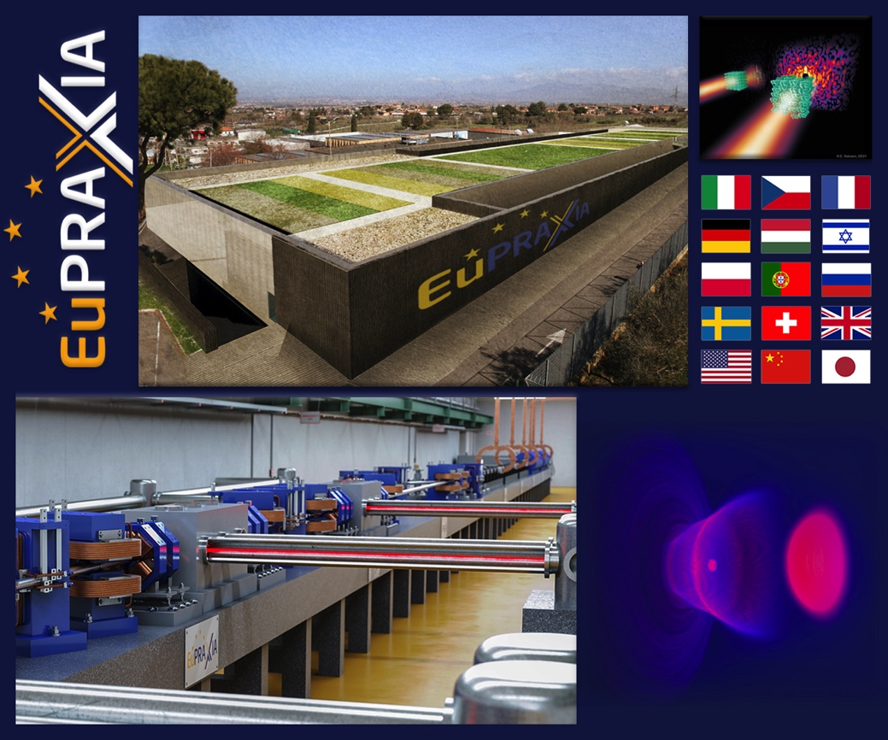
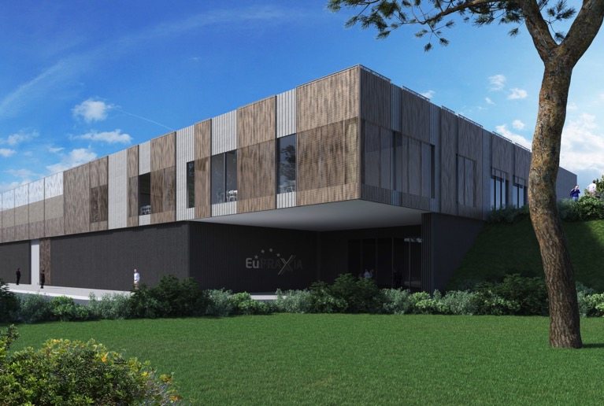
The EuPRAXIA Project for a European Research Infrastructure
Ralph Assmann (DESY & INFN)
GSI Seminar
Darmstadt, Germany (Virtual)
18.02.2021

Slide 2
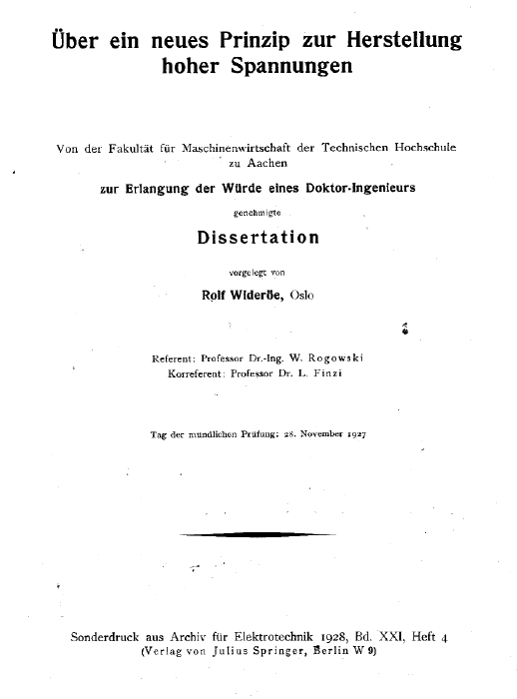
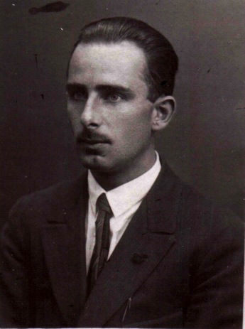

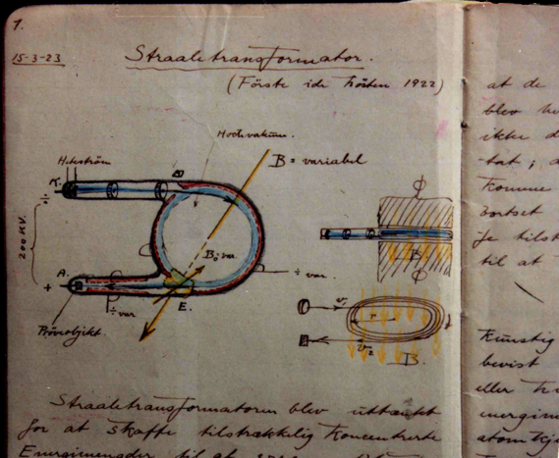
PhD Wideröe 1927: Start of RF Accelerators
27 pages

Slide 3
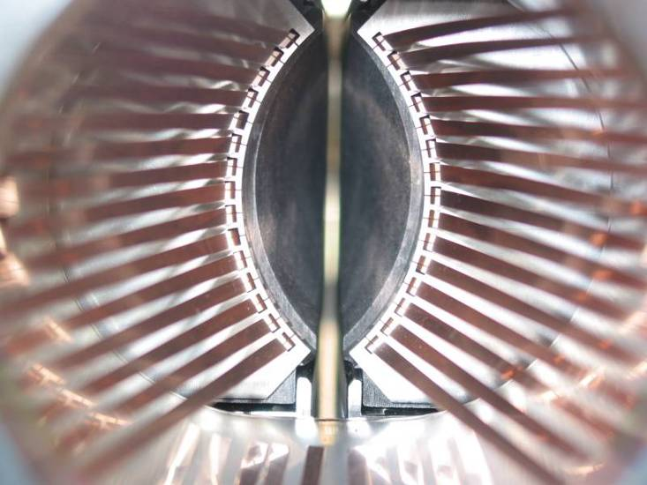
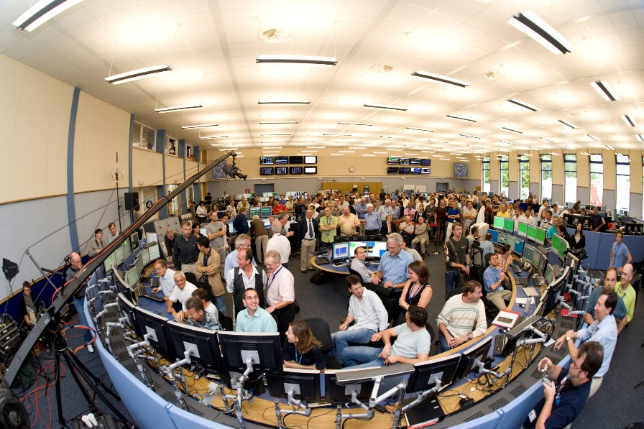
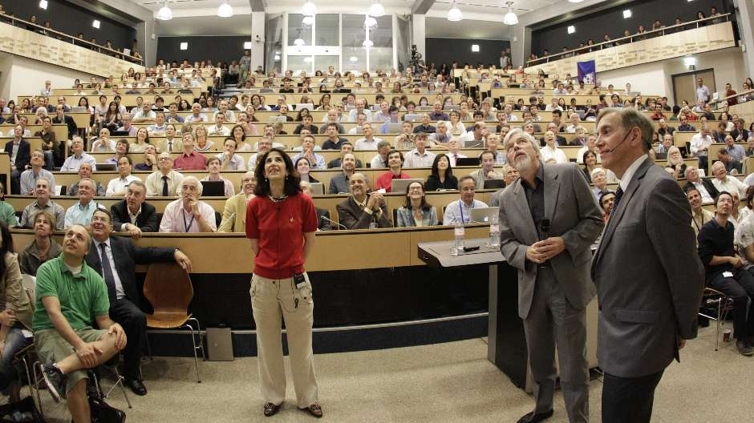
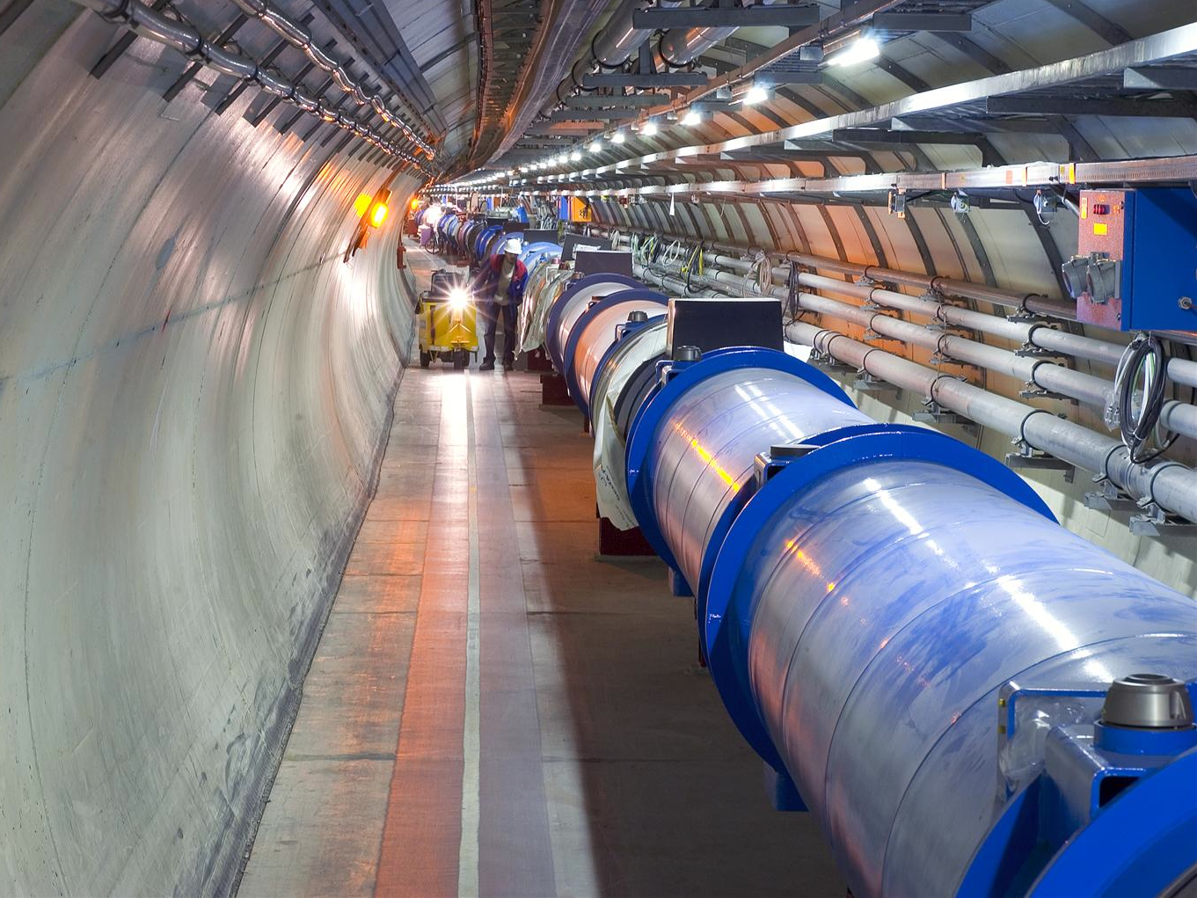

LHC as a Masterpiece of Accelerator Science
80 Years and many ideas and innovations later
Higgs
Sem.
4.7.
2012
First beam 10.9. 2008
→ FAIR at GSI will soon be another of those flagships…

Slide 4
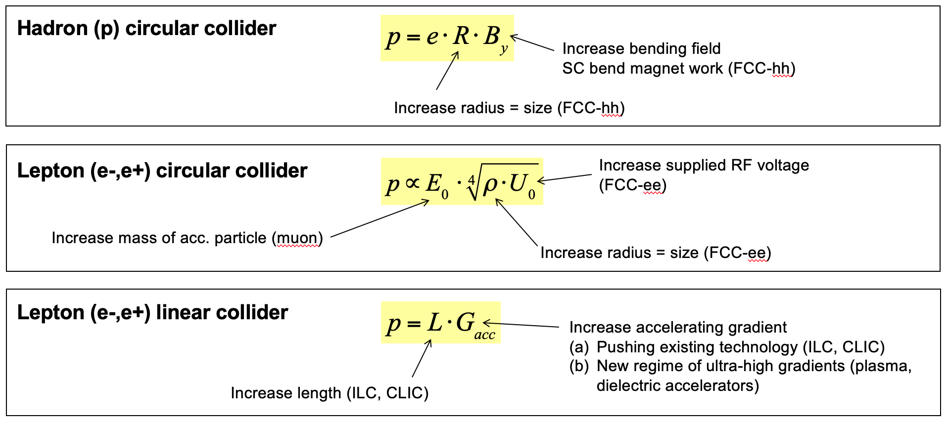
Limits of RF Accelerators
Fundamental physical and engineering limits encountered in:
Generation of strong magnetic fields to bend charged particles
Handling of power loss due to synchrotron radiation
Robustness of metallic walls against high electro-magnetic fields
Respecting physical and engineering limits → facilities grow in size and cost with each generation
Practical limitations in size and cost – decades to build a new facility.

Slide 5
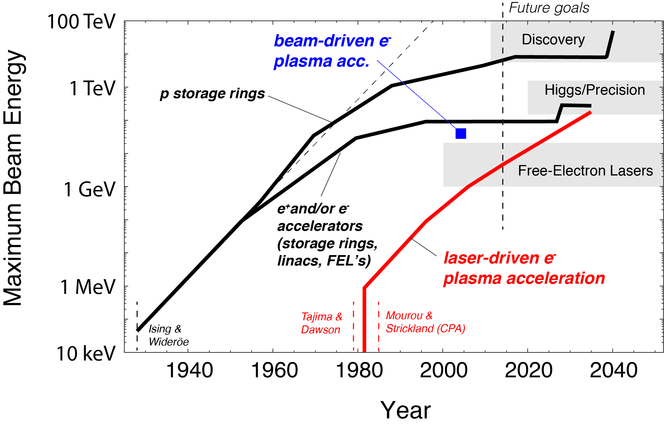
Slow-down of RF Accelerators and a new promise?
100 km
27 km
100 m

Slide 6
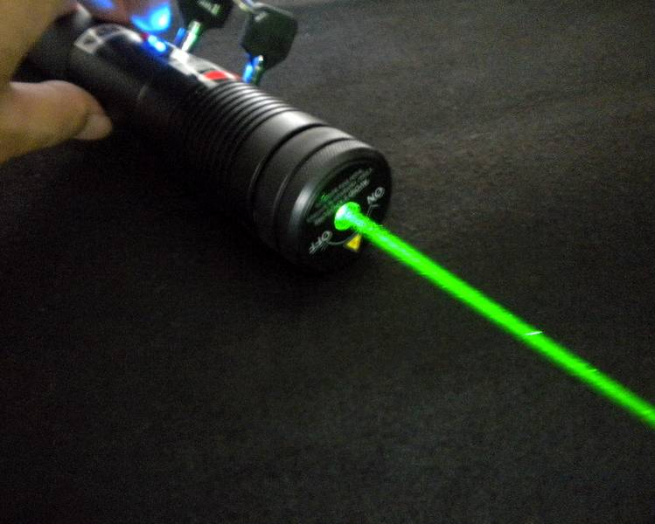
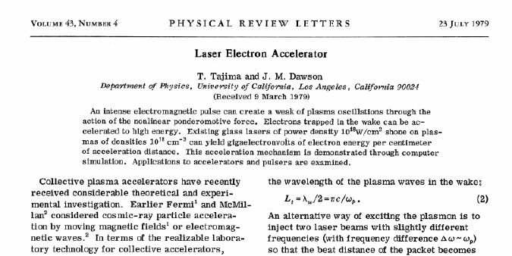
The Plasma Accelerator: The Next Step?
Starting question: We have very high fields in nature and technology! How to use them?
Modern lasers generate light pulses with very large transverse fields:
Many 1.000 billion Volt per meter (20 million V/m in RF structures)
Plasma or metallic structures couple fields to our particles!
Idea in 1979 (Tajima & Dawson):
Use a plasma to convert the transverse electrical field of the laser (or the space charge force of a beam driver) into a longitudinal electrical field in the plasma!

Slide 7
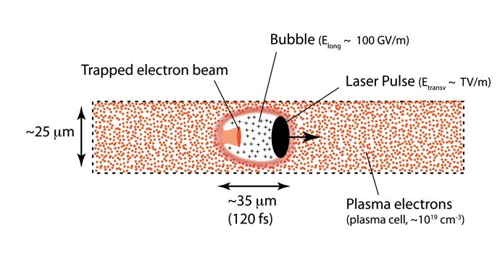
The Plasma Accelerator: The Next Step?
NOTE:
Plasma wakefield can also be driven by a charged beam pulse (electrons or protons) instead of a laser pulse

Slide 8
Compact Accelerators for HEP?
100 km
Shows potential of plasma acceleration for very high energies → HEP
27 km
100 m

Slide 9
Compact Accelerators for HEP?
100 km
Shows potential of plasma acceleration for very high energies → HEP
27 km
100 m
Plasma acc. today in regime required for FEL’s
→ Photon Science!

Slide 10
Compact Accelerators for HEP?
100 km
Shows potential of plasma acceleration for very high energies → HEP
27 km
100 m → 9 cm
Plasma acc. today in regime required for FEL’s
→ Photon Science!
Acceleration length (new versus conventional):
9 cm versus 100 m

Slide 11
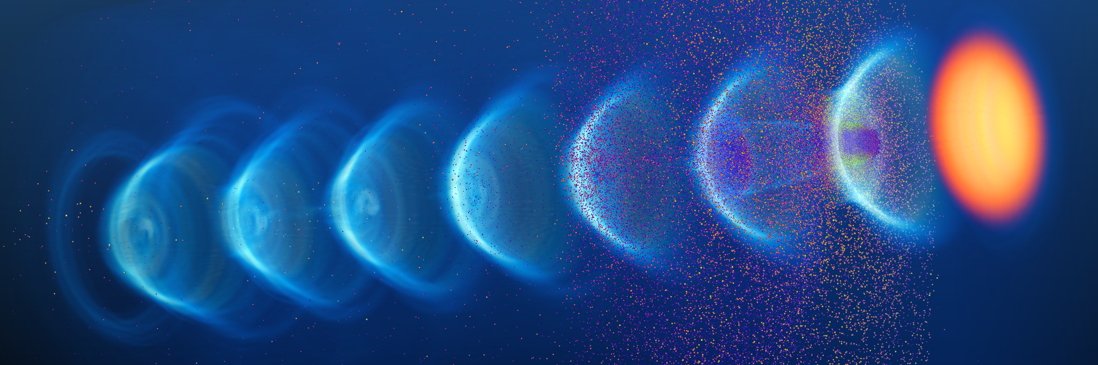


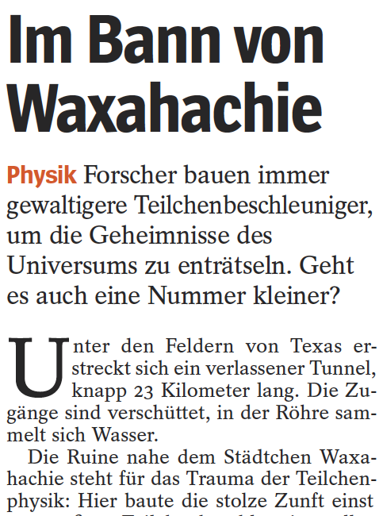
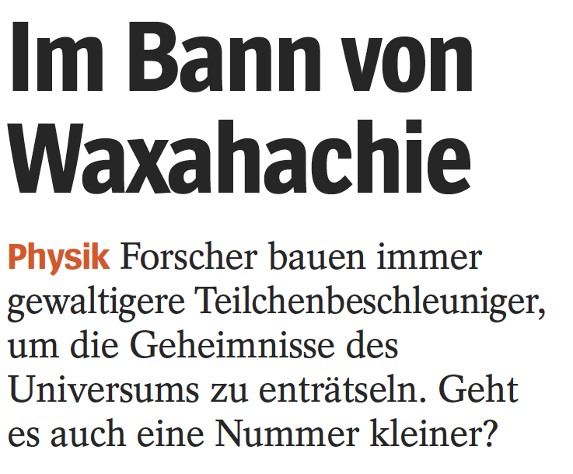


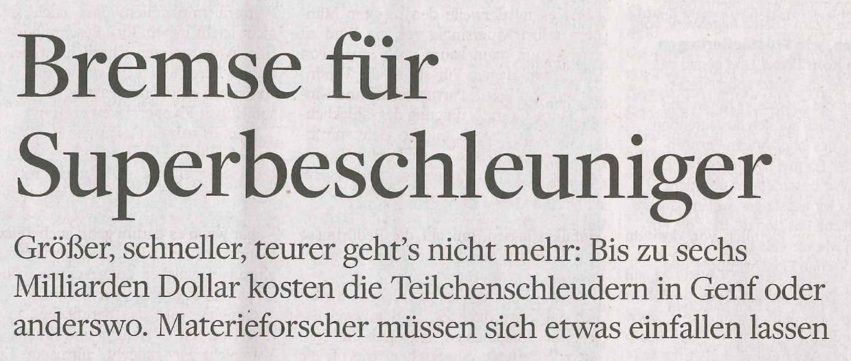
The Plasma Accelerator: The Next Step?
Illustration from PhD A. Ferran Pousa
A 1 TeV collider in 10-100 meters?
Not so easy...

Slide 12
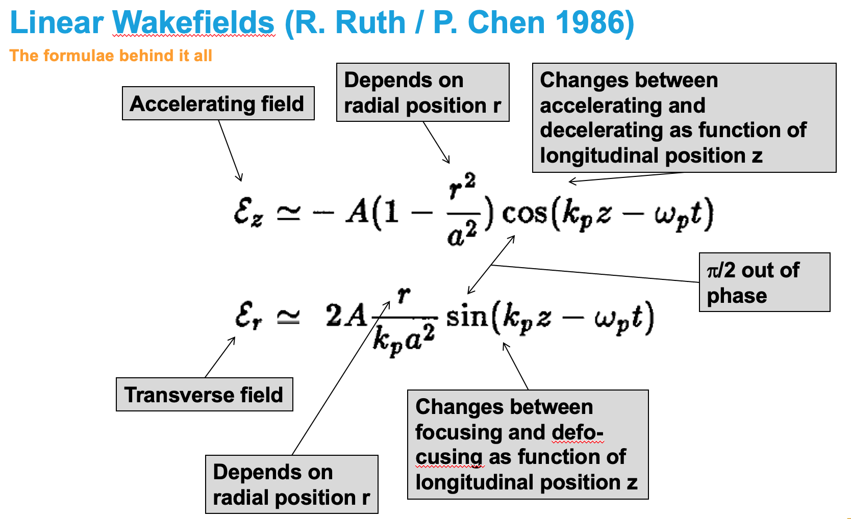
Some Issues of Electron Plasma Accelerators selected & simplified on 1 slide
Plasma accelerators are dynamic structures and face reproducibility issues (a new accelerator each shot)
Plasma accelerators are high frequency, therefore have very small dimensions and have inherent micron and sub micron tolerances
The beam dynamics of plasma accelerators is fundamentally different from RF accelerators: ultra-strong focusing fields must be handled for the accelerated beam (MT/m) → issues of matching, small beam size, large divergence, emittance growth, large energy spread, sub-micron transverse tolerances between stages and between drivers/beams
For details, see e.g. 1998 paper with Yokoya/Assmann
No useable beam yet from electron plasma accelerators since their proposal in 1979
NIM A410 (1998) 544-548

Slide 13
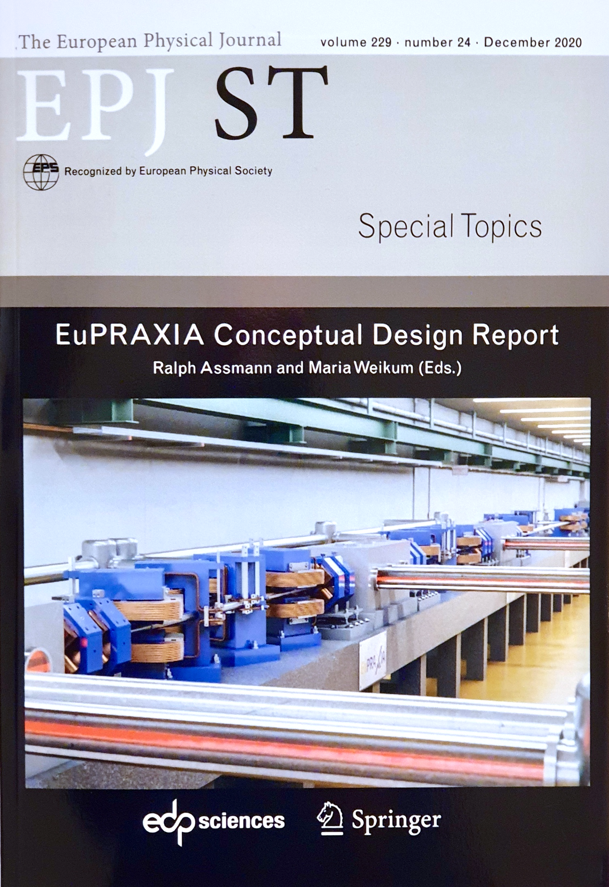
The EuPRAXIA Project
http://www.eupraxia-project.eu/
First ever international design of a plasma accelerator facility.
Challenges addressed by EuPRAXIA since 2015:
  How can plasma accelerators produce usable electron beams?
  For what can we use those beams while we increase the beam energy towards HEP and collider usages?
CDR for a distributed research infrastructure funded by EU Horizon2020 program. Completed by 16+25 institutes.
Next phase consortium with 40 partners, 10 observers.
Applied to ESFRI roadmap update 2021 with government support in Sep 2020.
Judged as eligible and has entered the ESFRI review.
653 page CDR, 240 scientists contributed

Slide 14
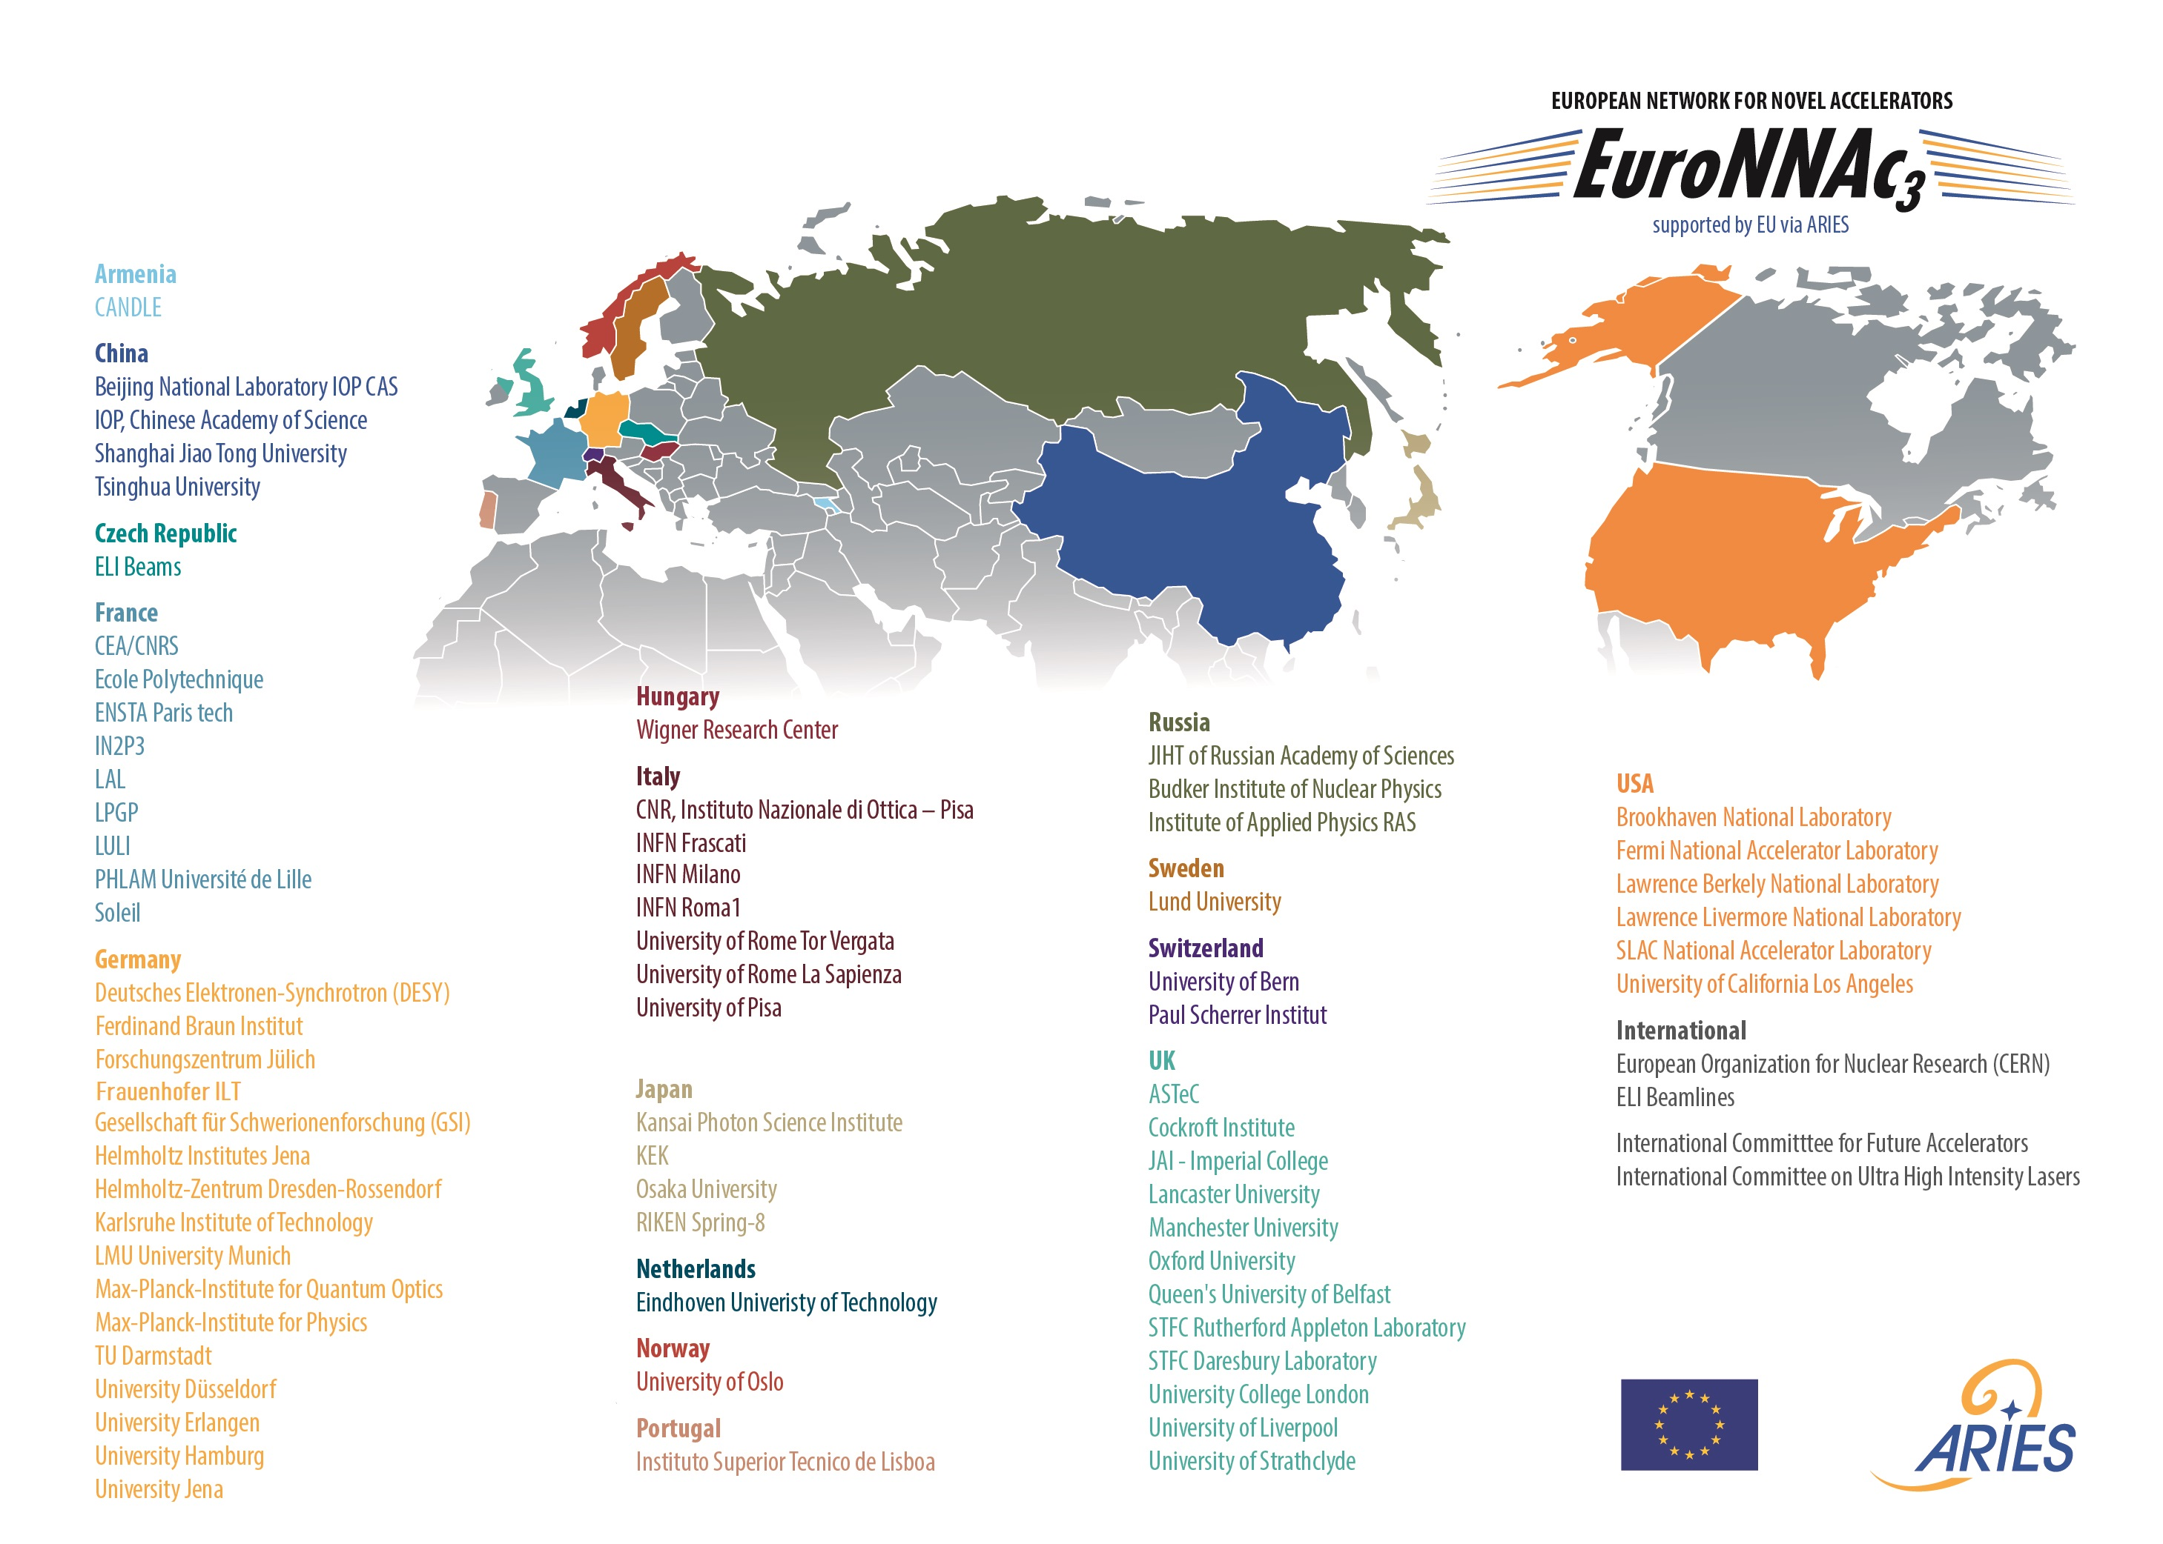
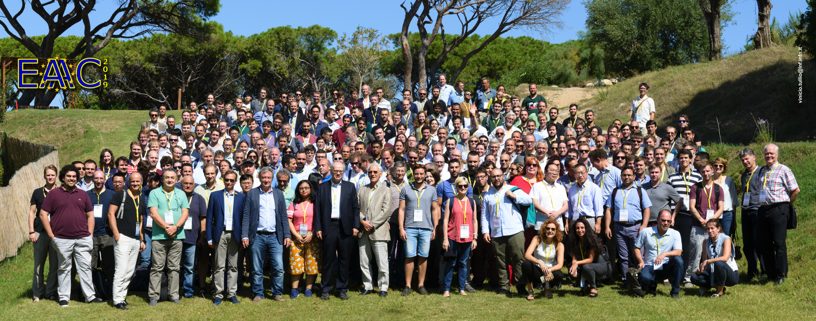
EuPRAXIA is a Community-Driven Project
European Network for Novel Accelerators (EuroNNAc)
65 institutes
Founded by RA in 2011 at CERN
EU support secured until 2025
Provided input to last two European Strategies in Particle Physics
Founded EAAC workshop series
Initiated EuPRAXIA
Supported ALEGRO
Bi-Annual European Advanced Accelerator Concepts Workshop EAAC
Founded by RA, MF and EuroNNAc steering group in 2013, EU support secured until 2025 (ARIES → IFAST)
267 participants in 2019 (limited by space)

Slide 15
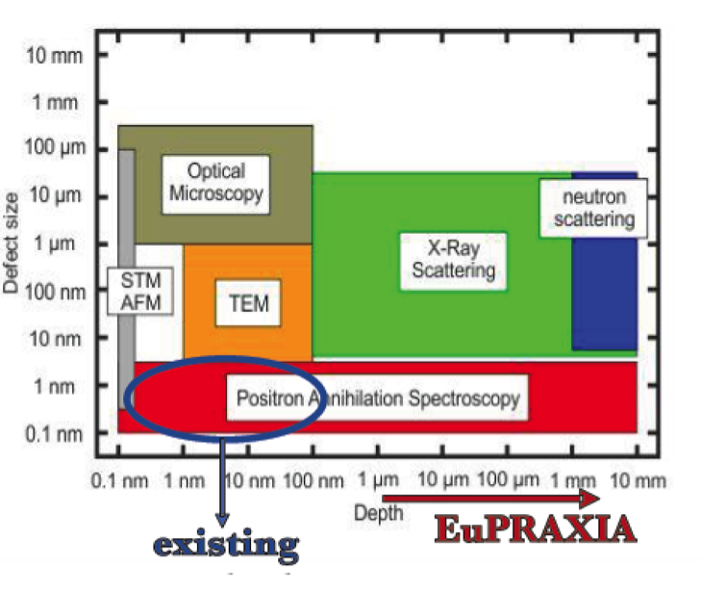
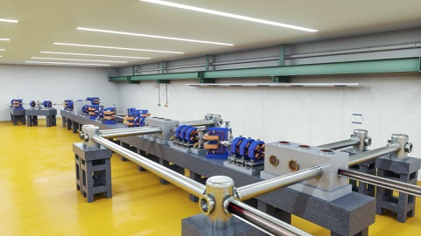
The EuPRAXIA “Philosophy”
Building links across labs, communities, technologies
Bringing together established excellence from RF accelerators, new innovative plasma accelerator concepts and laser technology
Building on existing infrastructure with realistic intermediate goals for plasma accelerators:
  150 MeV → 1 GeV → 5 GeV (FEL + other applications)
  1 plasma stage → 2 plasma stages → multiple
  factor 3 facility size reduction → factor 10 → ...
  Low charge, 10 Hz apps of electrons (+ positron generation)
  → high charge, 10 Hz applications (FEL) → 100 Hz
  Includes RF injectors, transfer lines, undulator lines, shielding, ...
EuPRAXIA Positron Annihilation Spectroscopy in a new regime:
Courtesy M. Butterling, HZDR

Slide 16
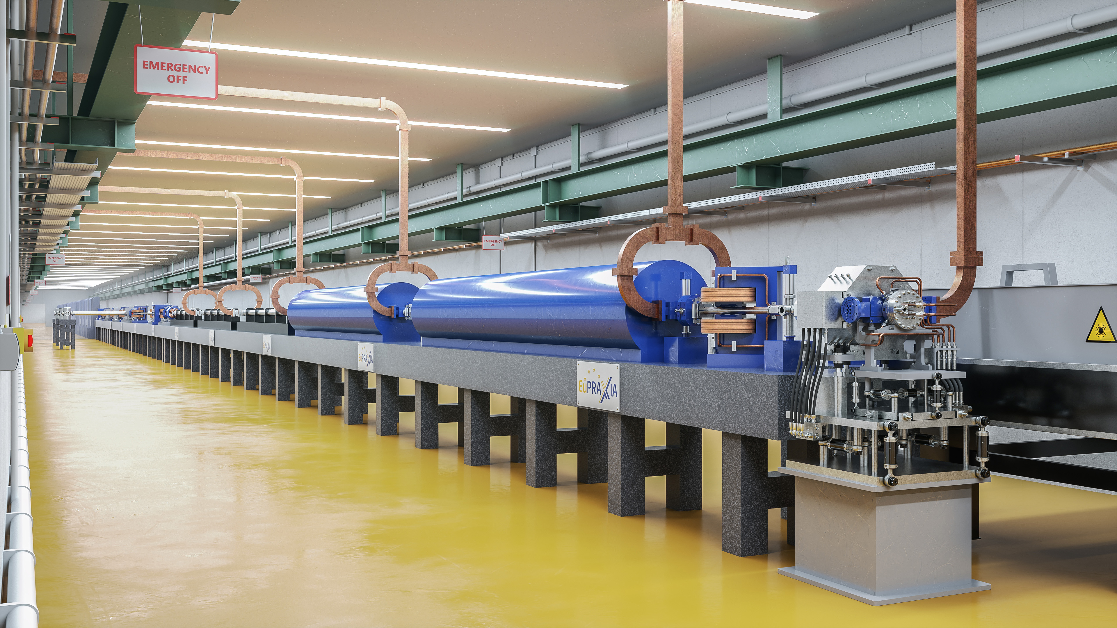
  IMPORTANT: EuPRAXIA design includes RF injectors, transfer lines, undulator lines, shielding, ...

Slide 17
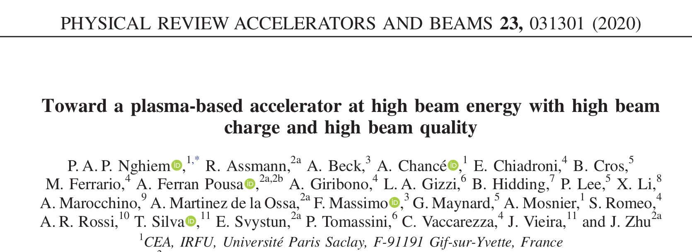
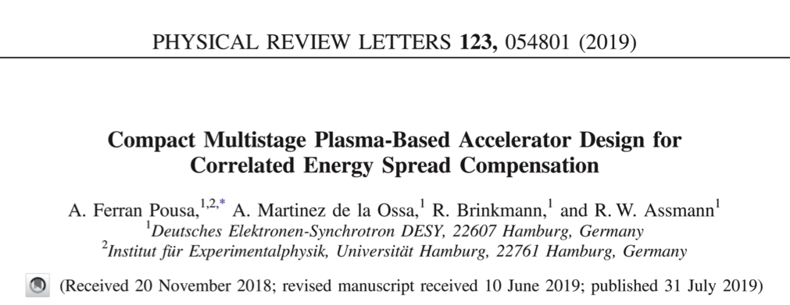
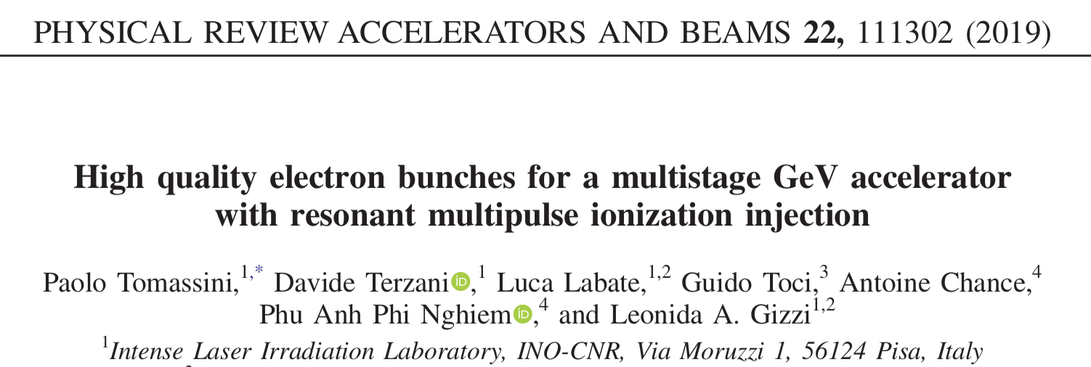
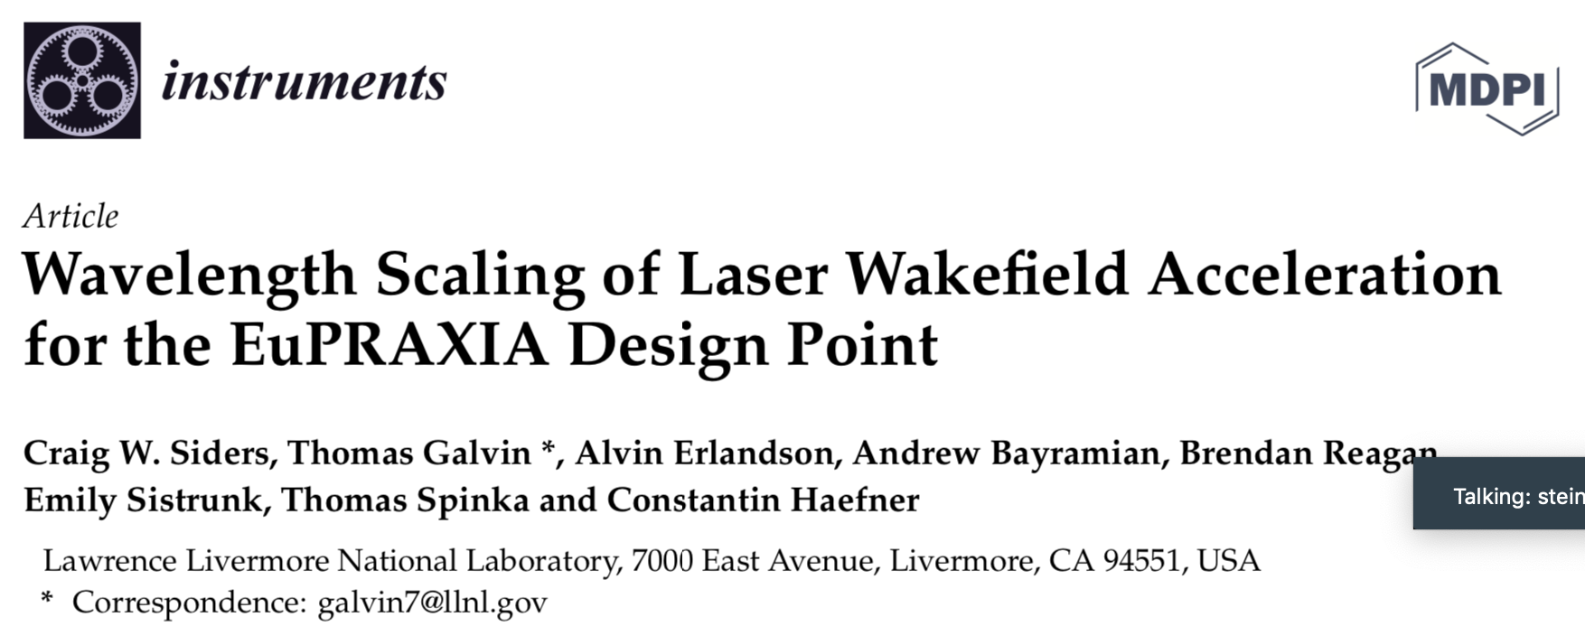
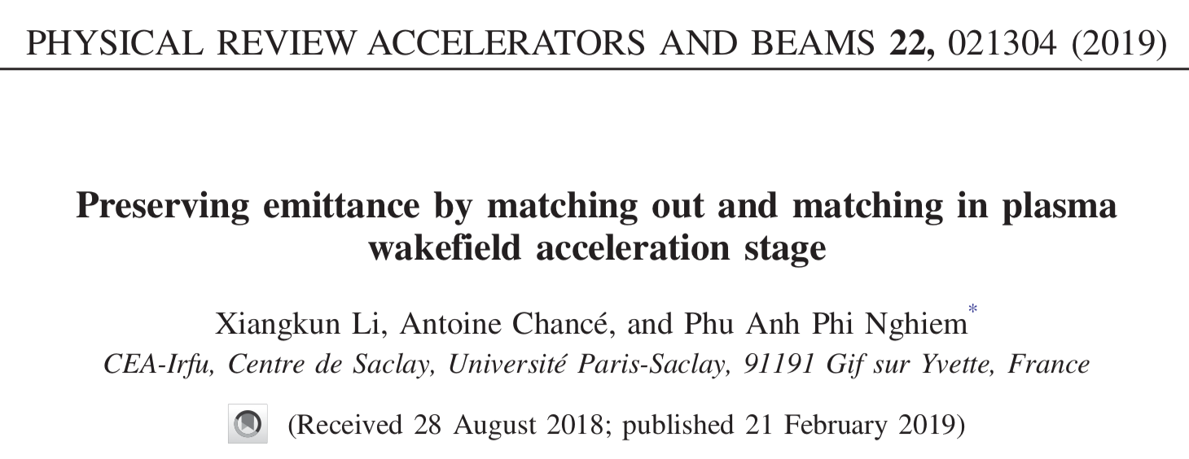
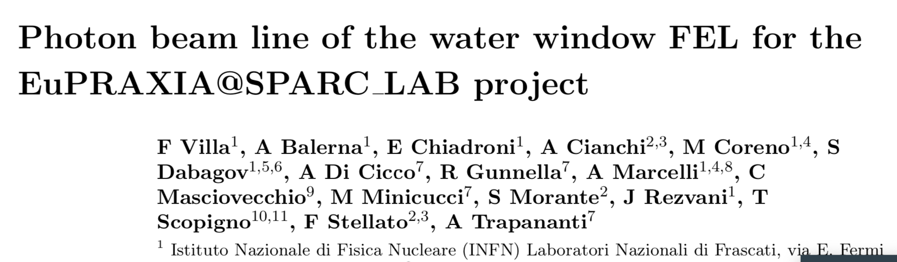
Examples of EuPRAXIA Ideas and Innovation

Slide 18
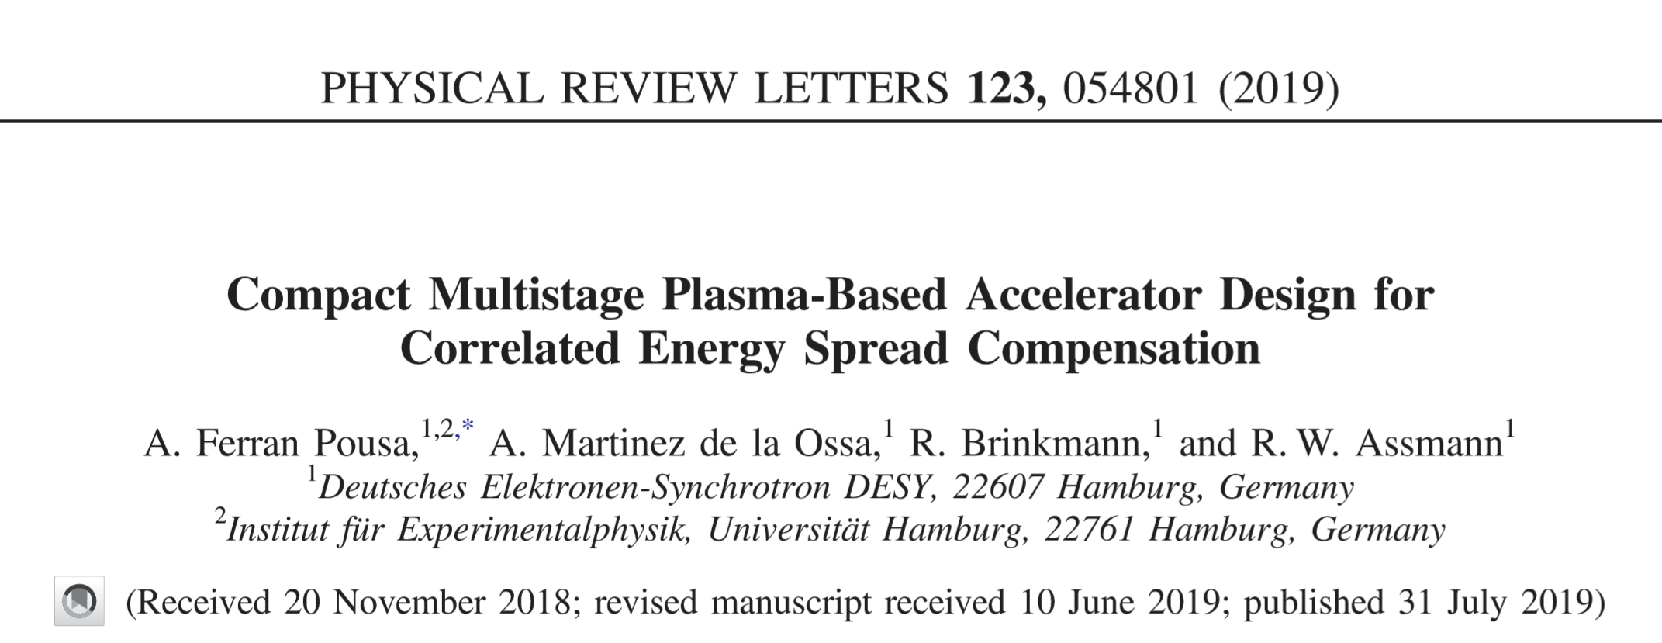
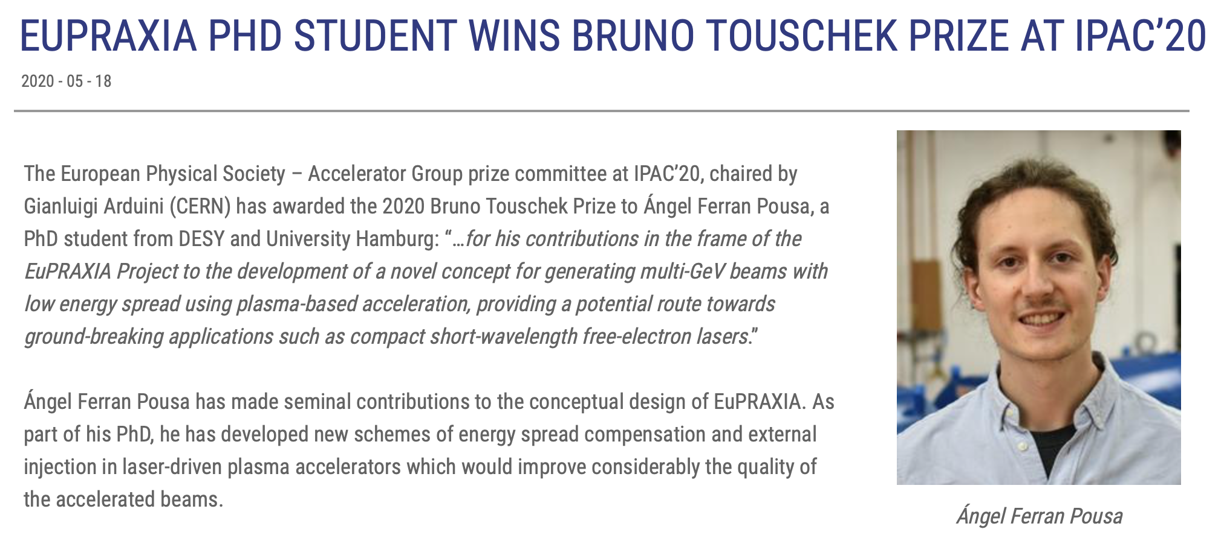
Examples of EuPRAXIA Ideas and Innovation

Slide 19
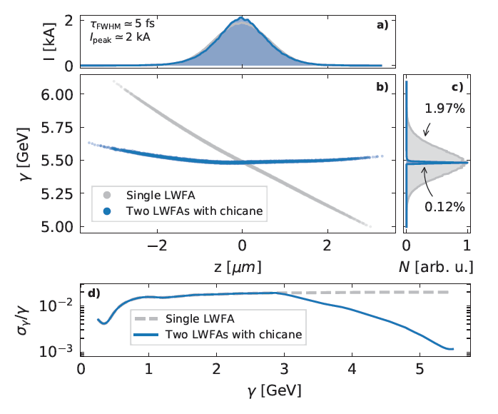
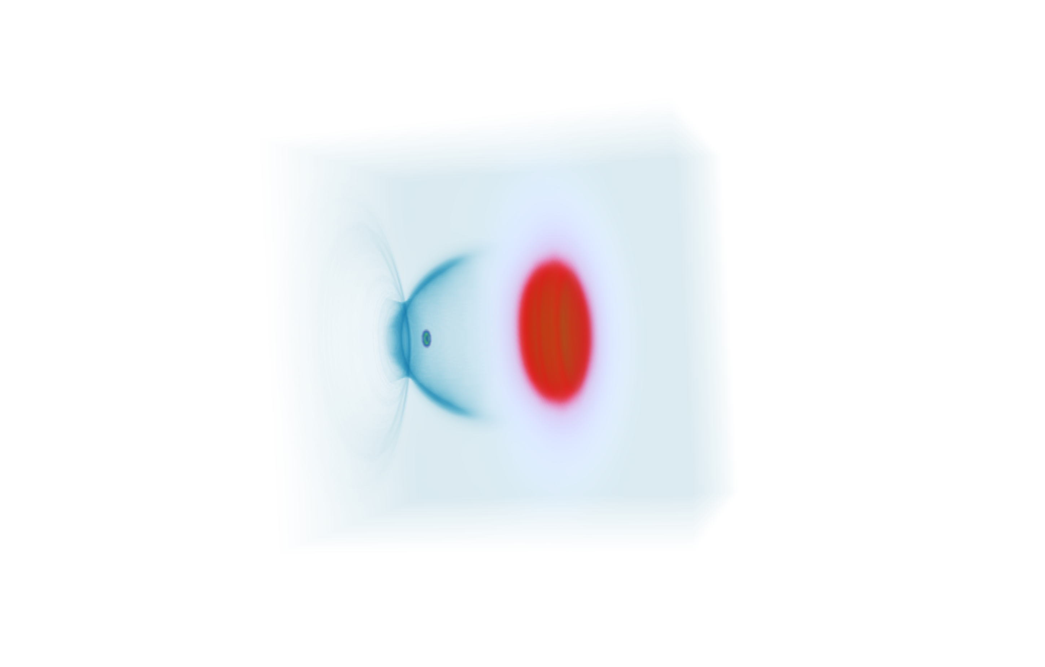






Example of EuPRAXIA Idea and Innovation
Electron beam
Ref.: Ferran Pousa, Martinez de la Ossa, Brinkmann, Assmann
PRL 123, 054801 (2019)
Not to scale. Compact setup 1.5 m.
Laser 1
Coherent Synchrotron Radiation (CSR) and Space-Charge checked
Plasma mirror
(coupling of laser 2)
Plasma accel. stage 2
Plasma mirror
(laser 1 removal)
Active plasma lens
Magnetic chicane
Plasma accel. stage 1
Active plasma lens
Laser 2
Accelerating in a plasma stage and...
... flipping phase space in the middle before second plasma stage

Slide 20
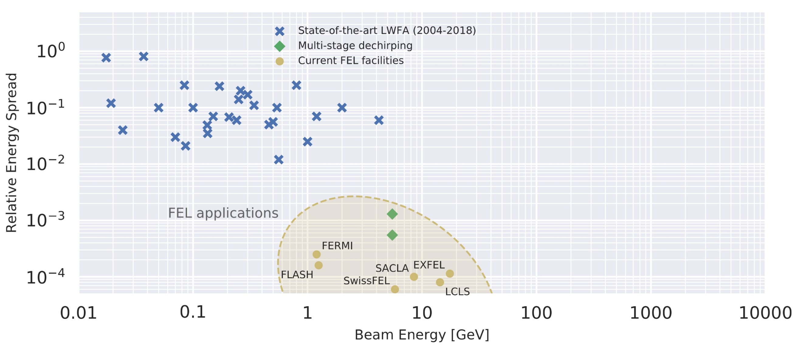

Example of EuPRAXIA Idea and Innovation
EuPRAXIA developed solutions for high beam quality in plasma accelerators, approaching performance of established RF accelerators!
STATE OF THE ART PLASMA ACCELERATORS
STATE OF THE ART COLLIDER
CLIC
CDR Vol. 1
EuPRAXIA
Design
ILC
TDR Vol. 1
STATE OF THE ART FEL

Slide 21
Example of EuPRAXIA Idea and Innovation
EuPRAXIA developed solutions for high beam quality in plasma accelerators, approaching performance of established RF accelerators!
STATE OF THE ART PLASMA ACCELERATORS
STEP 1
STATE OF THE ART COLLIDER
CLIC
CDR Vol. 1
EuPRAXIA
Design
ILC
TDR Vol. 1
STATE OF THE ART FEL

Slide 22
Example of EuPRAXIA Idea and Innovation
EuPRAXIA developed solutions for high beam quality in plasma accelerators, approaching performance of established RF accelerators!
STATE OF THE ART PLASMA ACCELERATORS
STEP 1
STATE OF THE ART COLLIDER
CLIC
CDR Vol. 1
STEP 2
ILC
TDR Vol. 1
EuPRAXIA
Design
STATE OF THE ART FEL

Slide 23
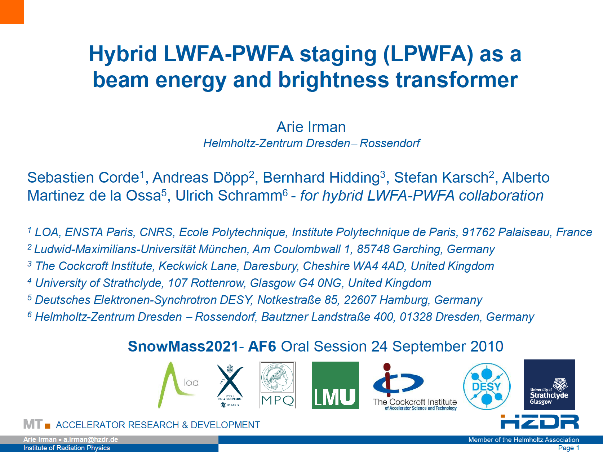
Advancing Spin Polarization and Hybrid Plasma Accelerators
e+e- colliders and physics reach enhanced by spin polarized beams
International Partners: Germany, Greece, China, and USA → facilities involved at FZJ, Shanghai, ...
Use a laser-generated electron beam for driving plasma wakefields in a second stage → HQ electron beam from ultra-compact setup
Several facilities involved at HZDR, Strathclyde, ...
See work by M. Büscher et al

Slide 24
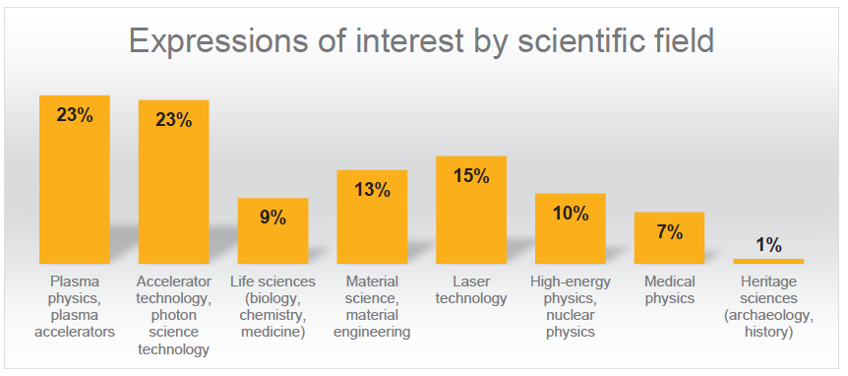
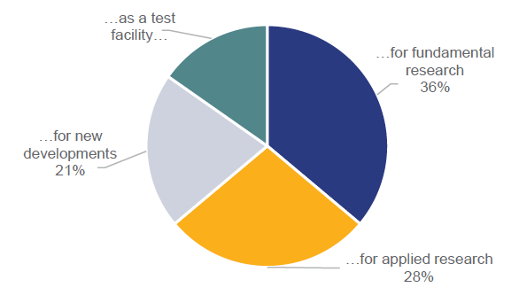
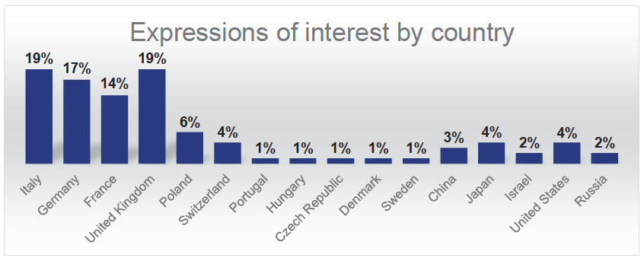
EuPRAXIA Deliverables and User Interests
EuPRAXIA is designed to deliver at 10-100 Hz ultra-short pulses of
Electrons (0.1-5 GeV, 30 pC)
Positrons (0.5-10 MeV, 10⁶)
Positrons (GeV source)
Lasers (100 J, 50 fs, 10-100 Hz)
Betatron X rays (5-18 keV, 10¹⁰)
FEL light (0.2-36 nm, 10⁹-10¹³)
Expressions of interest from 95 research groups representing several thousand scientists in total.

Slide 25
Targeted User Communities
EuPRAXIA provides particle and photon beams with exceptionally short duration and small size – ideal for the study of complex systems and ultrafast processes:
Biology structural biology, research on understanding molecular structures and biochemical processes
Chemistry crystallography, research on understanding molecular structures and chemical processes
Medicine pharmacological developments, research on understanding underlying mechanisms of drug
operating modes and delivery, diseases, etc.
Material science crystallography, research on understanding molecular structures and processes, e-beam machining, material analysis
Physics crystallography, research on understanding structures and processes
Archaeology & history non-destructive testing, material analysis
Beyond those applications various use cases of co-development including accelerator R&D, photon science technologies, compact and industrial applications, plasma-based acceleration and secondary sources for high-energy physics.

Slide 26
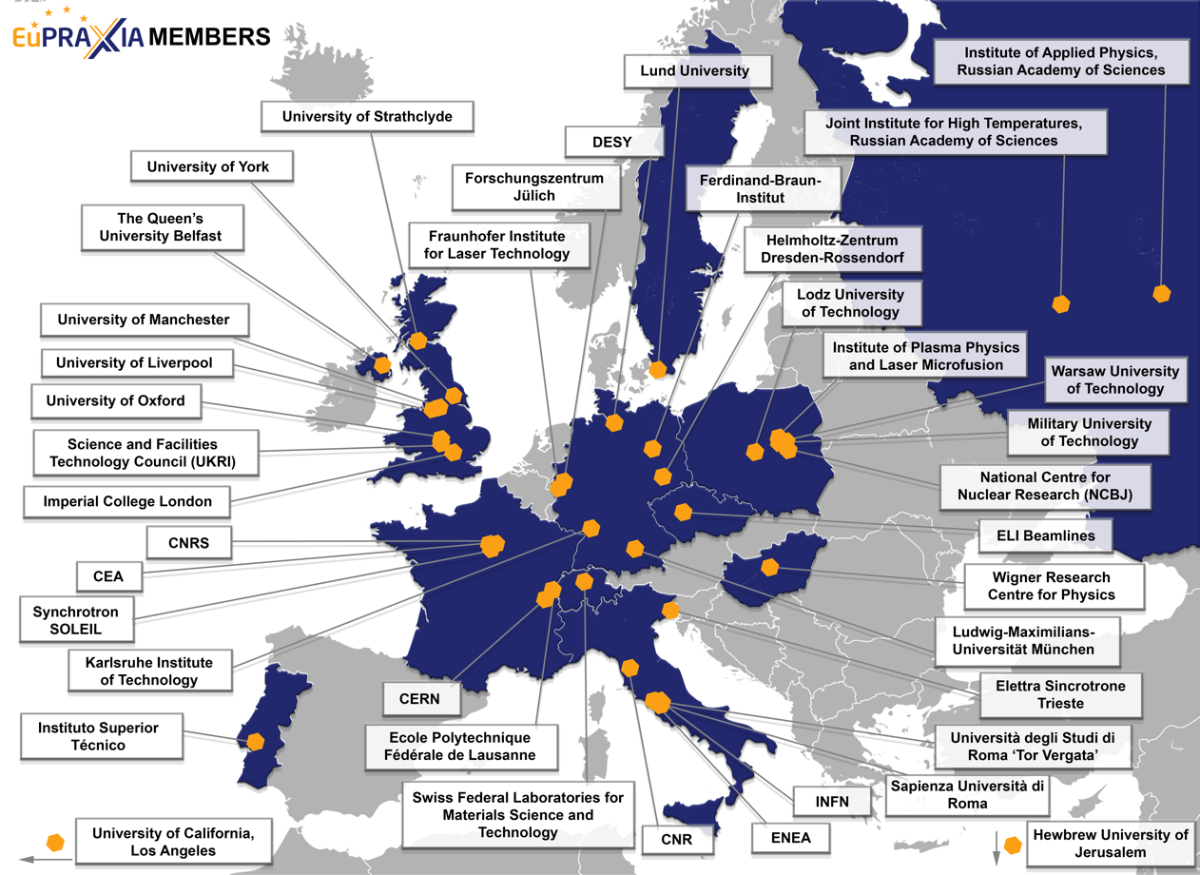
The Consortium Members for the Next Phase
(from 16 to 40)
40 Member institutions in:
Italy (INFN, CNR, Elettra, ENEA, Sapienza Università di Roma, Università degli Studi di Roma “Tor Vergata”)
France (CEA, SOLEIL, CNRS)
Switzerland (EMPA, Ecole Polytechnique Fédérale de Lausanne)
Germany (DESY, Ferdinand-Braun-Institut, Fraunhofer Institute for Laser Technology, Forschungszentrum Jülich, HZDR, KIT, LMU München)
United Kingdom (Imperial College London, Queen’s University of Belfast, STFC, University of Liverpool, University of Manchester, University of Oxford, University of Strathclyde, University of York)
Poland (Institute of Plasma Physics and Laser Microfusion, Lodz University of Technology, Military University of Technology, NCBJ, Warsaw University of Technology)
Portugal (IST)
Hungary (Wigner Research Centre for Physics)
Sweden (Lund University)
Israel (Hebrew University of Jerusalem)
Russia (Institute of Applied Physics, Joint Institute for High Temperatures)
United States (UCLA)
CERN
ELI Beamlines
pending
pending

Slide 27
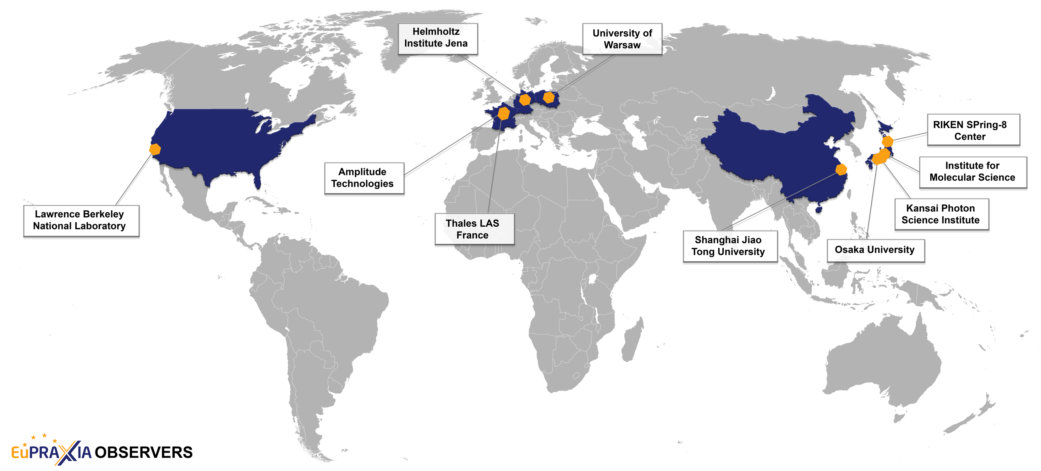
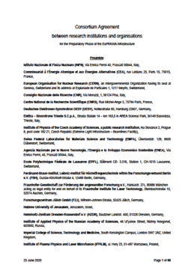
The Consortium Observers for the Next Phase
(from 25 to 10, Consortium Agreement signed)
10 Observer institutions in:
France (Amplitude Technologies, Thales LAS France SAS)
Germany (Helmholtz-Institut Jena)
Poland (University of Warsaw)
United States (LBNL)
China (Shanghai Jiao Tong University)
Japan (Institute for Molecular Science, Osaka University, Kansai Photon Science Institute, RIKEN SPring-8 Center)

Slide 28
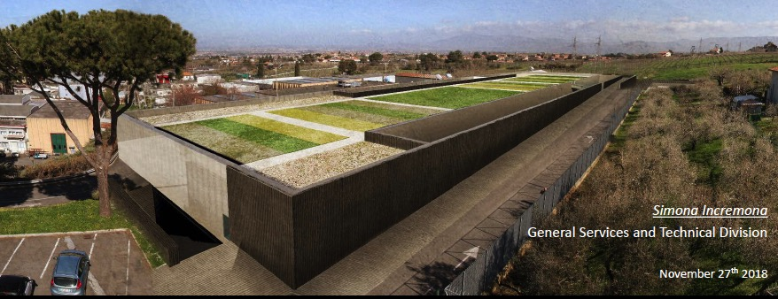
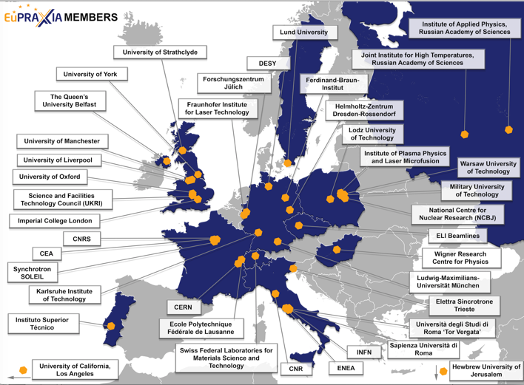
ESFRI Proposal: Financial and Political Support
EuPRAXIA strongly supported in European research landscape, it is timely, it offers highly attractive opportunities for innovation with industry, novel applications and pilot users.
Lead Country: Italy (LNF/INFN)
Political and financial support letter sent to ESFRI by Italian Ministry
Political support letters (at least two needed from countries):
  Hungary
  Portugal
  Czech Republic (ELI beamlines)
  UK
Note: All operational costs covered by host countries.
From political + scientific landscape it is seen that both Czech Republic and UK would be excellent sites for the second leg of EuPRAXIA, connecting to existing facilities with laser expertise, users and few 100 million € pre-invest.

Slide 29
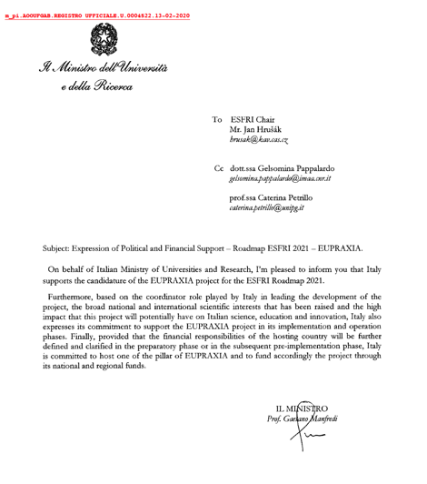
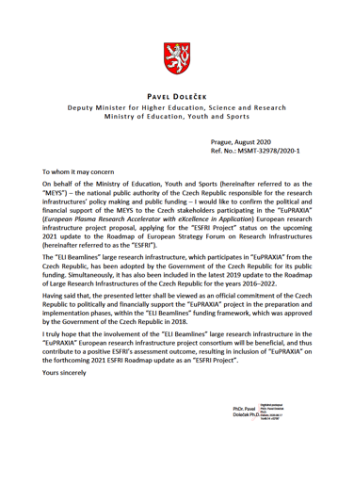
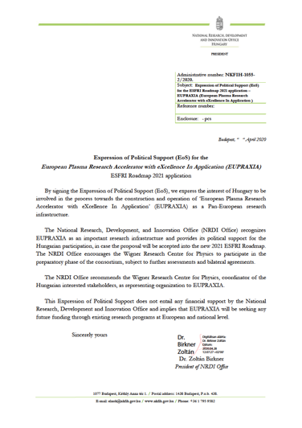
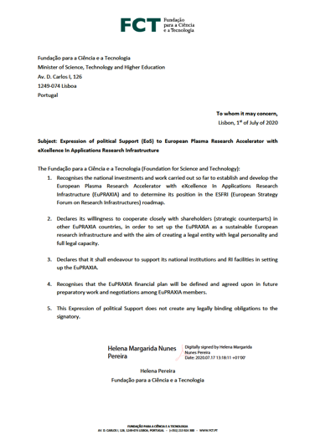
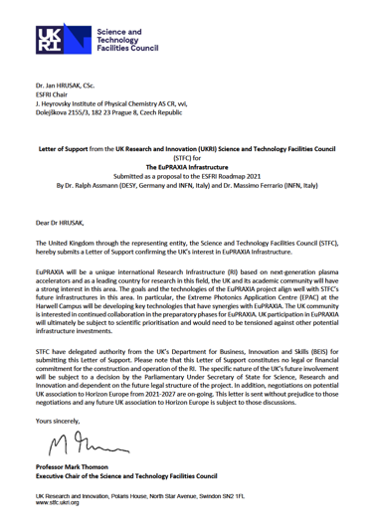
Government Support Letters
Italy Czech Republic Hungary Portugal United Kingdom
plus 32 non-governmental support letters

Slide 30


Budget Overview and Cost-Benefit Analysis
(all prepared according to ESFRI and EU rules)
Project duration | 10 years
Full cost (including manpower, past CDR cost and termination cost) | 569 M€
Cost of Phase I (including manpower and past CDR cost) | 388 M€
Operational cost | 30 M€/y
Internal rate of return | 9.22 %
Start of pilot operation | 2028
Funding secured (status 11/2020) | 118 M€ (21 % of full cost)
OP budget secured (status 11/2020) | 9 M€/y (30 %)
89 pages
Return rate found in cost-benefit analysis shows the expected gain of the sustained EuPRAXIA investment also in economical terms. Credits to our consultant F. Brottrier.

Slide 31
Executive summary
A sound methodology to evaluate the socio-economic impact of a research infrastructure project is provided by the Guide to Cost-Benefit Analysis of Investment Projects (sometimes referred to as the “Florio Guide”), released by the European Commission in 2014, completed by the Economic Analysis of Research Infrastructure projects in the Programming Period 2014-2020, by Robert Swerdlow, Dorothee Teichmann, and Tim Young, from the JASPERS Smart Development Division, released by JASPERS (a joint initiative of the European Commission and the European Investment Bank) in April 2016 and updated in April 2017. This methodology is also consistent with Regulation 207/2015, which provides the basic principles to be observed while conducting a Cost-Benefit Analysis.
After collecting data on the different future EuPRAXIA components, EuPRAXIA research organisation partners and defining how the future EuPRAXIA RI will function, the project team applied this methodology and obtained the following results:
Initial investment (“implementation budget”)
A total implementation budget of €563,432,900, the details of which are provided in Tables 3.1, 3.3, and 3.4. Figures include the value of resources provided in-kind (€15,417,262), but exclude the cost for conceptual design (€3,000,000) and termination (€3,090,217).
Operational costs (“operational budget”)
An average annual cost of operation of €32,584,693, the details of which are provided in Tables 4.1 and 4.2. Figures include the value of resources provided in-kind (workforce exclusively, worth €1,100,538/year on average) as well as capital re-investments for upgrades every five years.
Revenues
Revenues at EuPRAXIA include:
Contractual research fees (fees paid by users accessing EuPRAXIA through the market-driven access mode) with an evolution of total fees from €115,565 in 2028 to €2,497,830 in 2047 and €1,149,189 in 2061.
Residual value
The methodology applied to calculate the residual value of assets is the historical book value. After 38 years of operation, fixed assets such as buildings are not entirely depreciated, and therefore the residual value of EuPRAXIA assets is estimated at €17,777,066.
A market value approach may have returned a high positive value for EuPRAXIA buildings, due primarily to the value of the sq. m. of real estate in the area. It should be noted here that INFN is the owner of the land in Frascati where the beam-driven plasma acceleration site will be built. As the location of the laser-driven plasma acceleration site is unknown, we have not factored in the value of land for this site.
Decommissioning costs
At the current stage of the project, decommissioning costs are excessively difficult to estimate. EuPRAXIA, like most research infrastructure projects, is a one-of-a-kind project such that the identification of suitable benchmarks is difficult. Upon the advice of experts, such as Dr. Adolfo Esposito at INFN, however, it is foreseen that the active components of the accelerator that have to be dismantled during the decommissioning are only a small fraction of the entire facility itself. It is plausible e.g. that only accelerating sections and beam dumps must be dismantled, since all the other components have a lifetime shorter than the lifetime of the facility itself (e.g. vacuum valves, diagnostics etc…). All remaining active elements are anticipated to be kept on site for an undefined term, even though their activity levels will not be very high; the most common solution for such a setup today would be a small dedicated underground space to isolate the active components from the environment.
Based on these assumptions, the total decommissioning, including the removal and recycling of instruments, is estimated to amount to €3,090,217, including €1,090,217 for payroll of EuPRAXIA personnel maintained in their position for the duration of the Decommissioning Phase (2 years).

Slide 32
Executive summary
Socio-economic benefits, evaluated in compliance with JASPERS guidelines
In accordance with the Economic Analysis of Research Infrastructure projects in the Programming Period 2014-2020 from JASPERS, the socio-economic benefits analysed were:
Generation of new knowledge, through which the value of scientific output is assessed from €4,314,851 in 2021 to €12,442,945 in 2061, the last year of operation. It should be noted that only the worktime of EuPRAXIA-affiliated research personnel was considered, not including EuPRAXIA-affiliated support staff (data specialist, IT technicians, laboratory technicians, etc.) or management. Our model assumes an output level of 1.75 peer-reviewed publications per researcher starting from 2021 onwards, in journals with impact factor of 1.5 or higher. Other types of publication are not accounted for in this estimate.
Another major socio-economic benefit from EuPRAXIA is the “human capital formation”, a socio-economic benefit the evaluation method of which is provided by the Economic Analysis of Research Infrastructure projects in the Programming Period 2014-2020. This benefit is calculated using the average annual salary difference between PhD graduates and MSc graduates, as EuPRAXIA adopted a policy of training PhD candidates with specific measures to support them in their studies. The same methodology is applied for post-doctorate employees, with a lower salary delta (the difference considered is the difference between a PhD without post-doc at EuPRAXIA and PhD with a post-doc at EuPRAXIA). This socio-economic benefit ranges from €2,884,133 in 2021, peaks in 2027 (€42,885,006) and then evolves down to €2,143,538 in 2063, with the last cohort of EuPRAXIA PhD candidates assumed to be graduating that year. For both categories, figures increase until 2027, and decrease over time due to the particular computation methodology provided by JASPERS, with the discounted sum of expected salary differences over the career time accounted for entirely in the year of their PhD graduation or post-doc completion. As a result, the earlier EuPRAXIA-supported PhD candidates graduate, the higher the socio-economic benefit accounted for by EuPRAXIA. The difficulty in estimating this socio-economic benefit was to define an expected average salary difference between PhD graduates and MSc graduates, as EuPRAXIA trains PhD students in a wide range of scientific fields for which salary perspectives may be very different. After discussion with colleagues from several research organisations, we have retained an average salary difference between PhDs and MScs of €2,900/month, a conservative estimate for many countries, irrespective of the scientific discipline considered. For post-doc employees, the difference is estimated at €600/month. The calculation includes an average of 36 PhD candidates and 53 postdocs graduating or completing their contract in any given year between 2020 and 2062 (expressed in headcount), assuming that not all positions will be full-time and most contracts, especially for postdocs, typically last between 1 and 3 years.
The third large socio-economic benefit accounted for is the value of access at EuPRAXIA. The EuPRAXIA access policy is built so that users granted access through the scientific-excellence access mode and the quota access mode are granted access at no cost for the user. This can be interpreted as a research grant to users, which would be duly reflected in a socio-economic impact assessment, should the access be actually paid for by users. Under the provisions of the Economic Analysis of Research Infrastructure projects in the Programming Period 2014-2020, we have evaluated this access value by accounting for the full cost of access (as it is charged to users granted access through the market-driven access mode) but without any margin. To this amount, we have subtracted the value of the researcher workforce (salaries) already accounted for in the “generation of new knowledge” benefit, to avoid any double counting. This benefit ranges from €2,942,688 in 2028 up to €12,927,072 in 2060, then down to €12,883,447 in 2061, the last year of operation of EuPRAXIA in this Cost-Benefit Analysis.
Considering the uncertainties linked to intellectual property creation over the lifetime of the research infrastructure, it was agreed with JASPERS that a conservatively written CBA should not make any representation in terms of patents, copyright, trademarks or even spin-off companies. However, this does not preclude EuPRAXIA to nurture ambitions in this aspect of the RI activities as is visible in its scientific and innovation agenda and in the list of services (some services are defined precisely to address a private sector user base). The decision not to integrate any IPR or spin-off creation should not be construed as an absence of ambition, but rather as a methodological difficulty to quantify (quantity, but also value of IPRs, turnover and added value created by spin-offs) too important to be overcome convincingly at this stage of the project.

Slide 33
Executive summary
Socio-economic costs, evaluated in compliance with JASPERS guidelines
With attention paid to the environmental impact of EuPRAXIA – most particularly in the design of EuPRAXIA – we did not include traditional socio-economic costs such as carbon footprint. Among the other traditional socio-economic costs not considered for the implementation of EuPRAXIA, the noise produced during construction was also considered insignificant.
Net Present Value of Investment (“NPV/C”) and Internal Rate of Return of Investment (“IRR/C”)
Considering all the elements above, the Net Present Value of Investment is estimated at (€850,549,325), and an internal rate of return could not be found (i.e. no discount rate enables the polynomial equation to equal zero).
Net Present Value of Capital Invested (“NPV/K”) and Internal Rate of Return of Capital Invested (“IRR/K”)
Considering all the elements above, the Net Present Value of Capital invested is estimated at (€659,596,984), and an internal rate of return could not be found (i.e. no discount rate enables the polynomial equation to equal zero).
The NPV/K and IRR/K are calculated based on the assumption that 60% of the implementation budget (minus the value of resources provided in-kind) is financed by Structural Funds (ERDF), while 40% is financed by national budget contributions, either through Operational Programmes, or directly to the research organisation partners in charge of implementing EuPRAXIA components. The actual split between national funding and Structural Funds depends on (1) the ratio ERDF/total envelope of each Operational Programme for the period 2021-2027 in each region where a EuPRAXIA component is to be implemented, and (2) decisions at national level on the split between direct national funding for the implementation and non-refundable grants from Operational Programmes. A synthetic ratio of 60% ERDF and 40% national funds constitutes our best assumptions in a context where Operational Programmes for the period 2021-2027 are not developed yet.
Economic Net Present Value (“ENPV”) and Economic Internal Rate of Return (“EIRR”)
Considering all the elements above, the Economic Net Present Value is estimated at €80,985,945, and the internal rate of return is 9.22% (benefit/cost ratio 1.10).
Funding sources
Implementation costs. The implementation of EuPRAXIA is financed by a mix of direct national grants, and grants from Operational Programmes in the Preparation and Implementation periods (save in the United Kingdom, where all funds are expected from national sources). The ratio national contribution (direct grants + share of national contribution to the Operational Programme) to European Regional Development Fund is estimated at 40%/60%, but this ratio varies from country to country, and will be known precisely once all applications for co-funding through Operational Programmes are submitted and approved.
Operational costs
EuPRAXIA envisages a funding model that provides for a funding of operations 100% from direct ministerial/research-funding organisation grants directly to the research organisations in charge of operating EuPRAXIA components, including the access from users (except users accepted through the market-driven mode) but excluding the direct operational costs of the legal entity and its staff.
The EuPRAXIA legal entity and its limited staff (16 people, 10 FTEs) will be financed by Membership and Observership Fees. The EuPRAXIA legal entity will benefit from in-kind contributions from some partners under the form of workforce provided in-kind.
Financial sustainability
The funding sources detailed above guarantee that all costs incurred by EuPRAXIA during the implementation and operational phases are financed. The specific case of reinvestments should be noted, however, as the funding model provides that reinvestments will be financed by available funding opportunities such as future Operational Programmes.

Slide 34
Socio-economic analysis
The chart below indicates the variations of the ENPV when changing the socio-discount rate between 0 and 20%. As per the definition of internal rate of return, EuPRAXIA’s socio-economic net present value becomes negative when the socio-economic discount rate exceeds 9.22%.
Table 6.5. indicates that, once socio-economic benefits are added to the financial analysis, EuPRAXIA appears as a socially desirable project. The Economic Net Present Value (ENPV) is positive (black figures).
A discount rate of 9.22% or higher would however result in a negative ENPV. The benefit-cost ratio stands at 1.1.
Table 6.5 shows that, once the socio-economic value of
the new knowledge generated,
the training of PhD students and early career postdocs, and
the value of the service rendered to users
is factored in, the EuPRAXIA project is found to generate enough socio-economic value to compensate for the generation of operational deficits and the cost of the initial investment, and is therefore worth investing in.

Slide 35
Risk analysis
7.2.4. Qualitative risks
The qualitative risks report here below was developed partly in compliance with the Background Methodology for Preparing Feasibility and Cost Benefit Analysis of Research Infrastructure Projects in the Czech Republic, a document prepared by JASPERS and the Czech Ministry of Education in 2009, partly in compliance with DESY internal risk management practice.
This report provides an estimate of the relevance of the major qualitative risks threatening the EuPRAXIA project by comparing
the impact of the risk (risk relevance) on the project, should the risk occur
and its probability of occurrence (risk probability)
Risk relevance can take five values: very low, low, medium, high, very high
Risk probability can take five values: very low, low, medium, high, very high
The measure of risk impact is assessed according to the following table

Slide 36
Risk analysis
e.g. due to political circumstances, such as Brexit
Mitigation measures
The development of a strong consortium agreement defining clearly the benefits for partners as well as early discussions and negotiations with institution higher managements and national ministries mitigate this risk.
e.g. due to political circumstances, such as Brexit
Mitigation measures
Same as risk (a): A strong consortium agreement defining clearly the benefits for partners has been set up and early discussions and negotiations with institution higher managements and national ministries have begun.

Slide 37

EuPRAXIA Schedule
European World-Class RI on compact accelerators for the end of the 2020‘s to the beginning of the 2060‘s
More detail in Master Schedule

Slide 38
Organization

Slide 39
Concept Distributed Research Infrastructure

Slide 40




Started: Setup of EuPRAXIA Facility (EuPRAXIA@SPARC_lab) at Frascati
EuPRAXIA will combines compact X band RF technology from CLIC and the plasma accelerator at its Frascati construction site! Brings confidence and excellent synergy with international linear collider efforts!
The executive design of the building has officially started few weeks ago, the delivery of the design is expected in November 2020.
Multiple users from different fields:
studying and understanding bacteria, viruses, materials, ...
using intense bursts of photons, electrons, positrons resolving time-dependent processes in ultra-fast science
co-developing novel technologies for accelerators, users, ...

Slide 41

The EuPRAXIA Construction Site at Frascati
Multiple users from different fields: studying and understanding bacteria, viruses, materials, ...
using intense bursts of photons, electrons, positrons
resolving time-dependent processes in ultra-fast science
co-developing novel technologies for accelerators, users, ...

Slide 42


The Laser-Driven EuPRAXIA Construction Site (to be decided in Technical Design Phase)
Free-electron laser
Life-science & materials X-ray imaging (betatron source)
Ultracompact positron source
Table-top test beams
THREE HIGH-POWER LASER SYSTEMS
Wavelength | Energy on target | Pulse duration | Repetition rate
800 nm | 5 – 100 J | ≥ 20 – 60 fs | 20 – 100 Hz

Slide 43






EuPRAXIA Laser-Driven Site Option CNR
Preparation of the EuPRAXIA laser-driven site option at the CNR Campus in Pisa
Builds on experience running the existing facility including a >200 TW laser driver for electron and proton beamlines currently active;
Part of the National roadmap for Extreme Light Infrastructure, and founding participant to ELI along with INFN and Elettra ST;
Currently engaging R&D on key EuPRAXIA pillars:
  High average power laser development as efficient and reliable drivers
  Validation of novel schemes for FEL quality laser-driven acceleration
  Multi-disciplinary user operation at beamlines
Currently promoting EuPRAXIA laser-driven site option at National and Regional levels;
Strong focus on bio-medical uses of laser-driven sources for pre-clinical and clinical studies are motivating growing collaborations.
ESFRI listing of EuPRAXIA will boost all related developments and innovation.

Slide 44





ELI-Beamlines
L3 in ELI-Beamlines

Slide 45





ELI-Beamlines: Compact X-FEL Development
From incoherent to coherent undulator X-ray source
for users
Under preparation in E5 experimental hall
‘First L3-laser light’ in E5-LUIS → March 2021
‘Swiss-FEL’ type of undulator

Slide 46













Excellence Center for Laser Acceleration and FEL
3 French institutions have signed the EuPRAXIA Consortium Agreement : CNRS, CEA and Soleil
French contribution is structured around 2 main facilities and projects
LAPLACE
development of LPA and their applications
  high repetition rate (≥100Hz) LPA sources development
  FEL LPA-driven development, robust high quality beam LPA development (SOLEIL/LOA)
PALLAS
10 Hz, 150 MeV laser-plasma injector (LPI) test facility devoted to:
  advanced online control of LPI
  plasma target development for high beam beam quality
  beam transport for staging
In addition the following CNRS labs contribute to EuPRAXIA clusters
: multi-PW driven LPA experimental demonstration at APOLLON, applications to HEP and other field, beam diagnostics
and compact beam transport, and theory simulations and continuous development of PIC code
: new advanced laser technology development : Compressor, intensity stabilization, focal spot alignment stabilization, amplification stage, beam transport + bring benefit from its close links with the laser industrials partners to ensure the economic feasibility.
: R&D of optimised LPI in tailored plasma density profile and of specific plasma components,
based on novel discharge schemes or laser ionised plasmas, suitable for laser guiding over large propagation distances and experimental tests.

Slide 47






Participations to EuPRAXIA:
Theory and simulations
Integrated laser-plasma experiments on UHI 100
Design and fabrication of transport lines
Design and fabrication of laser and particle diagnostics

Slide 48


Plasma theory and simulations excellence center
Long tradition in developing plasma simulation tools in Portugal
Instituto Superior Técnico (IST) is the largest science&engineering school in Portugal
Concept: collaboratorium
  Platform for coordination, collaboration, scientific and technical exchange.
  Lead coordination efforts for code development and integration
  Front end for the EU exascale initiatives in plasma accelerators
  Hub for new and disruptive ideas, to explore future directions of facility.
Main goals
  Simulation and theory support for EuPRAXIA teams involved in computing
  Coordinate virtual interactions in EuPRAXIA in theory and simulations
  Visiting/workshop program on plasma accelerators (advanced
  trainning, convene PhD students, Post-Docs and senior researchers.
ZPIC
Osiris in the world

Slide 49

Main goals
Portugal has a long tradition in developing plasma computing tools
  Osiris – flagship plasma accelerator simulation tool
  Zpic – open source, plasma simulation educational toolkit
Instituto Superior Técnico
  Largest science&engineering school in Portugal (11500 students, 850 staff, 3 campii)
  Attracts top students in science and engineering
Excellence center - structure
  Site director, 1-2 admin, 3-5 computational scientists, inc.visualisation experts, 1 outreach/communication officer
  Strong connection with national and Iberian supercomputing infrastructures
  Visiting/workshop program on plasma accelerators (advanced trainning, convene students and researchers)
Osiris runs in the largest supercomputers worldwide. Above is Sequoia supercompter (LLNL) > 1 million cores.

Slide 50















UK contributions to EuPRAXIA
Primary contribution through Excellence Centre (in CDR)
Prototyping & Delivery of Application Beamlines (Betatron, high-& low-energy positrons, Gamma, Compton..): 91,570 k€
Individual contributions from institutions to different clusters
Coordinated by UK’s Plasma Wakefield Accelerator Steering Committee (PWASC)
PWASC
Potential Additional Contributions from the UK (through additional funding)
Part 1: A LWFA-based user facility in EPAC for applications in 2024
Part 2: A EuPRAXIA-driven technology development programme towards plasma-based X-FEL-ready beams
High-rep rate (>100Hz), high-brightness, high-quality beams for plasma-based X-FELs
Slide from R. Pattahil et al

Slide 51













@ EPAC
A potential flagship international research facility for propelling laser-driven plasma accelerators to transformative real-world applications
A distributed Infrastructure Proposal to combine EPAC with EuPRAXIA, for establishing the laser-driven arm of EuPRAXIA in the UK
First phase: developing EuPRAXIA-beamlines in collaboration with Universities and Accelerator institutes: £59M
Develop a 100Hz laser driver (technology development program exists already)
In the second phase (post-2024), expand the EPAC building to house the additional beamlines for EuPRAXIA
TIFR-EPIC
PWASC
Infrastructure proposal submitted to UKRI
Slide from R. Pattahil et al

Slide 52



EuPRAXIA @ EPAC
EPAC’s spec (PW@10Hz) is very close to EuPRAXIA baseline (PW@20Hz)
A dedicated facility for LWFA applications – hitting several EuPRAXIA milestones
EPAC will be operational in 2024 – during EuPRAXIA construction period
With EU funding, this could be a de-risking option for EuPRAXIA: technological & facility operations
Slide from R. Pattahil et al

Slide 53


Excellence Centre for Plasma Accelerators and High Repetition Rate Developments at DESY
Plasma accelerators at DESY are progressing toward
high beam quality, high average power, and applications
Ongoing technology R&D will be important
for integration at EuPRAXIA
Key DESY facilities involved
  FLASHForward‣‣: 10 kW, 1.2 GeV FEL-quality electron drive beam, user-facility-grade feedbacks, and advanced diagnostics
  KALDERA: kHz, kW drive laser and laser-plasma accelerator, accelerator-grade control-system integration, and stability systems
Research targeted at beam-quality conservation, high efficiency, high avg. power, stability, intelligent controls,
and applicability
10-year development roadmap in place
Wakefield Sampling
S.Schröder et al., accepted, Nat. Commun. (2020)
24-hour Operation
A.R.Maier et al., Phys. Rev. X 10, 031039 (2020)
For further information, please contact jens.osterhoff@desy.de

Slide 54


Hungarian user’s interests
Institute of Physics:
The group has leading role in the high-field THz generation by optical rectification. Near single cycle THz pulses with well controlled waveform can be generated at the 0.3-0.7 THz frequency range. The pulses have excellent focusability and around 0.5 MV/cm field strength is available. Using the setups newly proposed by the group, even higher ~10 MV/cm electric field will be available in the near future. These pulses could be used for streaking and other dynamic manipulation of electrons. The group owns US patents for manipulating charged particles with terahertz radiation.
J. Hebling et al., Opt. Express 10(21), 1161–1166 (2002), L. Pálfalvi et al., Opt. Express 25(24), 29560–29573 (2017), Gy. Tóth et al., Opt. Express 27(21), 30681-30691 (2019)
Interest: Carrier-envelope-phase (CEP) stable attosecond pulse generation:
Generation of extreme ultraviolet pulses with attosecond duration is nowadays routinely possible by high-order harmonic generation. However, a precise waveform control is difficult with this technique. Therefore, we proposed a device for producing CEP controlled single-cycle attosecond pulses in the EUV–VUV spectral range, which utilizes a LINAC or laser-plasma-based electron accelerator (the optimum electron energy is 1-2 GeV), a modulator undulator, and a radiator undulator. The waveform of the attosecond pulses can be engineered by the choice of the magnetic field distribution in the radiator undulator. Generation of both linearly and circularly polarized single-cycle attosecond pulses with up to 60 nJ energy and 90–400 attosecond duration in the 30–120 nm wavelength range are predicted by numerical simulation. We would like to perform proof-of-principle experiment in the EuPraxia project.
Z. Tibai et al., Phys. Rev. Lett. 113, 104801 (2014) (basic consideration)
Z. Tibai et al., Frontiers in Phys., 6, 140, (2018) (detailed numerical investigation)
Gy Tóth et al., JOSA B, 35(5), A103 (2018) (extension of the technique for producing
circularly polarized pulses)
Z. Tibai et al., Applied Physics B, 124, 113 (2018) (laser plasma accelerator based electron source)
Slide from I. Barna et al

Slide 55

Hungarian user’s interests
University of Szeged, Department of Oncotherapy:
The department has gained expertise in cancer treatment based on different types of radiation therapies, including novel approaches under clinical evaluations, e.g. hadron therapy, mixed energy radiotherapy or immuno-radiotherapy. It is also committed in testing and developing novel approaches under preclinical evaluations, like FLASH-Radiotherapy (FLASH-RT), Microbeam Radiation Therapy (MRT) for example, shows promising results in minimizing the side effects of radiotherapy, i. e. it lets the applied dose to be increased drastically without the patient having post-treatment complications. A 17 Gy conventional irradiation induced pulmonary fibrosis in 100% of the animals 24-36 weeks post-treatment, whereas no animal developed complications below 23 Gy flash RT. The FAST-01 (FeAsibility Study of FLASH Radiotherapy for the Treatment of Symptomatic Bone Metastases) clinical study was launched 12. Oct 2020.
Synchrotron-based MRT composed of spatially fractionated, planar x-ray (50-600keV) 25-75 micron-wide beams, with a very sharp penumbra, separated by a distance several times of their beam width. These microbeams create unique dose profiles of alternating peaks and valleys with high peak-to-valley-dose-ratios (PVDR). They can be produced in highly brilliant synchrotron sources and are characterised with very small beam divergence and extremely high dose rate, >100 Gy/s.
Favaudon V, Fouillade C, Vozenin MC Ultrahigh dose-rate, "flash" irradiation minimizes the side-effects of radiotherapy] Cancer Radiother. 2015 Oct;19(6-7):526-31
M.-C. Vozenin, P. De Fornel, K. Petersson, V. Favaudon, et al The advantage of FLASH radiotherapy confirmed in mini-pig and cat-cancer patients Clin Cancer Res 2018
Bourhis J, Sozzi WJ, Jorge PG, Gaide O, Bailat C, Duclos F, et al. Treatment of a first patient with FLASH-radiotherapy. Radiother Oncol 2019; 139: 18–22.
Zhang et al. Expert Rev Anticancer Ther. 2015 December
Interests:
Laser driven VHEE (Very High Energy Electron beams) can produce compton and betatron photons that are feasible for MRT. Ultraintense beam and ultrashort dose delivery results in short treatment time, and in general, in a treatment without increased entrance (skin) dose. There is no need for internal organ motion management. Since the EuPRAXIA electron beams make accessible high temporal and spatial resolution, the instrument would be ideal to perform immuno-RT, FLASH-RT and MRT treatments. In vivo an in vitro proof-of-principle experiments in MRT therapy.
Slide from I. Barna et al

Slide 56


2020 Update of European Strategy for Particle Physics
Update had input from the European Network for Novel Accelerators (EuroNNAc), EuPRAXIA, ALEGRO, AWAKE, ... on novel accelerators.
EuPRAXIA is a Europe-wide coordinated project and in itself is a deliverable for this decade.

Slide 57





EuPRAXIA as Required Intermediate Step
PRESENT EXPERIMENTS
Demonstrating
100 GV/m routinely
Demonstrating GeV electron beams
Demonstrating basic quality
EuPRAXIA INFRASTRUCTURE
Engineering a high quality, compact plasma accelerator
5 GeV electron beam for the 2020’s
Demonstrating user readiness
Pilot users from FEL, HEP, medicine, ...
PRODUCTION FACILITIES
Plasma-based linear collider in 2040/50’s
Plasma-based FEL in 2030’s
Medical, industrial
applications soon

Slide 58
First Feedback from EU
We are glad to inform you that, following ESFRI internal procedures, the proposal “European Plasma Research Accelerator with Excellence in Applications - EuPRAXIA” has been considered eligible and can now be assessed for entering the ESFRI Roadmap 2021.
The evaluation exercise has just started and below you can find the next steps with an indicative timeframe:
Invitation for the hearing with list of critical questions: February-March 2021
Hearing: April-May 2021

Slide 59
Some Quotes from Support Letters
(from 32 non-governmental support letters)
“...a fantastic opportunity for the regional scientific development as it would provide state-of-the-art facilities for education and training of the young community...” (TIARA)
“...truly European project that realizes a major competitive advantage, strong scientific impact, and important societal benefits.” (LEAPS)
“...is timely and has an extremely high potential for strengthening the European position in a world-wide highly competitive landscape.” (Thales)
“...tackles the need for compact and cost-effective particle and radiation sources for research and industry, as not yet addressed elsewhere at a European level.” (AVS)
Many thanks to all our supporters from local government, interest organizations, industry, universities and research organizations! This is extremely encouraging and valuable support!
It supports our view that there can be a very strong societal impact of such a European infrastructure on compact plasma accelerators!

Slide 60

Thank you
Many thanks to I. Barna, P. Campana, K. Cassou, B. Cros, A. Falone, A. Ferran Pousa, M. Ferrario, L. Gizzi, A.Molodozhentsev, P. Nghie, J. Osterhoff, R. Pattahil, A. Specka, J. Viera for help with the preparation of this talk, provision of slides and material..
Many apologies to my colleagues and the many outstanding results, contributions and infrastructures I could not mention today!
Many thanks to our consortium members and involved management for their untiring support to EuPRAXIA and help to form the new consortium!
Special thanks to P. Campana, A. Zoccoli, L. Silva, J. Viera, G. Korn, R. Hvezda, P. Levai, R. Pattahil, M. Thomson for help on obtaining the governmental support letters .
Special thanks to Maria Weikum, Massimo Ferrario, Pierluigi Campana, Antonio Falone and Franck Brottier for the ESFRI roadmap application support.

Slide 61
Reserve Slides

Slide 62









EuPRAXIA Parameter & Performance Tables
http://www.eupraxia-project.eu/

Slide 63

EuPRAXIA as European Open Innovation Facility

Slide 64


EuPRAXIA User Survey (before Corona)
Survey with responses from 30 groups with a total of more than 1,000 researchers, expressing interest in performing research at the EuPRAXIA facility.

Slide 65

Result EuPRAXIA User Survey (before Corona)

Slide 66
EuPRAXIA Deliverables and User Interests
EuPRAXIA is designed to deliver at 10-100 Hz ultra-short pulses of
Electrons (0.1-5 GeV, 30 pC)
Positrons (0.5-10 MeV, 10⁶)
Positrons (GeV source)
Lasers (100 J, 50 fs, 10-100 Hz)
Betatron X rays (5-18 keV, 10¹⁰)
FEL light (0.2-36 nm, 10⁹-10¹³)
Expressions of interest from 95 research groups representing several thousand scientists in total.

Slide 67

Backup: Invest Cost Split for ESFRI
Cost Breakdown for Preparation & Implementation | Investment cost (excl. contingencies, payroll)
Laser-driven plasma acceleration site | 148 M€
Beam-driven plasma acceleration site | 141 M€
Excellence Centres | 41.5 M€
Laser prototyping (Clusters) | 38.5 M€
Plasma prototyping (Clusters) | 7.3 M€
Applications prototyping (Clusters) | 25.7 M€
Other prototyping (Clusters) | 26.7 M€
Central EU Project Office | 0.8 M€
Total | 429.5 M€

Slide 68



Estimated Full Costs (2015 – 2031)
Estimated costs include the CDR cost, the termination costs and operating costs. See above.
Those are full costs, as required for the ESFRI application!

Slide 69


Coverage Real and Estimated Costs (2015 – 2031)
Presently funded: 21 % of the full project cost, mainly through Italy.
Supporting documents (government budget decree and INFN letter) submitted to ESFRI.

Slide 70

Budget + Schedule → Cost – Benefits Analysis (89 Pages)
Credits to F. Brottier who led this analysis.

Slide 71
Planning
Next steps:
Pushing ahead with implementation of 1st phase of EuPRAXIA at LNF (EuPRAXIA@SPARC_lab)
Answer ESFRI committee questions
Defend in ESFRI hearing
Outcome: Summer 2021?!
If successful: Apply for PP EU Project
In parallel: Moving EuPRAXIA coordination from DESY to INFN

Slide 72






LASER DRIVER TECHNOLOGY
Laser-driven plasma acceleration needs ultrashort, high power lasers with high average power
Available solution: ≈ kW/PW/kHz rep. rate with Ti:Sa technology, pumped by diode-pumped solid state (DPSSL)
  major industrial and research endeavour in place;
  3-5 years to go to first LWFA demonstrator (e.g. Eupraxia)
New technology for higher efficiency and rep. rate beyond kHz stability;
  Fiber lasers with coherent combination;
  Direct Chirped Pulse Amplification with novel lasing media;
    E.g. Thulium based materials, promising;
  5-10 yrs for first efficient, multi-kW-scale demonstrator,
  A strategy is needed to steer effort.
  IFAST project just funded:
    Task on “Lasers for Plasma Acceleration (LASPLA)”
      Roadmap to foster delivery of advanced industrial laser drivers with high-repetition rate and higher efficiency, for the first user plasma-based accelerator.
      Coordination activity with networking and training of main laser labs, focused on laser-driver R&D.

