Slide 1
Unilac – 26.1.2021
HSI-RFQ “re-calibration” by software done. Tantal beam tests on Thursday 28th January. (181Ta3+, A/q 60.5 > 59.5 U4+)
Tunnel Septum UT2MUZ/MUX:
Installation finished incl. commissioning.
New coil spare part ordering started.
Leakage in Z-branch: re-assembled, pumping.
Another new leakage: UXC, MU3 dipole baffle plate.
A4 / 10 Hz problem: new software version checked on Thursday 14th January. Okay!
RF Topics:
Commissioning ongoing
A1 Repair Senderwagen (pre amplifier stage), …

Slide 2
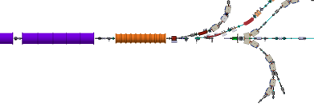
Leakage UXCMU3
Dipole Magnet MU3
Baffle Plate

