Slide 1


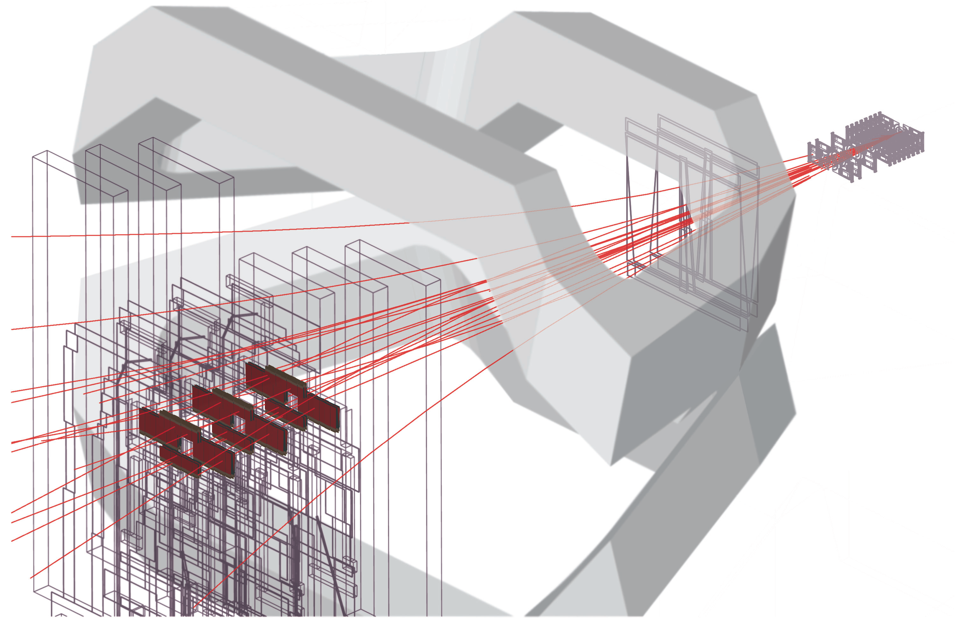
XYZ states at LHCb
International workshop on Heavy Quarkonium
GSI, Darmstadt, 4- 7th-October 2011
M. Needham
University of Edinburgh
On behalf of the LHCb collaboration

Slide 2
Outline
Introduction
X(3872): 2010 results and prospects for 2011
X(4140)
Prospects for the Z⁺(4430)
Summary + Outlook
Review what has been done so far and
what is ongoing

Slide 3
Motivation
Over the last ten years many exotic mesons reported that do not fit into
the conventional charmonium picture
X(3872), X(4140), Z+(4430)
Sparked much theoretical interest, and many models proposed
  Tetraquarks
  Molecular models
  Hybrid states
  ….

Slide 4
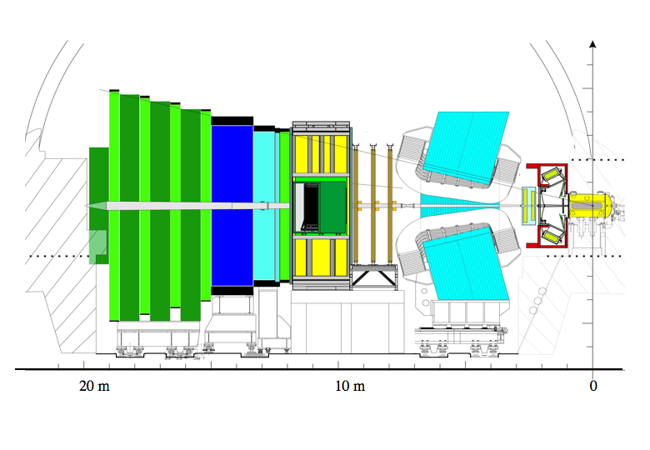
LHCb Detector
Muon System
RICH Detectors
Vertex Locator
VELO
pp collision Point
~ 1 cm
B
Calorimeters
Tracking System

Slide 5
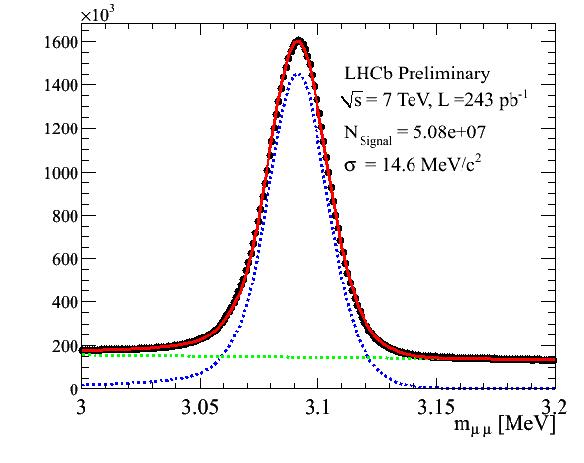
Introduction
36 pb⁻¹ collected in 2010 allowed
first studies of the X(3872) mass and
production cross-section
Now beginning to mine the order of magnitude larger 2011 dataset: 900 pb⁻¹ so far. Means more than 10⁸ J/ψ on tape !
Exotic onia studies @ LHCb can be performed in two ways
Using prompt candidates: large combinatorial background from pp interaction but possible in some cases [e.g. X(3872)]
In b-meson decays: better signal to background, but lower signal yield

Slide 6
X(3872)
First of the exotic charmonium states discovered by Belle in 2003 in b meson decays (PRL. 91, 262001 (2003))
Properties well measured at Tevatron and the B-factories:
  Mass known to 0.2 MeV and width, < 1.2 MeV
  Quantum number restricted to 1⁺⁺ or 2⁻⁺
But its nature is still uncertain: DD* molecule or tetraquark ?
Prompt production cross-section known to be high from the Tevatron and clean experimental signature in J/ψπ⁺π⁻ decay mode
First target in exotic spectroscopy program with 2010 data

Slide 7
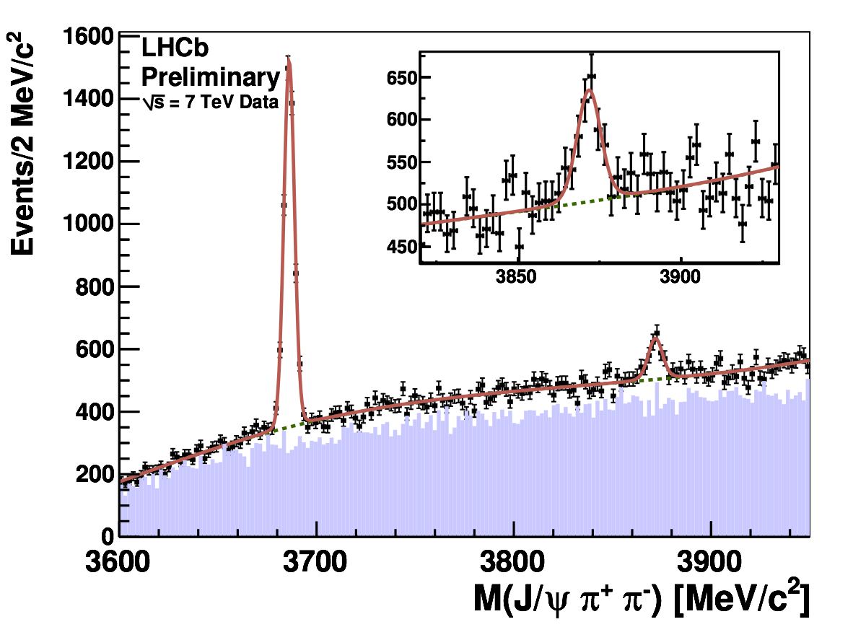
X(3872) mass
LHCb-CONF-2011-021
Same sign background
Using 585 ± 71 candidates from 35 pb⁻¹ of data collected in 2010
Dominated by statistics, will improve with 2011 data

Slide 8
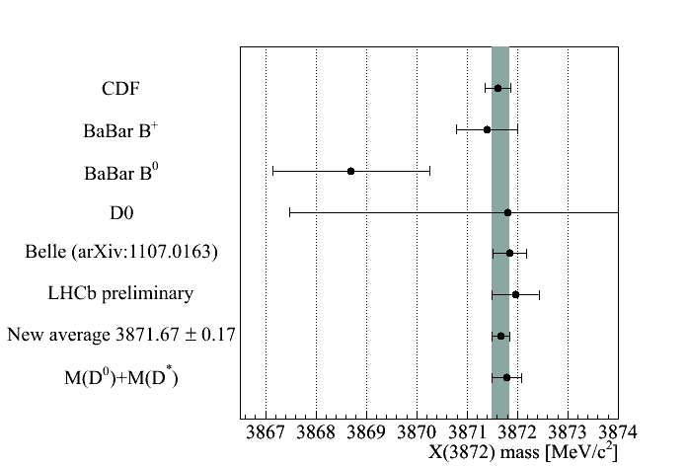
X(3872) mass
PDG 2010 gives X mass as 3871.56 ± 0.22 MeV
Add new LHCb
and Belle results
Threshold important
for molecule model

Slide 9
X(3872): Production
LHCb-CONF-2011-043
Measure product of production cross-section multiplied by
branching ratio to J/ψ
Inclusive cross-section assuming a 1⁺⁺ state
Fiducial range pt 5 – 20 GeV, 2.5 < y < 4.5 (Geometric acceptance well understood)
Complementary to CMS pt > 8GeV, |y| < 2.2 [CMS BPH-10-018]
Efficiency estimated from Monte Carlo
sWeight technique used to extract efficiency corrected yield

Slide 10
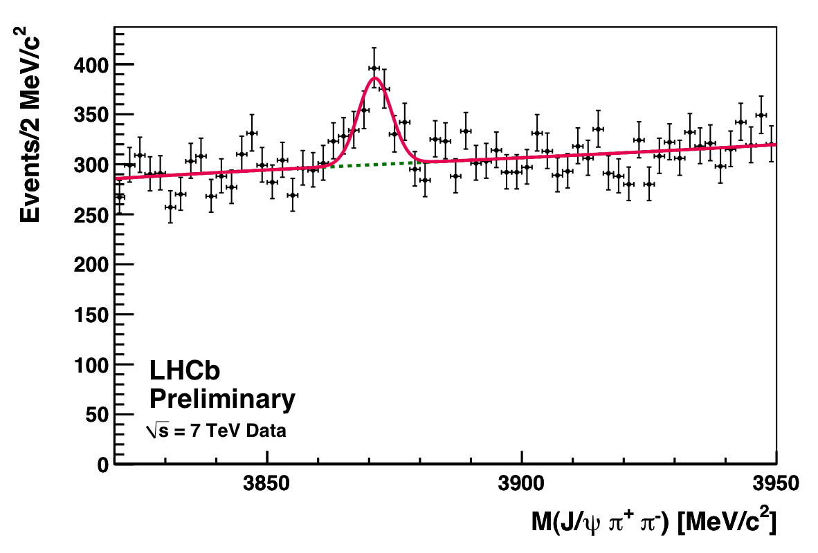
X(3872): Production
LHCb-CONF-2011-043
395 candidates (selected triggers),
fiducial cuts
Systematics due to decay width and tracking efficiency conservative and
expected to improve

Slide 11
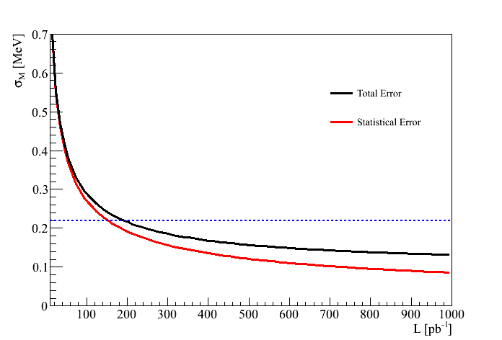
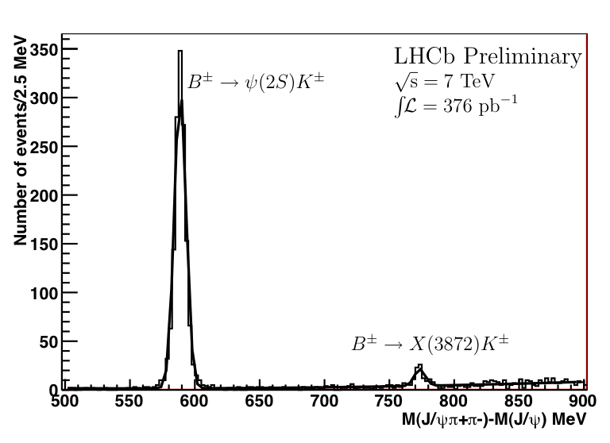
X(3872): Prospects
With 1 fb⁻¹ of data LHCb will have ~16,000 prompt X(3872) candidates
X(3872) mass measurement at ~ 0.1 MeV level
Precision production study
Sample will contain ~ 200 fully reconstructed B ➔ X K⁺
  Quantum number determination and study of m(ππ)
PDG 2010
71 ± 12 events

Slide 12
X(4140)
Exotic state reported by CDF in
study of the B⁺ ➔ J/ψϕK⁺ Dalitz plot
Initially refered to as the Y(4140)
Reported significance is 5σ
Also CDF find 3σ evidence for
a structure X(4274)
X(4274) ?
State has attracted much theoretical interest but remains unconfirmed

Slide 13
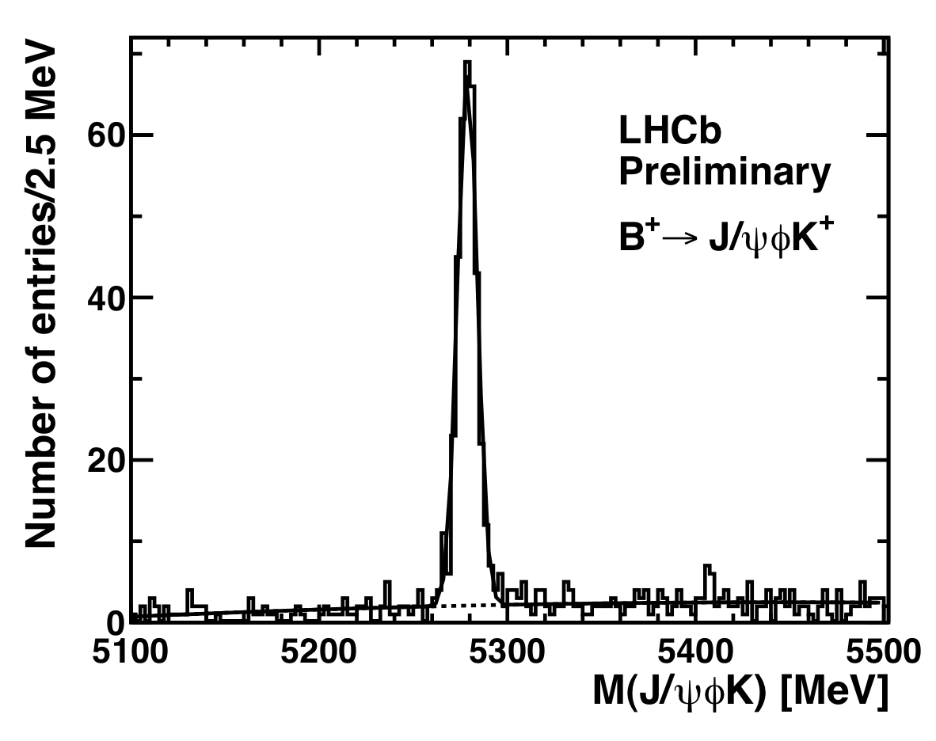
X(4140)
First LHCb study
First exotic onia study with 2011 data
Integrated Luminosity of 376 pb⁻¹
Analysis similar to that for B_{c} ➔ J/ψ 3π
Clean B± ➔ J/ψ ϕ K± signal
464 candidates after ϕ mass cut
Sample is ~ 3 times larger than CDF
LHCb-Conf-2011-045

Slide 14
X(4140)
Based on CDF result and our B⁺ ➔ J/ψϕK⁺ yield expect 39 ± 9 ± 6 events
Critical point: background
modelling
Fit with three body phase as
performed by CDF gives:
Expected signal
based on CDF
events
But poor description of data at
threshold
Better quality fit with second order polynomial,
gives zero signal

Slide 15
X(4140)
We do not observe the X(4140) therefore we set upper limits on
its production:
3 body phase space
Polynomial background
Compared to the CDF result:

Slide 16
Z⁺(4430): Prospects
Charged charmonium like state reported by Belle in the B ➔ ψ(2S)π K
Dalitz plot, not confirmed by Babar
No such structure in in B ➔ J/ψ π K
Possible interpretation: a charged tetraquark ?
Based on MC (CERN-THESIS-2009-129) studies and Belle result expect: ~860 events/ 1 fb⁻¹ with
ψ(2S) ➔μ⁺μ⁻
Studies with 2011 data of Dalitz plot
in both J/ψ and ψ(2S) modes in progress. Can also look in for example
Bs decays. Results expected soon.
State is
Relatively wide
Γ~ 100 MeV

Slide 17
Summary + Outlook
LHCb has an active exotic onia program profiting from the large dataset already collected in 2010/2011 running
X
Y
Z
Measurement of X(3872) mass and production using 2010 data
  Predictions for cross-section in 5 < pt < 20 GeV, 2.5 < y < 4.5 ?
  2011 dataset precision measurement of X mass, quantum numbers
and production. Plus supporting measurement of D mass
We do not confirm the existance of the X(4140). Paper in preparation
Z⁺(4430): Study in progress. If Belle claim is correct we will see a signal

Slide 18
Summary +Outlook
Planned to the exploit the large collected Υ dataset to search for exotics
such as the Z_{b} reported by Belle
Also planned to to look for tetraquarks in double J/ψ mass spectra
New ideas welcome

Slide 19
Backup

Slide 20
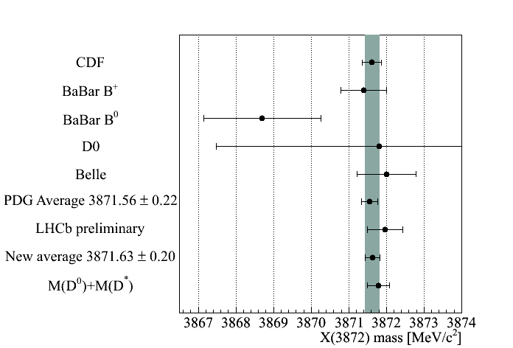
X(3872) mass
Add LHCb result to PDG 2010

Slide 21
X(3872) width
If there is a bias on the assumed σ this translates to a bias on Γ to good
approximation as:
5 % bias, with 2.8 MeV resolution
gives 0.3 MeV bias

Slide 22
X(3872) Quantum Numbers

Slide 23
X(4274)
CDF also report evidence for a broad state, X(4274). Based
on their study we expect 49 ± 18 events

Slide 24
Exotic States

Slide 25
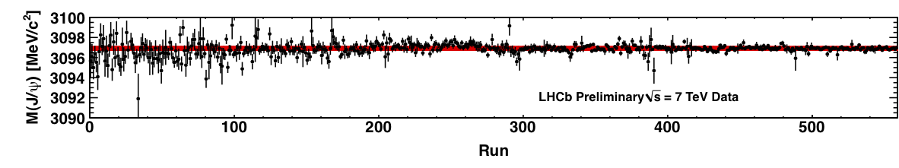
Momentum Scale Calibration
Momentum scale known to ~ 0.1 per mille for 2010
Stability versus time 2010

