Slide 1
Bottomonium:From hadronic matter to Quark Gluon plasma
Quarkonium Working Group 2011
GSI 4-7 October 2011
M. P. Lombardo
Humboldt Univ. zu Berlin & INFN LNF
G. Aarts, S. Kim, MpL, M.B.Oktay,
S.M.Ryan, D.K. Sinclair, J.I.Skullerud Phys. Rev. Lett. 106 (2011)
G. Aarts, C.Allton, S. Kim, MpL, M.B.Oktay,
S.M.Ryan, D.K. Sinclair, J.I.Skullerud arXiv:1109.4489

Slide 2
The QCD Phase Diagram
LHC
RHIC
NICA /FAIR / RHIC II
US NSAC Long RangePlan
(adapted)

Slide 3
Quark Gluon Plasma
C
Deconfinement
Chiral Symmetry Restoration
Spectrum Modifications

Slide 4
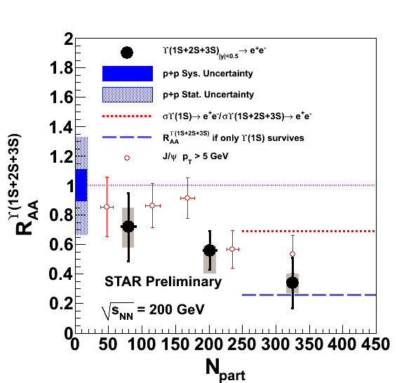
First measurements of Upsilon suppression by STAR
Rosi Reed @ QM2011
Further experimental results today:
Mironov (CMS) Grabowska-Bold(ATLAS)
Martinez(Alice) Reed (STAR)

Slide 5
A short History
The Theory : Charmonium suppression predicted
Matsui-Satz 1986
SPS : Charmonium suppression observed –
, Quark Gluon Plasma discovered!!
RHIC: Not really...previous theoretical analysis too crude.. Charmonium suppression is not enough .. Competing effects
LHC + RHIC: High precision Charmonium AND Bottomonium physics – calling for a better theoretical understanding

Slide 6
Temperature range: Experiments and our Bottomonium study
700-800 MeV (LHC expected)
500-600 MeV (LHC current)
350 MeV (RHIC-STAR)
Lattice Bottomonium
70 Mev – 360 MeV
Tc 170 MeV

Slide 7
OUTLINE Five Steps to Bottomonium:
1. Use full relativistic dynamics for up and down quarks
2. Treat bottom with NRQCD
3. Make the most of correlators in Euclidean space.
4. MEM analysis → Spectral functions
5. Masses, Width and Effective models
Summary

Slide 8
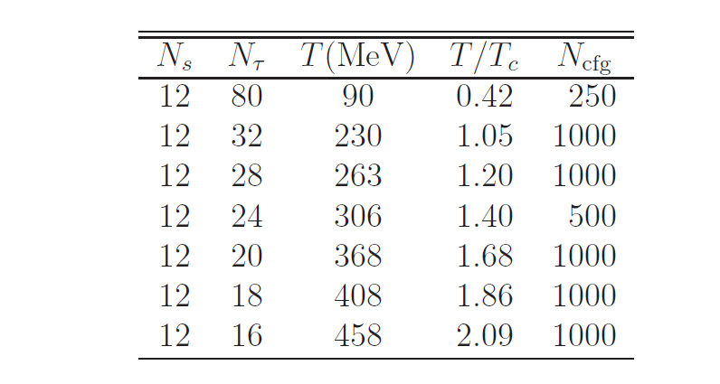
Step 1:
Full Relativistic Lattice QCD for light quarks with asymmetric gauge couplings to increase number of points in t-direction

Slide 9
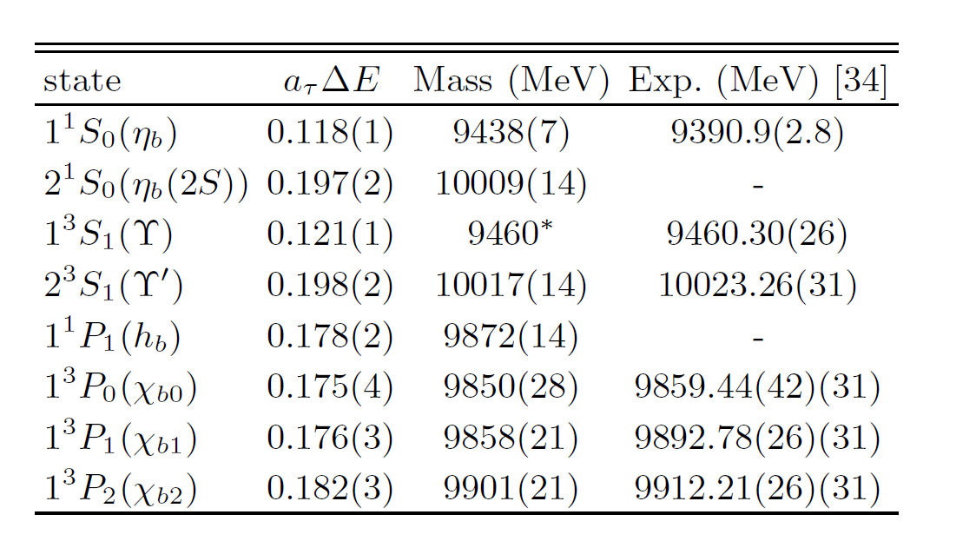
Step 2 : NRQCD for bottom quarks
Check: Zero Temperature Results

Slide 10
NRQCD for bottom quarks:
NB Propagators initial value problem
Temperature (= boundary condition) dependence is only due to the thermal medium!
NRQCD is still valid in our T range

Slide 11
STEP 3 : Analysis of propagators in Euclidean time
Bound states for S and P waves
Free behaviour for S and P waves
Laine et al 2010

Slide 12
:RESULTS
Bound states
Free quarks

Slide 13
Effective mass for the Υ

Slide 14
Effective mass for the χ

Slide 15
χ propagators and power law at T = 2.09 Tc : consistent with a free behaviour!

Slide 16
Y and (NO) free behaviour

Slide 17
χ free behaviour at T = 2.09Tc

Slide 18
Step 4: Spectral Functions
Laine, Petreckzy et al.

Slide 19
Step 4: Spectral Functions
Laine, Petreckzy et al.

Slide 20
Spectral Functions
NRQCD PLUS’es:
No Temperature dependence in the kernel
No problem with zero modes
Easier MEM analysis
Temperature dependence of the Euclidean correlators entirely dynamical

Slide 21
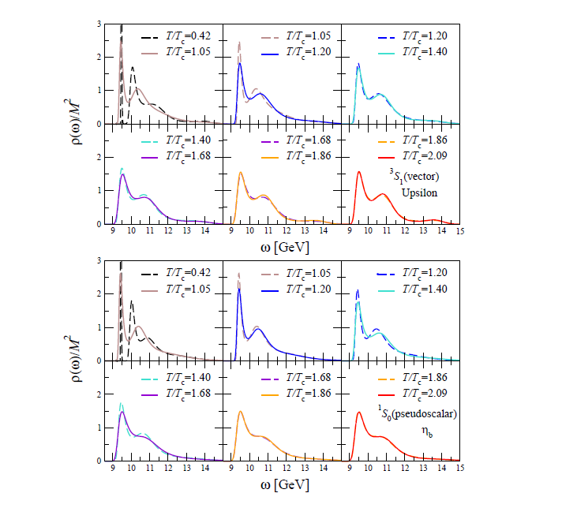
NRQCD spectral functions – S waves
S

Slide 22
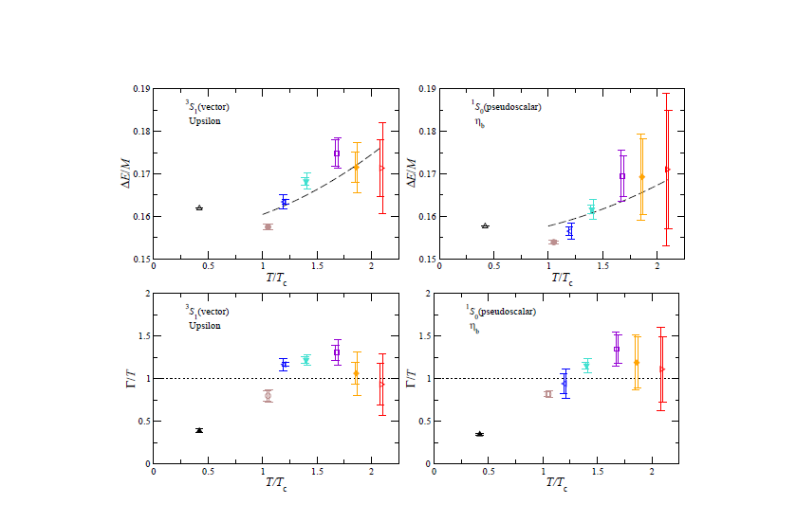
Step 5 : Results for Masses and Widths
S-Waves
Dashed line :
fit motivated by

Slide 23
Comparision with weak coupling expansion [N.Brambilla et al.2010]
Fit to:

Slide 24
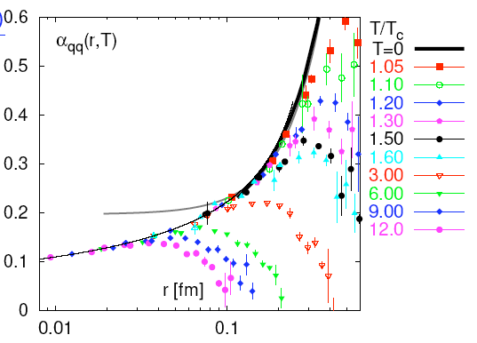
Q Qbar interactions at High T, Potential, Spectral functions
Running coupling at high T physically interesting.
However what makes the QGP strongly interacting not clear yet
Ambiguities in the definition of the potential producing ambigous results
Karsch et al
use
To clarify relation with lattice data compute spectral functions and potential on same configurations
Allton and Skullerud, in progress
From H.Satz

Slide 25
Summary
We have studied the temperature dependence of bottomonium for 0.4 Tc < T < T 2.1 Tc, using nonrelativistic dynamics for the bottom quark and full relativistic QCD for up and down quarks
Correlators and spectral functions indicate that the Upsilon and ηb fundamental states are insensitive to the temperature in this range
The χ show a crossover from an exponential decay characterizing the hadronic phase to a power-law behaviour consistent with nearly-free dynamics at 2Tc
The Upsilon and ηb excited states are no longer visible at temperatures above 1.4 Tc , in agreement with experimental observations at RHIC and LHC

