Slide 1
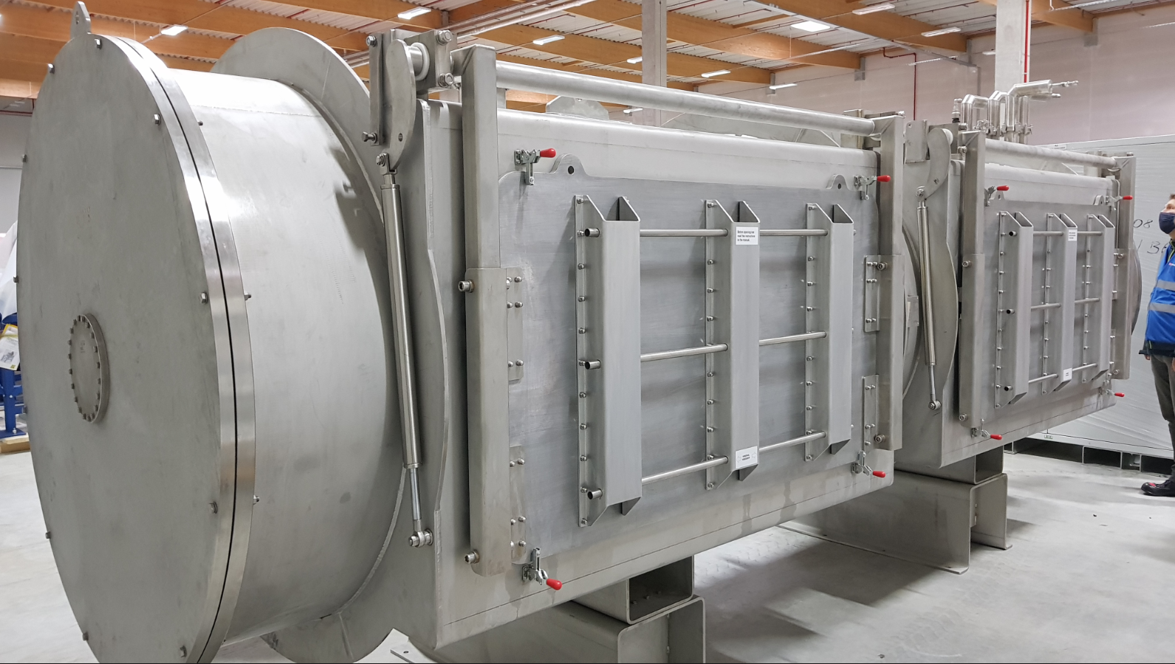
cw-LINAC, 12.01.2021
CH2-test @ Goethe Univ. Frankfurt again postponed due to (quasi) emergency operation
Preparation of advanced test campaign with CM1-CH-cavities at HI-Mainz (scheduled for Q1/2021 => posponed due to (quasi) emergency operation
Advanced demonstrator and CM2/delivery status:
superconducting solenoids: Q1/2020 (postponed)
22 rf-windows for high power couplers ordered 
CH3-5 tendering shifted by another 6 months
2 sc-rebunchers postponed 
rf-amplifiers (CM1) not yet postponed 
Prepration for further test (bath) cryostat at GSI
Beam line set up@SH4 successfully commissioned, report in preparation
BSM SAT scheduled for May/June 2021
APF-DTL
beam dynamics layout close to be finished
techn. spec
preliminary cost estimations requested
tender process should start in February 2021
high power rf test of IH-cavities (mid of 2022) in discussion
New test cryostat (CRYOWORLD Co.)

