Slide 1

Triangle singularities and new ideas about the X(3872)
Feng-Kun Guo
Institute of Theoretical Physics, CAS
Experimental and theoretical status of and perspectives for XYZ states
In memory of Mikhail Voloshin
12-15 April 2021
Triangle singularities (TSs):
M. Bayar, F. Aceti, FKG, E. Oset, PRD 94 (2016) 074039;
FKG, X.-H. Liu, S. Sakai, PPNP 112 (2020) 103757
Measuring the X(3872) binding energy using TS:
FKG, PRL122 (2019) 202002; S. Sakai, H.-J. Jing, FKG, PRD 102 (2020) 114041
X atom:
Z.-H. Zhang, FKG, arXiv:2012.08281

Slide 2

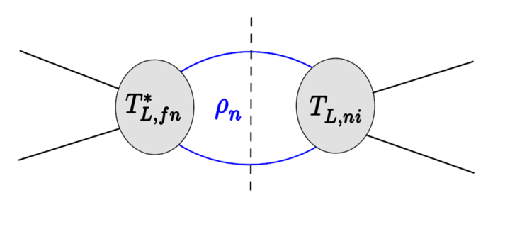
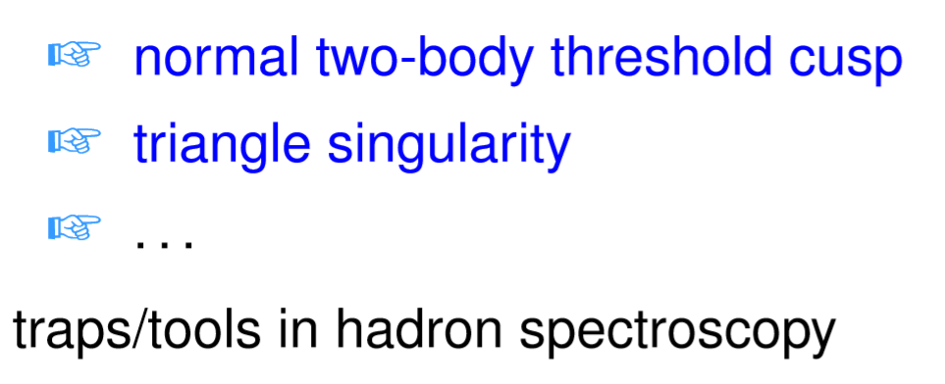
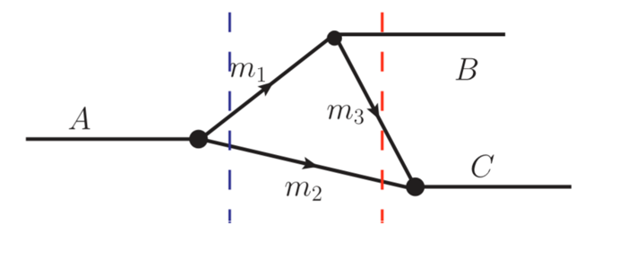
S-matrix singularities
Dynamics: poles, corresponding to hadron resonances, genuine physical states such as the ordinary and exotic mesons, baryons; location fixed by the dynamics
Kinematics: (normally) branch points of the S-matrix, due to on-shell intermediate particles, results of unitarity; location fixed by the involved kinematic variables: masses, energies
Known since long: Landau singularity
L.D.Landau (1959); J.D.Bjorken (1959); J.Mathews (1959); N.Nakanishi (1959)

Slide 3
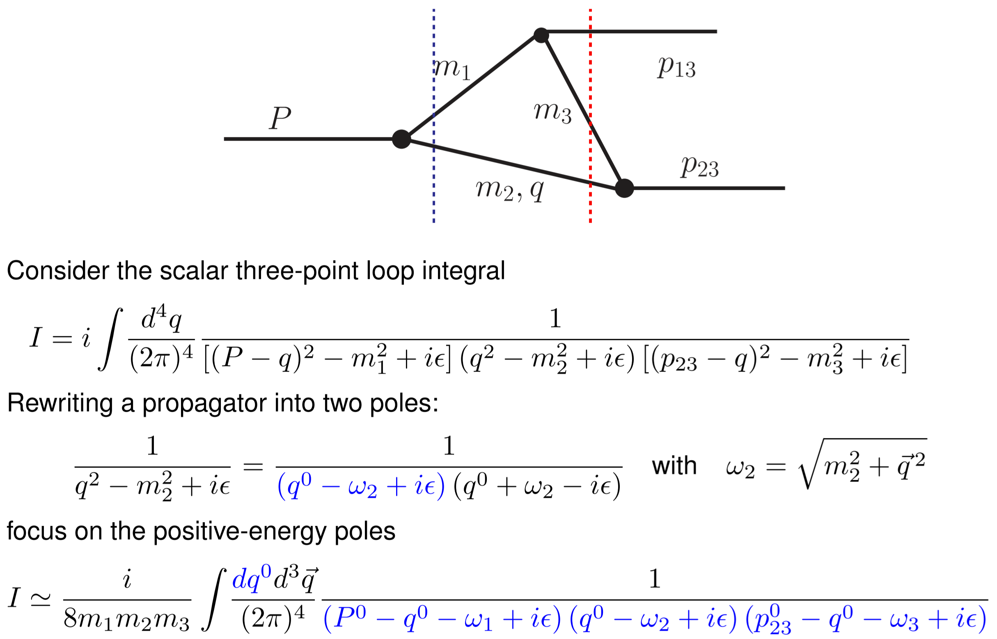
Derivation of the TS equation
Bayar, Aceti, FKG, Oset, PRD94(2016)074039
TS: Leading Landau singularity for a triangle diagram

Slide 4
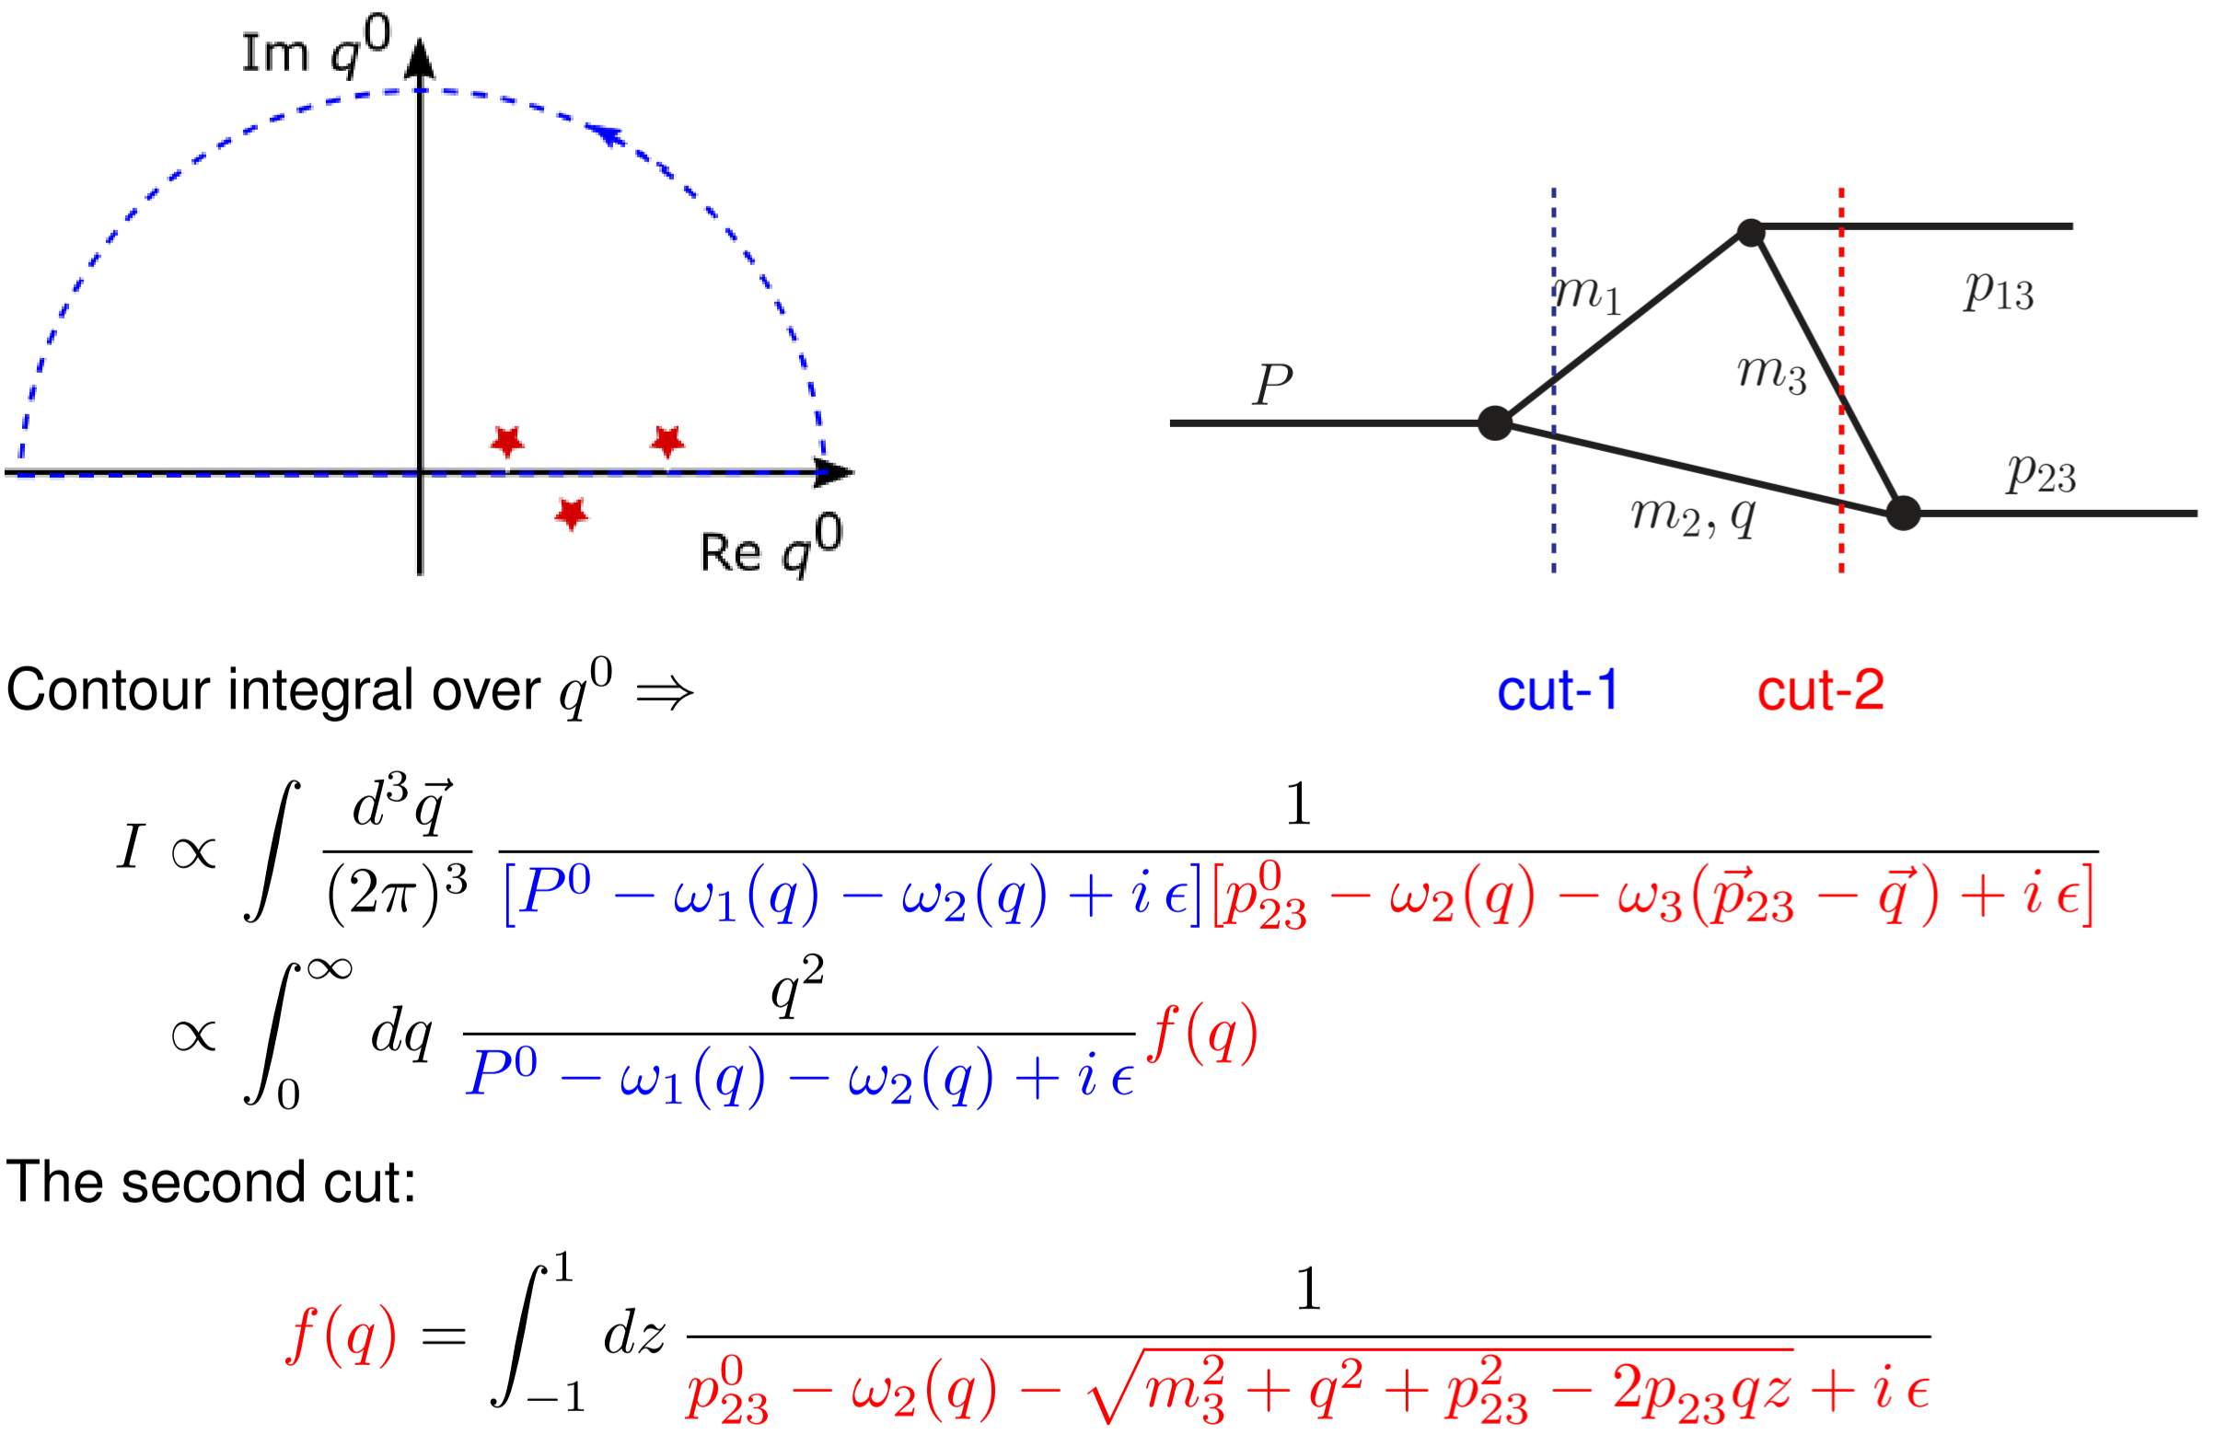
Derivation of the TS equation

Slide 5
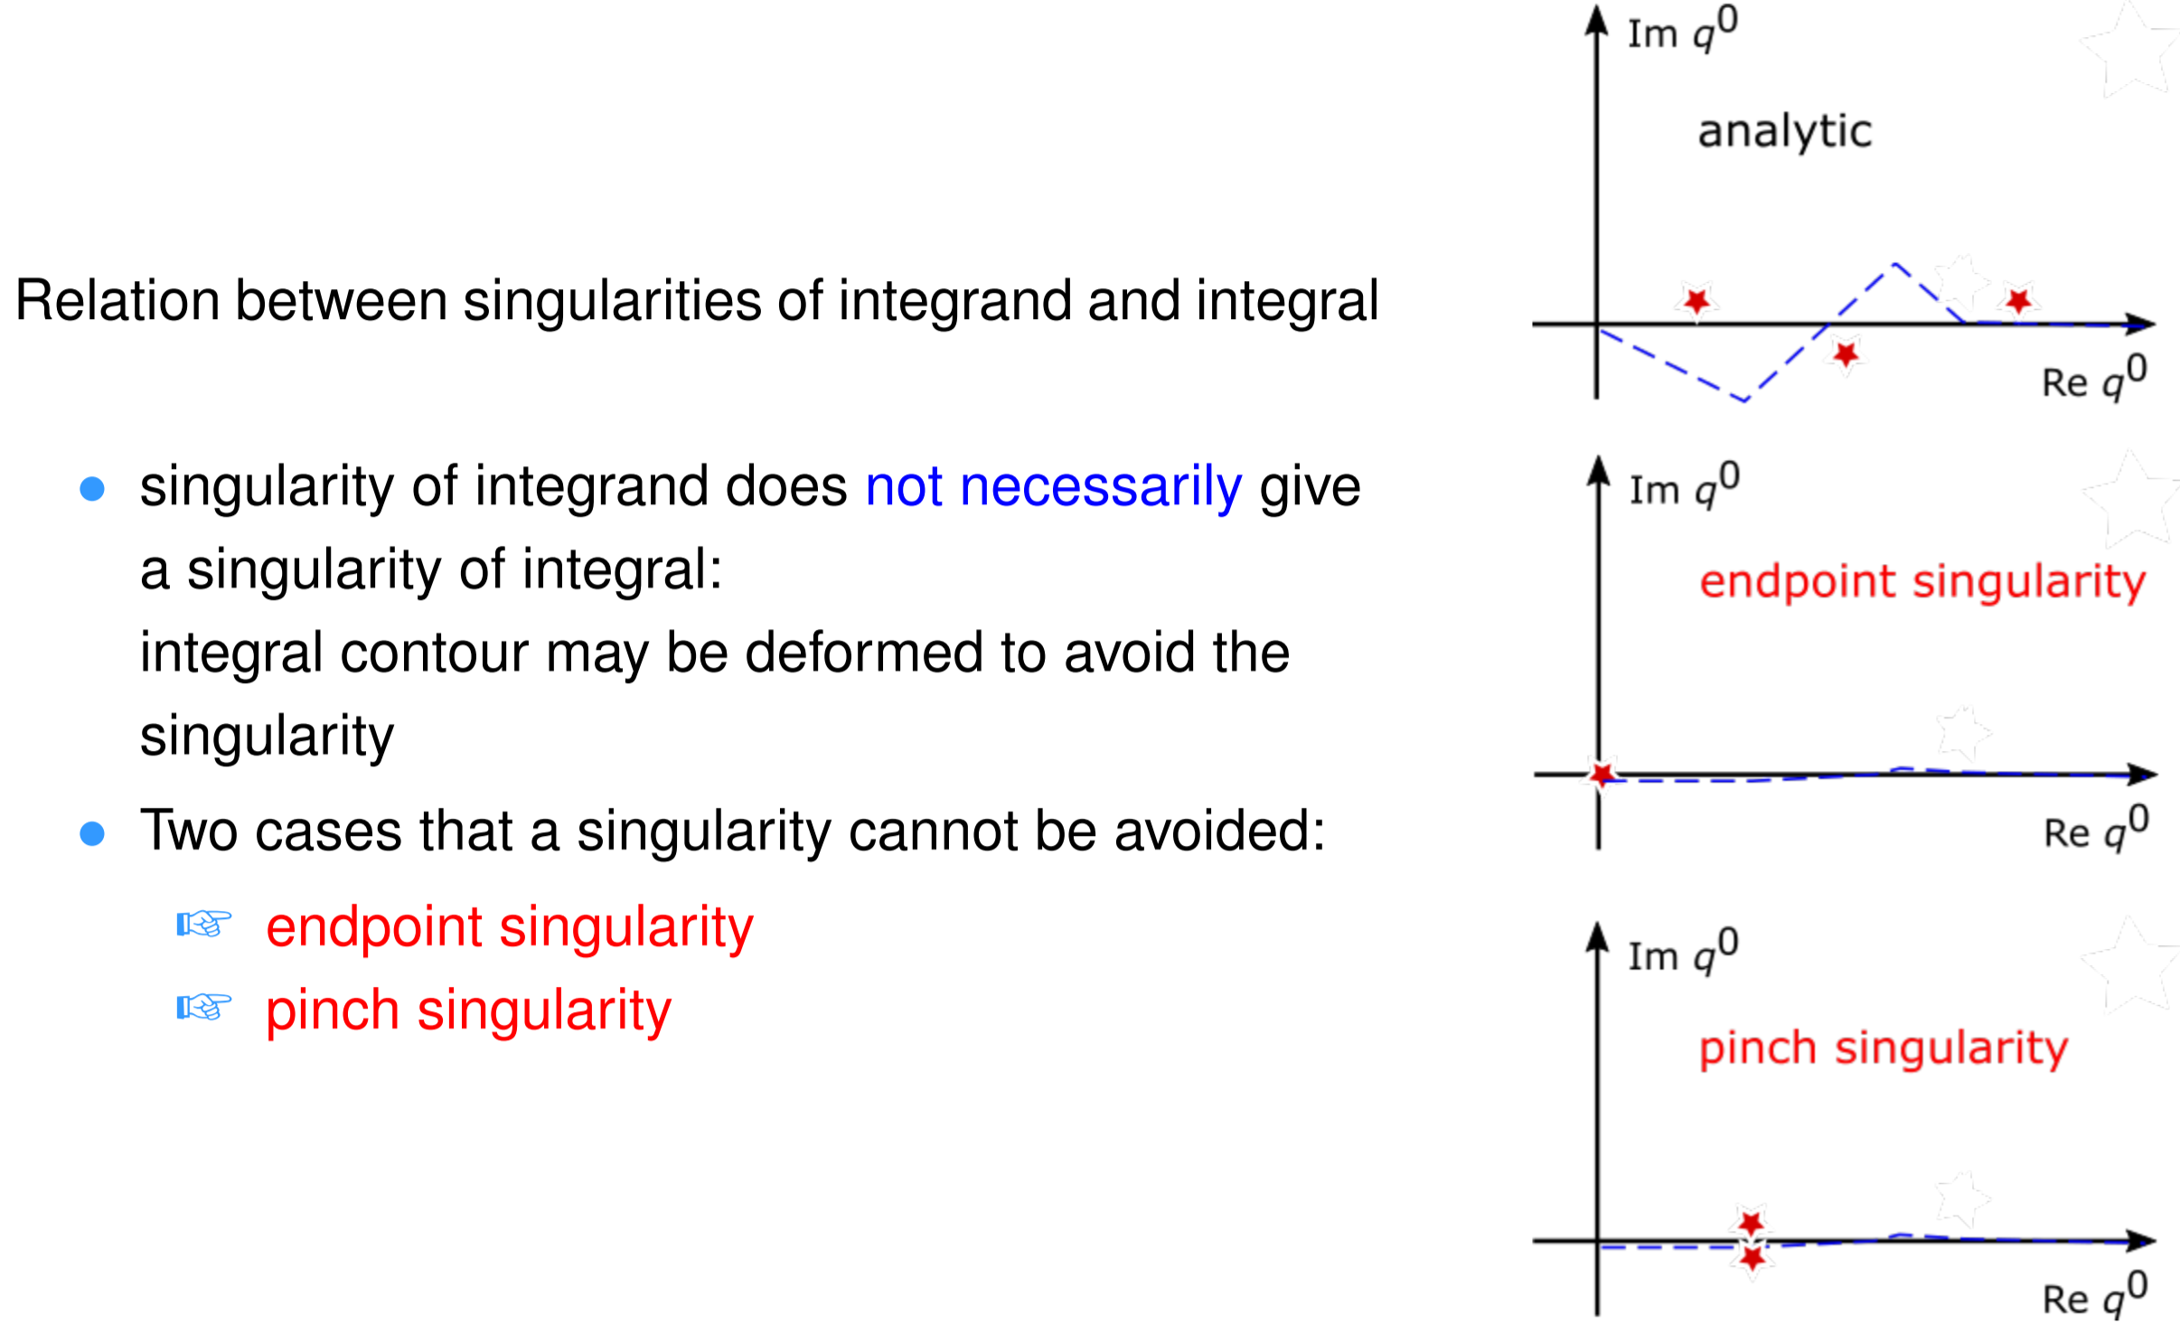
A little math

Slide 6
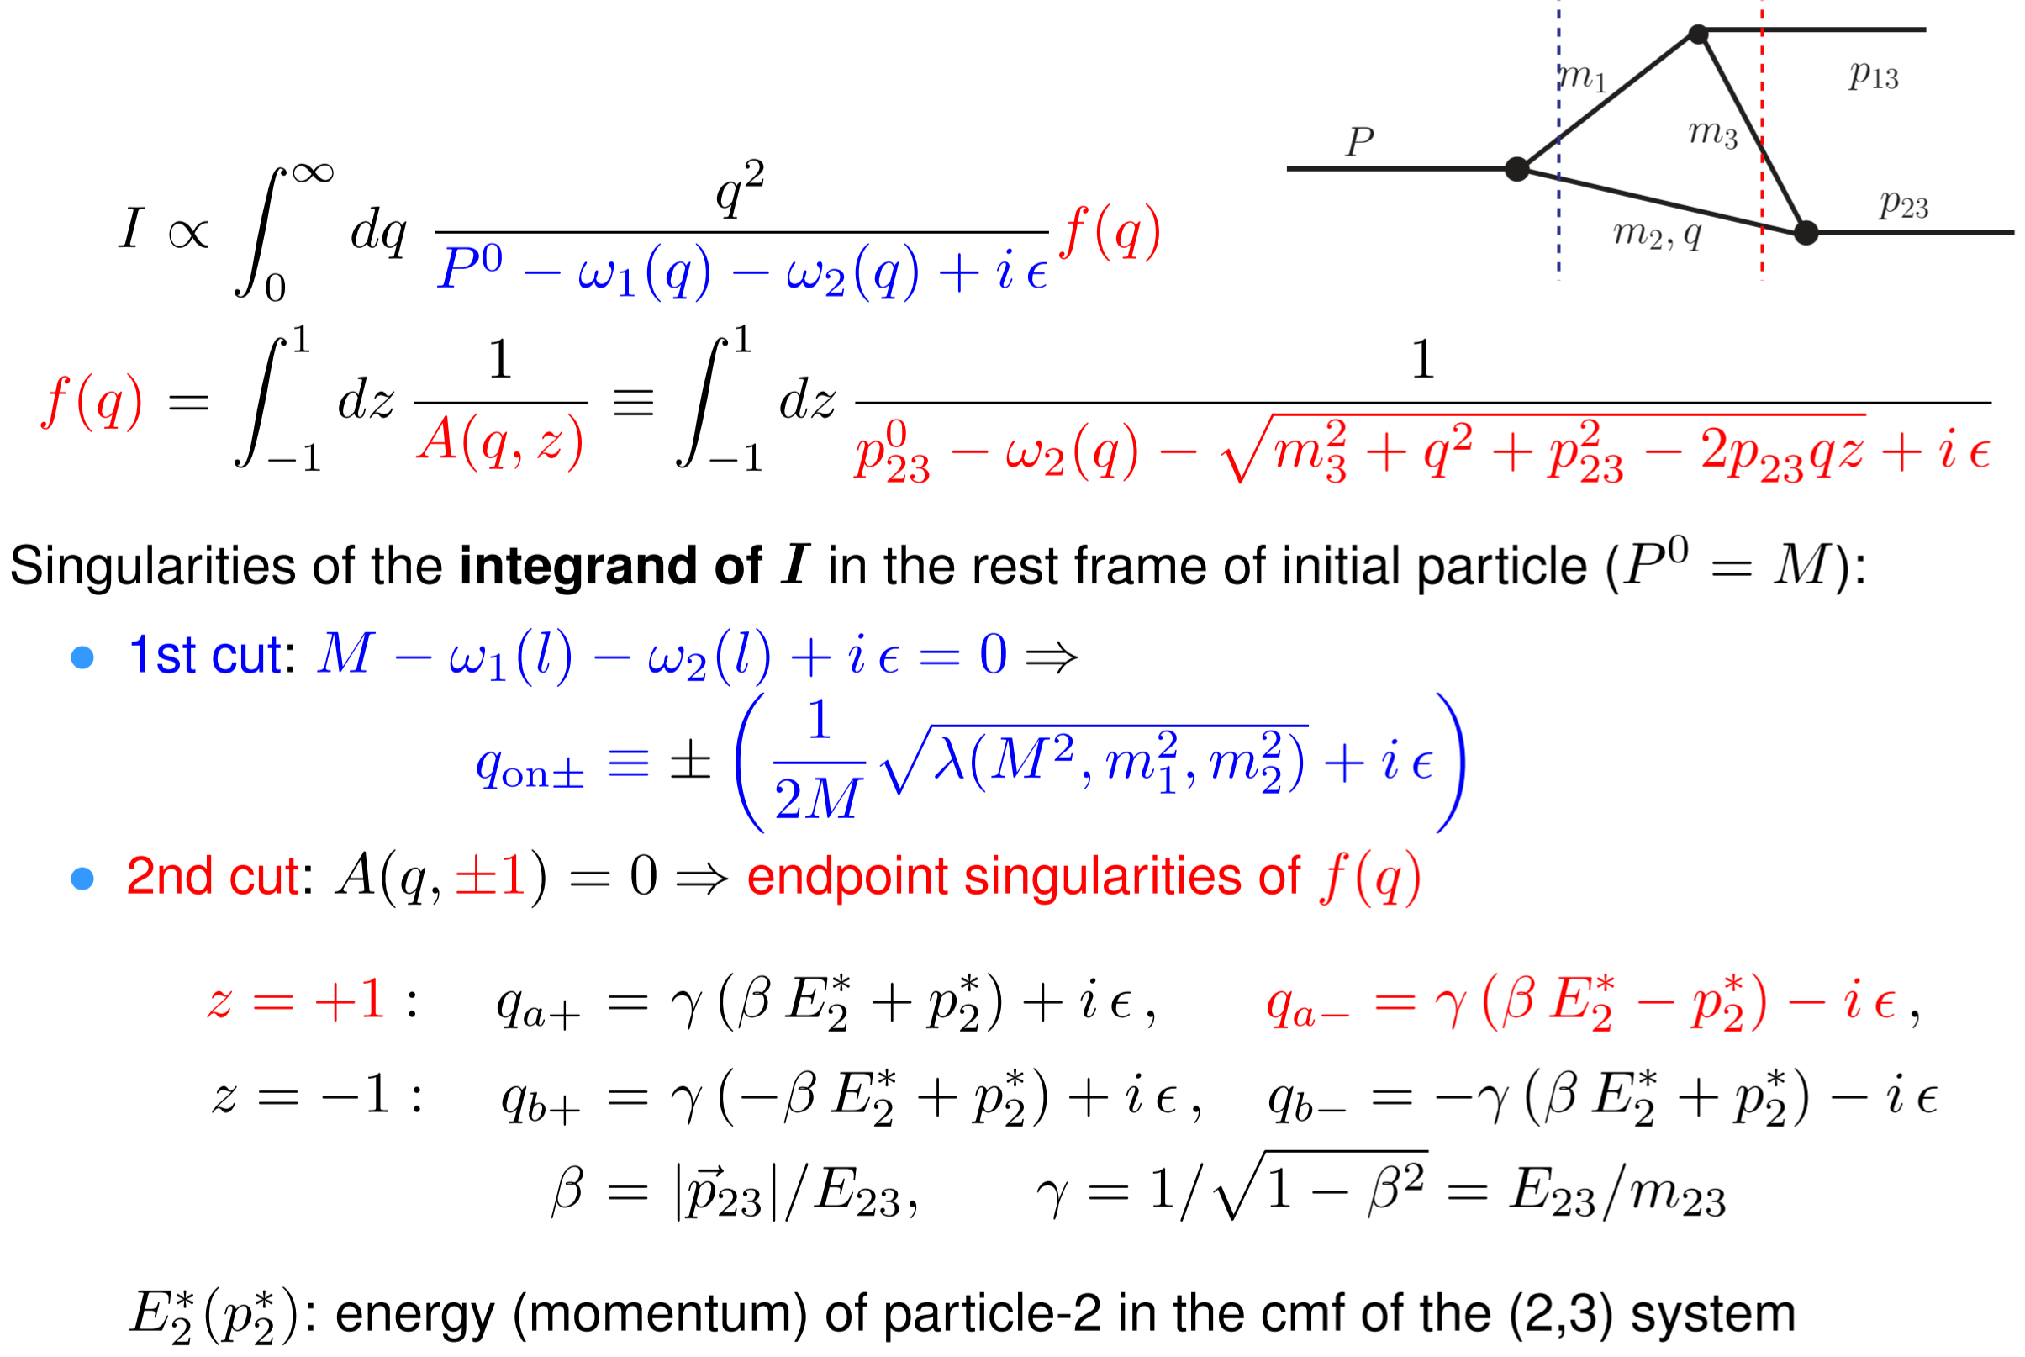
Derivation of the TS equation

Slide 7
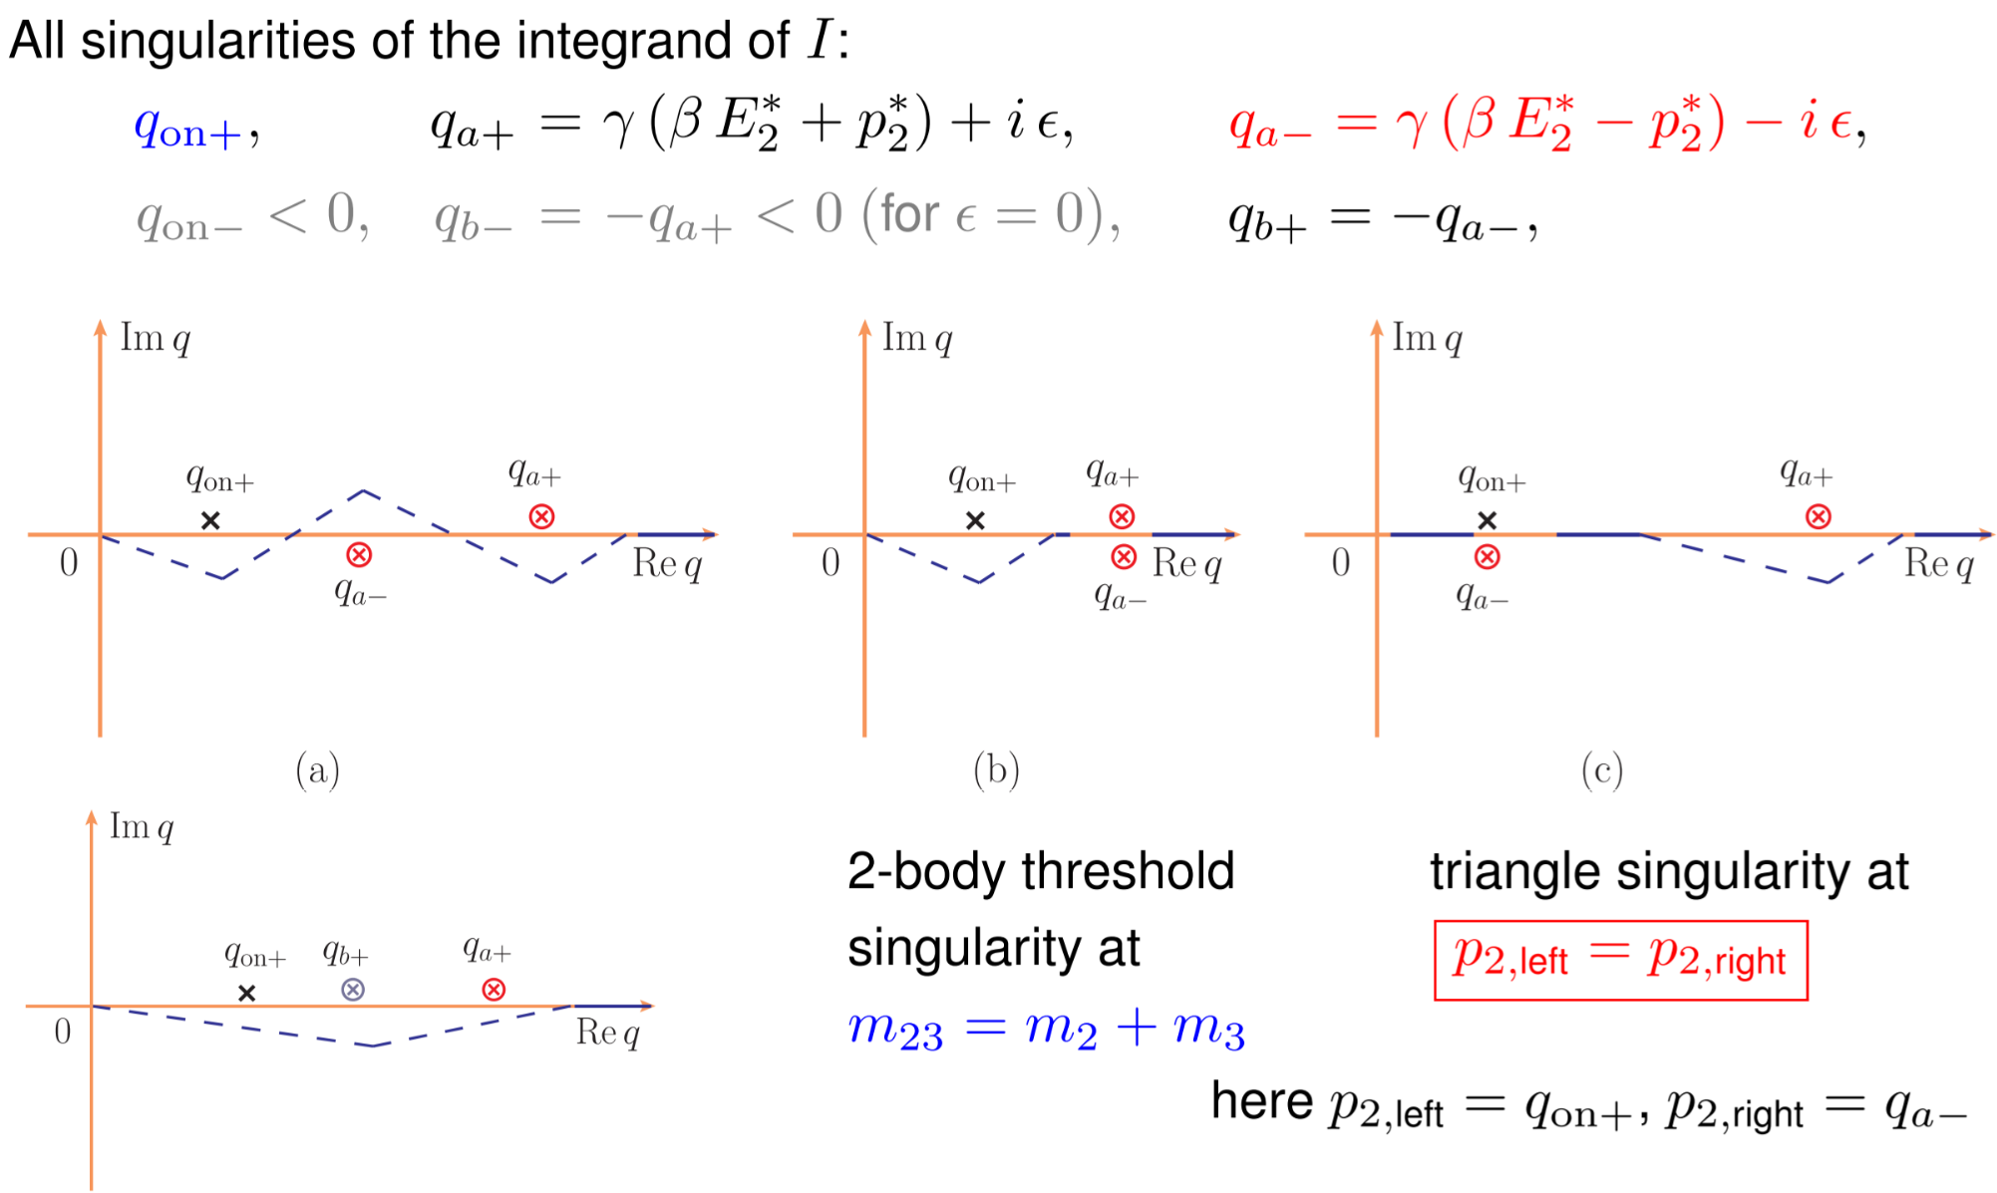
Derivation of the TS equation

Slide 8
Triangle singularity (TS)
Logarithmic singularity
Bayar, Aceti, FKG, Oset, PRD94(2016)074039
Coleman, Norton (1965); Bronzan (1964)

Slide 9
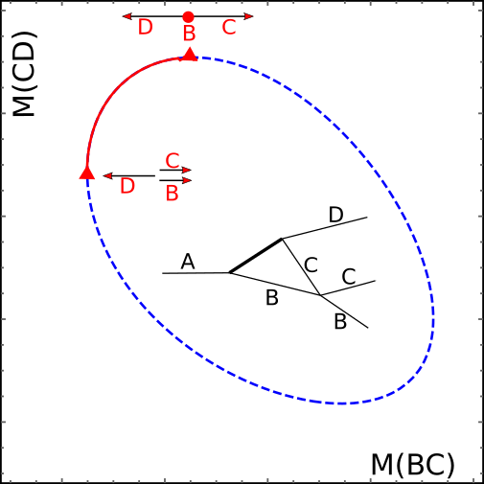
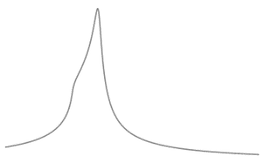
Triangle singularity (TS)
R
R

Slide 10
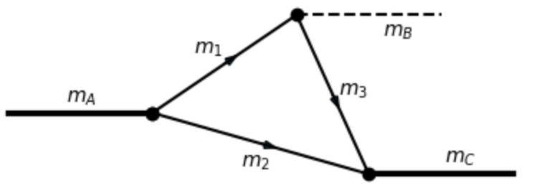
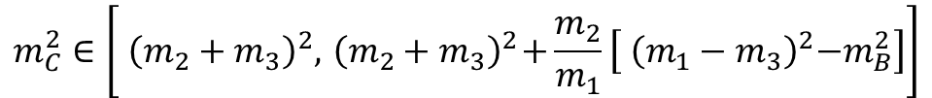
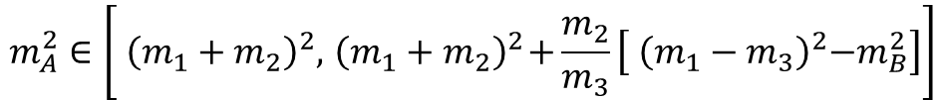
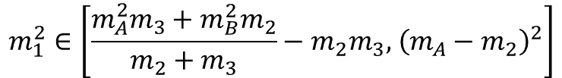
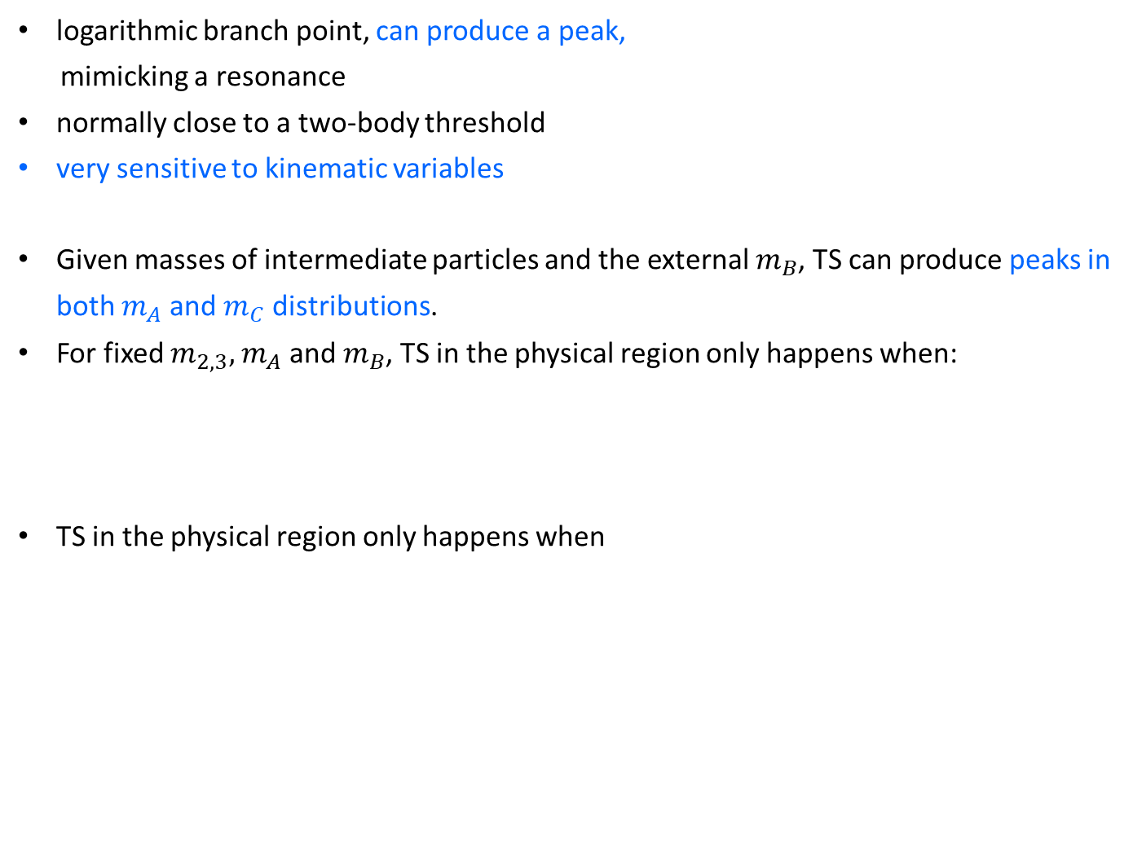
Features of TS
logarithmic branch point, can produce a peak,
mimicking a resonance
normally close to a two-body threshold
very sensitive to kinematic variables
Given masses of intermediate particles and the external $m_{B}$, TS can produce peaks in both $m_{A}$ and $m_{C}$ distributions.
For fixed $m_{2,3},$ $m_{A}$ and $m_{B}$, TS in the physical region only happens when:
TS in the physical region only happens when
$$m_{1}^{2}∈\left[\frac{m_{A}^{2}m_{3}+m_{B}^{2}m_{2}}{m_{2}+m_{3}}−m_{2}m_{3},{ \left({m_{A}−m}_{2}\right)}^{2}\right]$$
$$m_{A}^{2}∈\left[{ \left({m_{1}+m}_{2}\right)}^{2},{ \left({m_{1}+m}_{2}\right)}^{2}+\frac{m_{2}}{m_{3}}\left[{ \left({m_{1}−m}_{3}\right)}^{2}−m_{B}^{2}\right]\right]$$
$$m_{C}^{2}∈\left[{ \left({m_{2}+m}_{3}\right)}^{2},{ \left({m_{2}+m}_{3}\right)}^{2}+\frac{m_{2}}{m_{1}}\left[{ \left({m_{1}−m}_{3}\right)}^{2}−m_{B}^{2}\right]\right]$$

Slide 11
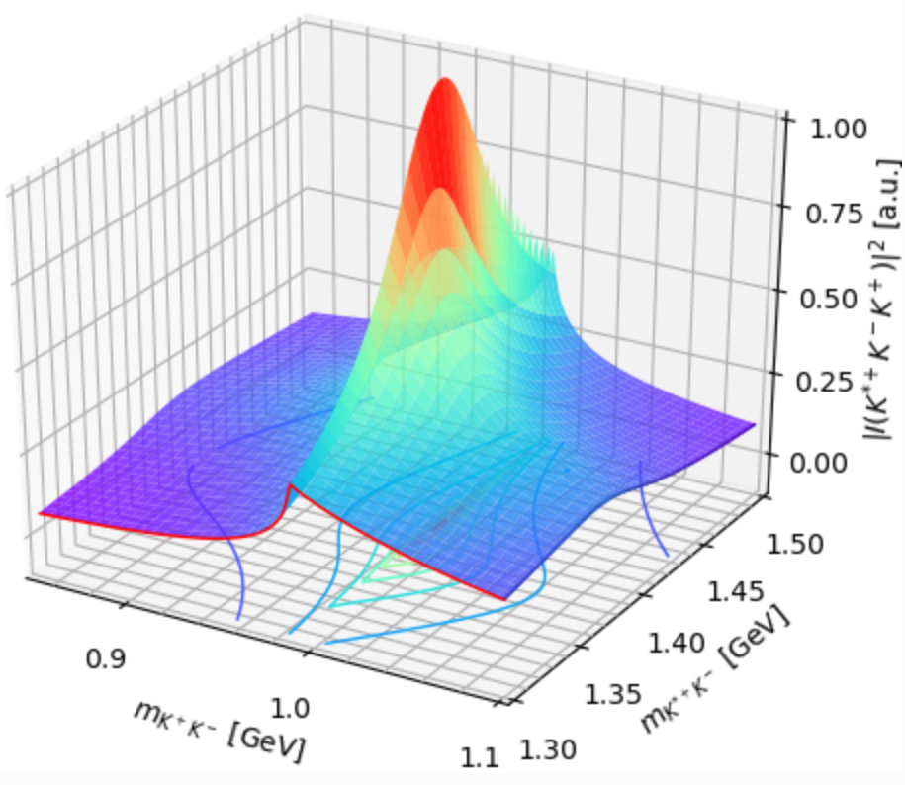
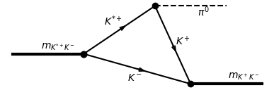
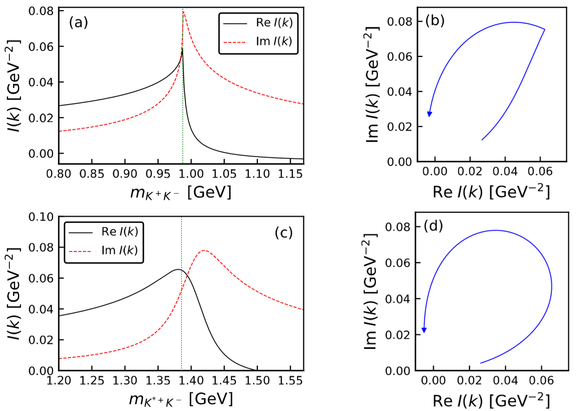






Features of TS
Phase motion of triangle diagram in the presence of a TS
$K\overline{K}$ threshold
$m_{K^{∗}\overline{K}}=1.42$ GeV
$m_{K\overline{K}}=0.99$ GeV
The argand plot is counterclockwise, resembling that of a resonance

Slide 12
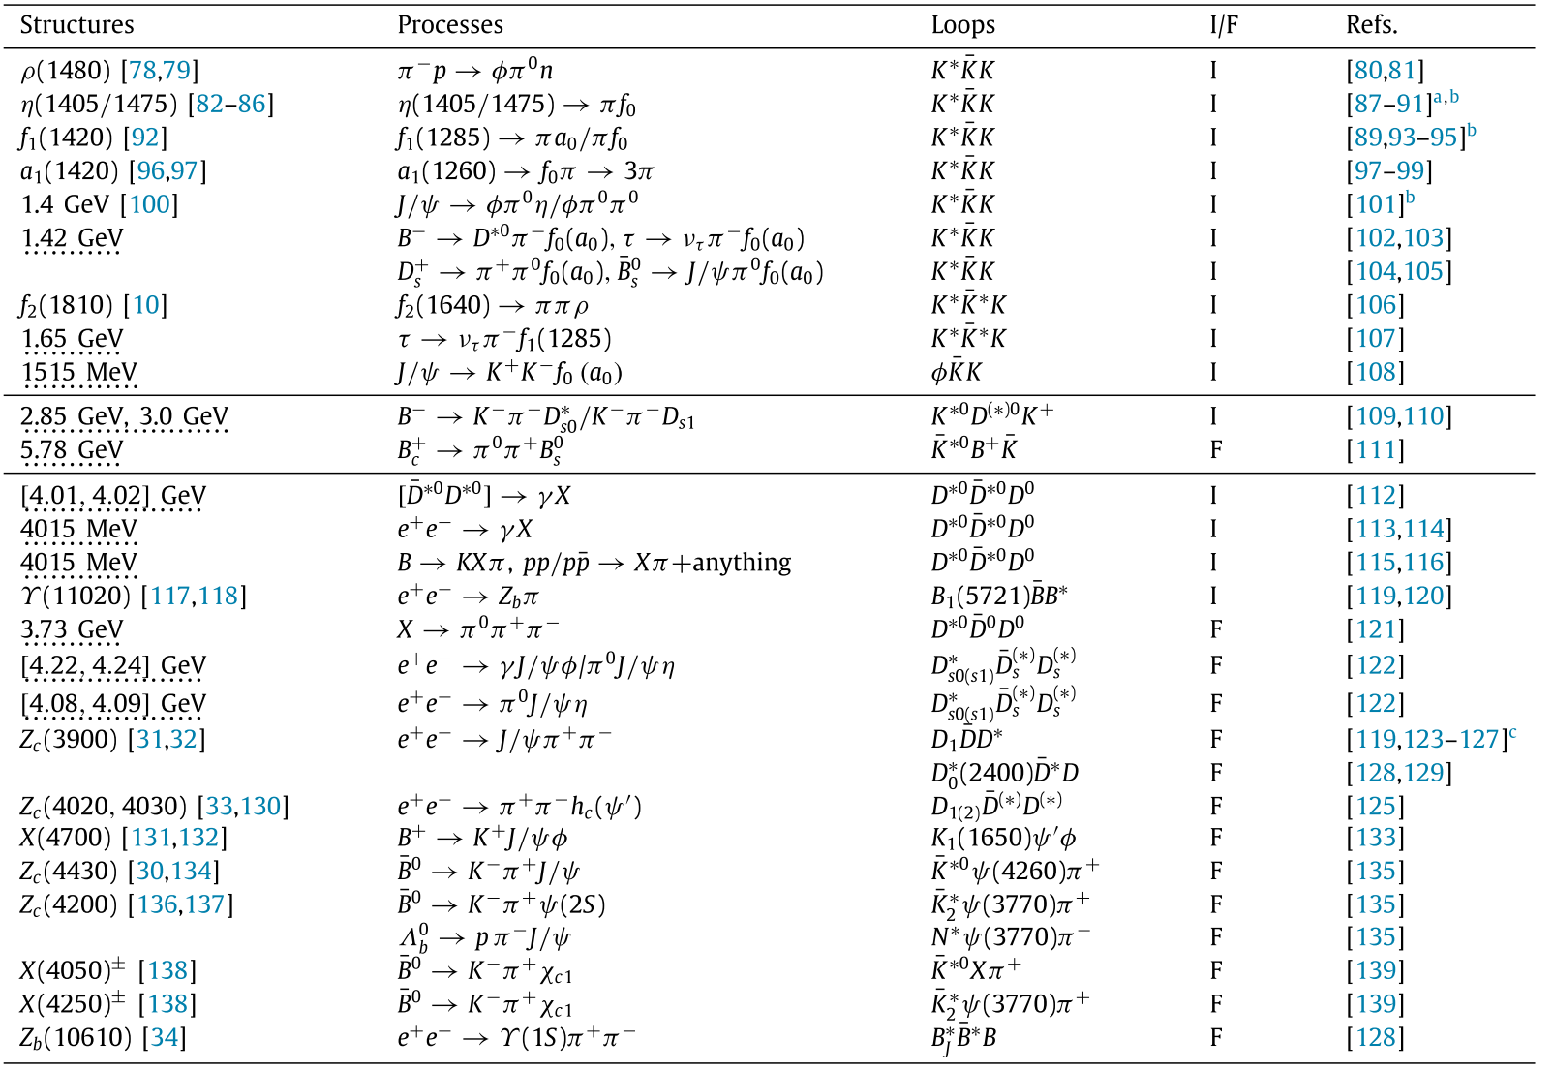
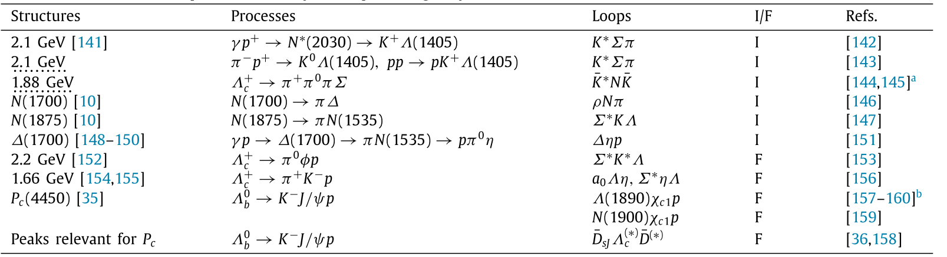
Reactions with TS
Reviewed in FKG, X.-H. Liu, S. Sakai, PPNP 112 (2020) 103757

Slide 13
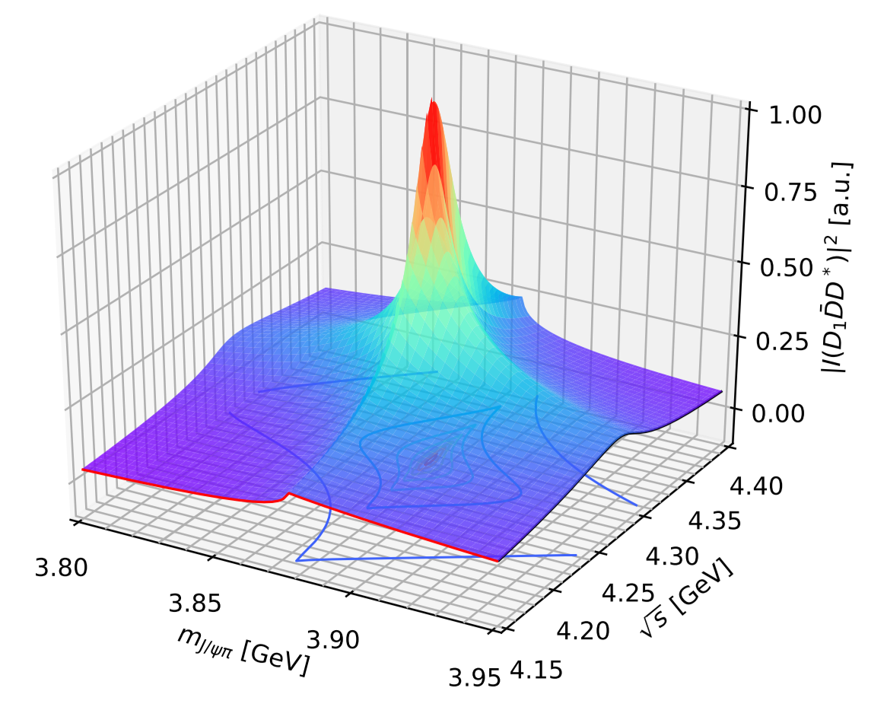
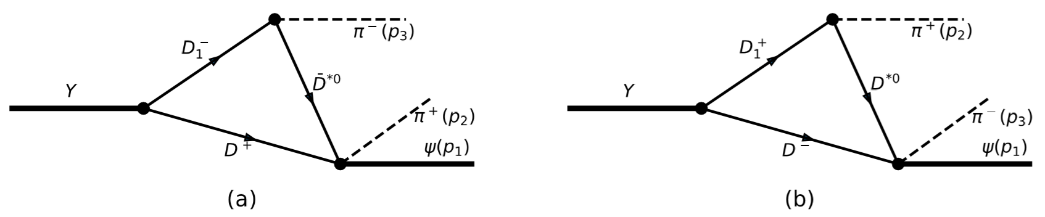
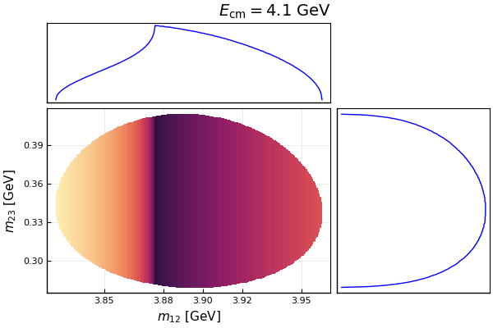
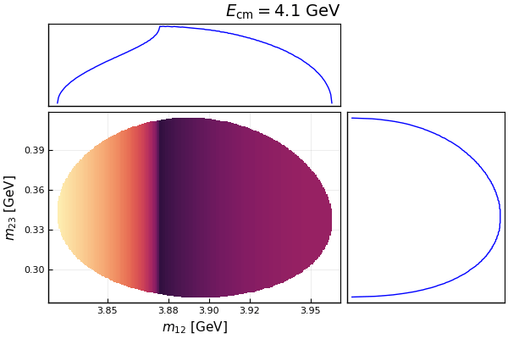
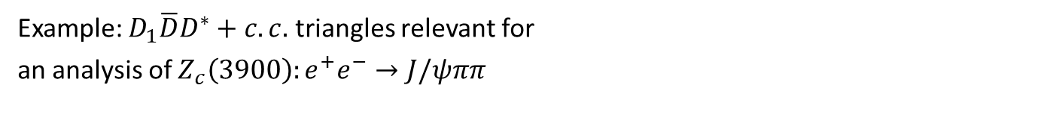



Example: $Z_{c}\left(3900\right)$
Example: $D_{1}\overline{D}D^{∗}+c.c.$ triangles relevant for
an analysis of $Z_{c}\left(3900\right):e^{+}e^{−}→J/ψππ$
Very sensitive to energy!
Scalar 3-point $D_{1}\overline{D}D^{∗}$ loop
Sum of $D_{1}\overline{D}D^{∗},D_{1}{\overline{D}}^{∗}D^{∗},D_{2}{\overline{D}}^{∗}D^{∗}$loops
TSs for $Z_{c}(3900)$: Wang et al. (2013); Albaladejo et al. (2015); JPAC(2016); Gong et al. (2018)
Despite the TSs, the $Z_{c}(3900)$ is still needed, see also the talk by I. Danilkin

Slide 14
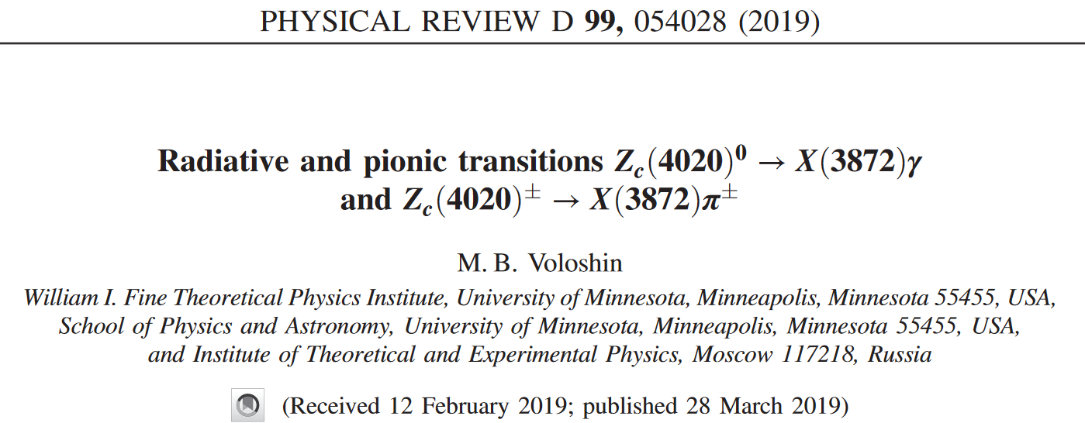
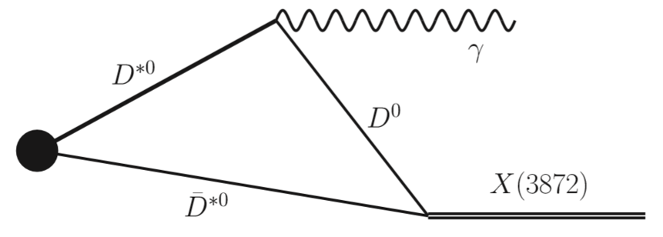
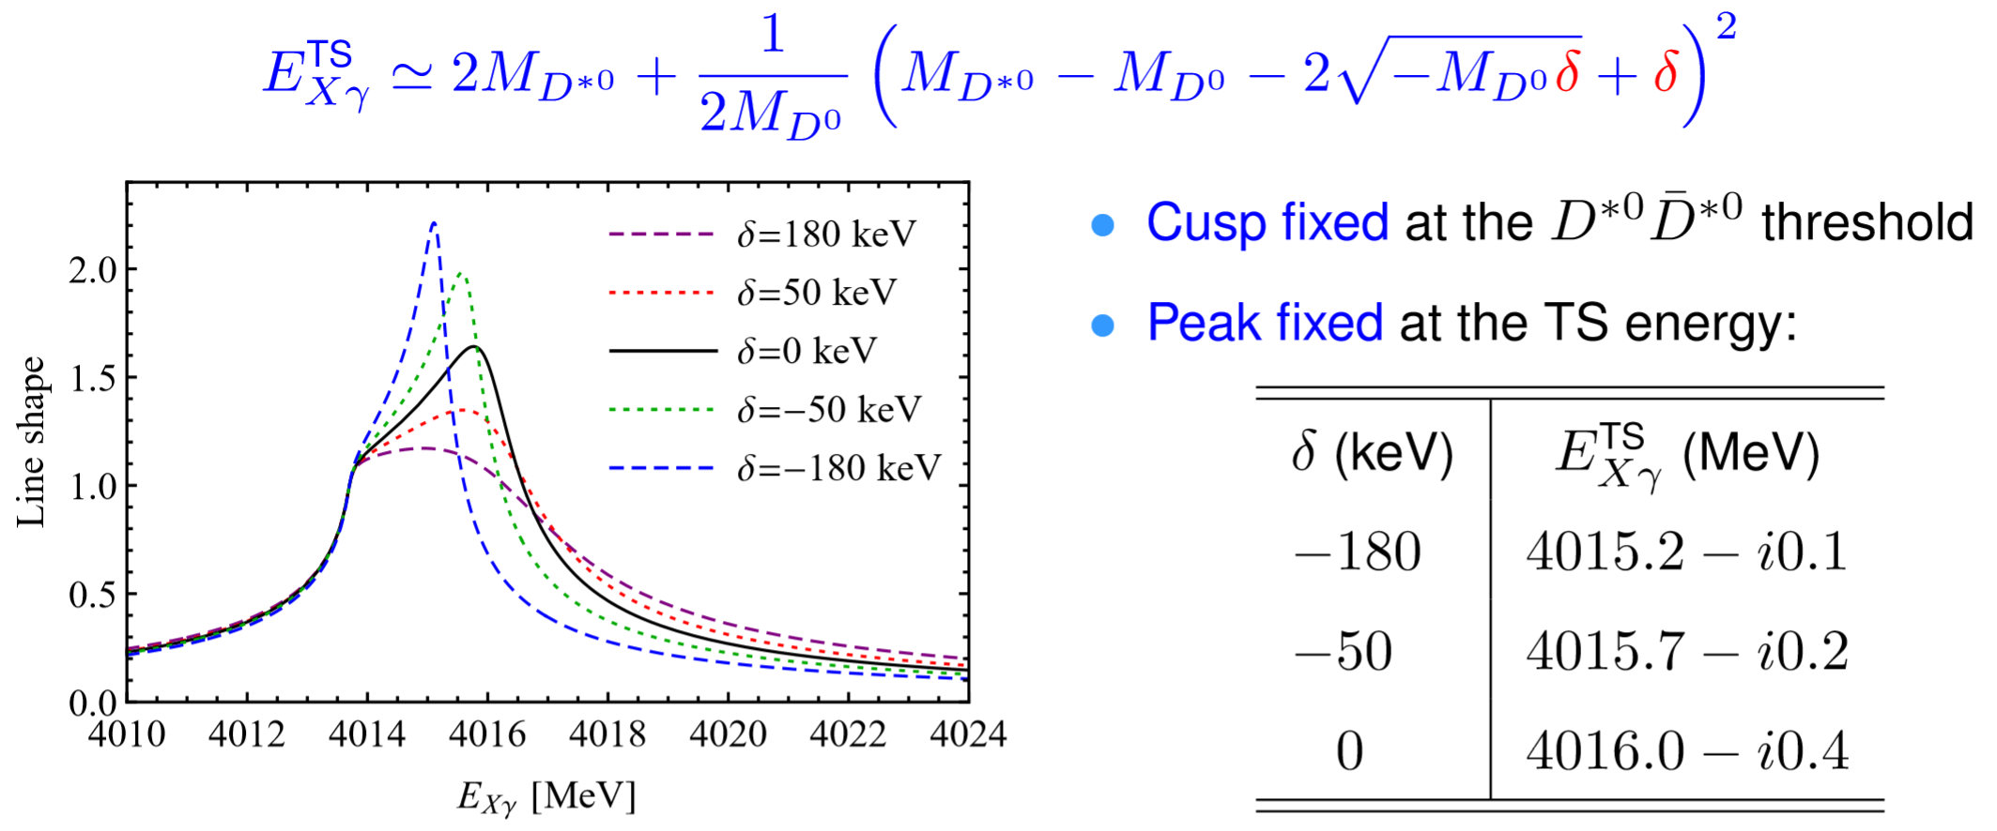
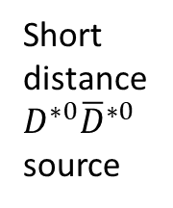
TS as a tool: precise measurement of X(3872)
FKG, PRL122 (2019) 202002
Short distance
$D^{∗0}{\overline{D}}^{∗0}$ source

Slide 15
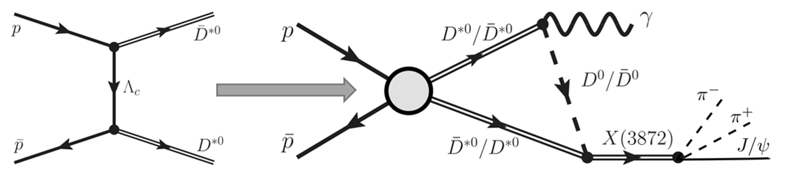
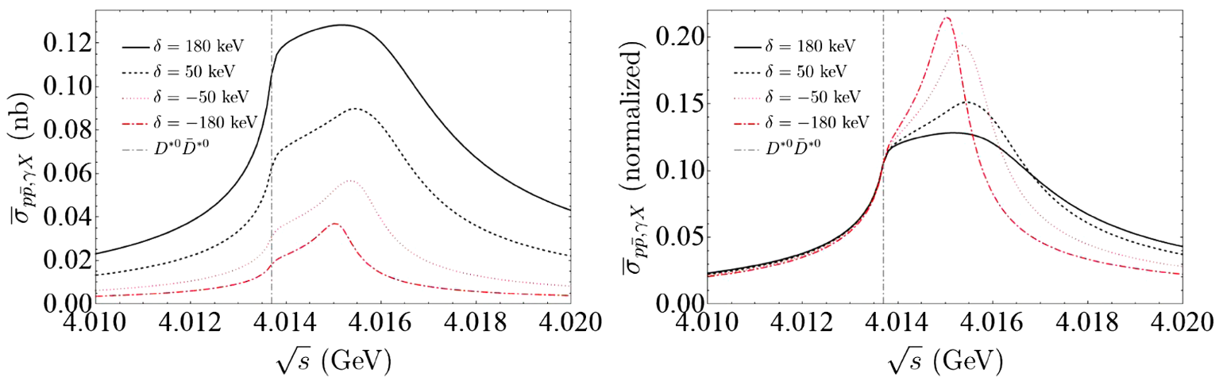

TS as a tool: precise measurement of X(3872)
Cross section estimate: $p\overline{p}→γX(3872)$
S. Sakai, H.-J. Jing, FKG, PRD 102 (2020) 114041
$σ\left(p\overline{p}→γX\right)×ℬ\left(X→J/ψπ^{+}π^{−}\right)=𝒪(10 pb)$
$𝒪(2×{10}^{3})$ events taking into account $ℬ\left(J/ψ→ℓ^{+}ℓ^{−}\right)≃12\%$ for an integrated luminosity of 2 ${fb}^{−1}$ at PANDA
PANDA, EPJA55(2019)42

Slide 16
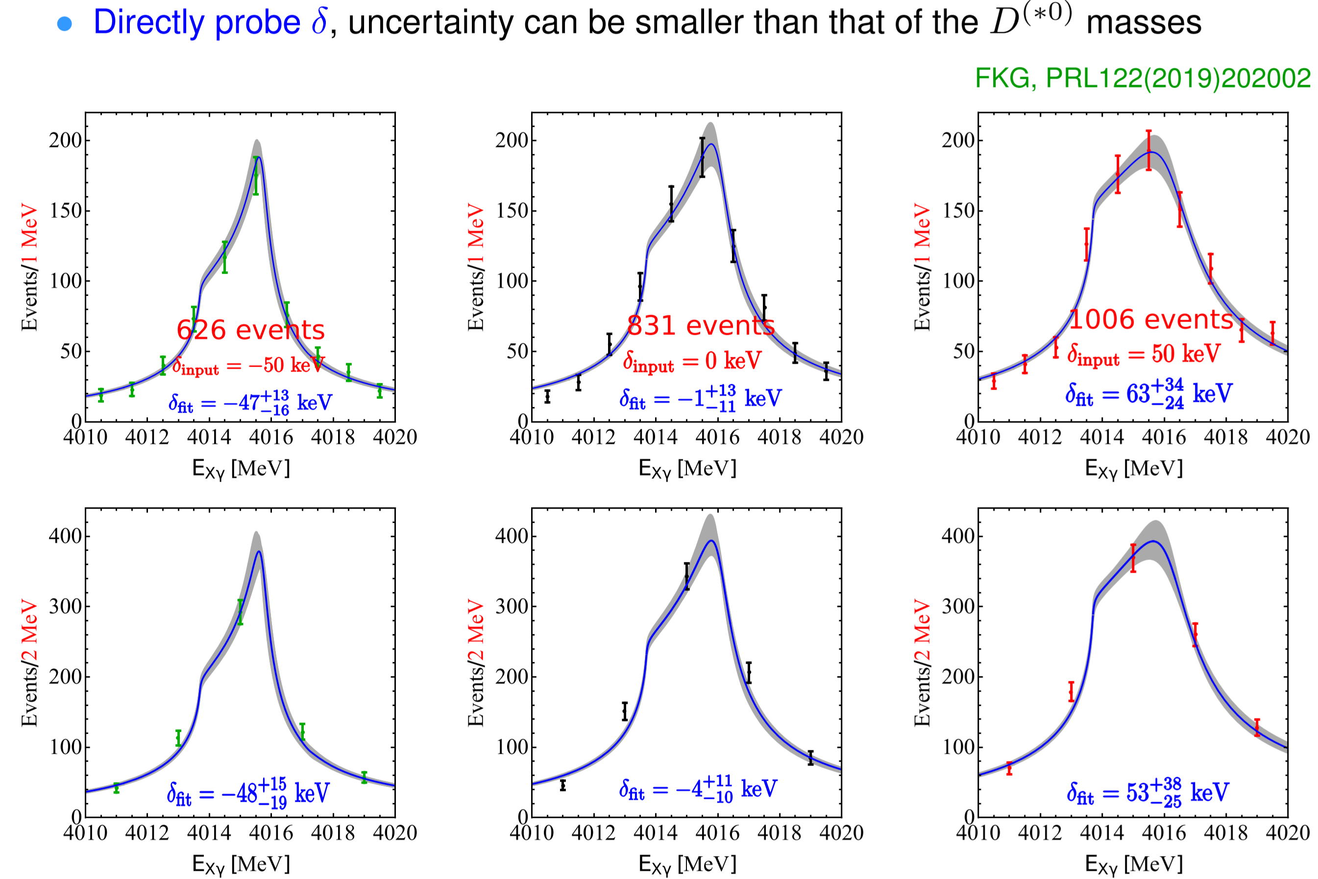
TS as a tool: precise measurement of X(3872)
Monte Carlo simulation of the sensitivity:
Effects of energy resolution studied in P. G. Ortega, E. Ruiz Arriola, arXiv:2007.11608

Slide 17


Other works on TS effects for X(3872)
Talk by E. Braaten
$$B→KπX(3872)$$
E. Braaten, L.-P. He, K. Ingles, Phys.Rev.D 100 (2019) 074028
S. Sakai, E. Oset, FKG, Phys.Rev.D 101 (2020) 054030
S. Nakamura, Phys.Rev.D 102 (2020) 074004
Production of $X(3872)$ at hadron collider
$$e^{+}e^{−}→γX(3872)$$
$$e^{+}e^{−}→γD^{0}{\overline{D}}^{∗0}$$
E. Braaten, L.-P. He, K. Ingles, Phys.Rev.D 100 (2019) 094006
E. Braaten, L.-P. He, K. Ingles, Phys.Rev.D 101 (2020) 014021
E. Braaten, L.-P. He, K. Ingles, Phys.Rev.D 101 (2020) 096020

Slide 18
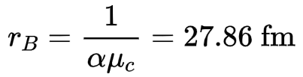







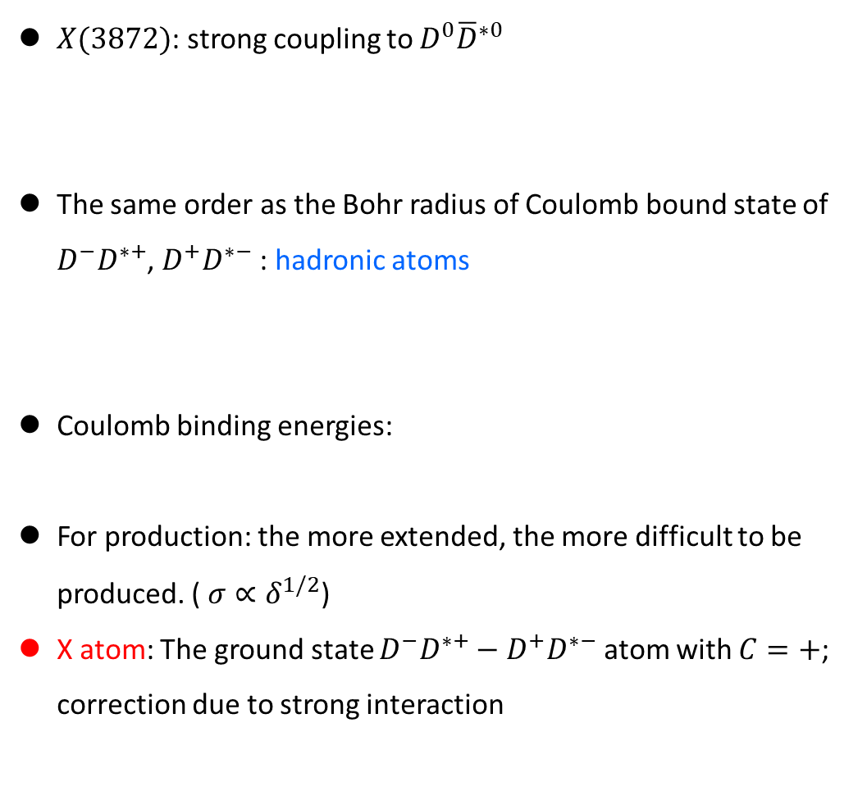
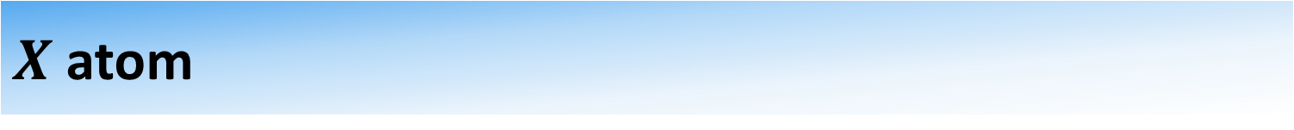


$X$ atom
$X(3872)$: strong coupling to $D^{0}{\overline{D}}^{∗0}$
The same order as the Bohr radius of Coulomb bound state of $D^{−}D^{∗+}$, $D^{+}D^{∗−}$: hadronic atoms
Coulomb binding energies:
For production: the more extended, the more difficult to be produced. ( $σ∝δ^{1/2}$)
X atom: The ground state $D^{−}D^{∗+}−D^{+}D^{∗−}$ atom with $C=+$; correction due to strong interaction
$$r_{X}≃\frac{1}{\sqrt{2μ_{0}δ}}≳10 fm$$
Unavoidably extended, large radius,
$$D^{∗+}$$
$$γ$$
$$D^{−}$$
thresholds: $Σ_{0,c}$
$$E_{n}=\frac{α^{2}μ_{c}}{2n^{2}}=\frac{25.81 keV}{n^{2}}$$

Slide 19
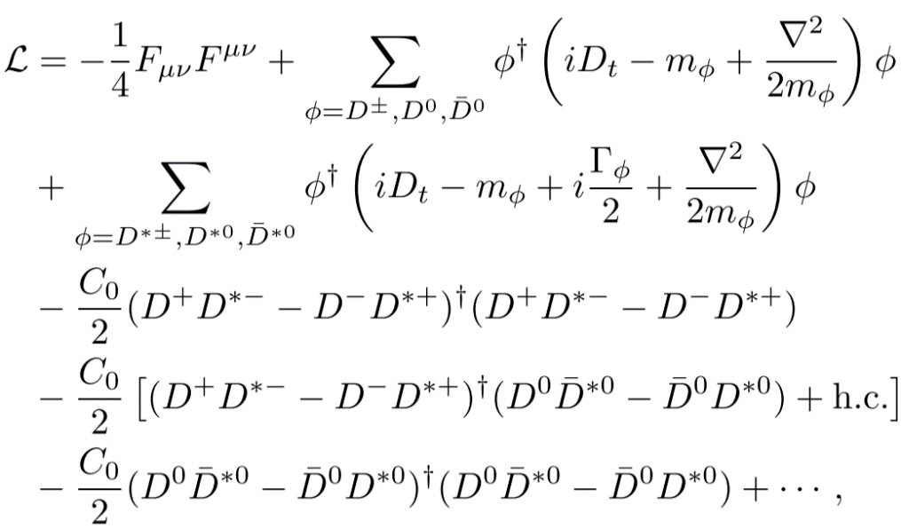


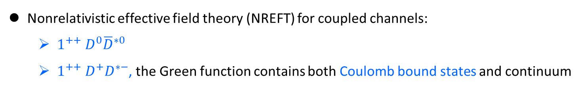


$X$ atom
Nonrelativistic effective field theory (NREFT) for coupled channels:
  $1^{++}{ D}^{0}{\overline{D}}^{∗0}$
  $1^{++} D^{+}D^{∗−}$, the Green function contains both Coulomb bound states and continuum
Around the threshold, LO in NREFT: constant contact terms for strong interaction
$$C_{0}$$
$$C_{0}$$
$$C_{0}$$
Approximation: Isospin-1 strong interaction neglected
  No isovector state was found
  Isospin breaking in the couplings is small:
Hanhart et al., PRD85(2012)011501
$$\frac{g_{Xρ}}{g_{Xω}}={0.26}_{−0.05}^{+0.08}$$

Slide 20
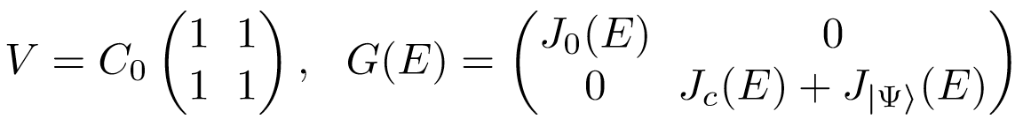
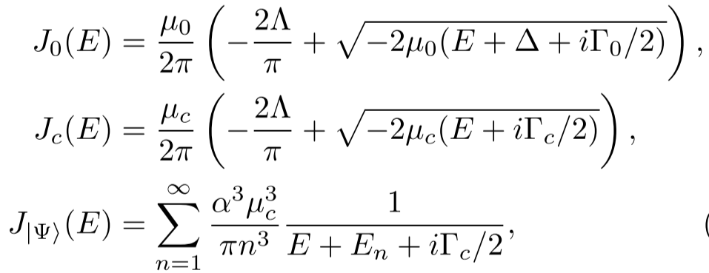



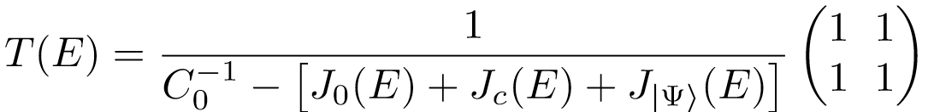


$X$ atom
The T-matrix for positive C parity channels: $T\left(E\right)=V{\left[1−G\left(E\right)V\right]}^{−1}$
$$Δ=Σ_{c}−Σ_{0}$$
The T-matrix has infinity of poles: $X\left(3872\right),$ hadronic atoms
Renormalization:

Slide 21
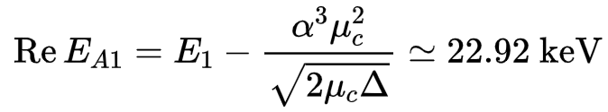
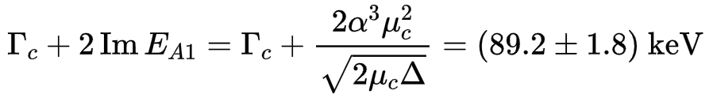
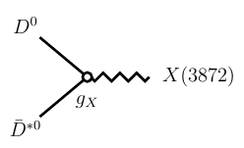
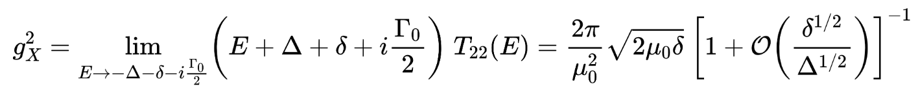

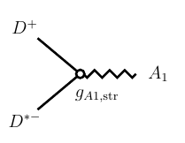




$X$ atom
X atom binding energy and decay width (due to decays of $D^{∗−}$ and into $D^{0}{\overline{D}}^{∗0}$ )
$$M_{A1}=\left(3879.89±0.07\right) MeV$$
$$=$$
$$\left(83.4±1.8\right) KeV$$
Effective coupling for$D^{0}{\overline{D}}^{∗0}→X(3872)$
Effective coupling for $D^{+}D^{∗−}→A_{1}$

Slide 22
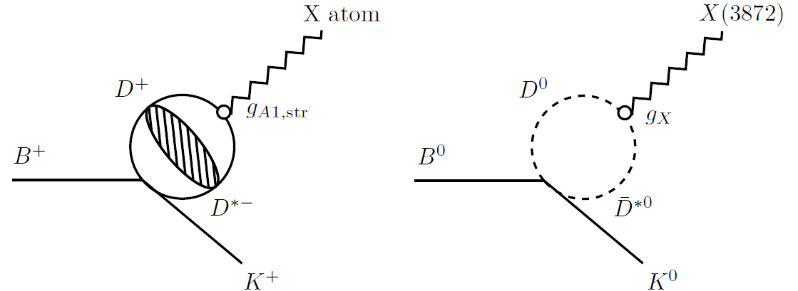
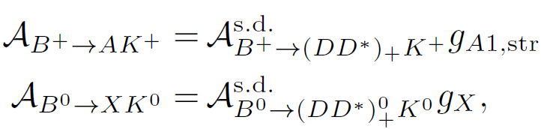
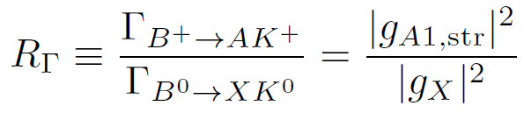
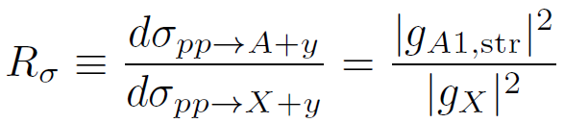




$X$ atom
Productions of the $X(3872)$ and the X atom
Scale separation: factorization
Braaten, Kusunoki, PRD72(2005)014012
Isospin symmetry: the short-distance parts are the same, productions of the X(3872) and the X atom are related
Production rate for the X atom:
Null signal leads to a lower bound on the $X(3872)$ binding energy
$$R_{Γ}≃R_{σ}≳1×{10}^{−3}$$
$$δ≃\frac{0.25 eV}{R_{Γ}^{2}}≃\frac{0.25 eV}{R_{σ}^{2}}$$

Slide 23


$X$ atom
LHCb, PRD102(2020)092005
LHCb, JHEP08(2020)123
X atom can be searched for at LHCb and PANDA

Slide 24



In memory of Misha Voloshin

Slide 25


Thank you for your attention!
Conclusion
Triangle singularity effects are sensitive to energies:
  TS-induced peak for the initial-state (final-state) energy distribution may be checked by varying the invariant mass of final (initial) states
The X(3872) has been discovered for 17 years, debates continue
New ideas regarding X(3872):
  Measuring the binding energy using TS, uncertainty not limited by that of $D^{\left(∗\right)0}$ masses, best at PANDA (high production rate and high energy resolution)
  X atom can be used to set a lower limit on the X(3872) binding energy and to settle the debates regarding the production

Slide 26




Features of TS
While a resonance would persist independent of energy.
TS in the physical region only when
$m_{K\overline{K}}∈\left[987,1026\right]$ MeV
$m_{K^{∗}\overline{K}}∈\left[1385,1435\right]$ MeV

Slide 27


TS as a tool: precise measurement of X(3872)
The cross section can be higher at higher energies, e.g. above 4.4 GeV, but seems still difficult for STCF…

Slide 28




$$B→KπX(3872)$$
S. Sakai, E. Oset, FKG, Phys.Rev.D101(2020)054030
Asymmetric line shape

Slide 29




$$Z_{c}\left(3900\right)$$
Example: $D_{1}\overline{D}D^{∗}+c.c.$ triangles relevant for an analysis of $Z_{c}\left(3900\right):e^{+}e^{−}→J/ψππ$
Importance of TS pointed out, but a $Z_{c}\left(3900\right)$ is still needed for $e^{+}e^{−}→J/ψππ$
Analyses of $e^{+}e^{−}→J/ψππ, D{\overline{D}}^{∗}π$ data in
Q.Wang, Hanhart, Q.Zhao, PRL111(2013)132002; PLB725(2013)106;
Q.-R. Gong, J.-L. Pang, Y.-F. Wang, H.-Q. Zheng, EPJC78(2018)276
Albaladejo, FKG, Hidalgo-Duque, Nieves, PLB755(2016)337
  triangle diagrams
  T-matrix for $J/ψπ$- $D{\overline{D}}^{∗}$ coupled channels
  T-matrix may or may not have a pole, data tell
used D-wave $D_{1}(2420)D^{∗}π$ coupling

Slide 30



$$Z_{c}\left(3900\right)$$
  The T-matrix from the best has a pole
Albaladejo, FKG, Hidalgo-Duque, Nieves, PLB755(2016)337
$χ^{2}/dof=$1.09
$χ^{2}/dof=$1.36
  The same parameters produce FV energy levels consistent with lattice results by Prelovsek et al.
Albaladejo, Fernandez-Soler, Nieves, EPJC76(2016)573

Slide 31



$$Z_{c}\left(3900\right)$$
However, the JPAC analysis has a different conclusion
Pilloni et al. (JPAC), PLB772(2017)200
used S-wave $D_{1}(2420)D^{∗}π$ coupling

Slide 32




$$Z_{c}\left(3900\right)$$
Partial waves for the $D_{1}(2420)D^{∗}π$ coupling make a difference
FKG, arXiv:2001.05884
Pure D-wave
Pure S-wave
Here the D-wave $D_{1}(2420)D^{∗}π$ coupling is fixed from the width of $D_{2}(2460)$ [spin partner of $D_{1}(2420)$]:
$$Γ_{D}\left(D_{1}\right)=15.2 MeV$$
$$Γ_{S}\left(D_{1}\right)=16.5 MeV$$
A reanalysis is ongoing (Yun-Hua Chen, FKG)
S+D-wave

Slide 33










Complications in resonance searching due to TS
Difficulties for multi-hadron final states
Many resonances from the cross channel: branching fractions often unknown, interference between overlapping resonances, …
Complicated 3-body FSI:
$$K$$
$$B$$
$$ψ$$
$$K$$
$$B$$
$$B$$
$$K$$
$$ψ$$
$$ψ$$
intermediate states can be different from external ones; threshold cusps; triangle singularities
Kinematical singularities (threshold cusp, TS) and resonances are NOT exclusive

Slide 34





Schmid theorem
Schmid, PR154(1967)1363; Debastiani, Sakai, Oset, EPJC79(2019)69; FKG, Liu, Sakai, arXiv:1912.07030
Channels with both tree-level and triangle diagrams: interference may give rich structure
tiny $Γ_{1}$
finite $Γ_{1}$

