Slide 1
In Memory of Misha Voloshin
(On history of the bottomonium-like states Z_{b} discovery)
Alex Bondar
(XYZ-workshop, 12 April, 2021, Online)

Slide 2
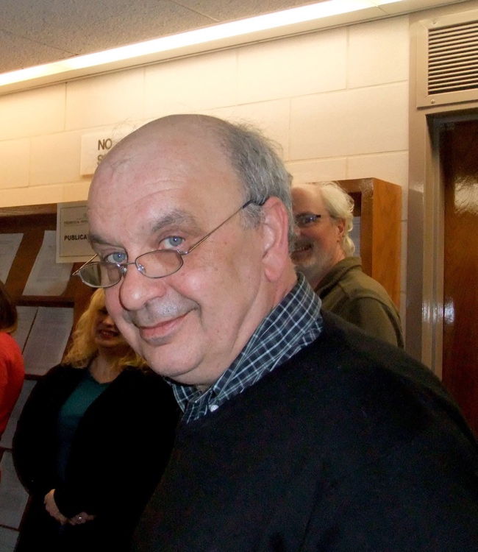
On March 20, 2020, the outstanding theoretical physicist Misha Voloshin passed away at the 67th year of life.
M.Voloshin was born on May 14, 1953 in Bucharest, Romania, where his father worked at that time. He graduated from the famous 57th Moscow school in 1970, and then entered, without exams, the Moscow Institute of Physics and Technology (MIPT) as a winner of the International Physics Olympiad.
. He received his Masters in physics from the Moscow Physics and Technology Institute in 1976 and presented his Ph.D. the following year from the Institute of Theoretical and Experimental Physics (ITEP) in Moscow.
The first paper by Voloshin was devoted to the decay of a false vacuum and was published in the Yadernaya fizika in 1974 independently and before Sidney Coleman.
Just after the J/Ψ discovery in November 1974, Voloshin and collaborators (M.Shifman, A.Vainshtein, V.Zakharov and others) immediately joined the development of quarkonium theory. Shortly after Voloshin without a doubt became one of the most prominent experts on heavy quark physics in the world.

Slide 3

He made a fundamental contribution to
Sum Rules, Physics of hadrons containing heavy quarks, Basic elements of QCD and quark model.
Even far from complete the list of his achievements is very impressive:
-Based on the QCD sum rules predicted the η_{c}-meson mass that was different from experimental values available at the time. This prediction was confirmed by subsequent experiments.
-Found an elegant way to evaluate the Vcb from exclusive semileptonic B decays.
-Proposed to measure time variations of neutrino fluxes associated with solar cycles as a method to search neutrino magnetic moment.
-In 1979 together with Vainshtein, Zakharov, Shifman proved low-energy theorems for interaction of Higgs boson with photons.
-Developed a new direction in quantum field theory, which is known as the threshold multiparticle production.

Slide 4

-Studied the possibility of electric charge nonconservation with massless photon, possibility of violation of the electric neutrality of atoms in Grand Unified theories and the existence of lepton photons.
-With Okun in 1977 predicted the possible existence of molecular charmonium.
-In recent years exotic tetra- and pentaquark states were among his numerous interests. Most reasonable scenarios – molecular and hadroquarkonium – were first proposed in his works.
From 1990, Misha Voloshin worked at the William Fine Theoretical Physics Institute of the University of Minnesota. There, he delivered lectures on High Energy physics for students. He was a regular lecturer at the ITEP Physics Winter School over 40 years.
Misha received the USSR Academy of Sciences Medal and Award in 1983, the J.J. Sakurai Prize for Theoretical Particle Physics from the American Physical Society (APS) in 2001 and the Alexander von Humboldt award for a senior U.S. scientist in 2003. He was made an APS Fellow in 1997. He authored more than 250 academic papers and served as the director of FTPI for six years.

Slide 5
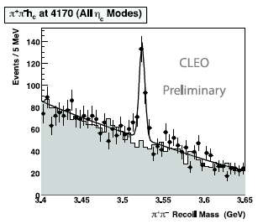
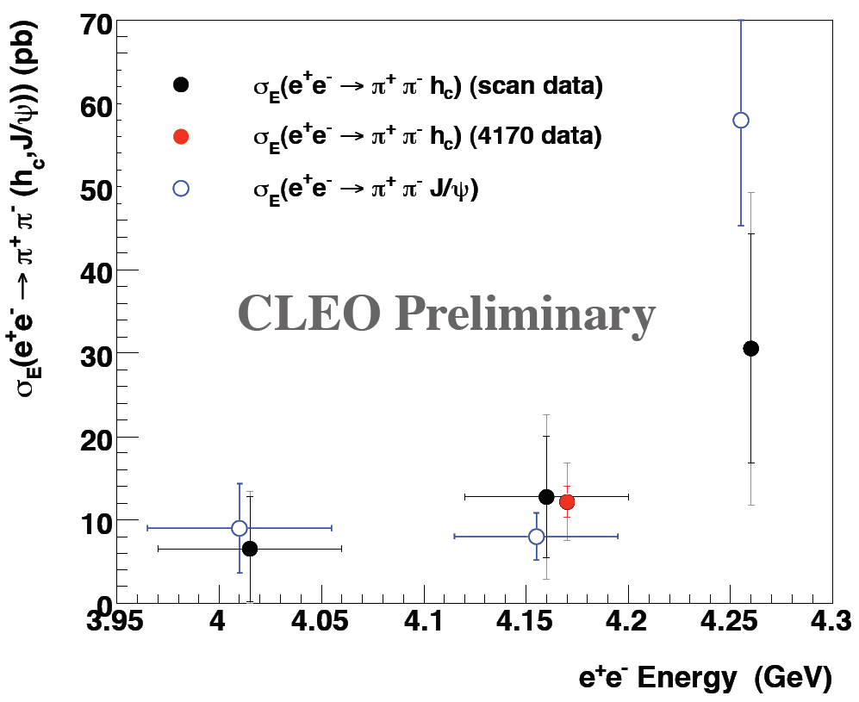
Observation of e⁺e⁻ → π⁺π⁻ h_{c} by CLEO
arxiv:1104.2025
PRL107,04803(2011)
Ryan Mitchell @ CHARM2010
Energy dependence
of the cross section
Enhancement of σ(h_{c} π⁺π⁻)
@ Y(4260)
σ(h_{b} π⁺π⁻) is enhanced @ Y_{b}?

Slide 6
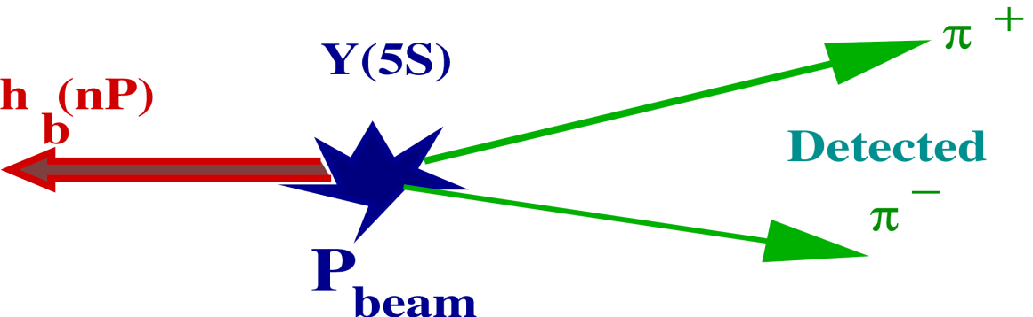
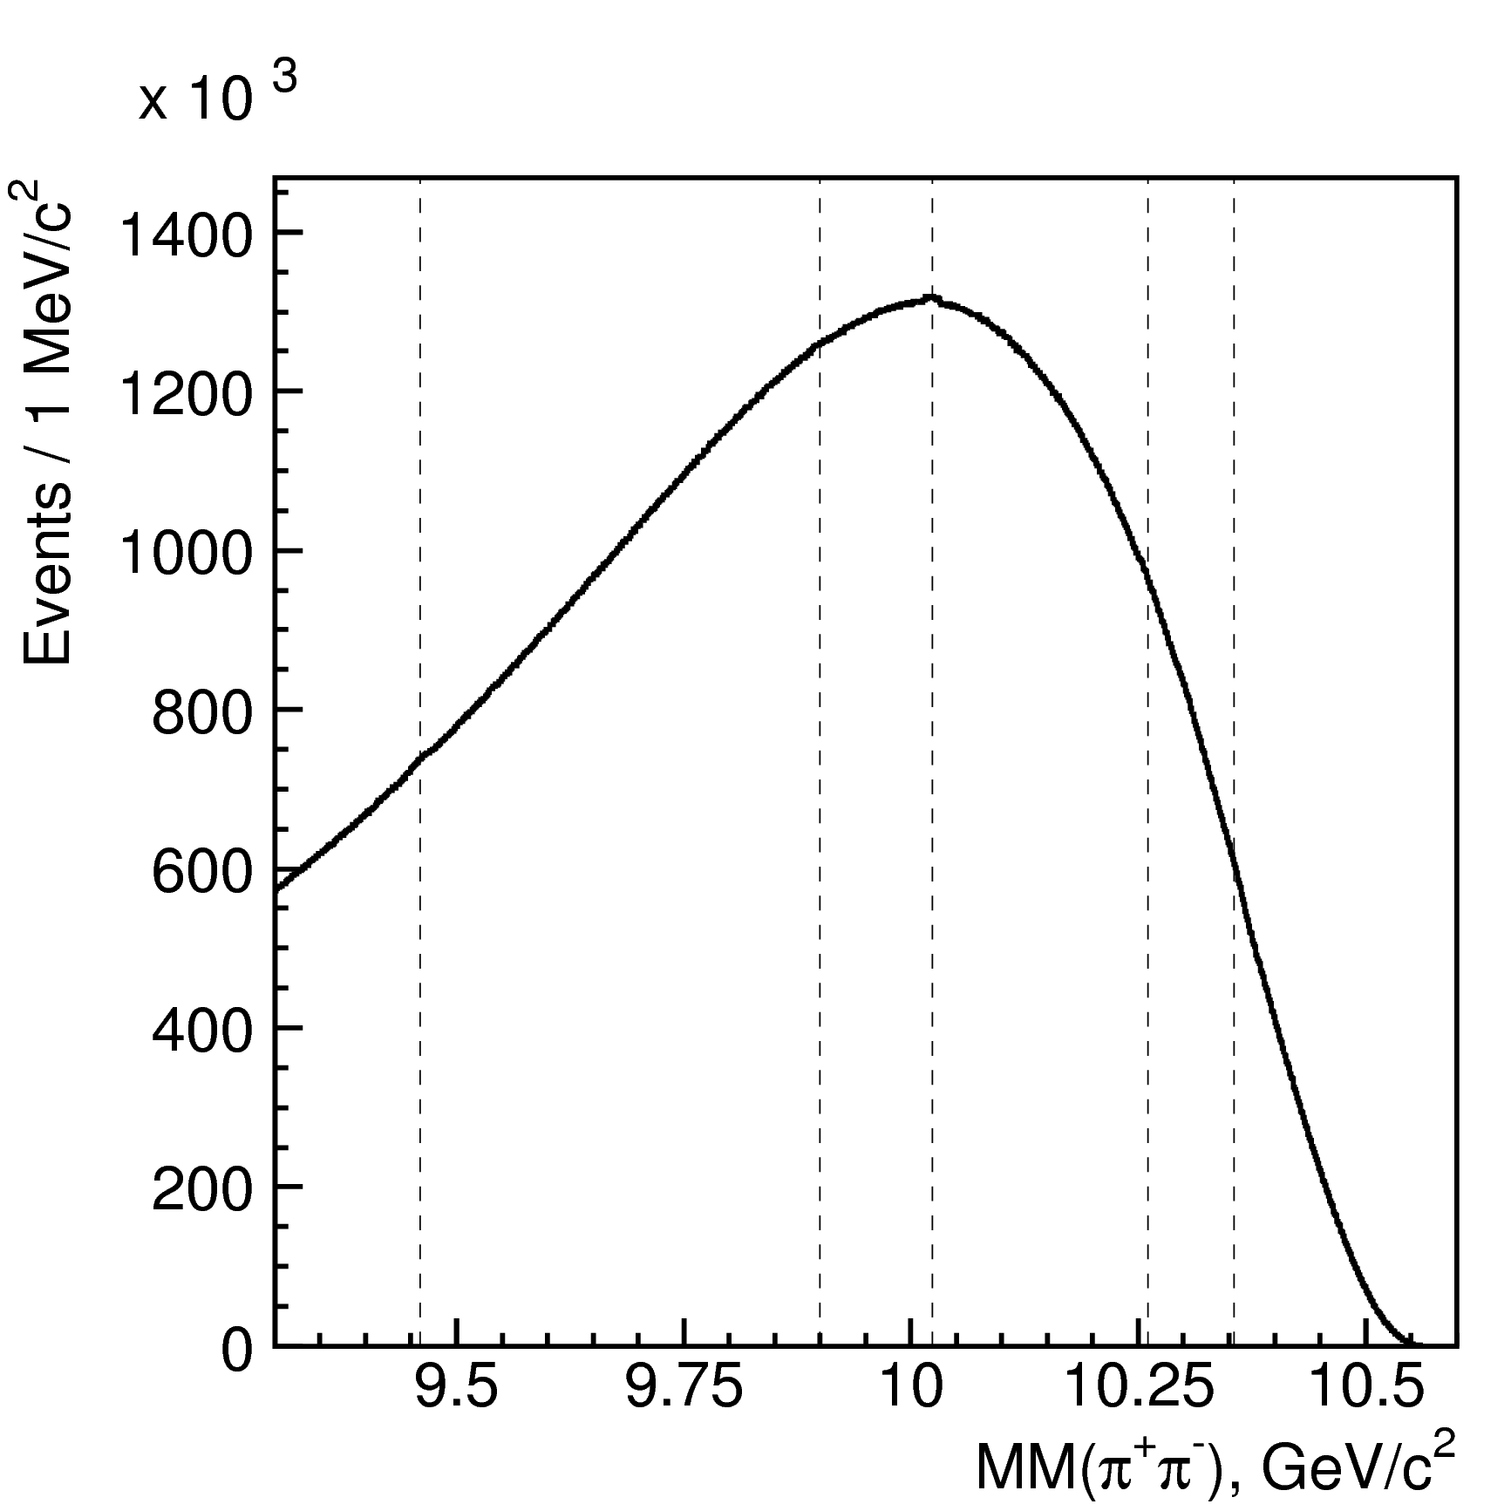

h_{b} reconstruction
Missing mass to ππ system
M_{hb(nP)} = √ ( P_{ϒ(5S)} – P_{π+π-})² ≡ MM(π+π-)
h_{b}(1P)
h_{b}(2P)
Simple selection :
ϒ(1S)
ϒ(3S)
ϒ(2S)
π⁺π⁻
: good quality, positively identified
Suppression of continuum events
FW R2<0.3
⇒ Search for h_{b}(nP) peaks
in MM(π⁺π⁻) spectrum
121.4 fb⁻¹
6
Notes:
6
6

Slide 7

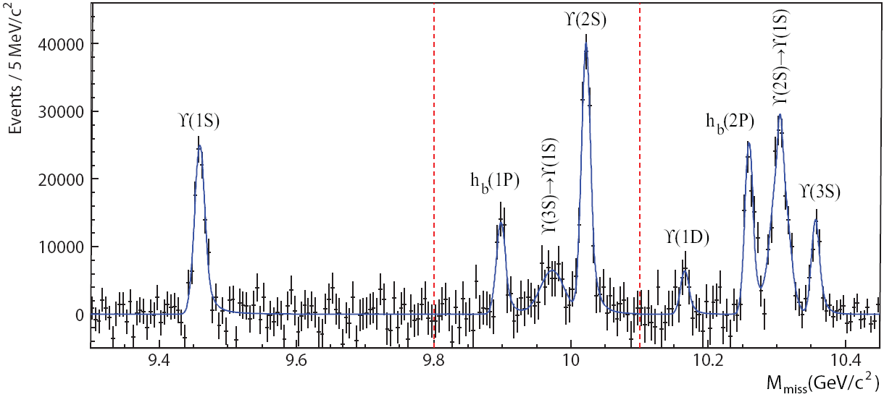
Observation of h_{b}(1P,2P)
e⁺e⁻ → ϒ(5S) → X π⁺π–
reconstructed, use M_{miss}(π⁺π⁻)
√(P_{e+e-} – P_{π+π-})²
ϒ(11020)
11.00
ϒ(10860)
Belle arxiv:1103.3419
PRL108,032001(2012)
10.75
π⁺π⁻
raw distribution
ϒ(4S)
2M(B)
h_{b}(2P)
10.50
η_{b}(3S)
ϒ(3S)
residuals
h_{b}(1P)
h_{b}(2P)
χ_{b}(2P)
10.25
η_{b}(2S)
ϒ(2S)
10.00
h_{b}(1P)
χ_{b}(1P)
ΔM_{HF}(1P)
9.75
Belle arxiv:1205.6351
ΔM_{HF}(1P) = +0.8 ± 1.1 MeV
ΔM_{HF}(2P) = +0.5 ± 1.2 MeV
consistent with zero,
as expected
9.50
η_{b}(1S)
ϒ(1S)
-
--
-
J^{PC=}0 ⁺
1
1 ⁺
(0,1,2)⁺⁺
Large h_{b}(1,2P) production rates
c.f. CLEO e⁺e⁻ → ψ(4170) → h_{c} π⁺π⁻

Slide 8
Observation of h_{b}(1P,2P)
e⁺e⁻ → ϒ(5S) → h_{b}(nP) π⁺π–
reconstructed, use M_{miss}(π⁺π⁻)
√(P_{e+e-} – P_{π+π-})²
ϒ(11020)
11.00
ϒ(10860)
Belle arxiv:1103.3419
PRL108,032001(2012)
10.75
π⁺π⁻
raw distribution
ϒ(4S)
2M(B)
h_{b}(2P)
10.50
η_{b}(3S)
ϒ(3S)
residuals
h_{b}(1P)
h_{b}(2P)
χ_{b}(2P)
10.25
19%
η_{b}(2S)
ϒ(2S)
10.00
h_{b}(1P)
χ_{b}(1P)
13%
9.75
γ
41%
Belle arxiv:1205.6351
ΔM_{HF}(1P) = +0.8 ± 1.1 MeV
ΔM_{HF}(2P) = +0.5 ± 1.2 MeV
consistent with zero,
as expected
9.50
η_{b}(1S)
ϒ(1S)
-
--
-
J^{PC=}0 ⁺
1
1 ⁺
(0,1,2)⁺⁺
Large h_{b}(1,2P) production rates
c.f. CLEO e⁺e⁻ → ψ(4170) → h_{c} π⁺π⁻
h_{b}(nP) decays are a source of η_{b}(mS)

Slide 9
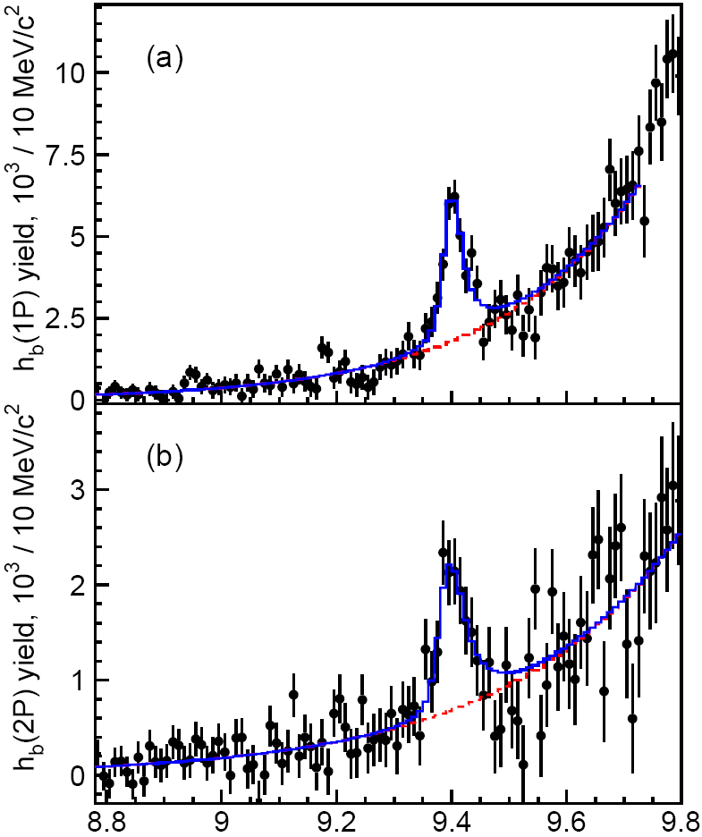
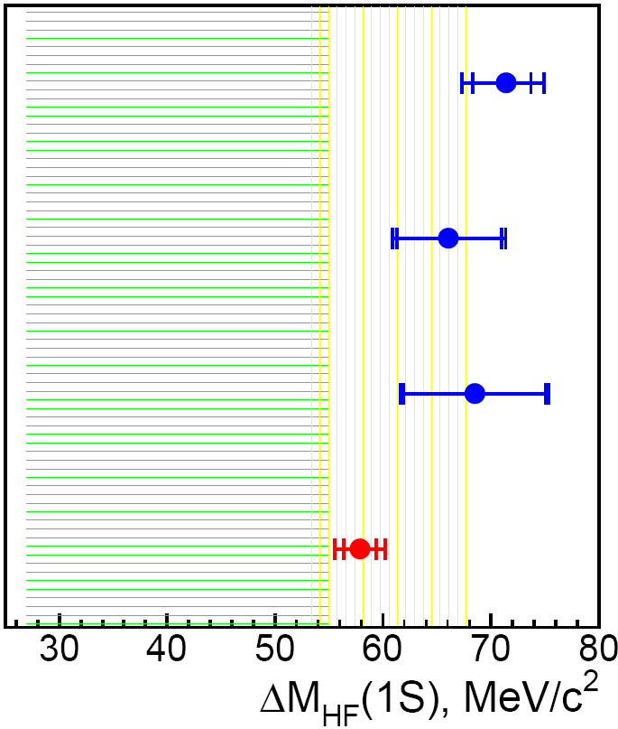
Observation of h_{b}(1P,2P)→ η_{b}(1S) γ
e⁺e⁻→ϒ(5S)→h_{b}(nP) π⁺π–
→ η_{b}(1S) γ
reconstruct
ΔM_{HF}(1S)
Belle : 57.9 ± 2.3 MeV
3σ
ϒ(11020)
arxiv:1205.6351
PDG’12 : 69.3 ± 2.8 MeV
11.00
ϒ(10860)
h_{b}(1P)
η_{b}(1S)
10.75
π⁺π⁻
BaBar ϒ(3S)
ϒ(4S)
2M(B)
BaBar ϒ(2S)
10.50
ϒ(3S)
η_{b}(3S)
h_{b}(2P)
χ_{b}(2P)
h_{b}(2P)
η_{b}(1S)
CLEO ϒ(3S)
10.25
η_{b}(2S)
ϒ(2S)
pNRQCD
LQCD
10.00
h_{b}(1P)
χ_{b}(1P)
γ
9.75
γ
Kniehl et al, PRL92,242001(2004)
M_{miss} (π⁺π⁻γ)
Meinel, PRD82,114502(2010)
^{(n)}
9.50
ϒ(1S)
η_{b}(1S)
ΔM_{HF}(1S)
Mizuk et al. Belle PRL 109 (2012) 232002
-
--
-
J^{PC=}0 ⁺
1
1 ⁺
(0,1,2)⁺⁺
Belle result decreases tension with theory
First measurement Γ = 10.8 ^{+4.0} ^{+4.5} MeV
_{–3.7}
_{–2.0}
as expected

Slide 10
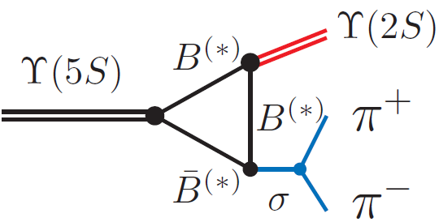

_
Anomalies in ϒ(5S)→(bb)π⁺π– transitions
ϒ(11020)
Belle: PRL100, 112001 (2008)
∼100
11.00
ϒ(10860)
Γ[ϒ(5S) →ϒ(1,2,3S) π⁺π–] >> Γ[ϒ(4,3,2S) →ϒ(1S) π⁺π–]
_
10.75
260
π⁺π–
⇐ Rescattering of on-shell B⁽*⁾B⁽*⁾ ?
2M(B)
ϒ(4S)
10.50
2
330
ϒ(3S)
Mass, GeV/c²
h_{b}(2P)
10.25
430
1
190
η_{b}(2S)
ϒ(2S)
Belle: PRL108, 032001 (2012)
10.00
h_{b}(1P)
expect suppression ∼Λ_{QCD}/m_{b}
290
spin-flip
6
Heavy Quark Symmetry
9.75
partial Γ(keV)
9.50
ϒ(1S)
ϒ(5S) → h_{b}(1,2P) π⁺π– are not suppressed
η_{b}(1S)
J^{PC} = 0⁻⁺ 1⁻⁻ 1⁻⁺
To quantify h_{b}(mP)π⁺π–/Y(nS) π⁺π⁻ ratio -> study Dalitz plots

Slide 11
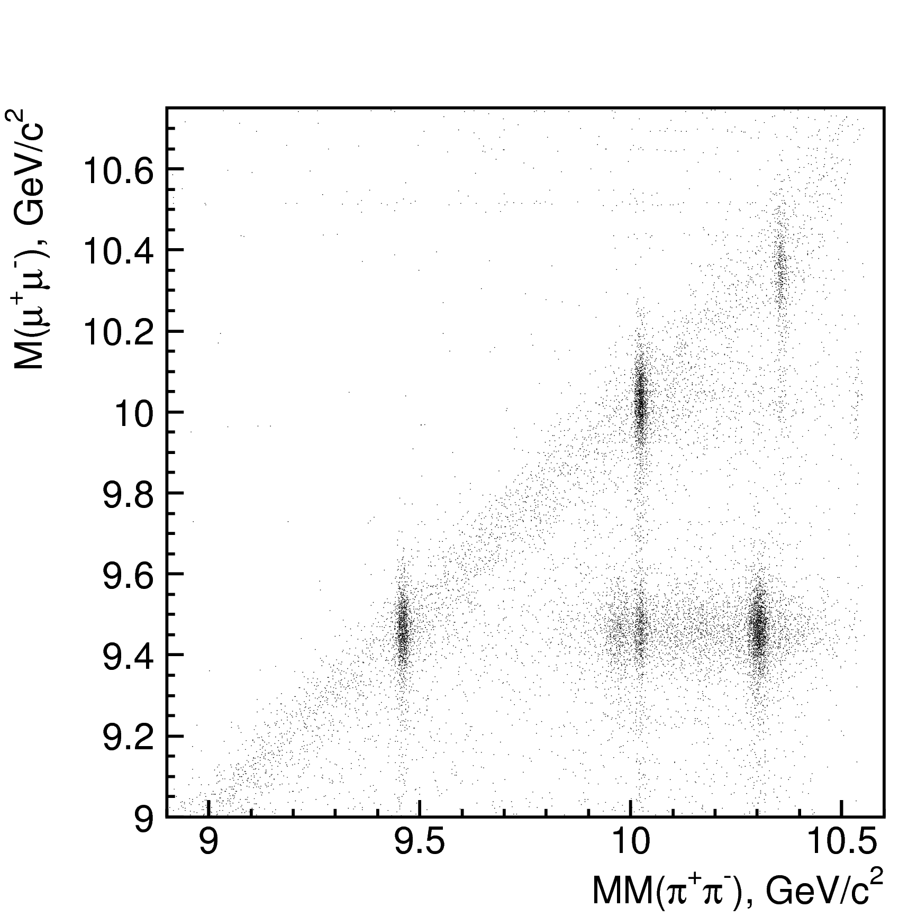
Exclusive ϒ(5S) ->ϒ(nS) π⁺π ⁻
ϒ(5S) → ϒ(nS) π+π-
(n = 1,2,3)
ϒ(nS) → μ+μ-
ϒ(3S)
ϒ(2S)
ϒ(1S)
reflections

Slide 12

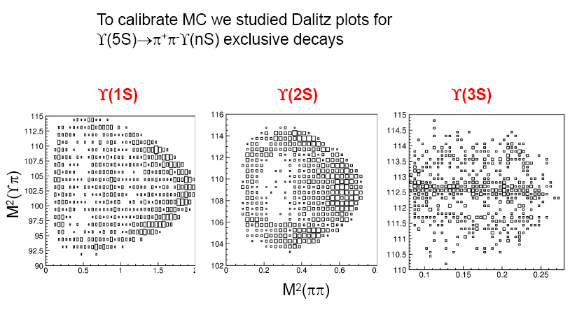
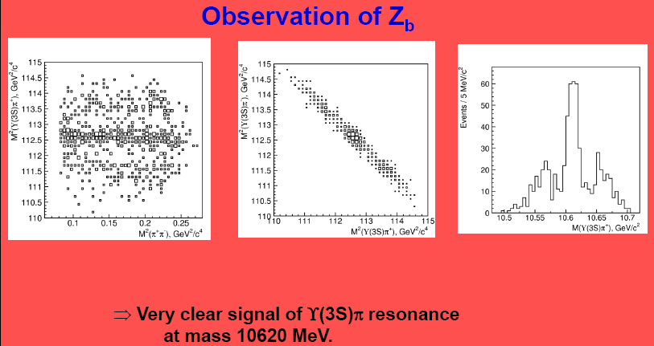
Belle Analysis Meeting, Feb 8, 2011

Slide 13
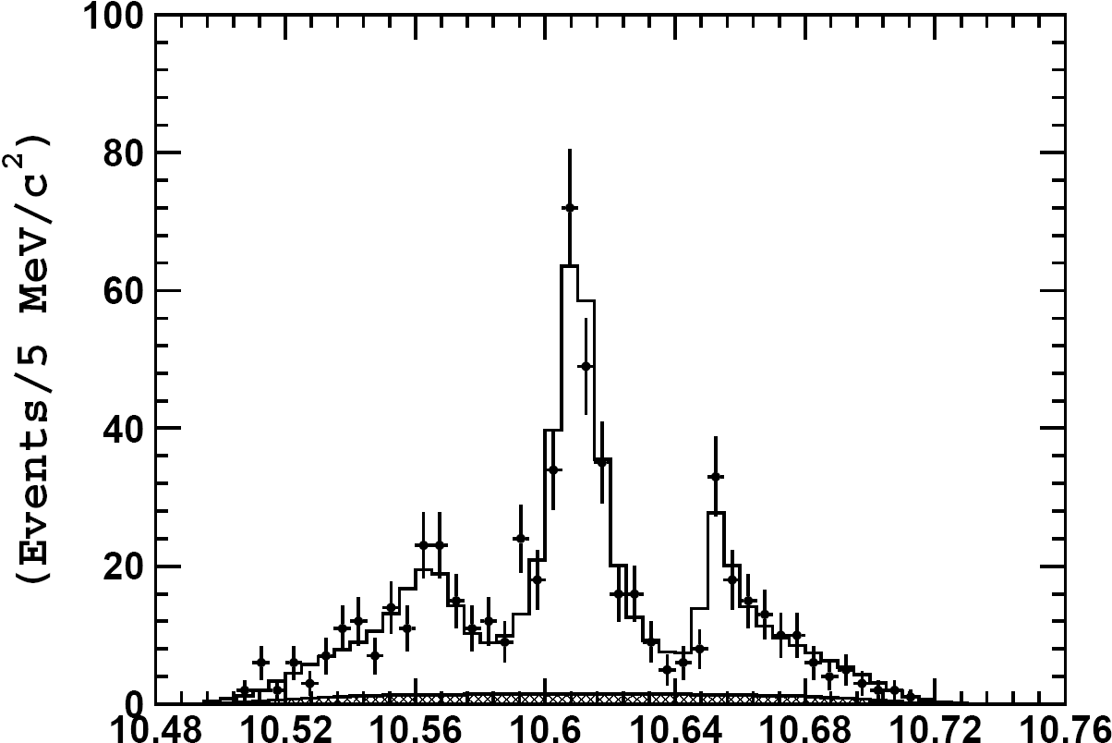
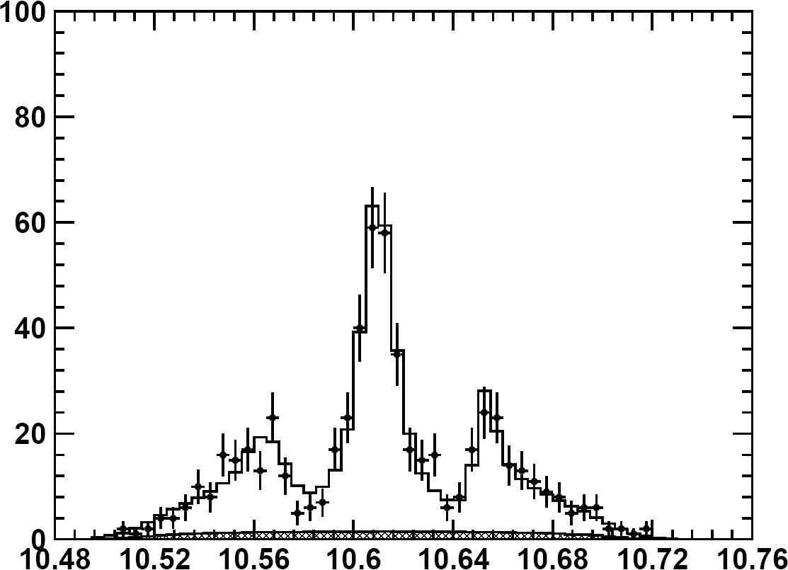
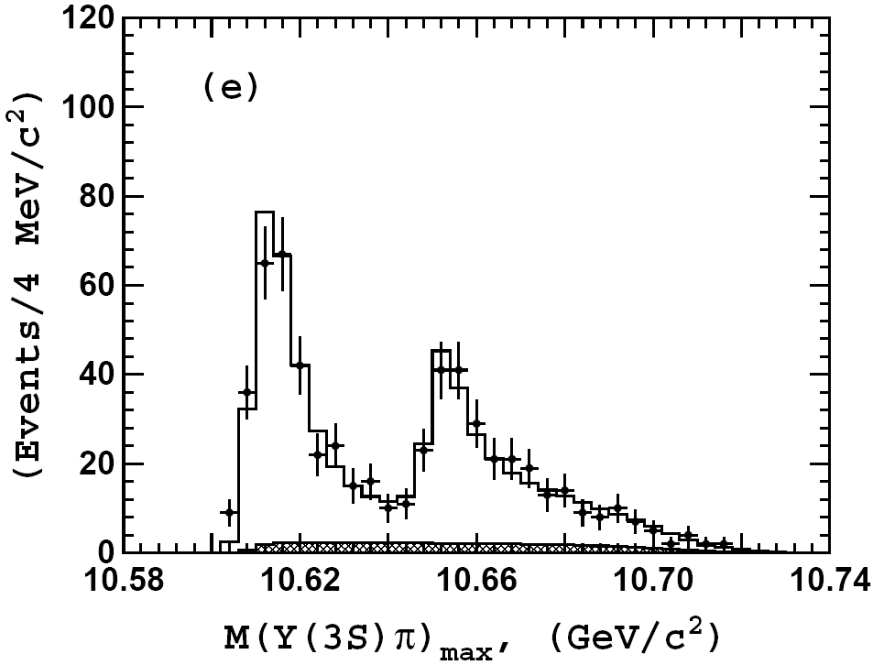
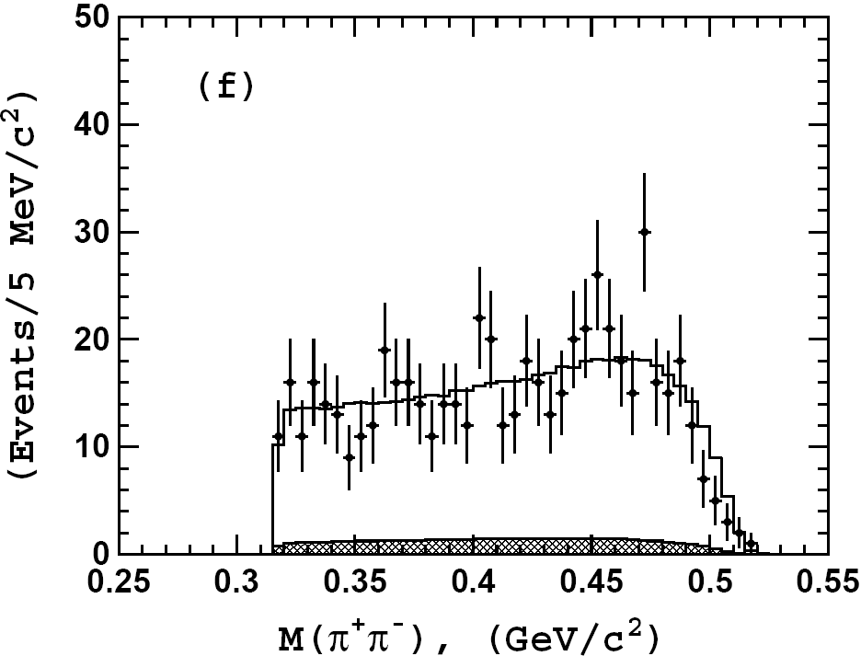
Results: ϒ(3S)π⁺π⁻
M(ϒ(3S)π⁺), GeV
M(ϒ(3S)π⁻), GeV

Slide 14
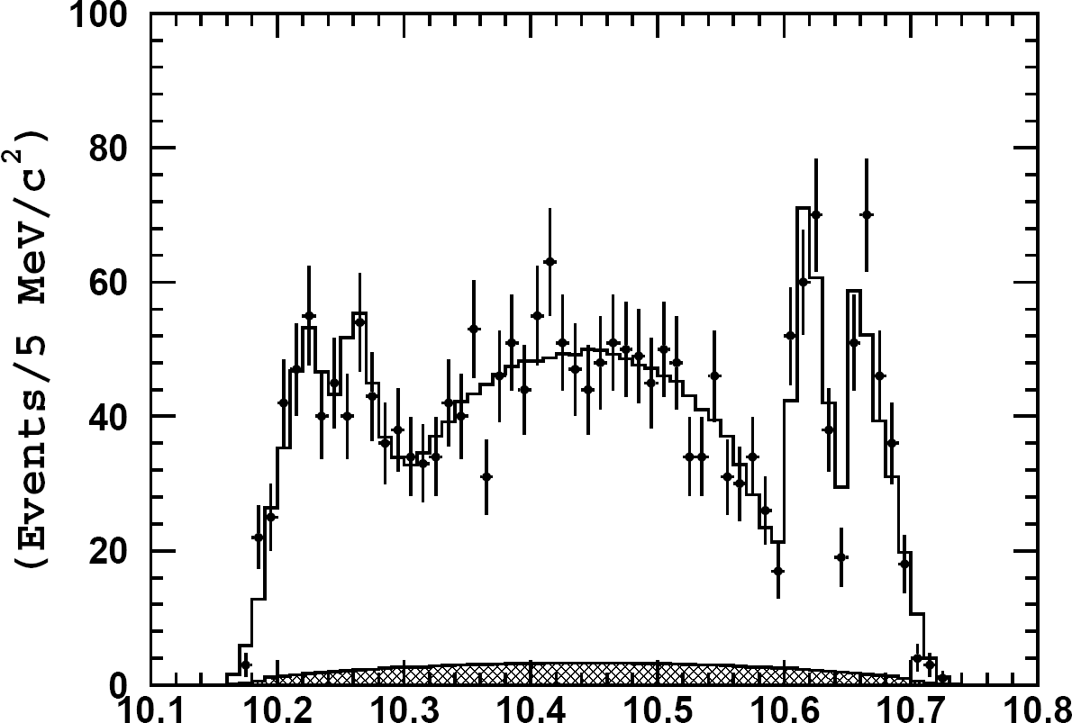
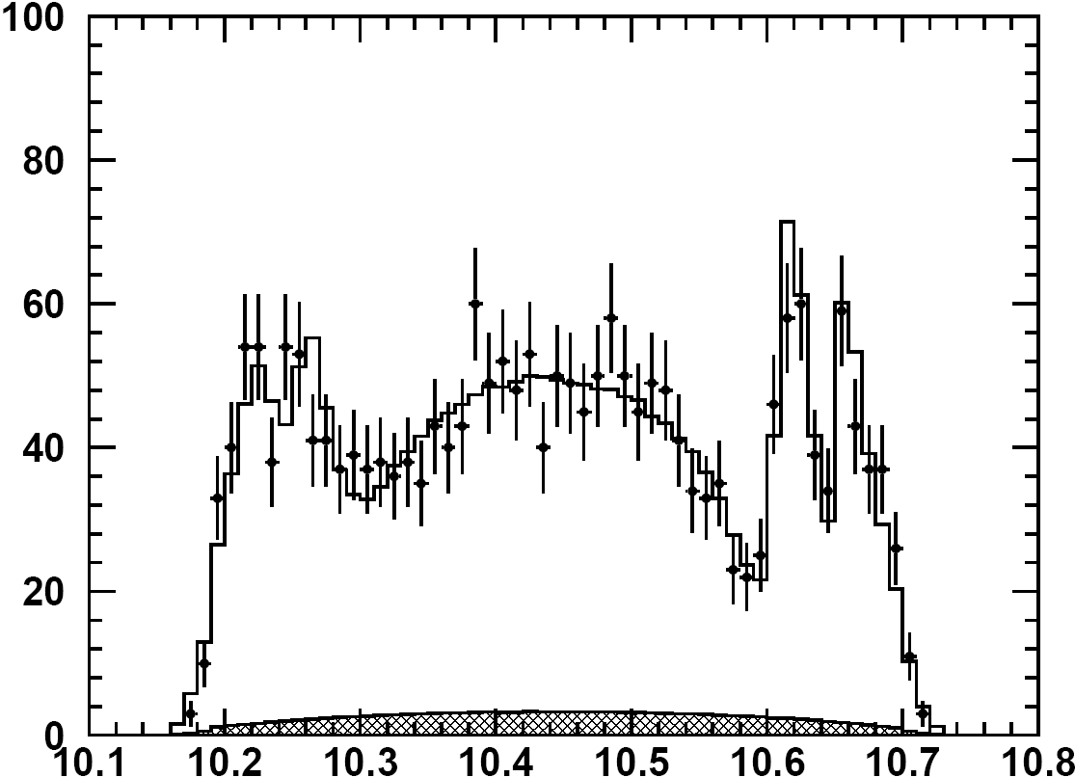
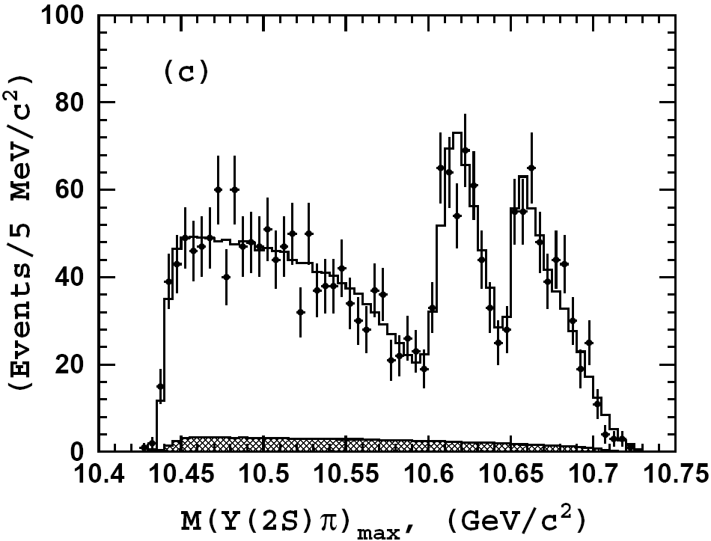
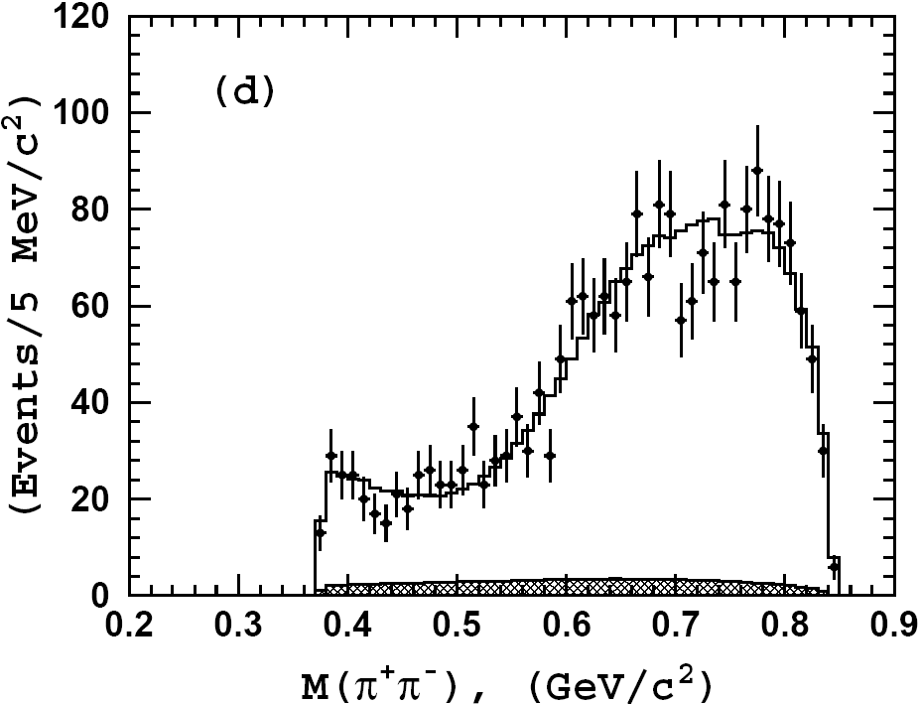
Results: ϒ(2S)π⁺π⁻
signals
reflections
M(ϒ(2S)π⁺), GeV
M(ϒ(2S)π⁻), GeV

Slide 15
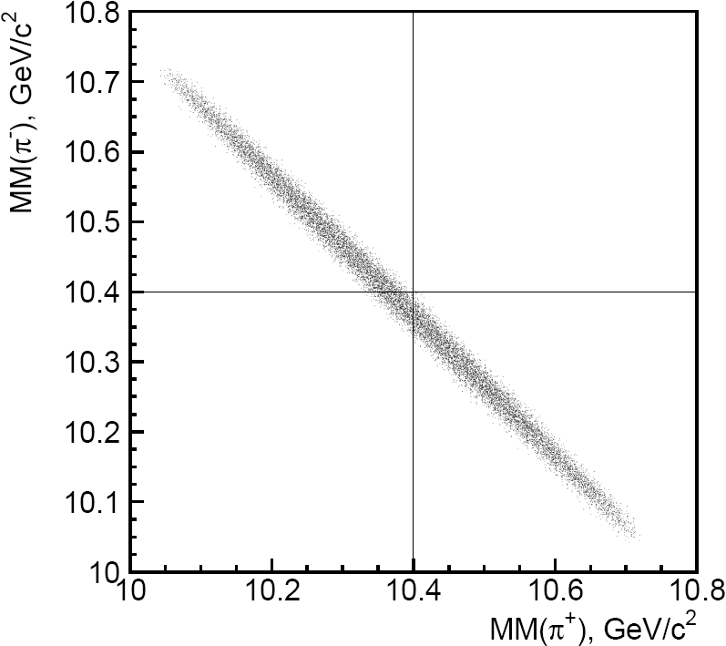
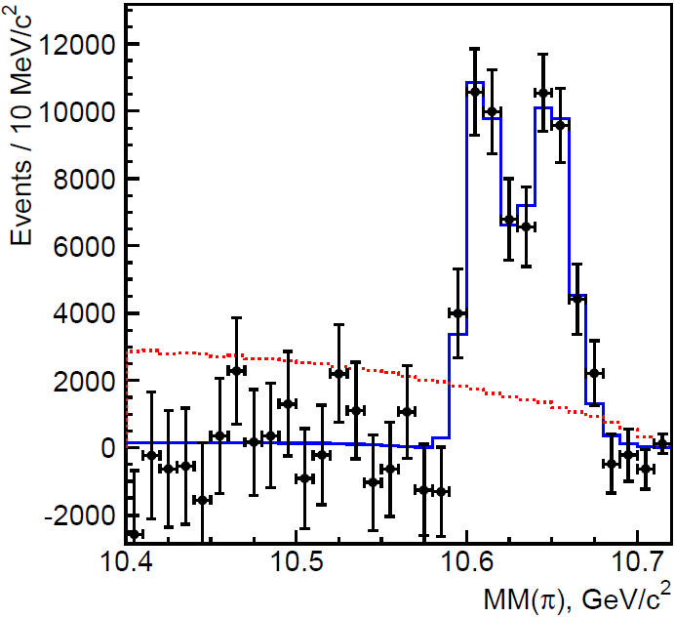
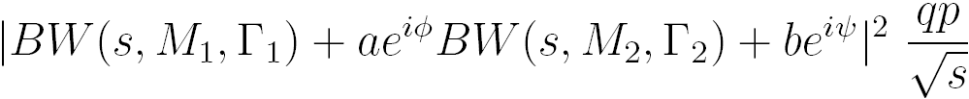






Resonant substructure of ϒ(5S) → h_{b}(1P) π⁺π⁻
P(h_{b}) = P_{ϒ(5S)} – P(π⁺π⁻) ⇒ M(h_{b}π⁺) = MM(π⁻)
⇒ measure ϒ(5S)→h_{b}ππ yield
in bins of MM(π)
phase-space MC
data
PHSP
combine
Fit function
[preliminary]
_
Results
M₁ =
MeV/c²
~BB* threshold
Significances
Γ₁ =
MeV
a =
2 vs.1 :
7.4σ
(6.6σ w/ syst)
_
_
2 vs.0 :
M₂ =
MeV/c²
~B*B* threshold
18σ
(16σ w/ syst)
Γ₂ =
MeV
ϕ =
degree
non-res. amplitude ~0

Slide 16
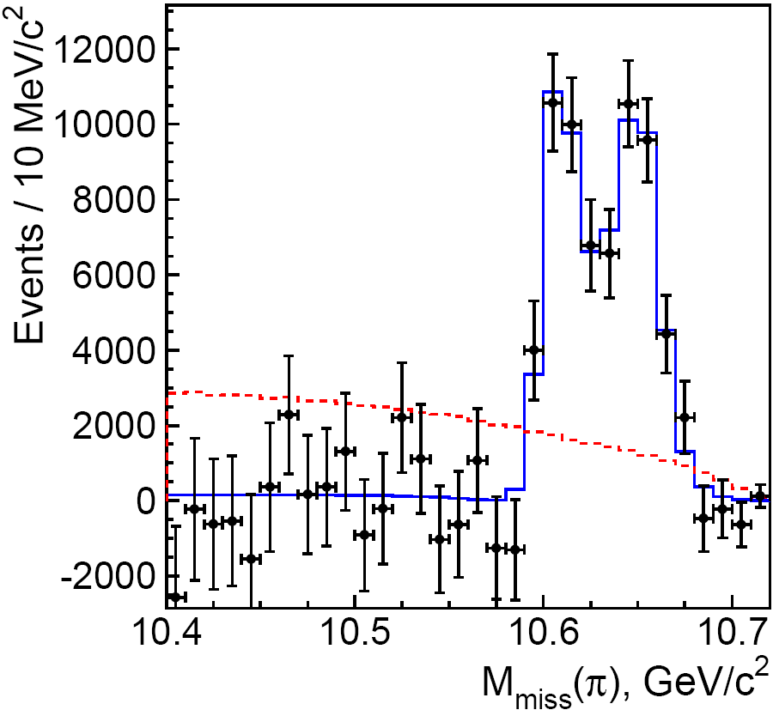
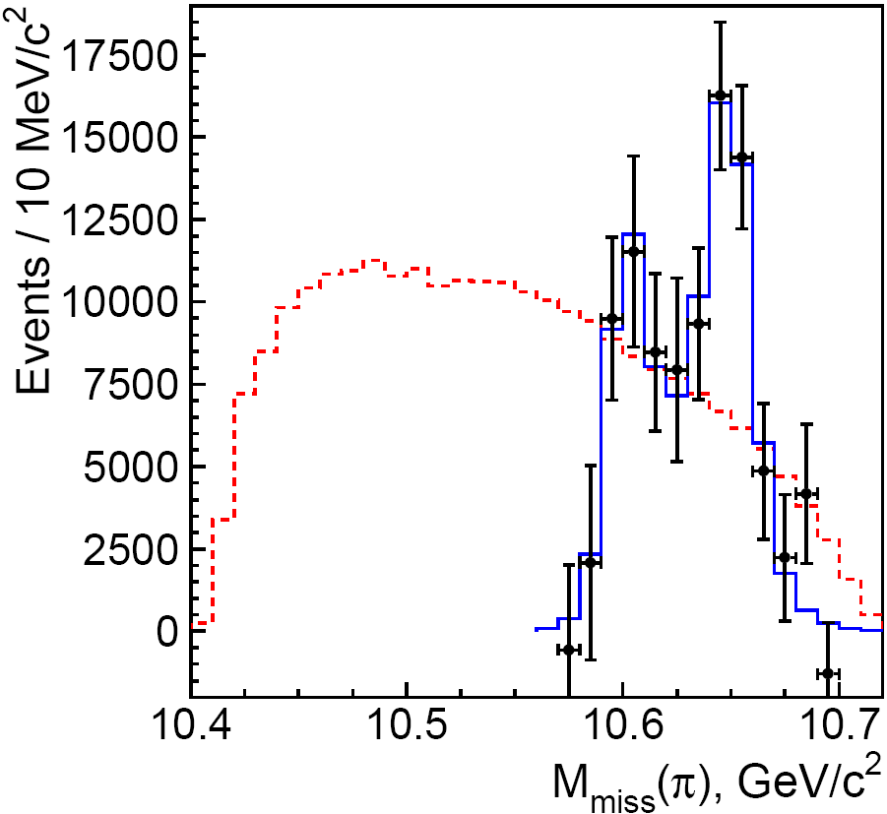

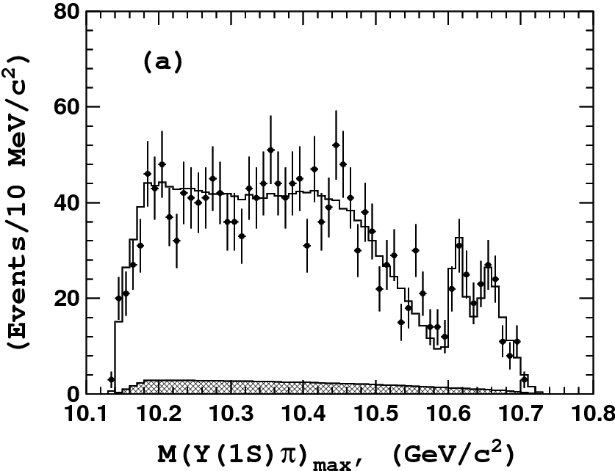
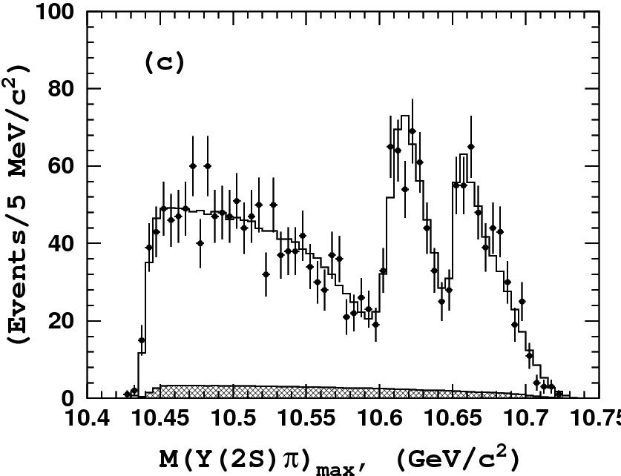
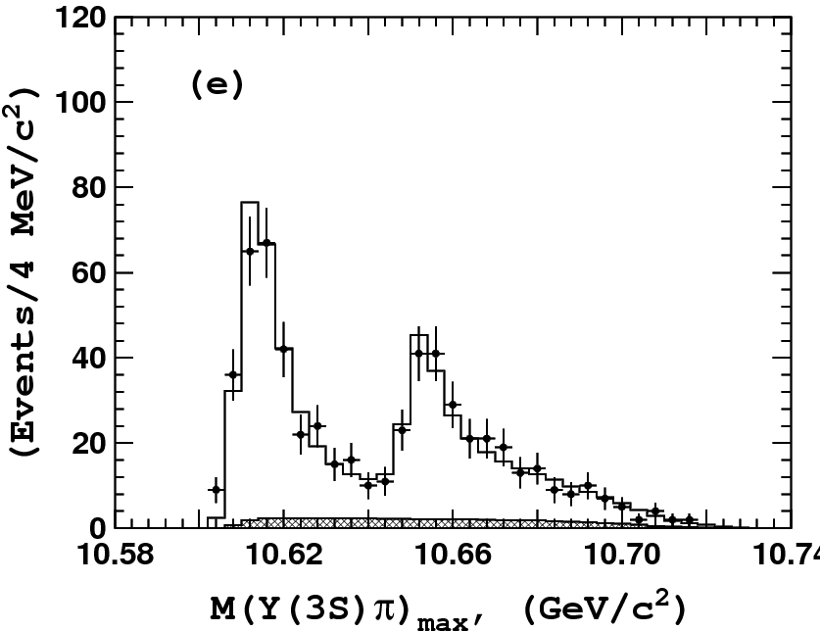
_
Resonant structure of ϒ(5S)→(bb)π⁺π–
ϒ(5S) → h_{b}(1P)π⁺π⁻
ϒ(5S) → h_{b}(2P)π⁺π⁻
Two peaks are observed
in all modes!
no non-res.
contribution
phsp
Belle: PRL108, 232001 (2012)
phsp
Z_{b}(10610) and Z_{b}(10650)
should be multiquark states
M[ h_{b}(1P) π± ]
M[ h_{b}(2P) π± ]
Dalitz plot analysis
ϒ(5S) →ϒ(1S)π⁺π⁻
ϒ(5S) →ϒ(2S)π⁺π⁻
ϒ(5S) →ϒ(3S)π⁺π⁻
note different scales

Slide 17
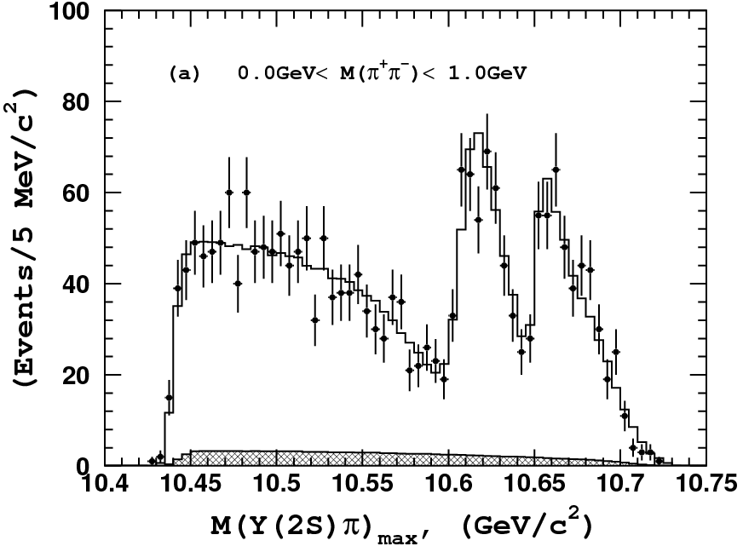
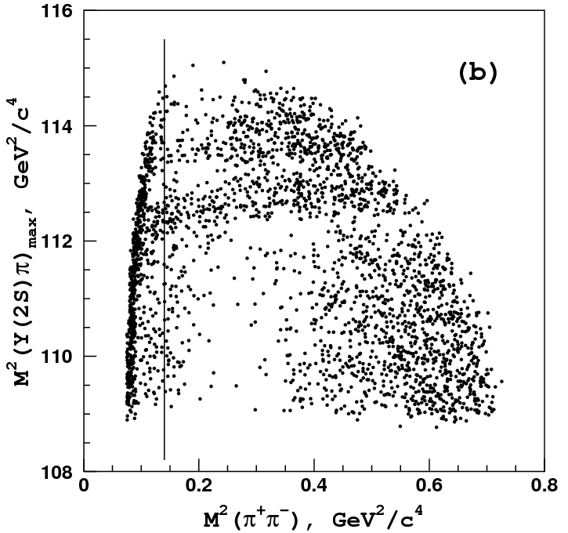
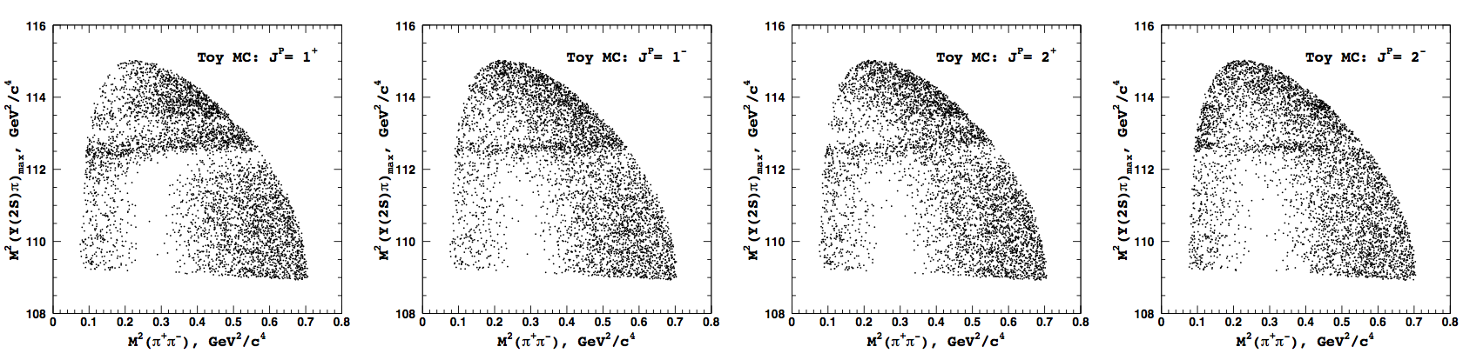
ϒ(5S)→ϒ(2S)π⁺π–: J^{P} Results
ϒ(2S)π⁺π Data
Toy MC with various J^{P}
J^{P} = 1⁺
J^{P} = 1⁻
J^{P} = 2⁺
J^{P} = 2⁻

Slide 18
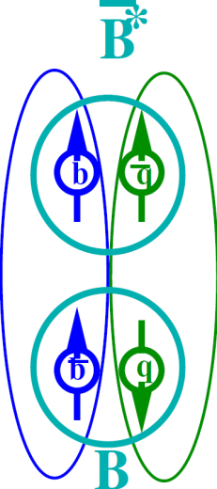
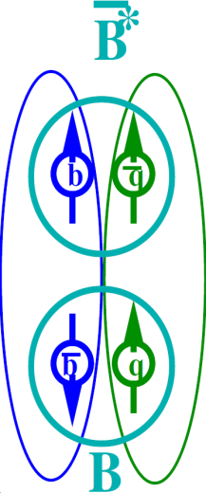
Heavy quark structure in Z_{b}
A.B.,A.Garmash,A.Milstein,R.Mizuk,M.Voloshin PRD84 054010 (arXiv:1105.4473)
Wave function at large distance – B(*)B*
Explains
Why h_{b}ππ is unsuppressed relative to ϒππ
Relative phase ~0 for ϒ and ~180⁰ for h_{b}
Production rates of Z_{b}(10610) and Z_{b}(10650) are similar
Widths –”–
Dominant decays to B(*)B*
Notes:
18

Slide 19
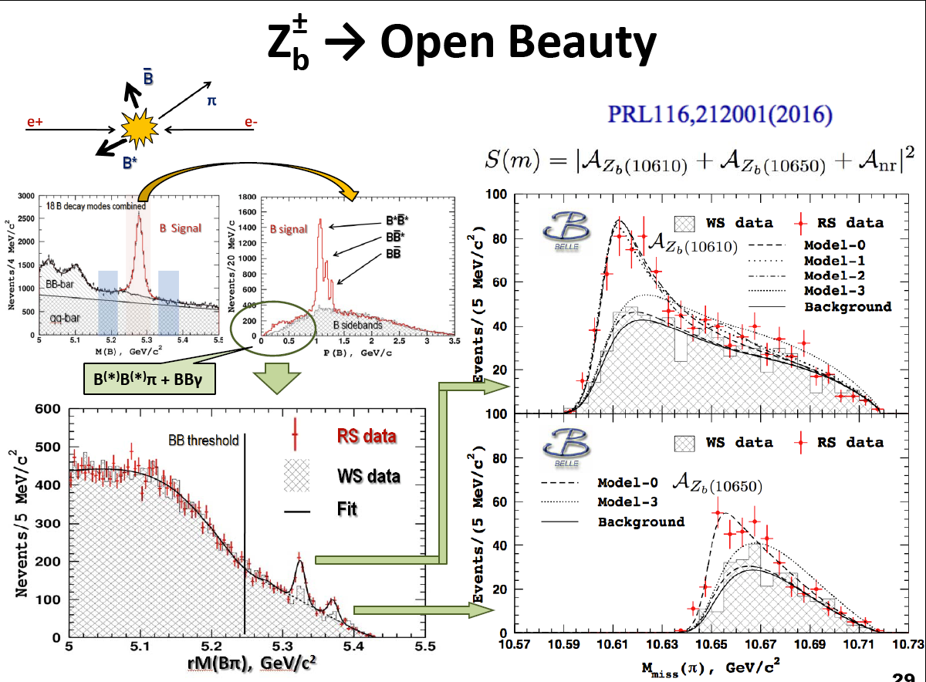
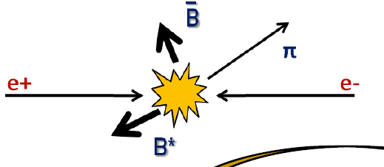
Observation of
_
Z_{b}(10610) → BB*
Z_{b}(10650) → B*B*
_
No signal of
_
Z_{b}(10650) → BB*

Slide 20
Belle PRL108,122001(2012)
PRL116,212001(2016)
PRL117,142001(2016)
J^{P} = 1⁺
6D amplitude analysis
PRD91,072003(2015)
M_{Zb(10610)} – (M_{B}+M_{B*}) = +2.6 ± 2.1 MeV
Γ_{Zb(10610)} = 18.4 ± 2.4 MeV
M_{Zb(10650)} – 2M_{B*} = +1.8 ± 1.7 MeV
Γ_{Zb(10650)} = 11.5 ± 2.2 MeV
_
Decays into constituents dominate
_
B*
Z_{b}(10610) = | B B* ⟩
smoking gun of molecular structure
_
Z_{b}(10650) = | B*B* ⟩
B
_
J^{P} = 1⁺ ⇒ B⁽*⁾B* in S-wave
20
Notes:
AAAA
A.Drutskoy, 32 Int'l Conference on HEP, August 16-22, 2004
20
e^+e^-\to\Upsilon(4S)\to B\bar B
B\bar B\ {\rm threshold}
b\bar b

Slide 21
M.Voloshin PRD84 (2011) 031502
12GeV
Υ(?S)
11.5GeV
Υ(6S)
η
Υ(5S)
ρ
ω
γ
ρ
ρ
π
γ
ω
ω
B*B*
Υπ h_{b}πη_{b}ρ
Υρ η_{b}π
Υρ
Υη η_{b}ω
Υω η_{b}η
γ
Υω
γ
Υρ
BB*
Υω
BB
Z_{b}
W_{b0}
X_{b}
W_{b1}
W_{b2}
0⁻(1⁺)
1⁺(1⁺)
0⁺(0⁺)
1⁻(0⁺)
0⁺(1⁺)
1⁻(1⁺)
0⁺(2⁺)
1⁻(2⁺)
0⁻(1⁻)
I^{G}(J^{P})

Slide 22

Misha Voloshin was always a friendly, and hospitable person. Anybody could address him with any problem, either personal or scientific.
He enthusiastically met the discussion of any interesting scientific problem and as a rule made extremely important comments.
He had a critical mind and quickly caught shortcomings, or contradictions of problems under discussion and criticized them without regards for the rank or title of his opponent.
It was a great pleasure to work with him, so how sad that he is no longer with us.

Slide 23
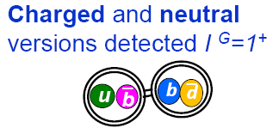
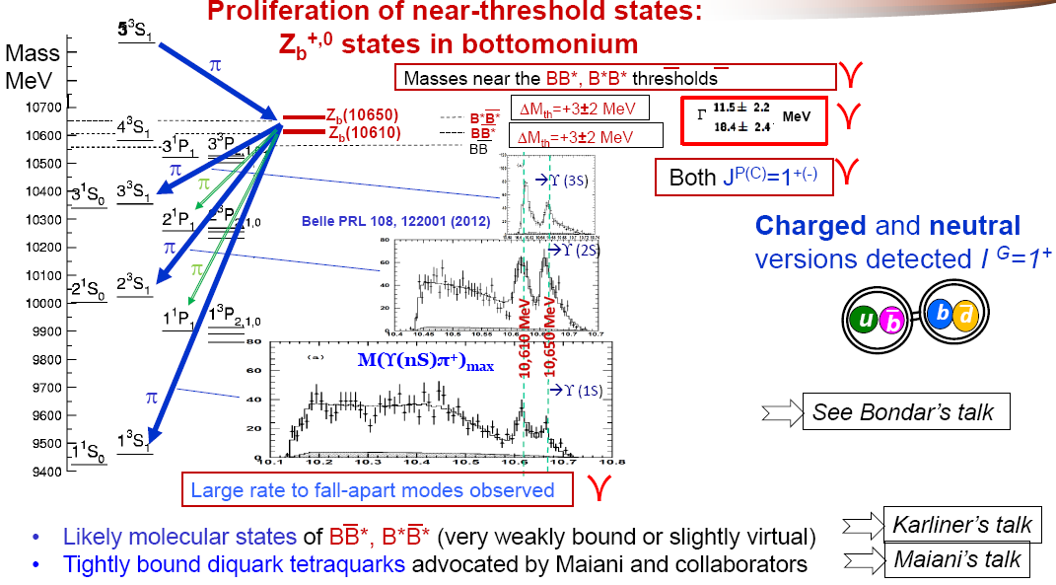
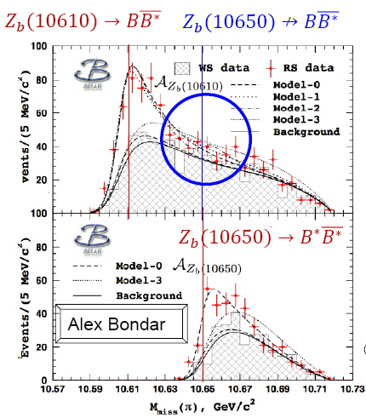
h_{b}(1P)
h_{b}(2P)
M[ h_{b}(1P) π± ]
M[ h_{b}(2P) π± ]

Slide 24
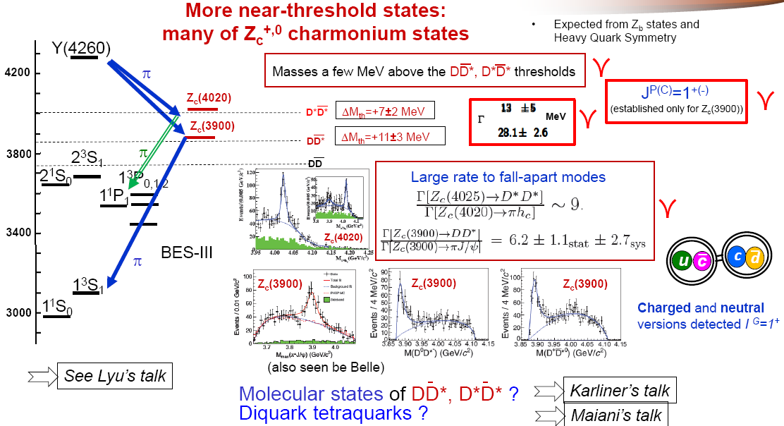

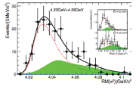
Z_{c}(4025)
(also seen by Belle)
No sign of Zc(4025) decay in DD*

