Slide 2

Michal Simon
XRootD5: from the client’s perspective
14/12/2020
Michal Simon

Slide 3
Outline
Short introduction to XRootD5
Secure root/xroot, why and how?
One last word on TLS …
Is there anything else?
Declarative API
EC for AliceO2
Plans & Summary
14/12/2020
Michal Simon

Slide 4
XRootD5 in few words
Major release, with the most important new feature being encryption
Protocol and API level backwards compatibility, it is not ABI compatible – plugins will require recompilation
Released in July, followed by 3 bugfix releases
  Release in OSG repo and EPEL
  5.1.0 coming this week
14/12/2020
Michal Simon

Slide 5
Secure root/xroot protocol
roots/xroots is the old good root/xroot protocol plus TLS
Based on OpenSSL
  Version 1.0.0 and above
  Custom hostname verification added to cover the older versions
Encrypted and unencrypted version of root/xroot protocol run on the same port (by default 1094)
14/12/2020
Michal Simon

Slide 6
Why do we need encryption?
Allows for authorization token handling (e.g. SciToken)
  Prerequisite for replacing proxy delegation with access tokens in WLCG
Encrypt confidential data
  Encryption ‘in transit’ especially for CERNBox
Encrypt possibly destructive metadata operations (could replace in the future request signing)
Improves data integrity and allows for further evolution of Third-Party-Copy
14/12/2020
Michal Simon

Slide 7
What triggers encryption?
On the client side the roots/xroots protocol;
  --notlsok options allows to proceed without encryption if the server is too old to support it
  --tlsmetalink option allows to apply encryption to all URLs in a metalink file
On the server side the xrootd.tls configuration directive, with few compatibility options:
  by default it is off
  enforce encryption only for clients that support it (capable)
  do encryption only at client discretion (none)
14/12/2020
Michal Simon

Slide 8
How flexible is it?
It is pretty flexible ;-) – not everything needs encryption and (at the beginning) not everyone will support encryption
One can configure the server to enforce encryption:
  only the third-party-copy orchestration
  control channel after login (handy for GSI auth)
  control channel before login
  data streams
  everything
On the client side:
  --tlsnodata allows to apply roots/xroots only to the control stream
14/12/2020
Michal Simon

Slide 9
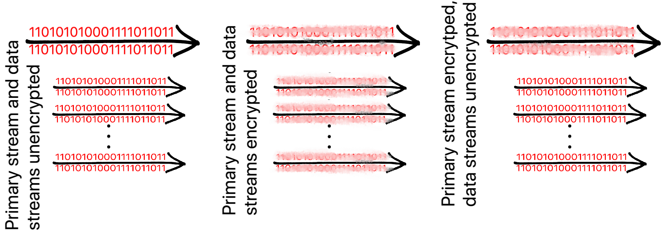
How flexible is it?
14/12/2020
Michal Simon

Slide 10
What lies beneath the flexibility?
Handshake negotiation
  All connections are initially non-encrypted
  The connection is being upgraded to TLS on client or server request
If only control channel should be encrypted the client opens a second (or multiple) physical connection(s) for the raw data
Encrypted and unencrypted traffic uses the same port number (not like http vs https) to ease operators lives
14/12/2020
Michal Simon

Slide 11
Is roots/xroots widely available?
GFAL2 has been ported to XRootD5 (rebuilt with XRootD5 in EPEL)
EOS has been ported to XRootD5 (successful encrypted transfer executed in PPS)
DPM has been ported to XRootD5 (rebuilt with XRootD5 in EPEL, passed all site’s and dev’s tests)
dCache devel team (with our help) implemented roots/xroots support (in Java!!!)
14/12/2020
Michal Simon

Slide 12
Certificates, certificates, …
XRootD server needs a host certificate in order to enable encryption
  configurable with xrd.tls directive
If roots/xroots is being used client will enforce host verification
  the hostname must match the one in the host certificate (or one of the SAN extensions)
  except for localhost (5.1.0)
14/12/2020
Michal Simon

Slide 13
Certificates, certificates, …
The client does not need to have a certificate
  the user may use his proxy certificate in order to establish a TLS connection
  server can be configured to enforce client certificate verification with: xrd.tlsca
Allowing the client to establish the TLS connection based on user X509 proxy certificate opens door to a new less complex implementation of gsi authentication in the future
14/12/2020
Michal Simon

Slide 14
Implementation
roots/xroots implementations is based on OpenSSL
  for better performance, asynchronous APIs and socket BIOs were used
All TLS actions are logged (e.g. when connection is upgraded to TLS, what version of TLS is being used)
We are aiming at isolating OpenSSL in the XrdTls component
  should facilitate migration from OpenSSL in the future (e.g. to NSS)
14/12/2020
Michal Simon

Slide 15
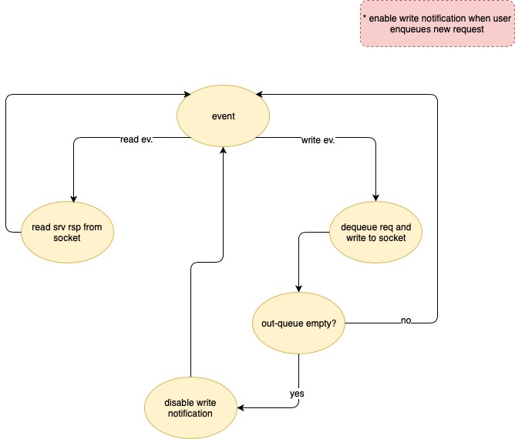
Implementation: event loop (no TLS)
14/12/2020
Michal Simon

Slide 16
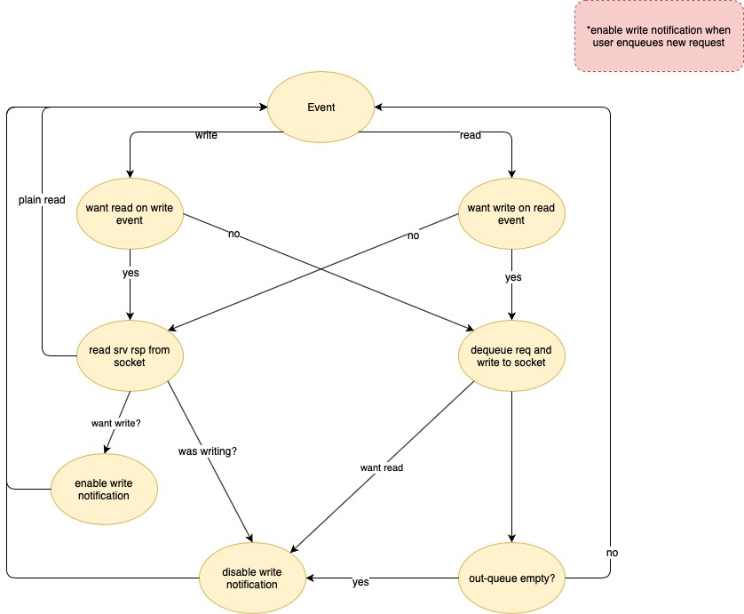
Implementation: event loop (with TLS support)
14/12/2020
Michal Simon

Slide 17
One last word on TLS …
Design choices (OpenSSL)
Memory BIO vs socket BIO
  avoid copying the data in memory
  safes time, memory and CPU cycles
Synchronous vs asynchronous interface
  reducing context management overhead (single-threaded way to handle multiple TLS connections)
  cryptographic transformations can be more easily processed on dedicated h/w (Intel QuickAssist)
    allows for more optimization
    parallel processing at crypto-level
14/12/2020
Michal Simon

Slide 18
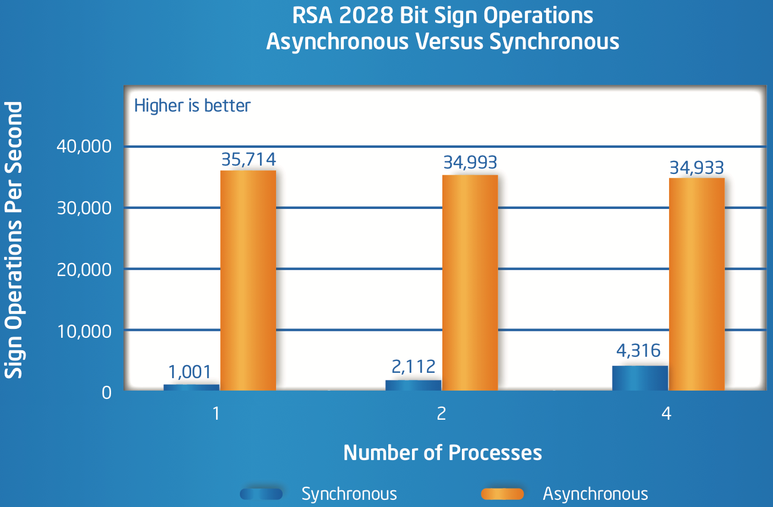
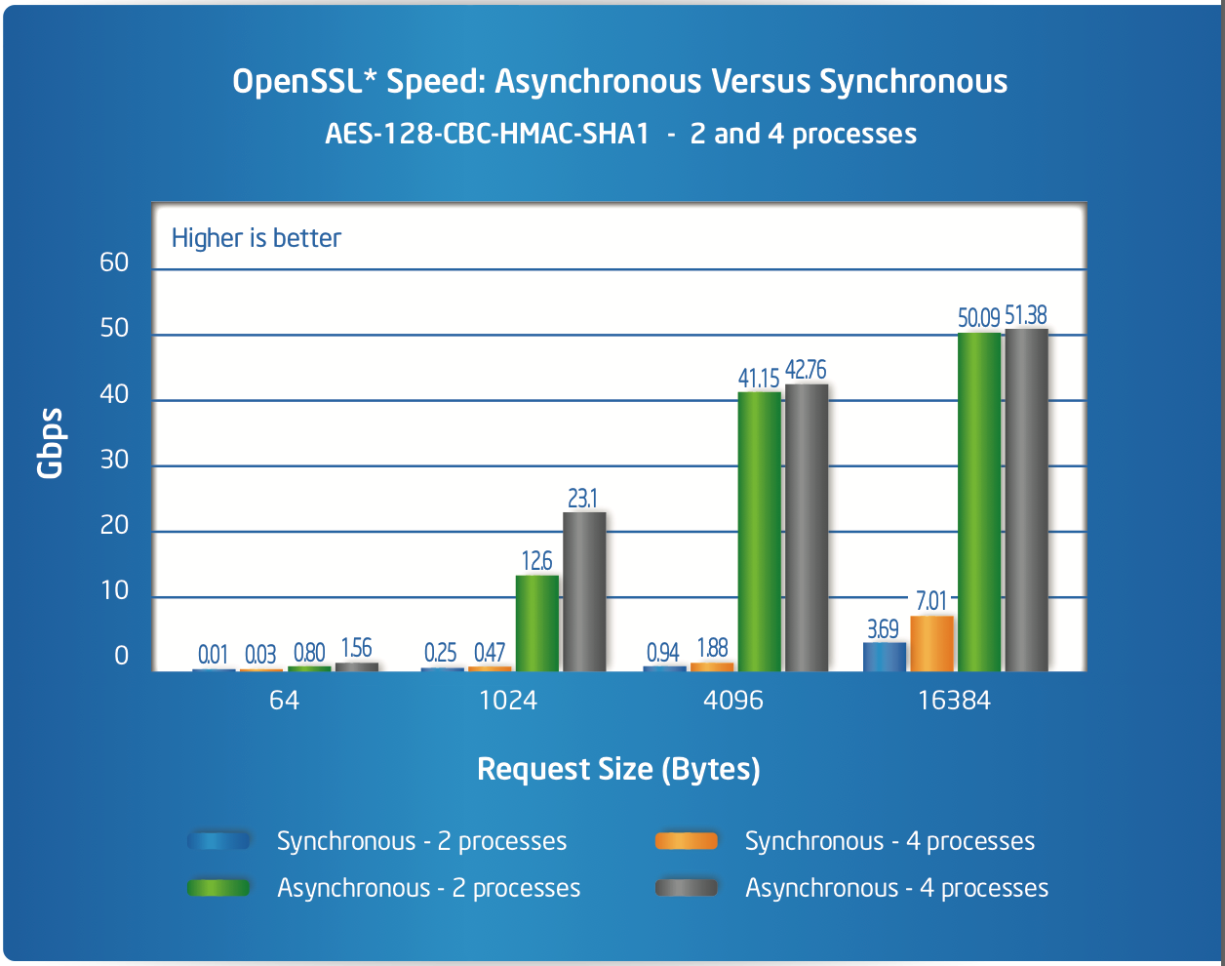
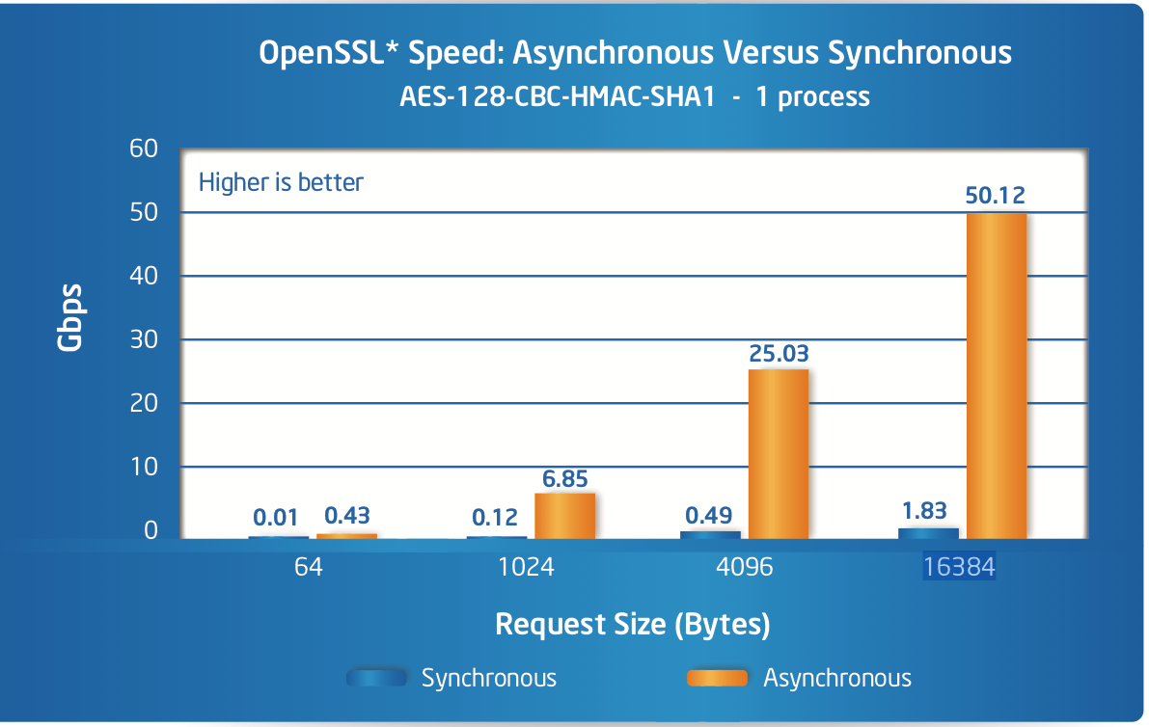
Async vs Sync
Intel preliminary test (2015)
https://www.intel.com/content/dam/www/public/us/en/documents/solution-briefs/accelerating-openssl-brief.pdf
14/12/2020
Michal Simon

Slide 19
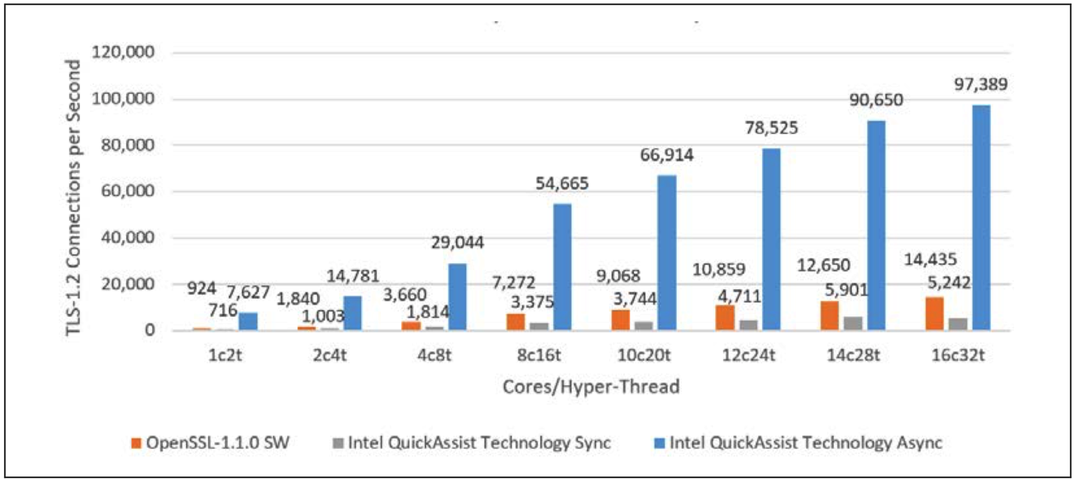
Async vs Sync
Intel NGINX test (2018)
async + QuickAssits is significantly faster than sync
https://01.org/sites/default/files/downloads/intelr-quickassist-technology/337003-001-intelquickassisttechnologyandopenssl-110.pdf
14/12/2020
Michal Simon

Slide 20
Some tests with XRootD
Overhead of upgrading the connection to TLS
  ~2.3 msec to carry out the plain XRootD HS
  ~7.6 msec to carry out the XRootD HS including upgrade to TLS (host & client cert verification)
  ~37.6 msec to carry out the XRootD HS including GSI authentication
No throughput penalty for encrypting data observed for test transfers, about +5% increase in CPU usage per encrypted connection (server-receiver +15%, to be investigated)
14/12/2020
Michal Simon

Slide 21
Anything else?
Universal (both root/xroot and http) VOMS attribute extractor plugin
Gerri’s xrdvoms plugin was the starting point
Now shipped as a sub-package of XRootD in EPEL
Obsoletes several packages (vomsxrd, xrootd-voms-plugin and xrdhttpvoms)
General purpose new features
Extended file attributes
Extended stat (sets stages for proper uid/gid tracking)
Hardware assisted CRC32C
Declarative API: more complete set of features
On connect callback (API)
14/12/2020
Michal Simon

Slide 22
Client Declarative API
Motivation
Use case: erasure coding plug-in for EOS ALICEO2
  Executing multiple operations on multiple remote files (stripes) in parallel
Problem with asynchronous operation composability and code readability
  Asynchronous Open() + Write() + Close() in the code is only visible as an Open() (rest of the workflow is in the callbacks)
14/12/2020
Michal Simon

Slide 23
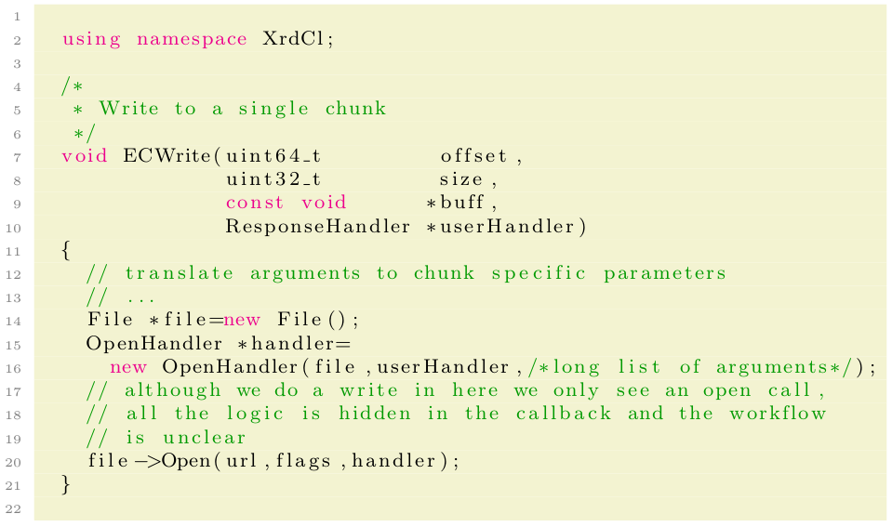
Client Declarative API
Update of a single stripe/chunk with standard XrdCl API ...
14/12/2020
Michal Simon

Slide 24
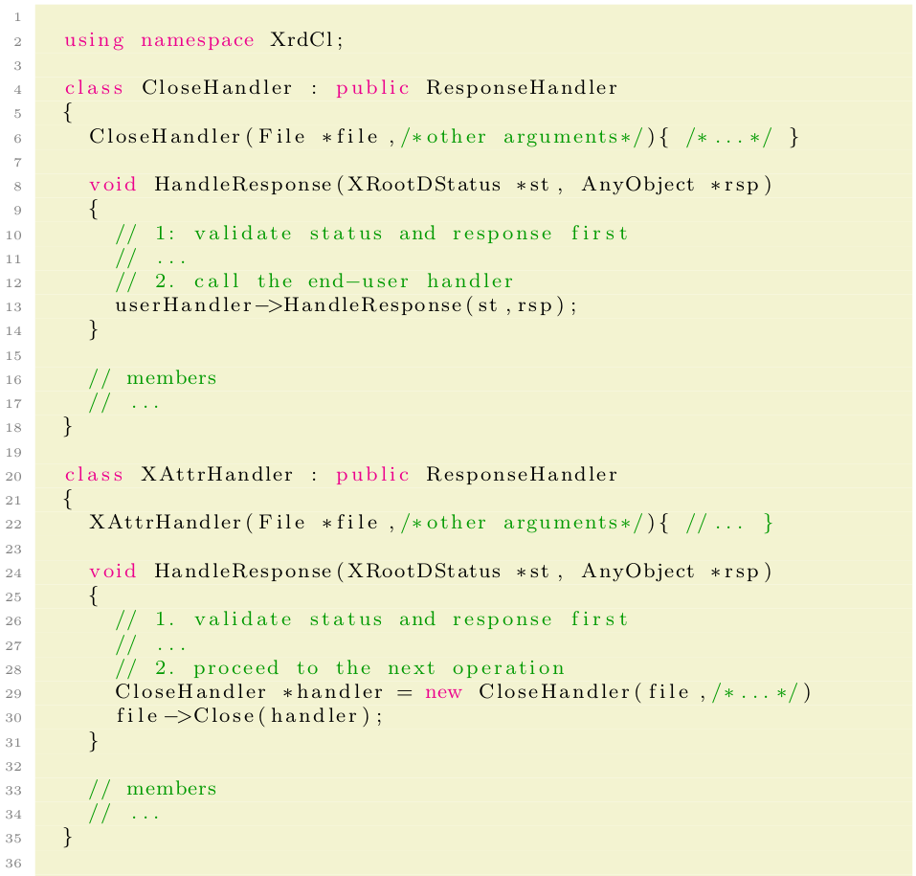
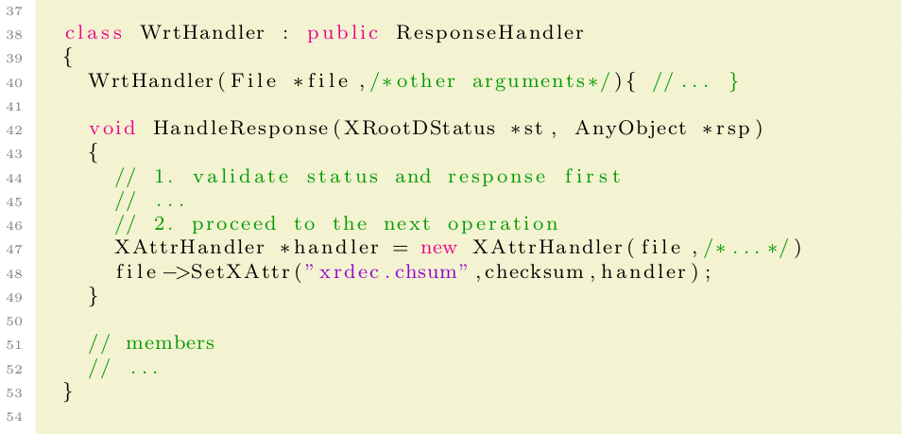
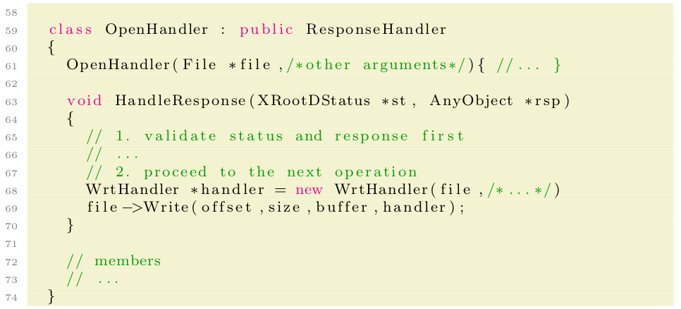
Client Declarative API
… also all this boilerplate code is needed!
14/12/2020
Michal Simon

Slide 25
Client Declarative API
What do we have so far:
We updated only one chunk
Write and SetXAttr happen sequentially (we would need yet another handler-class to aggregate the result of parallel execution)
The amount of boilerplait code is SIGNIFICANT!!!
To update all data stripes and parity stripes we will need yet another handler-class to cope with parallel execution
The boilerplait code is very repetitive!
14/12/2020
Michal Simon

Slide 26
Client Declarative API
We extracted the repeating patterns, applied significant amount of template meta-programming and got a new declarative API:
Asynchronous operation composability
Code readability
Clear workflow
In line with modern c++ (ranges v3 inspired, support for lambdas, std::futures)
Released in 4.9.0 but more complete set of features available only in 5.0.0
14/12/2020
Michal Simon

Slide 27
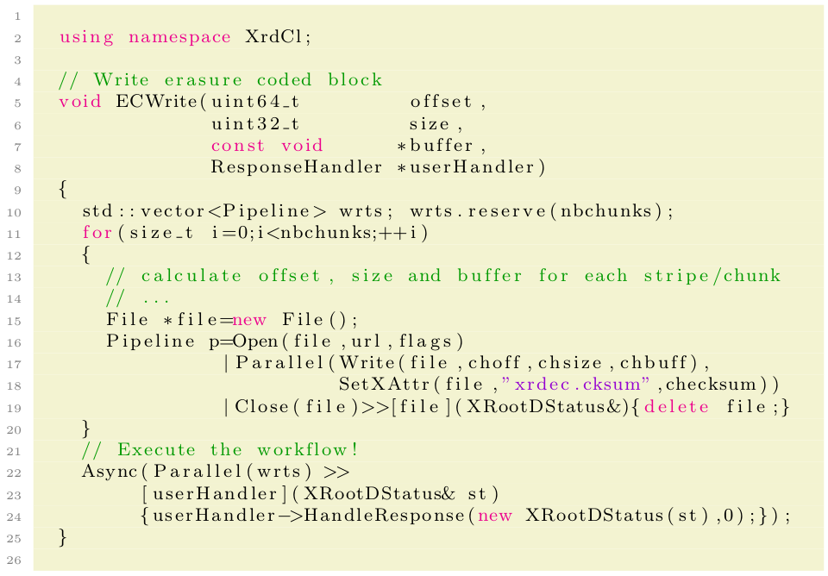
Client Declarative API
Using declarative API:
14/12/2020
Michal Simon

Slide 28
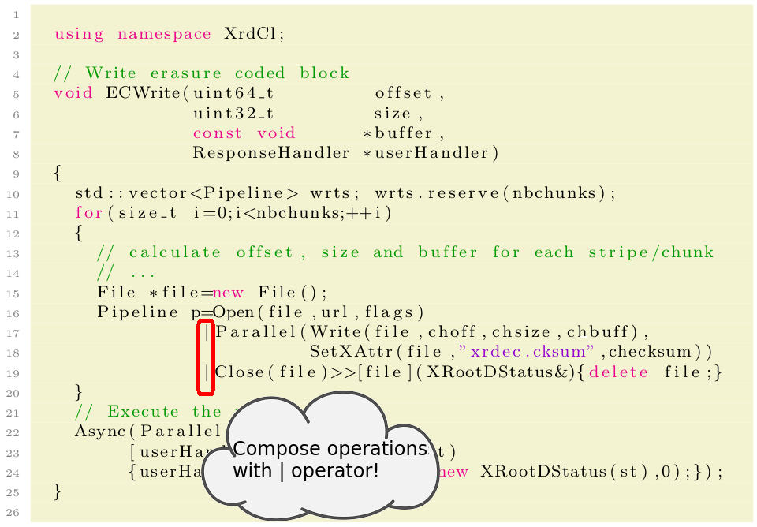
Client Declarative API
Using declarative API:
14/12/2020
Michal Simon

Slide 29
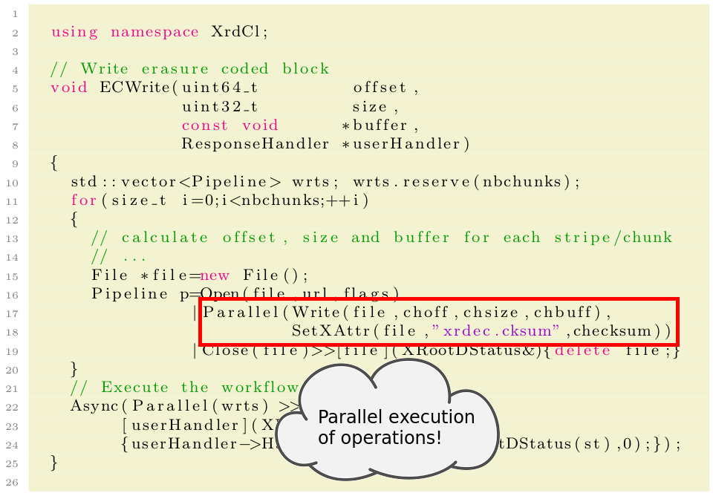
Client Declarative API
Using declarative API:
14/12/2020
Michal Simon

Slide 30
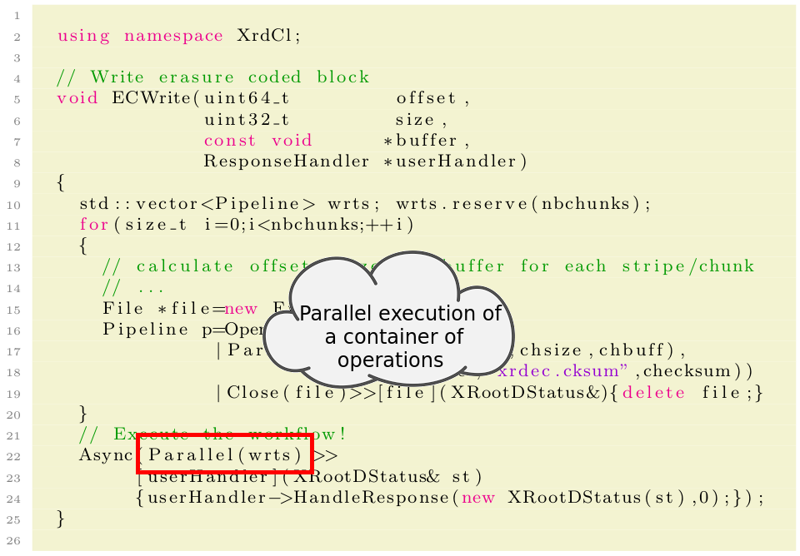
Client Declarative API
Using declarative API:
14/12/2020
Michal Simon

Slide 31
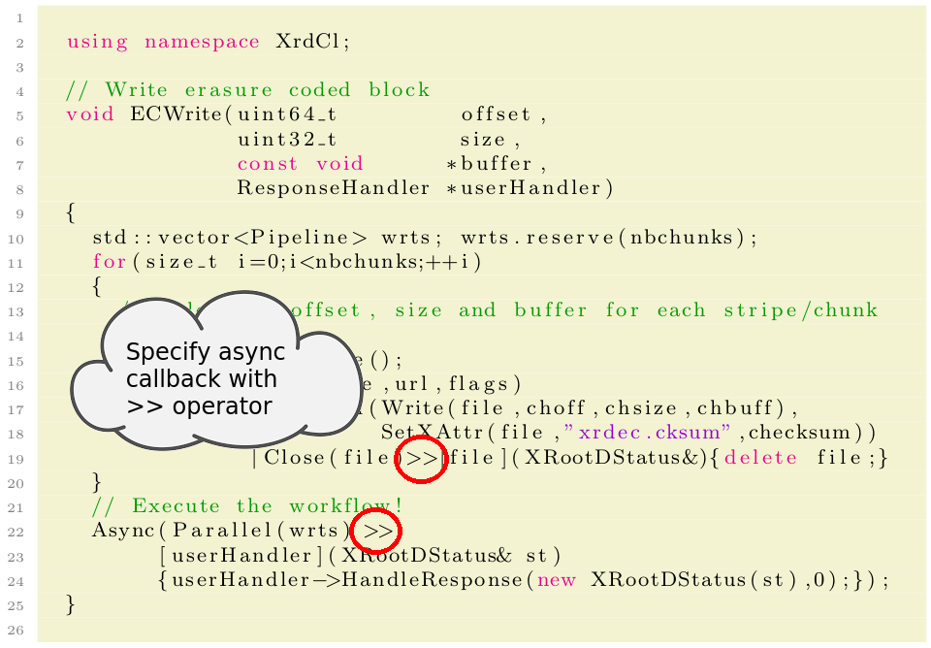
Client Declarative API
Using declarative API:
14/12/2020
Michal Simon

Slide 32
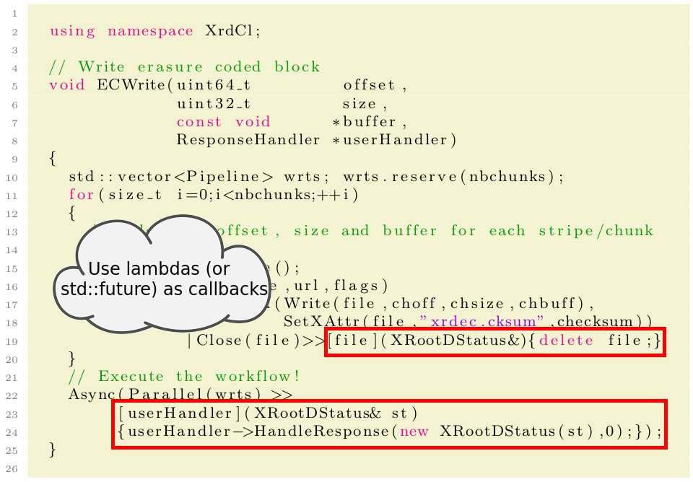
Client Declarative API
Using declarative API:
14/12/2020
Michal Simon

Slide 33
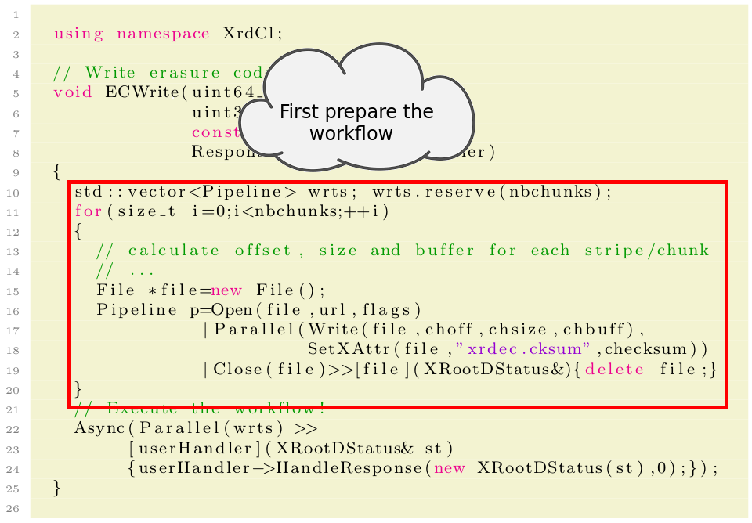
Client Declarative API
Using declarative API:
14/12/2020
Michal Simon

Slide 34
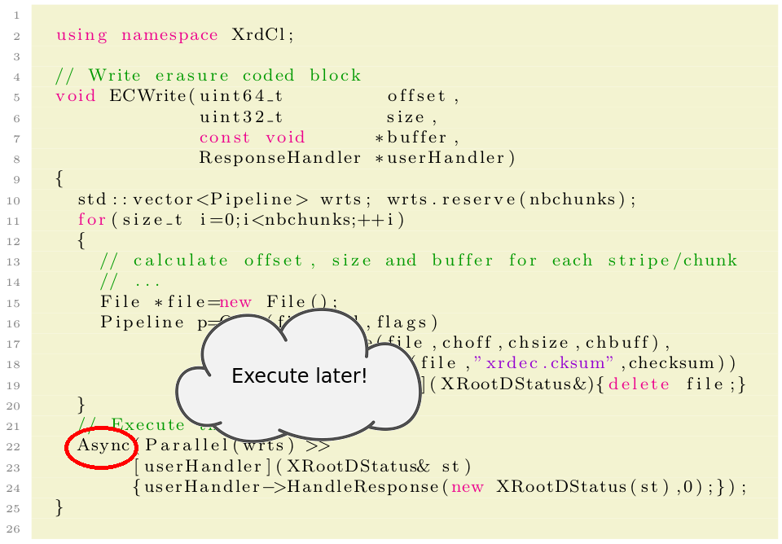
Client Declarative API
Using declarative API:
14/12/2020
Michal Simon

Slide 35
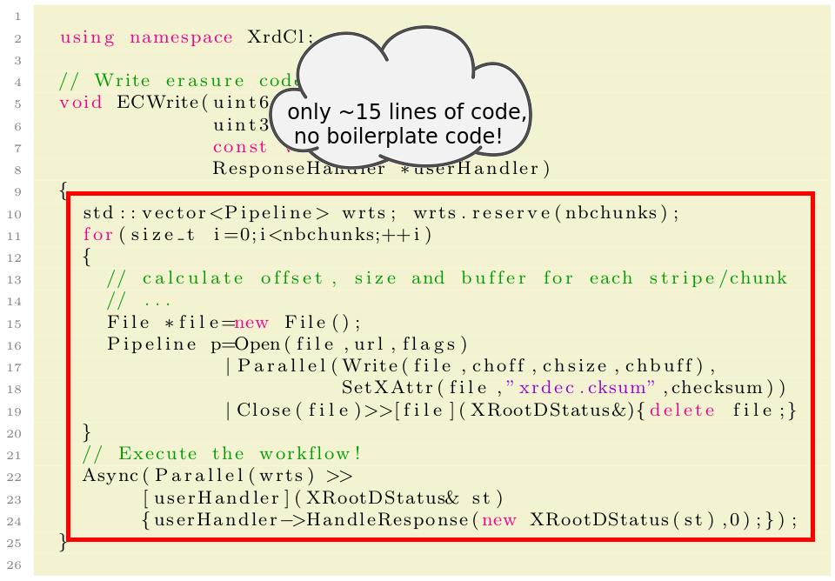
Client Declarative API
Using declarative API:
14/12/2020
Michal Simon

Slide 36
Client Declarative API
Another example: parsing ZIP using declarative API
Open remote ZIP archive and read the Central Directory
Once we have the archive size we can make an educated guess on the offset of the Central Directory
However it might be that there is a comment at the end of the archive which will invalided our guess
  In this case we need to adjust the offset we are reading at and reissue the read request
14/12/2020
Michal Simon

Slide 37
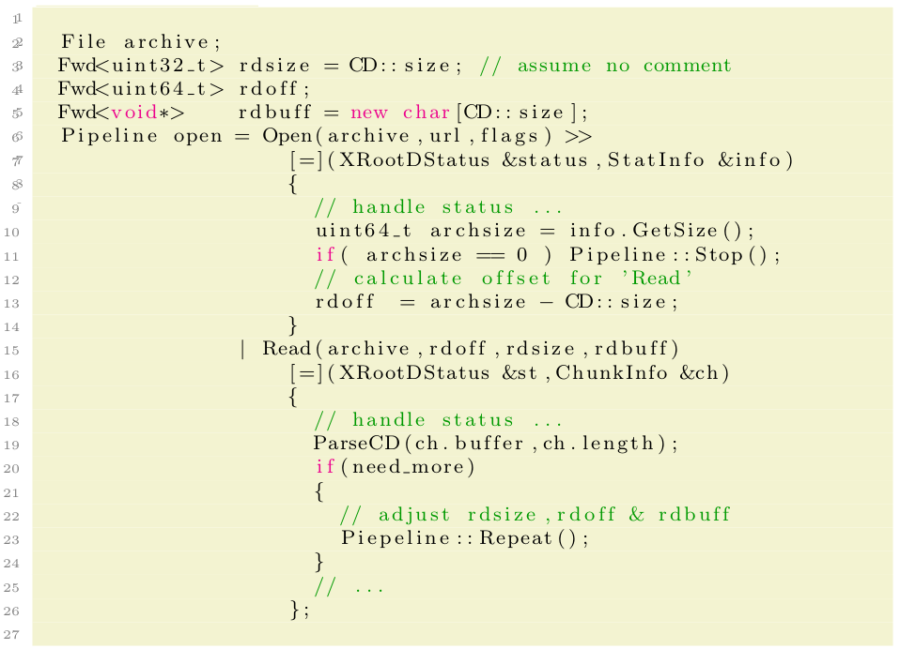
Client Declarative API
Parsing ZIP using declarative API:
14/12/2020
Michal Simon

Slide 38
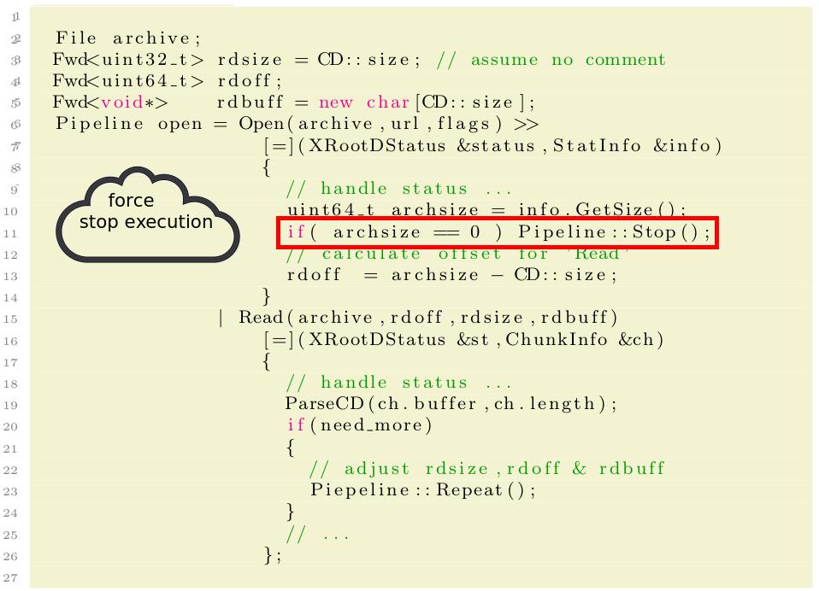
Client Declarative API
Parsing ZIP using declarative API:
14/12/2020
Michal Simon

Slide 39
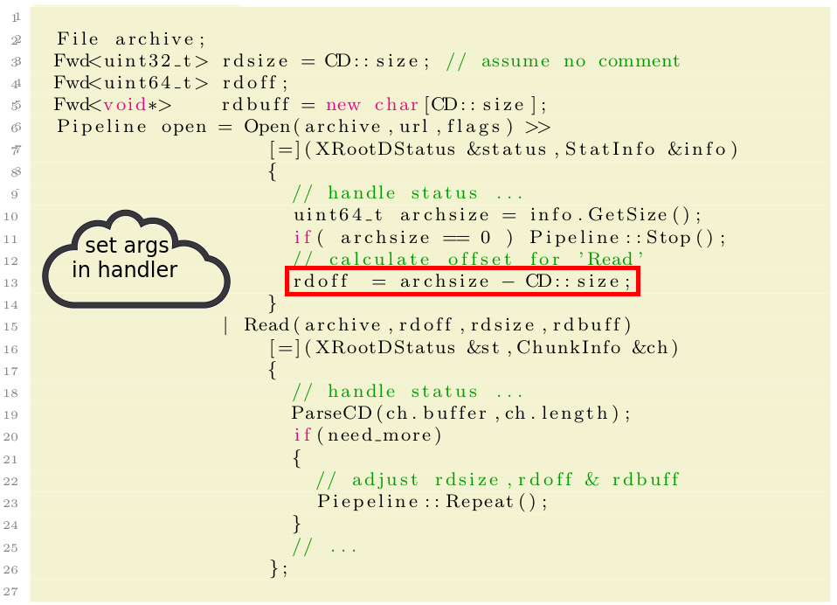
Client Declarative API
Parsing ZIP using declarative API:
14/12/2020
Michal Simon

Slide 40
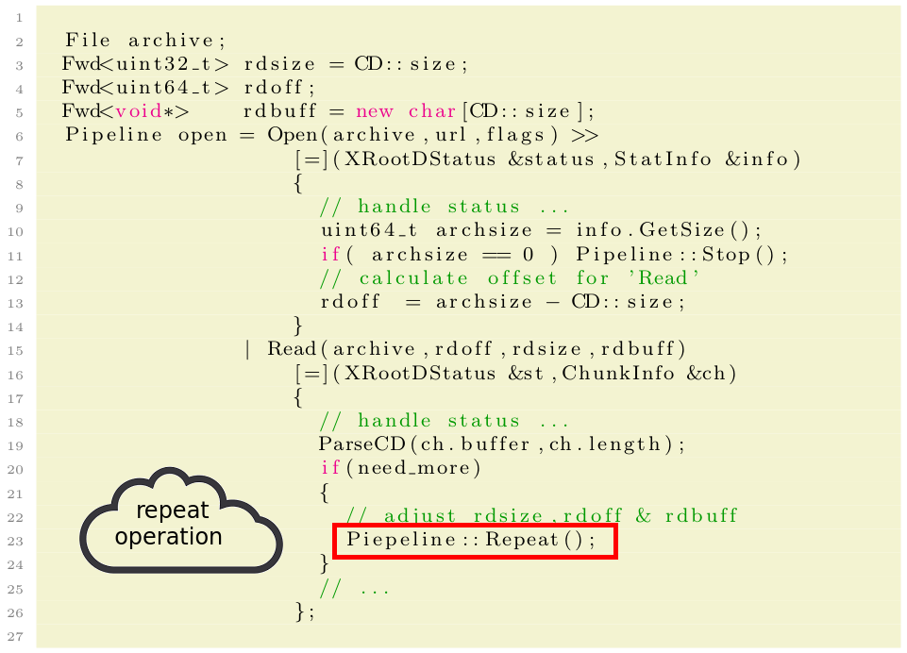
Client Declarative API
Parsing ZIP using declarative API:
14/12/2020
Michal Simon

Slide 41
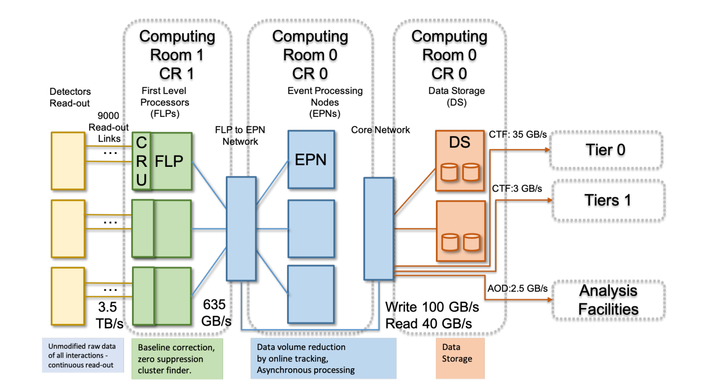
EC plugin for Alice O2
14/12/2020
Michal Simon

Slide 42
EC plugin for Alice O2
500 EPNs (Event Processing Node), each hosting 4 GPUs, each GPU generating a Time Frame every 40 seconds
  2000 data sources in total
A Time Frame (TF) corresponds to a single 2GB file in EOS
  TF has to be copied to EOS in less than 40 seconds
Data sources transfer data to EOS in (kind of) round robin fashion at 20 ms intervals
  every 20 ms a new file will be created and 2GB of data transferred
14/12/2020
Michal Simon

Slide 43
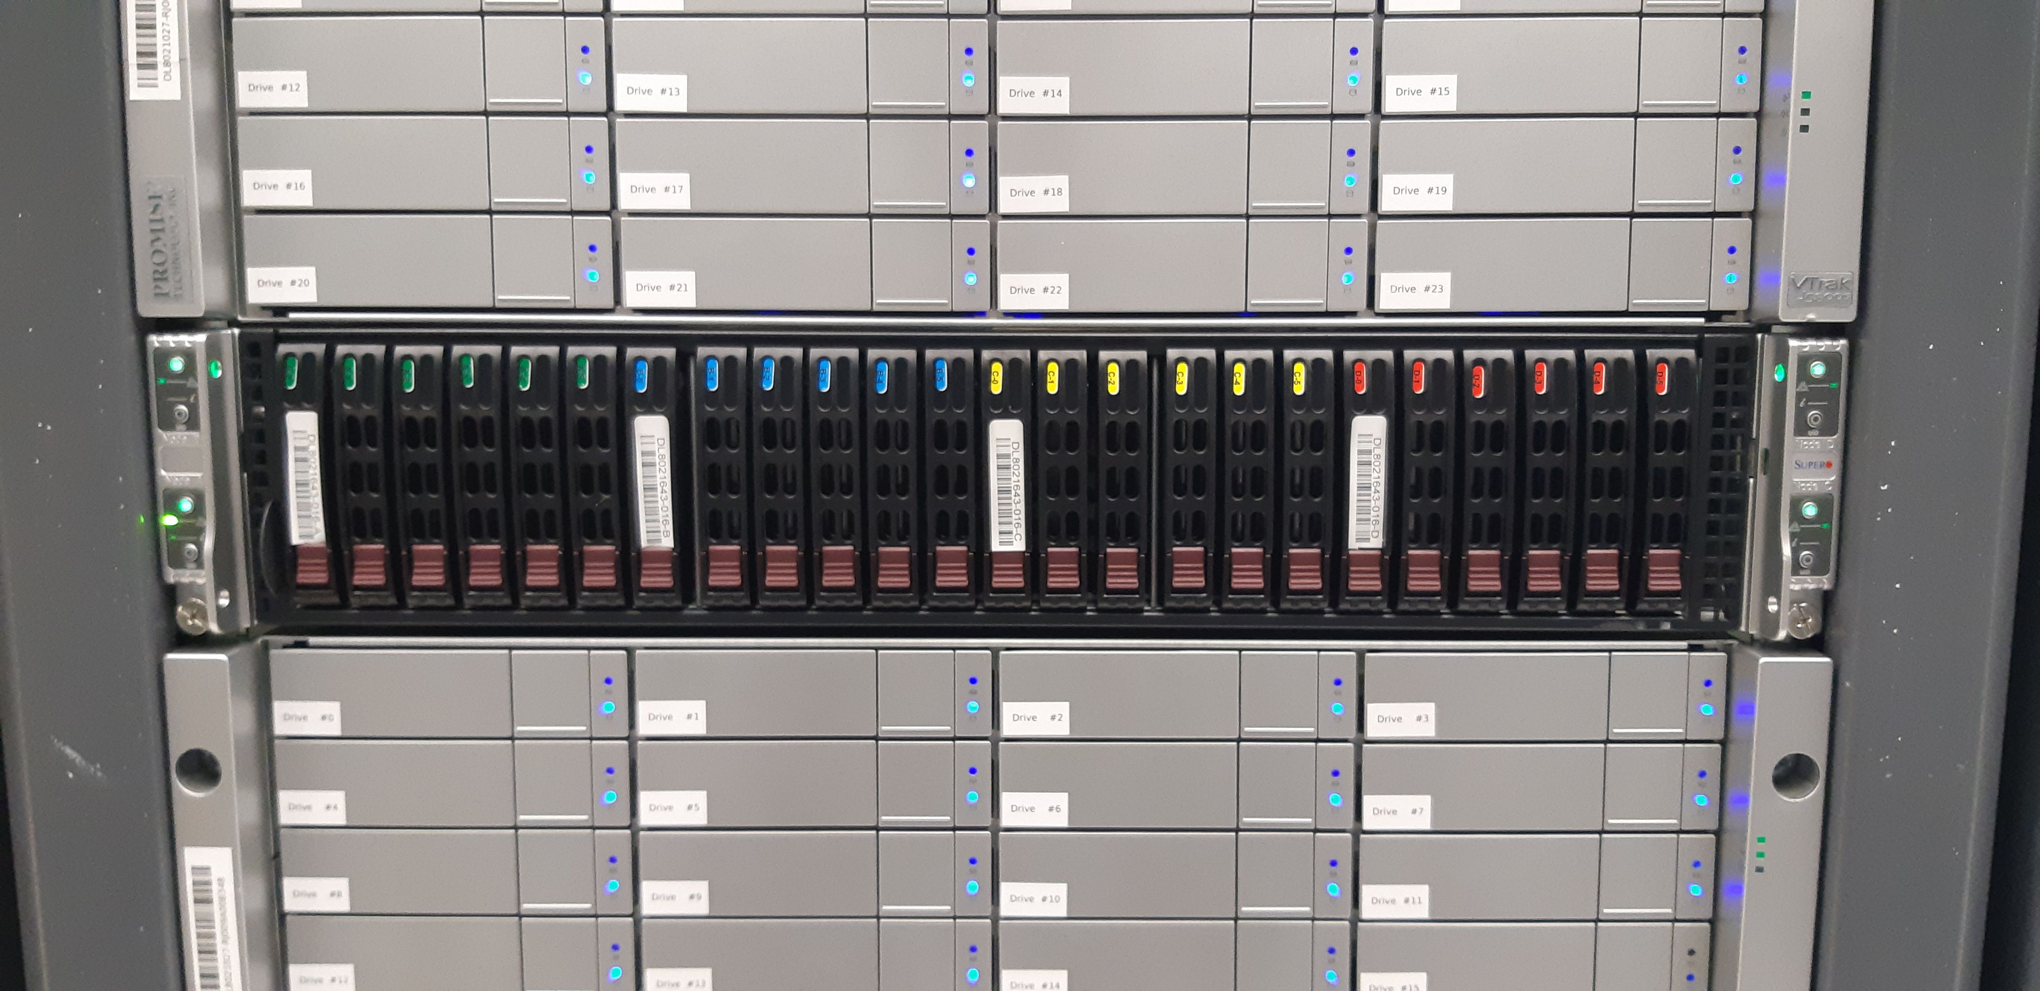
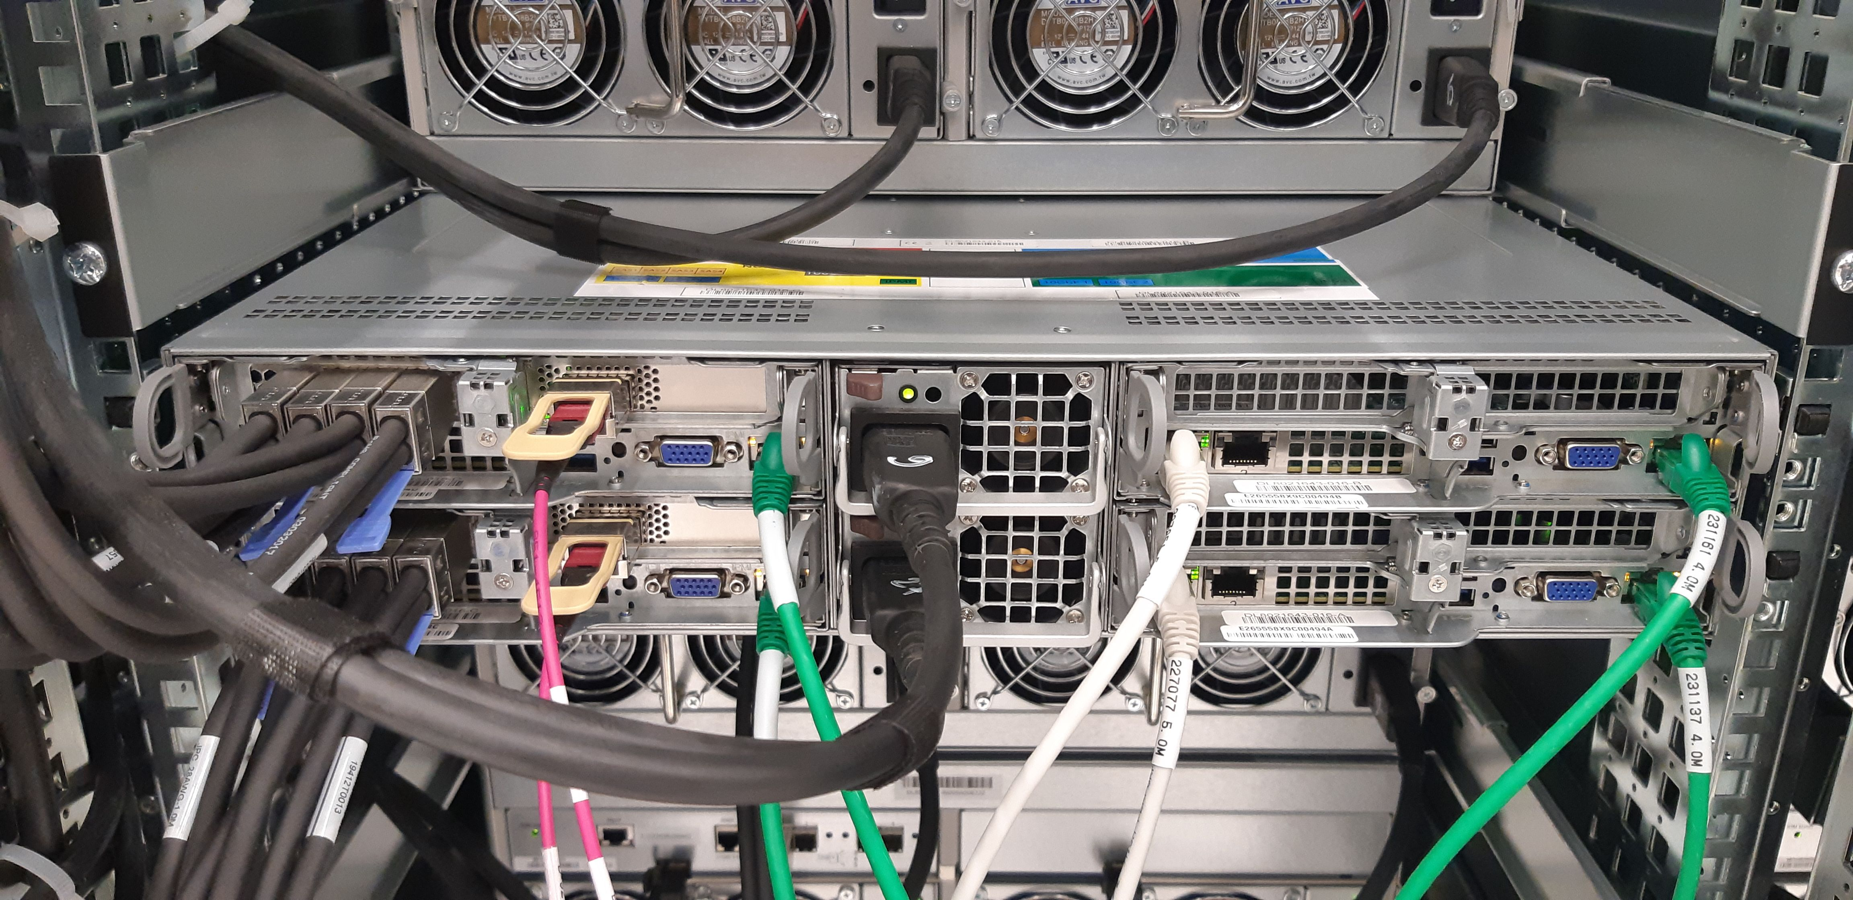
EC plugin for Alice O2
10 data servers, each 96 HDDs (12TB, 265 MB/s)
4 HBA controllers per data server with aggregated throughput of 12GB/s
each server is equipped with 100 Gigabit ethernet cards
all 10 servers on the same non-blocking switch
2 NUMA units, 64 cores
14/12/2020
Michal Simon

Slide 44
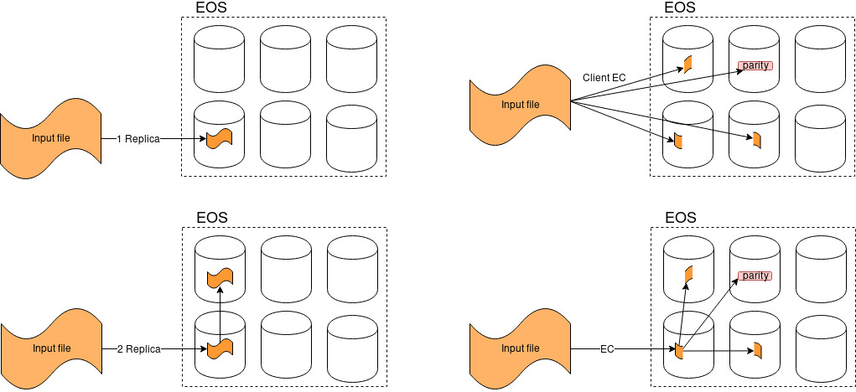
EC plugin for Alice O2
Copy variants:
14/12/2020
Michal Simon

Slide 45
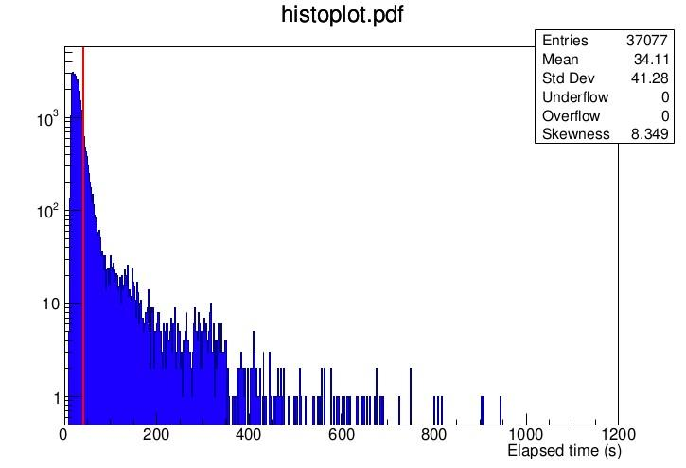

EC plugin for Alice O2
  20% capacity test
  clients run on the batch farm (simulating 20% of the target production load), data were recorded on EOSALICEO2 cluster (10 servers, again ~20% of the target production system)
  the mean is good, but we have a long tail of overflow
measured before Centos8 tuning
14/12/2020
Michal Simon

Slide 46
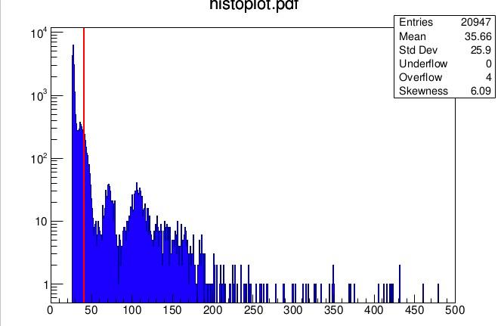
EC plugin for Alice O2
  20% capacity test
  in addition to previous test, 80MB/s bandwidth limitation has been applied (to reduce the overflow)
  source data were generated with dd
  still about 5-6% of the transfers overflow the 40s deadline
measured before Centos8 tuning
14/12/2020
Michal Simon

Slide 47
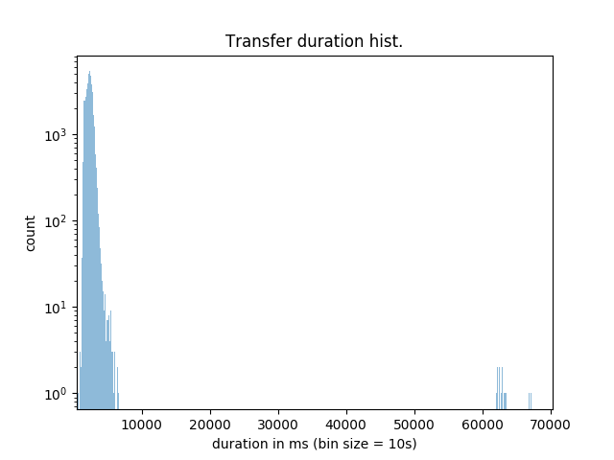
EC plugin for Alice O2
  Client Side EC
  target production load, data were recoreded on 6 EOSALICEO2 servers (running vanilla XRootD), roughly ~10% of the target production system
Average data transfer rate | 929.47 MB/s
Average transfer duration | 2325.34 ms
Transfer duration exceeded 40s | 21
Transfer duration exceeded 40s | 0.0355%
Data transfer rate standard deviation | 203.65
Transfer duration standard deviation | 1251.22
measured before Centos8 tuning
14/12/2020
Michal Simon

Slide 48
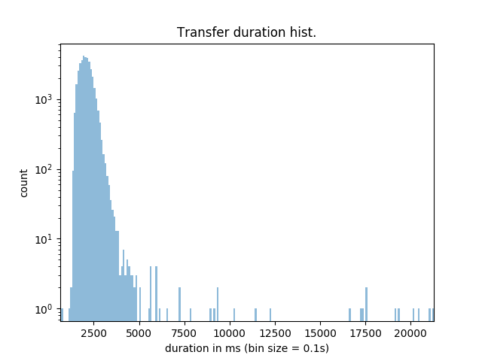
EC plugin for Alice O2
  Client side EC
  force stream timeout after 5s
Average data transfer rate | 1007.60 MB/s
Average transfer duration | 2098.03 ms
Transfer duration exceeded 40s | 0
Transfer duration exceeded 40s | 0%
Data transfer rate standard deviation | 218.13
Transfer duration standard deviation | 1271.70
measured before Centos8 tuning
14/12/2020
Michal Simon

Slide 49
EC plugin for Alice O2
  Summary:
  The initial tests with the client side erasure coding plug-in yielded very promising results
    much faster data transfer rate, cut the long tail (no overflows), better memory usage on EPN side
  Next step
    redo the throughput tests with Centos8 system
    test transfers from Alice P2 to CC
14/12/2020
Michal Simon

Slide 50
On the horizon (5.1.0)
Ensure data integrity in XCache; significantly reduce transfer failures due to checksum errors
Paged read: read request with CRC32C (hardware assisted) per 4KB block
On the flight page recovery on checksum error
For older servers can be substituted with vanilla read + TLS
PIP release: convert egg-info into proper dist-info
pip uninstall works properly with xrootd package
New scitokens plugin
authorization plugin for validating and extracting claims from SciTokens passed during a transfer
14/12/2020
Michal Simon

Slide 51
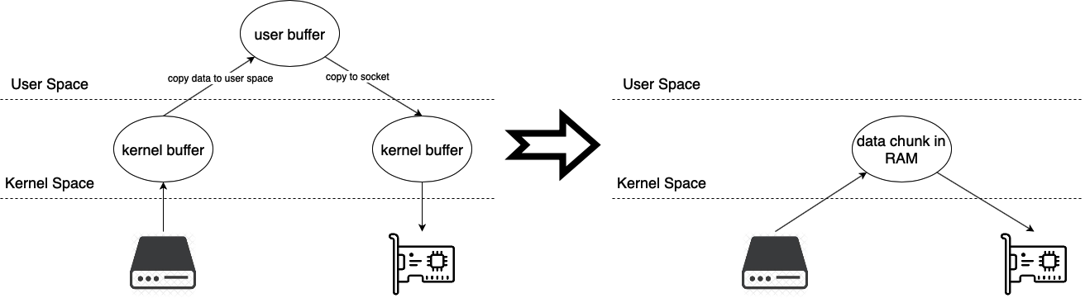
On the horizon (5.1.0)
New features for EOS
Write recovery at MGM (allows to recover 99% of I/O errors for xrdcp transfers to EOS)
Collapse redirect from passive to active MGM in xrootd client
  Facilitate FUSE interaction with passive-active MGM deployment
Simplify buffer management & avoid copying data between kernel and user space
  Speed up data transfer: for slow medium ~3-5%, for fast (like ramdisk) ~40%; reduces CPU usage by a factor of 3-4
14/12/2020
Michal Simon

Slide 52
2021: 5.2.x and more …
Follow up and support XRootD5 deployment; backporting critical bugfixes to XRootD4
Pushing XRootD to Debian distribution (big thanks to Mattias!)
High priority new developments
  Finalize client EC plugin for Alice O2 (Hook it up to EOS)
  ZIP append (initial work done by a summer student, needs checkpoint support on server side)
  Paged Write (Further boost XCache data integrity)
Other new developments
  uid/gid tracking; connect control and data streams on different interface; recursive delete (driven by webdav semantics)
  Get/put file (new TPC); channel level plug-ins; RDMA support; Extending testing infrastructure (mock event-loop)
14/12/2020
Michal Simon

Slide 53
Summary
We have a working and fully functional secure roots/xroots protocol
Many backwards compatibility ‘features’ to facilitate forward migration path
Plenty new features and enhancements facilitating development against XRootD framework
14/12/2020
Michal Simon

Slide 54
Questions?
14/12/2020
Michal Simon

