Slide 1
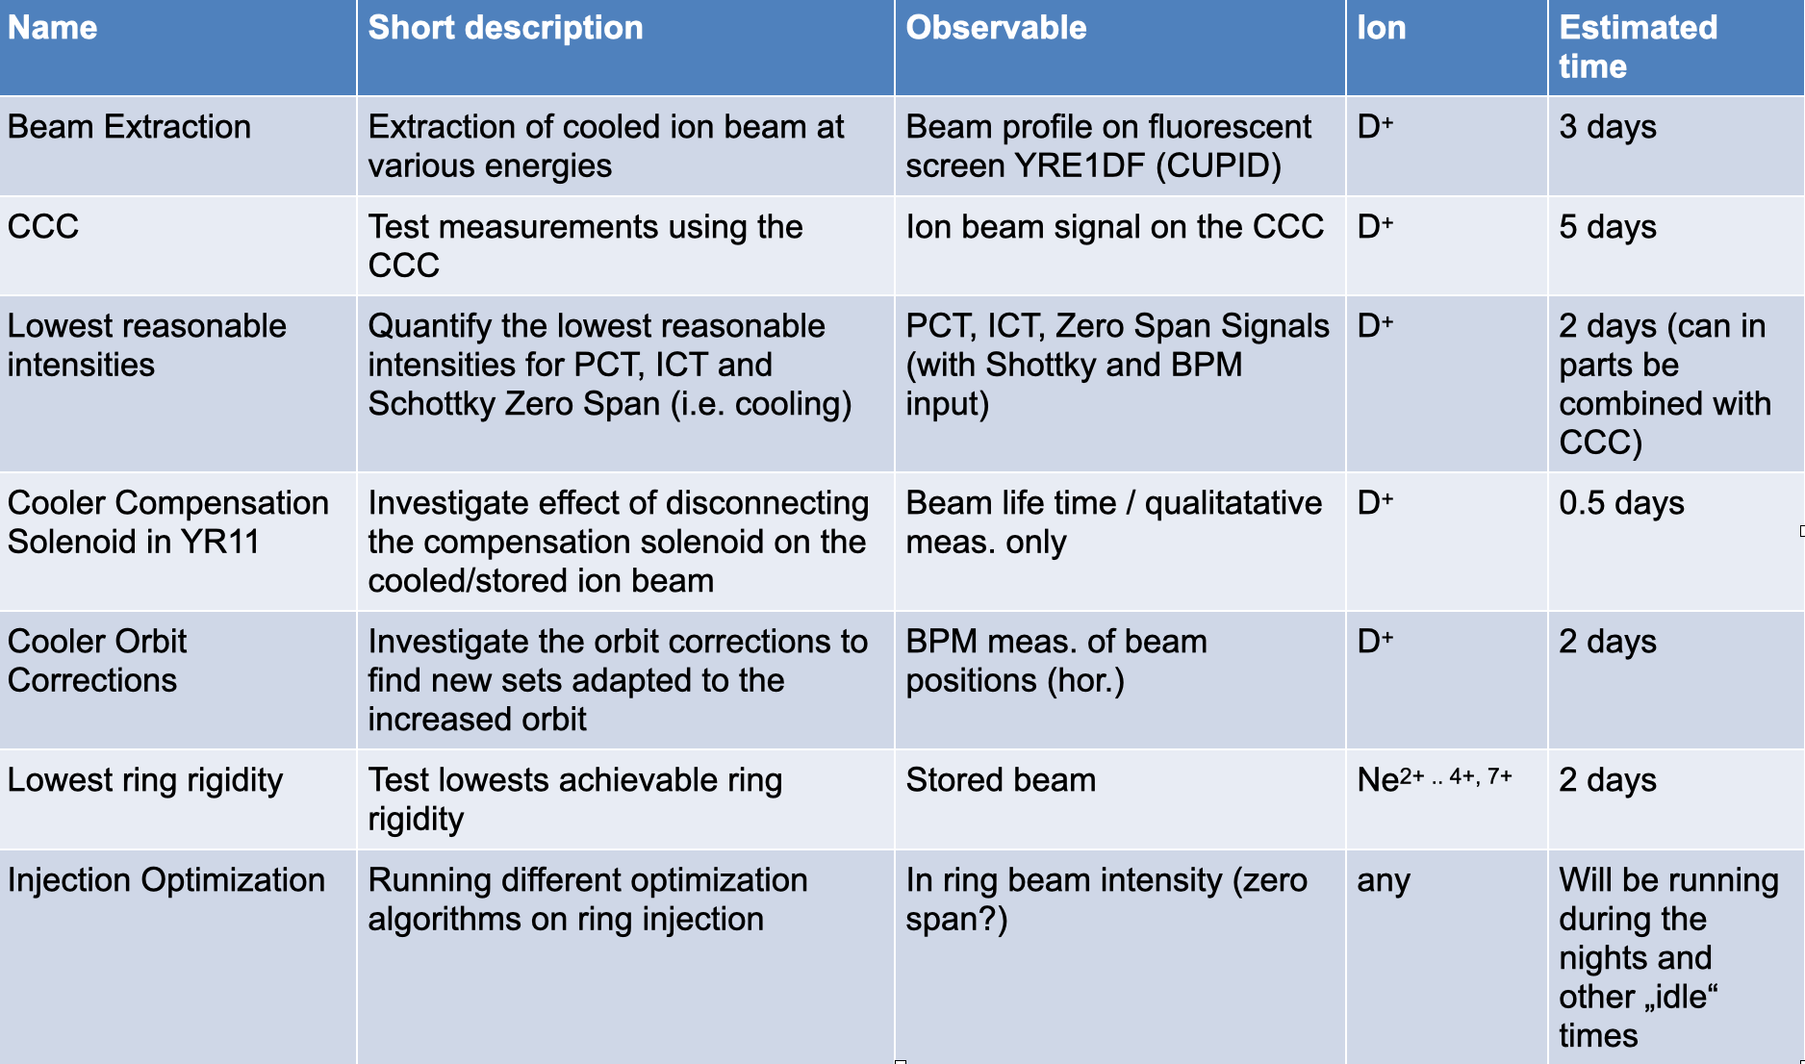
and HITRAP
CRYRING@ESR
CRYRING@ESR
Test with Beam finished
Extraction
CCC test
lowest achievable intensities
Cooler Orbit Correction
ECooler
vacuum issue, valve between cryo-pump and gun needs replacement and cryo-pump needs inspection – scheduled for Jan-14, 2021.
vacuum intervention section 05 – 08 ongoing, pumps will start again tonight
OnCall Service for 2021 coordinated (we rely on operation support as sketched during the operator training)
HITRAP
Electron/Ion transmission/storage test at the cooling Penning trap ongoing
discussion on Shutdown activities for HITRAP done, added to planning of COM
refit work started (IH in-coupling loop will be repaired) ! not all resource issues solved yet !
demonstrated
measured down to 5 nA
> 150 nA (1e6 q) required for initial tuning
calc. agree (found polarity inverted corrector)
Dec-15, 2020
Frank Herfurth

