Slide 1

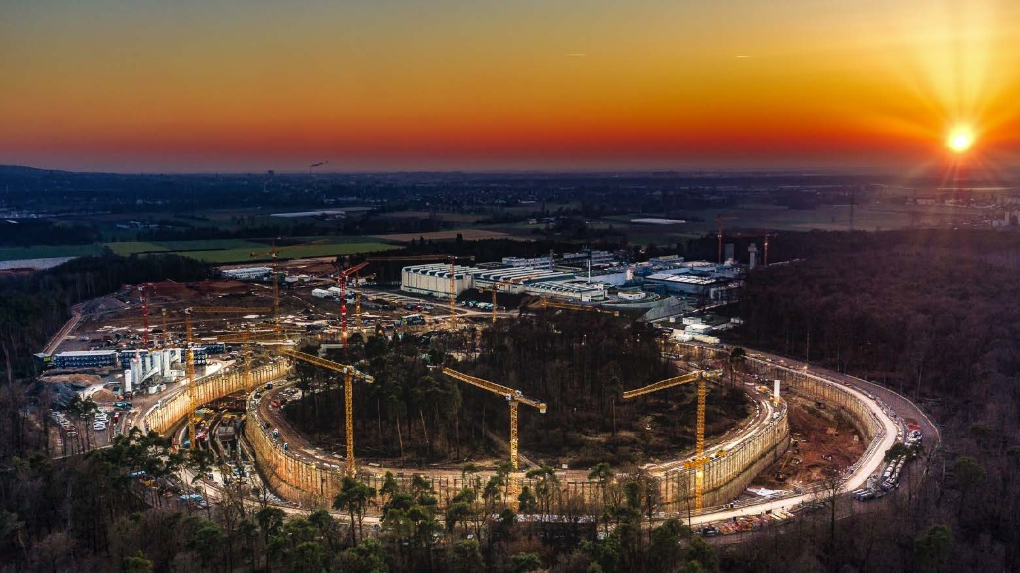
Status Funding
CBM and HADES experiment
10th CBM Resource Review Board meeting
9th February 2021
Report
CBM and HADES Resource Coordinator
Jürgen Eschke

Slide 2
Overview
Bases for CBM C-MoU – CBM funding status after 9th RRB meeting
Status funding of the CBM day 1 setup
and of the CBM start version (phase 1 - MSV)
Status Contracts for FAIR shareholder contributions
Status Funding of HADES@SIS18 (FAIR Phase 0)
and of HADES@SIS100 (FAIR Phase 1)

Slide 3
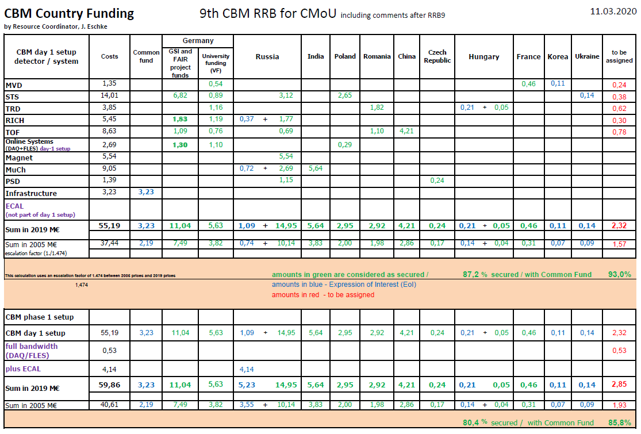
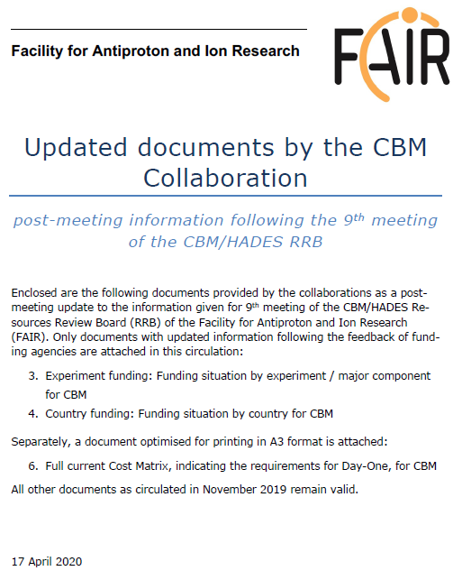

Slide 4
Experiment funding CBM day 1 setup 10th RRB 09.02.2021 (in 2005 and 2021 prices [M€])
and CBM phase 1 setup (CBM start version@SIS100)

Slide 5
Funding CBM day-1 setup (RRB10, 9 Feb. 2021)
93% secured funding
2021 prices
k€

Slide 6
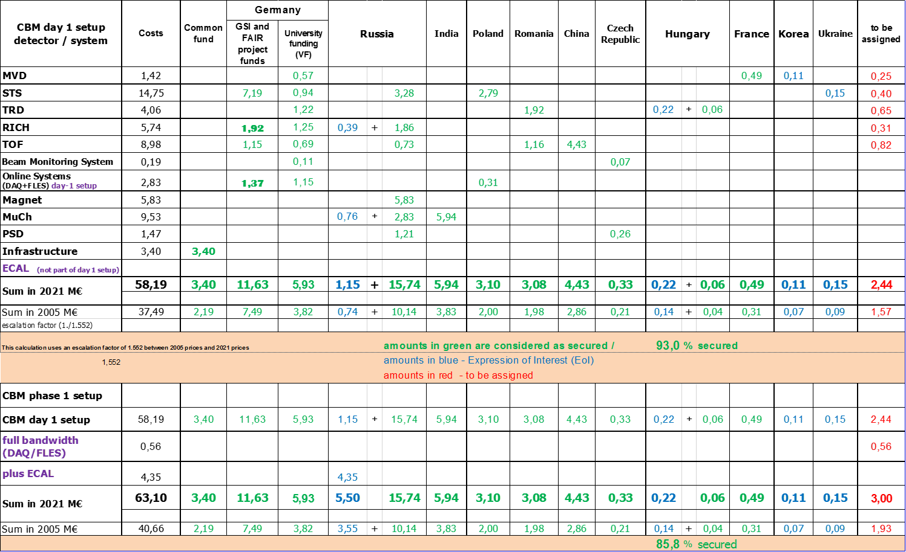
Country funding (in 2021 prices [M€]) CBM day 1 setup 10th RRB 09.02.2021
and CBM phase 1 setup (CBM start version)

Slide 7
Country funding (in 2005 prices [M€]) CBM day 1 setup 10th RRB 09.02.2021
and CBM phase 1 setup (CBM start version)

Slide 8
CBM Cost Matrix and HADES Cost Matrix
please consult distributed
cost matrix for all details!

Slide 9
Status CBM collaboration contracts (Russia)
Project | Partner in Russia | Task | Costs (€ 2005 ) | Council Decision | Status contract
SC dipole magnet | BINP Novosibirsk | Design and Construction | 3.758 Mio | 9.07.2014 | signed
STS | JINR Dubna | Construction of detector ladders for first 4 stations | 2.115 Mio | 10.12.2013 | signed
PSD | INR Troitzk | Design and Construction | 0.778 Mio | 30.06.2015 | signed
RICH | PNPI Gatchina | Construction of mechanical structures, gas system | 1.2 Mio | 9.11.2016 | signed
MUCH | PNPI Gatchina | Construction of absorbers, mechanical structures, gas system | 1.822 Mio | 9.11.2016 | signed
TOF | ITEP | Inner zone | 0.468 Mio | 9.11.2016 | In preparation (draft agreed)

Slide 10
Status CBM in-kind contracts (other shareholders)
Project | Partner Institution | Task | Costs k€ 2005 | Council decision | Status In-Kind contract
STS | AGH, Crakow, Poland | Design and Construction of STS-XYTER chip | 572 | 30.06.2015 | Signed
STS STS STS | JU, Crakow JU, Crakow GSI, Germany | Sensors and QA Front End Boards, test procedures for STS-XYTER chip and FEE STS system | 707 261 4630 | 28.06.2016 28.06.2016 28.06.2016 | Signed! Signed! Signed
HADES | JU, Crakow, Poland | HADES ECAL Mechanical frame | 200 | 30.06.2015 | Signed (frame delivered and installed in HADES cave)
STS | WUT, Warsaw, Poland | Development of DAQ Data Processing Boards (DPBs) | 260 | 30.06.2015 | In preparation
TOF | IFIN-HH, Bukarest, Romania | RPC chambers | 748 | 30.06.2015 28.06.2016 | In preparation
TOF TRD | GSI, Germany IFIN-HH, Bukarest | FEE TRD Chambers | 740 752 | 28.06.2016 29.4.2019 | In preparation In preparation
MUCH | BOSE, Kolkata VECC +12 Indian Institutes | GEM chambers and FEE | 3790 | 10.12.2015 | Signed
10

Slide 11
Summary CBM Costs and Funding
The CBM collaboration has define the “day 1“ setup, which will be operational, when the SIS100 beam will be switched on.
The total cost of the CBM day 1 version (37,49 M€ in 2005 prices) is almost unchanged (increased by 48 T€ (2005 prices)) compared to the RRB9 estimate (37,44 M€ in 2005 prices), because of additional costs for the beam monitoring system, which was introduced as an independent subsystem of the CBM experiment.
Conclusion:
The CBM collaboration has implemented a Common Fund for covering the costs of the common infrastructure of 3,4 M€ (2021 prices). The details for covering theses costs are regulated in the CBM Construction MoU, which is signed presently by the CBM member institutions and their funding agencies or ministries.
The CBM day 1 setup has 93% secured funding including Common Fund
The CBM start version (including ECAL and the full bandwidth of the DAQ/FLES) has 85,8% secured funding

Slide 12

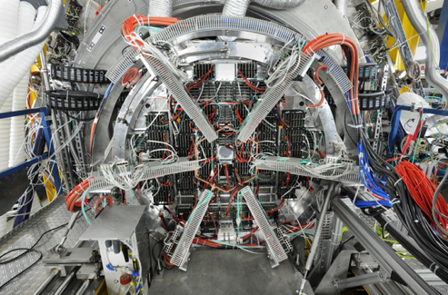
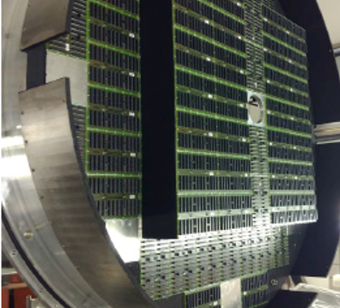
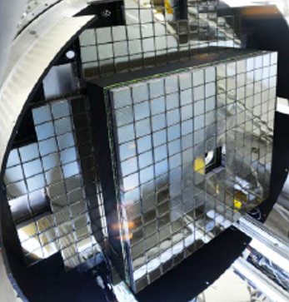
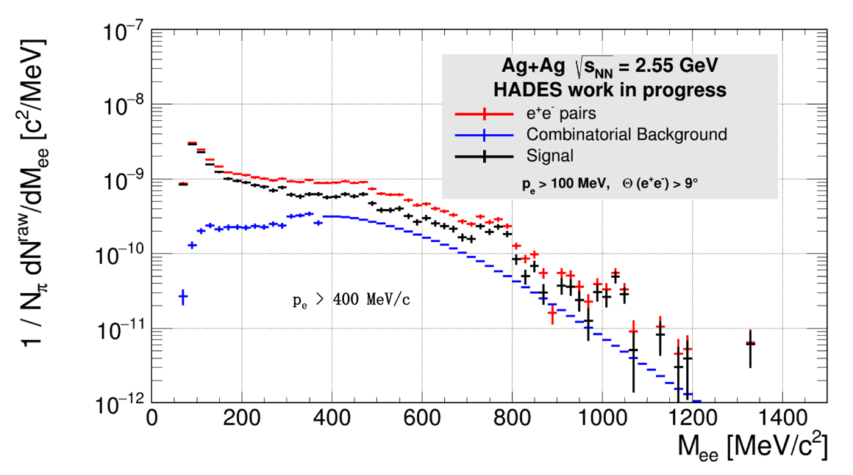
Excellent dilepton performance with new RICH photo camera
Back-side view (in beam direction) of the new RICH photo camera
A success story:
Usage of CBM funded detectors beforehand in HADES.
  Win-win situation – efficient use of funding.
  CBM MAPMTs with TRB3 based readout.
  Synergy project between HADES and CBM
  (Univ’s Münster, Gießen, Frankfurt and GSI).
  Stable operation during four weeks of beamtime in 2019.
  High time precision allows near-background-free ring recognition.
First measurement of dilepton yield beyond vector meson
region (M_{ee} > 1 GeV/c²) at SIS beam energies.
focal plane with PCBs
396 MAPMTs inserted
narrow t0 coincidence condition applied

Slide 13
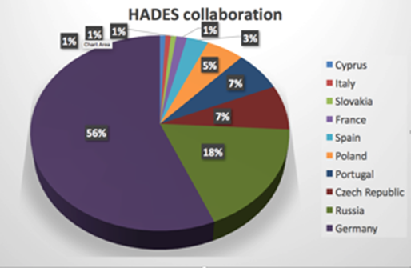
HADES timeline
Upgrade phase, preparation for SIS18 (FAIR phase 0))
  Until 2019: Installation of CBM/HADES UV photo-detector for RICH, ECAL detector
  2020: Installation Forward detector
  2022: Installation MDC readout upgrade
2019-2024… (experiment campaign at SIS18 - FAIR phase 0)
  Five proposal submitted (1 ½ granted)
    𝜋+(CH₂)_{n}/LH₂: baryon em transition form factors,
    baryonic resonances with strangeness
    p+A/p+p: strangeness/vector mesons in medium,
    hyperon em transition form factors
    A+A: downward (in energy) beam energy scan
2025… on (HADES at SIS100)
  Transfer spectrometer to new experimental hall
  Cold matter physics (p+A)
  Exclusive measurements (p+p)
  A+A collisions
Notes:
XB

Slide 14
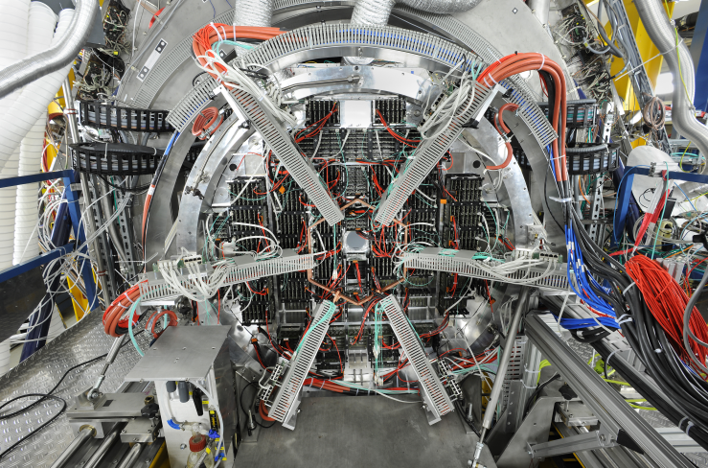
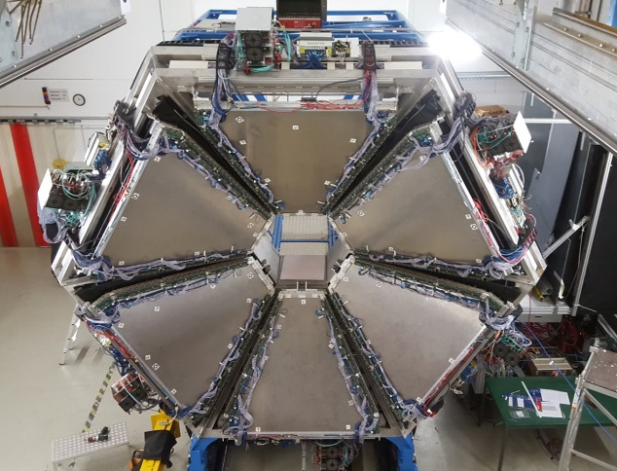
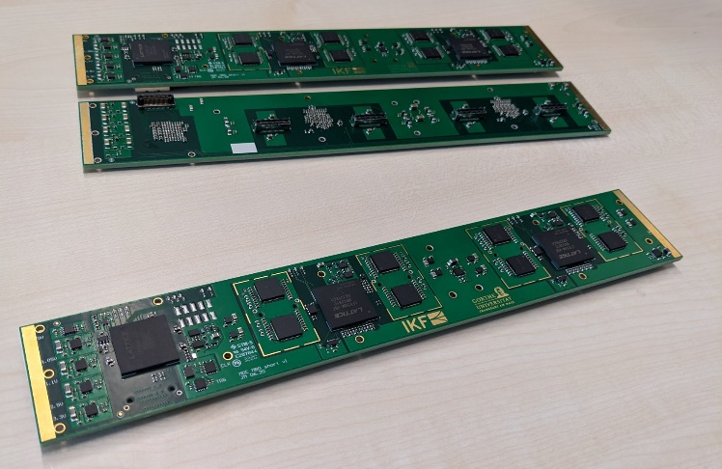
HADES upgrades
RICH Upgrade
ECAL
MDC readout upgrade
RICH (HADES/CBM phase 0 project), Univ. – finished, used in 2019 beam time U. Wuppertal, U. Gießen, U. Frankfurt, GSI, U. München
  Gain in lepton pair detection efficiency (x 3)
  Improved background/noise rejection:
    Better conversion pair rejection
    Precise time information (down to 300ps precision)
  Joint (CBM/PANDA/HADES) development of read-out system based on TRB3 platform.
ECAL (FAIR detector) – 2 sectors in 2019 beam time, 6 sector by end of 2021 Rez, U. Prague, Jagiellonian U., TU Darmstadt, GSI, IPNO Paris
  π0 and η decays into γγ channel
  Electromagnetic decays of baryonic resonances
  Improved e/π separation: important for di-electron spectroscopy
  Proven technology: lead glass modules read out with Hamamatsu PMTs
Forward Detector (HADES/PANDA phase 0 project) – ready for test beam (see next slide) TransFAIR Jülich, AGH Cracow, Jagiellonian U., GSI,
  Enhance HADES capabilities for exclusive channels – forward region
  Hyperon production and EM decays
  PID via TOF, dE/dx(straw tube) – no magnetic field
MDC readout upgrade (uses PASTTREK chip) – prototype under test, installation in 2022 Univ. Frankfurt, GSI, AGH Cracow
  Multi-hit TDC (FPGA based, TRB3 system) – essential for high rate experiments
  Read-out trigger rate increase from 50 kHz to 200 kHz
Notes:
HADES upgrade projects, summary page.
RICH upgrade finished, ready for production beam in Feb. 2019
HADES ECal: 4 sectors out of 6 ready to collect data, Feb. 2019
Forward Detector: extends the acceptance for angles < 6 degrees, will be installed in 2019
MDC readout upgrade: scheduled for 2020

Slide 15

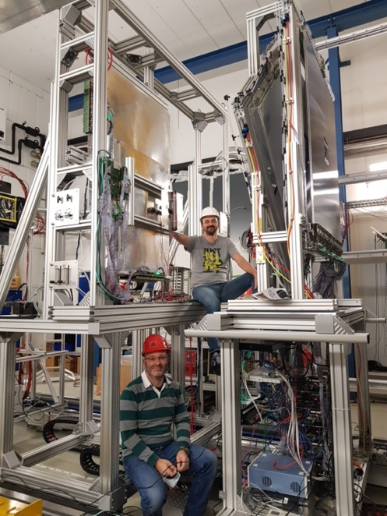
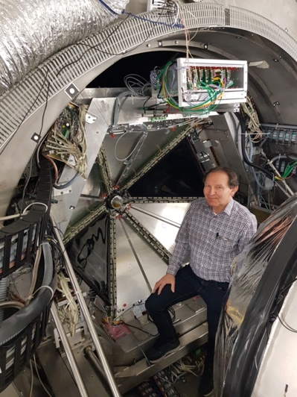
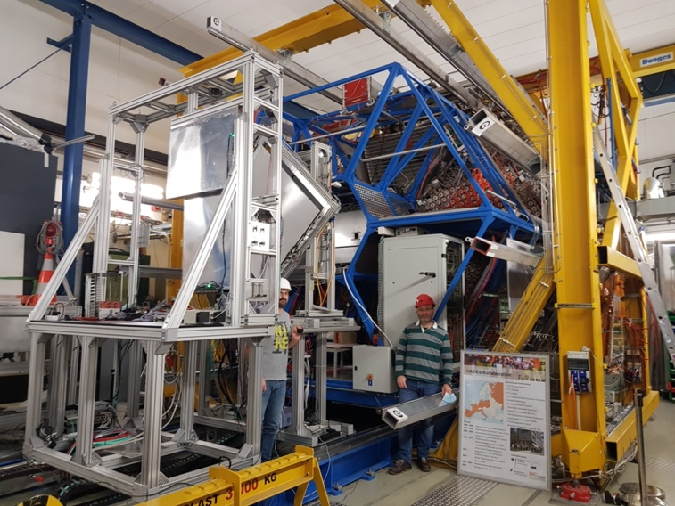
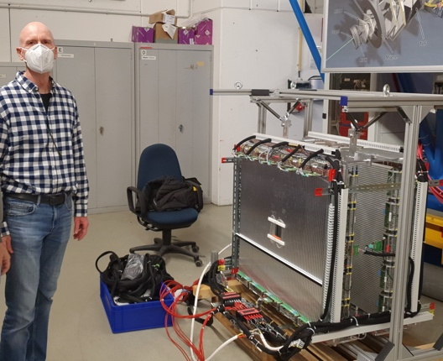
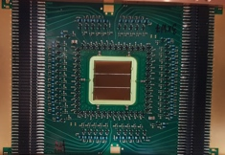
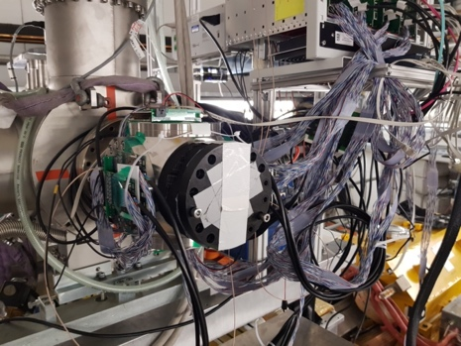
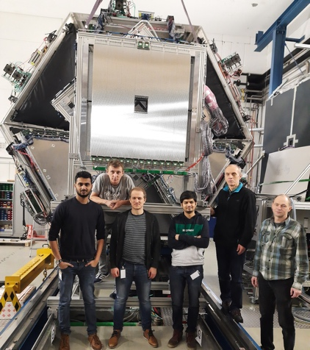
The upgraded HADES detector
(five new detector systems)
Improved physics performance through instrumentation of the very forward hemisphere using FAIR technology.
In particular important for the Hyperon Program.
iTOF
TransFAIR, Jülich
APD read-out
Enhances trigger purity
Forward RPC
LIP Coimbra
Based on R&D for neuLAND
TRB3 read-out
STS2
Jagiellonian Univ.
PANDA straw technology
PANDA PASTTRECK FEE chip
STS1
TransFAIR, Jülich
PANDA straw technology
PANDA PASTTRECK FEE chip
T0
GSI, TU Darmstadt
LGAD technology
In-beam detector

Slide 16
HADES upgrade costs
• The HADES upgrade for SIS18 (total costs in 2005 prices is 1,118 M€) has 94,4% secured funding
(no change compared to RRB9).
The costs of the HADES experiment at SIS100 (FAIR phase 1) amounts to 2,594 M€ (2005 prices) (plus 141 T€). The full HADES upgrade costs including the moving to the CBM cave at SIS100 has 71,8% secured funding (+7,3% compared to RRB9) at present.

Slide 17

HADES upgrade for
FAIR Phase 0 (SIS18) & FAIR Phase 1 (SIS100)
Secured Czech Contribution to HADES increased by 280 k€ to 906 k€ (2005 prices)
since the 9th RRB.
Notes:
one can edit/change the numbers is table
numbers seems to be OK.

Slide 18
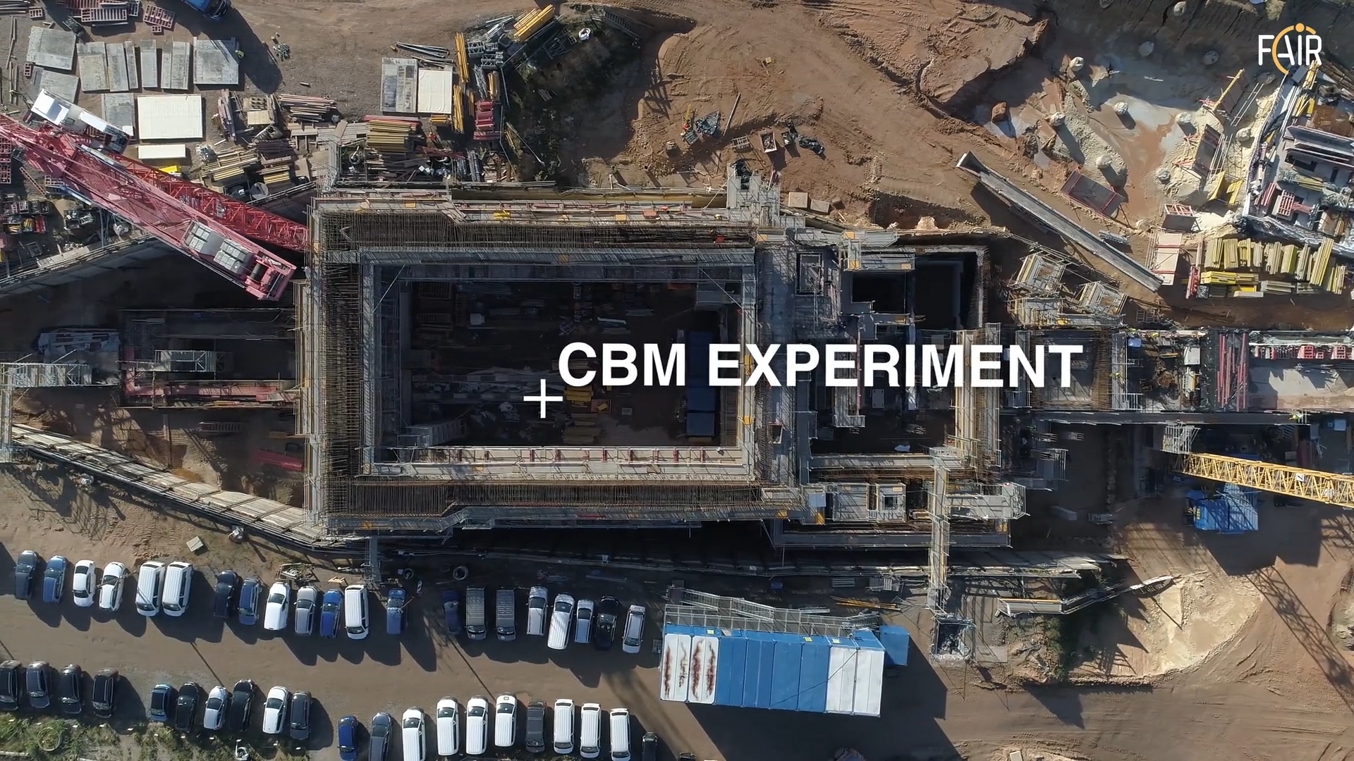
Thank you for your attention!

Slide 19
Backup slides

Slide 20
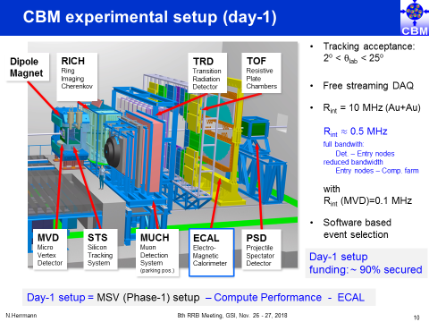
Definition CBM DAY 1 and CBM start version (MSV)
full bandwidth
costs additional ~0,5 M€
(>1% of day 1 cost)
 | CBM Day 1 setup | CBM start version (MSV)
Micro Vertex Detector (MVD) | yes | yes
Silicon Tracking System (STS) | yes | yes
Ring Image Cherenkov Detector (RICH) | yes | yes
Muon Detector (MUCH) | yes | yes
Transition Radiation Detector (TRD) | yes | yes
Time of Flight System (TOF) | yes | yes
Electromagnetic Calorimeter (ECAL) | no | yes
Projectile Spectator Detector (PSD) | yes | yes
Dipol MAGNET | yes | yes
Online Systems (DAQ and FLES) | yes | yes
Front End | 100% | 100%
Back End (bandwidth) | 20% | 100%
Infrastructure | yes | yes

Slide 21
Status CBM/HADES Technical Design Reports January 2021
Nr. | CBM subsystem | Status
1 | Superconducting dipole magnet | approved
2 | Silicon Tracking System (STS) | approved
3 | Ring Imaging Cherenkov Detector (RICH) | approved
4 | Projectile Spectator Detector (PSD) | approved
5 | Muon Chamber System (MUCH) | approved
6 | Time of Flight (TOF) system | approved
7 | Transition Radiation Detector (TRD) | approved
8 | Micro-Vertex Detector (MVD) | submission Q1 2021
9a | Online Systems I: Data Acquisition (DAQ) | submission Q2 2022
9b | Online Systems II: Computing | submission Q1 2023
10 | Electromagnetic Calorimeter (ECAL) | submission t.b.d.
11 | HADES Electromagnetic Calorimeter | approved

Slide 22
CBM status: score card
09.02.2021
10th CBM RRB Jürgen Eschke, CBM RC

