Slide 1
UNILAC-HSI-Machine Investigations (16.11. – 26.11.20)
Redefinition of HSI-RFQ-“working point“ (U_{rfq})?
- PIG (Ar¹⁺, Ar²⁺), ≈0.1 emA
MUCIS (Ar¹⁺), ≤18 emA
as probe beams for an advanced machine investigations program…

Slide 2
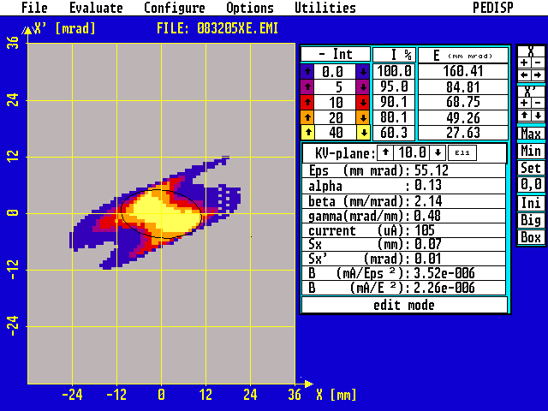
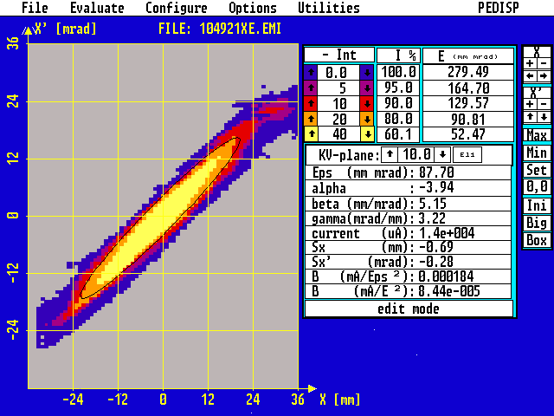
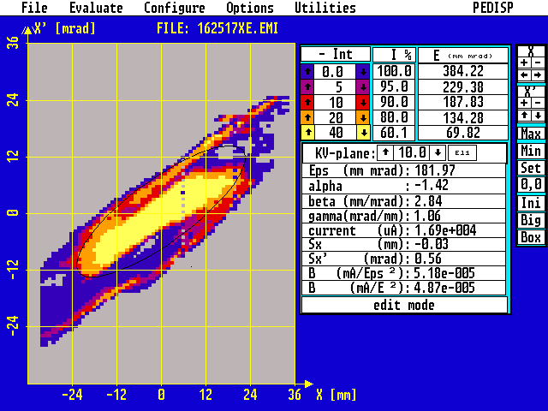
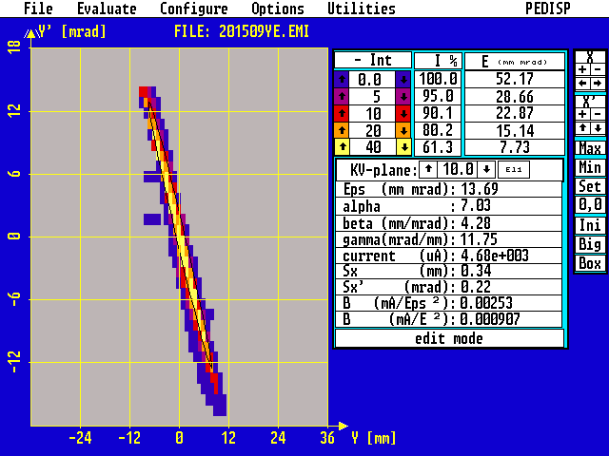
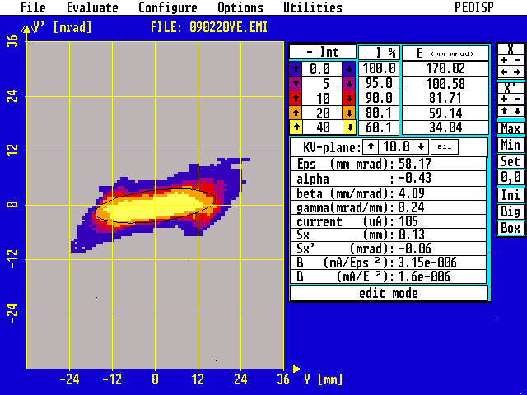
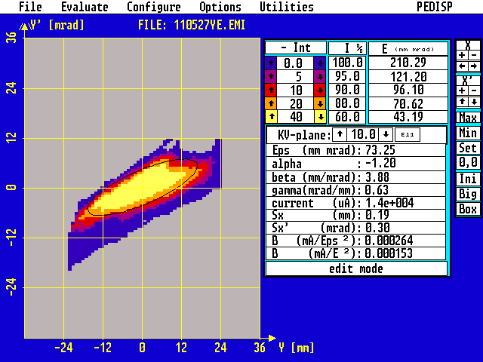
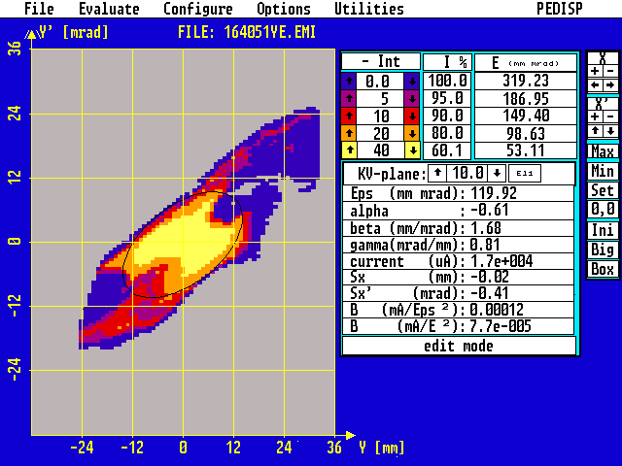
Beam emittance @2.2 keV/ u
horizontal:
0.1 emA (PIG] 14 emA 18 emA
vertical:
0.1 emA (PIG] 14 emA 18 emA

Slide 3
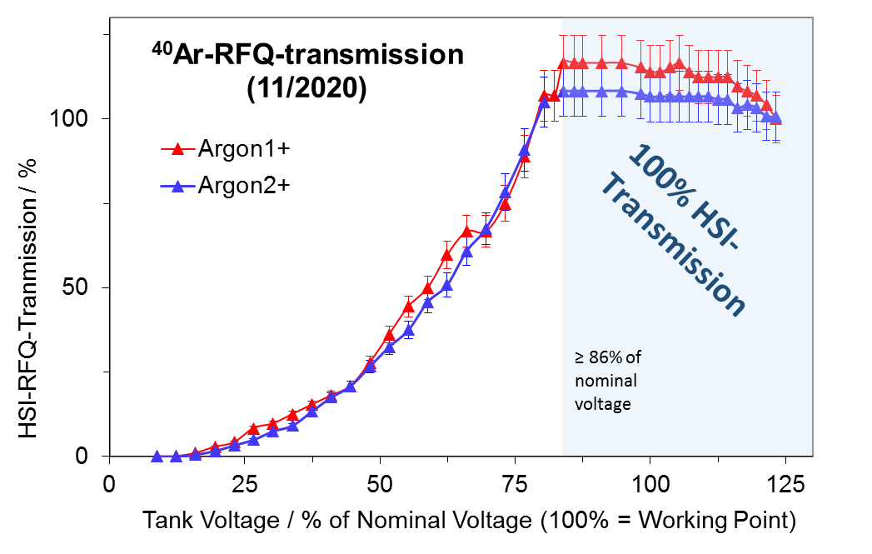
HSI-RFQ-transmission investigations with PIG-beam

Slide 4
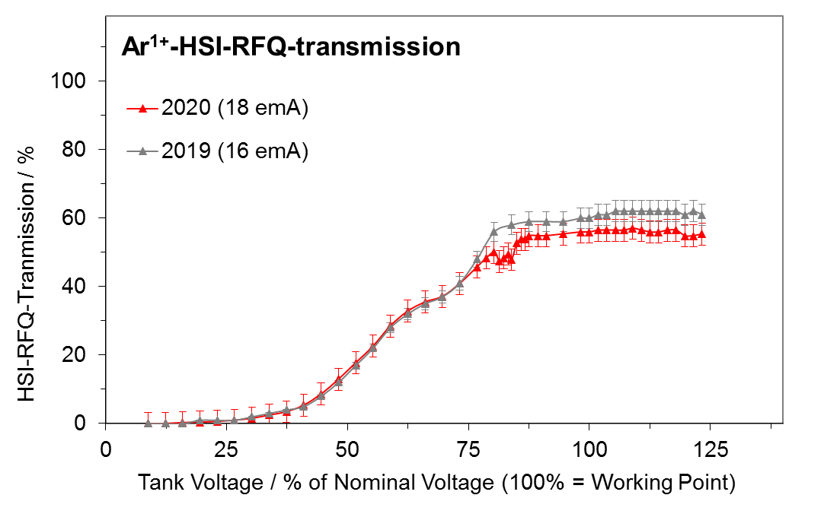
HSI-RFQ-High Current Investigation Campaign

Slide 5
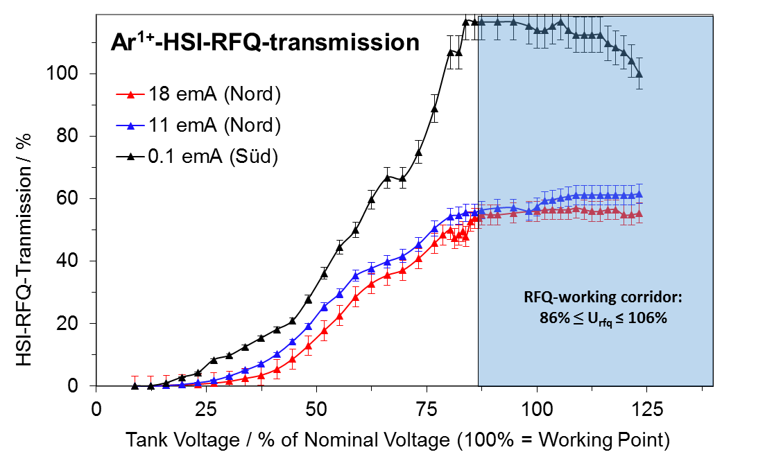
HSI-RFQ-High Current Investigation Campaign

Slide 6
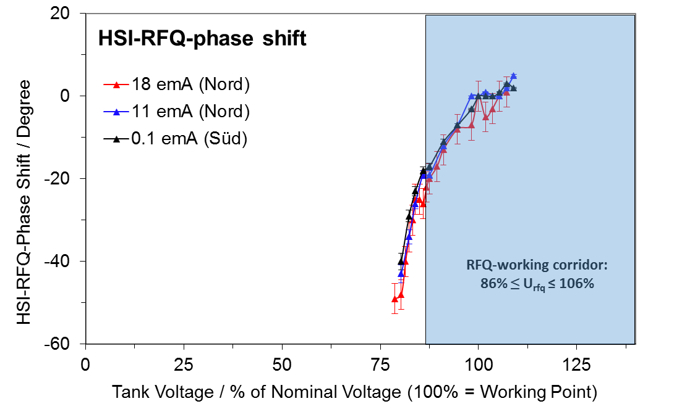
RFQ-phase shift to compensate HSI-transmission drop

Slide 7
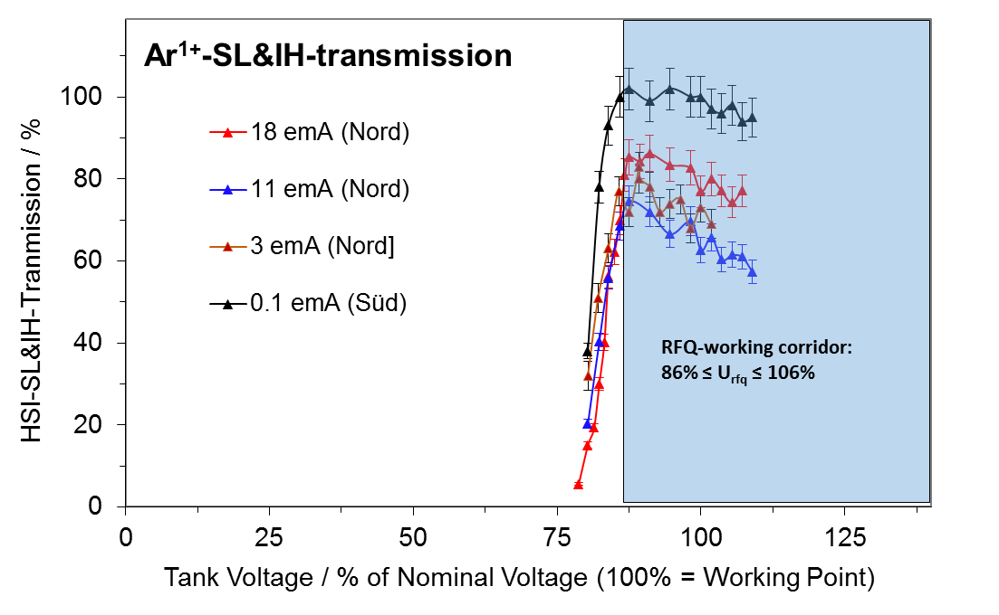
HSI-IH-transmission

Slide 8
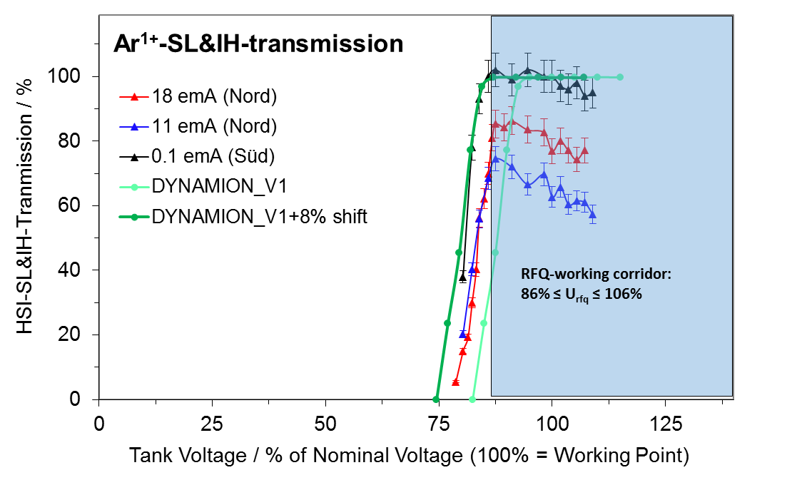
HSI-IH-transmission

Slide 9
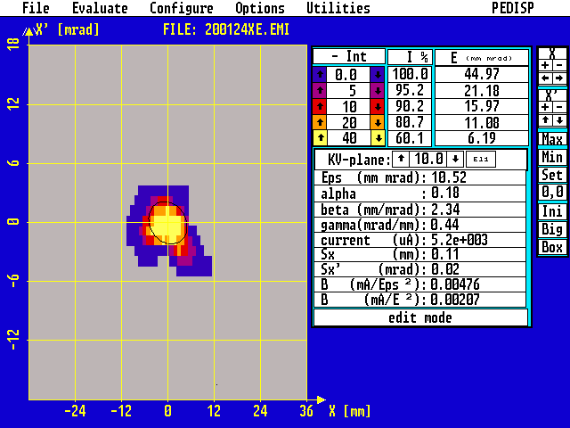
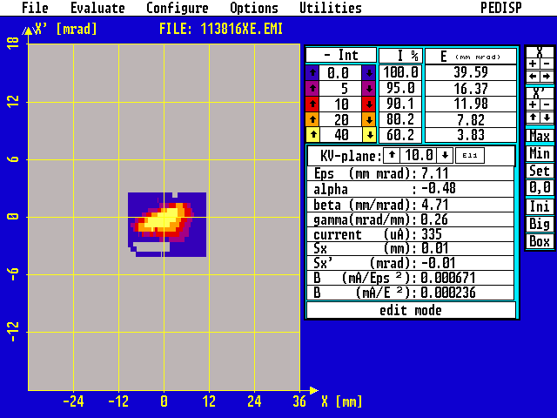
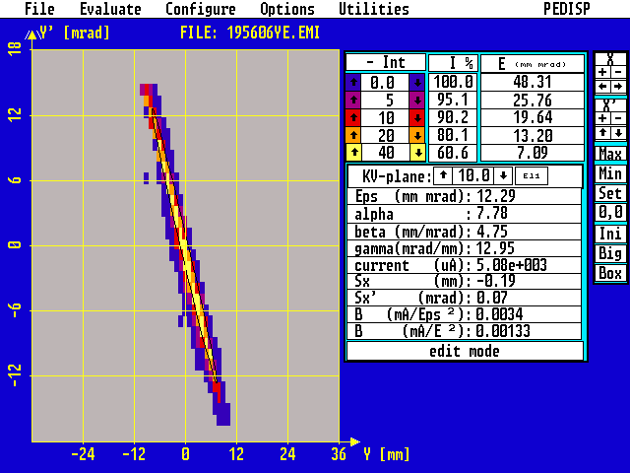
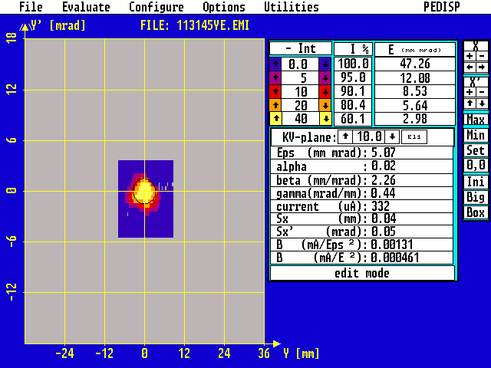
Beam emittance at 85.7%, @1.4 MeV/u
MUCIS (7emA) PIG (0.1 emA)
horizontal:
vertical:

Slide 10
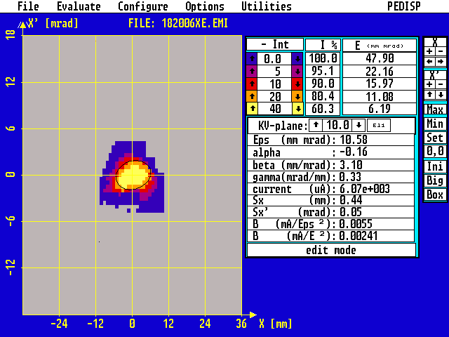
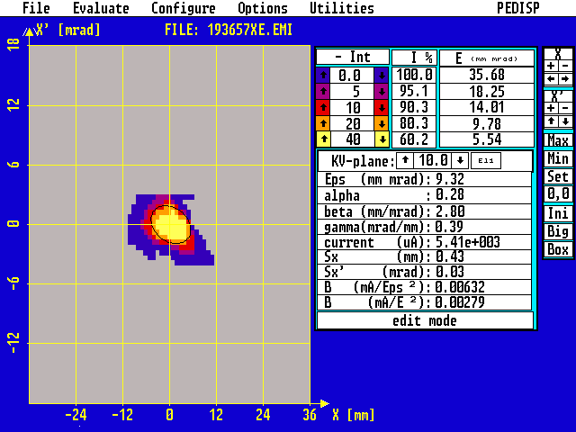
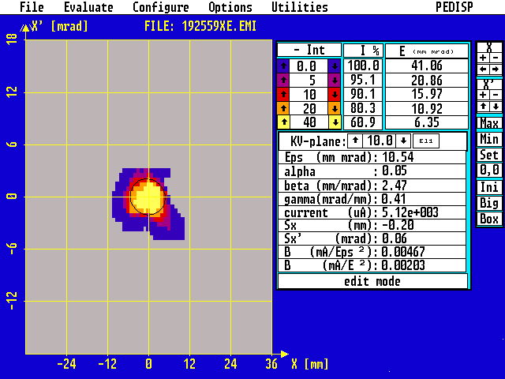
Beam emittance @1.4 MeV/u
horizontal:
85,7% 86,8% 92,9% 100% 107,1%
vertical:
85,7% 86,8% 92,9% 100% 107,1%

Slide 11
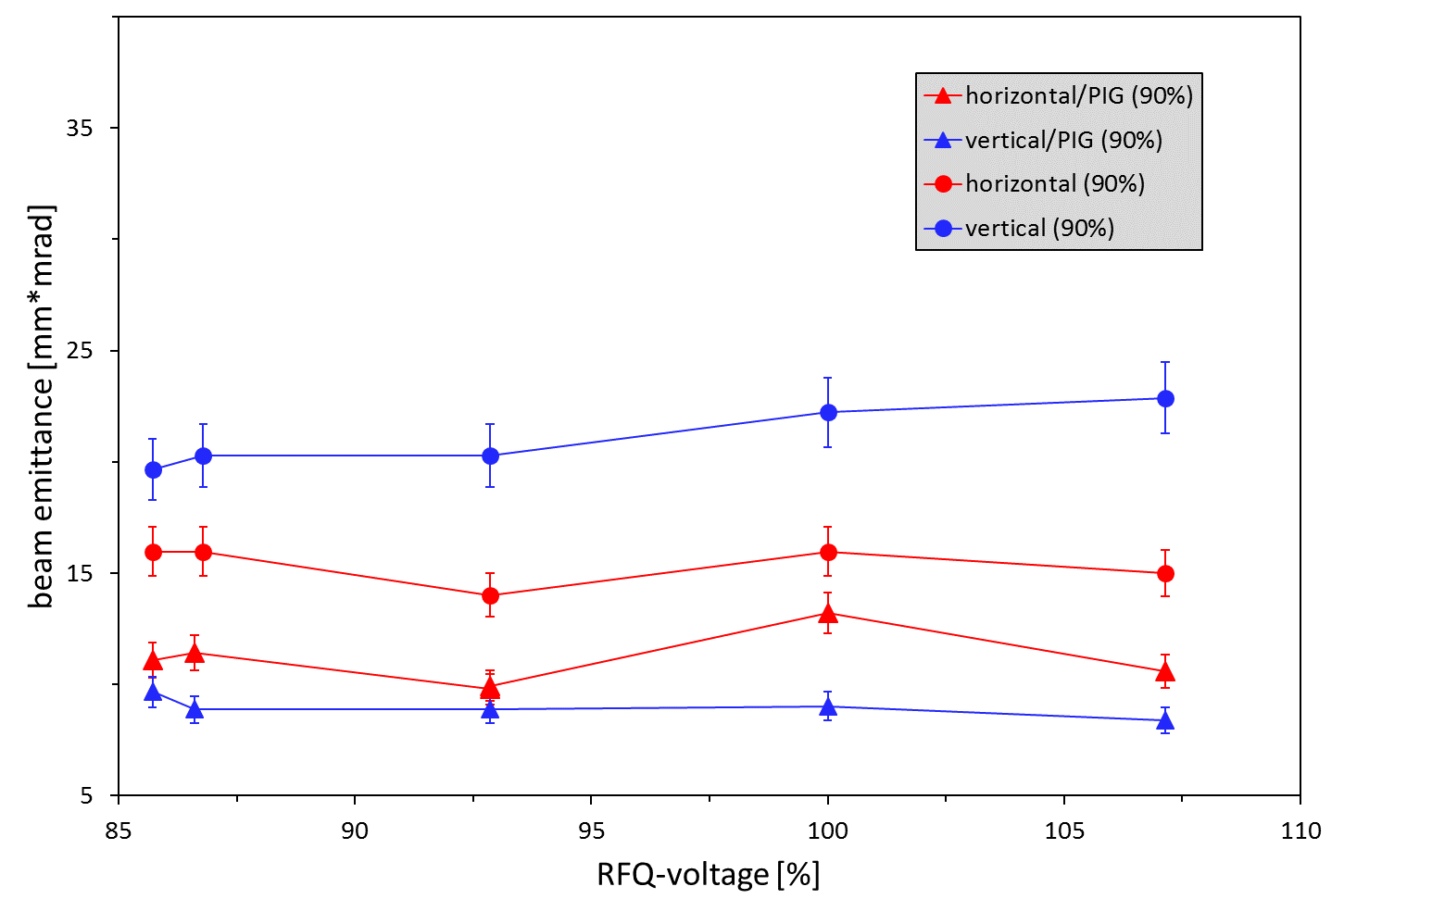
Beam emittance measurement @1.4 MeV/u

Slide 12
Outlook
Verification of measured RF-voltage (re-calibration of probe signal)
Rf-conditioning-campaign: U_{rfq} ≈ 7.4 V
Update of U_{rfq}(P_{forw.})
Definition of a new working corridor (≥ 86%)
U⁴⁺-operation at U_{rfq} ≥ 7.1 V (86%)

