Slide 1
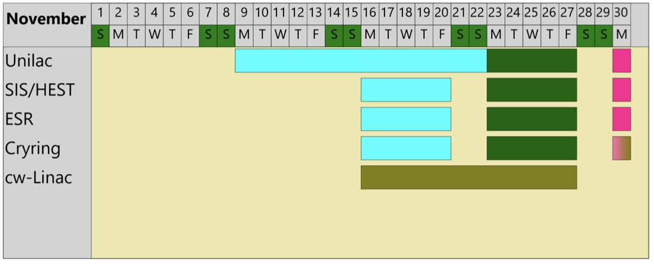
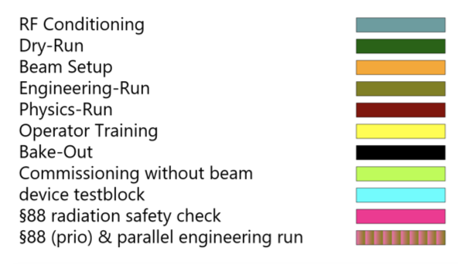
Ion Source Status
Dec 01, 2020
Ion Sources operation
 | TERMINAL NORD | TERMINAL SÜD | HLI
ELEMENT | Ar⁺ | Ar⁺ ,Ar²⁺ | Ar⁸⁺
INTENSITY | 15 mA (avg) (max 18 mA in UH1) | 200 µA | 200 µA (max) 150 µA (avg)
NOTES | Smooth operation without any problem |  | - Stable operation -Two on-call interventions to switch off the ion source

