Slide 1
Effects of overlapped quadrupole fringe fields for HSI-RFQ transverse matching
C. Xiao
UNILAC post stripper upgrade department, GSI

Slide 2
Outline
general introduction
transfer matrix method
introduction of new QQ focusing system
measured one-dimensional field-map including fringe field
Mathcad program
comparing of results of hard edge and fringe field models
conclusion

Slide 3
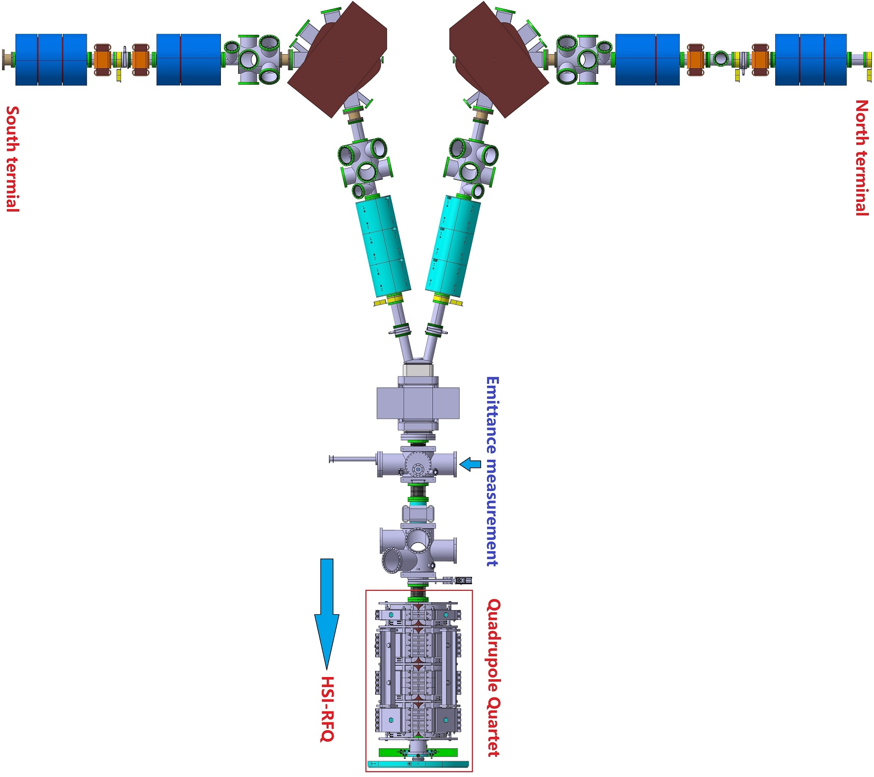
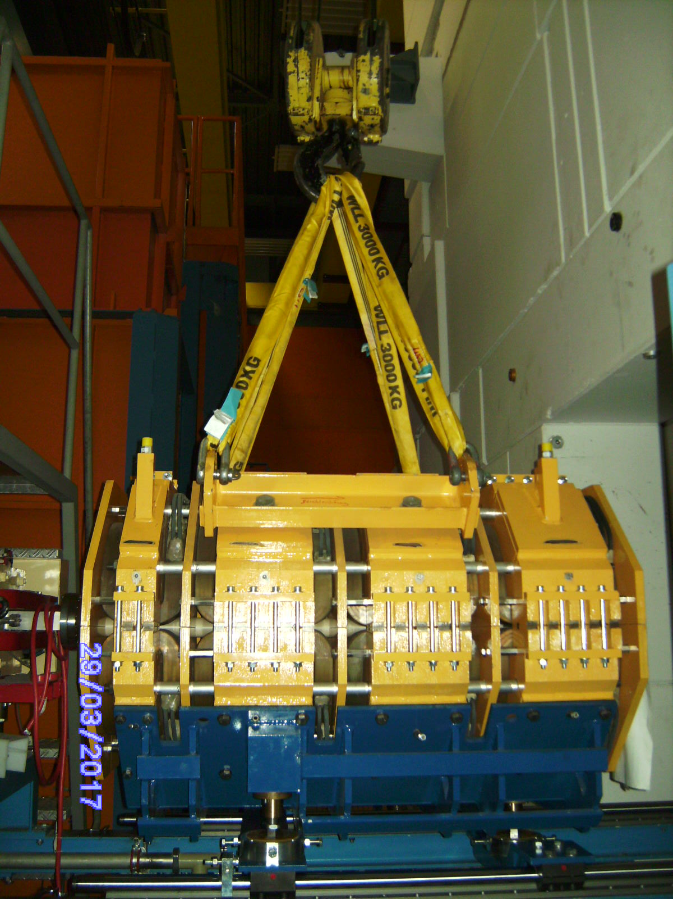
HSI-LEBT and quadrupole quartet (QQ)

Slide 4
General introduction
1: replacement of the QQ by a new one
5: vary the proposed setting in order to maximize transmission efficiency
2: commissioned with low and high current Argon beam
6: re-simulate all measurements and compare simulations and experiment
3: measuring Twiss parameters in front of the new QQ
7: using the transfer matrix (hard-edge mode) method showed disagreement: best setting (experiment) not as proposed, but 1.075 times the proposed values
4: matching the envelope to the HSI-RFQ, set proposed setting, and measure HSI-RFQ transmission efficiency

Slide 5
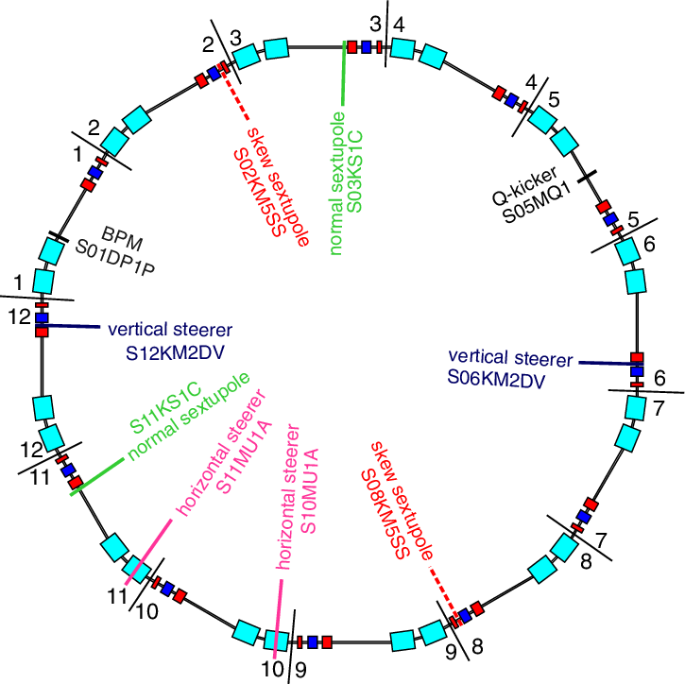
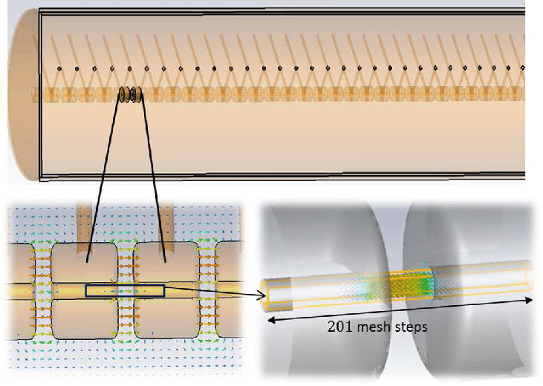
Idea of quadrupole fringe field overlap
No
No
to be investigated
will the overlapped fringe field of quadrupoles reduce the effective values: $G×L$?

Slide 6
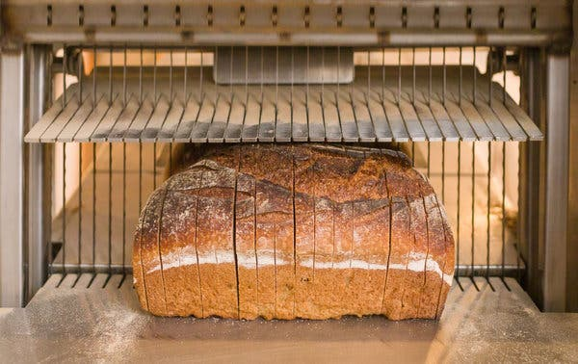
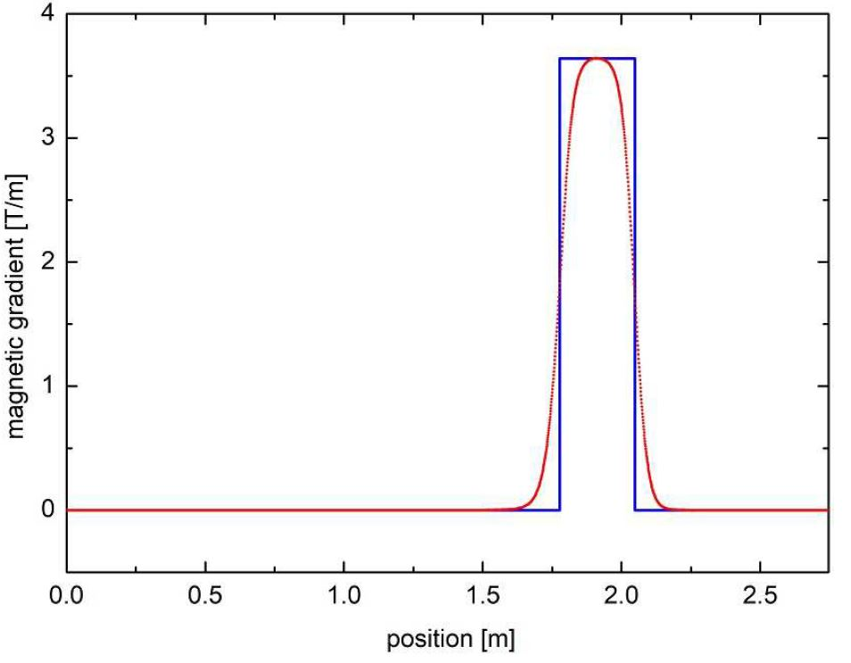
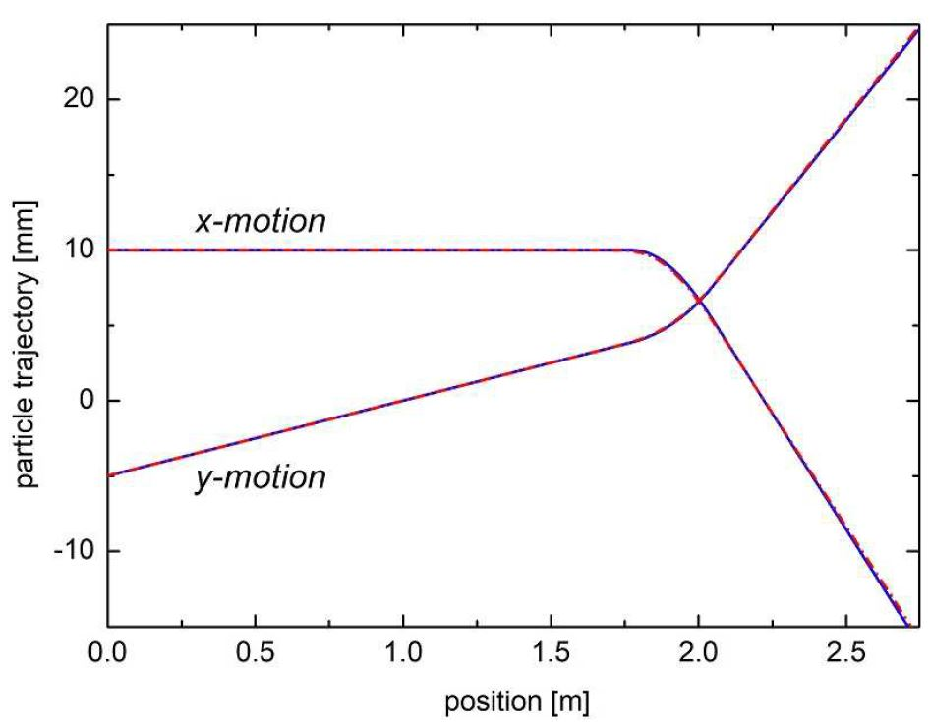
Standard transfer matrix method
$${\left[\begin{matrix}x \\ x′\end{matrix}\right]}_{f}=\left[\begin{matrix}cos\left(kL\right) & \frac{sin\left(kL\right)}{L} \\ −ksin\left(kL\right) & cos\left(kL\right)\end{matrix}\right]{\left[\begin{matrix}x \\ x′\end{matrix}\right]}_{i}$$
$${\left[\begin{matrix}y \\ y′\end{matrix}\right]}_{f}=\left[\begin{matrix}cosh\left(kL\right) & \frac{sinh\left(kL\right)}{L} \\ ksinh\left(kL\right) & cosh\left(kL\right)\end{matrix}\right]{\left[\begin{matrix}y \\ y′\end{matrix}\right]}_{i}$$
$$k=\sqrt{\frac{G}{Bρ}}→$$
$$focusing parameter$$

Slide 7
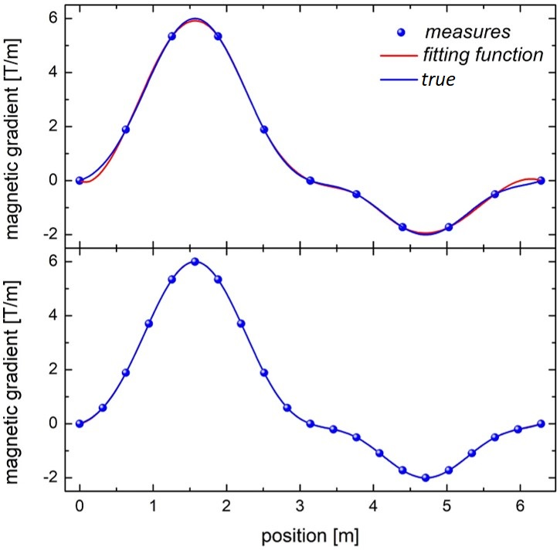
Algorithm of precise fitted function
small step (more measures) means precise fitting
$G\left(z\right)=sin\left(z\right)$+$2{sin\left(z\right)}^{2}+3{sin\left(z\right)}^{3}⁡$
position
$$D=\left[\begin{matrix}z_{1} & G_{1} \\ \begin{matrix}z_{2} \\ \begin{matrix}⋮ \\ z_{n}\end{matrix}\end{matrix} & \begin{matrix}G_{2} \\ \begin{matrix}⋮ \\ G_{n}\end{matrix}\end{matrix}\end{matrix}\right]→\left\{\begin{matrix}Z=D^{\left\langle 1\right\rangle }→1^{st} column \\ G=D^{\left\langle 2\right\rangle }→2^{nd}column\end{matrix}\right.$$
magnetic gradient
a fitting function can be described as
$$Fit\left(z\right)=interp\left(F,Z,G,z\right)$$
a cubic spline non-linear function can be
written
$$F=cspline\left(Z,G\right)$$

Slide 8
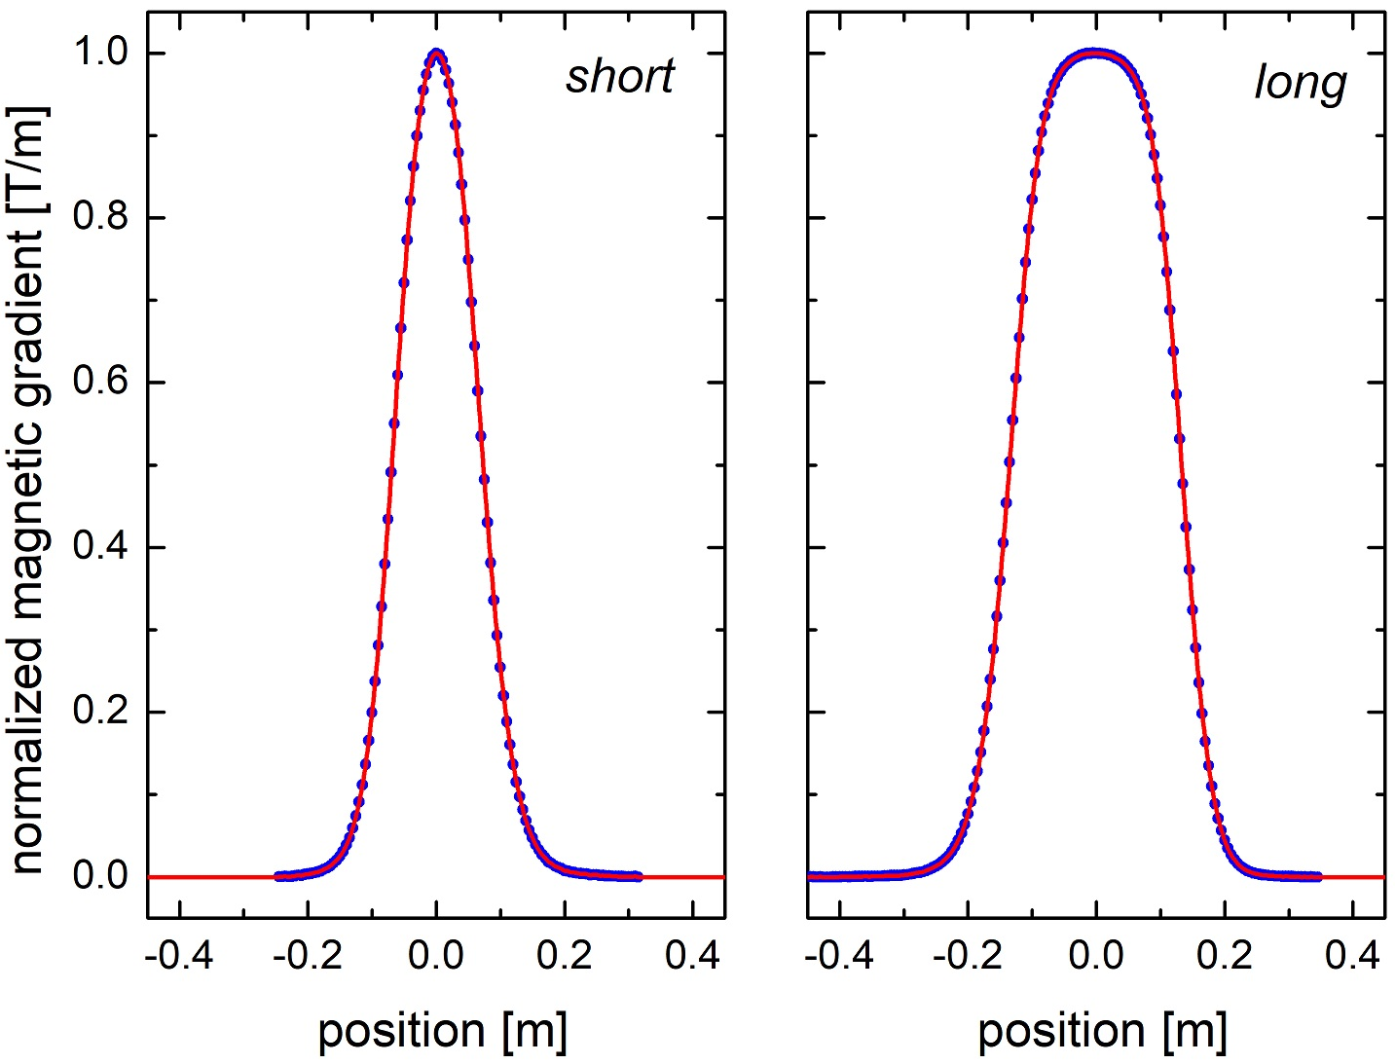
Measured field maps of the QQ quadrupoles
courtesy F. Kloos et al.
effective length of quadrupole is calculated as
$$L=\frac{\int_{z_{start}}^{z_{end}}{Fit\left(z\right)}dz}{Fit\left(z=0\right)}$$
$$Fit\left(z=0\right)$$
maximum gradient
numerical integration of cubic spline fitted function
$$L\left(S\right)=0.1505 m L\left(L\right)=0.2713 m$$

Slide 9
Mathcad routine
$$M={{{{{{{{D_{5}∙Q}_{4}∙D}_{4}∙Q}_{3}∙D}_{3}∙Q}_{2}∙D}_{2}∙Q}_{1}∙D}_{1}$$
RFQ entrance
$$D$$
transfer matrix of drift
initial
quad
quad
quad
quad
drift
final
drift
drift
drift
drift
$$Q$$
transfer matrix of quadrupole
target
emittance measurements
$$C_{f}=MC_{i}M^{T}$$
Mathcad
$$C_{i}=\left[\begin{matrix}ε_{x}\left[\begin{matrix}β_{x} & −α_{x} \\ −α_{x} & \frac{1+α_{x}^{2}}{β_{x}}\end{matrix}\right] & 0 \\ 0 & ε_{y}\left[\begin{matrix}β_{y} & −α_{y} \\ −α_{y} & \frac{1+α_{y}^{2}}{β_{y}}\end{matrix}\right]\end{matrix}\right]$$
solution
$$M=M\left(G_{1},G_{2},G_{3},G_{4}\right)$$
target !!!
$$α=1.00 β=0.065 m/rad$$

Slide 10
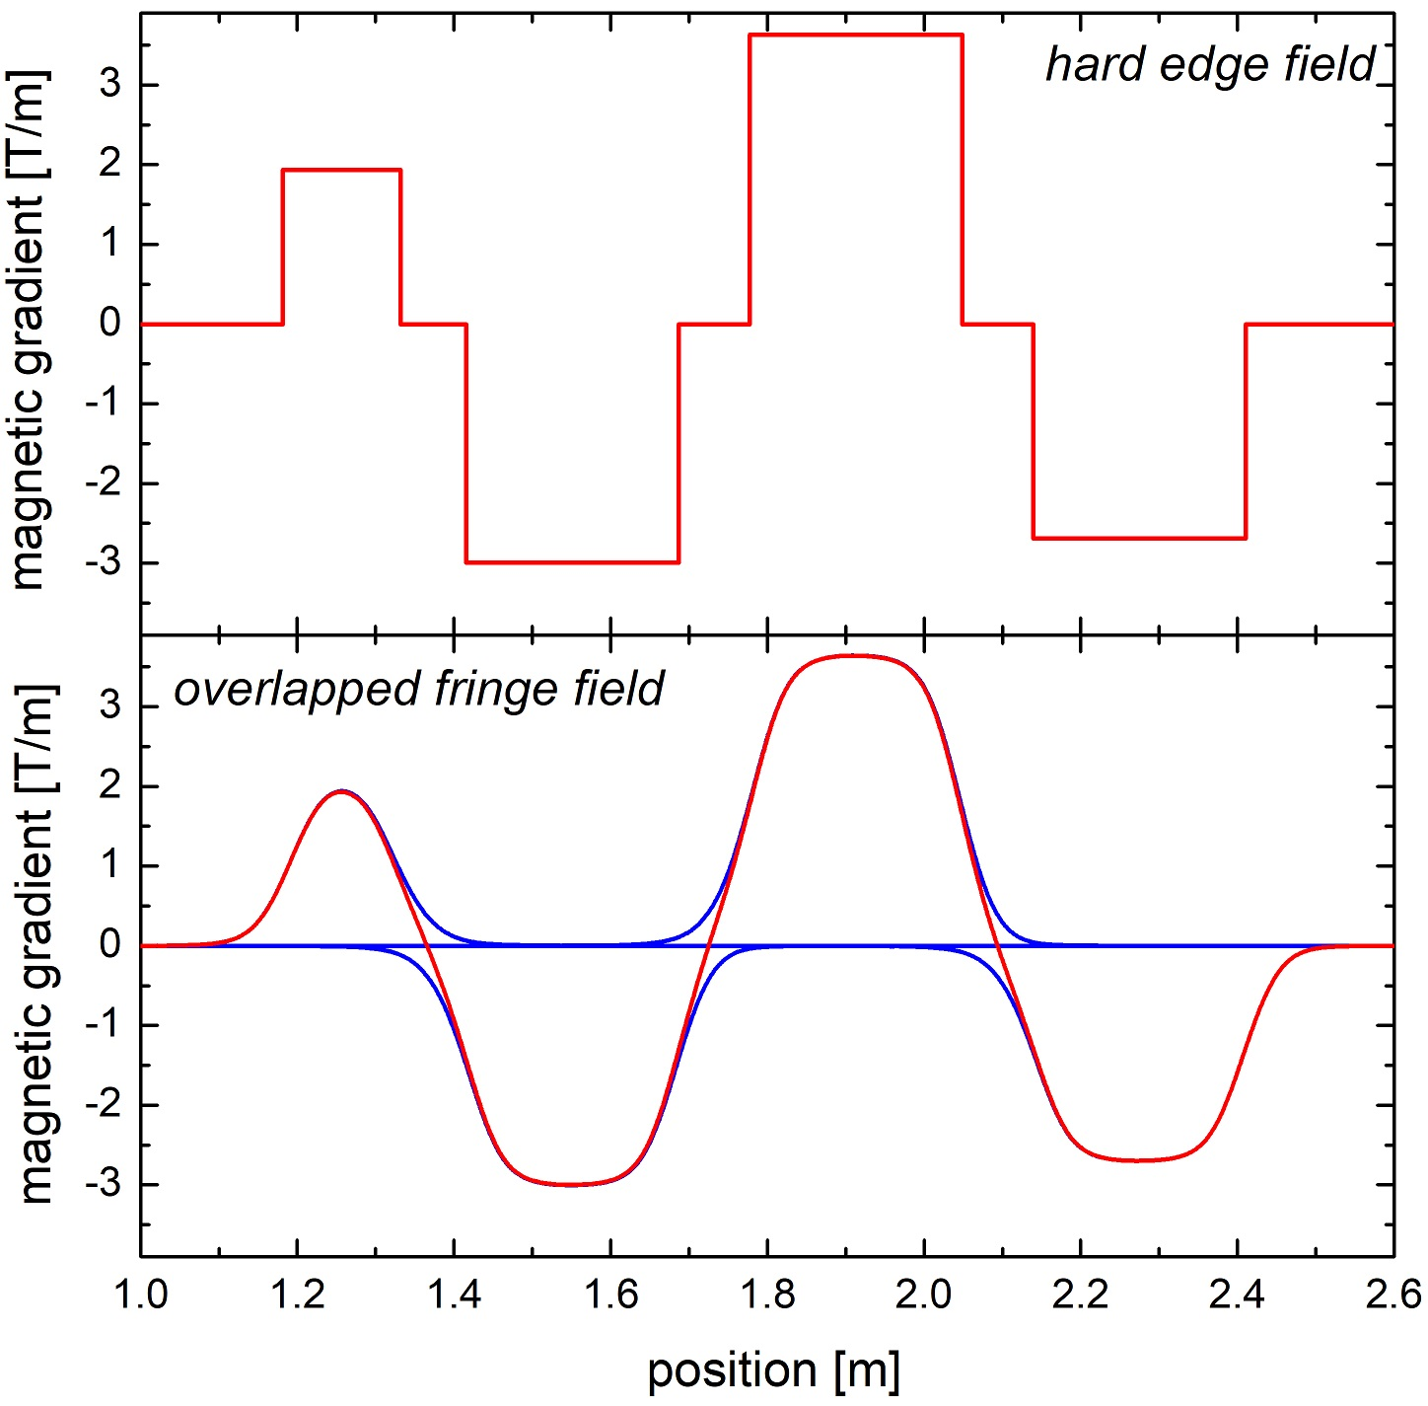
Overlapped fringe field map (${Ar}^{1+}$)
measurements at slit/grid position (in front of QQ)
one dimensional field map
parameter | $ε$[mm mrad] | $$α$$ | $β$ [m/rad]
horizontal | 107.96 | -5.52 | 11.18
vertical | 122.43 | -2.94 | 4.33
basing on the standard transfer-matrix method
$$solution=\left[\begin{matrix}\begin{matrix}G_{1}L_{1} \\ G_{2}L_{2}\end{matrix} \\ G_{3}L_{3} \\ G_{4}L_{4}\end{matrix}\right]=\left[\begin{matrix}\begin{matrix}−0.2920 \\ +0.8144\end{matrix} \\ −0.9877 \\ +0.7317\end{matrix}\right]$$
setting #0
transported parameters at the HSI-RFQ entrance
parameter | $ε$[mm mrad] | $$α$$ | $β$ [m/rad]
horizontal | 107.96 | 1.03 | 0.065
vertical | 122.43 | 1.00 | 0.065

Slide 11
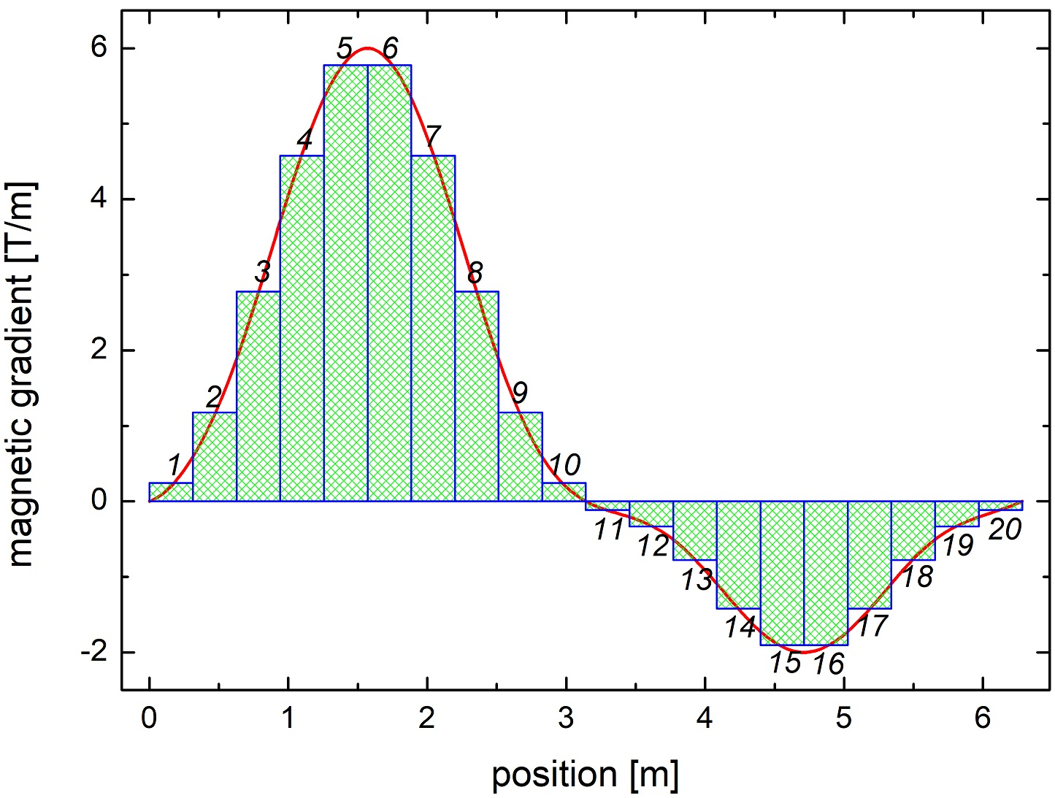
Multiplying all slice matrices from field map
$$N=\frac{L}{s} i=1,2⋯N j=1,2⋯N$$
divided in to many slices
$$G_{i}=\frac{\int_{\left(i−1\right)∙s}^{i∙s}{G\left(z\right)}}{s}dz$$
multiplying all slice matrices
decomposition of an actual quadrupole field profile into many segments of hard edge quadrupoles
$$M_{j}=\prod_{j=j}^{1}{M\left(G_{j},s\right)}$$

Slide 12
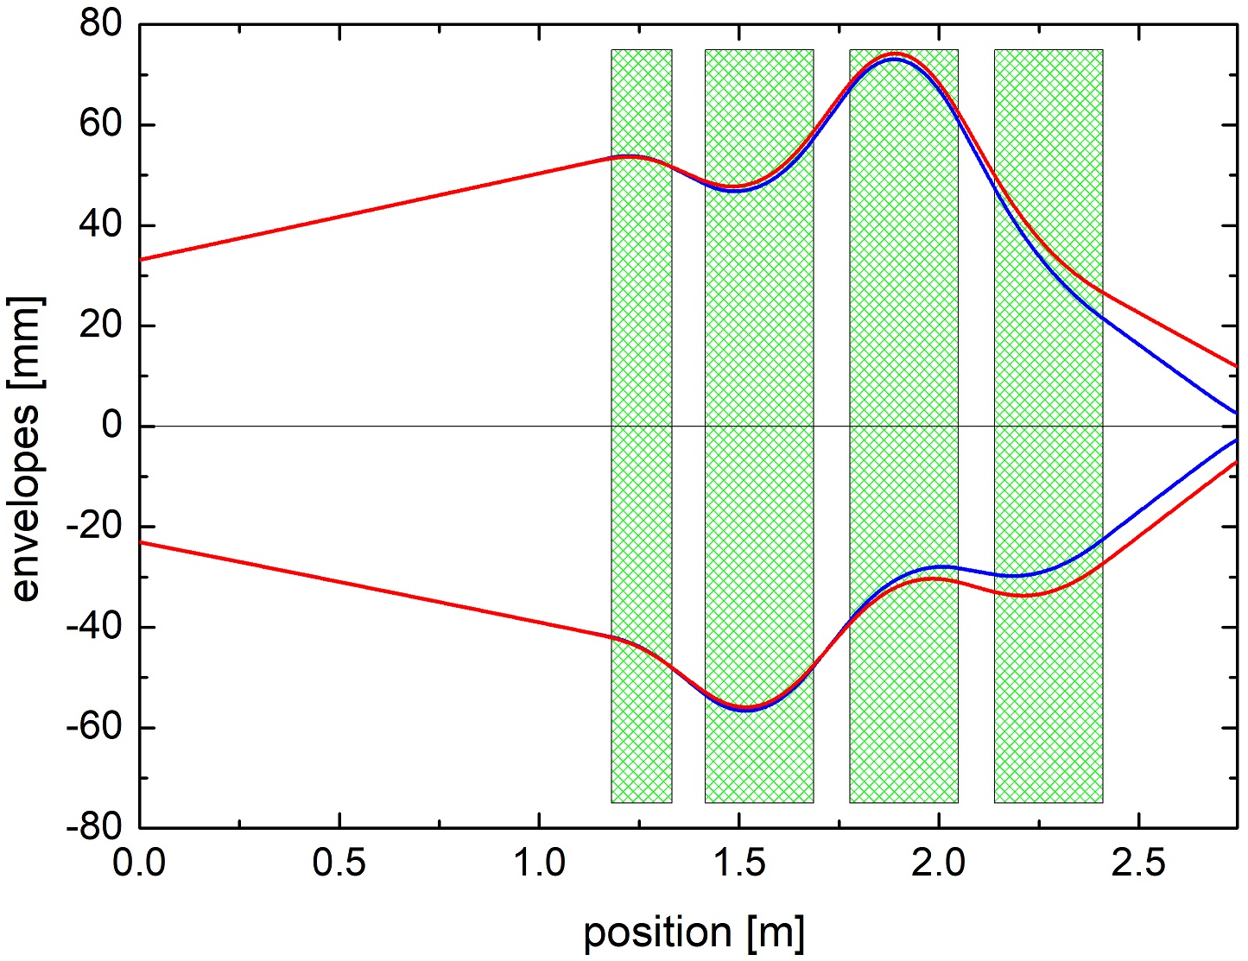
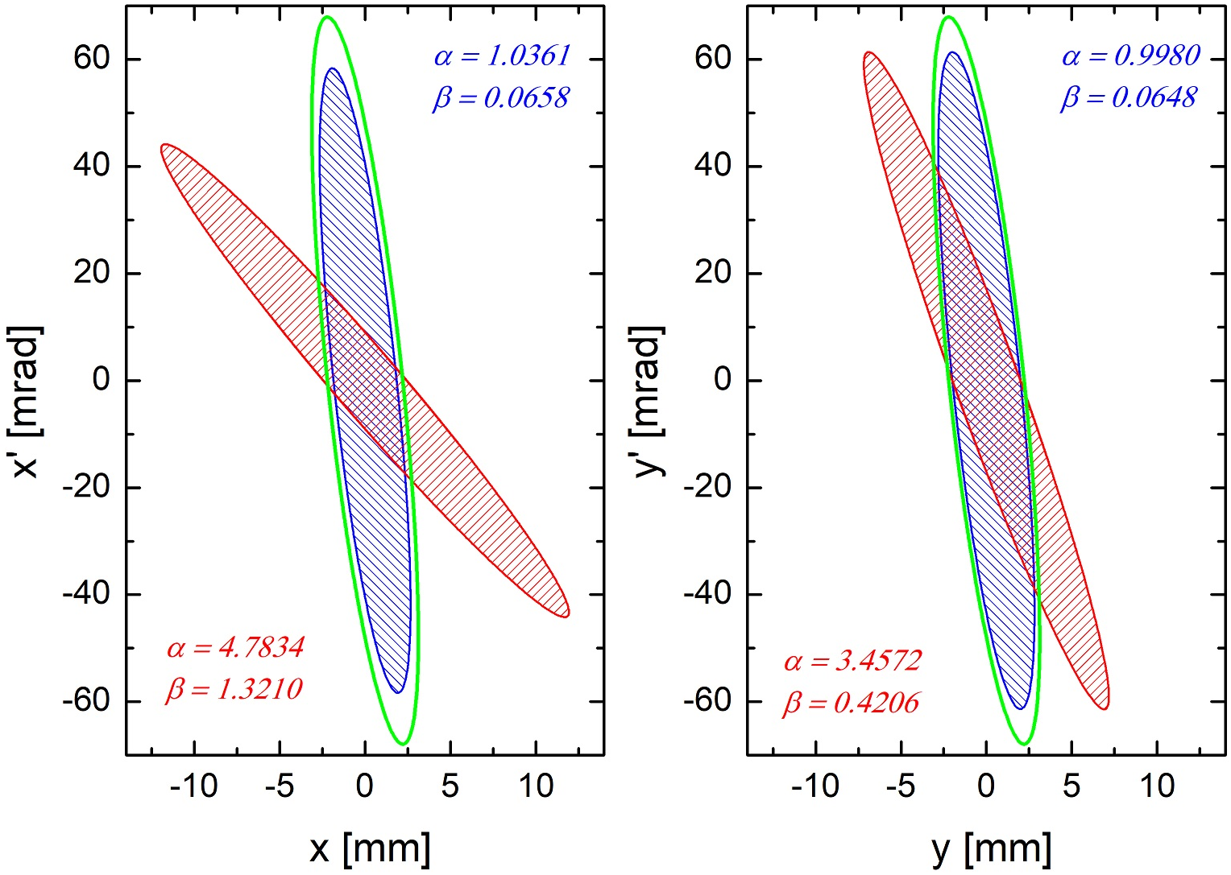
Simulated beam envelopes
setting #0 has been used (assumes hard edge fields!)
the corresponding hard edge field mode and overlapped fringe field mode have been simulated for comparison
target Twiss @ RFQ
$$ε=150 mm mrad$$
$α=1$.0
$β=0.065$ m/rad

Slide 13
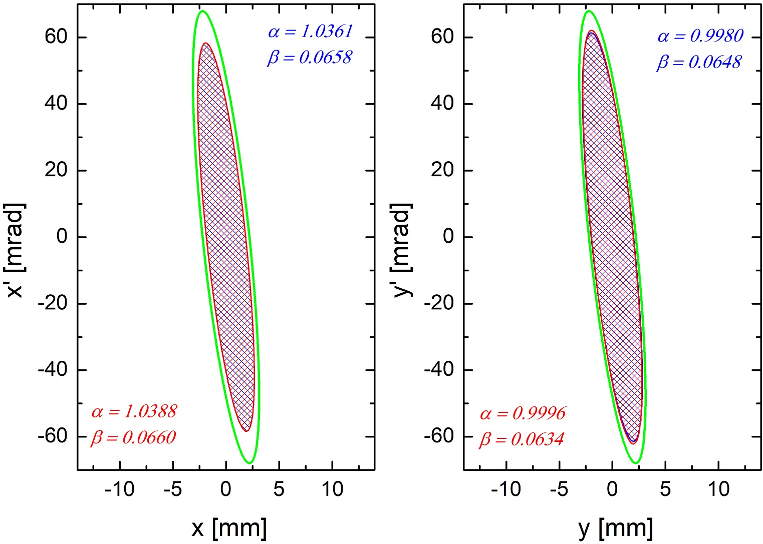
Tuning the quadrupole strengths
target Twiss @ RFQ
$$ε=150 mm mrad$$
$α=1$.0
$β=0.065$ m/rad
two modes has the similar results
$$\left[\begin{matrix}\begin{matrix}G_{1}L_{1} \\ G_{2}L_{2}\end{matrix} \\ G_{3}L_{3} \\ G_{4}L_{4}\end{matrix}\right]=\left[\begin{matrix}\begin{matrix}−0.2920 \\ +0.8144\end{matrix} \\ −0.9877 \\ +0.7317\end{matrix}\right]$$
unchanged
hard edge field mode: all the gradients of quadrupoles are not changed
factor
overlapped fringe field mode: all gradients of quadrupoles are multiplied by factor of 1.069
setting #0

Slide 14
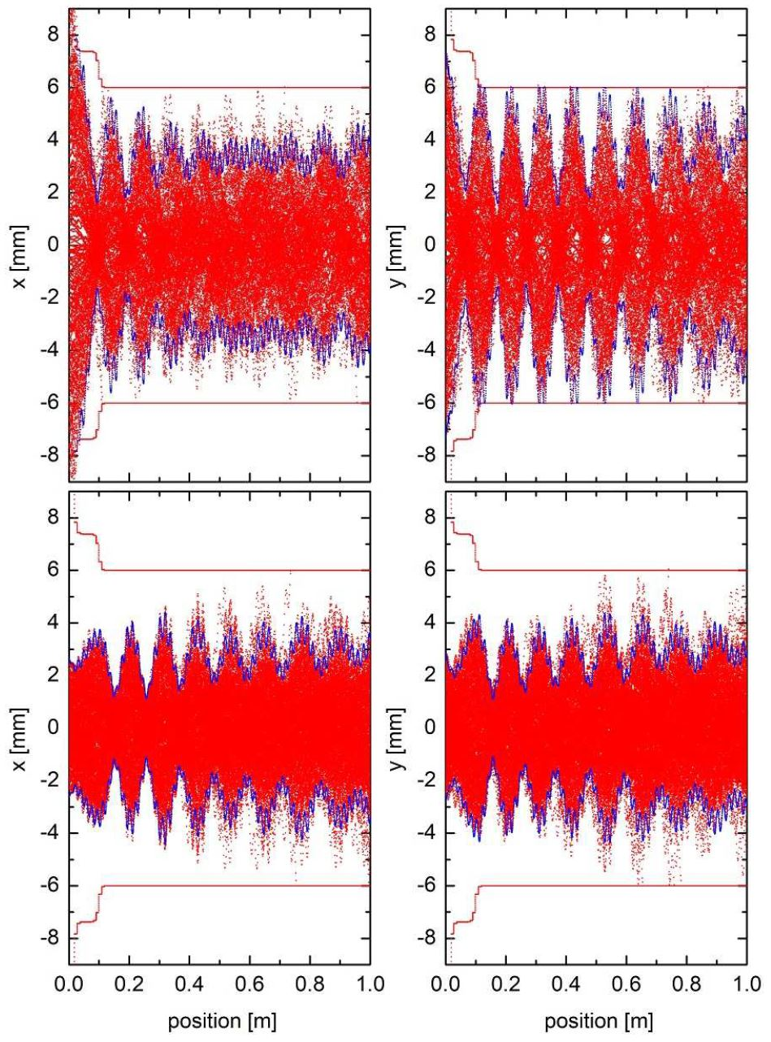
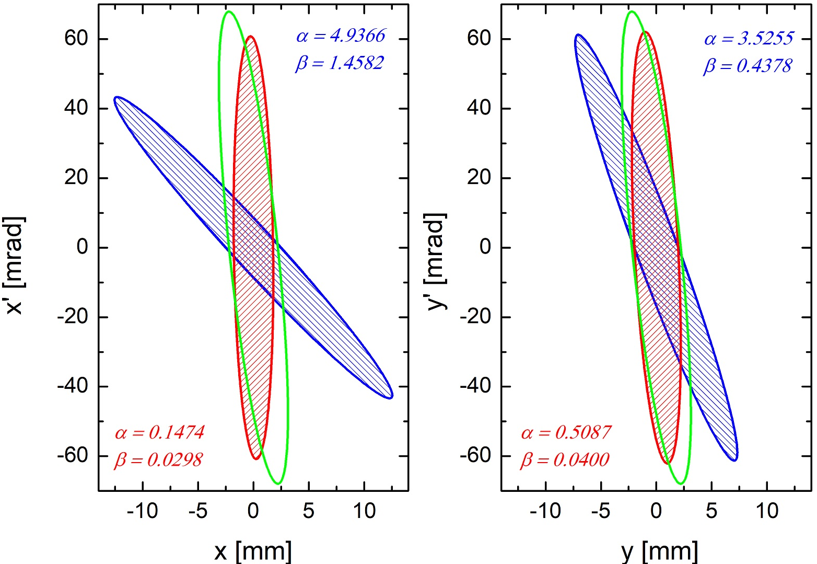
Experiment using high current ${Ar}^{1+}$ beam
setting #1: designed gradients from hard edge field
setting #2: scaled gradients from overlapped fringe field
both settings simulated with overlapped fringe fields
Setting #1
$$\left[\begin{matrix}\begin{matrix}G_{1}L_{1} \\ G_{2}L_{2}\end{matrix} \\ G_{3}L_{3} \\ G_{4}L_{4}\end{matrix}\right]=\left[\begin{matrix}\begin{matrix}−0.2930 \\ +0.8123\end{matrix} \\ −0.9846 \\ +0.7294\end{matrix}\right]$$
$$\left[\begin{matrix}\begin{matrix}G_{1}L_{1} \\ G_{2}L_{2}\end{matrix} \\ G_{3}L_{3} \\ G_{4}L_{4}\end{matrix}\right]=1.075\left[\begin{matrix}\begin{matrix}−0.2930 \\ +0.8123\end{matrix} \\ −0.9846 \\ +0.7294\end{matrix}\right]$$
Setting #2

Slide 15
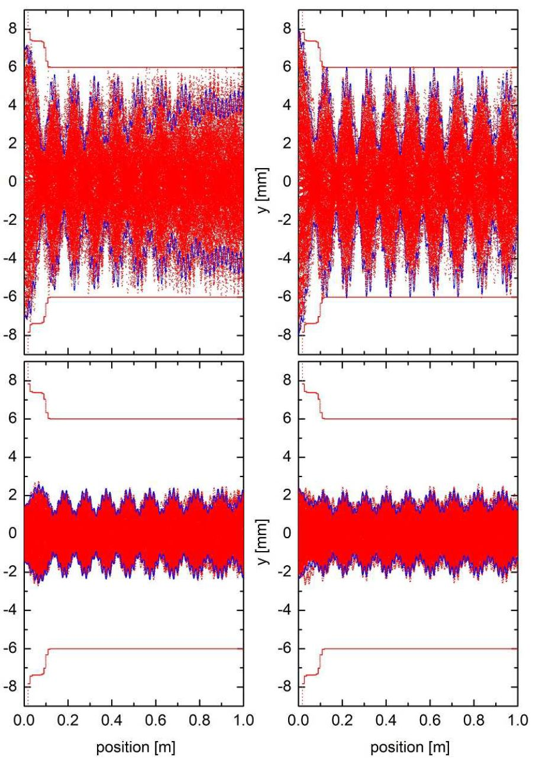
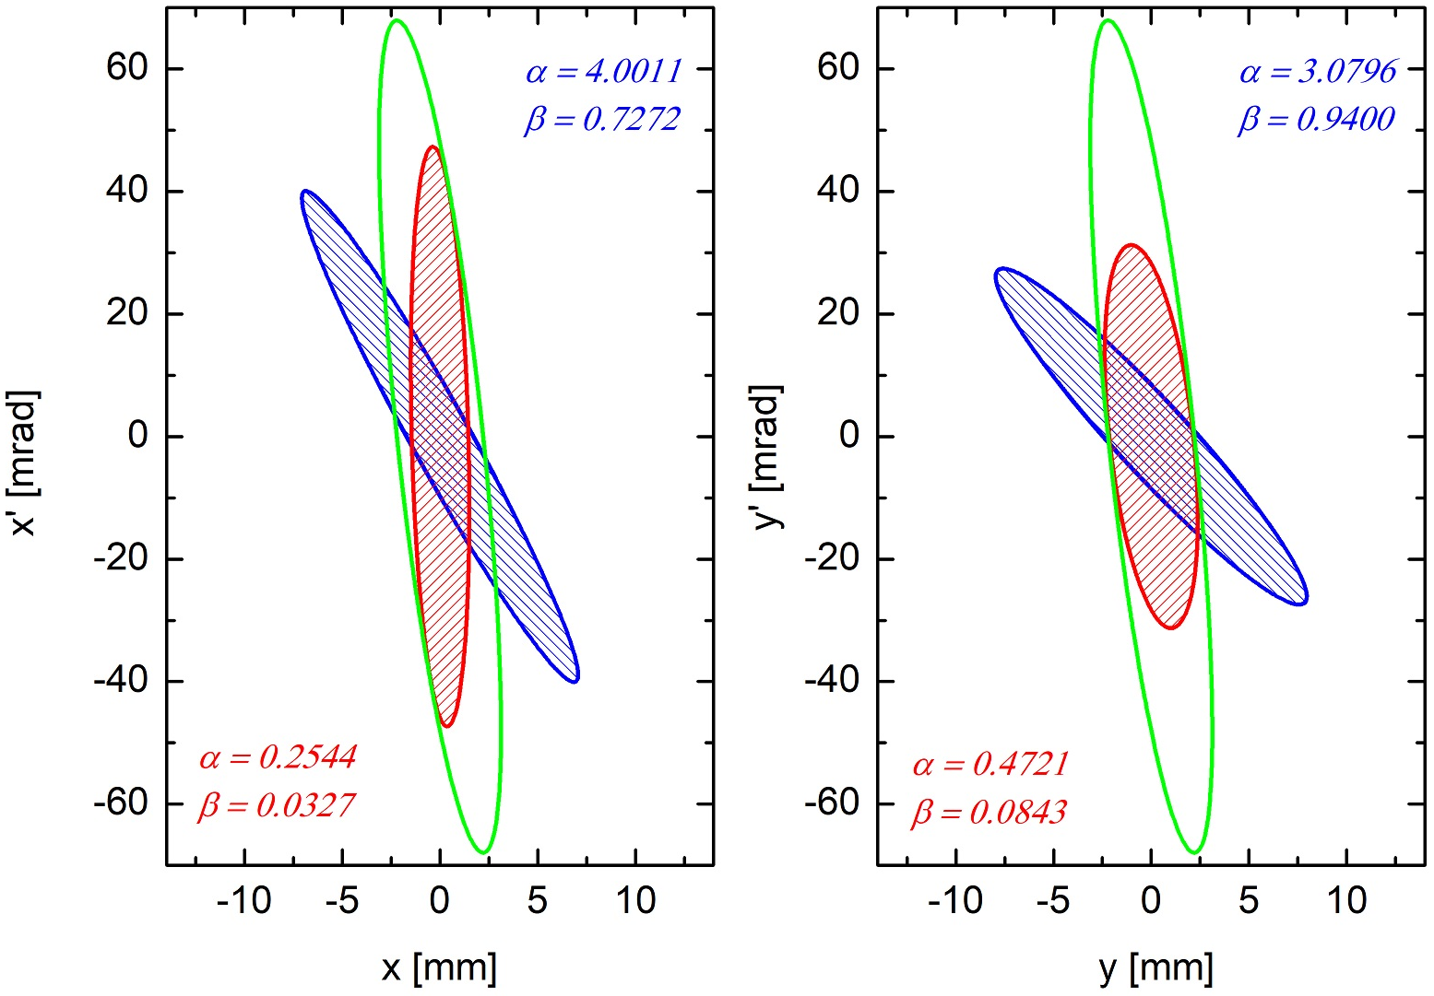
Experiment using low current ${Ar}^{2+}$ beam
setting #3: designed gradients from hard edge field
setting #4: scaled gradients from overlapped fringe field
both settings simulated with overlapped fringe fields
Setting #3
$$\left[\begin{matrix}\begin{matrix}G_{1}L_{1} \\ G_{2}L_{2}\end{matrix} \\ G_{3}L_{3} \\ G_{4}L_{4}\end{matrix}\right]=\left[\begin{matrix}\begin{matrix}−0.2087 \\ +0.4496\end{matrix} \\ −0.4197 \\ +0.1806\end{matrix}\right]$$
$$\left[\begin{matrix}\begin{matrix}G_{1}L_{1} \\ G_{2}L_{2}\end{matrix} \\ G_{3}L_{3} \\ G_{4}L_{4}\end{matrix}\right]=1.075\left[\begin{matrix}\begin{matrix}−0.2087 \\ +0.4496\end{matrix} \\ −0.4197 \\ +0.1806\end{matrix}\right]$$
Setting #4

Slide 16
Exp. and simulated results of LEBT QQ & RFQ
beam currents have been measured before and after the HSI-RFQ
simulations have been done with BEAMPATH code
KV distributions have been assumed at the entrance of the HSI-RFQ
HSI-RFQ transmission efficiency
settings #1 and setting #3: neglecting fringe overlap
settings #2 and setting #4: considering fringe overlap
 | setting #1 | setting #2
simulation | 24.28% | 59.53%
experiment | 28% | 55%
 | setting #3 | setting #4
simulation | 36.99% | 99.53%
experiment | 34% | 100%
high current ${Ar}^{1+}$beam
low current ${Ar}^{2+}$beam

Slide 17
Conclusion
The new QQ at GSI LEBT section is applied to match the Twiss parameters at the RFQ entrance to the required value
The new QQ at GSI LEBT has been investigated using two modes: hard edge mode and field-map mode
A dedicated program basing on MATHCAD has been developed to simulate the above modes through the new QQ section
Fringe field effects of the quadrupole in beam line were often neglected in previous studies
Sharp cut-off approximation of fields (hard edge mode) can be assumed in DTL simulations as quadrupoles are well separated w.r.t. fringe extension
Field imperfections from overlapped fringe fields can significantly affect final Twiss parameters
A specific factor of 1.069 has been determined using field-map mode by simulations. The experimental result of 1.075(25) agrees very well
Thanks for the support and help from our colleagues at GSI

