Slide 1
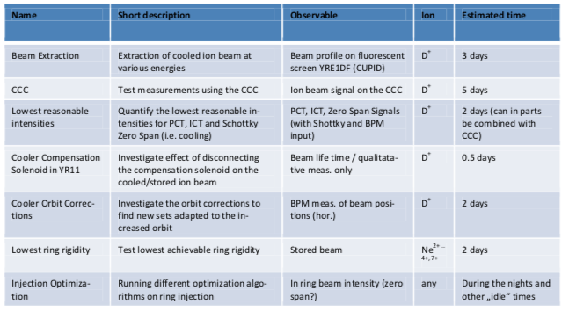
and HITRAP
CRYRING@ESR
CRYRING@ESR
CCC, after final test, installed on its frame into the ring, pumping and baking now
Prepare test run in Nov/Dec for extraction, CCC test and others
Need to move out of HKR to allow for roof repair - efforts ongoing for local control room and office control
BEA - SPS programmer issue unsolved (safety FC…)
HITRAP
Cooling Penning trap work ongoing, ion storage, electron storage
HITRAP recommissioning related Shutdown work for 2021-22 can be handled by Commons departments – Ok from Mr. Menke received.
Linac RF manpower and scheduling discussed, can be handled
Open issues:
DEC manpower - background talks ongoing
Nov-03, 2020
F. Herfurth

