Slide 1
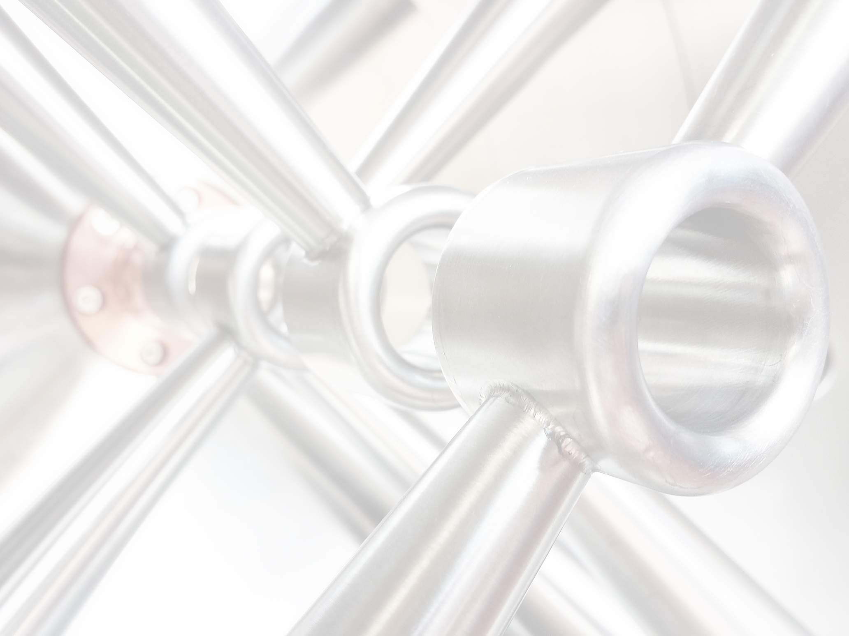


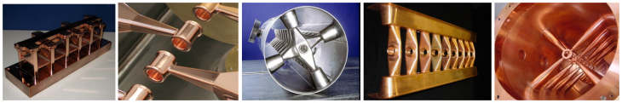

The MYRRHA Project
Challenges for a Reliable High Power Proton Linac
Holger Podlech
IAP / Goethe University Frankfurt, Germany
Notes:
Good Afternoon,…..
Pleasure to give a presentation about the proposal….

Slide 2
Outline
Motivation
Reliability
Design Philosophy
MYRRHA Linac
Conclusion

Slide 3

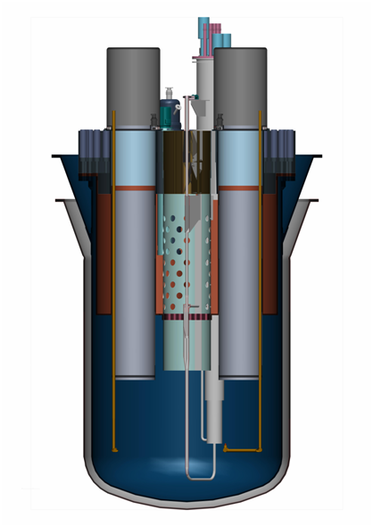
The MYRRHA Project
Fast Reactor
subcritical mode (50-100 MW_{th})
critical mode (~100 MW_{th})
Accelerator
(600 MeV – 4 mA proton)
Aims to demonstrate the large scale feasibility of nuclear waste transmutation
Provides neutrons for various other applications
Spallation source
Fast
neutron
source
Multipurpose flexible
Irradiation facility
Lead-Bismuth
coolant

Slide 4
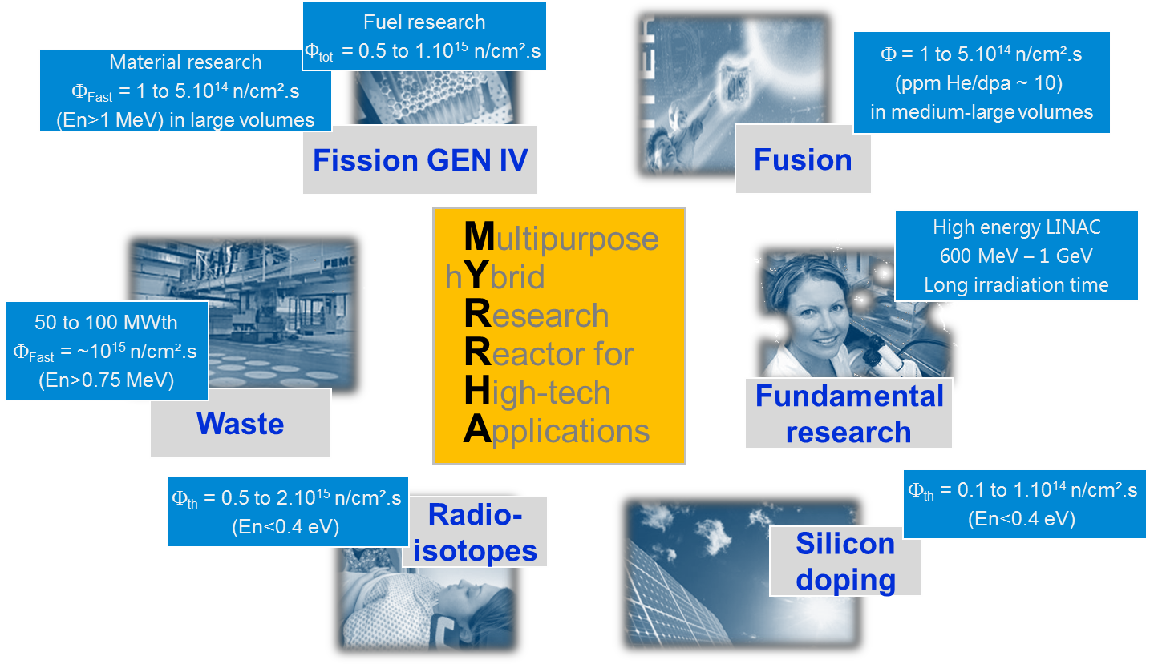
Research @ MYRRHA

Slide 5
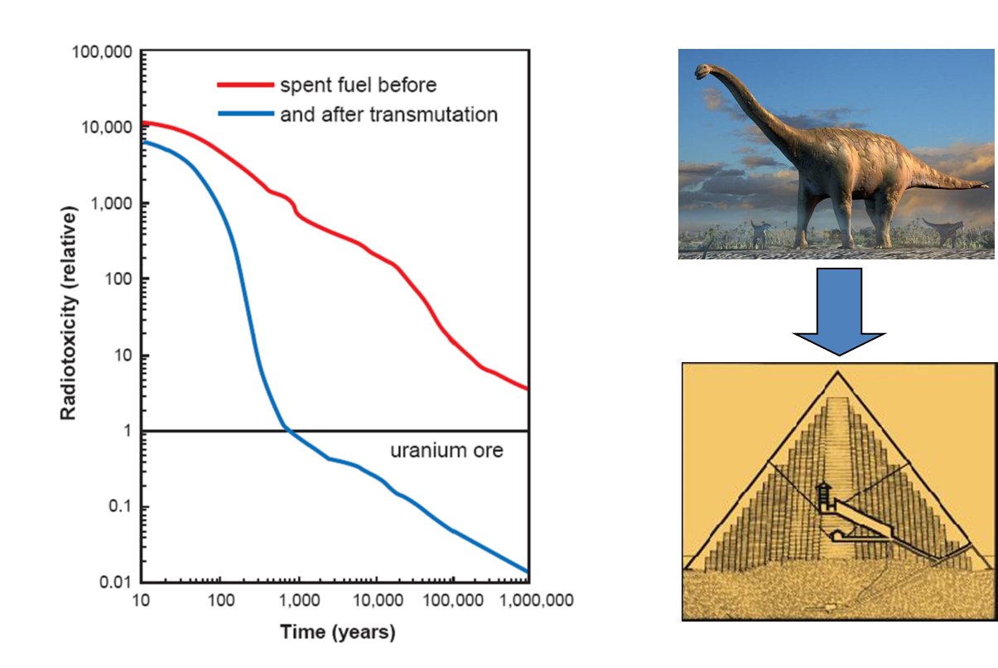
Transmutation @ MYRRHA
Transmutation of radioactive waste
Generation of fast neutrons using a proton accelerator (spallation reaction)
Sub-critical reactor core for fission of minor actinides
95% of the neutrons are produced by fission, 5% are supplied by the accelerator
→ criticality ≈ 0.95

Slide 6
Parameter MYRRHA Linac
Proton energy | 600 MeV
Beam current | 0.1 to 4.0 mA
Beam power | 2.4 MW
Beam duty cycle | 100%
Beam power stability | < ± 2% on a time scale of 100ms
Beam footprint on reactor window | Circular ∅85mm
Beam footprint stability | < ± 10% on a time scale of 1s
# of allowed beam trips on reactor longer than 3 sec | 10 maximum per 3-month operation period
# of allowed beam trips on reactor longer than 0.1 sec | 100 maximum per day
# of allowed beam trips on reactor shorter than 0.1 sec | unlimited
Extreme reliability level

Slide 7
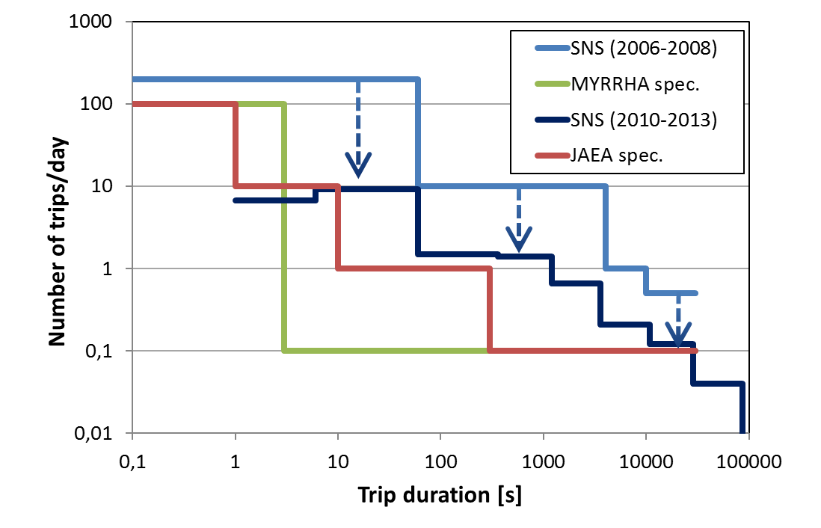
Reliability
Beam trips longer than 3 sec must be very rare:
To minimize thermal stress & fatigue on reactor
structures & fuel assemblies
To ensure an 80% availability: determined by the foreseen reactor start-up procedures
The overall availability (Linac+Reactor) is given by the reliability of the accelerator not by its availability
Conservative design & redundancy

Slide 8
Reliability
Goal: High Reliability
Measures to reach reliability goal:
Conservative Design
Plenty of margin for components
(PS, SSA, cavitiy gradients …)
Beam dynamics
Advanced Control
Plenty of diagnostics
(beam properties, detection of failures and beam loss)
Fault Tolerance
Redundancy
Parallel
Serial

Slide 9
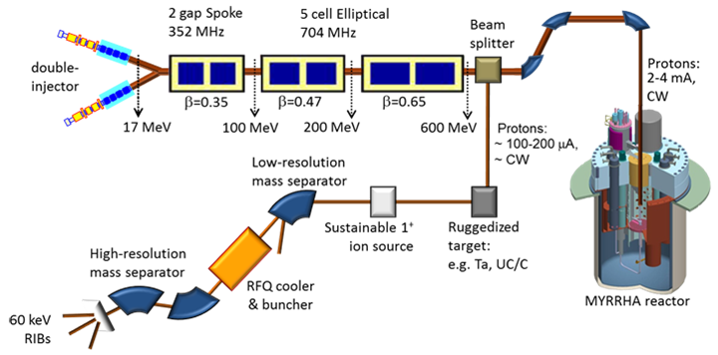
Redundancy
Parallel redundancy: one or more independent systems can provide the requested functionality.
→ Two injectors
Parallel Redundancy
Serial
Redundancy
sc Linac
Serial redundancy: the requested functionality of a given element is ensured by means of dynamic fault compensation by non-failed elements, taking over the load of the failed one.
→ This implies that all elements must be operated well below their nominal performance

Slide 10
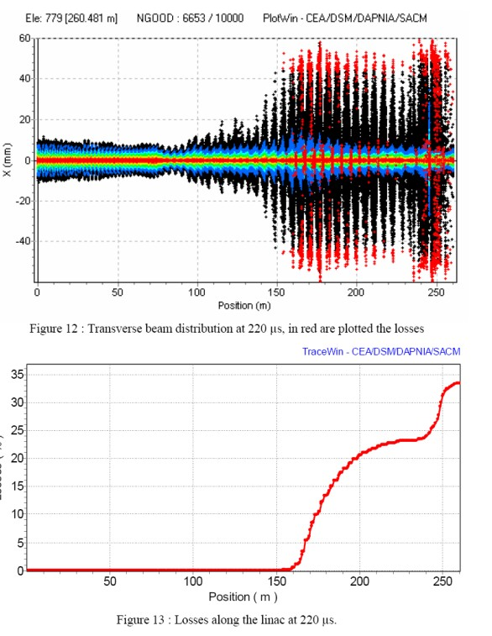
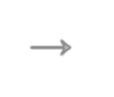





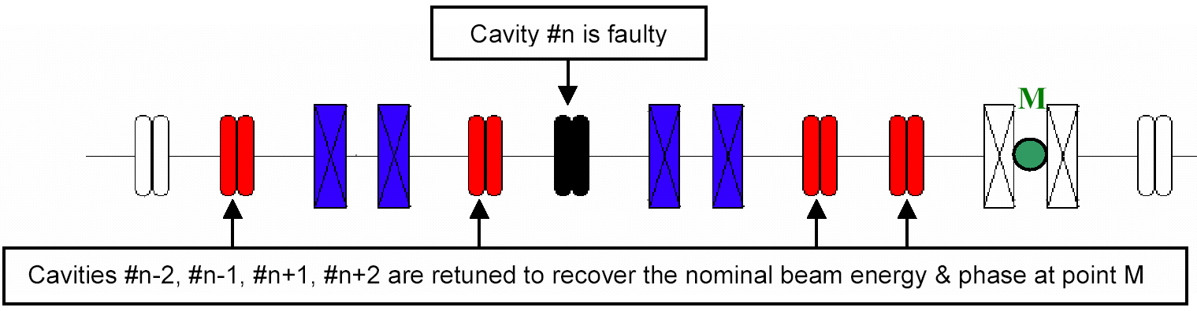
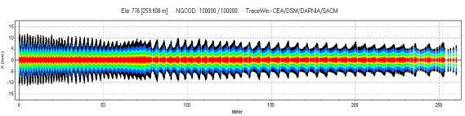
Dynamic Fault Compensation
 New V/φ set-point
cavities adjacent to t
→ Set-points determined application and/or at the c
Failed cavity position
1. A failure is detected anywhere
→ Beam is stopped by the MPS in injector at t₀
→ Need for an efficient fault diagnostic system
2. The fault is localized in a sc cavity RF loop
→ The failed cavity is detuned (to avoid beam loading effect)
3. Neighbouring cavities are retuned (amplitude and phase)
→ Need enough margin for amplifiers
→ Need enough margin for cavity gradients
After fault compensation
4. Once steady state is reached, beam is resumed at t₁ < t₀+3 sec

Slide 11
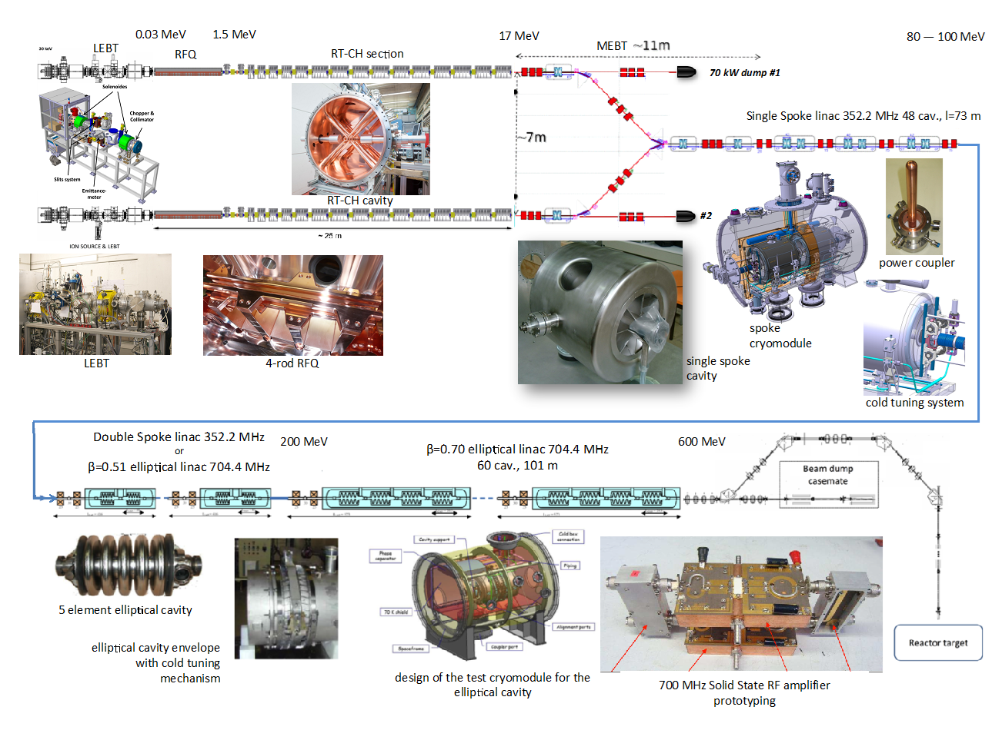
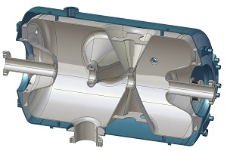
Detailed Overview MYRRHA Linac
Double Spoke Linac
352.2 MHz
ESS type Double Spoke cavity

Slide 12
100 MeV Linac
Decision to build in Mol/Belgium a new large research infrastructure MYRRHA in 2018
Staging of Project
Phase 1 (2019-2026)
Phase 2+3 (2027-2033)
Construction of 100 MeV Linac
and Proton Target Facility
Further R&D on 600 MeV Linac and Reactor
Construction of 600 MeV Linac
Construction of Reactor
The reasons for this approach are to construct, test and operate a representative
section of the MYRRHA accelerator (MINERVA).
This is particularly important with respect to reliability of the MYRRHA Linac and to demonstrate the feasibility of fault compensation.

Slide 13
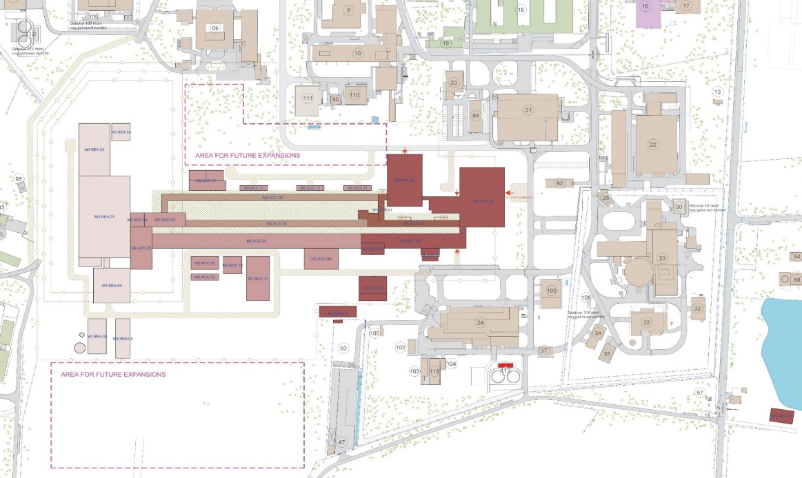
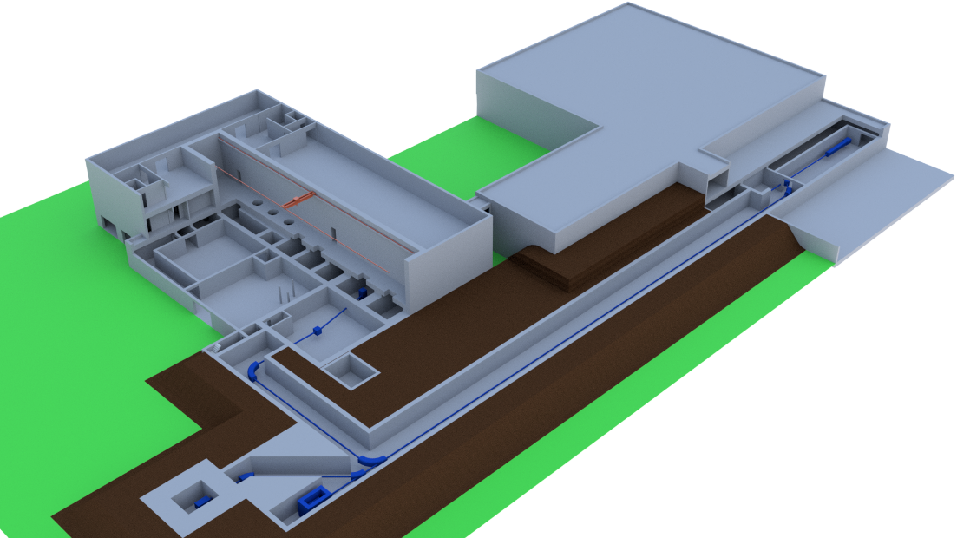
100 MeV Linac
Reactor
Injector
600 MeV
Target Station Facility
MINERVA
BR2
Sc Spoke Linac

Slide 14
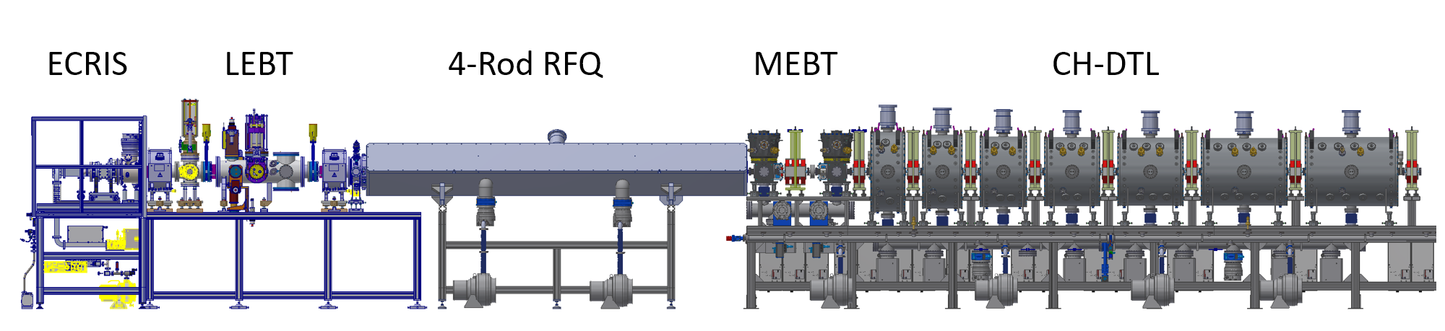
5.9 MeV Injector
The construction of the first part of the MYRRHA injector up to 5.9 MeV has started
First installation at the cyclotron center in Louvain-la-Neuve (Belgium)
30 keV
1.5 MeV
5.9 MeV

Slide 15
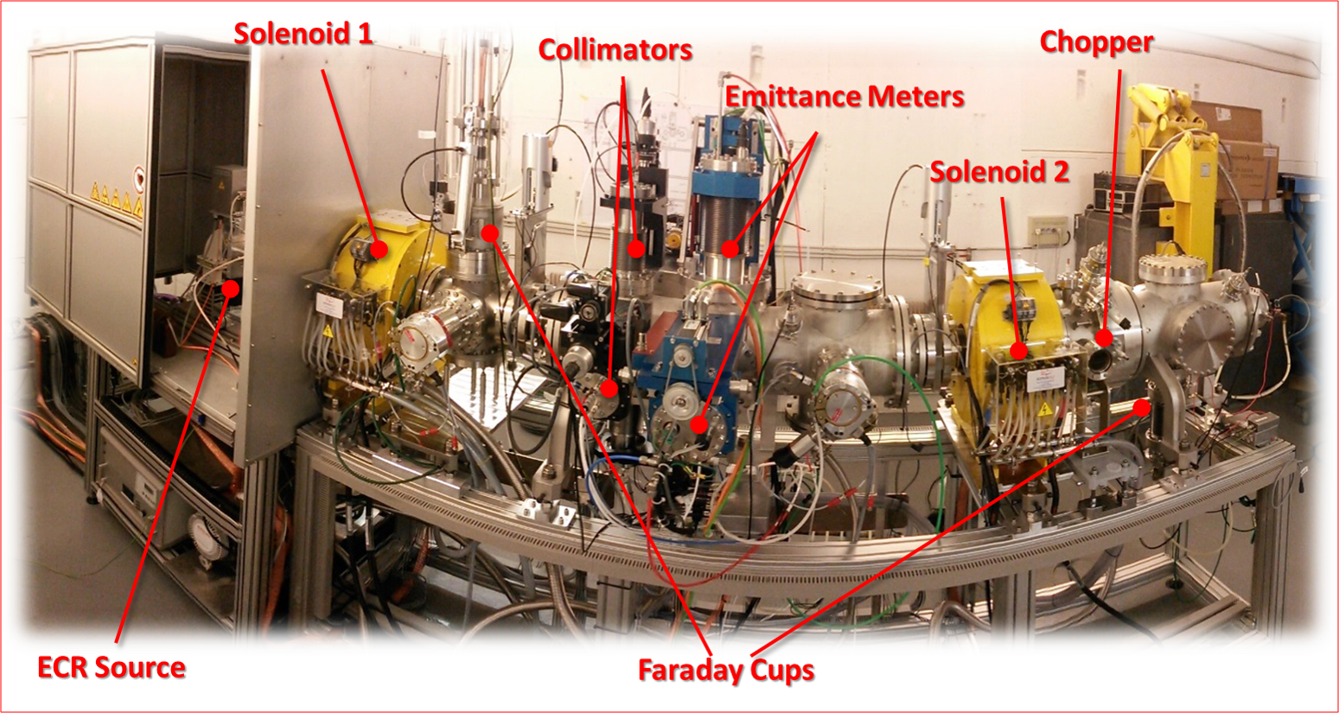
MYRRHA Front-End
F. Bouly, LPSC Grenoble, CNRS

Slide 16
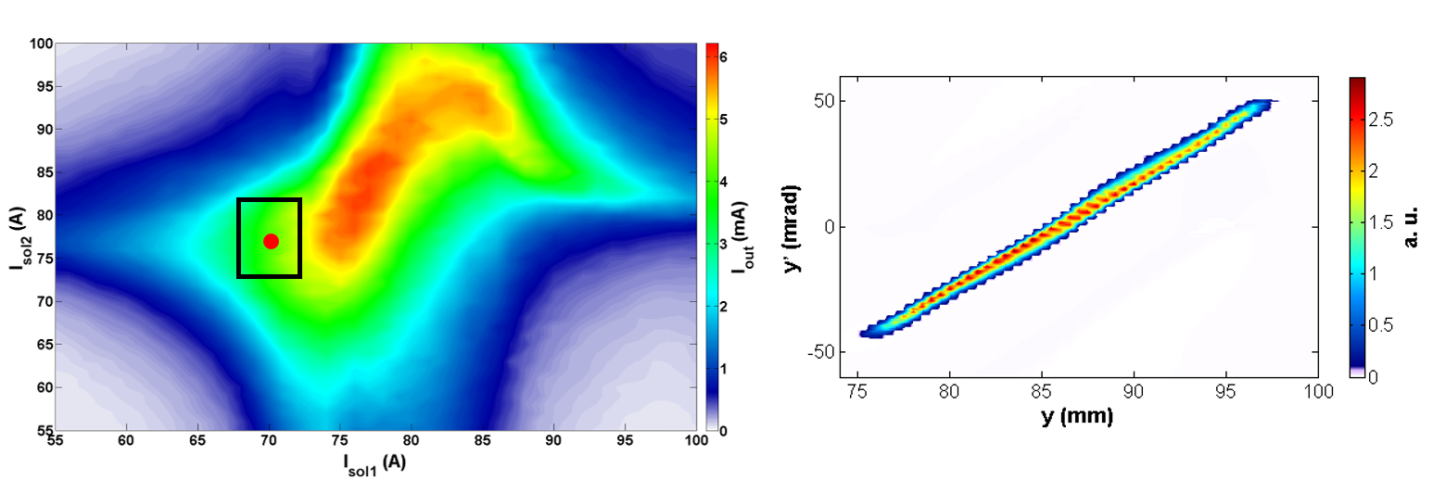
Tuning of the MYRRHA Front-End
Maximum transmission with minimum emittance
Optimization of beam parameter for RFQ injection
Systematic investigation of beam transport
Space charge experiments
Front-End has been fully characterized
ε_{rms,N} < 0.2 π mm mrad at RFQ entrance
F. Bouly, LPSC Grenoble, CNRS
F. Bouly, LPSC Grenoble

Slide 17
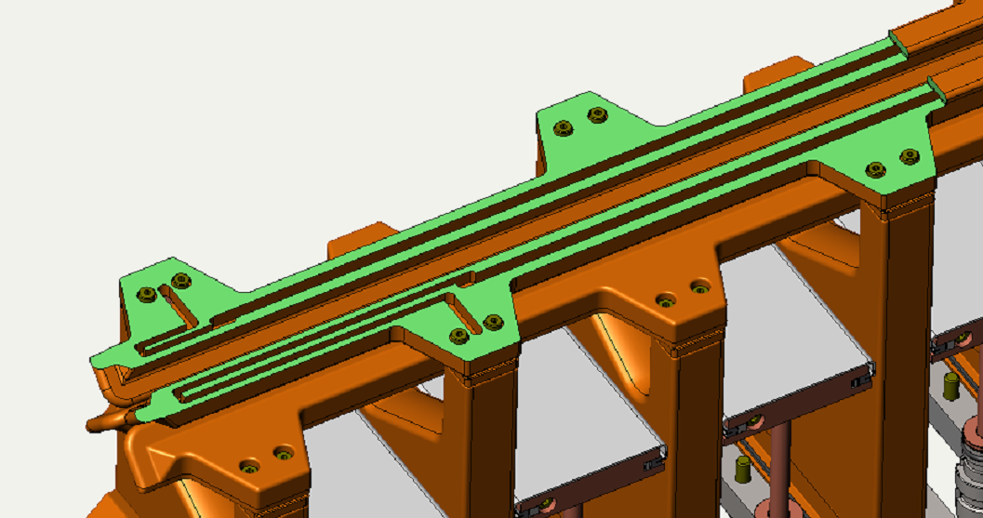
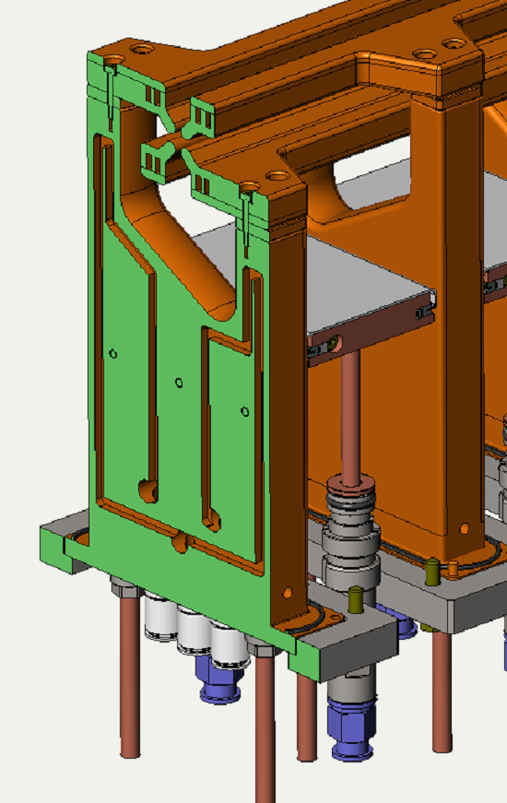
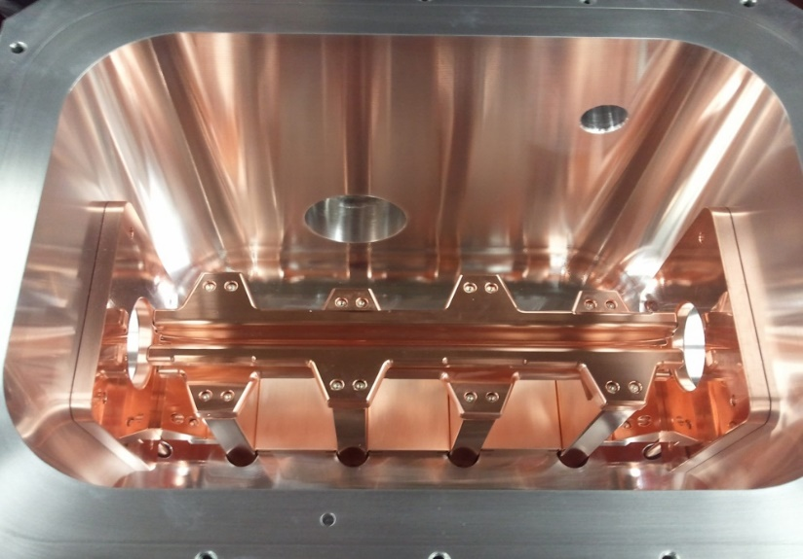
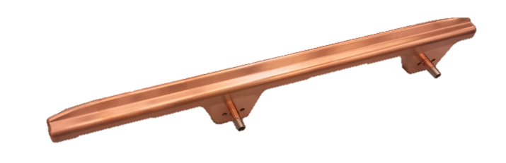
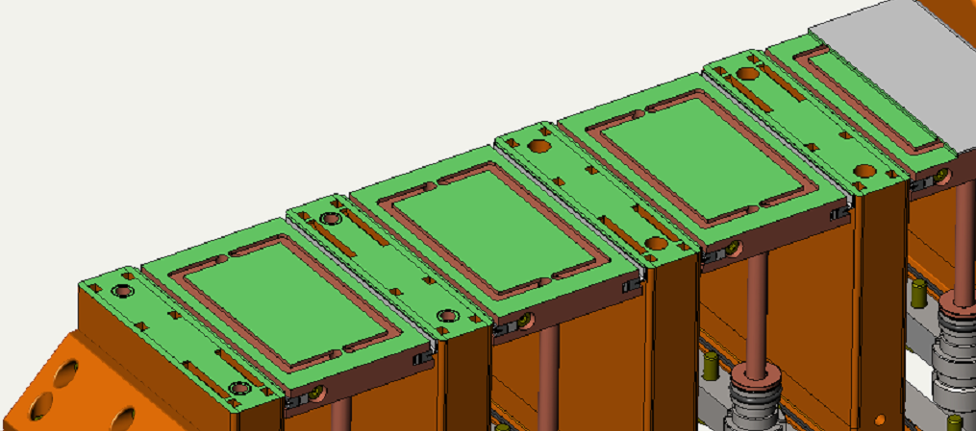
MYRRHA RFQ
A 4-Rod RFQ has been chosen with conservative design
Moderate voltage: 44 kV
Moderate thermal load: 26 kW/m
Well improved cooling
Beam dynamics optimization with emphasis on longitudinal phase space
Optimized cooling channels
Short prototype has been tested up 120 kW/m cw

Slide 18
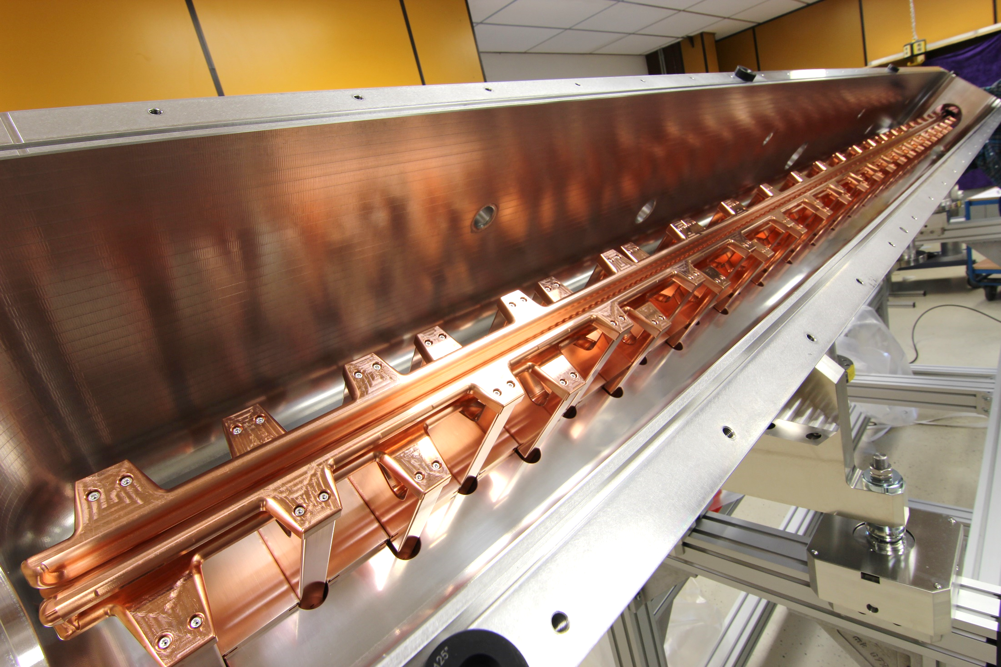
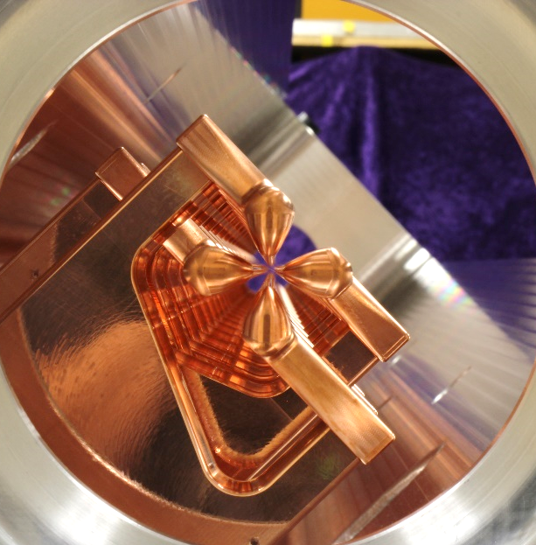
MYRRHA RFQ
Parameter | Value | Unit
RF Structure | 4.Rod | ---
Frequency | 176.1 | MHz
Beam current | 5 | mA
Duty factor | 100 | %
E_{out} | 1.5 | MeV
R_{p} | 72 | kΩm
RF Power with beam | 113 | kW
Specific power loss | 26.5 | kW/m
Voltage | 44 | kV
Length | 4 | m

Slide 19
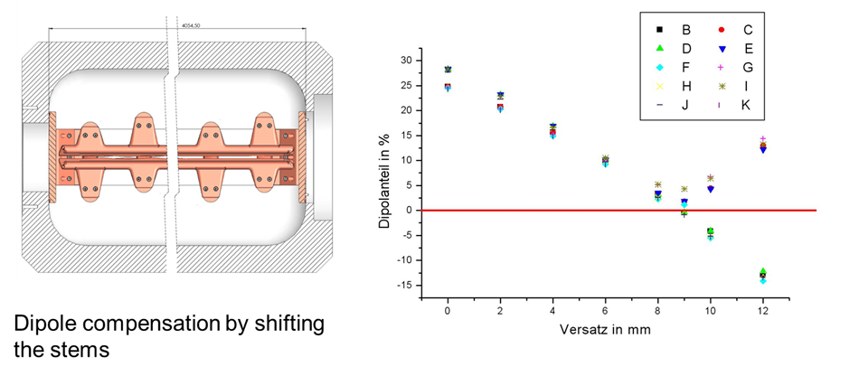
MYRRHA RFQ
Worldwide the first 4-Rod RFQ with full dipole compensation

Slide 20
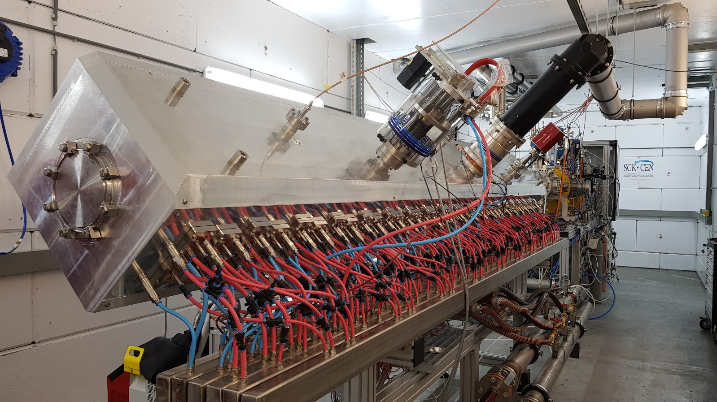
MYRRHA RFQ
MYRRHA RFQ in LLN prepared for high power tests

Slide 21
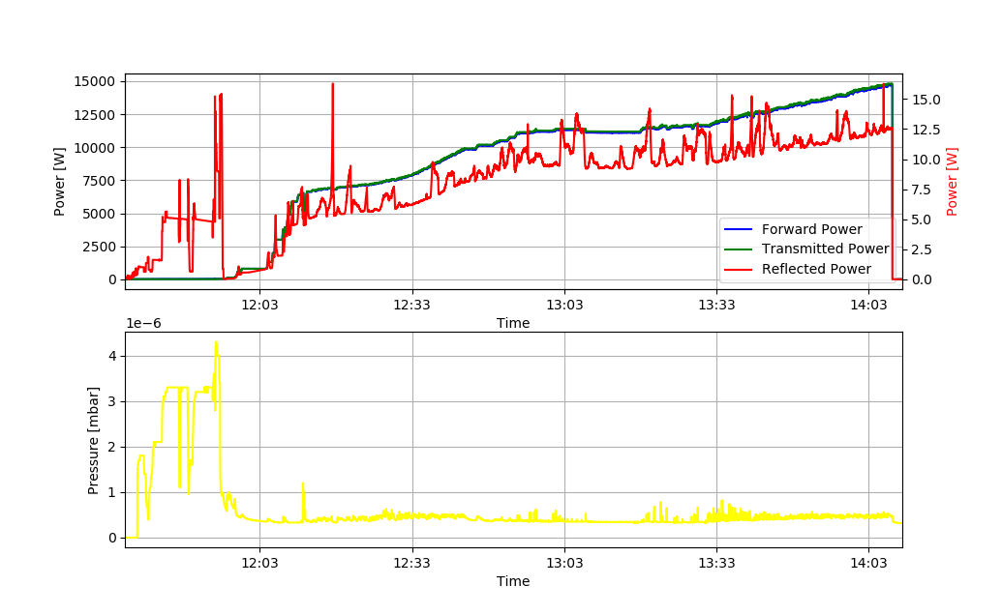
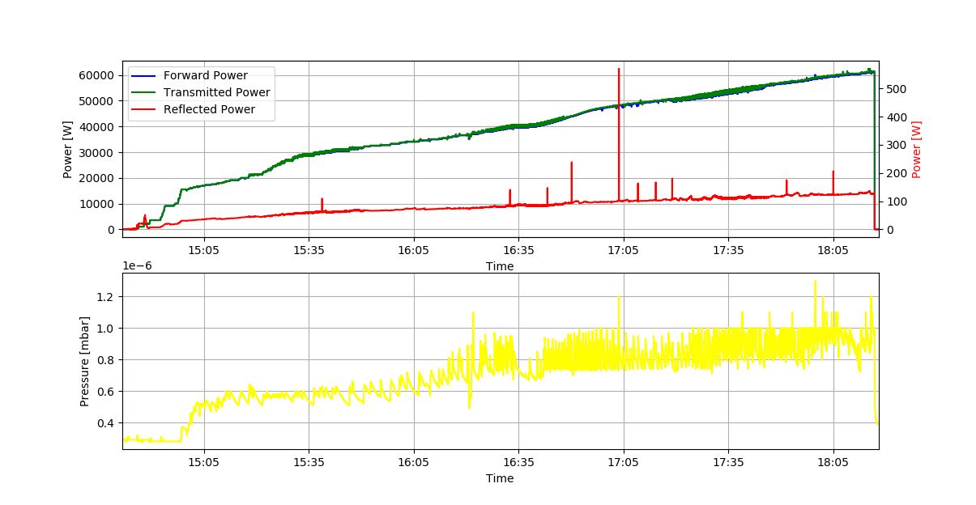
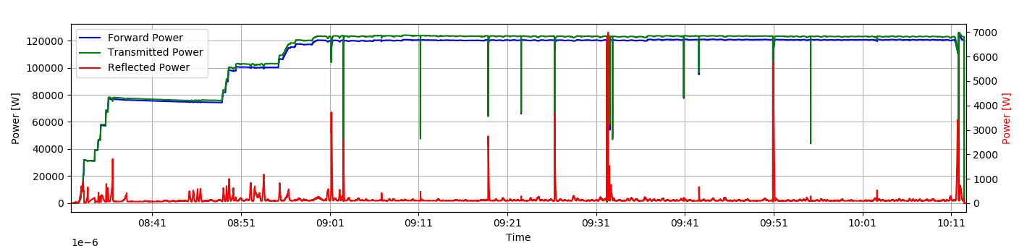
Conditioning of the MYRRHA RFQ
The RFQ requires about 108 kW RF power (losses)
Conditioned up to 145 kW cw
Conditioning time about 10 work days
First beam test in 2020:
95% Transmission

Slide 22
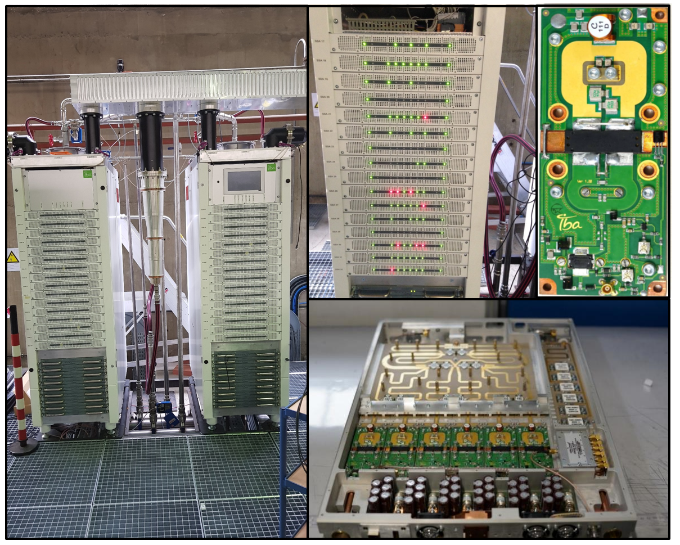
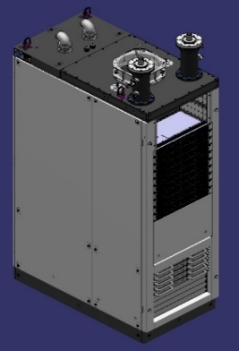
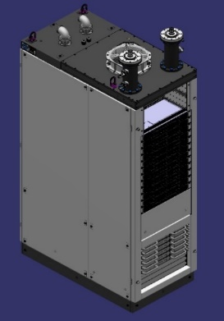
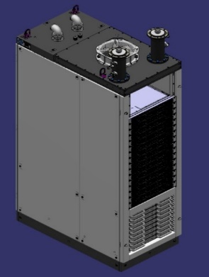
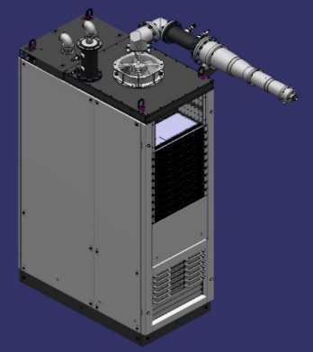
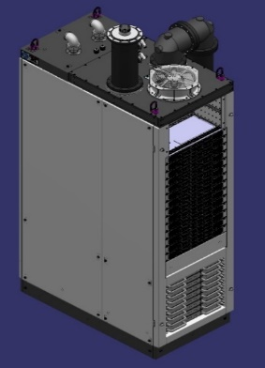
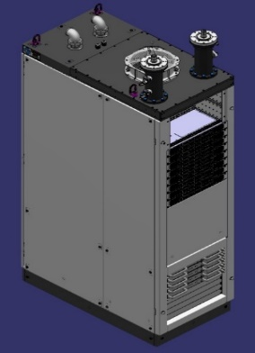
Solid State RF Power Amplifier
RF Power Amplifiers
The RF system is very critical wrt to reliability
Solid state amplifiers can provide high reliability
SSA for the RFQ has been built and tested
P=192 kW cw
All amplifiers have the same architecture
  → 6 kW RF pallets (6 transitors, MRF1K50N)
  → commercial power supplies (Astrodyne) in parallel
M. Abs, J. Brison, IBA
QWR1&2 (2 x 6 kW) CH1&2 (2 x 24 kW) 176 MHz | CH3&4 (2 x 36 kW) 176 MHz | CH5&7 (2 x 48 kW) 176 MHz | CH6 (60 kW) 176 MHz | Coupler test (80 kW) 352 MHz | Cryomodule test (2 x 20 kW) 352 MHz

Slide 23
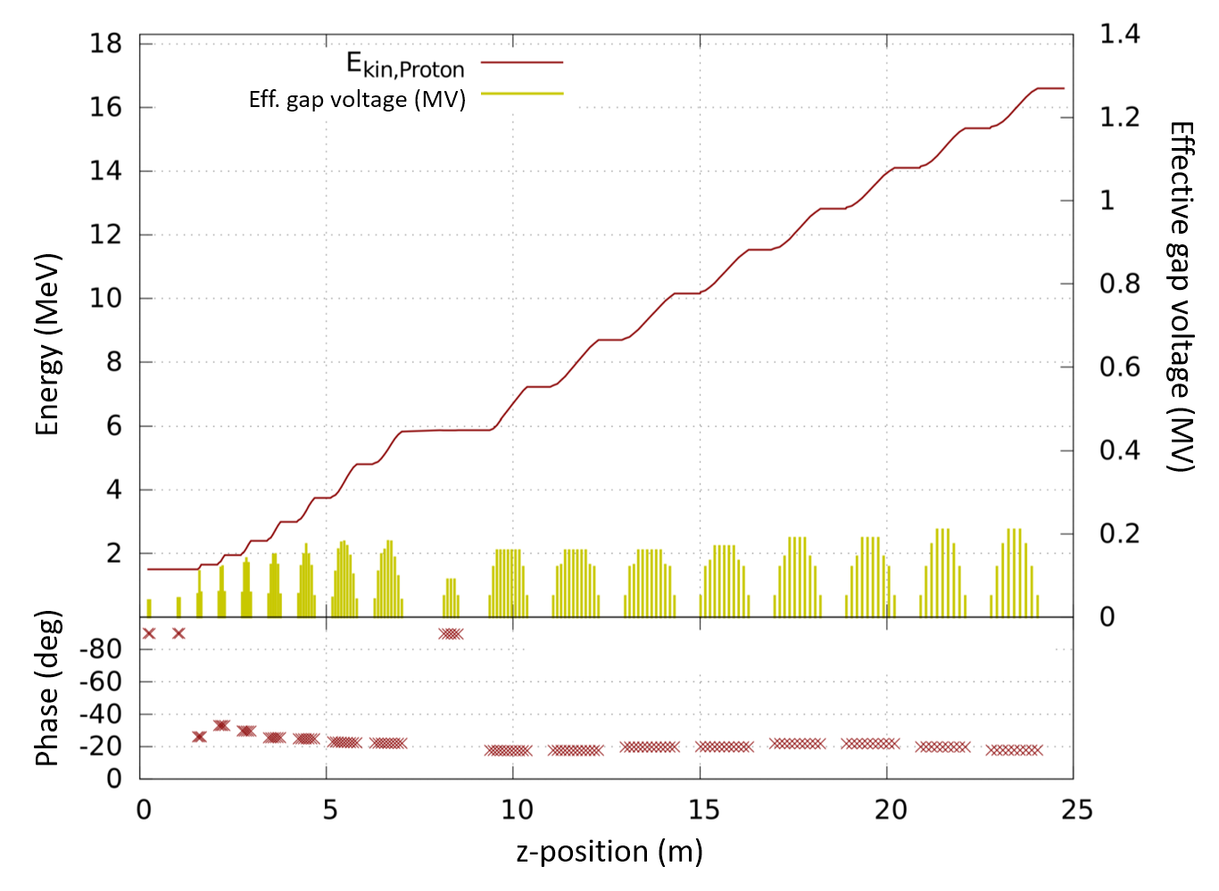
CH-DTL
Design philosophy Injector DTL
As conservative a necessary, as efficient as possible
The injector DTL is based on rt CH-cavities
15 cavities are used (+ 1 CH-rebuncher)
Conservative beam dynamics (const. synch. phase)
Quasi-periodic lattice (doublets between cavities)

Slide 24
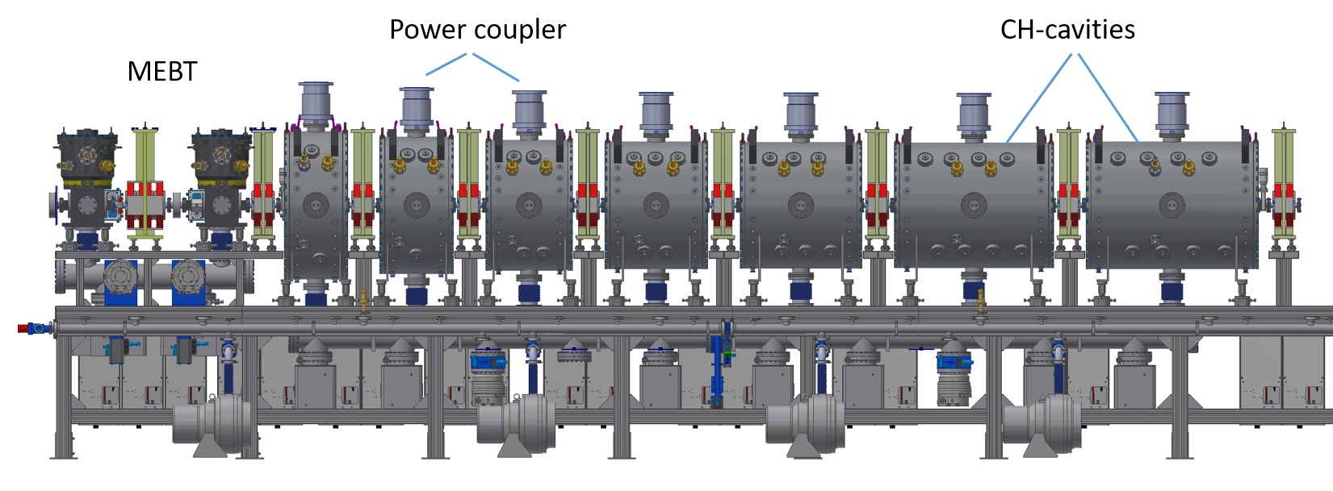
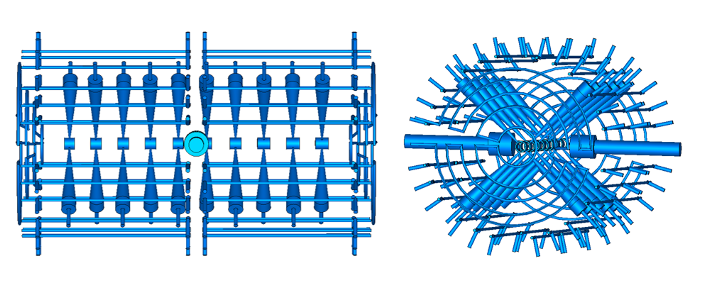
CH-DTL
First CH-DTL section up to 5.9 MeV presently under construction
MEBT components constructed and delivered
CH 1+2 and QWR 1+2: conditioned
All quads delivered
All Power couplers deliverd
Cavity cooling

Slide 25
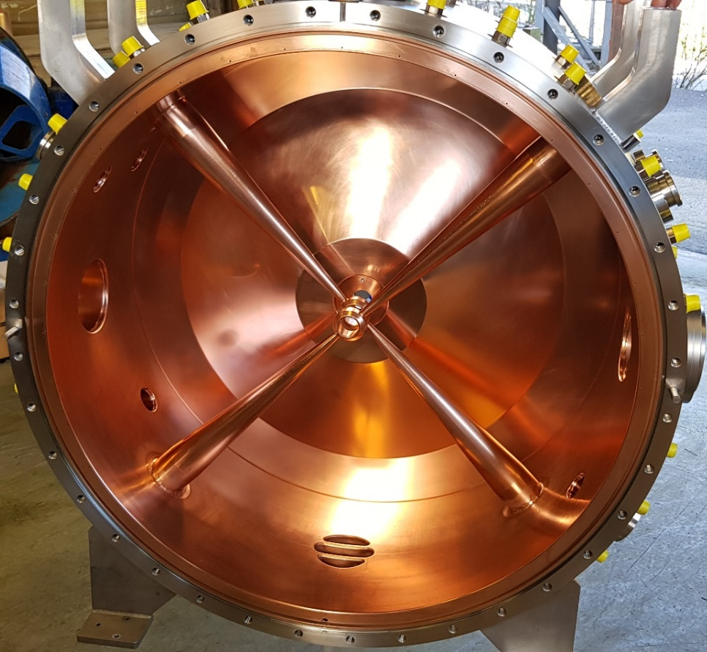
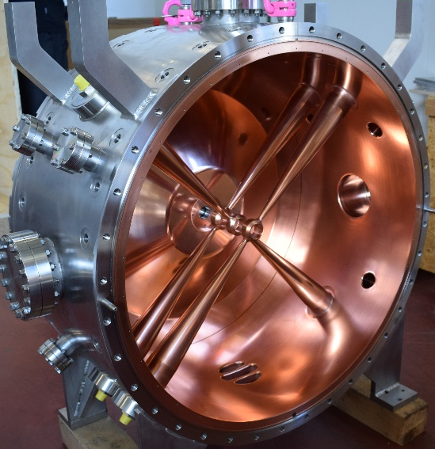
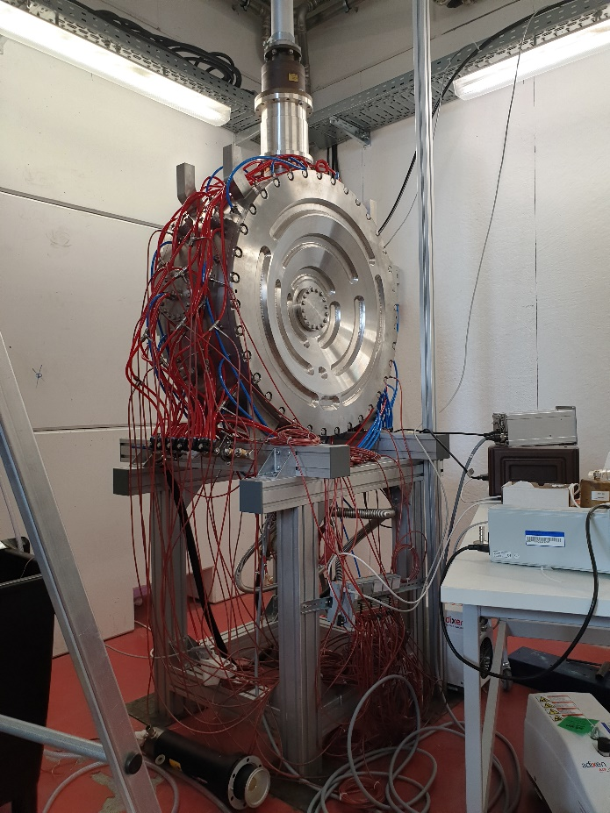
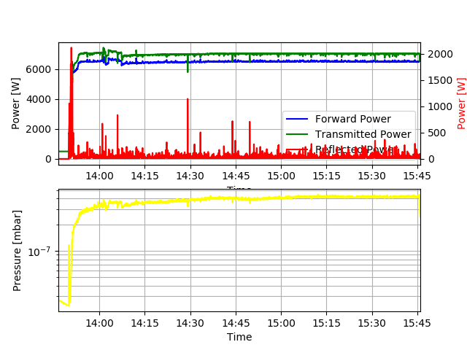
CH-DTL
CH-1
CH-2
CH-1
Both CH-cavities have been successfully conditioned up to 40 kW/m cw
Commissioning CH-1

Slide 26
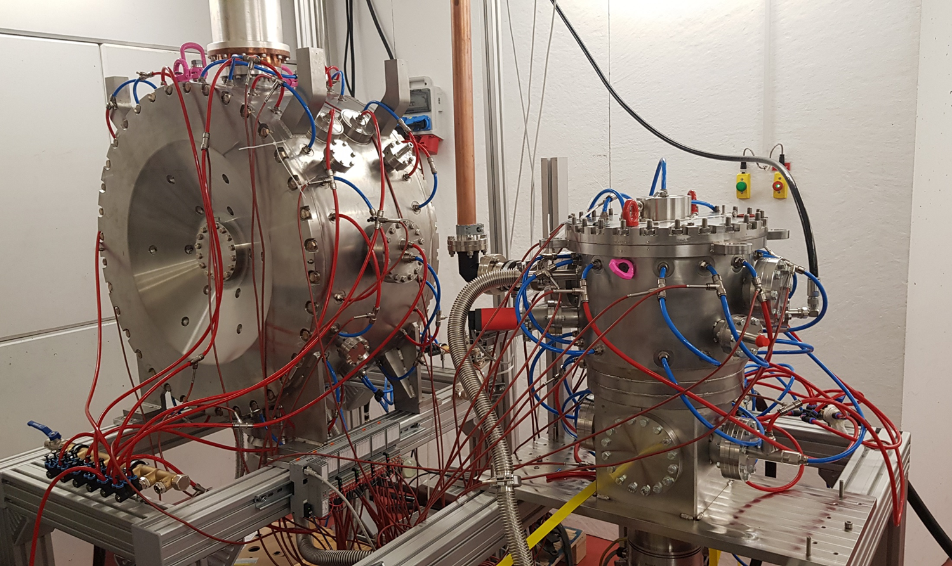
CH-DTL
High Power test stand at IAP
CH-2
QWR-1

Slide 27
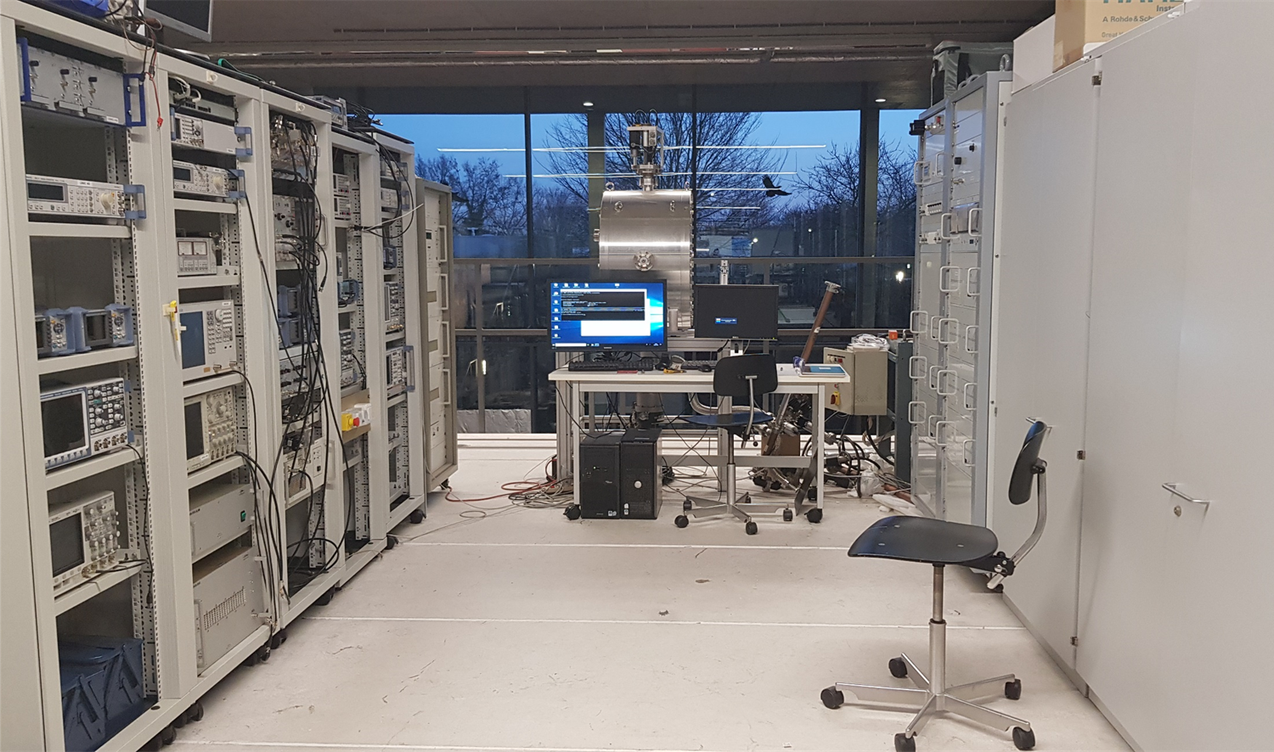
CH-DTL
RF test stand and RF Control

Slide 28
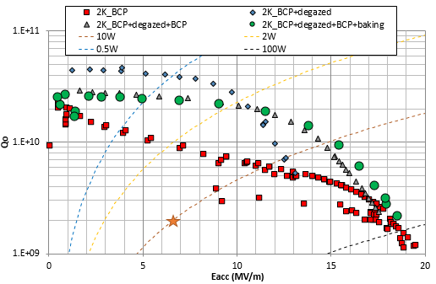
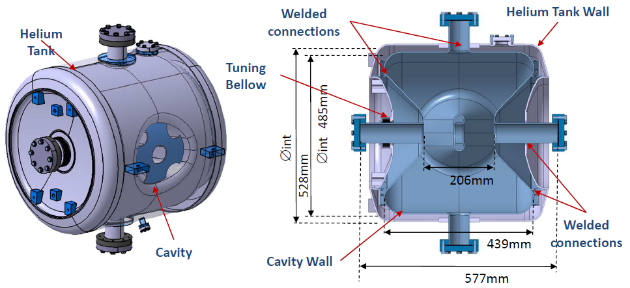
SC Spoke Cavities
60 Spoke cavities cover the energy range between 17 and 100 MeV
β=0.35, f=352.2 MHz
Two protoypes have been developed and tested
Important issue was the optimal surface treatment:
An optimal surface treatment procedure has been defined: standard procedure + hydrogen degassing at 650°C during 10h without post chemical etching
D. Longuevergne, INPO Orsay, CNRS

Slide 29
Beam Dynamics
Beam Dynamics is one of the most important issues for the MYRRHA Linac
Beam loss of a 600 MeV Linac with an average beam power of 2.4 MW should be as low as possible to prevent possible damage to components and to minimize activation
Excessive beam loss can result in a shut down and lower availability of the whole facility
Minimum emittance growth, maximum longitudinal acceptance
Several tools have been developed: Virtual accelerator, automatic retuning procedures after cavity failure compensation
Done:
Sensitivity analysis to check the robustness of beam dynamics regarding input beam mismatch
Errors study
Error study with cavity failures and compensation

Slide 30
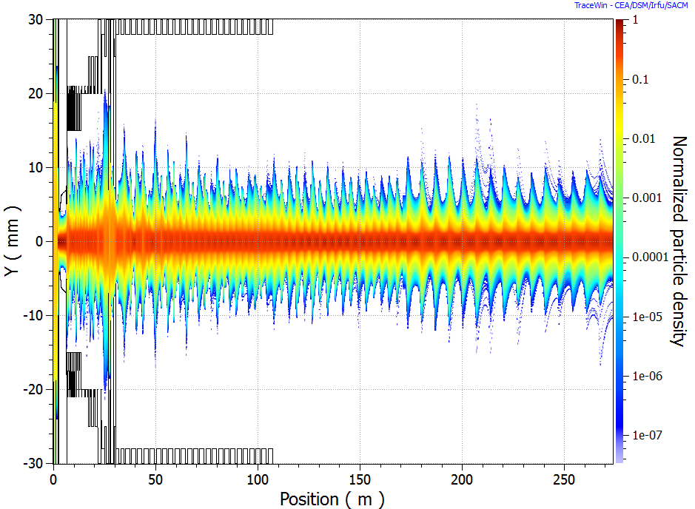
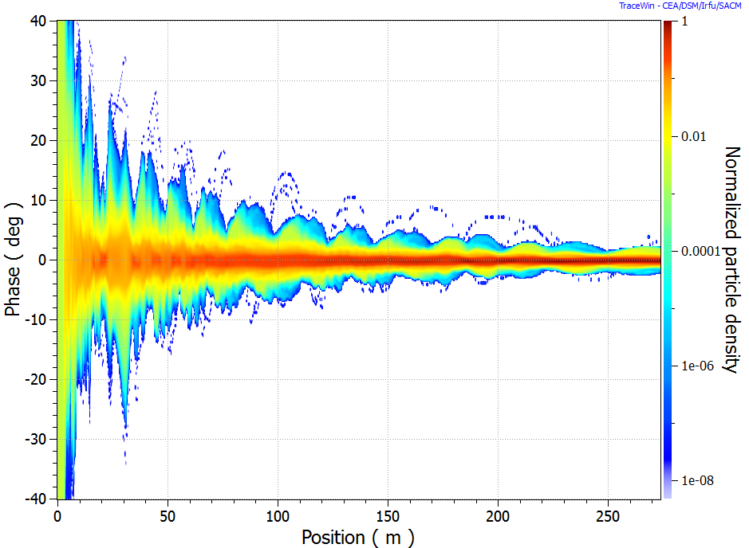
Beam Dynamics
End-to-End Simulations without Errors
Simulation with 100 million particles
Realistic 3D field maps incl. the RFQ have been used
D. Uriot, CEA Saclay

Slide 31


Beam Dynamics
End-to-End Simulations with Errors
1000 Linacs with 3∙10⁶ particles each
Cumulative plot for all Linacs with 3 billion particles
90% of Linacs do not show losses
99% have maximum losses of 0.2 W/m
Worst case 0.85 W/m locally
D. Uriot, CEA Saclay

Slide 32


Beam Dynamics
Cavity recovery issues:
Problem: Longitudinal acceptance is shrinking
Multi cavity failure: 1 Spoke-cavity, 1 cryomodule in section 2 and 1 elliptical cavity in section 3
Each cavity is compensated by 4 neighbouring cavities
Nominal
Fault-Recovery
D. Uriot, CEA Saclay
Double-Spoke cavities @ 352 MHz instead of 5-cell elliptical at 704 MHz
Increase of longitudinal acceptance
Less agressive compensation scheme, more cavities for compensation

Slide 33

A view into the future

Slide 34

A view into the future
Courtesy SCK • CEN

Slide 35
Summary
The MYRRHA Project couples a 2.4 MW Proton-Linac to a 100 MW Reactor
Desicion to built the first 100 MeV section with target station in 2018
Reliability of the Accelerator is the major issue to ensure the availability of the whole facility
→ Conservative design and redundancy, dynamic fault compensation
Front-End (Source+LEBT) operational
RFQ has been conditioned up to 145 kW cw
CH-DTL under construction, CH1+2 are tested with high power
Spoke prototypes are performing very well
100 MeV Linac operational 2026
Full MYRRHA Project operational 2034

Slide 36














MYRRHA Collaboration
H. Podlech, K. Kümpel, S. Lamprecht, N. Petry, A. Schempp, P. P. Schneider, Institute for Applied Physics (IAP),
Goethe University Frankfurt, Germany
C. Angulo, J. Belmans, F. Doucet, A. Gatera, F. Pompon, A. Ponton, D. Vandeplassche, SCK•CEN, Mol, Belgium
J.-L. Biarrotte, C. Joly, D. Longuevergne, IPNO, CNRS, Orsay, France
F. Senee, D. Uriot, CEA Saclay, Saclay, France
F. Bouly, Univ. Grenoble Alpes, CNRS, Grenoble INP, LPSC-IN2P3, Grenoble, France
M. Abs, J. Brison, IBA, Louvain-la-Neuve, Belgium
A. Apollonio, J. Uythoven, CERN, Geneva, Switzerland
H. Höltermann, U. Ratzinger, Bevatech GmbH, Frankfurt, Germany
A. Bechtold, NTG GmbH, Gelnhausen, Germany
R. Modic, Cosylab, Ljubljana, Slovenia
T. Junquera, ACS, Orsay, France
A. E. Pitigoi, P. Fernandez Ramos, Empresarios Agrupados, Madrid, Spain
C. Zhang, GSI Helmholtzzentrum für Schwerionenforschung GmbH, Darmstadt, Germany

