Slide 1
Simulations on operation of the new UNILAC
post-stripper with intense proton beams:
longitudinal phase advances below and beyond 90°
Anna Rubin, GSI, Darmstadt, Germany 12.11.2020

Slide 2
90° phase advance limit: transverse and longitudinal
New GSI – UNILAC post stripper Alvarez 2.0
High longitudinal phase advance for the test lines
Complete Alvarez 2.0 DTL: simulations with longitudinal phase advance below and beyond 90°
Summary
Anna Rubin, GSI, Darmstadt, Germany 12.11.2020

Slide 3
90° phase advance limit
intense linac designs are restricted to k_{0,t} < 90⁰
limit is a well respected linac design rule
(SNS, J-PARC, ESS, …)
longitudinal phase advance is typically also below 90⁰
Quadrupole channel, k₀ = 120°
M. Reiser, Theory and design
of charged particle beams, 1994
Anna Rubin, GSI, Darmstadt, Germany 12.11.2020

Slide 4
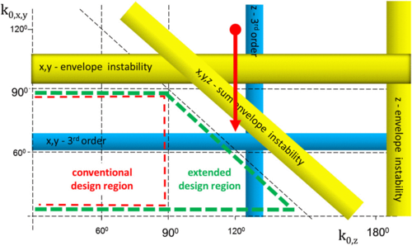
accepted and respected lattice design rule is
limitation of the phase advance to less than 90°
could be extended for certain focusing beam lines
stability plot for quadrupole beam line
I. Hofmann et al, Phys. Rev. Lett. 118, 114803 (2017)
Anna Rubin, GSI, Darmstadt, Germany 12.11.2020

Slide 5
accepted and respected lattice design rule is
limitation of the phase advance to less than 90°
could be extended for certain focusing beam lines
Questions:
does the 90° limit apply longitudinally for the beam line with acceleration?
is there extended design region ?
stability plot for quadrupole beam line
lower rf-phase → increased phase advance
> 90° can be accessed if rf-power is available
this is the case for heavy ion linacs
→ use GSI‘s UNILAC as test bench
I. Hofmann et al, Phys. Rev. Lett. 118, 114803 (2017)
Anna Rubin, GSI, Darmstadt, Germany 12.11.2020

Slide 6
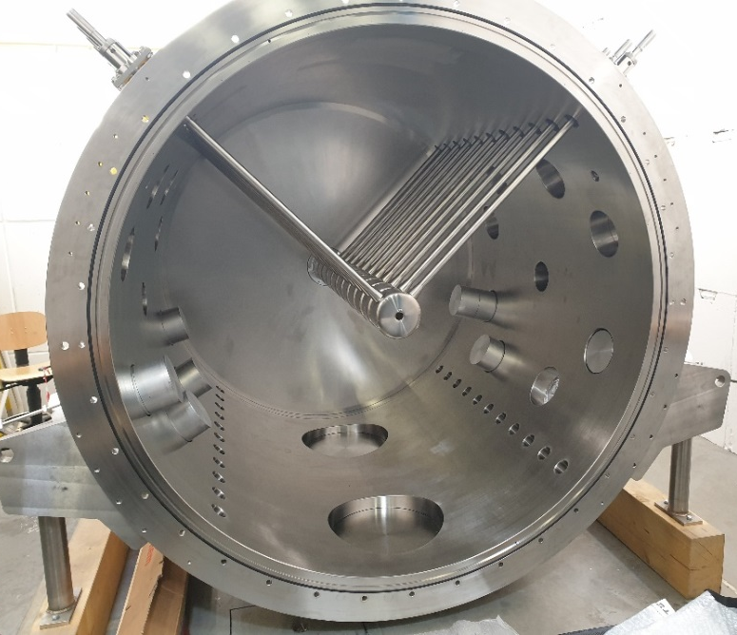
New GSI-UNILAC post stripper Alvarez 2.0 DTL is under construction
Pulsed operation allows flexibility and efficiency for providing adequate beam to an increased number of users (multi-ion operation)
An optimized drift tube shape increases the shunt impedance.
Varying stem orientations mitigates parasitic rf-modes.
FOS new poststripper DTL
Alvarez DTL
3.3/5.4/7.6/9.8/11.4 MeV/u
AI
AIIa
AIIb
AIII
AIV
S. Mickat et. al, CDR (2017)
Anna Rubin, GSI, Darmstadt, Germany 12.11.2020

Slide 7
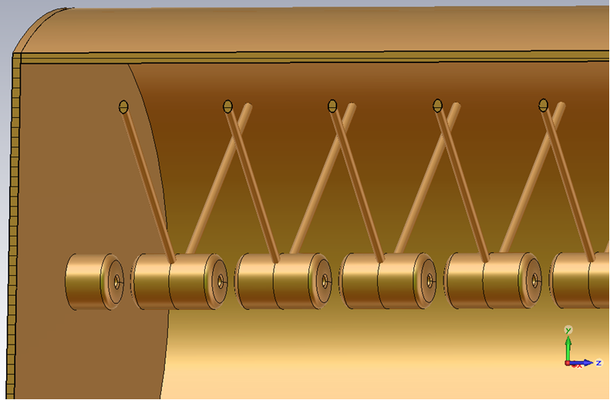
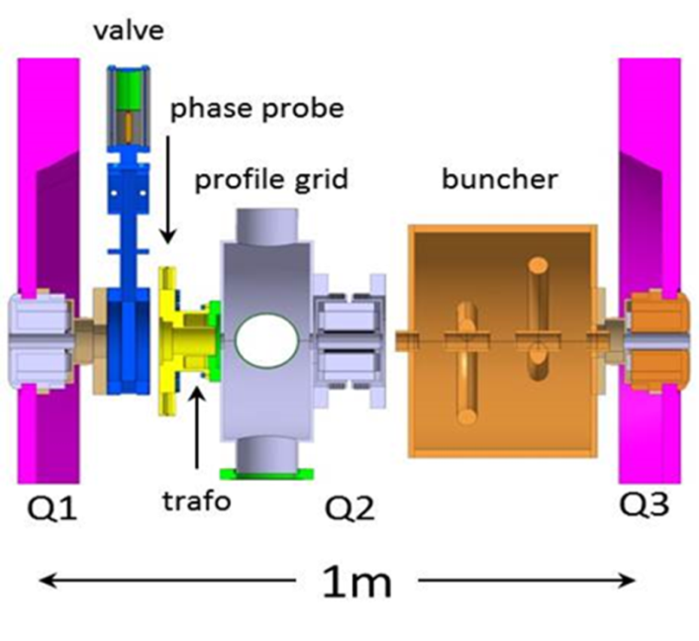
INTERTANK
New Alvarez 2.0 DTL layout:
5 rf-cavities for acceleration, 180 cells
4 intertank sections
185 pulsed quadrupoles
4 intertank re-bunchers
F
D
D
F
Tank | Effective lengths of the DTL quadrupoles
AI | DT 1-15 | 96 mm
 | DT 16-36 | 113 mm
 | DT 37-54 | 134 mm
AIIa | 155 mm
AIIb | 193 mm
AIII | 243 mm
AIV | 285 mm
RF design phases: -30⁰ (AI - AIIb) , -25⁰ (AIII - AIV)
zero current phase advances: transverse k_{0,t} = 65⁰, longitudinal k_{0,z} = 41⁰
AI
IT1
AII
a
AII
b
IT2
AIII
IT3
AIV
Emittance growth for U²⁸⁺ (nominal FAIR case, 16 emA) is about 5-10%
Anna Rubin, GSI, Darmstadt, Germany 12.11.2020

Slide 8
Tank AI of the new Alvarez 2.0 DTL
13.5 FDDF cells
2.0 emA (17 emA for U²⁸⁺)
from 1.4 MeV/u to 3.3 MeV/u
for our simulations:
operation with protons, 2mA
transverse phase advance from 35⁰ to 125⁰
longitudinal phase advance from 70⁰ to 145⁰
stability plot for quadrupole beam line
Anna Rubin, GSI, Darmstadt, Germany 12.11.2020

Slide 9
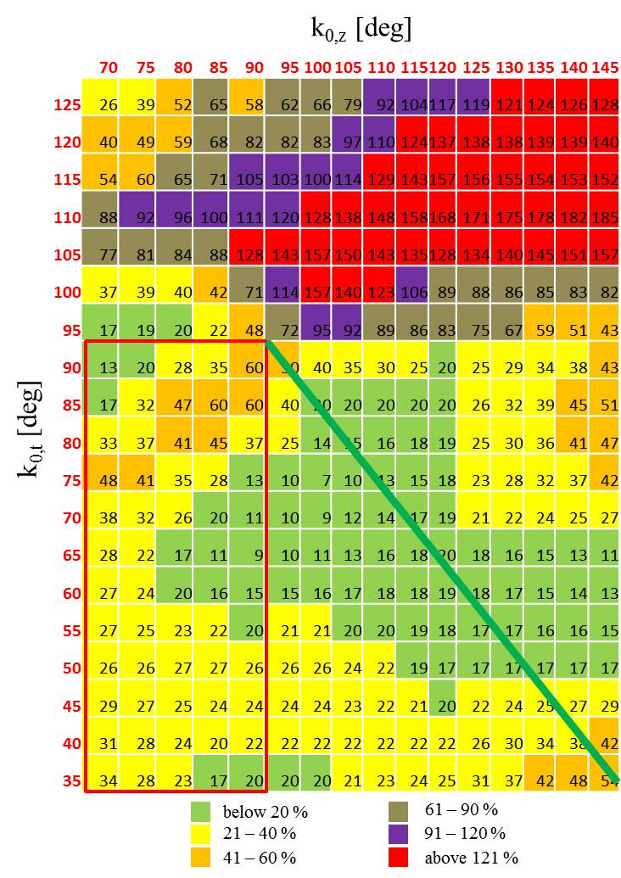
transverse emittance growth for the proton beam in AI
Tank AI of the new Alvarez 2.0 DTL
13.5 FDDF cells
2.0 emA (17 emA for U²⁸⁺)
from 1.4 MeV/u to 3.3 MeV/u
> 90° is feasible longitudinally
stability plot for quadrupole beam line
Anna Rubin, GSI, Darmstadt, Germany 12.11.2020

Slide 10
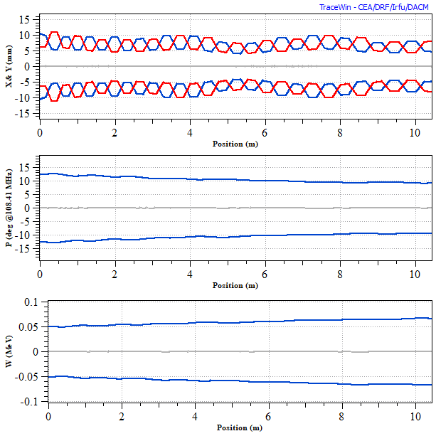
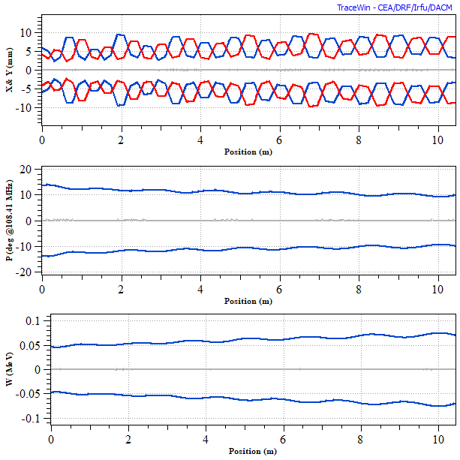
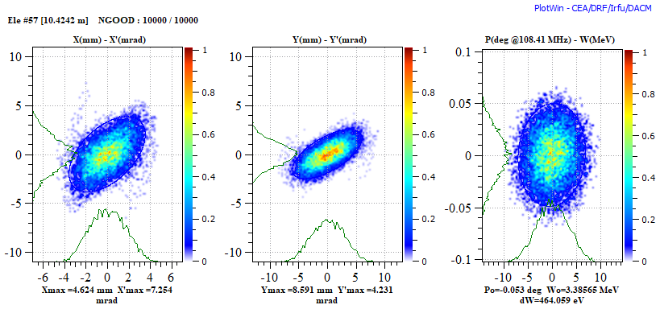
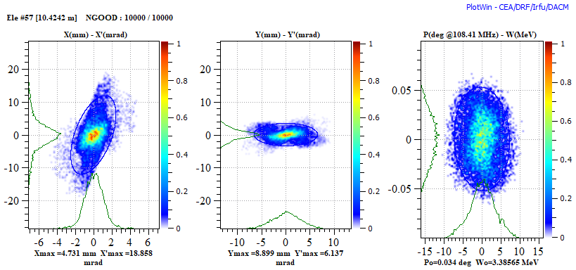
Tank AI of the new Alvarez 2.0 DTL with k_{z,0} = 120°
> 90° is feasible longitudinally
k_{t,0} = 50°, k_{z,0} = 120°
k_{t,0} = 110°, k_{z,0} = 120°
transverse emittanse growth 17%
transverse emittanse growth 170%
Anna Rubin, GSI, Darmstadt, Germany 12.11.2020

Slide 11
Long beam line AI + AIIa + AIIb
Question:
how robust is the beam dynamics for the long line
with high longitudinal phase advance?
31 FDDF cells
proton beam
input current 2.0 emA
from 1.4 MeV/u to 7.17 MeV/u
continuous accelerating-focusing channel without inter tanks
1 inter tank section (1m long) behind cell # 16
3 inter tank sections (1m long) behind cells # 8, 16 and 24
7 inter tank sections (1m long) behind cells # 4, 8, 12, 16, 20, 24 and 28
Anna Rubin, GSI, Darmstadt, Germany 12.11.2020

Slide 12
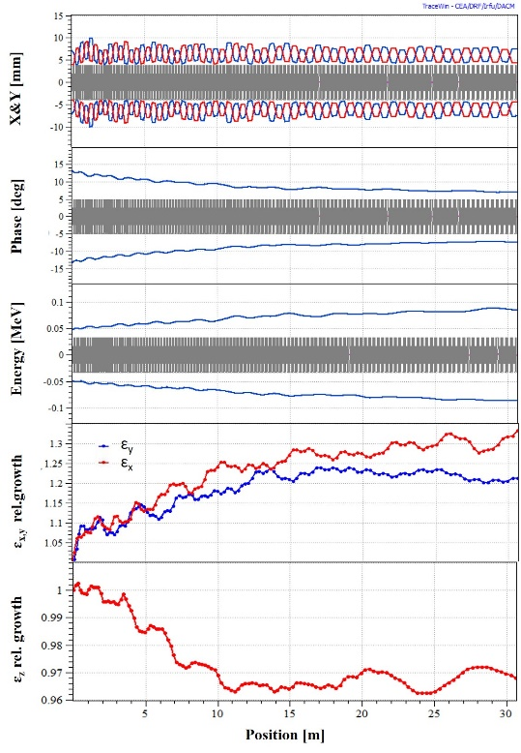
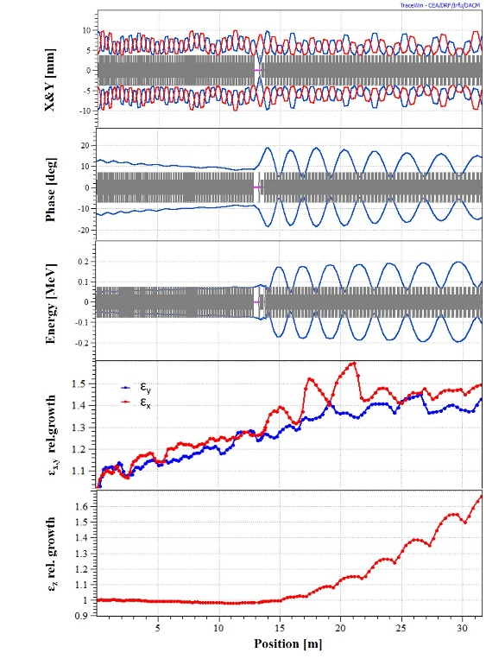
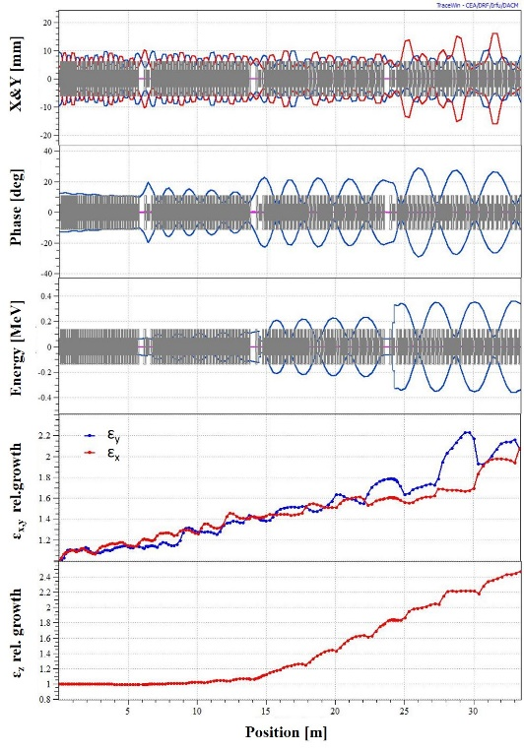
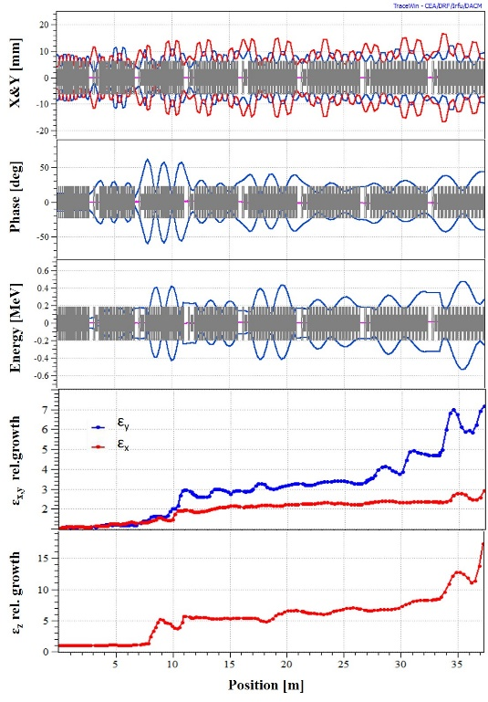
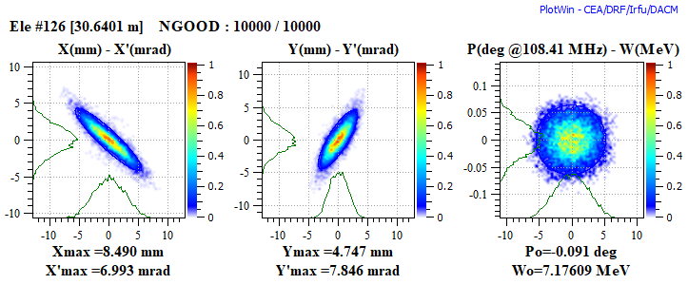
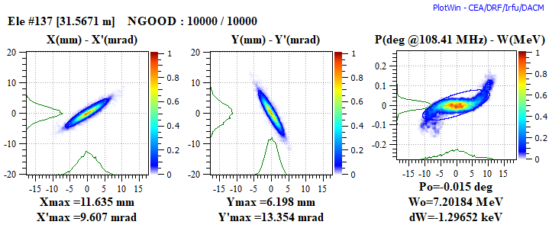
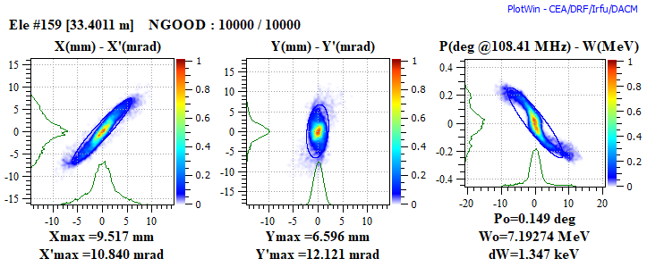
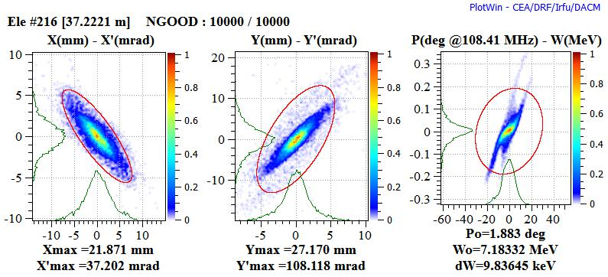
Long beam line AI + AIIa + AIIb
k_{t,0} = 65°, k_{z,0} = 120°
no inter tanks
1 inter tank
3 inter tanks
7 inter tanks
Anna Rubin, GSI, Darmstadt, Germany 12.11.2020

Slide 13
Long beam line AI + AIIa + AIIb
Beam emittance growth
31 FDDF cells with 0, 1, 3 and 7 inter tanks
for nominal k_{t,0} = 65° and k_{z,0} = 41°, 90° and 120°
horizontal
vertical
longitudinal
Anna Rubin, GSI, Darmstadt, Germany 12.11.2020

Slide 14
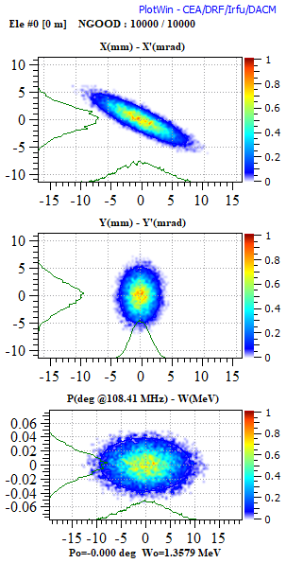
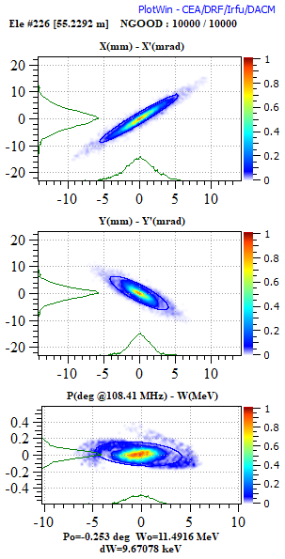
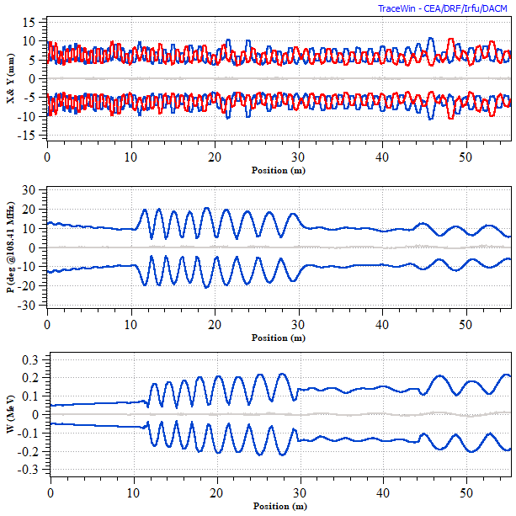
Complete Alvarez 2.0 DTL as designed
k_{t,0} = 65°, k_{z,0} = 120°, I = 2mA
AI
IT1
AIIa
AIIb
IT2
AIII
IT3
AIV
X&Y (mm)
Phase (deg)
W (MeV)
input
output
Emittance growth: transverse ~ 130%, longitudinal ~ 80%
Anna Rubin, GSI, Darmstadt, Germany 12.11.2020

Slide 15
Complete Alvarez 2.0 DTL as designed
emittance growth seems significant
however, FAIR includes dedicated p-linac for 70 mA
UNILAC may serve as backup proton source (for commissioning of instrumentation etc. with protons)
p-linac
(under production)
C. Kleffner et al. ,
LINAC16-MOPRC018 (2016)
UNIversal Linear ACcelerator
(UNILAC)
W. Barth et al.,
PHYS. REV., 050102 (2015)
& GSI technical note (2020)
Anna Rubin, GSI, Darmstadt, Germany LINAC2020 04.09.2020

Slide 16
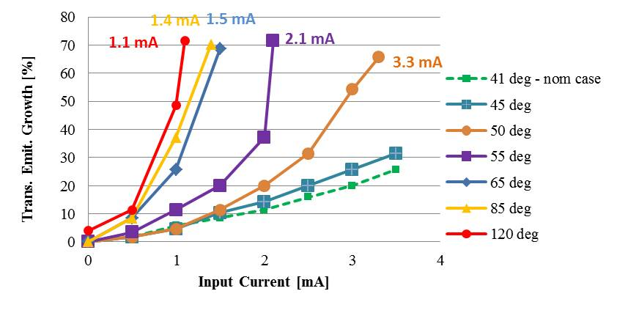
Complete Alvarez 2.0 DTL as designed
Transverse emittance growth in new poststripper Alvarez DTL
for different longitudinal phase advance and input current
nominal transverse phase advance, k_{t,0} = 65°
rf-power
28kW
rf-power
60kW
preferable rf-power above 60kW corresponds to
longitudinal phase advance k_{z,0} > 67° for proton beam
Anna Rubin, GSI, Darmstadt, Germany 12.11.2020

Slide 17
Summary
the limit of phase advance ≤ 90° does not strictly apply to the longitudinal plane
extension of stability was predicted by I.Hofmann et al. for beam without acceleration in perfect lattices
extension of stability was confirmed in simulation applying the real machine design with acceleration
stable acceleration with reasonable preservation of beam quality can be provided with up to 120°
proper choice of transverse phase advance could improve beam quality and reduce emittance growth
Anna Rubin, GSI, Darmstadt, Germany 12.11.2020

Slide 18
Many thanks to my coauthors
Lars Groening and Ingo Hofmann!
Thank you for your attention!
Anna Rubin, GSI, Darmstadt, Germany 12.11.2020

