Slide 1











NUSTAR finances and project management
ECE/ECSG meeting
October 26, 2020
Alexander Herlert
NUSTAR Resource Coordinator
FAIR
Finland
France
Germany
India
Poland
Romania
Russia
Slovenia
Sweden
UK
Czech Republic

Slide 2
Day-one configuration – funding status
33.0 MEUR
funding (secured and expected) from:
(FAIR members/associates in bold face)
  Bulgaria
  Canada
  Finland
  France
  Germany
  Hungary
  India
  Israel
  Netherlands
  Poland
  Romania
  Russia
  Slovenia
  Spain
  Sweden
  United Kingdom
Common Fund
to be defined
Status: November, 2019

Slide 3
Recent changes
HISPEC/DESPEC
  TDR of HISPEC/DESPEC infrastructure approved
  Cost-matrix update (PSP 1.2.2.1-1.2.2.6) in progress
R³B
  TDR of vacuum components submitted
  TDR of infrastructure in final round
ILIMA
  Heavy-ion detector funded (group at TRIUMF received grant)
Super-FRS Experiment
  Cost-matrix for Day-one configuration submitted to FAIR committees (recommendation from ECE/ECSG)

Slide 4
NUSTAR score card

Slide 5
LEB infrastructure (1.2.1)
Detailed technical specifications for GSI in-kind to Stopping Cell in preparation
Grant request in preparation (BMBF-VF)
Distribution beam line (to MATS and LaSpec) to be covered by Common Fund

Slide 6
HISPEC/DESPEC (1.2.2)
TDR of infrastructure approved
Clarification of EoIs for infrastructure in progress

Slide 7
MATS (1.2.3)
Detailed technical specification for RFQ in work

Slide 8
LaSpec (1.2.4)
Optical pumping: some delay due to Covid-19 (no travel)
Laser: broken – order placed – commissioning expected Nov 2020

Slide 9
R³B (1.2.5)
Infrastructure TDR in final round (internal review) before submission
Si tracker: STFC is funding R&D project to determine options

Slide 10
ILIMA (1.2.6)
In-kind contract for ToF detector signed
Heavy ion detector fully funded

Slide 11
Infrastructure items for Common Fund (RRB 9)
  Several components required for the Day-one configurations have been identified by the NUSTAR Collaboration as common infrastructure items.
  These items cannot be taken over by partner institutes.
  Update of this list is in progress
PSP | Name | cost (2005) [k€]
1.2.1.2.4 | Detectors and slit system in front CSC | 135.7
1.2.1.2.5 | Beam line to MATS-LaSpec hall | 154.0
1.2.1.7 | Beam line to MATS RFQ | 200.0
1.2.2.3.5 | HISPEC/DESPEC Mechanics | 10.4
1.2.2.5.1 | Safety measures | 96.4
1.2.5.1.1.3.3 | Valve box GLAD | 128.1
1.2.5.1.1.3.4 | Infrastructure magnets | 200.0
NUSTAR Common Fund |  | 924.6

Slide 12
Common Fund: work in progress …
PSP | Name | cost (2005) [k€]
1.2.1.2.4 | Detectors and slit system in front CSC | 135.7
1.2.1.2.5 | Beam line to MATS-LaSpec hall | 154.0
1.2.1.7 | Beam line to MATS RFQ | 200.0
1.2.2.3.5 | HISPEC/DESPEC Mechanics | 10.4
1.2.2.5.1 | Safety measures | 96.4
1.2.5.1.1.3.3 | Valve box GLAD | 128.1
1.2.5.1.1.3.4 | Infrastructure magnets | 200.0
  Components for Cryogenic Stopping Cell and connection beam line (to MATS and LaSpec) have been defined in CSC TDR
  No change expected

Slide 13
Common Fund: work in progress …
PSP | Name | cost (2005) [k€]
1.2.1.2.4 | Detectors and slit system in front CSC | 135.7
1.2.1.2.5 | Beam line to MATS-LaSpec hall | 154.0
1.2.1.7 | Beam line to MATS RFQ | 200.0
1.2.2.3.5 | HISPEC/DESPEC Mechanics | 10.4
1.2.2.5.1 | Safety measures | 96.4
1.2.5.1.1.3.3 | Valve box GLAD | 128.1
1.2.5.1.1.3.4 | Infrastructure magnets | 200.0
  Detailed survey on HISPEC/DESPEC infrastructure in progress
  Additional components for NUSTAR Common fund expected

Slide 14
Common Fund: work in progress …
PSP | Name | cost (2005) [k€]
1.2.1.2.4 | Detectors and slit system in front CSC | 135.7
1.2.1.2.5 | Beam line to MATS-LaSpec hall | 154.0
1.2.1.7 | Beam line to MATS RFQ | 200.0
1.2.2.3.5 | HISPEC/DESPEC Mechanics | 10.4
1.2.2.5.1 | Safety measures | 96.4
1.2.5.1.1.3.3 | Valve box GLAD | 128.1
1.2.5.1.1.3.4 | Infrastructure magnets | 200.0
  R³B vacuum TDR with ECE (under review)
  R³B infrastructure TDR soon to be submitted
  For valve box no change expected
  Additional components to be covered by Common Fund possible

Slide 15
Common Fund: work in progress …
PSP | Name | cost (2005) [k€]
1.2.1.2.4 | Detectors and slit system in front CSC | 135.7
1.2.1.2.5 | Beam line to MATS-LaSpec hall | 154.0
1.2.1.7 | Beam line to MATS RFQ | 200.0
1.2.2.3.5 | HISPEC/DESPEC Mechanics | 10.4
1.2.2.5.1 | Safety measures | 96.4
1.2.5.1.1.3.3 | Valve box GLAD | 128.1
1.2.5.1.1.3.4 | Infrastructure magnets | 200.0
1.2.1.X | LEB infrastructure | ???
  Survey for missing infrastructure components in LEB cave in progress
    Alignment tools, mobile concrete blocks, LH2 safety measures, …
  TDR in preparation
  Additional items for Common Fund expected

Slide 16
Project Administration Web: General ideas
web access and shared access
  global project -> global access
  no local files -> data up-to-date (if maintained in database)
  distribution of work -> different aspects/data maintained by different users
simple front-end and database
  HTML with standard PHP – PostgreSQL database (open source)
modular system
  flexible, tailored add-ons possible (reporting!)
  access to modules and data can be adapted (per user)
automatic reminders/reports
  cron-jobs for reporting, open action items, etc.
connect different systems/databases
  links to EDMS documents
  direct access to MS Project (via interface database)
  interface to external member database(s) (CSV)
  data exchange (via CSV) with PLM system
  updating GSI-ListServ email lists

Slide 17
Project Administration Web (PAW) – structure
MS Project
web page
elections
system
milestones
activities
member
database
boards
persons
sub-system
WPs
WP teams
contract
specific data
working
group
institutes
groups
TDRs
funding
bodies
contract
follow-up
email
lists
countries
components
PLM
ListServ

Slide 18
PAW – basic modules in operation
MS Project
web page
elections
system
milestones
activities
member
database
boards
persons
sub-system
WPs
WP teams
contract
specific data
working
group
institutes
groups
TDRs
funding
bodies
contract
follow-up
email
lists
countries
components
PLM
ListServ

Slide 19
Status of TDRs
Sub-system | TDR # | name | status
NUSTAR | 2_01 | LEB infrastructure | expected
LEB infrastructure | 2_02 | Cryogenic Stopping cell | approved
HISPEC/DESPEC | 2_04 | HISPEC/DESPEC infrastructure | approved
NUSTAR | 2_05 | NUSTAR DAQ | approved
HISPEC/DESPEC | 2_07 | Active target (India) | expected
HISPEC/DESPEC | 2_08 | HYDE | expected
HISPEC/DESPEC | 2_09 | LYCCA | approved
HISPEC/DESPEC | 2_10 | Plunger | approved
HISPEC/DESPEC | 2_11 | AIDA | approved
HISPEC/DESPEC | 2_12 | DEGAS | approved
HISPEC/DESPEC | 2_13 | FATIMA | approved
HISPEC/DESPEC | 2_14 | BELEN | approved
HISPEC/DESPEC | 2_15 | MONSTER | approved
HISPEC/DESPEC | 2_16 | NEDA | approved
HISPEC/DESPEC | 2_17 | DTAS | approved
HISPEC/DESPEC | 2_18 | Isomeric moments | expected
NUSTAR | 2_19 | MATS/LaSpec | approved
R3B | 2_21 | GLAD | approved
R3B | 2_22 | R3B tracking | approved
R3B | 2_24 | CALIFA barrel | approved
R3B | 2_25 | CALIFA fwd endcap | approved
R3B | 2_26 | Si tracker | expected
R3B | 2_27 | NeuLAND | approved
R3B | 2_28 | R3B vacuum | submitted
R3B | 2_29 | R3B infrastructure | expected
R3B | 2_30 | R3B spectrometer | expected
R3B | 2_32 | ACTAF | approved
ILIMA | 2_33 | ILIMA Schottky | approved
ILIMA | 2_34 | ILIMA TOF detectors | approved
ILIMA | 2_35 | ILIMA Heavy ion detector | approved
HISPEC/DESPEC | 2_37 | Slowed down beam setup | expected
Super-FRS Experiment | 2_38 | EXPERT | approved
Super-FRS Experiment | 2_39 | Super-FRS Exp infrastructure | approved
Super-FRS Experiment | 2_40 | Liquid hydrogen target | expected
Super-FRS Experiment | 2_41 | (Ice target and tensor force) | expected
Super-FRS Experiment | 2_42 | (future WASA) | expected
24 | approved
1 | submitted
3 | expected
8 | beyond “Day one”

Slide 20
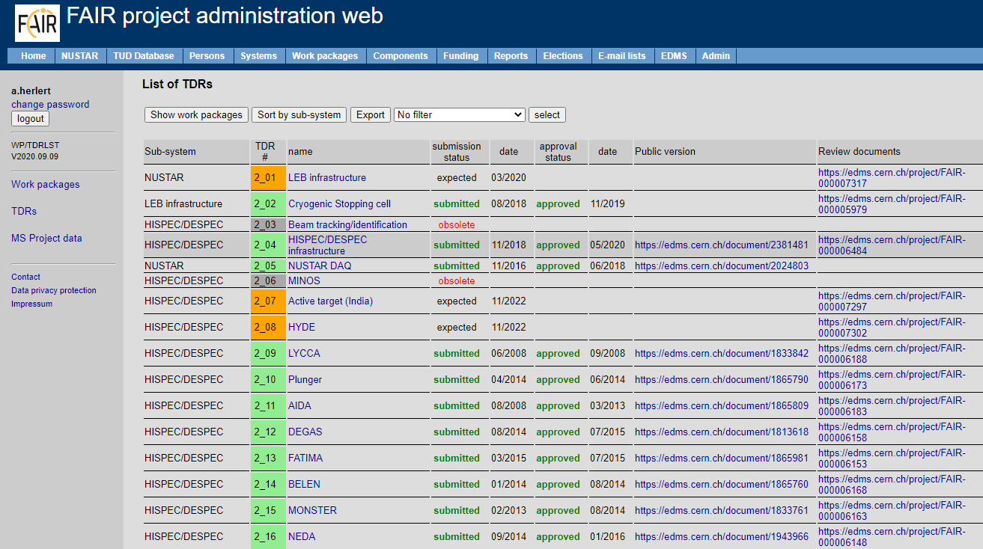
Status of TDRs … monitored on-line
Sub-system | TDR # | name | status
NUSTAR | 2_01 | LEB infrastructure | expected
LEB infrastructure | 2_02 | Cryogenic Stopping cell | approved
HISPEC/DESPEC | 2_04 | HISPEC/DESPEC infrastructure | approved
NUSTAR | 2_05 | NUSTAR DAQ | approved
HISPEC/DESPEC | 2_07 | Active target (India) | expected
HISPEC/DESPEC | 2_08 | HYDE | expected
HISPEC/DESPEC | 2_09 | LYCCA | approved
HISPEC/DESPEC | 2_10 | Plunger | approved
HISPEC/DESPEC | 2_11 | AIDA | approved
HISPEC/DESPEC | 2_12 | DEGAS | approved
HISPEC/DESPEC | 2_13 | FATIMA | approved
HISPEC/DESPEC | 2_14 | BELEN | approved
HISPEC/DESPEC | 2_15 | MONSTER | approved
HISPEC/DESPEC | 2_16 | NEDA | approved
HISPEC/DESPEC | 2_17 | DTAS | approved
HISPEC/DESPEC | 2_18 | Isomeric moments | expected
NUSTAR | 2_19 | MATS/LaSpec | approved
R3B | 2_21 | GLAD | approved
R3B | 2_22 | R3B tracking | approved
R3B | 2_24 | CALIFA barrel | approved
R3B | 2_25 | CALIFA fwd endcap | approved
R3B | 2_26 | Si tracker | expected
R3B | 2_27 | NeuLAND | approved
R3B | 2_28 | R3B vacuum | submitted
R3B | 2_29 | R3B infrastructure | expected
R3B | 2_30 | R3B spectrometer | expected
R3B | 2_32 | ACTAF | approved
ILIMA | 2_33 | ILIMA Schottky | approved
ILIMA | 2_34 | ILIMA TOF detectors | approved
ILIMA | 2_35 | ILIMA Heavy ion detector | approved
HISPEC/DESPEC | 2_37 | Slowed down beam setup | expected
Super-FRS Experiment | 2_38 | EXPERT | approved
Super-FRS Experiment | 2_39 | Super-FRS Exp infrastructure | approved
Super-FRS Experiment | 2_40 | Liquid hydrogen target | expected
Super-FRS Experiment | 2_41 | (Ice target and tensor force) | expected
Super-FRS Experiment | 2_42 | (future WASA) | expected
24 | approved
1 | submitted
3 | expected
8 | beyond “Day one”

Slide 21
Collect information on each contribution
work package
TDR #
phase
step 1
contribution 1
cost
step 2
contribution 2
secured?
funding agency
contribution 3
country
institute
contribution 4
team
FAIR budget?
contribution 5
Council request?
contribution 6
Council decision
contract

Slide 22
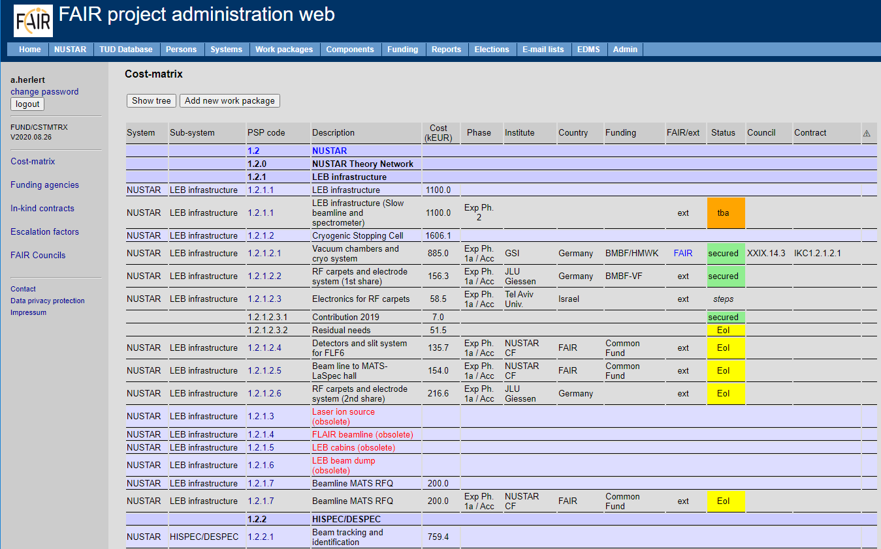
… and keep track on-line
work package
TDR #
phase
step 1
contribution 1
cost
step 2
contribution 2
secured?
funding agency
contribution 3
country
institute
contribution 4
team
FAIR budget?
contribution 5
Council request?
contribution 6
Council decision
contract

Slide 23
In-kind and Collaboration Contracts
Country | Experiment | Description | in-kind value | Council? | specs? | contract? | signed?
Finland | HISPEC/DESPEC | DEGAS stage 2 | 268 | yes | no | no | no
 | HISPEC/DESPEC | MONSTER | 119.9 | yes | yes | yes | yes
 | MATS | RFQ | 215.2 | yes | Draft | no | no
 | LaSpec | Laser-based beam preparation | 106.4 | yes | Draft | no | no
France | R3B | GLAD | 2530 | yes | yes | yes | no
Germany | LEB infrastructure | Cryogenic stopping cell (CSC) | 885 | yes | no | no | no
 | HISPEC/DESPEC | DEGAS stage 1 | 390 | yes | no | no | no
 | HISPEC/DESPEC | DEGAS stage 2 | 100 | yes | no | no | no
 | R3B | GLAD | 2530 | yes | yes | yes | yes
 | R3B | NeuLAND stage 1 | 390 | yes | no | no | no
 | ILIMA | Heavy Ion Detector | 65.7 | update | no | no | no
 | ILIMA | Schottky pick-ups | 341.3 | yes | Draft | no | no
 | ILIMA | Time-of-flight detectors | 333 | yes | yes | yes | yes
India | HISPEC/DESPEC | DEGAS | 1410 | yes | yes | yes | yes
 | HISPEC/DESPEC | MONSTER | 560 | yes | yes | yes | yes
 | MATS | Preparation Penning Trap | 40 | yes | Draft | no | no
Poland | HISPEC/DESPEC | Finger detectors | 227.9 | yes | no | no | no
Romania | HISPEC/DESPEC | FATIMA | 100 | yes | no | no | no
 | HISPEC/DESPEC | Plunger | 122.5 | yes | no | no | no
Russia | R3B | ACTAF – Small chamber ACTAF 2 | 174.7 | yes | yes | yes | yes
 | R3B | NeuLAND - HV distribution system | 415 | yes | yes | yes | yes
 | R3B | CALIFA endcap – iPhos detection modules | 300 | yes | yes | yes | yes
 | R3B | Proton arm spectrometer | 489.3 | yes | yes | yes | yes
Sweden | HISPEC/DESPEC | DEGAS stage 2 | 450 | yes | no | no | no
 | HISPEC/DESPEC | LYCCA | 150 | yes | yes | yes | yes
 | R3B | CALIFA barrel stage 1 | 399.2 | yes | yes | yes | yes
 | R3B | CALIFA forward endcap | 575.8 | yes | no | no | no
United Kingdom | HISPEC/DESPEC | AIDA | 975 | yes | no | no | no
 | HISPEC/DESPEC | DTAS | 84 | yes | no | no | no
 | HISPEC/DESPEC | FATIMA | 464.6 | yes | no | no | no
 | HISPEC/DESPEC | LYCCA | 705.4 | yes | Draft | no | no

Slide 24
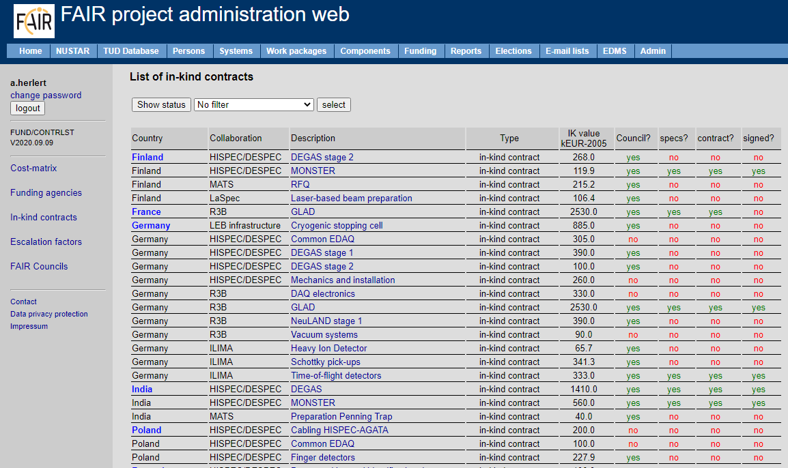
… and follow-up progress on-line
Country | Experiment | Description | in-kind value | Council? | specs? | contract? | signed?
Finland | HISPEC/DESPEC | DEGAS stage 2 | 268 | yes | no | no | no
 | HISPEC/DESPEC | MONSTER | 119.9 | yes | yes | yes | yes
 | MATS | RFQ | 215.2 | yes | Draft | no | no
 | LaSpec | Laser-based beam preparation | 106.4 | yes | Draft | no | no
France | R3B | GLAD | 2530 | yes | yes | yes | no
Germany | LEB infrastructure | Cryogenic stopping cell (CSC) | 885 | yes | no | no | no
 | HISPEC/DESPEC | DEGAS stage 1 | 390 | yes | no | no | no
 | HISPEC/DESPEC | DEGAS stage 2 | 100 | yes | no | no | no
 | R3B | GLAD | 2530 | yes | yes | yes | yes
 | R3B | NeuLAND stage 1 | 390 | yes | no | no | no
 | ILIMA | Heavy Ion Detector | 65.7 | update | no | no | no
 | ILIMA | Schottky pick-ups | 341.3 | yes | Draft | no | no
 | ILIMA | Time-of-flight detectors | 333 | yes | yes | yes | yes
India | HISPEC/DESPEC | DEGAS | 1410 | yes | yes | yes | yes
 | HISPEC/DESPEC | MONSTER | 560 | yes | yes | yes | yes
 | MATS | Preparation Penning Trap | 40 | yes | Draft | no | no
Poland | HISPEC/DESPEC | Finger detectors | 227.9 | yes | no | no | no
Romania | HISPEC/DESPEC | FATIMA | 100 | yes | no | no | no
 | HISPEC/DESPEC | Plunger | 122.5 | yes | no | no | no
Russia | R3B | ACTAF – Small chamber ACTAF 2 | 174.7 | yes | yes | yes | yes
 | R3B | NeuLAND - HV distribution system | 415 | yes | yes | yes | yes
 | R3B | CALIFA endcap – iPhos detection modules | 300 | yes | yes | yes | yes
 | R3B | Proton arm spectrometer | 489.3 | yes | yes | yes | yes
Sweden | HISPEC/DESPEC | DEGAS stage 2 | 450 | yes | no | no | no
 | HISPEC/DESPEC | LYCCA | 150 | yes | yes | yes | yes
 | R3B | CALIFA barrel stage 1 | 399.2 | yes | yes | yes | yes
 | R3B | CALIFA forward endcap | 575.8 | yes | no | no | no
United Kingdom | HISPEC/DESPEC | AIDA | 975 | yes | no | no | no
 | HISPEC/DESPEC | DTAS | 84 | yes | no | no | no
 | HISPEC/DESPEC | FATIMA | 464.6 | yes | no | no | no
 | HISPEC/DESPEC | LYCCA | 705.4 | yes | Draft | no | no
In-kind follow-up
contract milestones
payments
documentation (links to EDMS)
link to MS Project

Slide 25
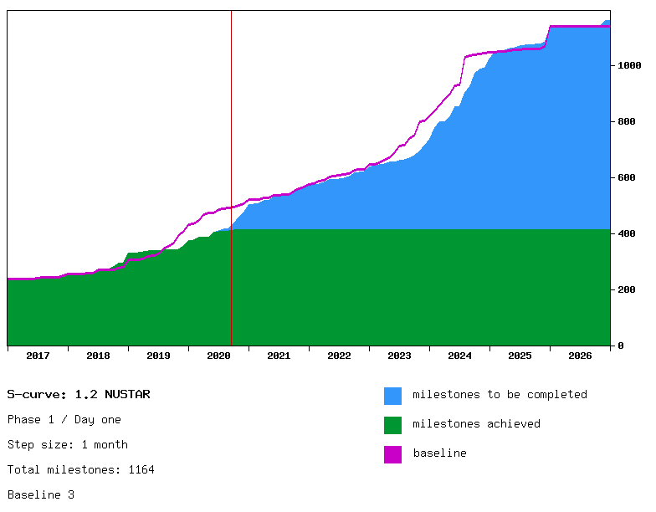
Progress of project milestones (S-curve)

Slide 26
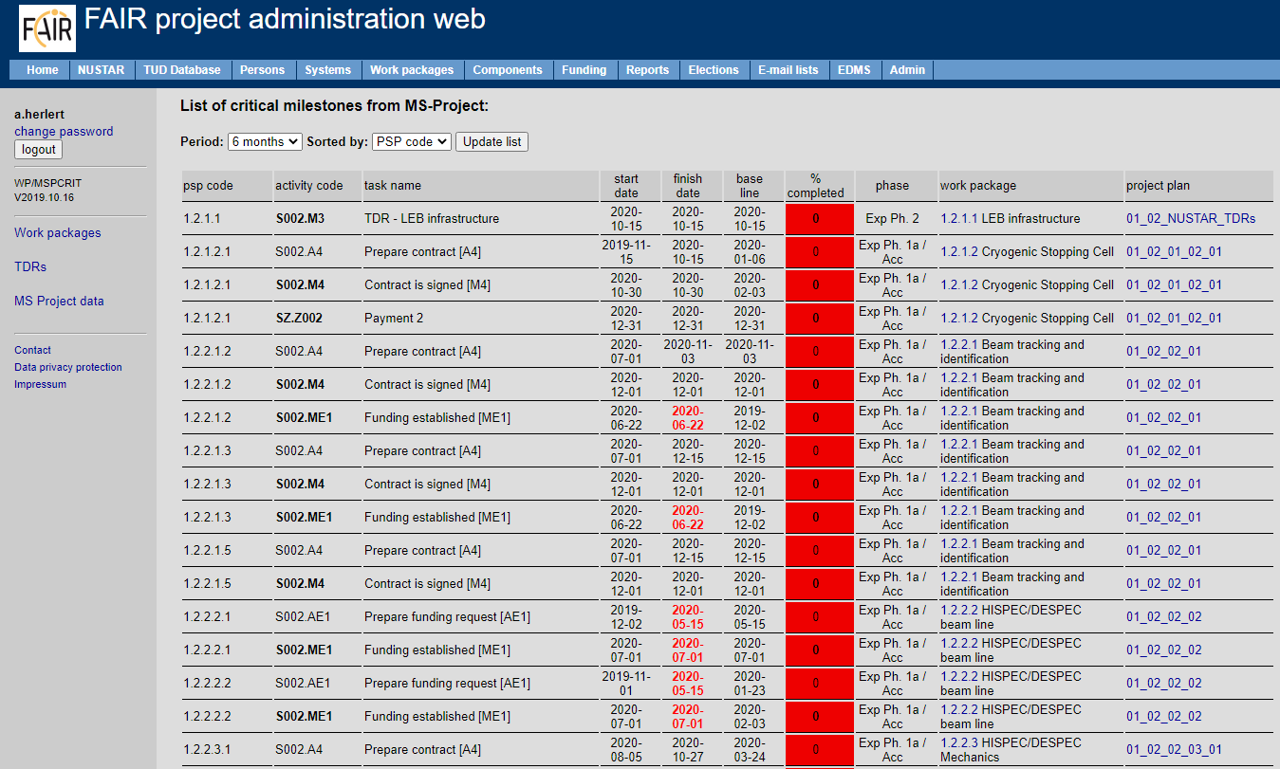
… and filter critical items
Re-baselining for FAIR
project early next year

Slide 27
From cost sharing …
PSP-Code | Description | Cost. 2005 [k€] | Inst. | secured 2005 [k€]
1.2.5.1.2.5 | Neutron ToF spectrometer (NeuLAND) | 4,617.0 |  | 2,595.2
1.2.5.1.2.5.1 | NeuLAND stage 1
1.2.5.1.2.5.1.1 | NeuLAND stage 1 (1st share) | 273.6 | TU Darmstadt | 273.6
1.2.5.1.2.5.1.2 | NeuLAND stage 1 (2nd share) | 204.9 | Univ. Frankfurt | 204.9
1.2.5.1.2.5.1.3 | NeuLAND stage 1 (3rd share) | 267.6 | Univ. Cologne | 267.6
1.2.5.1.2.5.1.4 | NeuLAND stage 1 (4th share) | 390.0 | GSI | 390.0
1.2.5.1.2.5.1.5 | NeuLAND stage 1 (5th share) | 585.0 | PNPI Gatchina | 0.0
1.2.5.1.2.5.2 | NeuLAND stage 2
1.2.5.1.2.5.2.1 | NeuLAND stage 2 (1st share) | 532.0 | TU Darmstadt | 532.0
1.2.5.1.2.5.2.2 | NeuLAND stage 2 (2nd share) | 104.0 | KVI-CART | 104.0
1.2.5.1.2.5.2.3 | NeuLAND stage 2 (3rd share) | 237.0 | Univ. Frankfurt | 237.0
1.2.5.1.2.5.2.4 | NeuLAND stage 2 (4th share) | 159.0 | Univ. Cologne | 159.0
1.2.5.1.2.5.2.5 | NeuLAND stage 2 (5th share) | 250.0 | PNPI Gatchina | 0.0
1.2.5.1.2.5.2.6 | NeuLAND stage 2 (6th share) | 12.1 | ATOMKI Debrecen | 12.1
1.2.5.1.2.5.2.7 | NeuLAND stage 2 (7th share) | 86.8 | N/A | 0.0
1.2.5.1.2.5.3 | NeuLAND stage 3
1.2.5.1.2.5.3.1 | NeuLAND stage 3 (1st share) | 400.0 | N/A | 0.0
1.2.5.1.2.5.3.2 | NeuLAND stage 3 (2nd share) | 400.0 | N/A | 0.0
1.2.5.1.2.5.3.3 | NeuLAND stage 3 (3rd share) | 300.0 | N/A | 0.0
1.2.5.1.2.5.4 | NeuLAND high-voltage distribution system | 415.0 | PNPI Gatchina | 415.0

Slide 28
… to components
CID | description | PSP |  | Institute | completion [%]
11000006022 | NeuLAND double plane 1 | 1.2.5.1.2.5.1.1 | NeuLAND stage 1 | TU Darmstadt | 100
11000006039 | NeuLAND double plane 2 | 1.2.5.1.2.5.1.1 |  | TU Darmstadt | 100
11000006046 | NeuLAND double plane 3 | 1.2.5.1.2.5.1.2 |  | Univ. Frankfurt | 95
11000006053 | NeuLAND double plane 4 | 1.2.5.1.2.5.1.2 |  | Univ. Frankfurt | 95
 |  | 1.2.5.1.2.5.1.4 |  | GSI
11000006060 | NeuLAND double plane 5 | 1.2.5.1.2.5.1.4 |  | GSI | 100
11000006077 | NeuLAND double plane 6 | 1.2.5.1.2.5.1.4 |  | GSI | 100
11000006084 | NeuLAND double plane 7 | 1.2.5.1.2.5.1.3 |  | Univ. Cologne | 100
11000006091 | NeuLAND double plane 8 | 1.2.5.1.2.5.1.3 |  | Univ. Cologne | 100
11000006107 | NeuLAND double plane 9 | 1.2.5.1.2.5.2.1 | NeuLAND stage 2 | TU Darmstadt | 100
11000006114 | NeuLAND double plane 10 | 1.2.5.1.2.5.2.1 |  | TU Darmstadt | 100
11000006121 | NeuLAND double plane 11 | 1.2.5.1.2.5.2.1 |  | TU Darmstadt | 100
11000006138 | NeuLAND double plane 12 | 1.2.5.1.2.5.2.1 |  | TU Darmstadt | 100
11000006145 | NeuLAND double plane 13 | 1.2.5.1.2.5.2.2 |  | KVI-CART | 70
 |  | 1.2.5.1.2.5.2.6 |  | ATOMKI Debrecen
11000006152 | NeuLAND double plane 14 | 1.2.5.1.2.5.2.3 |  | Univ. Frankfurt | 5
11000006169 | NeuLAND double plane 15 | 1.2.5.1.2.5.2.3 |  | Univ. Frankfurt | 5
 |  | 1.2.5.1.2.5.2.4 |  | Univ. Cologne
11000006176 | NeuLAND double plane 16 | 1.2.5.1.2.5.2.4 |  | Univ. Cologne | 5

Slide 29
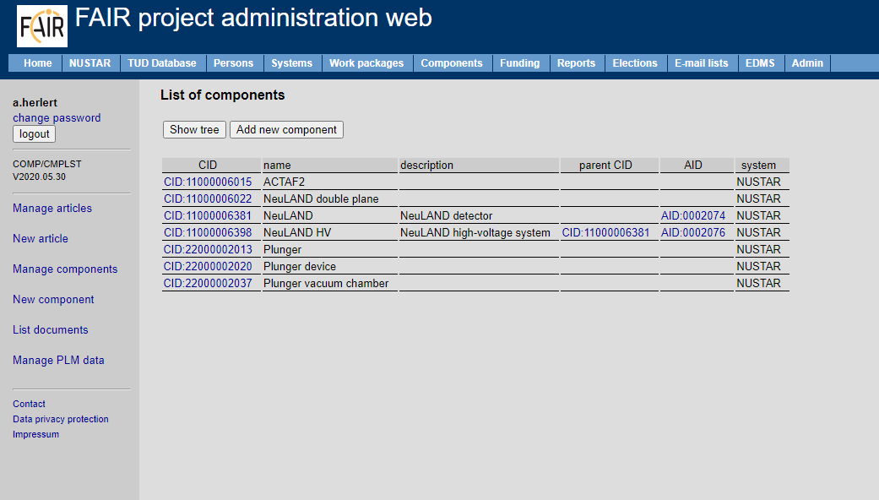
… and manage information
CID | description | PSP |  | Institute | completion [%]
11000006022 | NeuLAND double plane 1 | 1.2.5.1.2.5.1.1 | NeuLAND stage 1 | TU Darmstadt | 100
11000006039 | NeuLAND double plane 2 | 1.2.5.1.2.5.1.1 |  | TU Darmstadt | 100
11000006046 | NeuLAND double plane 3 | 1.2.5.1.2.5.1.2 |  | Univ. Frankfurt | 95
11000006053 | NeuLAND double plane 4 | 1.2.5.1.2.5.1.2 |  | Univ. Frankfurt | 95
 |  | 1.2.5.1.2.5.1.4 |  | GSI
11000006060 | NeuLAND double plane 5 | 1.2.5.1.2.5.1.4 |  | GSI | 100
11000006077 | NeuLAND double plane 6 | 1.2.5.1.2.5.1.4 |  | GSI | 100
11000006084 | NeuLAND double plane 7 | 1.2.5.1.2.5.1.3 |  | Univ. Cologne | 100
11000006091 | NeuLAND double plane 8 | 1.2.5.1.2.5.1.3 |  | Univ. Cologne | 100
11000006107 | NeuLAND double plane 9 | 1.2.5.1.2.5.2.1 | NeuLAND stage 2 | TU Darmstadt | 100
11000006114 | NeuLAND double plane 10 | 1.2.5.1.2.5.2.1 |  | TU Darmstadt | 100
11000006121 | NeuLAND double plane 11 | 1.2.5.1.2.5.2.1 |  | TU Darmstadt | 100
11000006138 | NeuLAND double plane 12 | 1.2.5.1.2.5.2.1 |  | TU Darmstadt | 100
11000006145 | NeuLAND double plane 13 | 1.2.5.1.2.5.2.2 |  | KVI-CART | 70
 |  | 1.2.5.1.2.5.2.6 |  | ATOMKI Debrecen
11000006152 | NeuLAND double plane 14 | 1.2.5.1.2.5.2.3 |  | Univ. Frankfurt | 5
11000006169 | NeuLAND double plane 15 | 1.2.5.1.2.5.2.3 |  | Univ. Frankfurt | 5
 |  | 1.2.5.1.2.5.2.4 |  | Univ. Cologne
11000006176 | NeuLAND double plane 16 | 1.2.5.1.2.5.2.4 |  | Univ. Cologne | 5
+ link to SAP / PLM
work in progress

Slide 30
Document types (articles and components)
 | Document type | Description | Milestone
AID | design | design documentation, incl. drawings, schematics, etc.
 | risk/hazard analysis | risk analysis and hazard analysis incl. definition of mitigation actions
 | operating/user manual | operating manual / user manual
 | miscellaneous | miscellaneous documention of the article
CID | specific technical documentation | technical documentation of the individual component, e.g. test records and assessment
 | goods-in inspection (SAT Aa) | Site acceptance test part Aa (SAT Aa) - incomming goods inspection | M10
 | SAT Ba | Filled out release document of SAT Ba | M11
 | SAT Bb | Filled out release document of SAT Bb | M12
Data/documents stored on EDMS
automatic upload to PLM system

Slide 31
Conclusion
TDRs
  Almost done … for Si tracker and LEB infrastructure still some work ahead
Funding
  Need to identify partners for Infrastructure items
  Need to establish Common Fund for all remaining items
  Provide detailed technical specifications for in-kind contracts
Project plan
  Keep track of construction status (score card)
  Work toward reliable planning – report if milestone achieved (S-curve)
Components
  Define minimum set of components for all experiments
  Provide step-by-step required documentation

