Slide 1
NUSTAR Project Status
NUSTAR Project Status
ECE/ECSG
26. October 2020
virtual
J. Gerl

Slide 2
NUSTAR Overall Schedule
2018 | 2019 | 2020 | 2021 | 2022 | 2023 | 2024 | 2025 | 2026 | 2027
Early Start
Day one
Super-FRS
Intermediate objective
construction and installation
commissioning
full operation
NUSTAR caves
civil construction
infrastructure inst.
NUSTAR experiments
construction/operation „outside“ FAIR (GSI and ext.)
installation
commissioning
operation at FAIR
Phase 0
Phase 1

Slide 3
TDR Status
approved 5.20
24 approved
1 under evaluation by ECE
3 needed for Day-one and are still expected in the next months
8 more expected, but not time critical
submitted

Slide 4
In-kind and Collaboration Contracts
Country | Experiment | Description | in-kind value | Council? | specs? | contract? | signed?
Finland | HISPEC/DESPEC | DEGAS stage 2 | 268 | yes | no | no | no
 | HISPEC/DESPEC | MONSTER | 119.9 | yes | yes | yes | yes
 | MATS | RFQ | 215.2 | yes | Draft | no | no
 | LaSpec | Laser-based beam preparation | 106.4 | yes | Draft | no | no
France | R3B | GLAD | 2530 | yes | yes | yes | no
Germany | LEB infrastructure | Cryogenic stopping cell (CSC) | 885 | yes | no | no | no
 | HISPEC/DESPEC | DEGAS stage 1 | 390 | yes | no | no | no
 | HISPEC/DESPEC | DEGAS stage 2 | 100 | yes | no | no | no
 | R3B | GLAD | 2530 | yes | yes | yes | yes
 | R3B | NeuLAND stage 1 | 390 | yes | no | no | no
 | ILIMA | Heavy Ion Detector | 65.7 | update | no | no | no
 | ILIMA | Schottky pick-ups | 341.3 | yes | Draft | no | no
 | ILIMA | Time-of-flight detectors | 333 | yes | yes | yes | yes
India | HISPEC/DESPEC | DEGAS | 1410 | yes | yes | yes | yes
 | HISPEC/DESPEC | MONSTER | 560 | yes | yes | yes | yes
 | MATS | Preparation Penning Trap | 40 | yes | Draft | no | no
Poland | HISPEC/DESPEC | Finger detectors | 227.9 | yes | no | no | no
Romania | HISPEC/DESPEC | FATIMA | 100 | yes | no | no | no
 | HISPEC/DESPEC | Plunger | 122.5 | yes | no | no | no
Russia | R3B | ACTAF – Small chamber ACTAF 2 | 174.7 | yes | yes | yes | yes
 | R3B | NeuLAND - HV distribution system | 415 | yes | yes | yes | yes
 | R3B | CALIFA endcap – iPhos detection modules | 300 | yes | yes | yes | yes
 | R3B | Proton arm spectrometer | 489.3 | yes | yes | yes | yes
Sweden | HISPEC/DESPEC | DEGAS stage 2 | 450 | yes | no | no | no
 | HISPEC/DESPEC | LYCCA | 150 | yes | yes | yes | yes
 | R3B | CALIFA barrel stage 1 | 399.2 | yes | yes | yes | yes
 | R3B | CALIFA forward endcap | 575.8 | yes | no | no | no
United Kingdom | HISPEC/DESPEC | AIDA | 975 | yes | no | no | no
 | HISPEC/DESPEC | DTAS | 84 | yes | no | no | no
 | HISPEC/DESPEC | FATIMA | 464.6 | yes | no | no | no
 | HISPEC/DESPEC | LYCCA | 705.4 | yes | Draft | no | no

Slide 5
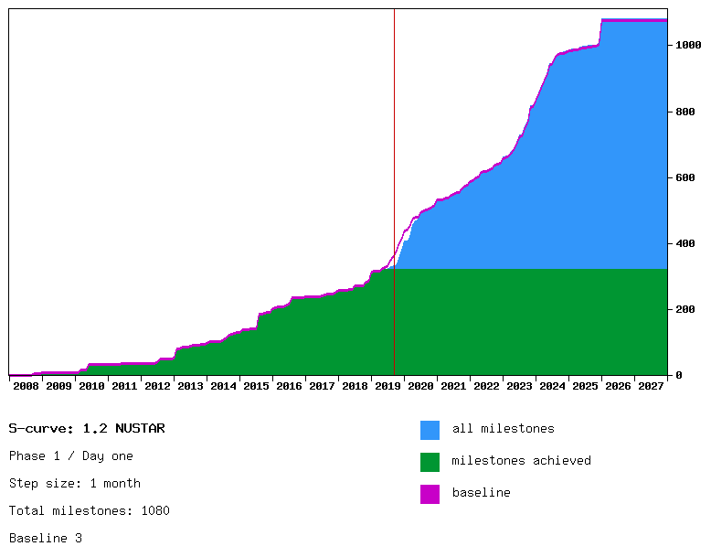
“Day one” project plan (September 2019)

Slide 6
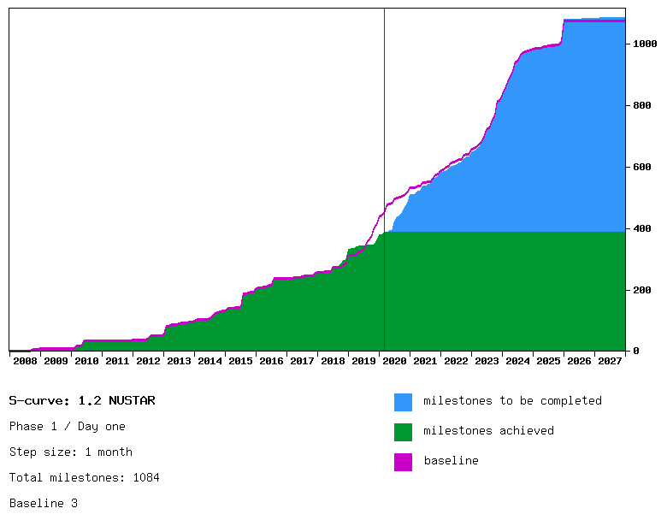
“Day one” project plan (February 2020)

Slide 7
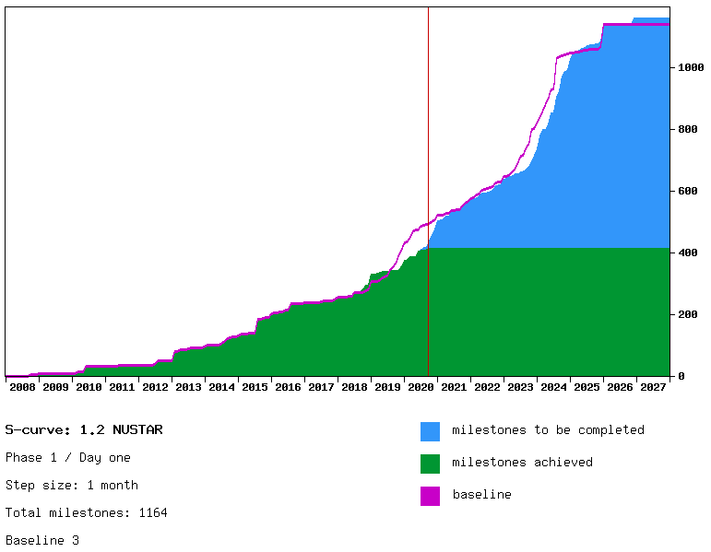
“Day one” project plan (September 2020)
Re-baselining for FAIR
project early next year

Slide 8
Lessons learned for new baseline
Main delays are due to administrative issues like overlong contracting times
Many items are produced and brought into operation without formal contract and ignoring formal FAT/SAT procedures
Collaborators need guidance to cooperate…
Things are getting better!
Remaining (respectively assumed new) float sufficient to keep end dates
There is a good chance that a new baseline with somewhat relaxed intermediate milestone dates but keeping end dates could be followed

Slide 9
Score Card
progressing steadily…

Slide 10
Risk Register
Waiting for decision on Common Funds
Done
Technical investigation ongoing
New risk: CALIFA forward endcap phoswhich inhomogenious light yield

Slide 11

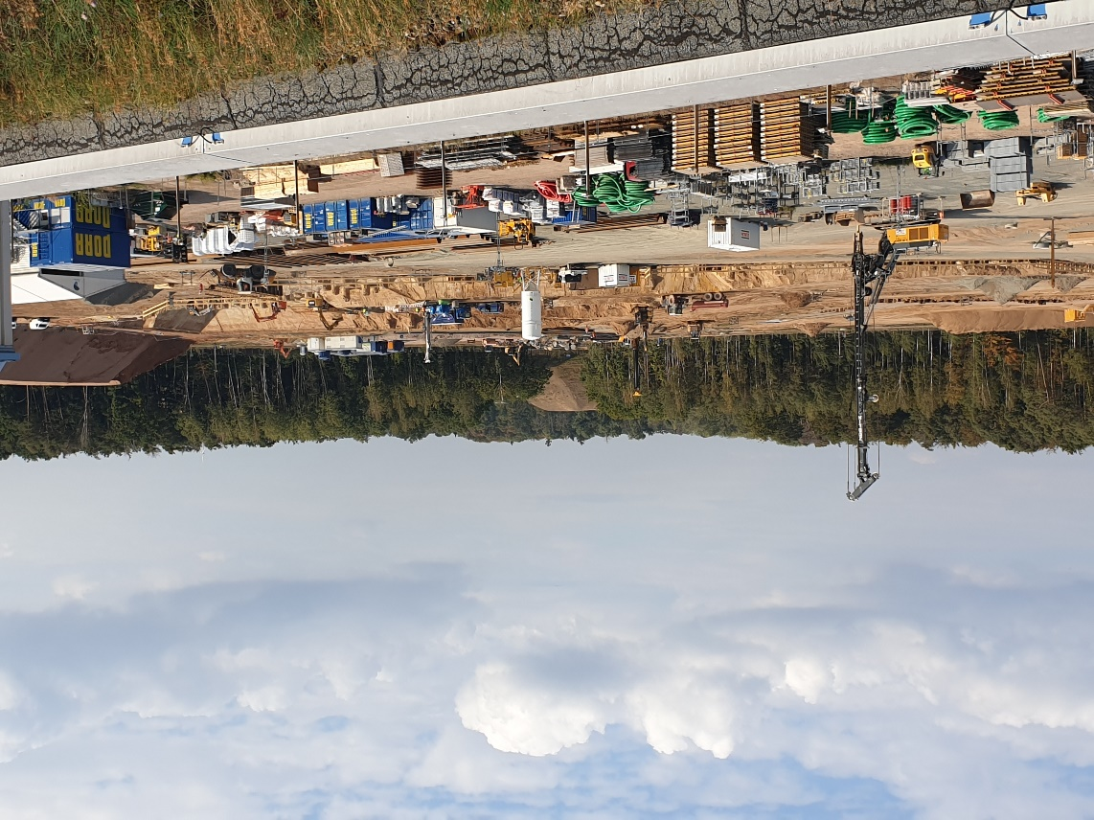
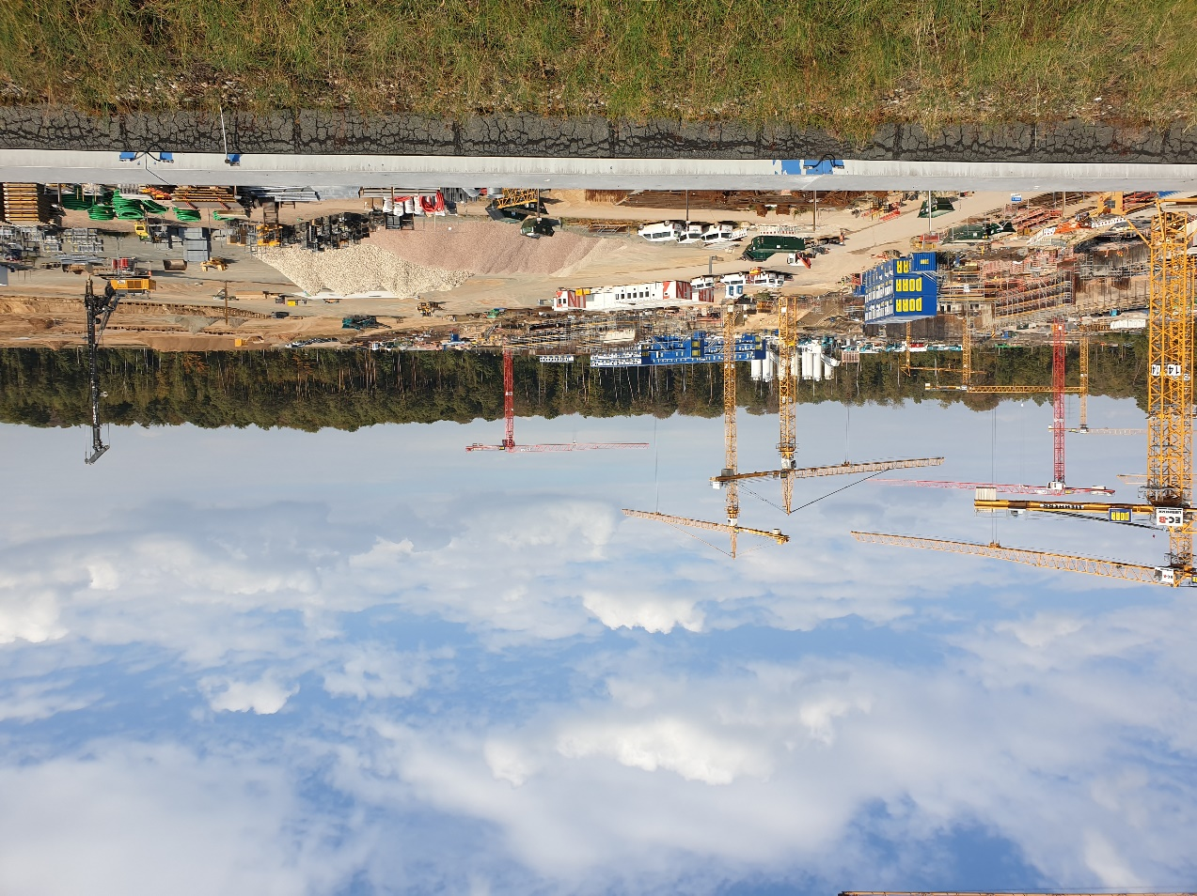
Super-FRS and NUSTAR Caves
All NUSTAR experiments are planned to move into the FAIR buildings in 2022-2024.
Construction just started!
SIS 100
LEB
S-FRS
HEB
Super-FRS

Slide 12
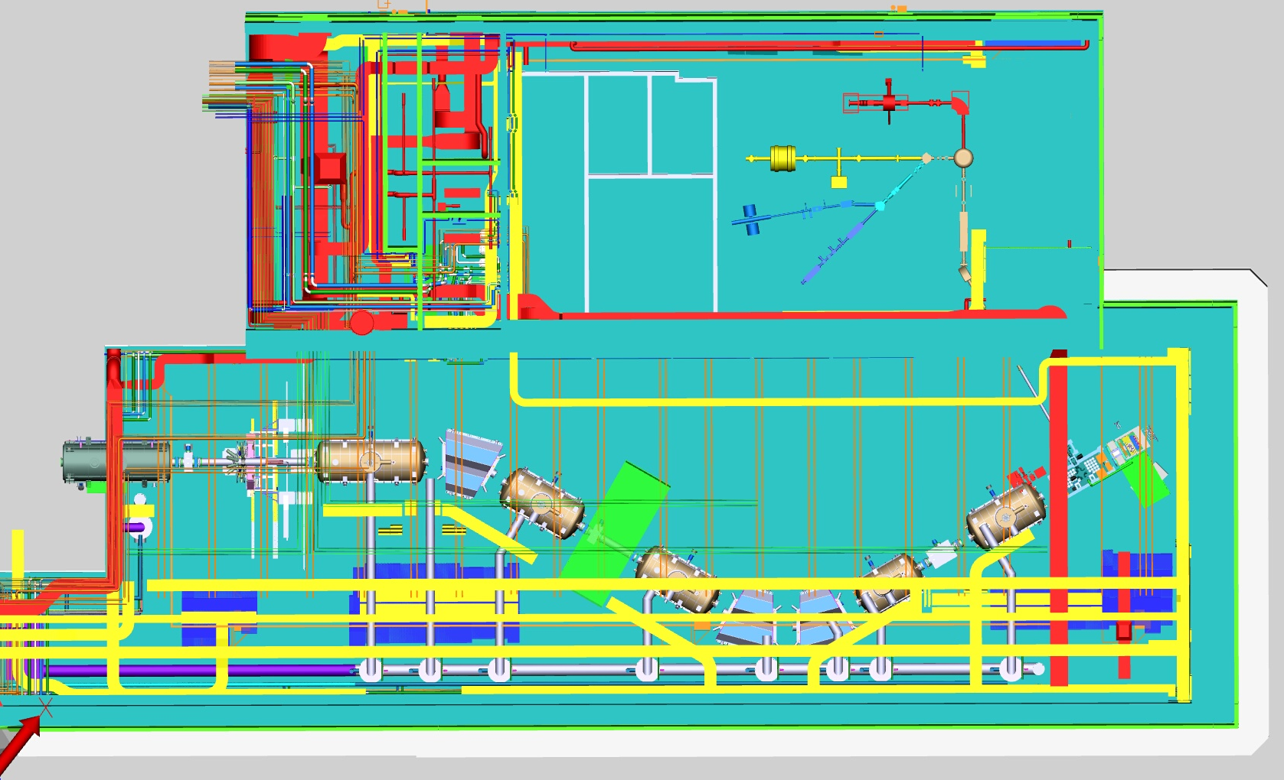
Infrastructure preparations
Many activities are going on
cable lists
door lists
emergency switches
cryo-line optimization
collision checks
LEB Cabin
installation planning
….

Slide 13
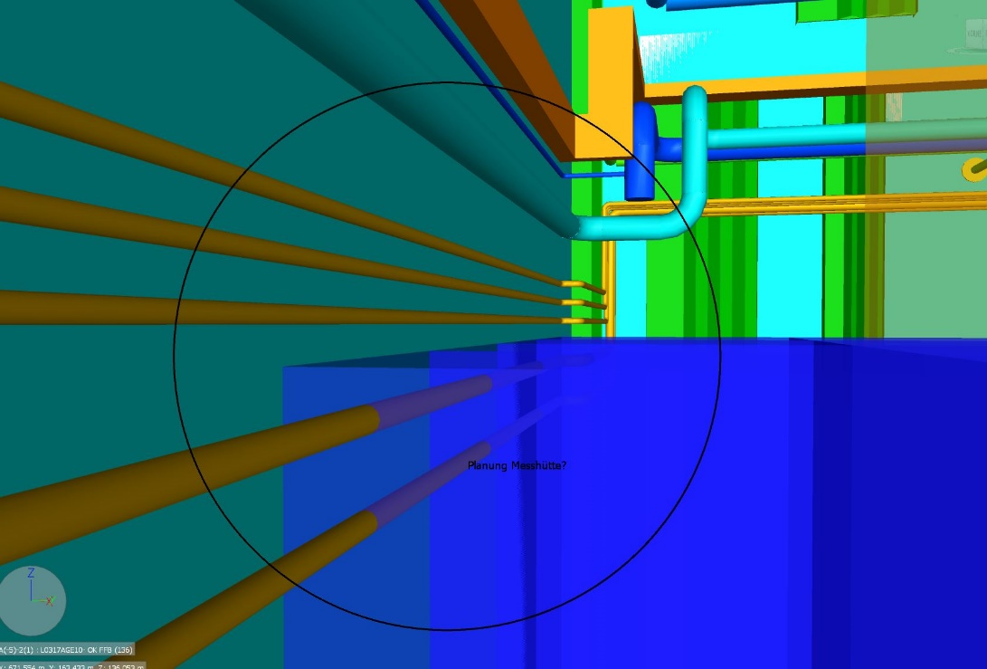
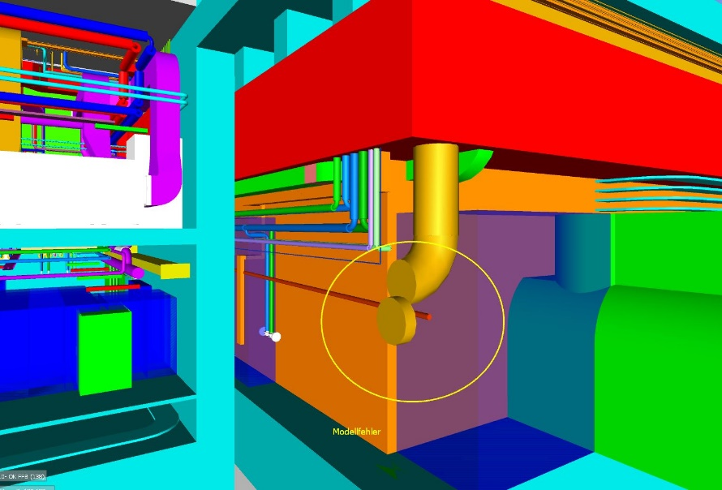
Collision Review L0317A
Piping through Racks
..or sometimes just a mistake in the model data…

Slide 14
Installation Planning - Structure
Installation Overview
(Construction)
SFRS
Installation plan
NUSTAR
Installation plan
S007.A112
S007.A119
S007.M11
S007.A112 Assembly
S007.A119 Execute SAT Ba / test without beam
S007.M11 SAT Ba accepted / ready for beam
NUSTAR
Level3 Plans
CR Installation plan
MSP Plans / Overlap
Input / Influence
Outcoming Activities / Milestones

Slide 15
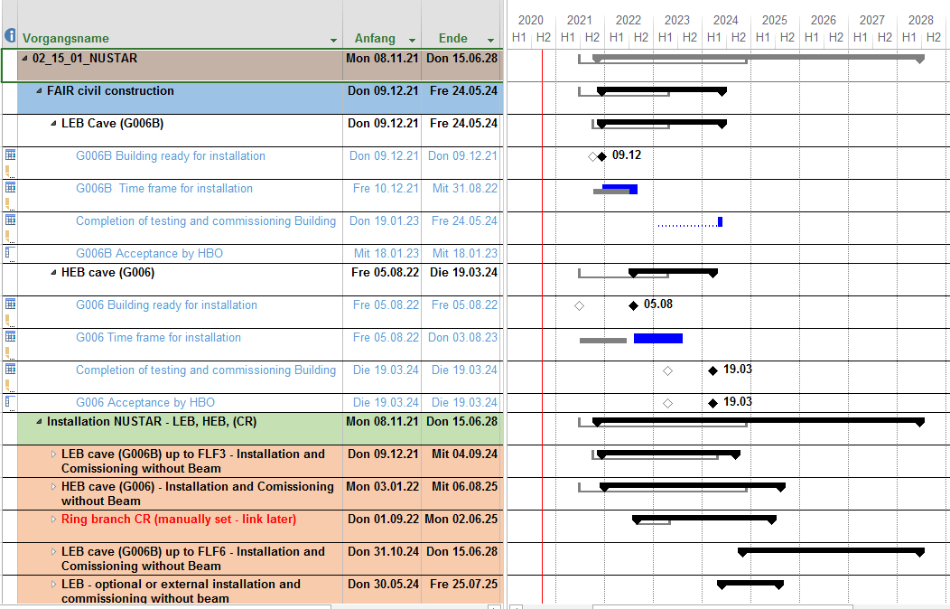
Installation Planning … in the making
work in progress
managed by Petra Hofmann

Slide 16
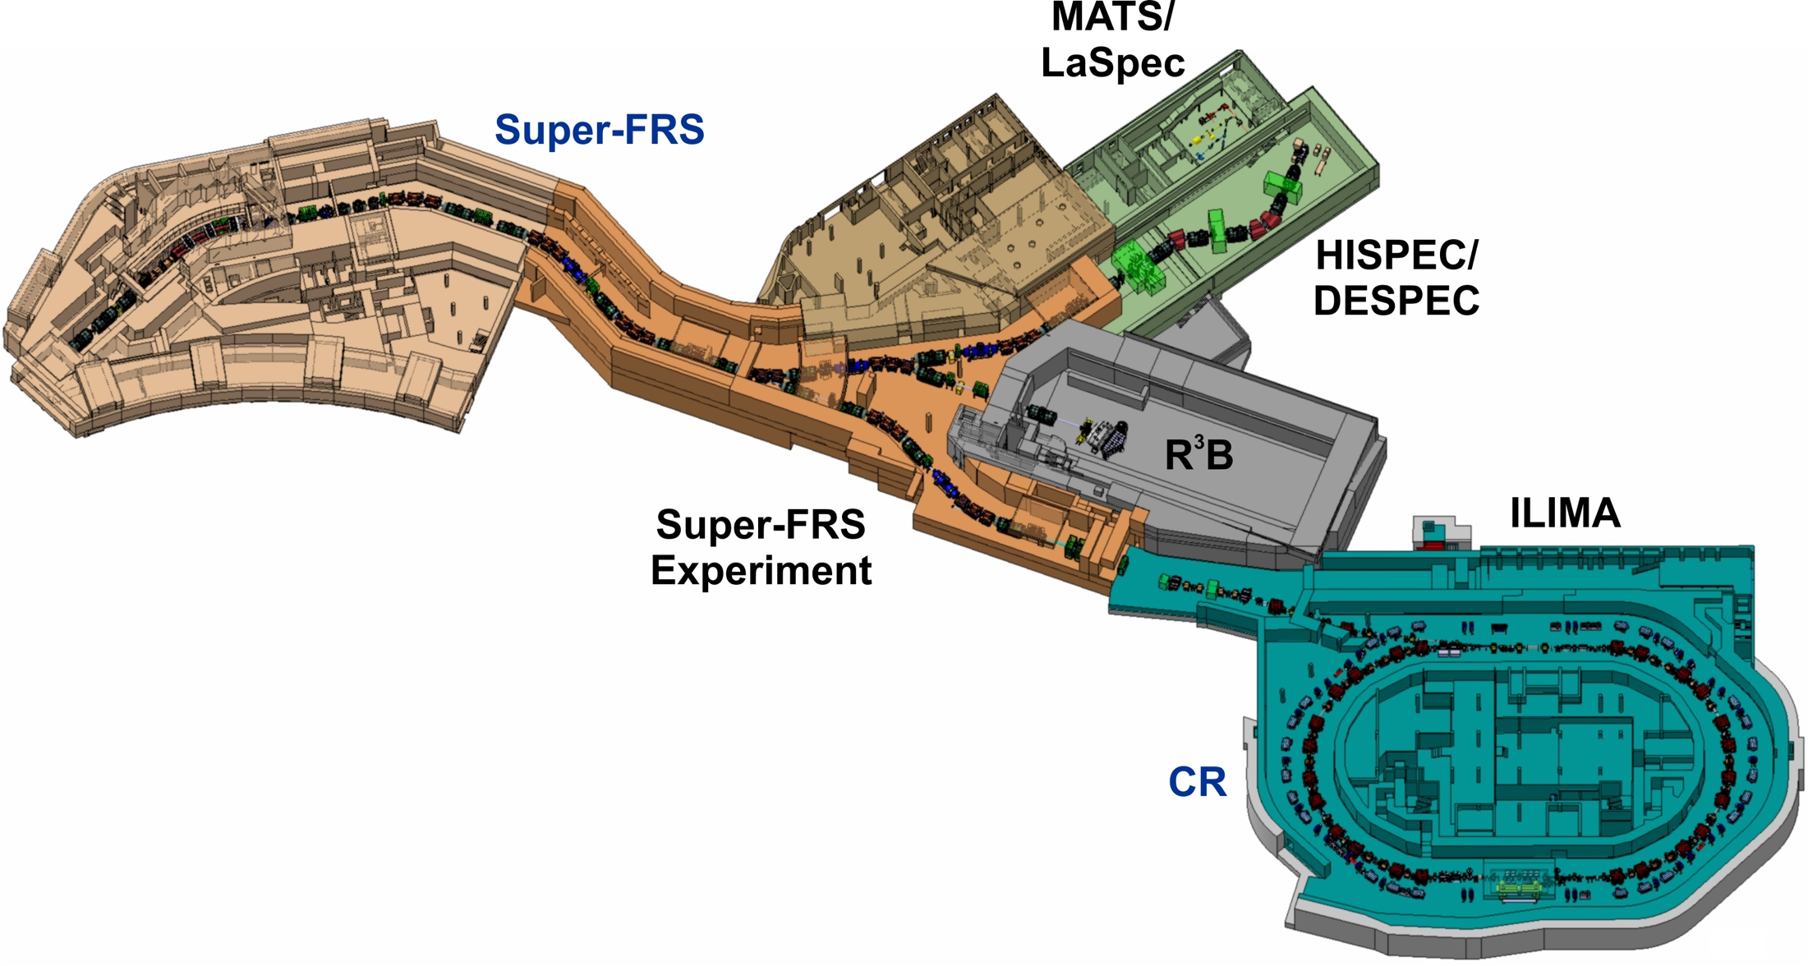
NUSTAR Early Implementation
Commissioning and early physics program possible with SIS18 beams
Could even start once Super-FRS is installed until FMF2 (delaying further installation…)
Low-energy and ring branch will be taken consecutively into operation

Slide 17
Safety requirements at GSI/FAIR
For each component, subsystem or set-up to be operated at the GSI/FAIR campus it is mandatory to have a
Risk assessment (list of possible dangers)
and a
Safety concept (list of measures to reduce and manage the risks)
There needs to be a written document which could be in the simplest case a manual, but depending on the complexity it may require special documents. Obviously for trivial items no written document is requested. One needs to demonstrate that one has carefully thought about risks.
First Safety and QA officer for all FAIR research to be hired

Slide 18
Conclusion
NUSTAR progressing well
Components and systems realized in time
Planning and infrastructure preparation advanced
Early physics already possible in 2024
MoU needed soon to enable infrastructure funding
Safety requirements need to be tackled

