Slide 1
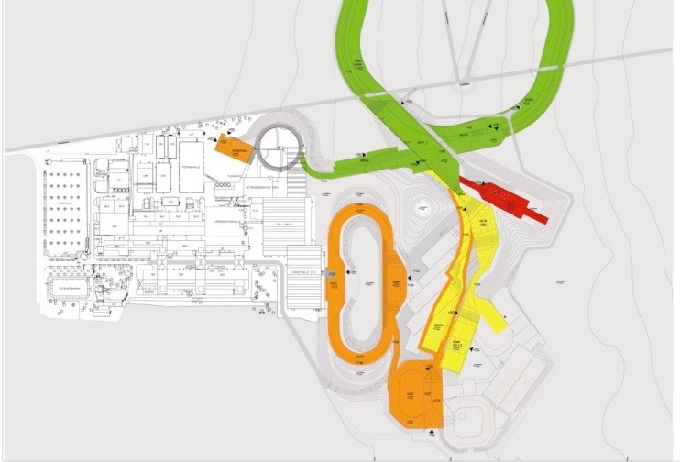
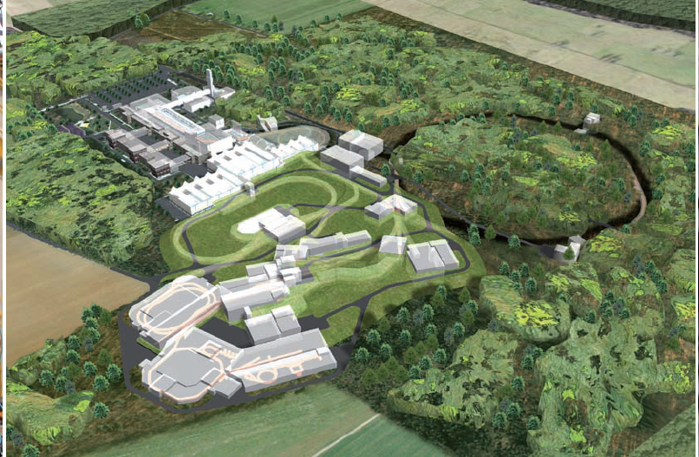
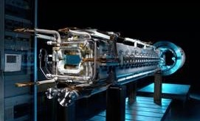











APPA collaborations
SPARC Progress Report
ECE meeting, October 27th, 2020
Thomas Stoehlker, Deputy Spokesperson
Angela Braeuning-Demian, Technical Coordinator
Finland
France
Germany
India
Poland
Romania
Russia
Slovenia
Sweden
UK

Slide 2
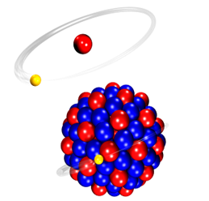
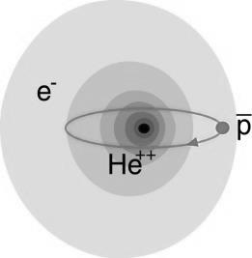


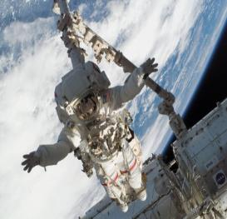
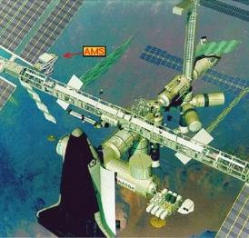
Atomic Physics, Plasma Physics, and Applied Sciences
from fundamental to applied research
FACILITY CAPABILITY
SCIENTIFIC CAPABILITY
Highest Charge States Extreme Static Fields
Relativistic Energies Extreme Dynamical Fields and Ultrashort Pulses
High Intensities Very High Energy Densities and Pressures
High Charge at Low Velocity Large Energy Deposition
Low-Energy Anti-Protons Antimatter Research
Atomic Physics
Plasma
Materials
Bio
SPARC
FLAIR
Plasma@FAIR
MAT/BIOMAT
BIO/BIOMAT
strong field research
... probing of fundamental laws of physics
antimatter
... matter / anti-matter symmetry
extreme states of matter
... states of matter common in astrophysical objects
radiation effects
... degradation and nanostructuring of materials
space travel
& therapy
... cosmic radiation risk and theranostics

Slide 3

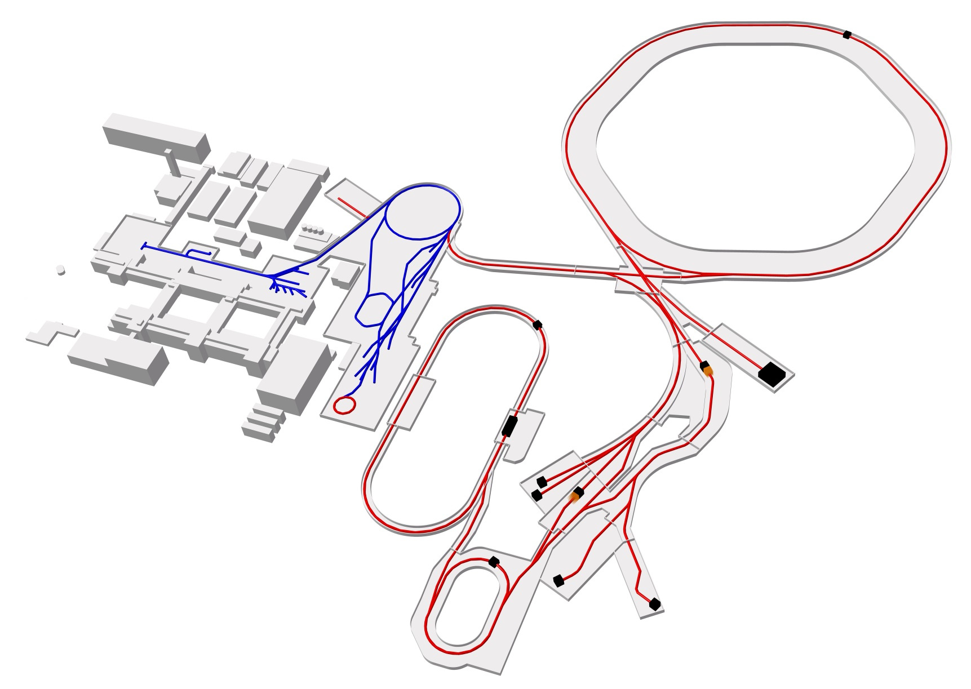

SPARC Facilities at FAIR
SIS 18
SIS 100
Linear
accelerator
CRYRING
ESR
HITRAP
HESR
HESR
APPA Cave
SIS100
100 meters
Existing facility
Planned facility
Experiments
Collector
ring

Slide 4

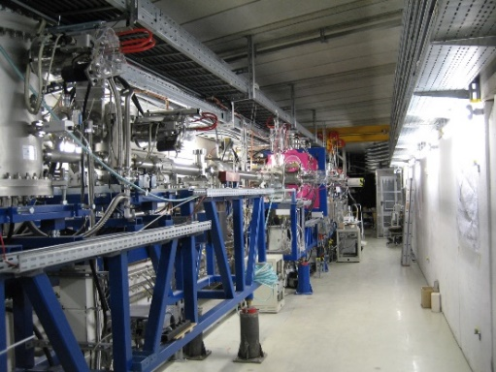
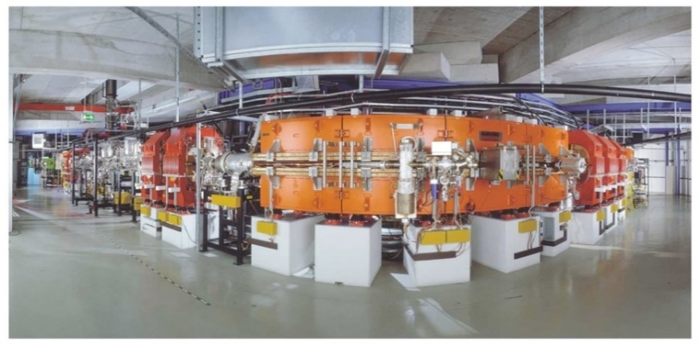
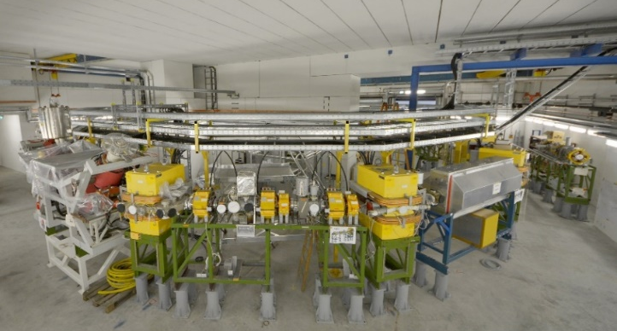

FAIR Phase-0: Granted Beam Times
KIND REMINDER: ESR, CRYRING@ESR & HITRAP are part of the Modularized Start Version (MSV)
Storage & Trapping of Highly Charged, Heavy Ions and Exotic Nuclei
HITRAP
ESR
CRYRING
GPAC 2017: Category A 186 shifts / 62 days
Delay by more than two years
ESR / CRYRING@ESR: Substantial progress in 2020 (despite COVID-19): commissioning and first experiments
HITRAP: Not yet ready, but there are no real technical issues
GPAC 2020: Category A 420 shifts / 140 days
substantial financial
support provided by e.g.
Joint ECE 13 and ECSG 4 Meeting, 26-30 October 2020, Darmstadt

Slide 5

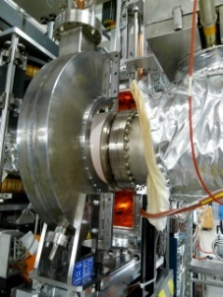
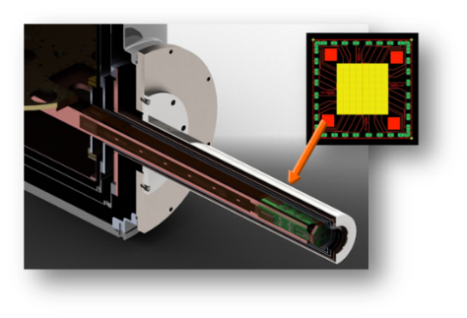
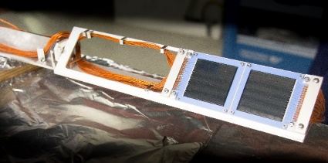

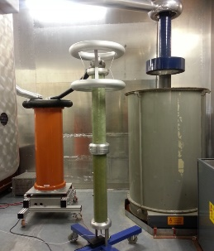
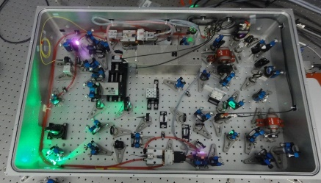
FAIR Phase-0:
Experimental Storage Ring ESR
Experiments FAIR Phase-0 (A and A-)
E125 Δn=0 in He- and Li-like U scheduled but postponed / COVID-19
E137 Spectroscopy via RCE Li-like U scheduled but postponed / COVID-19
E128 Hyperfine Spectroscopy delayed
E135 Spectroscopy of ³P₀ in Be-like Kr (laser, XUV) to be continued
E132 1s-1s Ioniz. & Charge Transfer (target, e⁻-spectr.)
E121 Bound state beta-decay (Schottky)
E127 astrophys. p-process (p,γ) (target) to be continued
ü
Dedicated & novel FAIR equipment
ü
ü
ü
µ-Calorimeter
Facility Challenges
Schottky
Si-strip p.-detector
Commissioning of new FAIR control system (substantial progress)
diagnostics, and in-ring instrumentation; (substantial progress)
re-establishment of deceleration capability (substantial progress)
MOST IMPORTANT FOR 2021: REPAIR OF E-COOLER
(needed for E128 and “nuclear clock” exp. ²²⁹Th) and further commissioning of
FAIR control system; improvement of vacuum conditions
Joint ECE 13 and ECSG 4 Meeting, 26-30 October 2020, Darmstadt

Slide 6
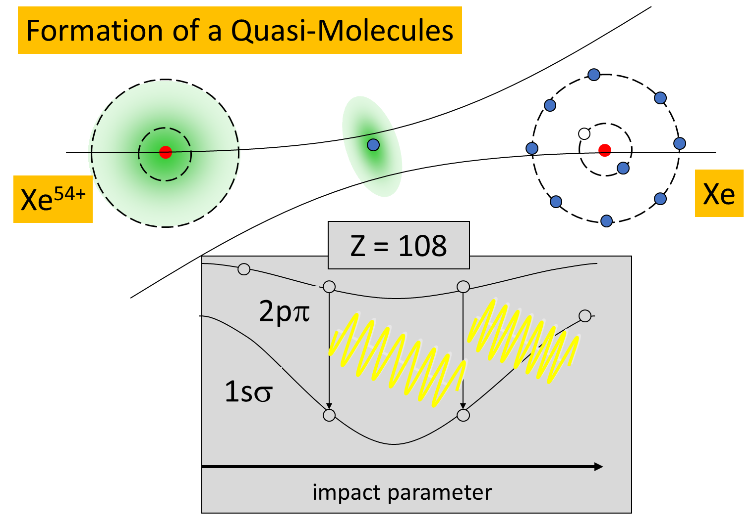
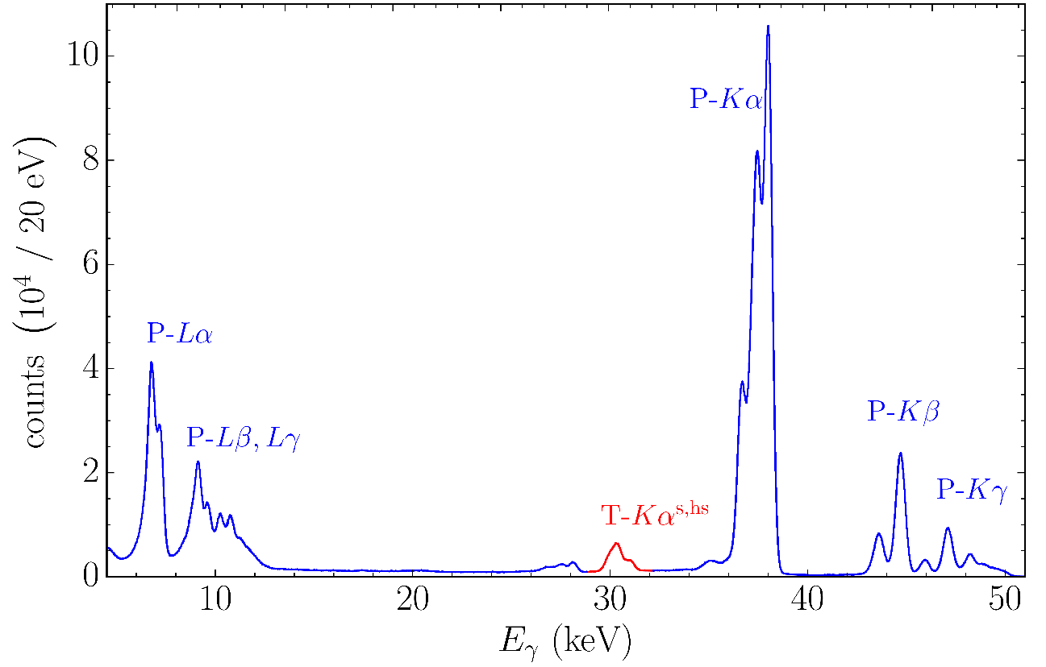
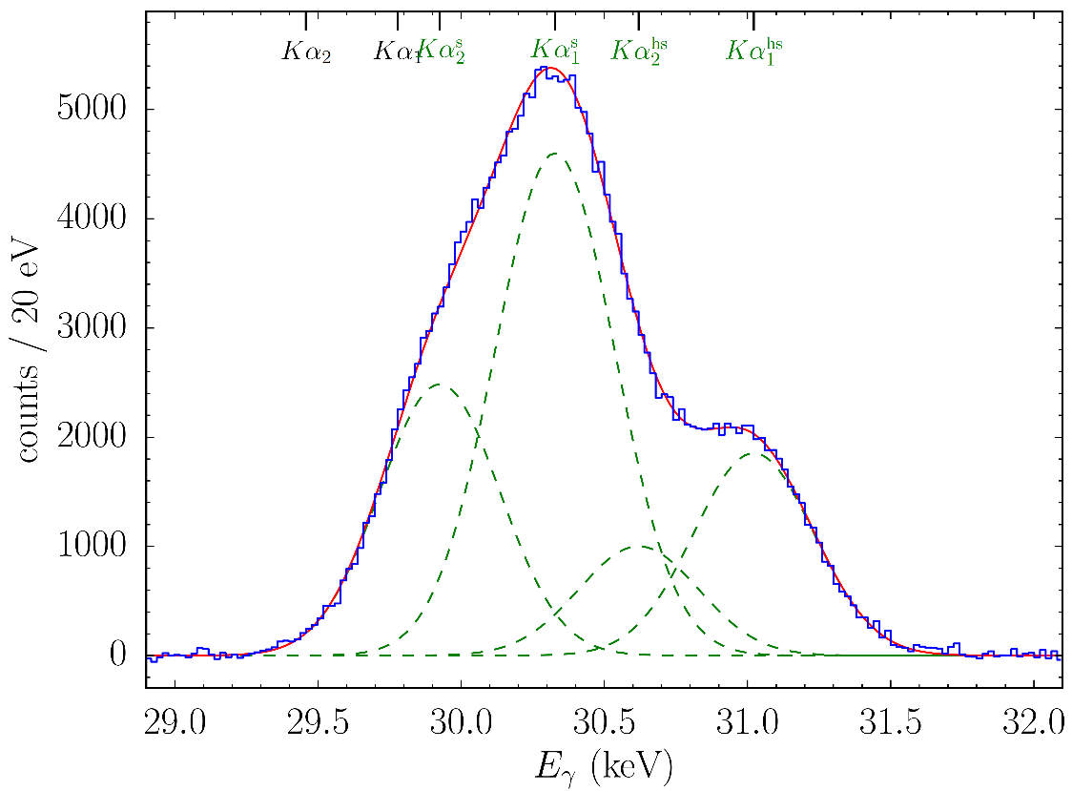

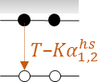

E132 Towards Super-Critical Fields:
Xe⁵⁴⁺ + Xe collisions at the ESR
Strategy
Innermost molecular orbitals of super-heavy molecules
Map x-ray energies E(R) as function of impact parameter
1s to 1s electron transfer in Quasimolecules (Z_{united}=108)
Experiment completed
ü
Experiment
Adiabatic collisions (15 and 30 MeV/u)
TOF of target recoil ions
Kα x-rays detection (target and projectile)
Coincidences target recoil and Kα x-rays
Strong oscillations in the impact parameter dependence expected: determination of binding energies
Xe⁵⁴⁺ + Xe at 30 MeV/u
Projectile
Target
satellite
hyper-
satellite
P.-M. Hillenbrand, S. Hagmann et al.
Joint ECE 13 and ECSG 4 Meeting, 26-30 October 2020, Darmstadt

Slide 7


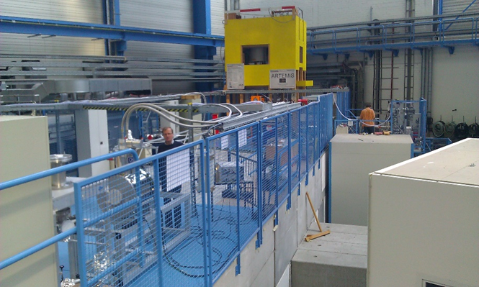
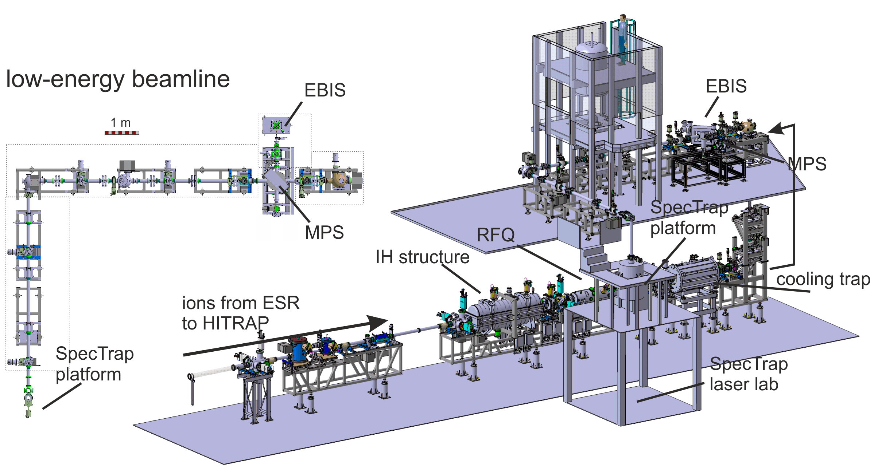
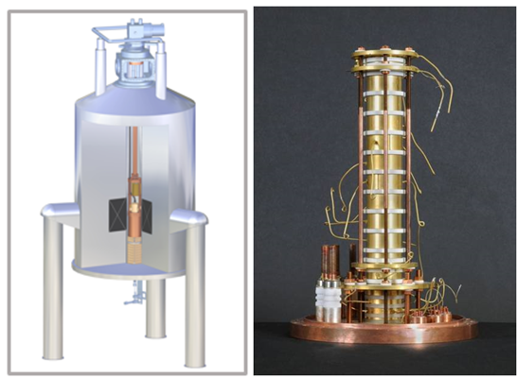

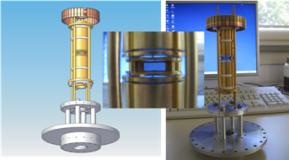

HITRAP
Challenge
Implementation of FAIR controls
Commissioning of the HITRAP decelerator ( with FAIR controls)
Commissioning of the cooler trap (scientific challenge) and transport of HCI to the HITRAP experiments
First experiments with beams from ESR in 2022/2023
Experiments
E130 Cooling and precision spectr. of ²⁰⁹Bi⁸²⁺ with ARTEMIS and SPECTRAP (traps) A [DELAYED]
Joint ECE 13 and ECSG 4 Meeting, 26-30 October 2020, Darmstadt

Slide 8
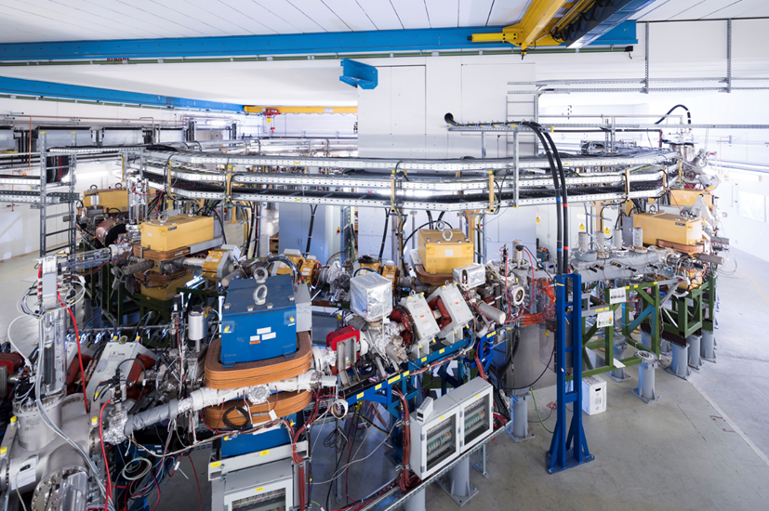
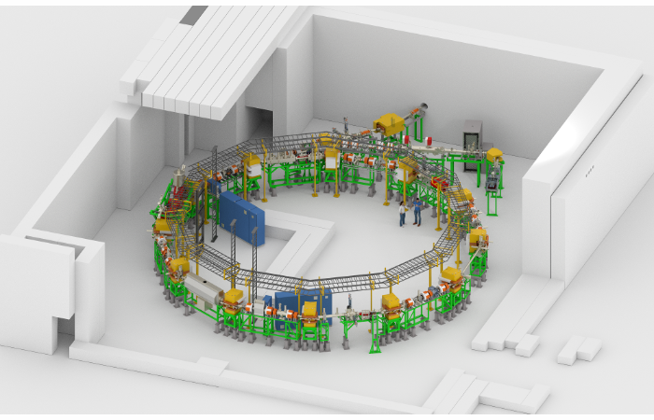
CRYRING
Fully installed and operational
Ion sources:
ESR, MINIS and EZR (local)
Gas Jet target
E-target
CARME
E-cooler
Extraction &
MAT setup
Laser spectroscopy
Notes:
Laser infrastructure (laser lab, laser beam transport, laser coupling to the ring) have been already installed. The laser is fully funded and will be provided by U. Darmstadt

Slide 9

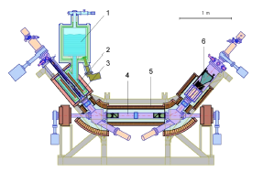
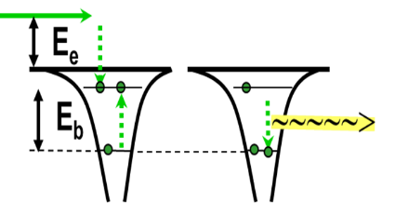
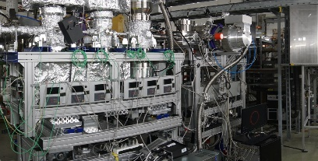

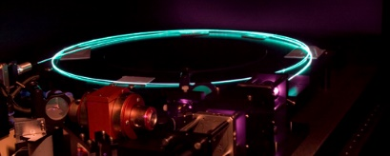

FAIR Phase-0: CRYRING
CRYRING
CRYRING Electron Cooler
Up to two orders of magnitude higher resolving power as compared to the ESR
Experiments FAIR Phase-0
E138 1s Lamb Shift in U⁹¹⁺ scheduled but postponed / COVID-19
E129 Photoionization of C¹⁺ (laser) to be continued
E131 Spectroscopy of Be-like ions scheduled but postponed / COVID-19
S461 Nuclear astrophysical reaction studies (target) A-
2020 commissioning of CRYRING with beams from ESR
ü
Dedicated & novel FAIR equipment
SPARC
Internal
Target
Facility Challenge
(substantial progress)
Electron cooler
Commissioning of ring installations for experiments
Test beams from ESR: Pb⁷⁸⁺, Pb⁸²⁺
XUV coupling unit
(substantial progress)
µ-calorimeter
(substantial progress)
Further improvement of vacuum condition towards 10⁻¹² mbar
Substantial increase of the amount of stored ions (in particular ions from ESR)
Local injector
XUV photon source
Si-strip p.-detector
Joint ECE 13 and ECSG 4 Meeting, 26-30 October 2020, Darmstadt

Slide 10
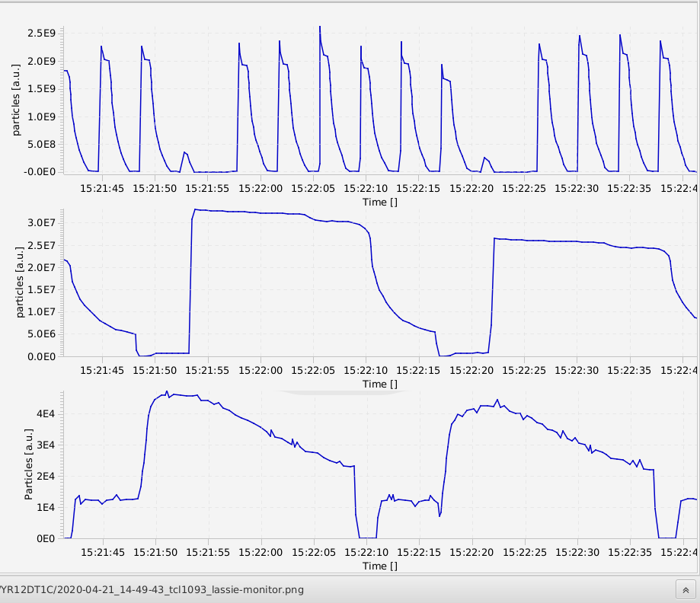
CRYRING@ESR: commissioning 2020
SIS18
all relevant ring systems are commissioned
beam injection from ESR and storage in CRYRING
reliable operation of the e-cooler
Further work:
improvement of the ESR-CRY beam transfer efficiency (25 % to 50 % losses!) and reduce the setting time
ESR
20 sec
CRY
15 sec
commissioning of the extraction
further improvement of the ring vacuum (1E-11 mbar)
installation of the experiment equipment for FAIR Phase zero 2021
complete the experiment infrastructure: particle detectors, scarpers, windows
Joint ECE 13 and ECSG 4 Meeting, 26-30 October 2020, Darmstadt
Notes:
beams of single charged ions

Slide 11
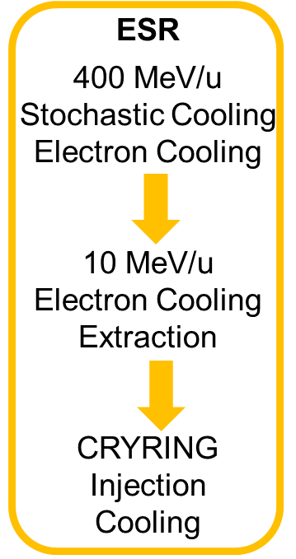
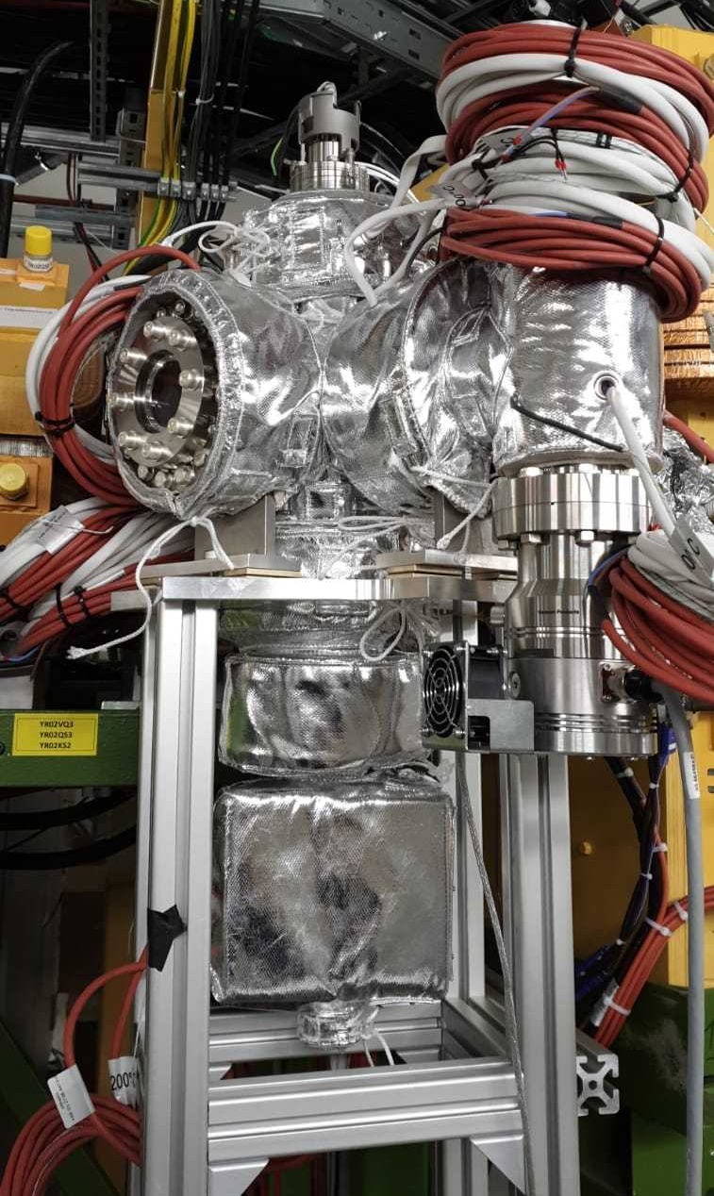
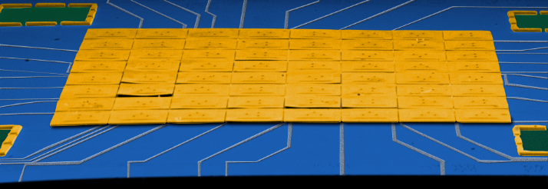
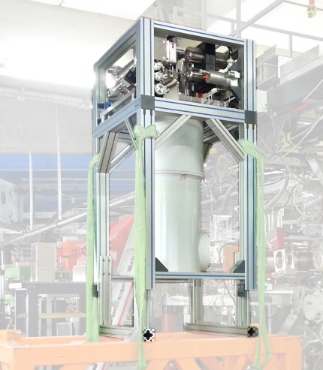
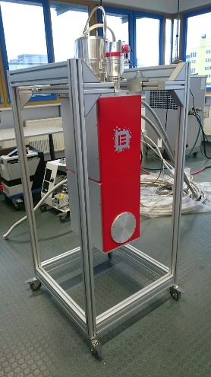




E138 1s Lamb Shift in H-like Uranium
(test of non-perturbative QED on the 1 eV level)
X-ray emission at CRYRING@ESR (electron cooler)
[commissioning run for E138]
Implementation of novel high-resolution, cryogenic μ-calorimeters with pixel areas
${Pb}^{82+}$+ $e^{−} →{Pb}^{81+}+ℏω$
(detectors are currently assembled)
X-ray viewport;
Be window
Viewports at 0 deg and 180 deg
(conventional Ge(i) detectors)
Intense Lyman ground-state transitions
Intense Balmer transitions (not affected by QED)
Status: Ready
42 approved shifts
11 research institutions from 4 countries
Joint ECE 13 and ECSG 4 Meeting, 26-30 October 2020, Darmstadt

Slide 12
Beam time Requests and Recommendations by collaboration, 2020
Collaboration | Shifts requested | Recommendations
 | total main+(sec+para)/10 | A | A-
APPA / SPARC | 927 (153) | 420 | 136
HADES / CBM | 574.7 (0) | 119 | 49
NUSTAR: R3B | 300.8 (23) | 164 | 28
NUSTAR: S-FRS | 394 (29) | 104 | 26
NUSTAR: DESPEC | 503.2 (59) | 145 | 22
NUSTAR: SHE | 447.6 (0) | 247 | 57
NUSTAR: ILIMA | 68 (0) | 18 | 0
∑ | 3215.3(266) | 1217 | 318
Numbers in parentheses are shifts granted by G-PAC43 to the unchanged rank A re-submissions.
Secondary and parasitic shifts count 1/10 of main shifts
Numbers without ERC-grant-related proposals
Joint ECE 13 and ECSG 4 Meeting, 26-30 October 2020, Darmstadt

Slide 13
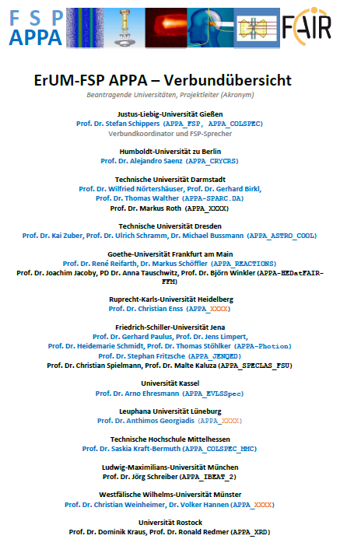
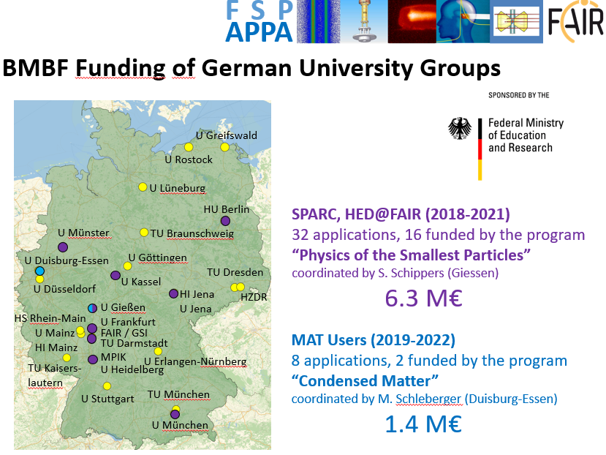
Preparation of ErUM-FSP „Verbundforschung“
Funding Periode 2021-2023
preliminay
[2018-2021]
FAIR Core-Invest: ≈ 1,7 M€

Slide 14
1.3.1.5 CRYRING Experiments
Funding: applications for new funding through the Collaborative Research German program; submission November 1st 2020
Reaction microscope
Röntgen optics
Ion detectors
Electron target
# Von Hamos high precision x-ray spectrometer for CRYRING, in-kind Kielce University, Po: funding 100% assigned by the FAIR council, inkind contract in preparation.
Completion date: 2023
Joint ECE 13 and ECSG 4 Meeting, 26-30 October 2020, Darmstadt

Slide 15
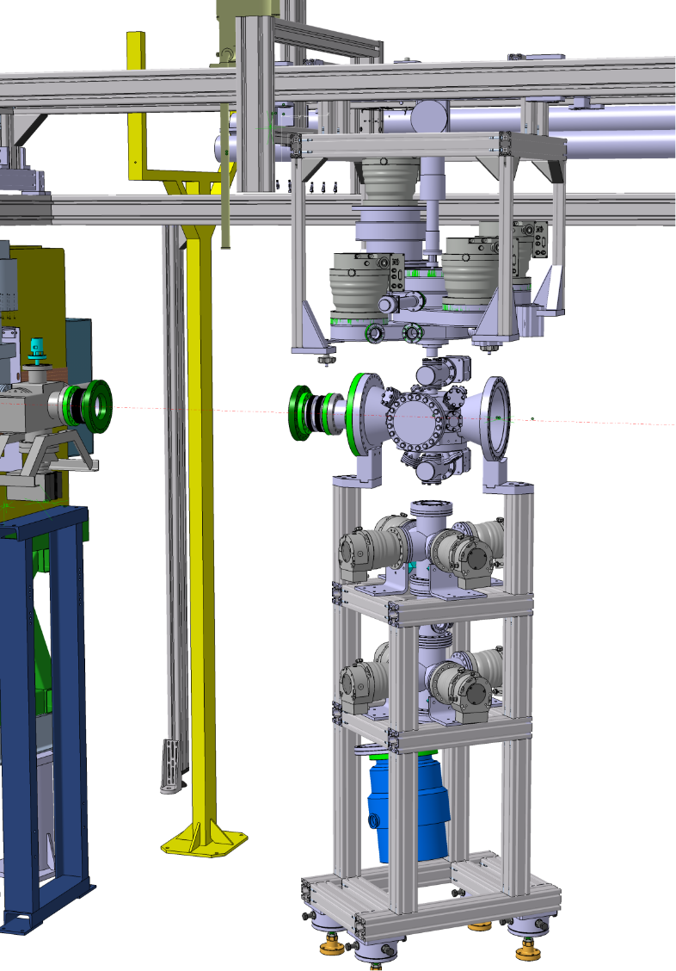
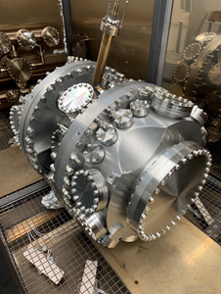
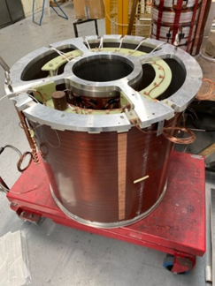
1.3.1.5 CRYRING Experiments
Construction status:
Internal Jet Target: almost all components for the vacuum system (in-kind Uppsala Univ.) have been delivered at GSI; due to the pandemic the delivery and the component testing at GSI are delayed. Delay in the realization of the target support frame.
Risk: further delays could jeopardize the time line f0r
installation in 2021
CARME spectrometer for nuclear reactions (in-kind UK): interaction chamber delivered at GSI: testing at GSI started. Next delivery scheduled for October 30st.
Risk: Extremely complex component, many subsystems;
Ring UHV compatibility
Mitigation: Extensive vacuum tests at Daresbury lab.;
Pre-installation leak tests at GSI
SPECTRAP magnet (in-kind Uppsala Univ.): construction and delivery delayed do to the pandemic. Factory acceptance scheduled again for November 2020.
Risk: online acceptance procedure; in case of nonconformities the magnet must be
sent back to UK (Brexit!!!)
Mitigation: List of requested tests sent to provider
Support from the GSI magnet and engineering teams who already
performed online magnet acceptances
Joint ECE 13 and ECSG 4 Meeting, 26-30 October 2020, Darmstadt

Slide 16
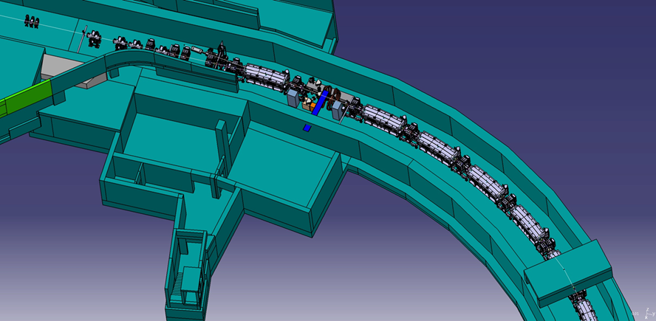
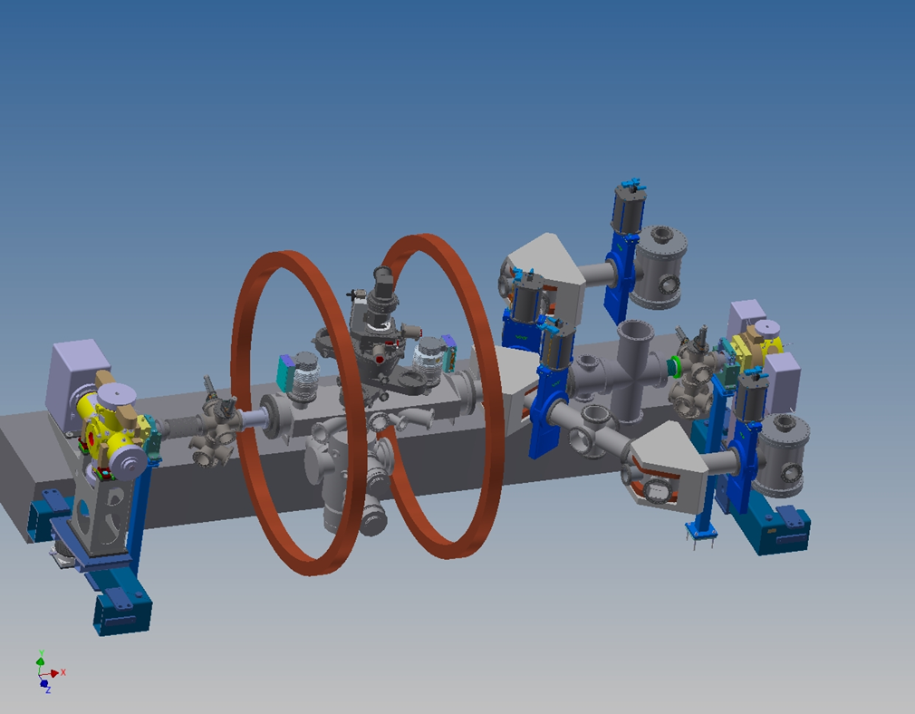
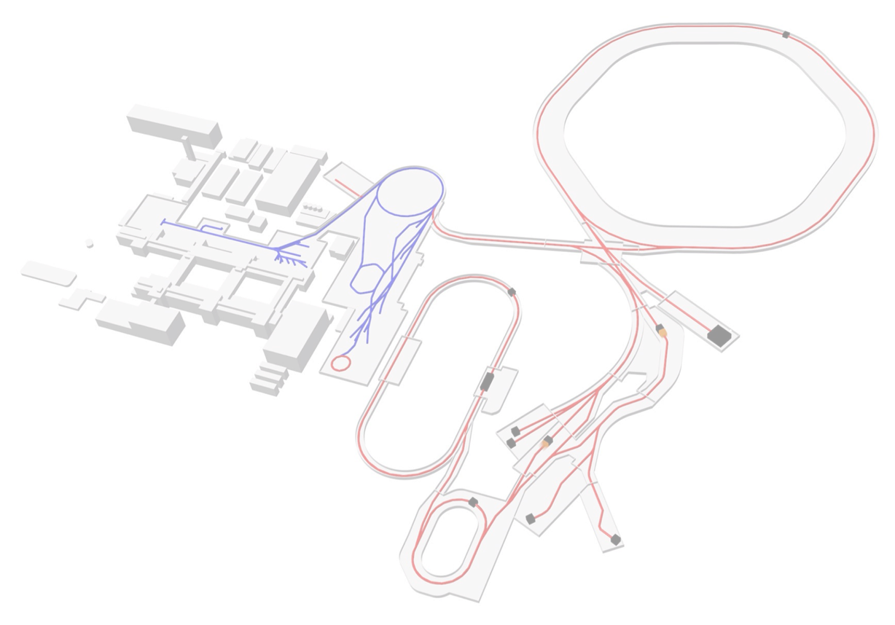
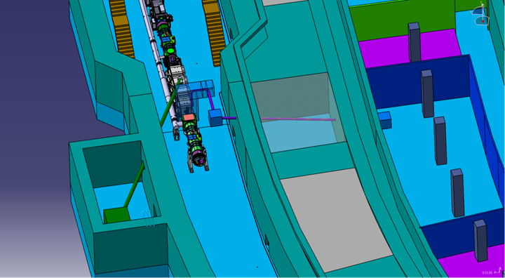

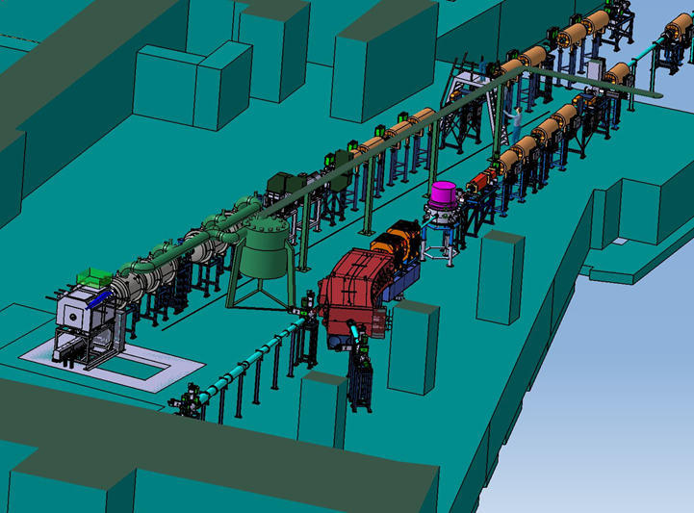
SPARC facilities in construction
HESR SPARC setup
SIS100
HESR
APPA cave
Joint ECE 13 and ECSG 4 Meeting, 26-30 October 2020, Darmstadt

Slide 17
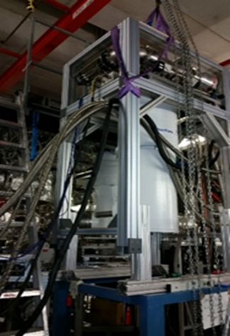
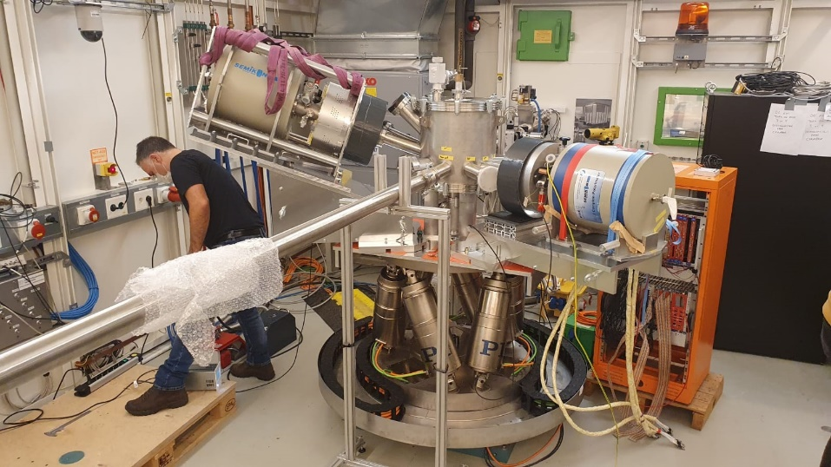
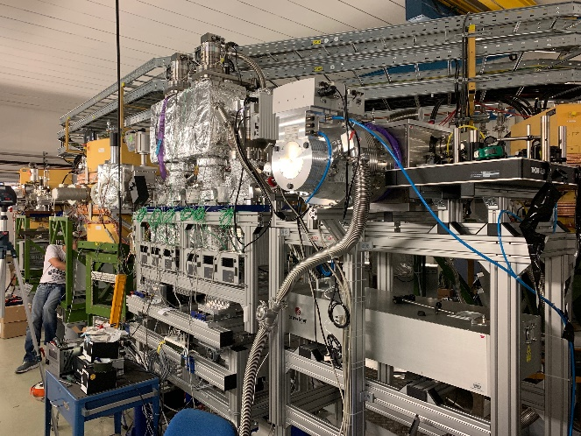
1.3.1.3 SPARC at HESR
Calorimeter _1: VF application for funding for electronics upgrade in 2020
2D Polarimeter: currently beam time at DESY, Hamburg: “Polarisation transfer in elastic scattering of high energetic photons”
XUV-laser setup: tested at CRYRING; beam time scheduled for 2021; in the future it will be installed at ESR for a FAIR phase–zero experiments
Risk: delay in the realization of the HESR building
Joint ECE 13 and ECSG 4 Meeting, 26-30 October 2020, Darmstadt

Slide 18
1.3.1.3 SPARC at HESR
Calorimeter _1: VF application for funding for electronics upgrade in 2020
2D Polarimeter: currently beam time at DESY, Hamburg: “Polarisationtransfer in elastic scattering of high energetic photons”
Internal jet target: construction postponed due to the vacuum system and the HESR time line
Lepton spectrometer: missing resources; postponed
Infrastructure: only partially funded
Risk: cost increase due to delays
Intense activity of Infrastructure planning: cabling, gas system, vacuum controls, labs, emergency-stop security system, etc
Risk: delay in the realization of the HESR building
Joint ECE 13 and ECSG 4 Meeting, 26-30 October 2020, Darmstadt

Slide 19
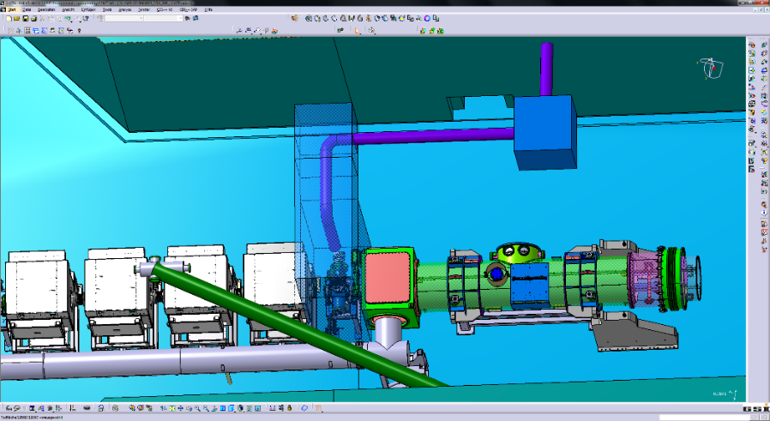

1.3.1.1 Laser cooling at SIS100
TDR submission to FAIR for evaluation
Application for funding to the Collaborative Program for German universities
Test beam time at ESR in FAIR Phase–zero 2020 with the prototype of the pulsed UV-Laser system (TU Da); further acquisition of laboratory infrastructure
SIS100 building in advanced stage of realisation: the special pipe housing the laser beam line was constructed, tested and delivered to the construction site for installation in the walls.
Risks: not all needed budget will be allocated
the proposed laser systems will not reach the design parameters
Joint ECE 13 and ECSG 4 Meeting, 26-30 October 2020, Darmstadt

Slide 20

1.3.1.2 SPARC at APPA Cave
a SPARC-BIOMAT common TDR is in work
preparation of the input for the design of the emergency-stop security system in cave and labs
intense work of integration and control of the experimental setups and the building general infrastructure
partial upgrade of the Control System of the RCE setup
Joint ECE 13 and ECSG 4 Meeting, 26-30 October 2020, Darmstadt

Slide 21
ECE/SGEC Recommendations
18_R09: ECE recommends to the APPA collaborations to carry out a detailed plan for expert needs and succession planning or new hires to mitigate the risk, and coordinate with FAIR management who to best address this to resolve thus risk.
    Researchers in the Atomic Physics group at GSI to cover the retirements and to cover specialized support tasks for the experiments (Internal targets, DAQ, UHV,..)
    Specialist for industrial controls for programing the vacuum systems for SPARC at FAIR
    Cryogenics specialist for support of CRYRING operation: request is on the management list; pending due to the limited personal budget and difficulty to find the experts. Mitigation: currently support from the GSI Cryogenics group
    Support / expertize for Work security and associated documentation for the conformity declarations
18_R12, 19_R01, 20_R05: TDR revisions where is necessary
No need for SPARC TDR revisions
20_R04: The collaborations are asked to track the risks and their mitigation and report back to ECE/ECSG.
Joint ECE 13 and ECSG 4 Meeting, 26-30 October 2020, Darmstadt

Slide 22
Summary and Outlook
significant progress in the realization of SPARC components are already available or in an advanced stage of realization
ESR FAIR controls installed and the ring is back in operation; first experiments successfully conducted
CRYRING commissioning well advanced: the ring is ready for operation with ESR beams
HITRAP goal, to make HITRAP ready for first experiments in 2021/2022.
few day-one components are still waiting for resources (funding and/or manpower)
one more Day-one-relevant TDRs is finalized
FAIR Phase-zero preparation of experiments are on a good track. Biggest challenge: to perform beamtimes in view of OVID-19
experiments integration in the CRYRING is of outmost importance
preparation of the approved FAIR Phase-zero experiments
Joint ECE 13 and ECSG 4 Meeting, 26-30 October 2020, Darmstadt
Notes:
log-range vs short –rage tasks
close- and far-future plans
the existing instruments must be used at GSI: installation and beam time request
left-over task: infrastructure and installation at FAIR

Slide 23
Thank you for your attention
Joint ECE 13 and ECSG 4 Meeting, 26-30 October 2020, Darmstadt

