Slide 1

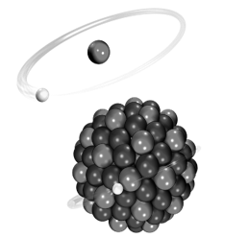
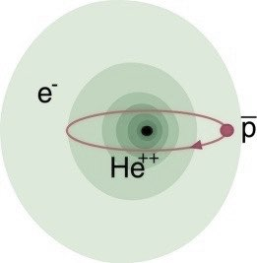
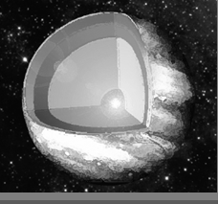

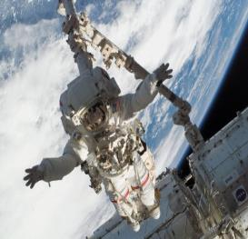
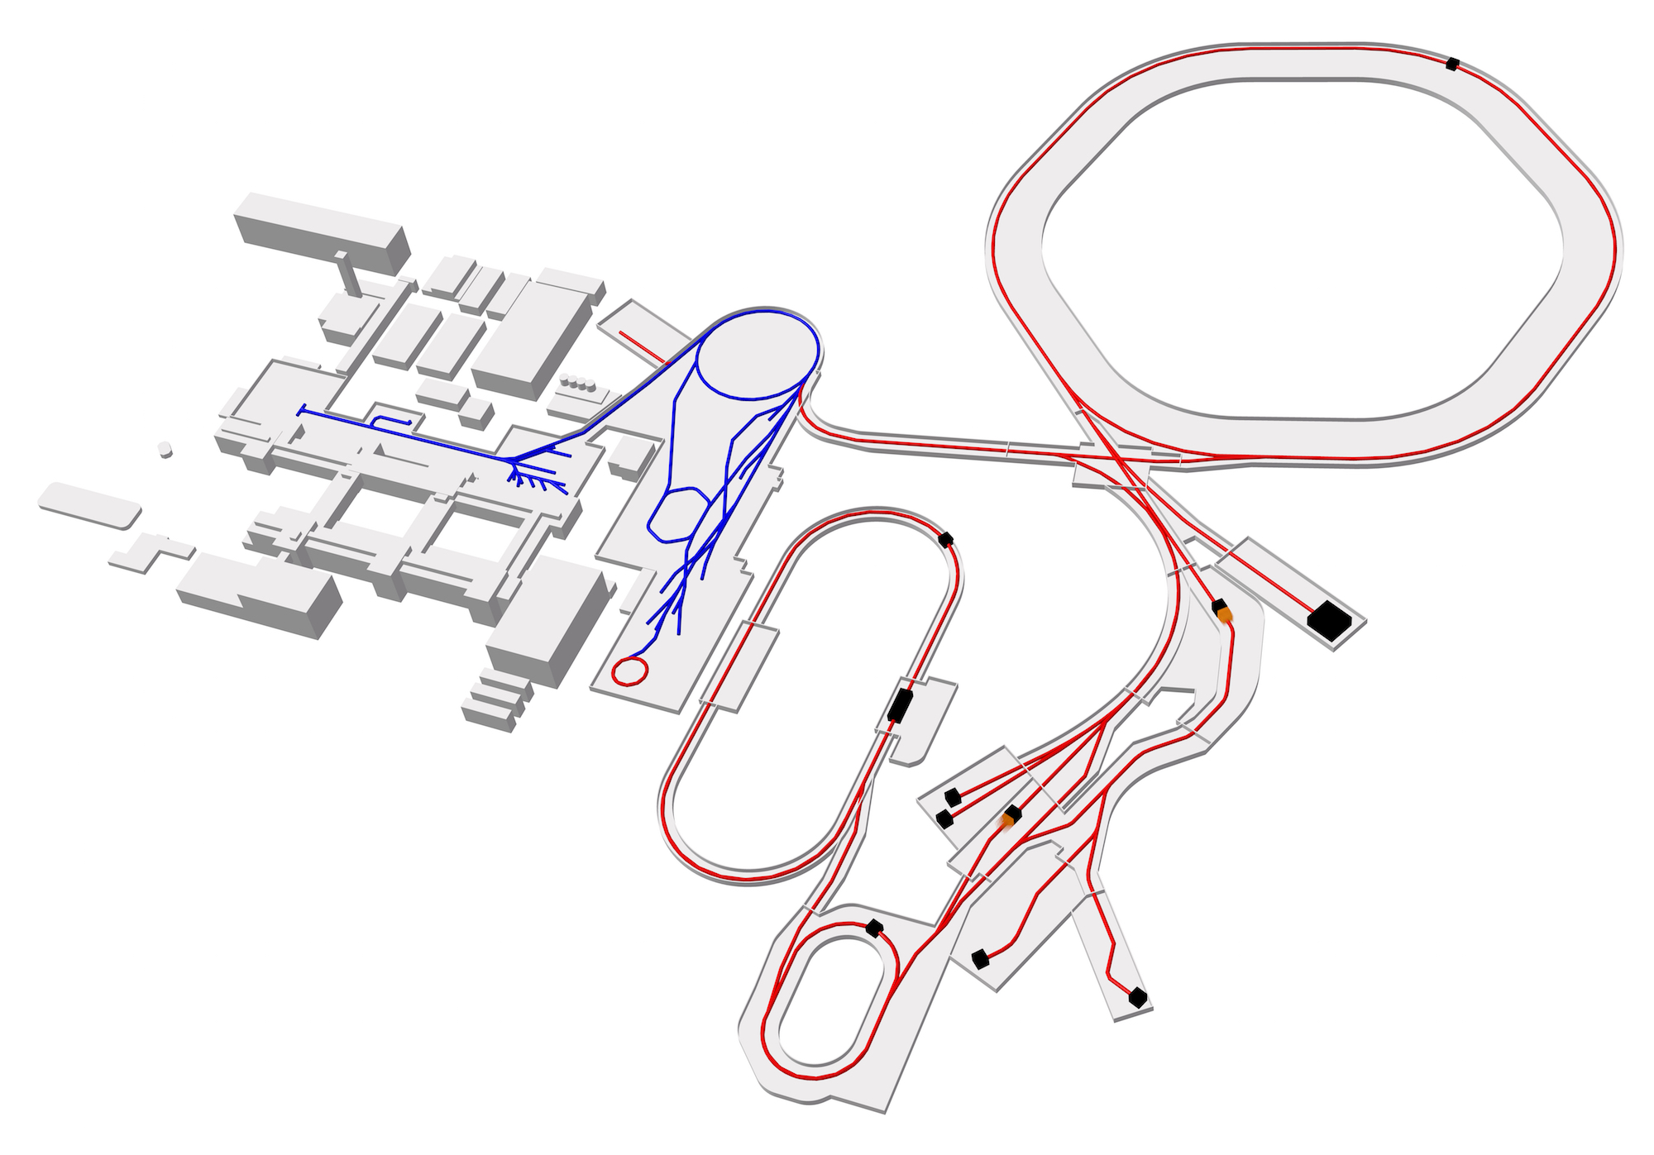
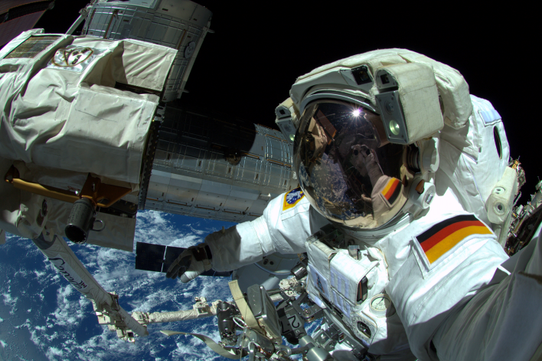
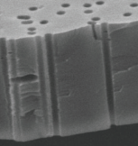
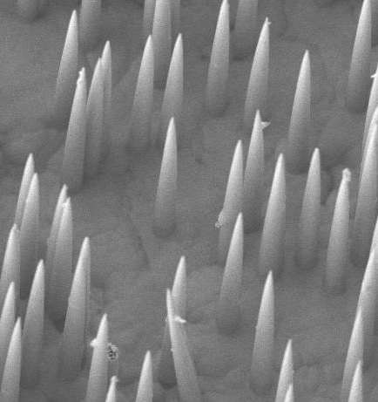

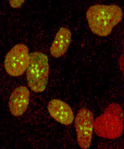
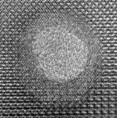
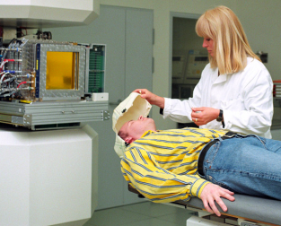
Biophysics and Materials Sciences
Atomic Physics
Plasma Physics
Materials Science
Biophysics
SPARC
FLAIR
HED@FAIR
MAT/BIOMAT
BIO/BIOMAT
strong field research
... probing fundamental laws of physics
antimatter
... matter / anti-matter symmetry
(not in MSV)
extreme states of matter
... common in astrophysical objects
radiation effects
... materials degradation and nanostructuring
space travel & therapy
... cosmic radiation risk and theranostics
M branch
X branch
10 µm
5 µm
Cave M
Cave A
CRYRING
APPA cave
Gd₂Ti₁O₅
5 nm

Slide 2
MAT Experiments within FAIR Phase-0
MAT-PAC recommendation for 2021/2022
36 proposals submitted for experiments in 2021/2022
recommended → 31 shifts at SIS-18 ( 77 requested)
143 shifts at UNLIAC (288 requested)
25 shifts at CRYRING ( 32 requested)
MATPAC recognizes
“… MAT program is highly multidisciplinary (materials science, nanoscience, applied physics, chemistry, astro-chemistry, mineralogy, geochemistry, molecular biology).
….. involves small teams: often multi-institutional and international (10 different countries)”.
“….New capabilities and target station development….”
  Multipurpose chamber – FTIR & cryogenic (M-Branch, UNILAC)
  ToF SIMS/SNMS - upgraded fs laser system (M-Branch, UNILAC)
  In-Situ Raman Spectroscopy (Cave A, SIS18)
  MAT target station with ToF SIMS/SNMS and desorption/ionization by highly-charged ions (CRYRING)

Slide 3
MAT Experiments within FAIR Phase-0
MAT-PAC recommendation for 2021/2020
36 proposals submitted for experiments in 2021/2022
recommended → 31 shifts at SIS-18 ( 77 requested)
143 shifts at UNLIAC (288 requested)
25 shifts at CRYRING ( 32 requested)
MATPAC recognizes
“… MAT program is highly multidisciplinary (materials science, nanoscience, applied physics, chemistry, astro-chemistry, mineralogy, geochemistry, molecular biology).
….. involves small teams: often multi-institutional and international (10 different countries)”.
Experimental developments are used at UNILAC and SIS-18 many of them can later be transferred to APPA cave and CRYRING
“….New capabilities and target station development….”
  Multipurpose chamber – FTIR & cryogenic (M-Branch, UNILAC)
  ToF SIMS/SNMS - upgraded fs laser system (M-Branch, UNILAC)
  In-Situ Raman Spectroscopy (Cave A, SIS18)
  MAT target station with ToF SIMS/SNMS and desorption/ionization by highly-charged ions (CRYRING)

Slide 4
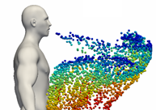
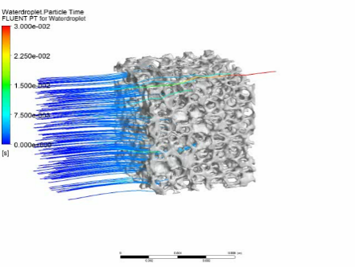
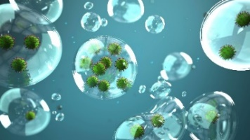
MAT Experiments within FAIR Phase-0
Contributions to Covid-19 related research
accepted
FISCOV: Helmholtz large research infrastructures in the fight against epidemic outbreaks
(DESY, HZB, FZJ, GSI & HI Jena)
Virus detection using coated single nanopores
Nanostructuring polymer substrates for fixing protein crystal and for XRD screening
pre-proposal accepted
CORAERO: Project in Impuls & Vernetzungs Fond
(DESY, DLR, HZDR, HZG, HMGU, KIT, GSI, TUM, UKA, OTH-R)
Airborne Transmission of SARS Coronavirus - From Fundamental Science to Efficient Air Cleaning Systems
Virus inactivation by membrane coating (MAT contribution)

Slide 5
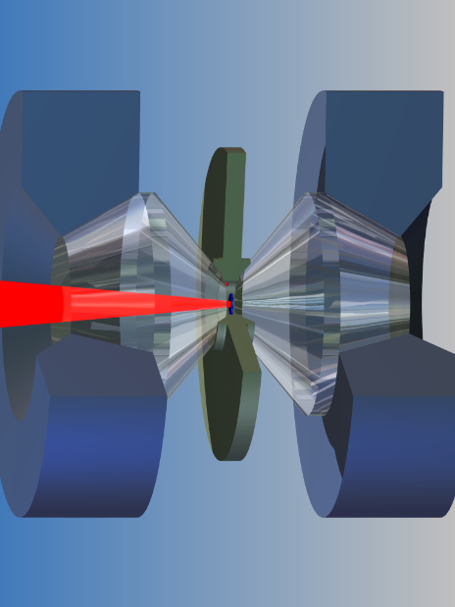
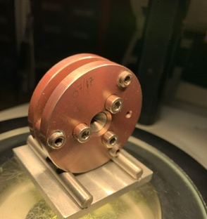
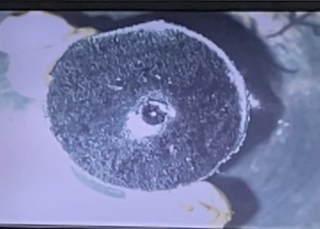
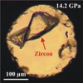
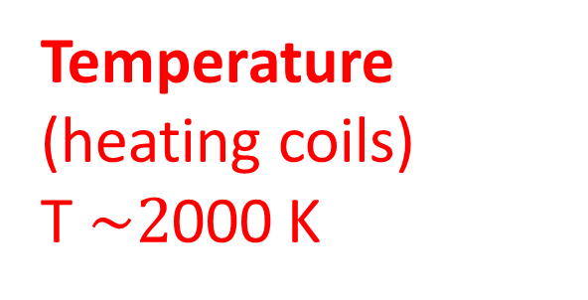
MAT Experiments within FAIR Phase-0
Materials under extreme conditions: High-Pressure Irradiations
gasket
Pressure
(up to 100 GPa)
2 mm
X
5 cm
Temperature (heating coils)
T $\sim 2$000 K
Irradiation
sample
diamond anvil cell (DAC)
sample
gasket manufacturing
and sample mounting

Slide 6
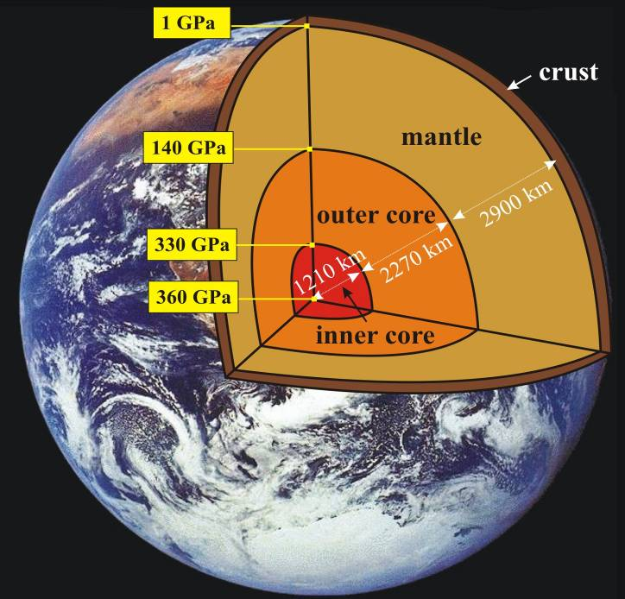
MAT Experiments within FAIR Phase-0
Materials under extreme conditions: High-Pressure Irradiations
gasket
Pressure
(up to 100 GPa)
2 mm
X
5 cm
Temperature (heating coils)
T $\sim 2$000 K
Irradiation
sample
Material science
novel phases
superconductors
energy materials (H₂, N₂, CO₂)
nanomaterials
Planetary Science
Rheology of Earths‘ interior
Planetary ice compounds (e.g. H₂O, CH₄, NH₃)
diamond anvil cell (DAC)
sample
gasket manufacturing
and sample mounting

Slide 7
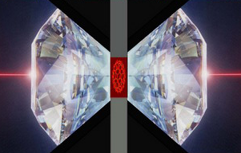



MAT Experiments within FAIR Phase-0
High-Pressure Irradiations and in-situ Raman spectroscopy
Raman laser
2 mm
Raman signal
2 mm
gasket with
sample
beam
collimator
new setting needed for in-situ Raman spectroscopy
Raman signal
Collaboration:

Slide 8
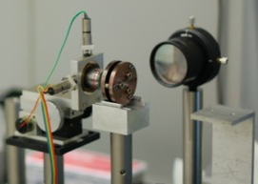
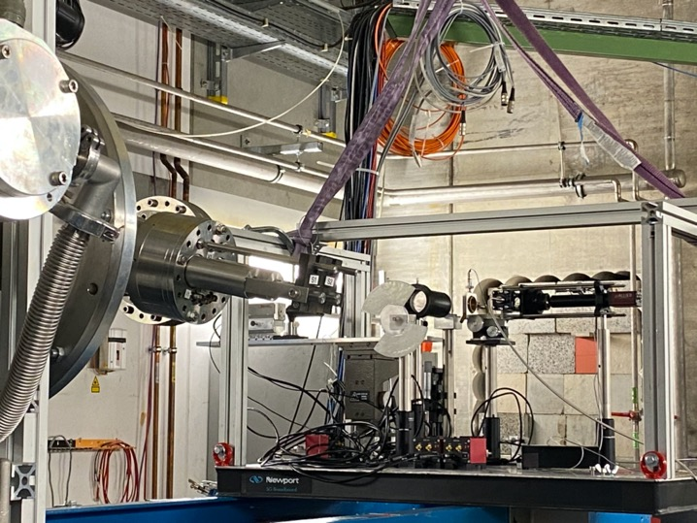
MAT Experiments within FAIR Phase-0
High-Pressure Irradiations and in-situ Raman spectroscopy
Raman laser
2 mm
gasket with
sample
New beam collimation system
beam
collimator
Raman signal
Customer-made Raman system for monitoring phase transformations of materials exposed to extreme pressure and beam conditions
Tests planned in beamtime 2021

Slide 9
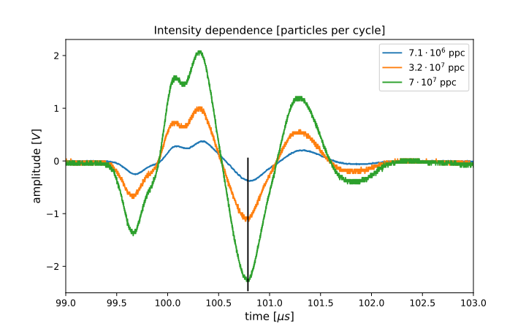
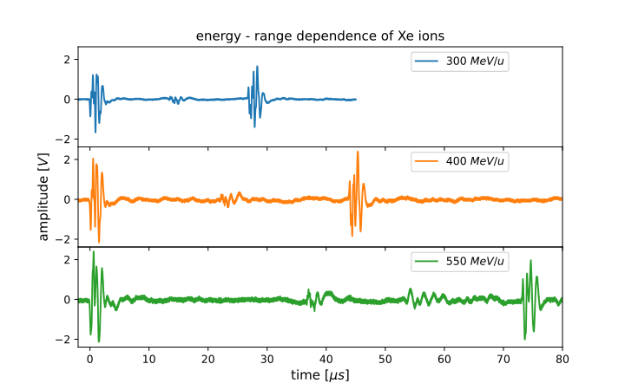
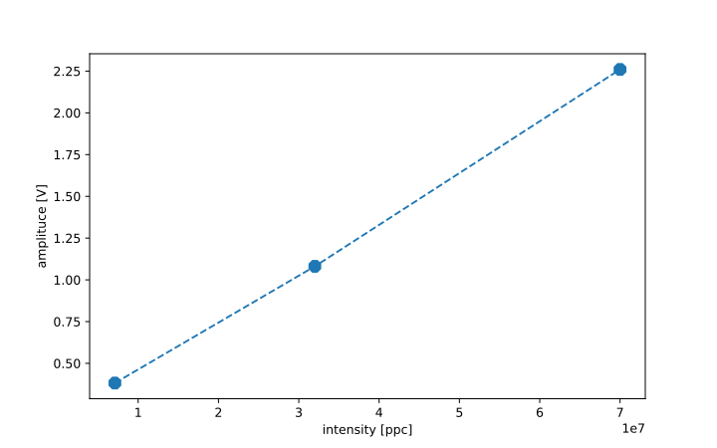
MAT Experiments within FAIR Phase-0
Ionoacoustics: sound of ion pulses
Ultrasonic signals characterization of ion pulses stopped in water
resolve ion beam microstructure
accurate energy measurements via signal length
ion intensity measurement by signal amplitude
detector development for single pulses at high energies
Ionoacoustic signals at three different intensities
Dependence of signal length on ion energy
Collaboration
more experiments in beamtime 2021
Linear dependence of beam intensity and signal amplitude

Slide 10
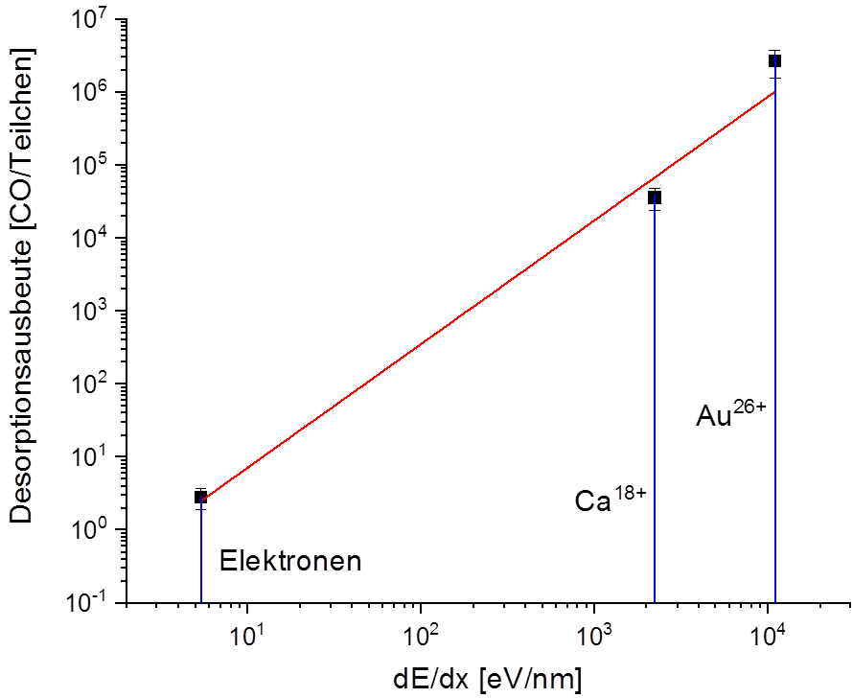
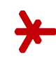
MAT Experiments within FAIR Phase-0
Beam-induced desorption effects - mitigation of dynamic vacuum problems
Investigation of electron- and ion-induced desorption yields from frozen CO-layers
Desorption yield (CO per particle
Collaboration:
Hochschule RheinMain

Slide 11
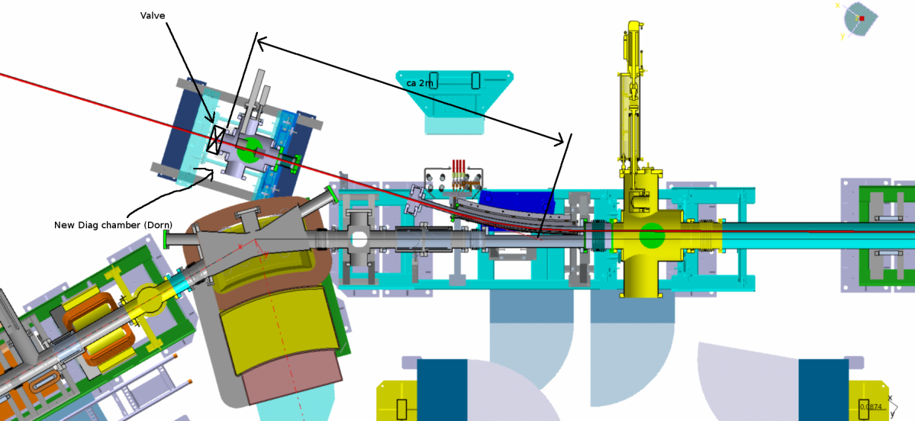


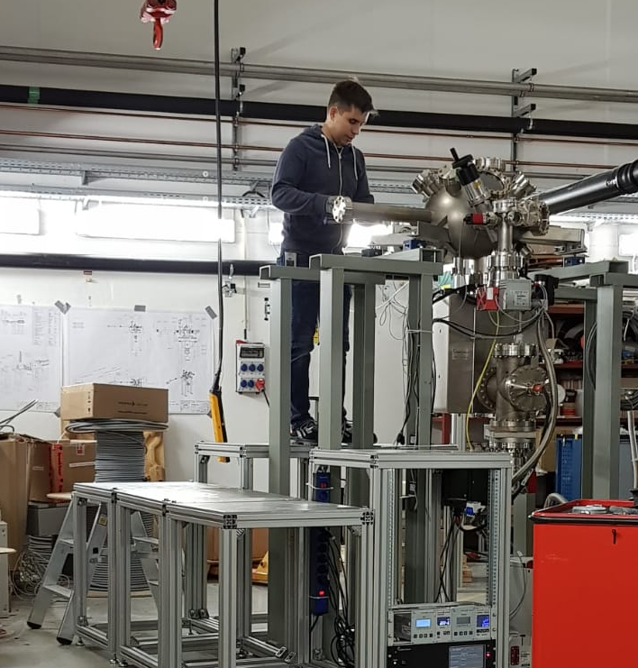
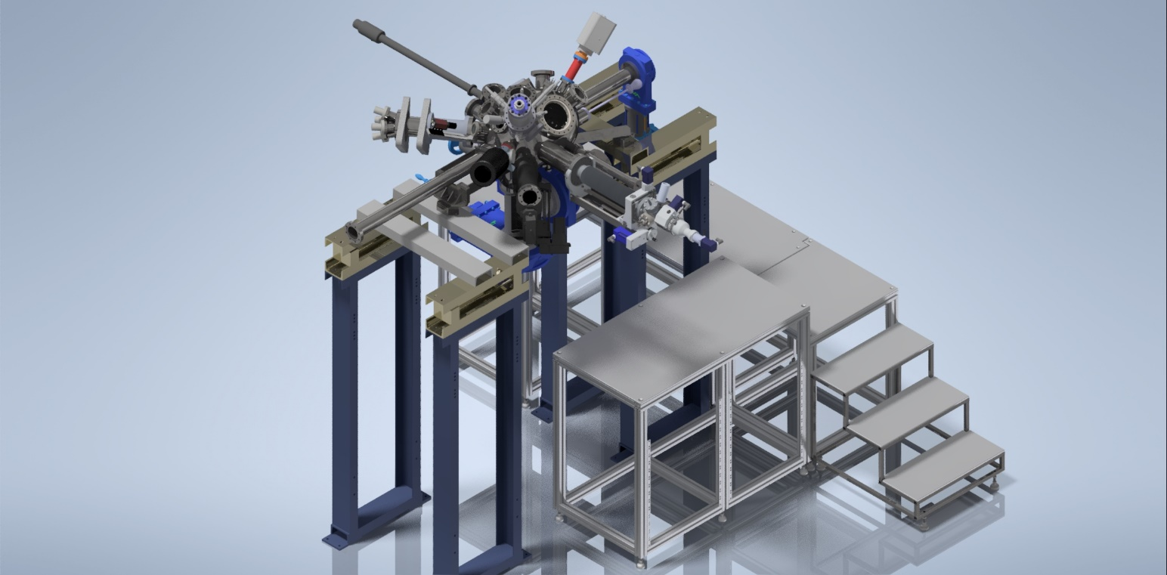
MAT Experiments within FAIR Phase-0
Status of MAT station at CRYRING
Target station:
demanding UHV conditions
flexible configuration for sample irradiation
various analytical methods
MAT station
manipulator
components ready for mounting
delay due to manpower shortage
Collaboration: Univ. Duisburg/ Essen

Slide 12
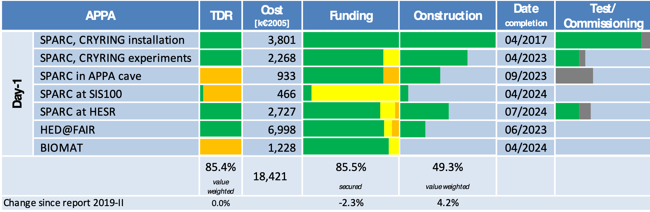
Summary and Outlook
      Next steps: - Preparation for next beamtime ongoing
      - Planned SIS-18 experiments for testing new in-situ Raman experiments in combination with Diamond anvil cells
      - Installation and commissioning of MAT-setup at CRYRING postponed to next year
      - TDR for BIOMAT beamline in APPA cave in preparation
Impact of COVID-19
      Particularly the SIS-18 program has suffered due to cancelled experiments
      No radiation hardness tests of electronic components (ESA et al)
      Challenges for coming beamtime due to many small groups with short experiments
Funding situation
      No changes compared to 5/2020

