Slide 1
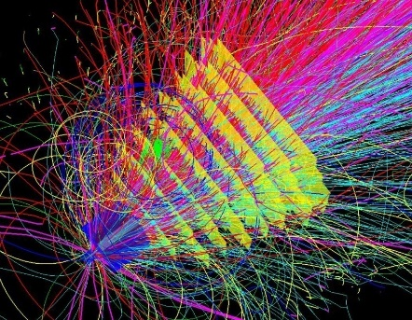
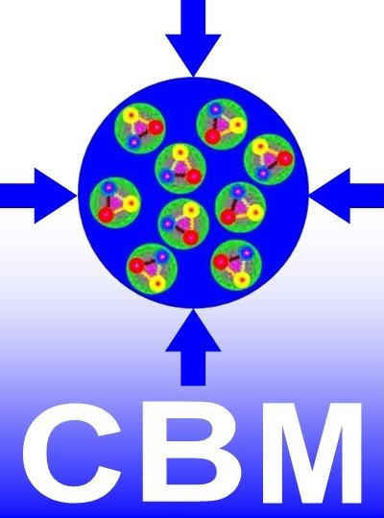
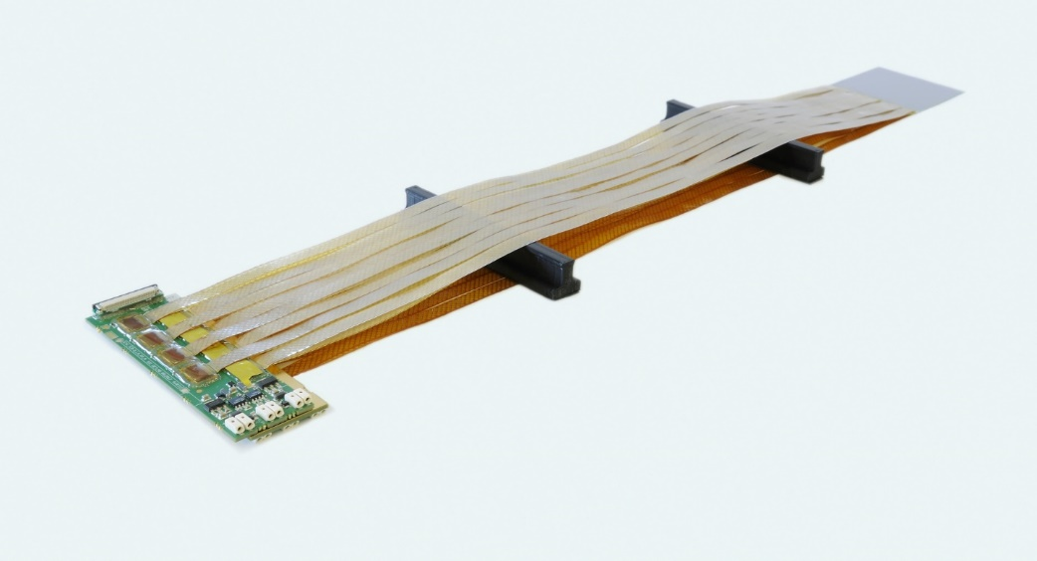





CBM-STS
Module and Ladder Assembly
FAIR-ECE-13 Meeting
Oct. 26, 2020
Christian J. Schmidt,
GSI Darmstadt,
for the CBM Collaboration

Slide 2
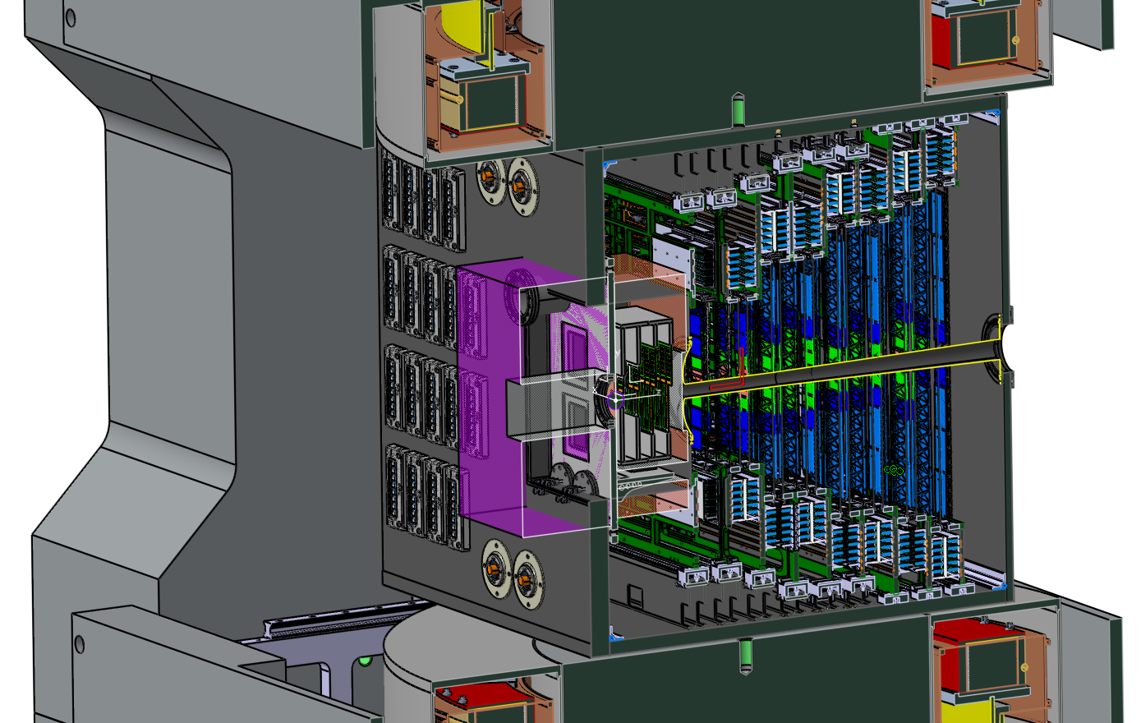
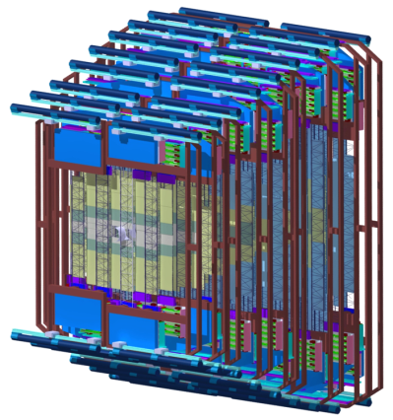
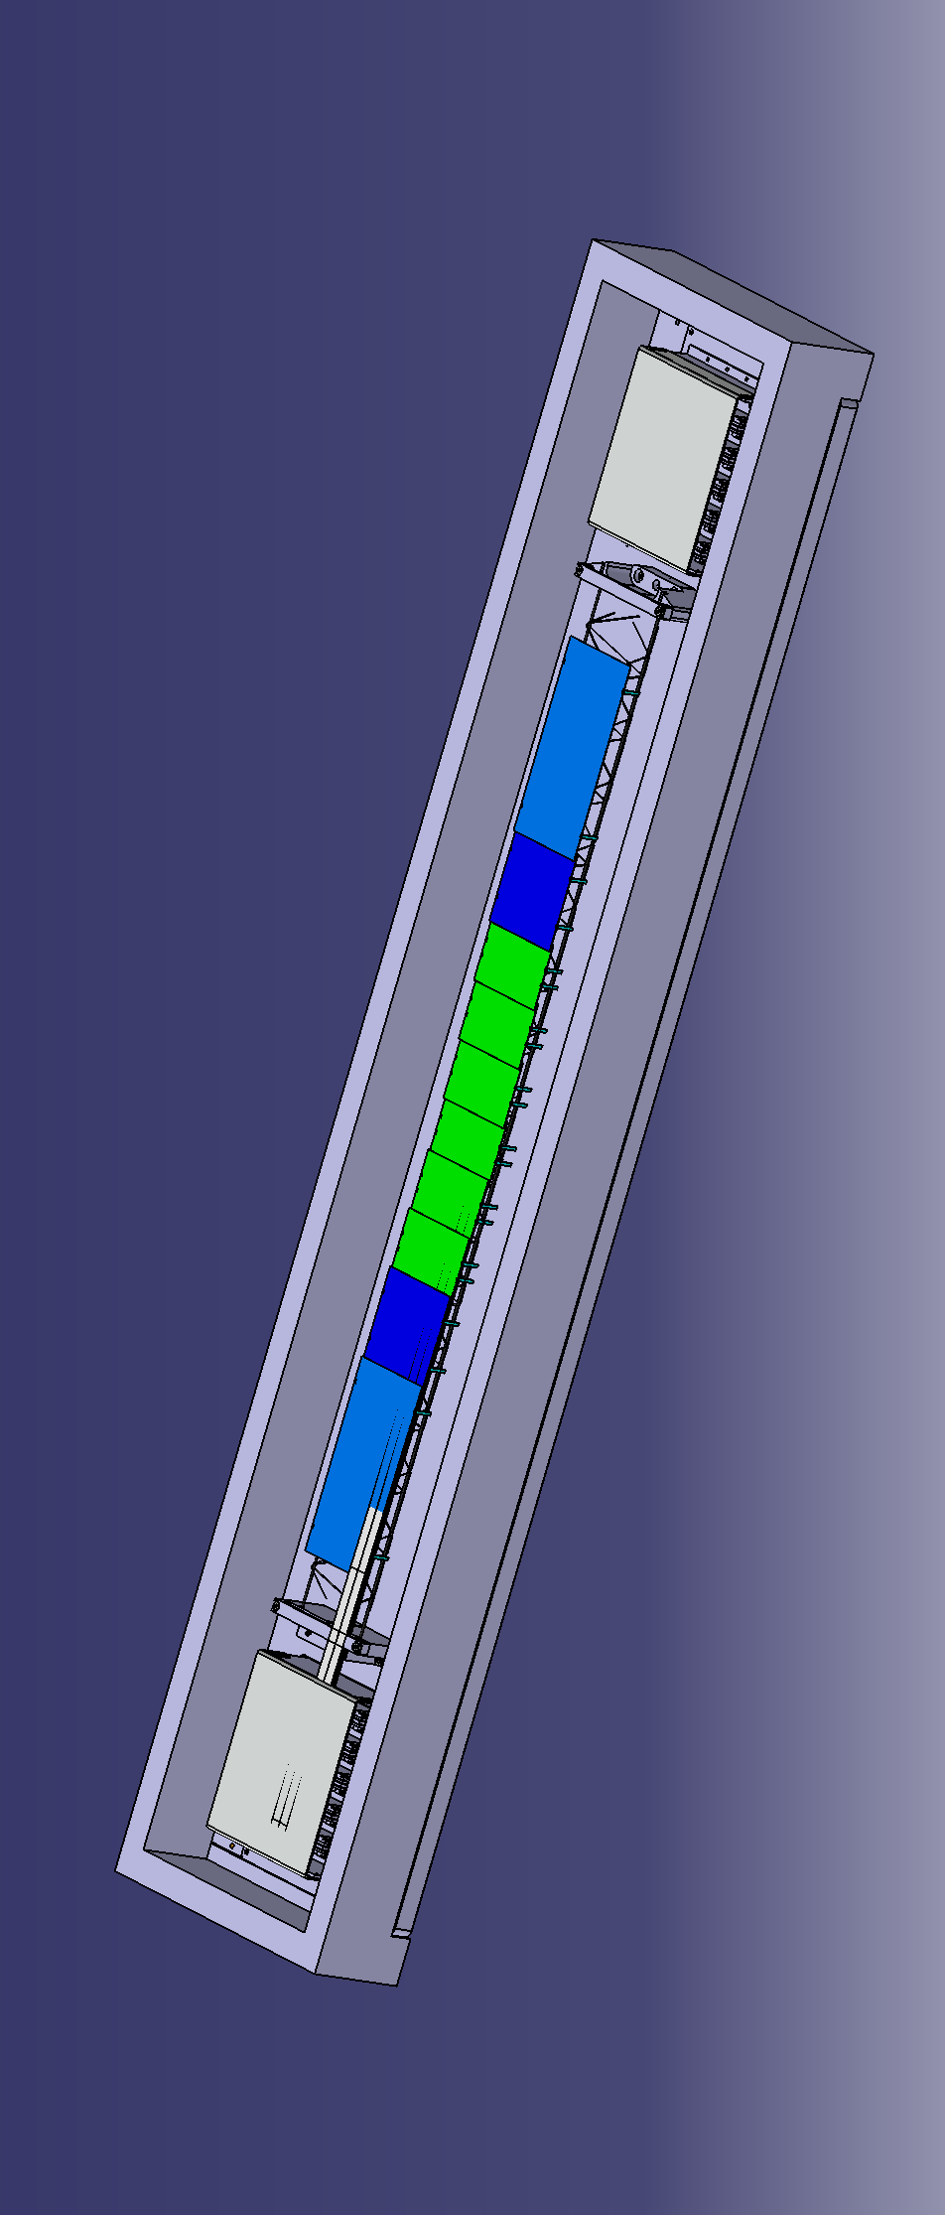


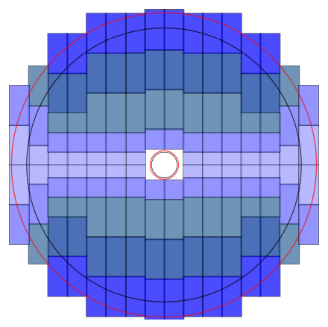
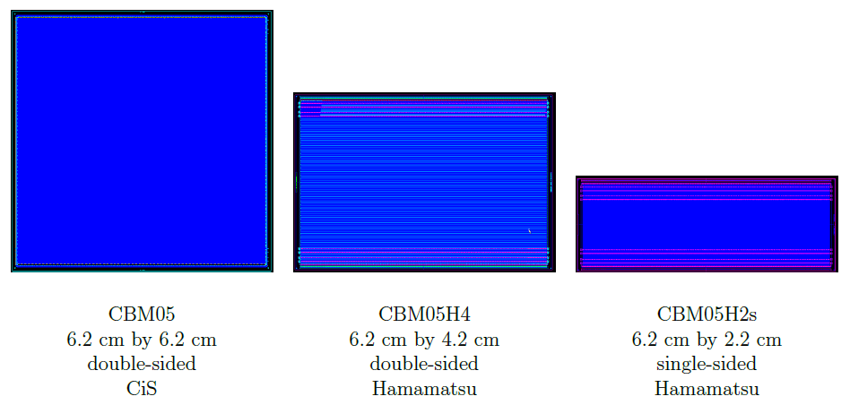
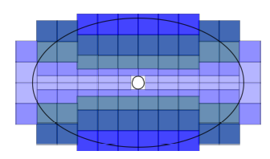
Fixed-Target Geometry → Tracking with 8 detector stations
1m
sensor
8 tracking layers
cables
electronics
106 ladders
876 modules
double-sided, 320 µm thick, 1024 strips per side at 58 µm pitch, 7.5 deg angle front/back
6.2 cm × 2.2 cm
6.2 cm × 4.2 cm
6.2 cm × 6.2 cm
6.2 cm × 12.4 cm

Slide 3
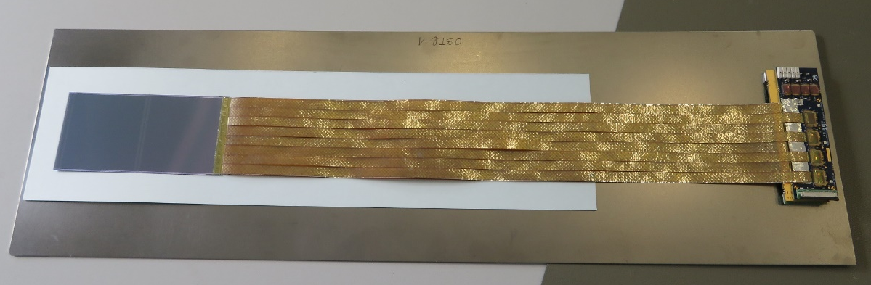
STS-Detector Module, 876 Monolithic Items to make up STS
Fixed-target geometry implies module design in at least 166 variants!
All in all 64 different pieces to be assembled in various different ways.
One common module design
Variation through sensor length, cable length and symmetry
→ need „assembly on demand“, order along specific ladder´s BOM
Module rework not feasible at all, modules are monolithic, microassembled entities

Slide 4
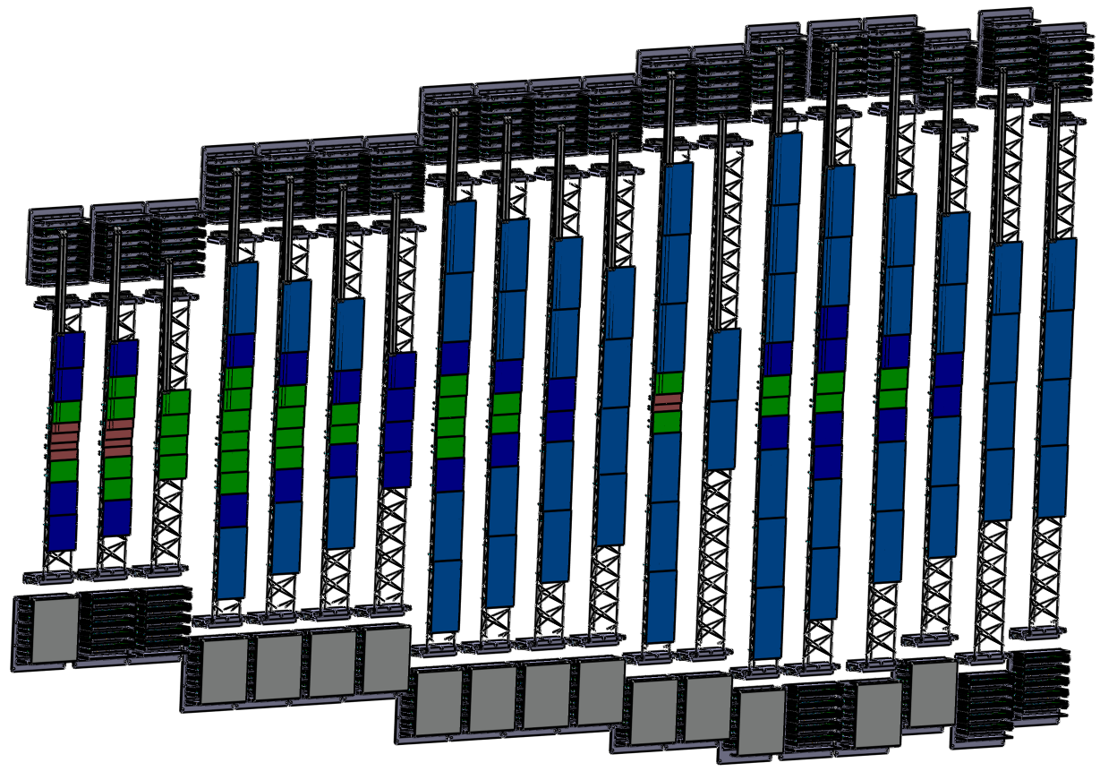
Essential: Material Logistics and Continuous QA
Employ QA-verified ingredients only (sensors, cables, chips etc.)
Logistics will keep one person busy, need someone very tedious
Continuous tests following every step of assembly → rigid but streamlined QA procedures
STS ladder variants
w/o beam pipe versions

Slide 5
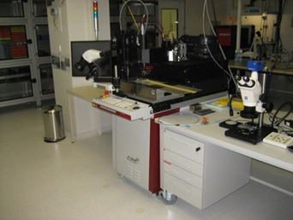
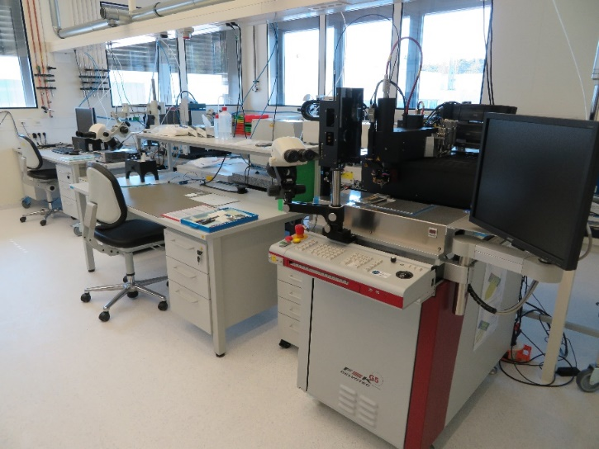
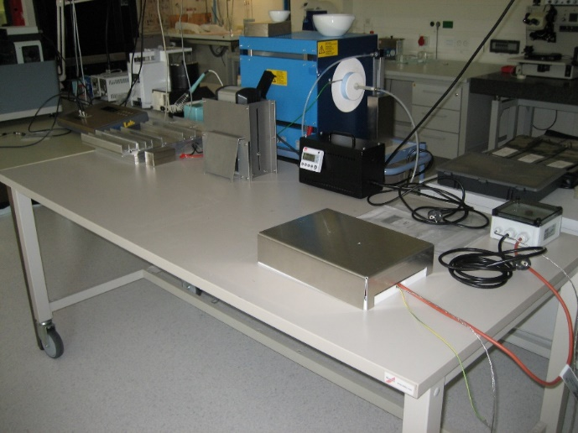
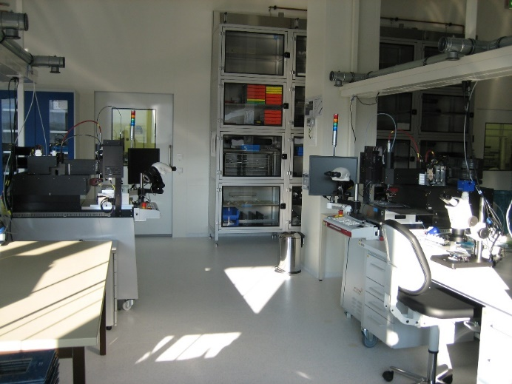
Cleanroom space, machinery at GSI Detector Lab
TAB-bonding-machine:
F&K Delvotec G5
dedicated wire-bonding-machine:
F&K Delvotec G5
UV-lamp and heating mat for glue curing
Nitrogen cabinet wall for storage

Slide 6
Assembly Procedures → CBM-TN-18005, March 2019
Assembly Workflow has been worked out and optimized during past years (→ C. Simons, R. Visinka)
Jigs, procedures and workflow optimized for assembly yield (DTL team)
Electronic-logbook as tool for documentation employed (A.Wilms)
e-log forms elaborated addressing every step in assembly (A.Wilms, C.Simons)
  as guidence through assembly procedures
  for documentation
Database structures prepared for documentation on what has been built out of which parts and sub-assemblies (A.Wilms, E. Lavrik on databank-backbone)
Various glues qualified for functional quality as well as radiation tolerance (S.Metha, C.Simons, R.Visinka, A.Lymanets) functional tests and exposure to neutron reactor core

Slide 7
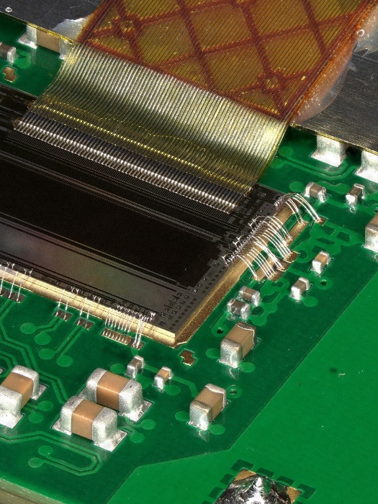
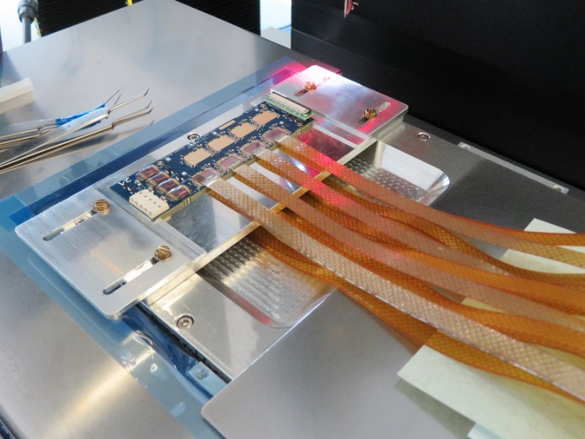
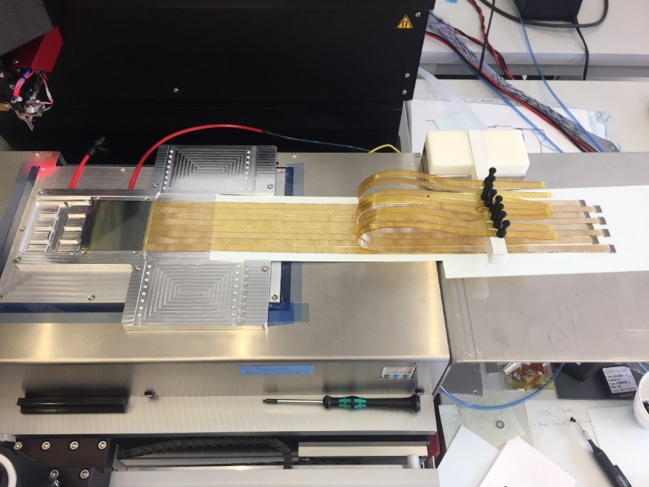
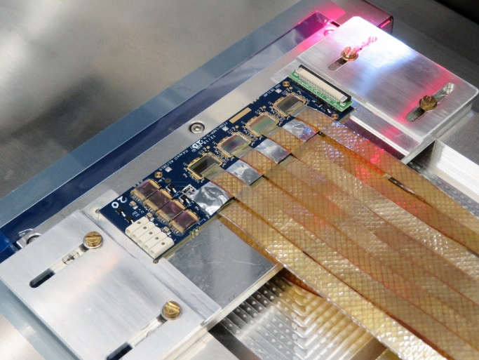
Workflow STS-Module-Assembly
four main elements repeated for p- and n-side:
Chip-cable assembly: TAB-bonding of micro-cables to the STS-XYTER
FEB-assembly: Die- and wire-bonding ASICs to FEB-PCBs in two rows
Tab-bonding of micro-cables to silicon sensor on p- and n-side
glueing of shielding-layers and spacers

Slide 8
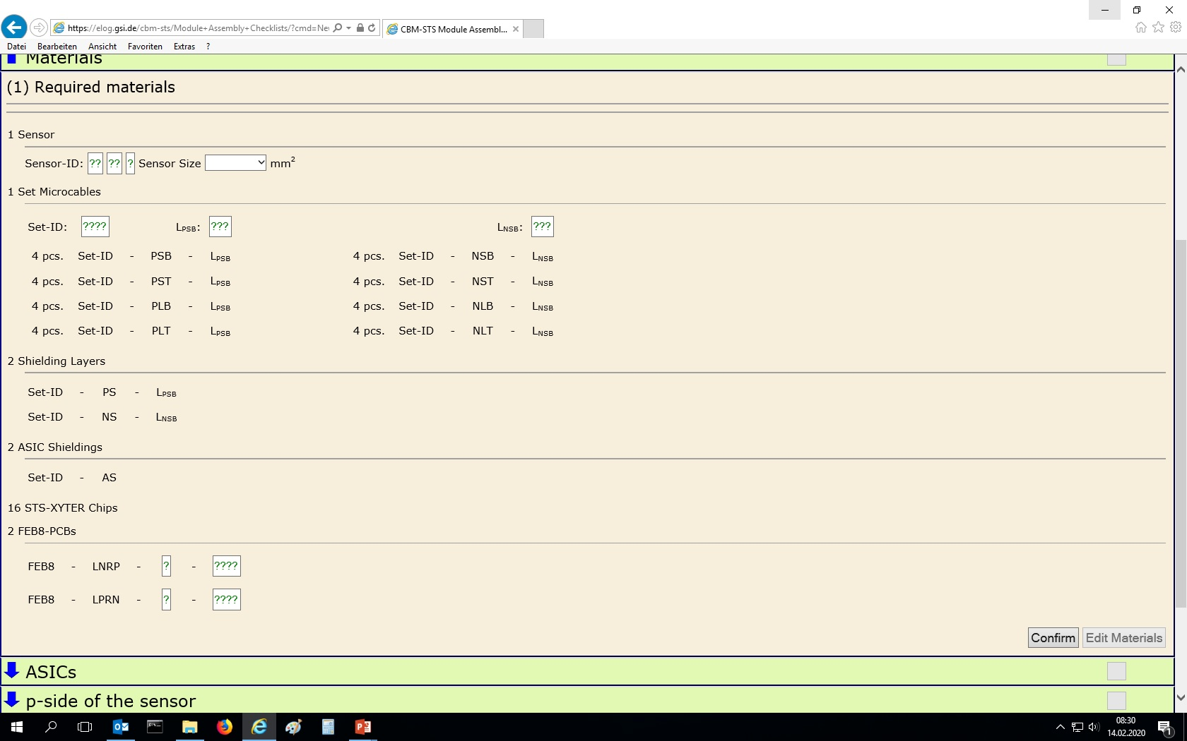
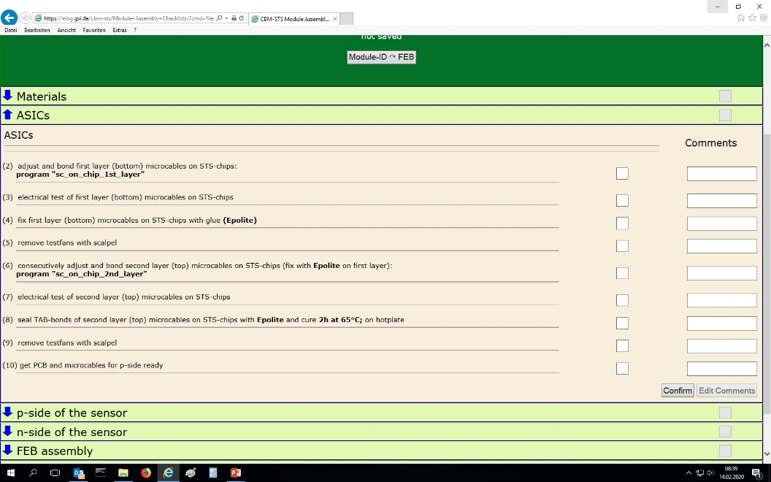
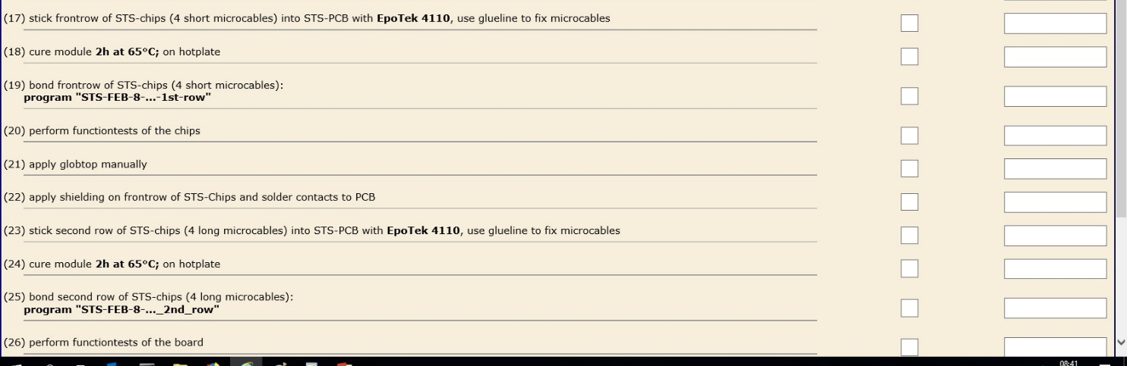
Accompanying documentation in electronic logbook

Slide 9
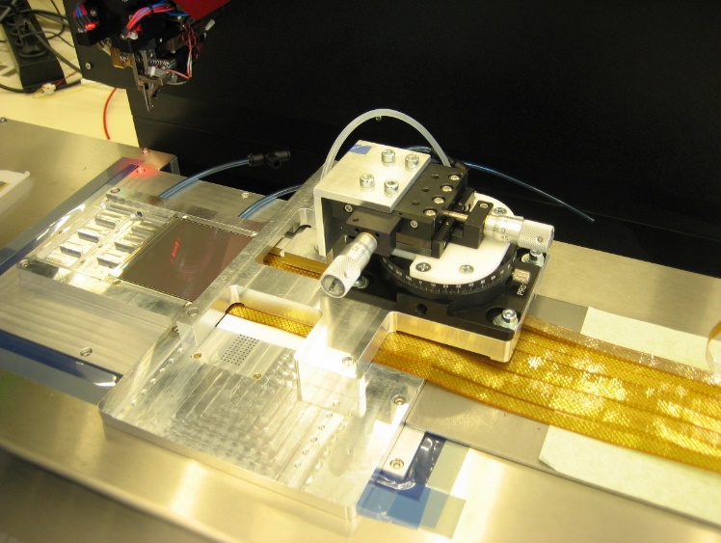
Scalable Assembly Unit: People, Machinery and Tools
4 technical personnel (one beyond existing team)
1 wire-bonding machine
2 tab-bonding machines
(one available, one additional machine expected)
Assembly-jigs
Test-jigs and -setups – including test software with semaphor conclusion
In preparation: Outsourcing of chip-cable assembly to cable supplier LTU (1/3 overall effort)
    (earliest, low risk integration step, well feasible at LTU, tab-bonding machine available)
→ Assembly Capacity at GSI: 16 functional modules/month
Total volume module serial assembly: 480 modules in 30 months

Slide 10
Partner Assembly Sites will Add Their Share
IPE-KIT (Germany):
contract under renewal on assembly of 450 modules
JINR (Russia):
Collaboration contract on module and ladder assembly, currently readjusting final quantities and focus
Dynamic adjustment possible at GSI: Introduce second, 5 hour afternoon assembly shift at GSI.

Slide 11
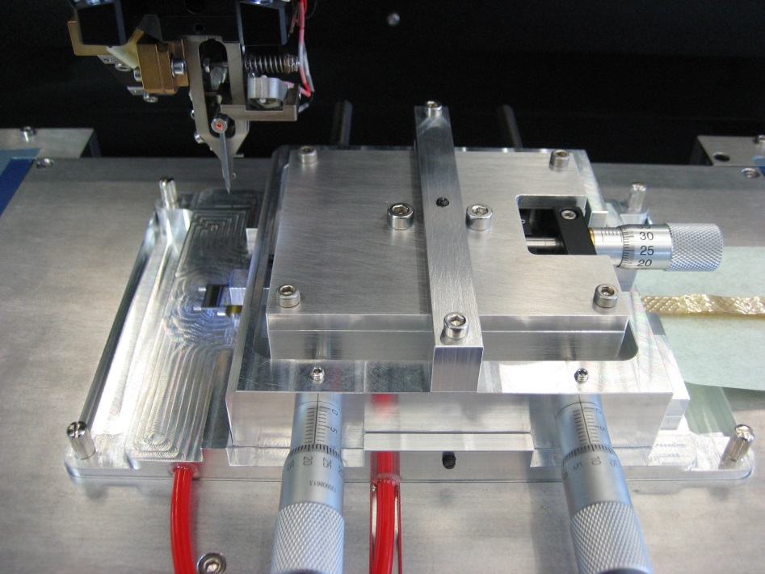
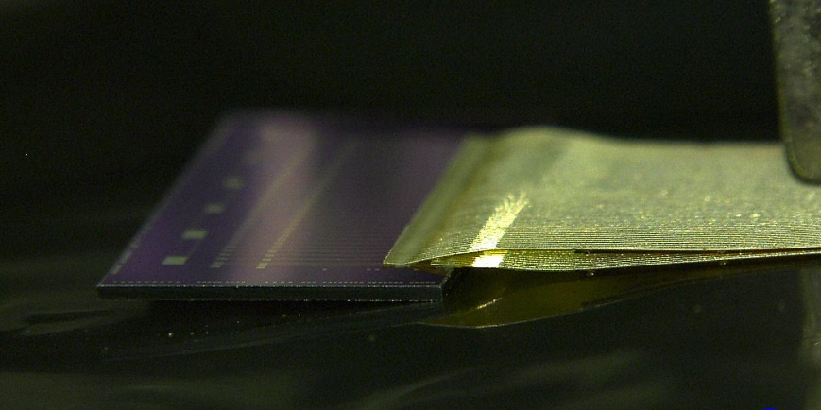
Chip Cable: two micro-cables tab-bonded to an STS-XYTER-ASIC
Bond micro-cables onto readout chip in two layers for 128 channels.
Stabilize with glue

Slide 12
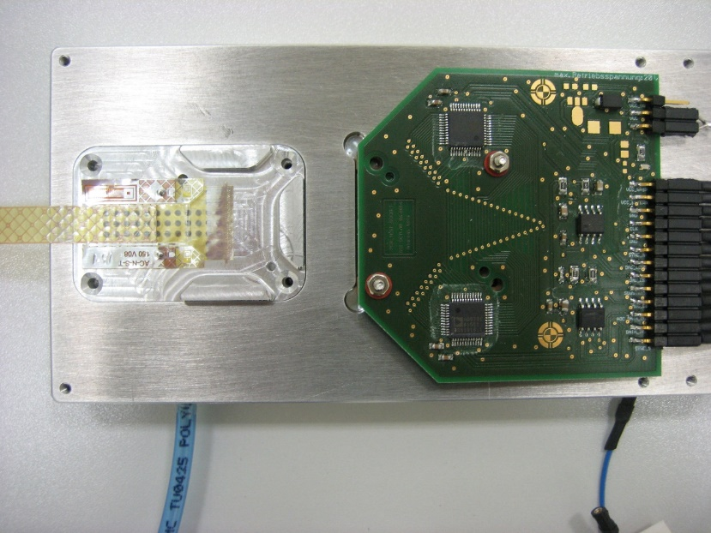
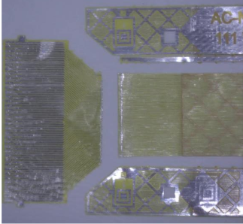
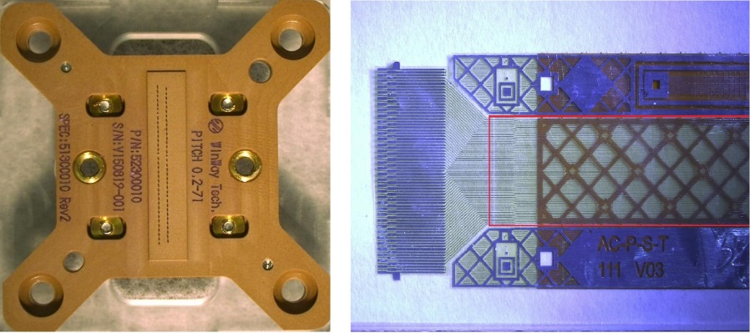
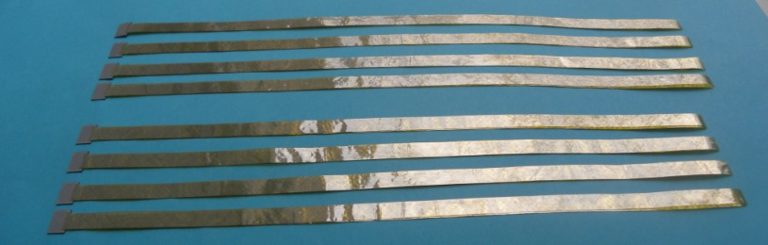
Chip Cable: two micro-cables tab-bonded to an STS-XYTER-ASIC
Connectivity test with test fan-out and pogo-pin test jig
Jig developed by Andreas Weis and Ralf Kapell at DTL
Finally test fan-out needs to be cut off
16 chip cables, 8 types needed for one module

Slide 13
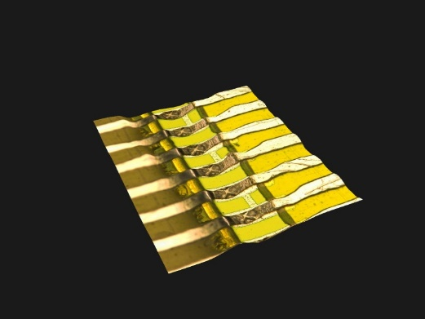
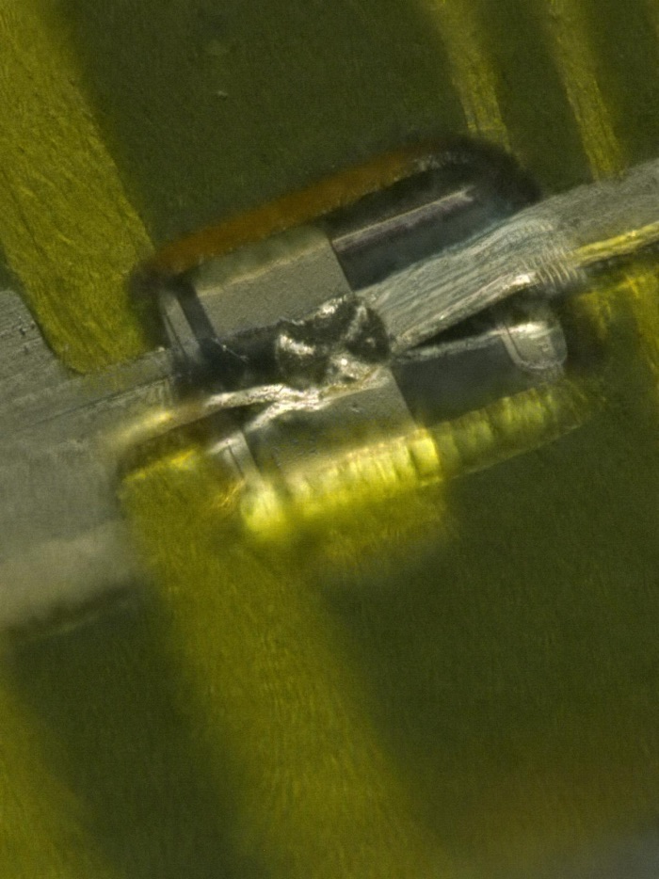
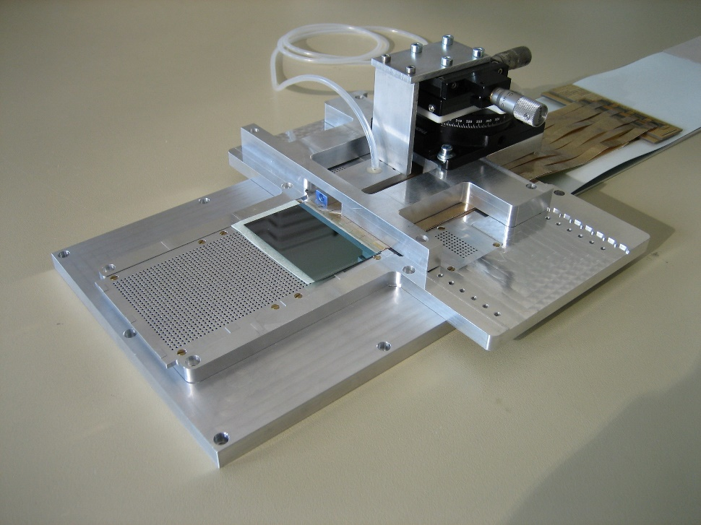
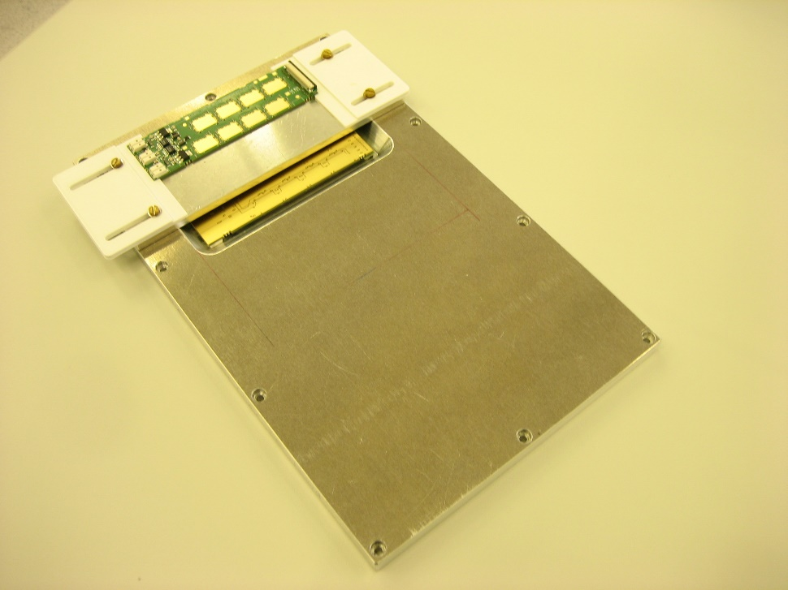
Jigs-Finalized
Tab-bonds
universal STS-tab-bonding jig
Free standing Al trace
FEB wire-bonding jig

Slide 14
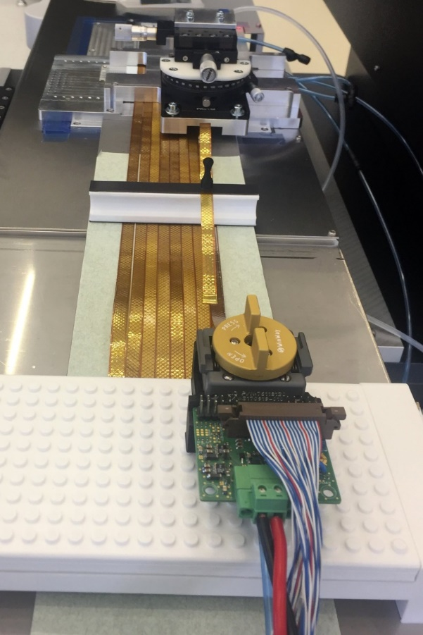
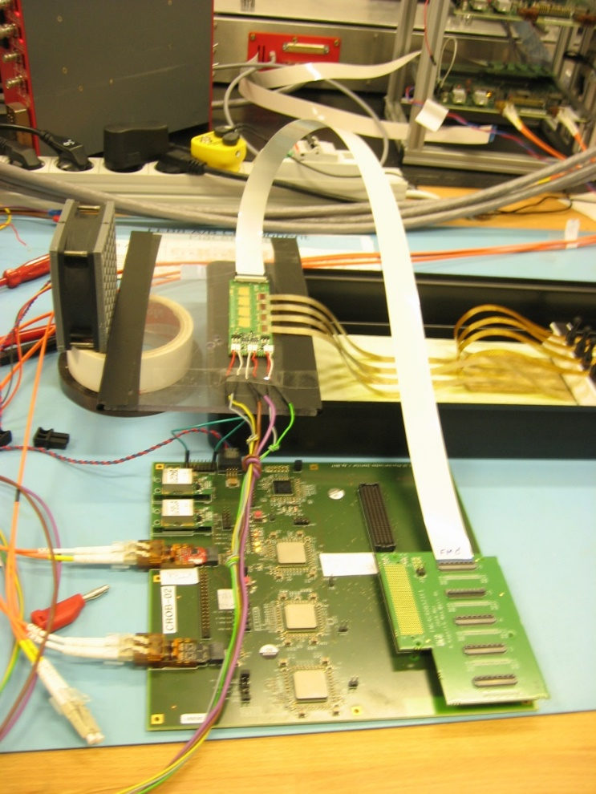
Test Setups
FEB- and Module -Tester
WinWay Pogo-Pin Chip
and
Chip-Cable Tester
Needs to be streamlined!

Slide 15
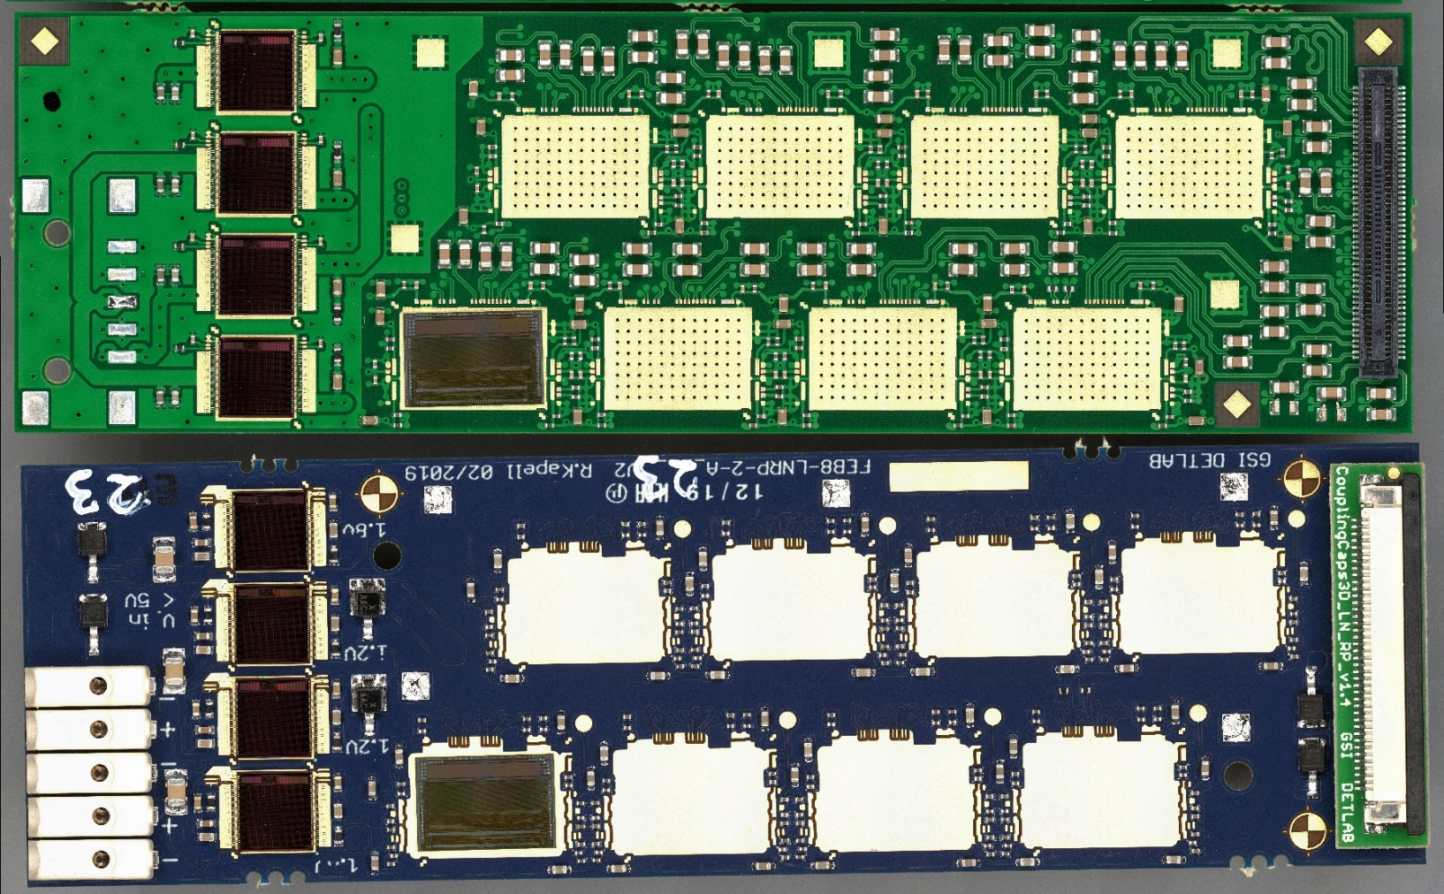
Towards EDR: Front-End Board Design and Connectivity
  FEB challenge: High bandwidth, floating at half bias, power connectivity
101.5 mm
  capacitors
  distributed all over
  PCB,
  42 LVDS pairs
30.6 mm
  capacitors
  placed vertically
  underneath signal
  connector
FEB8-5: full bandwidth, 400 Mhits/sec, 5 e-links per chip
FEB8-2: less connectivity, 160 Mhits/sec, 2 e-links per chip

Slide 16
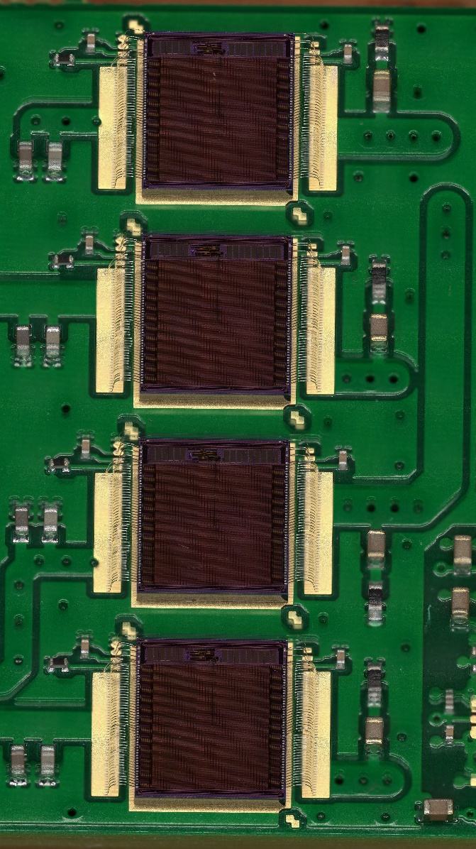
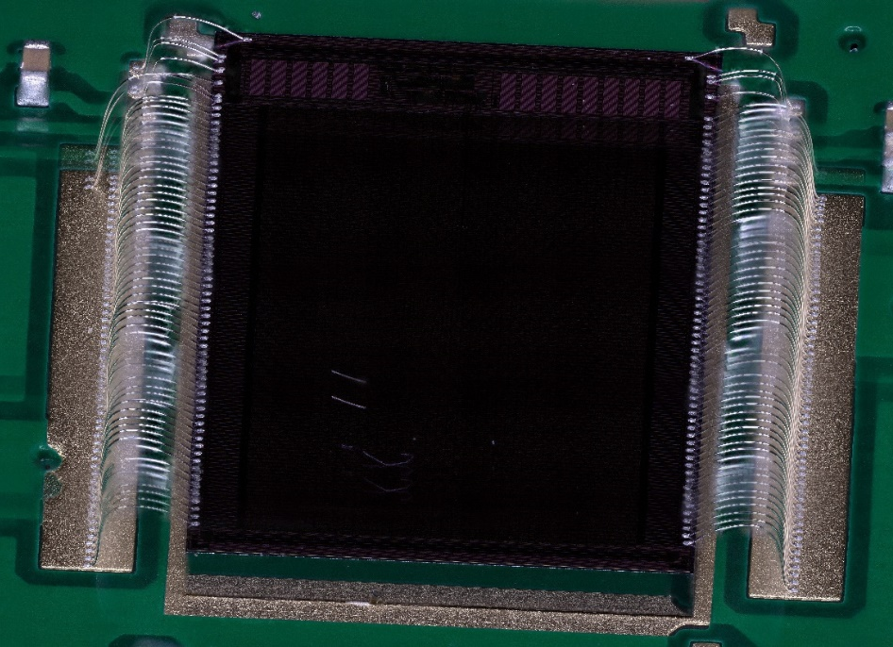
FEB: Bonding of Skimming Regulator Chips
  Regulators developed and provided by SCL, India
  Radiation hardened, very low dropout, very low variation σ ~ 3 per mille, bare dies.
  1.8V and 1.2V at 1.6A

Slide 17
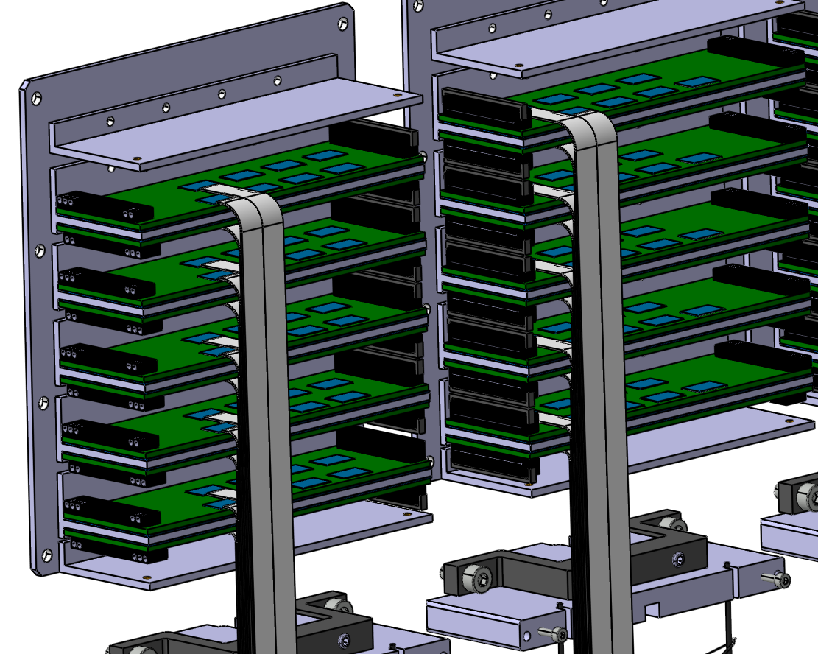
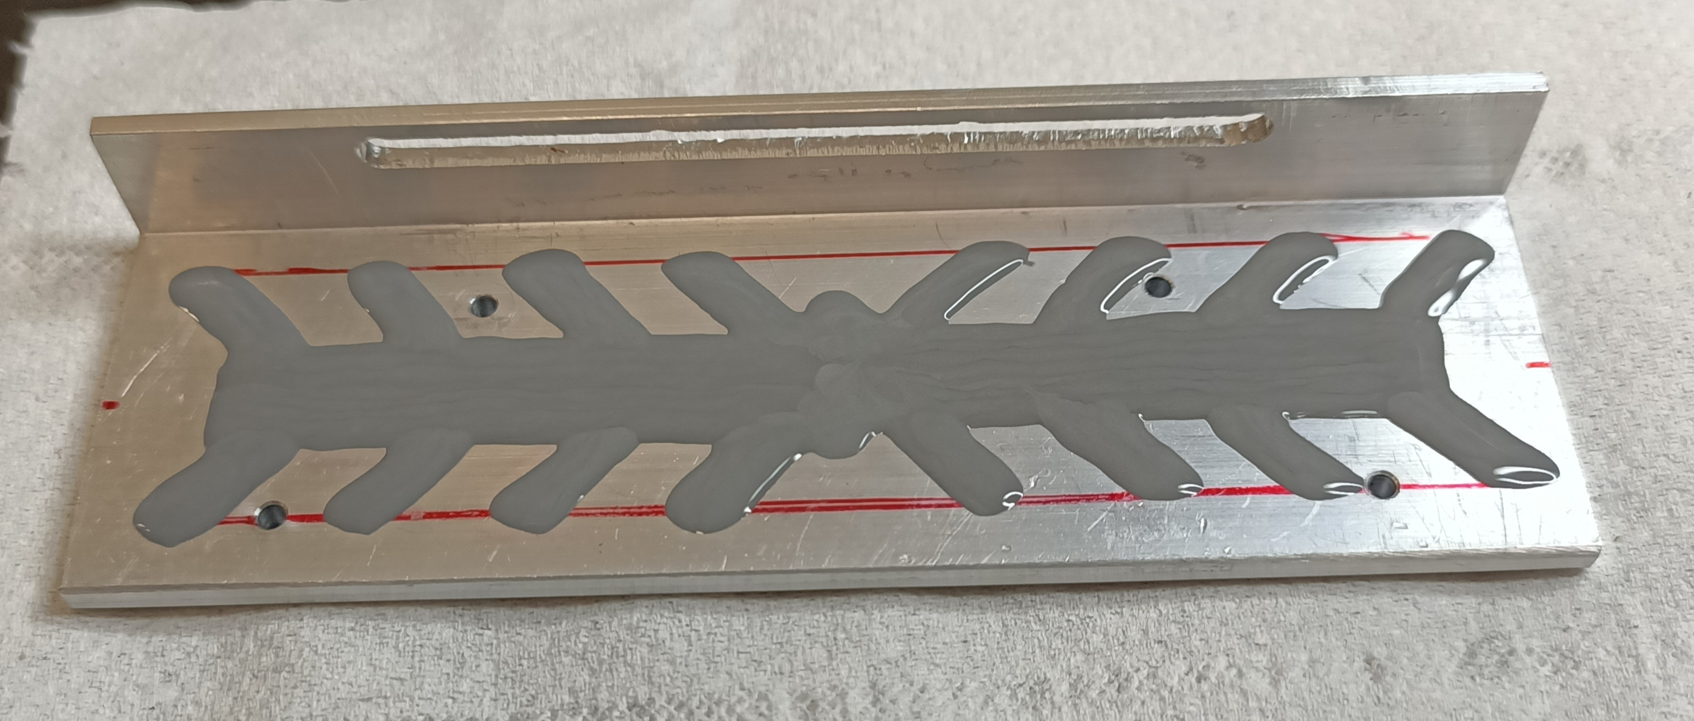
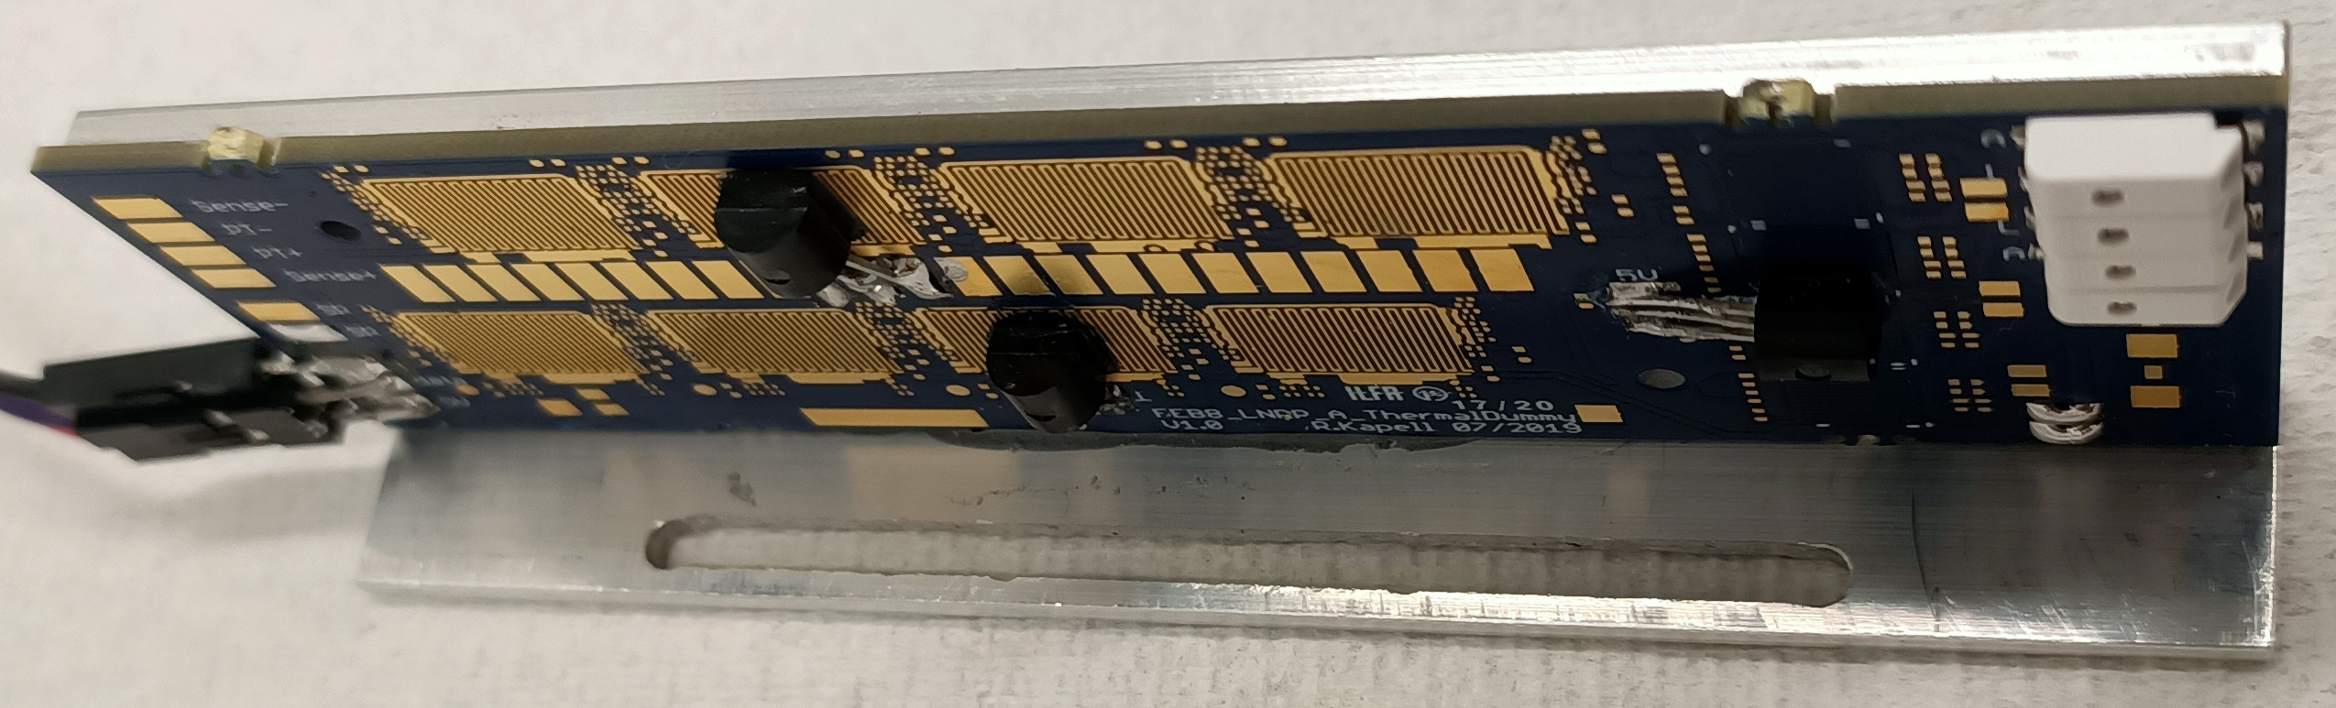
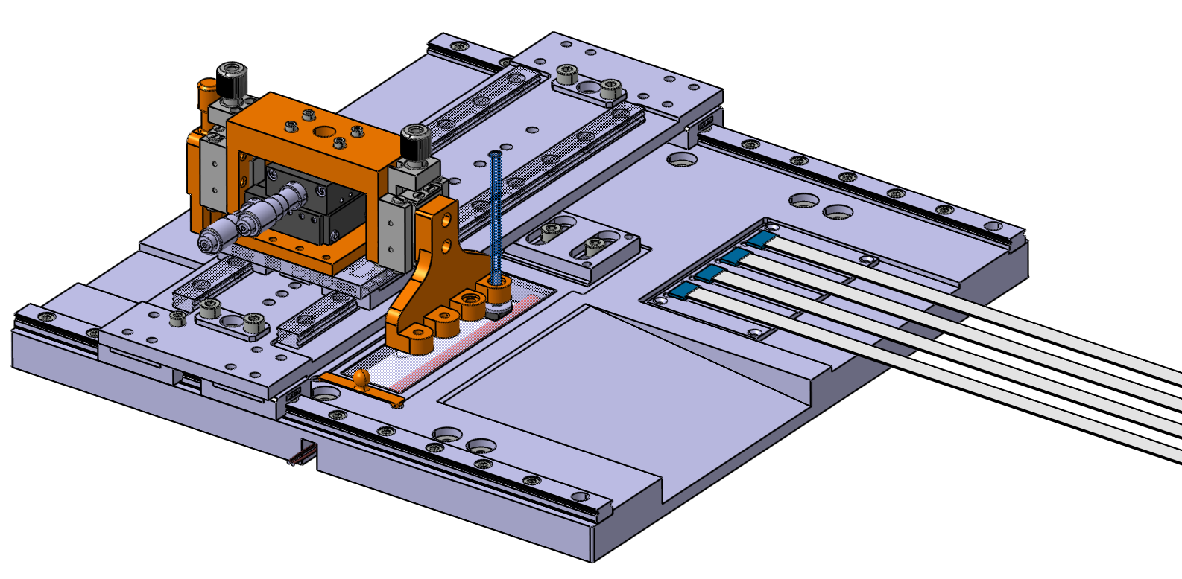
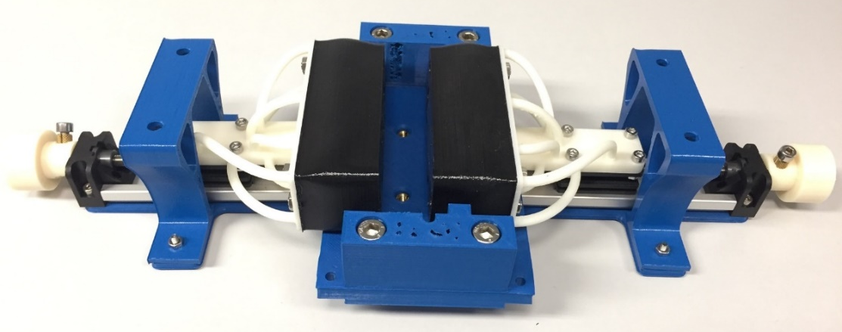
Further items being optimized on module level:
mounting FEBs to cooling shelf
electronics shelves at extends of ladders
chip-cable allocation and die bonding

Slide 18
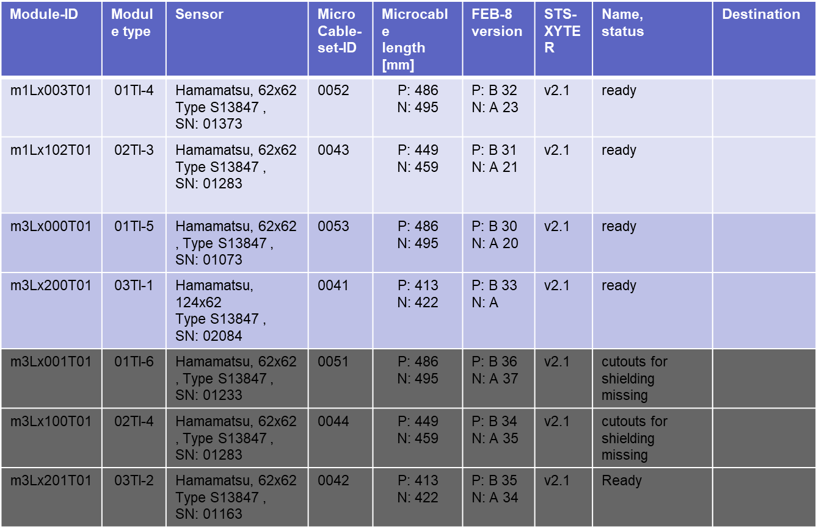
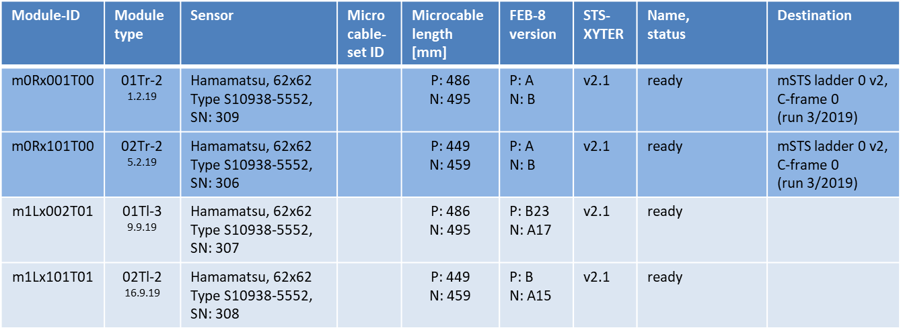
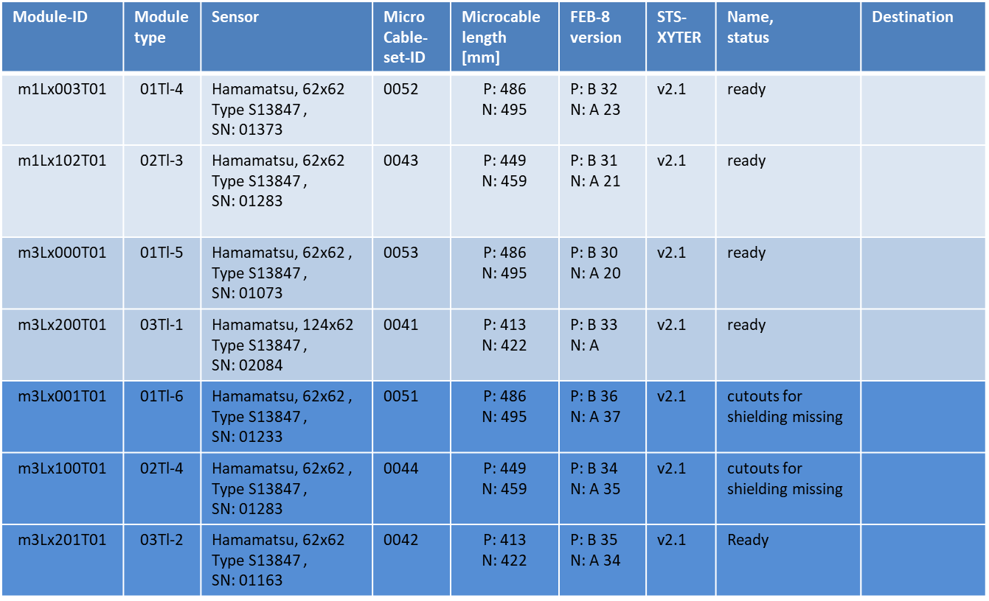
Overview: Status Module Assembly
20 functional modules assembled at GSI
Test-bed mSTS
Elaborated counter-measures for diverse hick-ups
5 first modules assembled at KIT
JINR is very elaborate on assembly already → good technical team

Slide 19
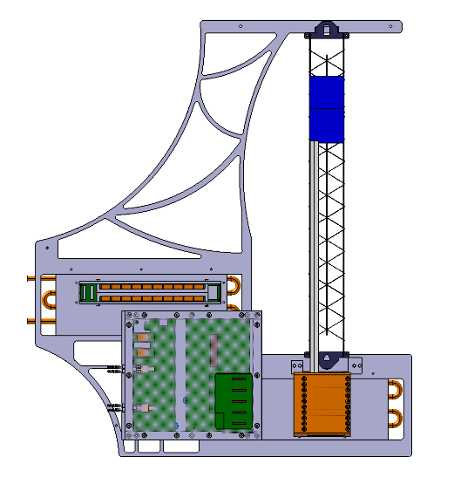
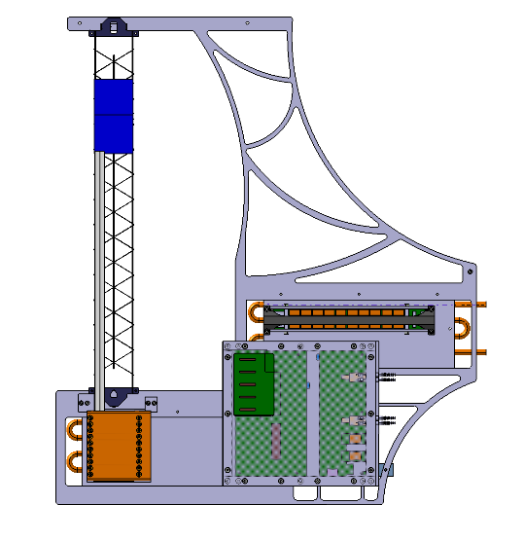
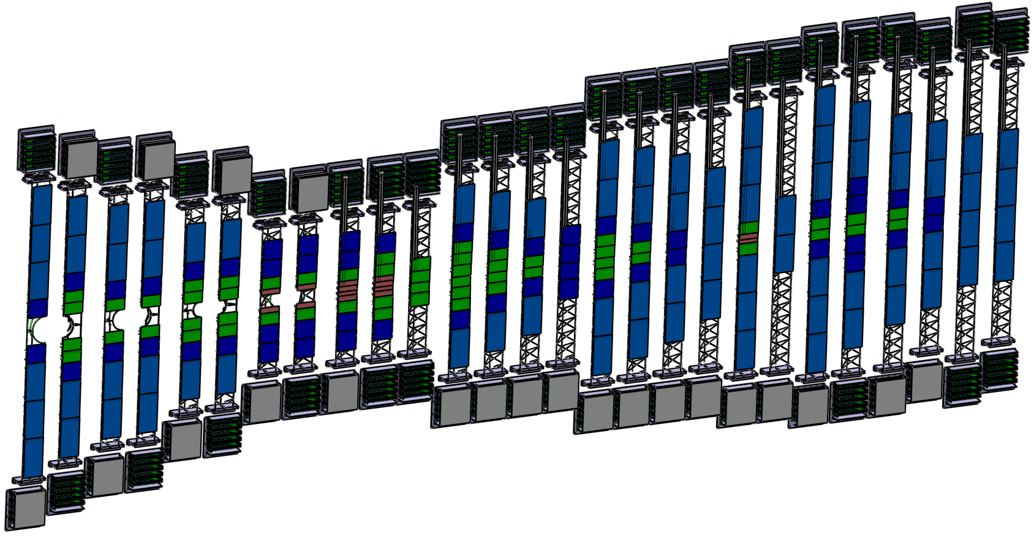
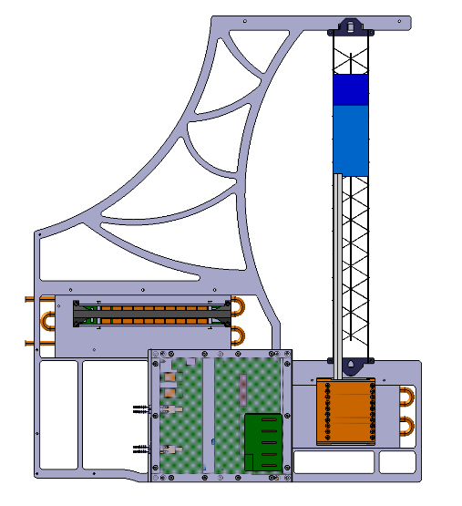

Development Activities for Ladders and their Assembly
108 STS-ladders comprise 4 to 10 modules
mounted on Alice-ITS like carbon fiber structures
Electronics outside detector acceptance
Specialized ladders with beampipe cutout
mSTS units with half-length ladders
Assembly practiced with mSTS prototype ladders

Slide 20


Development Activities for Ladders and their Assembly
CF-ladders fully produced
CF-ladders with beampipe cutouts under development and prototyped
Length-adaptable ladder assembly jig in development and test
L-Leg glueing tool
sensor holder
mounting block sensor position
  Ladder Assembly Jig Det_12
F. Nickels, U. Frankenfeld, S. Metha

Slide 21

Towards EDR in December: CM Immunity
Build and operate tripple module stack on a ladder to show: no mutual interference
Need fully shielded ladder test box → rework COSY test box ongoing
CM Immunity to be verified on module level
Show:
- Capacitive decoupling on FEBs between p-Side, n-Side and GND functional
- (RC)² bias-line filtering adequate → overcome ω-rise in front-end sensitivity

Slide 22

Timeline
Development and optimization work towards EDR (Dec 2020)
Optimized procedures will give full assembly throughput for mSTS modules
PRR in April 2021 → kick off module production
Finish module assembly in Dec. 2023 (last module)
Delay in start of assembly will cause delay for CBM
… but we need fully optimized procedures!
… good, reliable partners KIT and JINR
… and good logistics

Slide 23


