Slide 1





Quality Assurance of STS
Andrea Wilms, GSI Darmstadt
for the CBM Collaboration

Slide 2
How to get started…
A large amount of different components…..how to start?
First step: enable everyone to distinguish the component types through
appropriate nomenclatures
  Ensure unique identifiers for all of them!
‘Analytic phase’ of QA:
Identification of relevant QA parameters for
each component type and/or crucial workflow steps which need QA
‘Constructive phase’ of QA:
Establishing measurement setups and necessary software & documentation tools
Organizing the corresponding QA teams (‘organizational phase’)
…….GO!

Slide 3
Current STS Nomenclature family (1)
Module :
Ladder :
4
R
4
4
01
T
0
0A
Unit Side
Module Pos. y
Top/Bottom
Unit No.
Module Pos. x
Module-SN
(Consecutive
number)
Ladder-type
0: upstream
1: downstream
4
R
4
#
10
#
0
0A
Unit Side
Left blank
Left blank
Unit No.
Ladder Pos. x
0: upstream
1: downstream
Ladder-SN
(Consecutive
number)
Ladder-type

Slide 4
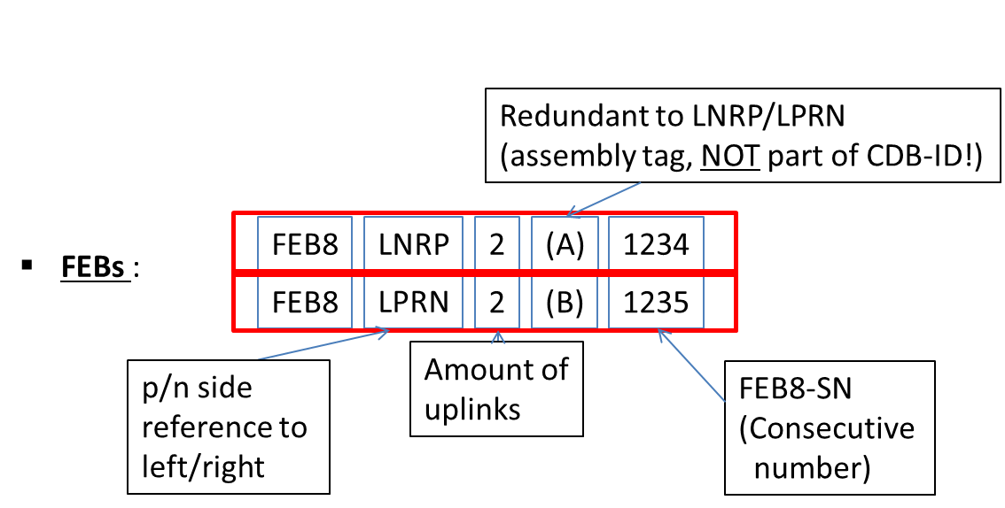
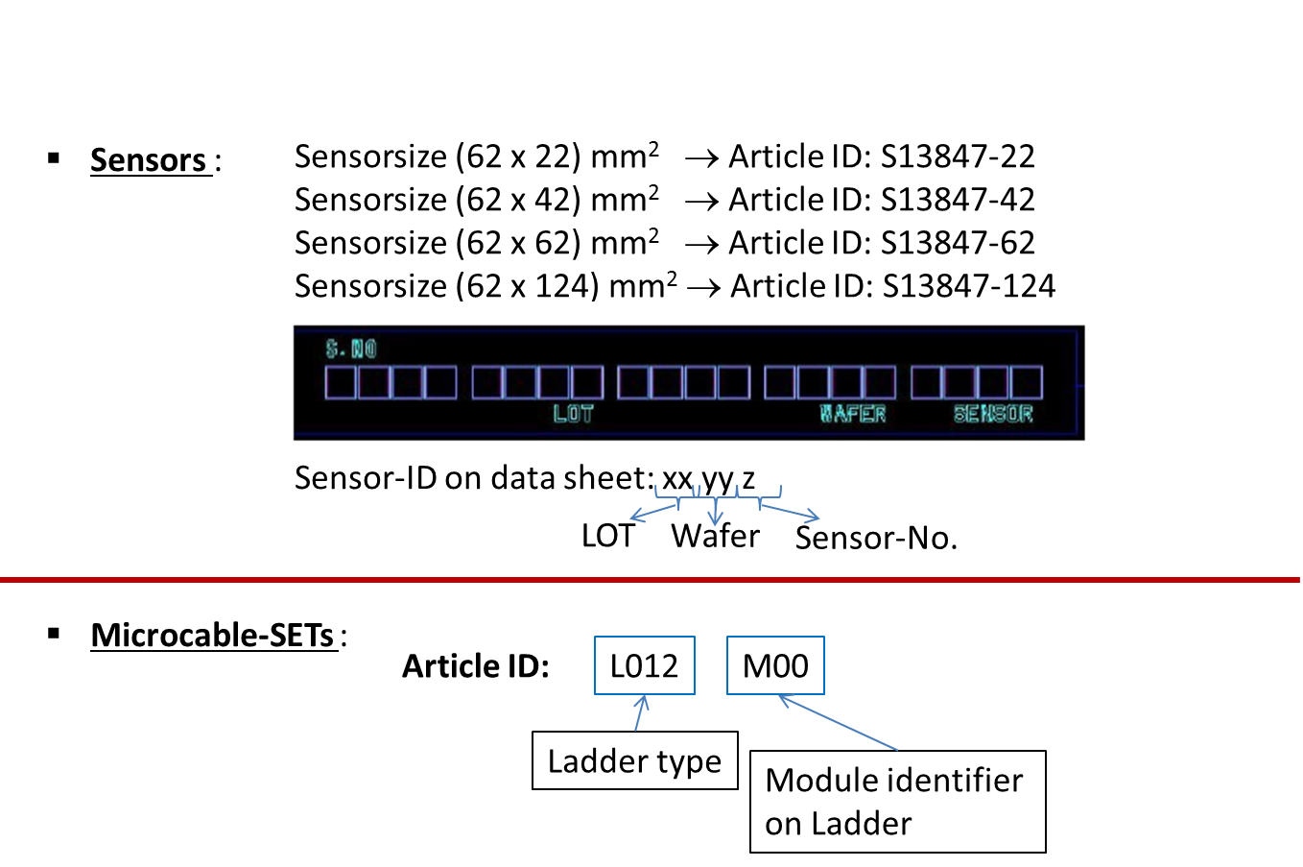
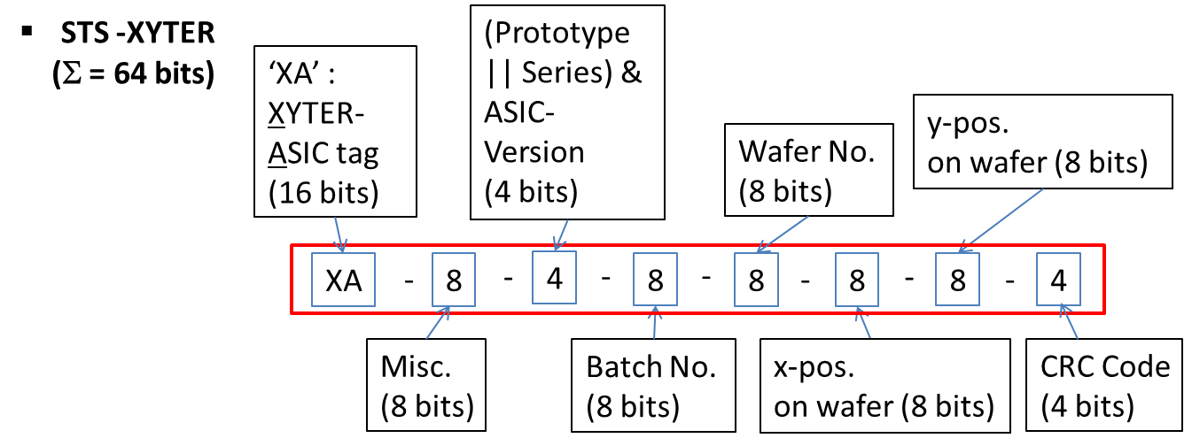
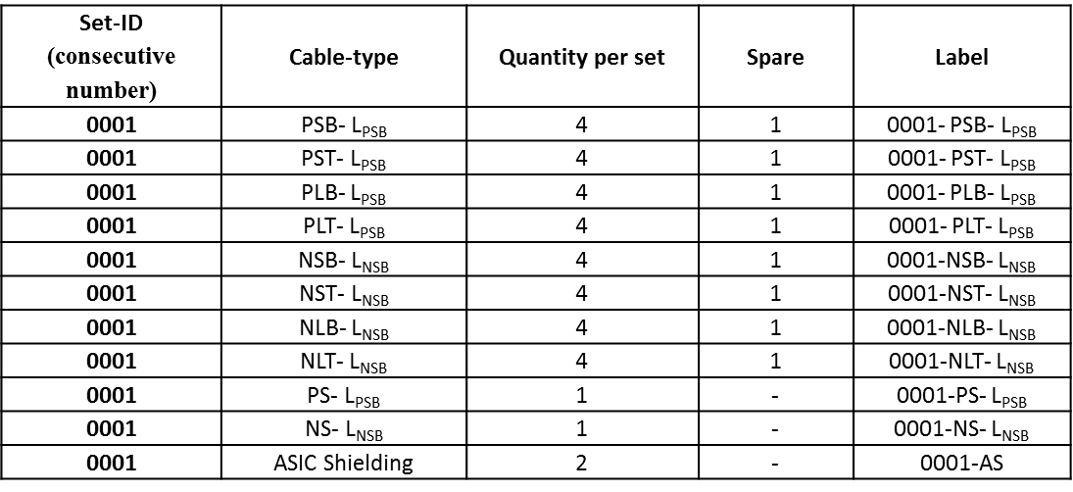
Current STS Nomenclature family (2)
Set content:
…………………………… to be continued

Slide 5
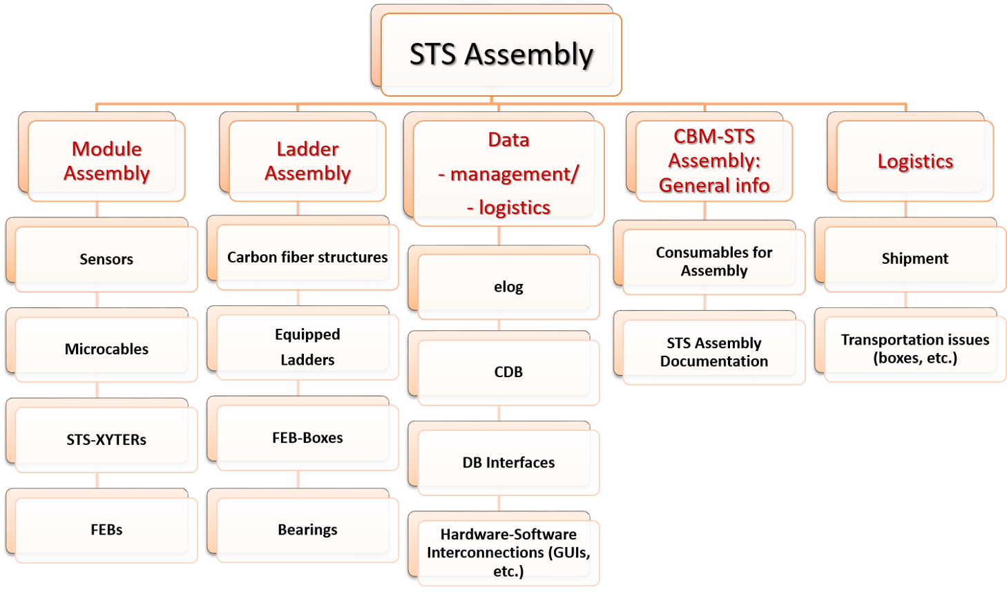
Coordination Tool / Current Assignee Groups
to be continued
…………………
Redmine

Slide 6
QA essentials
Workflows and all logistic aspects have to be documented and organized
Electronic logbooks (ELOG) were created
and are continuously optimized according
to users experiences and their special
needs
Redmine as coordination tool
  Therein: clearly defined
  assembly teams, component groups, responsibles for logistics, data handling, etc…
Logistic classes in Database
Software
Documentation:
Hardware
User manuals for setups
Accompanying processflow sheets (elog)
QA protocols
Software User Guides
GUIs
Data taking
Analysis
….
Setups
QA procedures for components, compounds and assembly steps have to be clearly defined and documented
  Introduction of QA protocols and (for responsible operators) user manuals
  Software for specific QA items has to be documented and optimized regarding users needs
Test results have to be documented and stored
  ELOG
  CDB
  Central storage

Slide 7
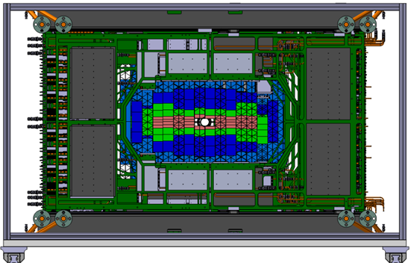
Modules: Component overview
876 modules:
  876 Sensors
  876 L-shaped FEB cooling fins
  2 x 876 = 1752 Front-End Boards (FEB8)
  4 x 1752 = 7008 Low Drop Out regulators (LDOs)
  8 x 1752 = 14016 Readout ASICs (STS-XYTER)
  16 x 1752 = 28032 Microcables
Sensors
  QA ongoing
  QA protocol in preparation
Module Assembly
FEB8s
  QA in preparation
  QA protocol in preparation
Module Assembly
STS-XYTERs
  QA on waferlevel (AGH)
  QA protocol (AGH) existing
  QA in preparation
Module Assembly
Module Assembly
LDOs
  QA on waferlevel (SCL)
Module Assembly
Microcables
Module
Assembly
  QA ongoing
  QA protocol existing
L-shaped fins

Slide 8
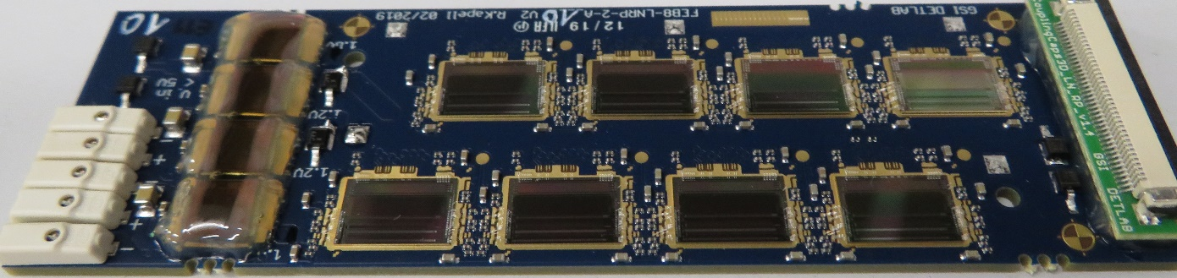
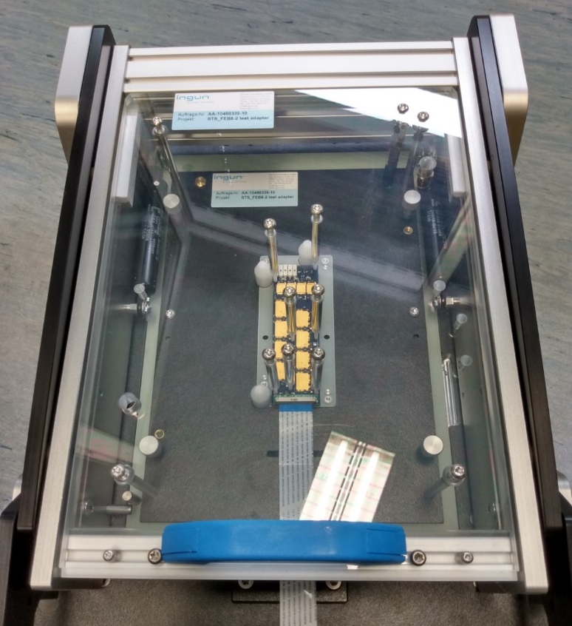
FEB8
Assembled FEB8
  8 STS-XYTER
  4 LDOs
  36 capacitors below
  the connector
FEB8 Testbox
QA procedures performed without ASICs bonded:
Test sequence ‘Capacitor test’ of capacitors C1 -….. - C36
(currently under discussion):
  ALL values inside tolerances? (3.3 nF ± 20 %)
  Occurance of shorts between Capacitors?
Test sequence ‘LDO test’:
  Test of voltages VDD18, AVDD18, AVDD12_1, AVDD12_2
  to be performed at three different load levels:
        no load
        nom. load
        max. load

Slide 9
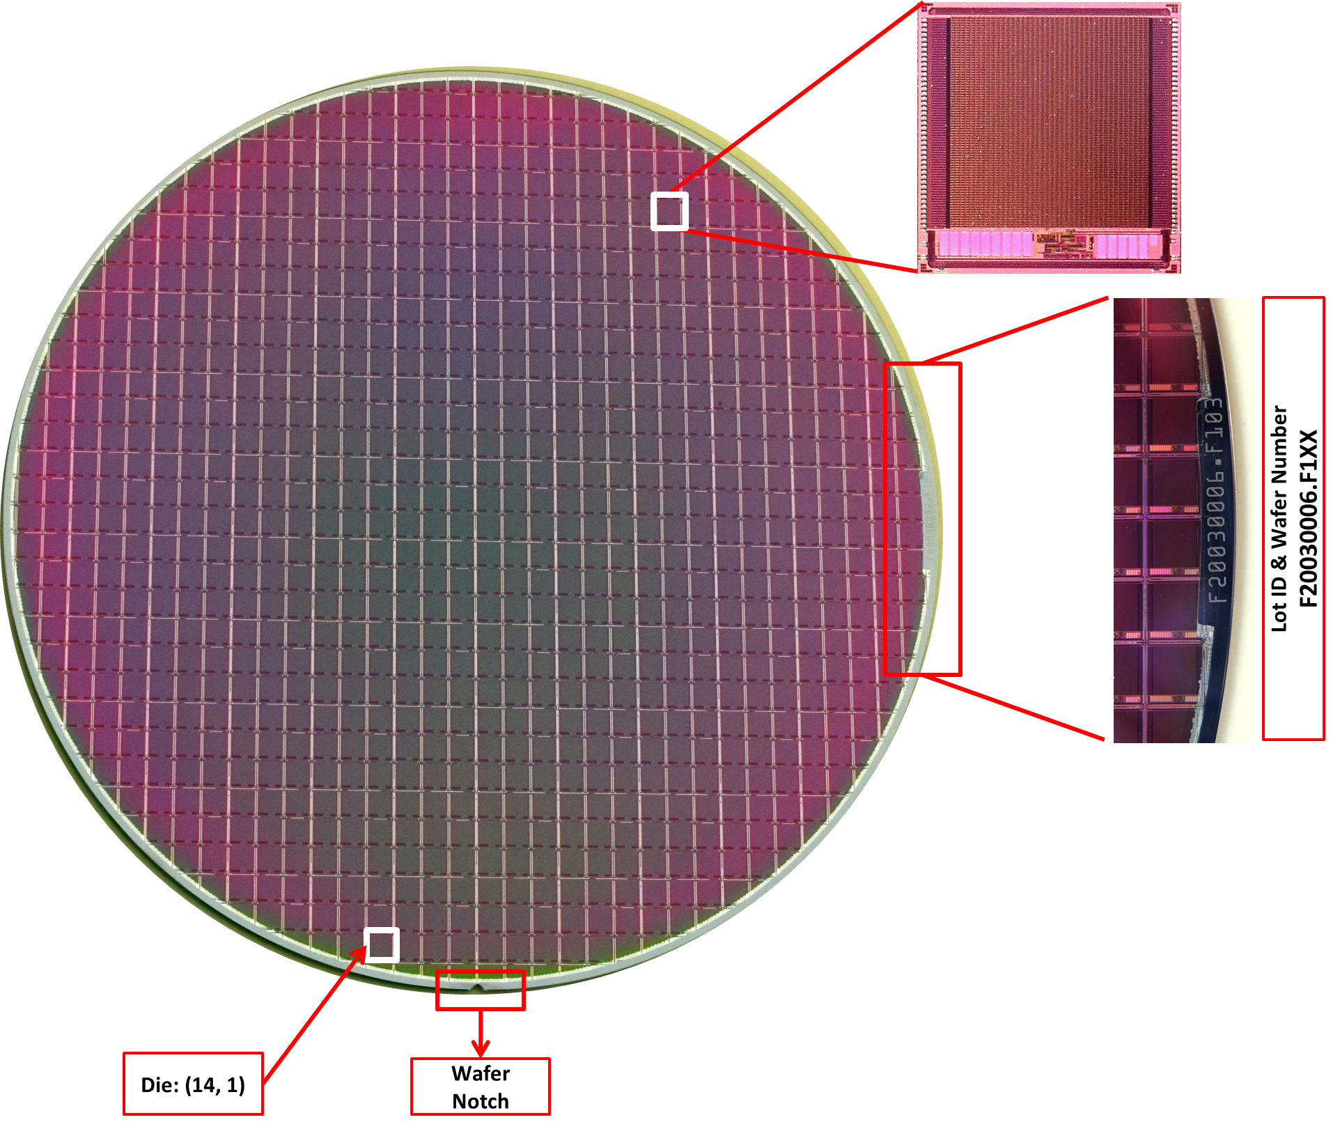
LDOs
Two versions:
  1.2 V, 1.6A
  1.8V, 1.6A
Artcle-ID on each die:
  1.2 V: SC1028-0
  1.6 V: SC1026-0
2 x 6 Wafers shipped from VECC to GSI
detailed wafer map on QA results (tests performed at SCL) supplied
second batch of 2x6000 dies
will be delivered later
Provided QA parameters (example for 1.2V, 1.6A):

Slide 10
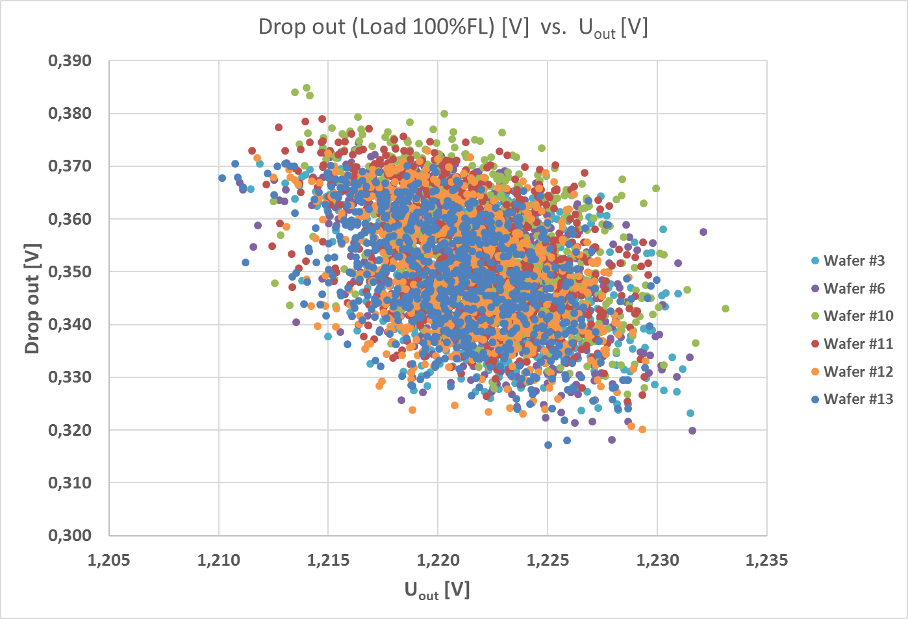
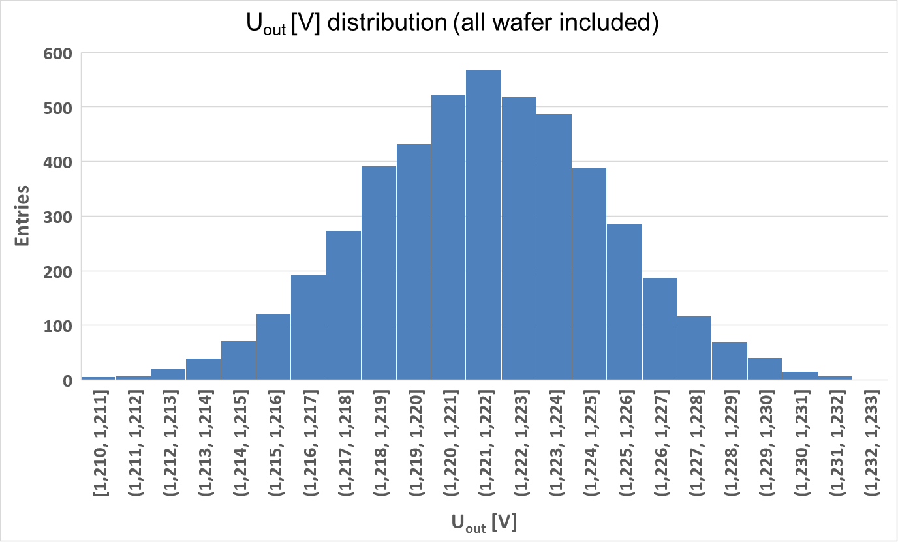
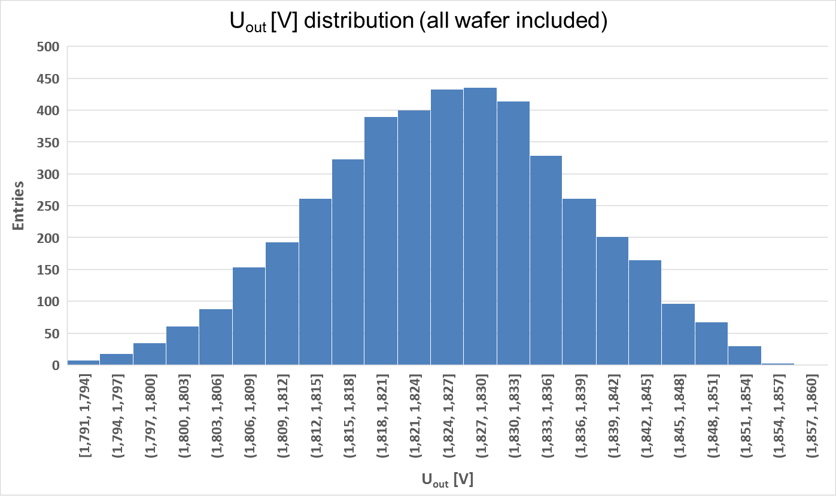
LDOs (2)
Wafermap example:
Wafer dependent distributions
(examples for 1.2V, 1.6A)
Yield for 1.2 V devices: 96%
U_{out} = (1.222 ± 0.0034)V
(1.2V, 1.6A)
(1.8V, 1.6A)
Yield for 1.8 V devices: 89%
U_{out} = (1.823 ± 0.0115)V
Very low variations:
σ ≈ 0.3 % and σ ≈ 0.6 %

Slide 11
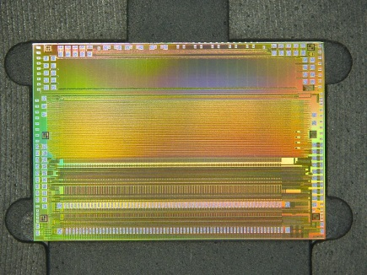
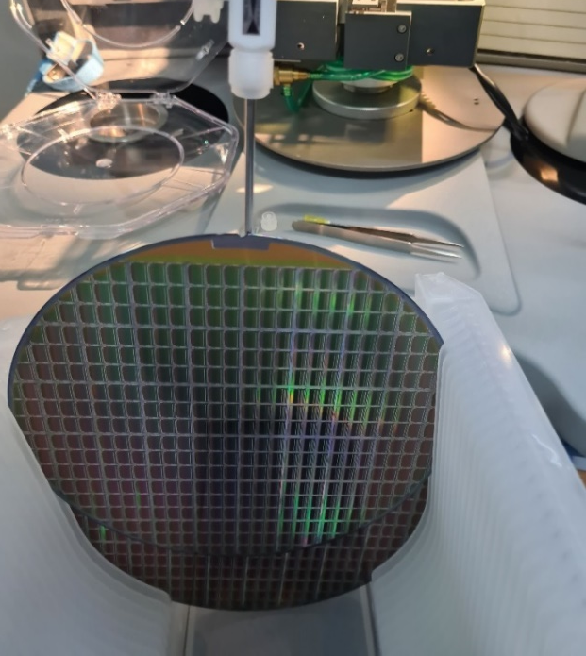
STS-XYTER
Custom made readout chip
First batch of dies of final
STS-XYTER Version 2.2
will arrive at GSI in November
GSI Detector lab prepared with
  FEB-C for thorough chip-test
  FEB-8 A and B for FEB-8 test
STS XYTER 2.2
STS-XYTER test setup at GSI is under optimization
  foreseen: cross-check of QA parameters for samples
Very detailed QA protocol for tests on the waferlevel:
provided by AGH
  QA results at AGH will be provided to GSI
  these data serve as calibration
QA at GSI on samples will be described in QA protocol including consistency check between AGH and GSI
AGH, Poland

Slide 12
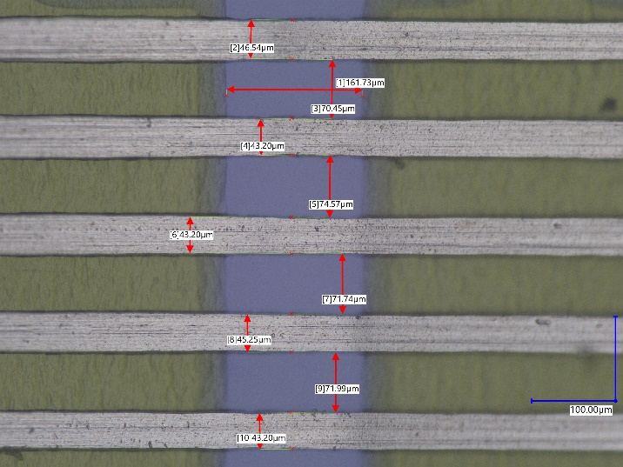
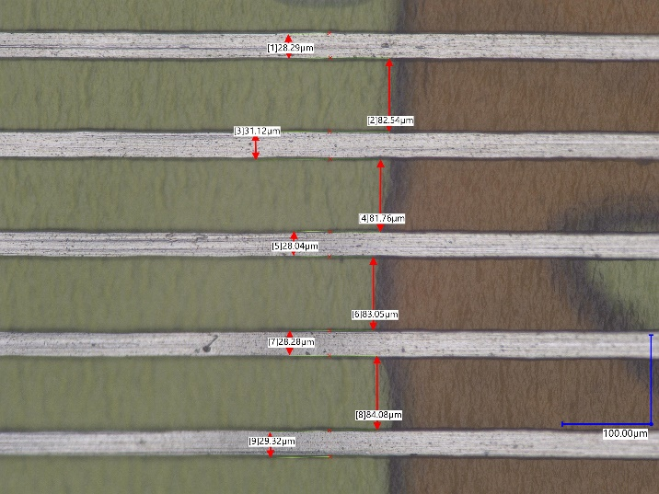
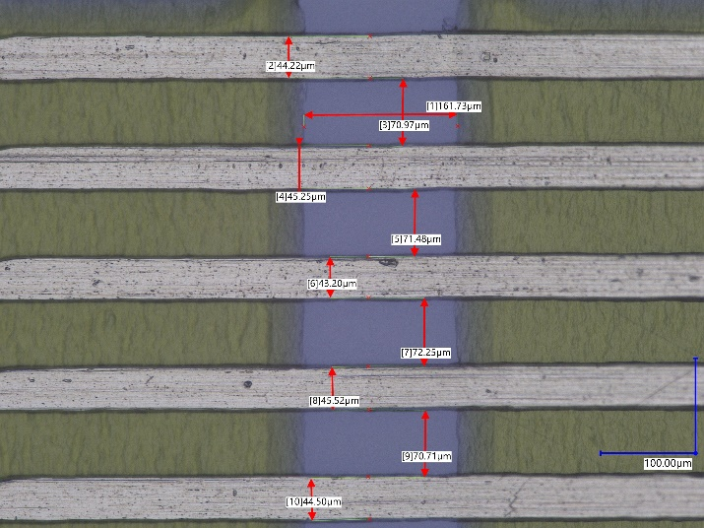
Microcables
Microcable specifications (including QA criteria at LTU) explained in detail in CBM -TN-20003
LTU, Ukraine: flexible aluminum cables and their additional shieldings
ASIC Bonding area
Middle area
Sensor Bonding area
QA parameters measured on three samples of each set for different cable types:
  Width of Bond area
          Width/distance of Bond traces
                Width/distance of traces
QA results available in Elog
QA procedure described in QA protocol

Slide 13
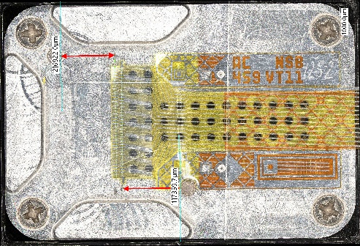
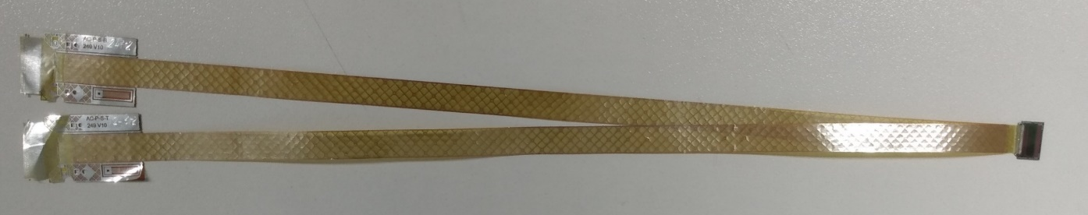
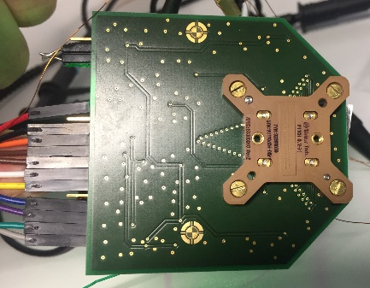
Chipcables
QA passed STS-XYTER meets 2 QA passed microcables → Chipcable
Pogo-Pin Testsocket setup
Foreseen QA-Procedure:
Measurement of line resistances towards the testfan of the microcable
In parallel: Identification of possibly existing shorts
GUI input for microcables to be used: check of IDs via RegEx
GUI shows measured Current and Resistance values per channel in Expert mode
  common usage: GUI shows ‘QA Pass‘ or ‘QA Fail‘ per channel (QA borders defined internaly)
Logistic aspects:
Definition of cable-sets with unique ID, cable-IDs and so called ‘spare cables’ (also unique IDs existing)
  nomenclatures finalized recently → to be added to list of STS nomenclatures

Slide 14
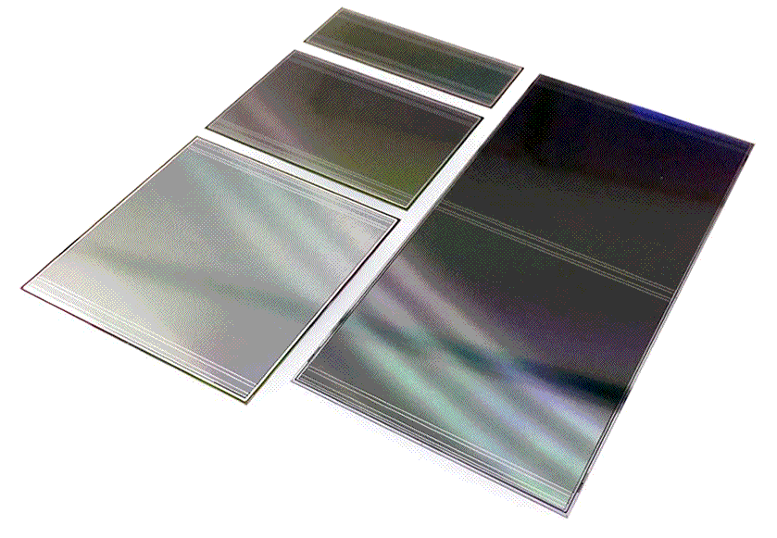
Sensors: Overview
Progress in
electrical and optical inspection
Sensors of four different sizes:
  (62 x 22) mm²
  (62 x 42) mm²
  (62 x 62) mm²
  (62 x 124) mm²
E. Lavrik and M. Shiroya
Logistic aspects:
Last digit of SN represents the sensor size
Wafer and LOT number are also encoded in SN

Slide 15
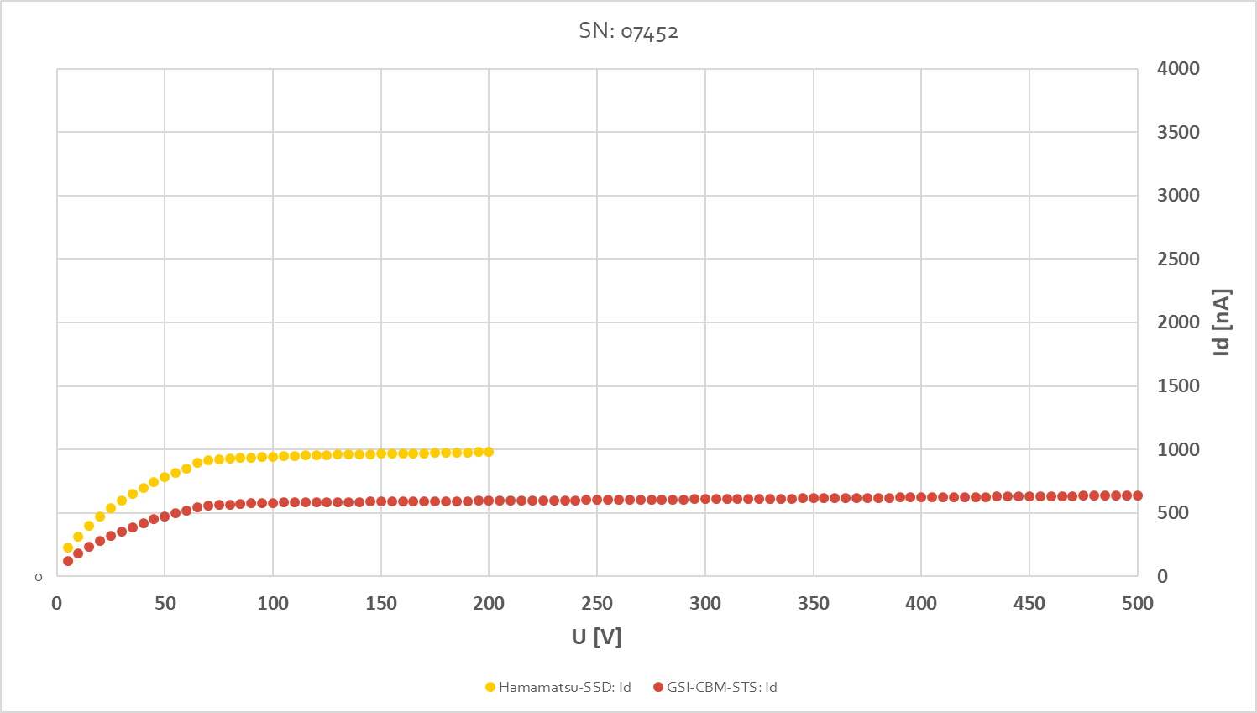
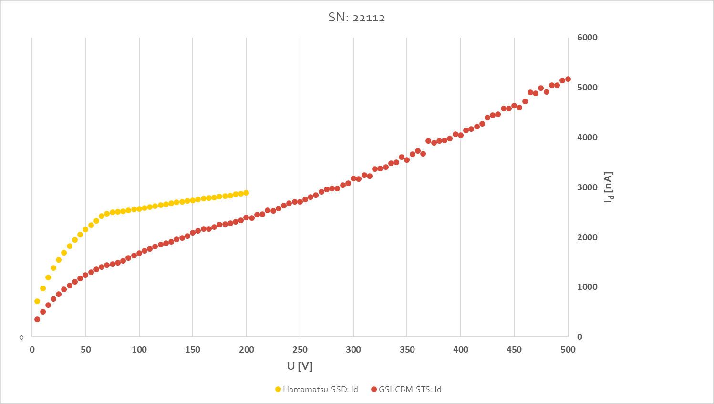
Sensors: Electrical inspection
810 sensors tested until 13.10.2020 (C-V and I-V characteristics):
(62 x 22) mm² | (62 x 42) mm² | (62 x 62) mm² | (62 x 124) mm²
71 | 290 | 284 | 165
I-V and C-V are measured for ALL sensors
  I-V is measured up to U_{bias} = 500 V (Vendor: up to U_{bias} = 200 V)
  C-V is measured up to U_{bias} = 200 V (Vendor: up to U_{bias} = 150 V)
samples directly measured
after each delivery
  inbound check!!
Some sensors show ‘charge-up’ problematics
after delivery
→ re-measurement to be done after ‘shower’ with ionizing air-blower
(currently under test)
ALL sensors delivered so far inside given techn. specs. !
additional QA conditions defined by STS (rad. hard. aspects, etc…)

Slide 16
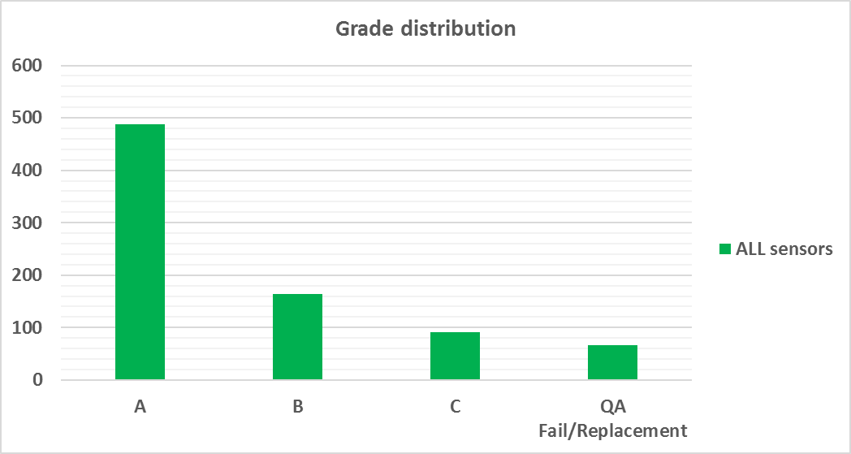
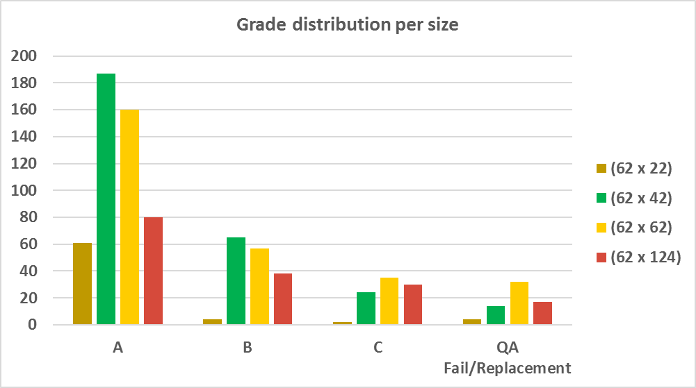
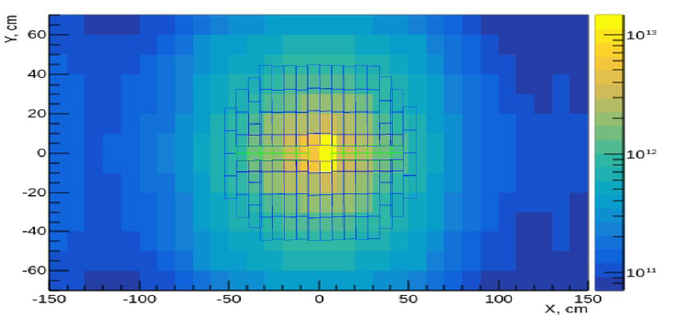
Sensors: Electrical inspection (2)
Grading introduced to determine possible positions of sensors in different radiation dose regions in the detector:
Grading based on current evolution behavior depending on applied bias
stable operation at higher voltage → useable for modules at positions exposed with higher doses of non-ionizing radiation
additional STS QA criteria for electrical inspection:
dedicated range values for the parameters
        I_{R1} = I(250 V) / I(150 V)
        I_{R2} = I(350 V) / I(150 V)
        I_{R3} = I(500 V) / I(150 V)
to be re-measured/
not usable for STS
1 MeV n_{eq}
to be re-measured/
not usable for STS
J.Heuser, TB 07/07/2020

Slide 17
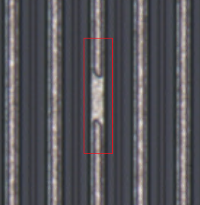
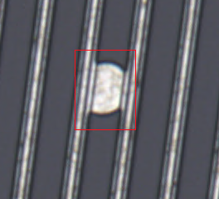
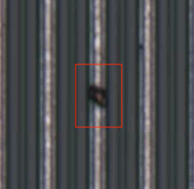
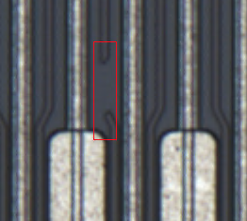
Sensors: Optical inspection
Aim of optical inspection:
identification of anomalies
  performed on ALL sensors
sensor metrology measurements
  to be performed before assembly
Defects contributing to ‚broken strip‘ definition via
optical inspection:
Al open & short, Implant open & short
Status Optical Inspection: 88.45%
of overall sensor delivery measured (973 pieces)
Status Electrical Inspection: 75.45%
of overall sensor delivery measured (830 pieces)
Status Striptest: 0.63%
of overall delivery measured (7 pieces)
E. Lavrik
Currently used approach for optical grading:
amount of questionable strips
Current QA activity:
search for correlations between electrical, optical and
module operational results → How many sensors need ‘strip-testing’?

Slide 18
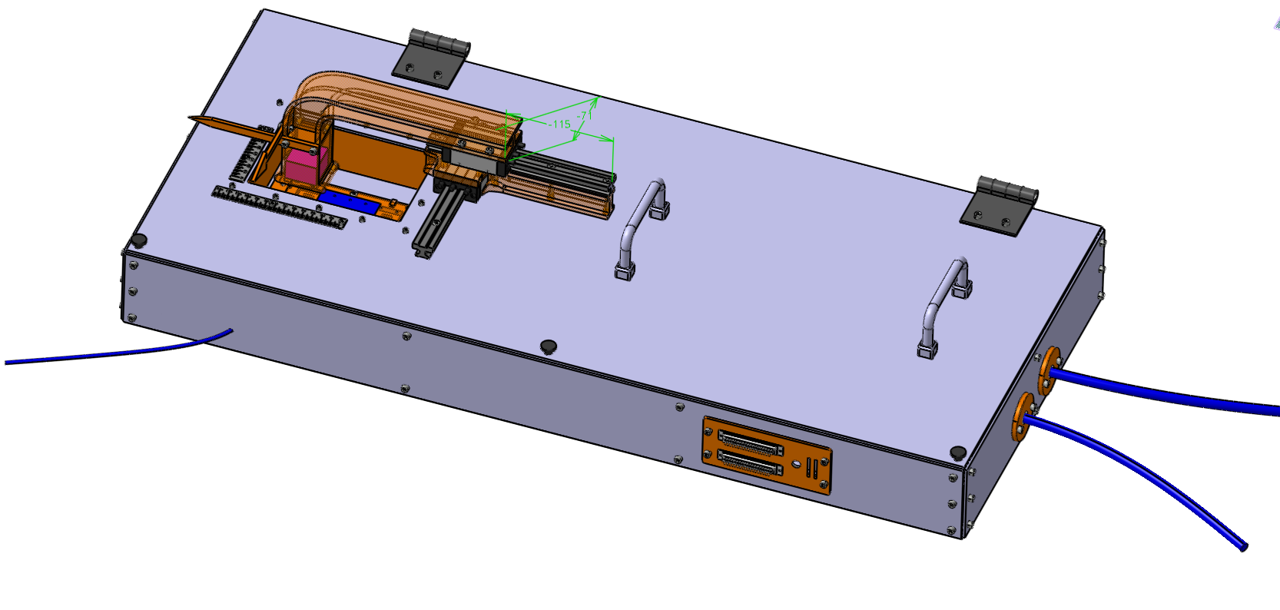
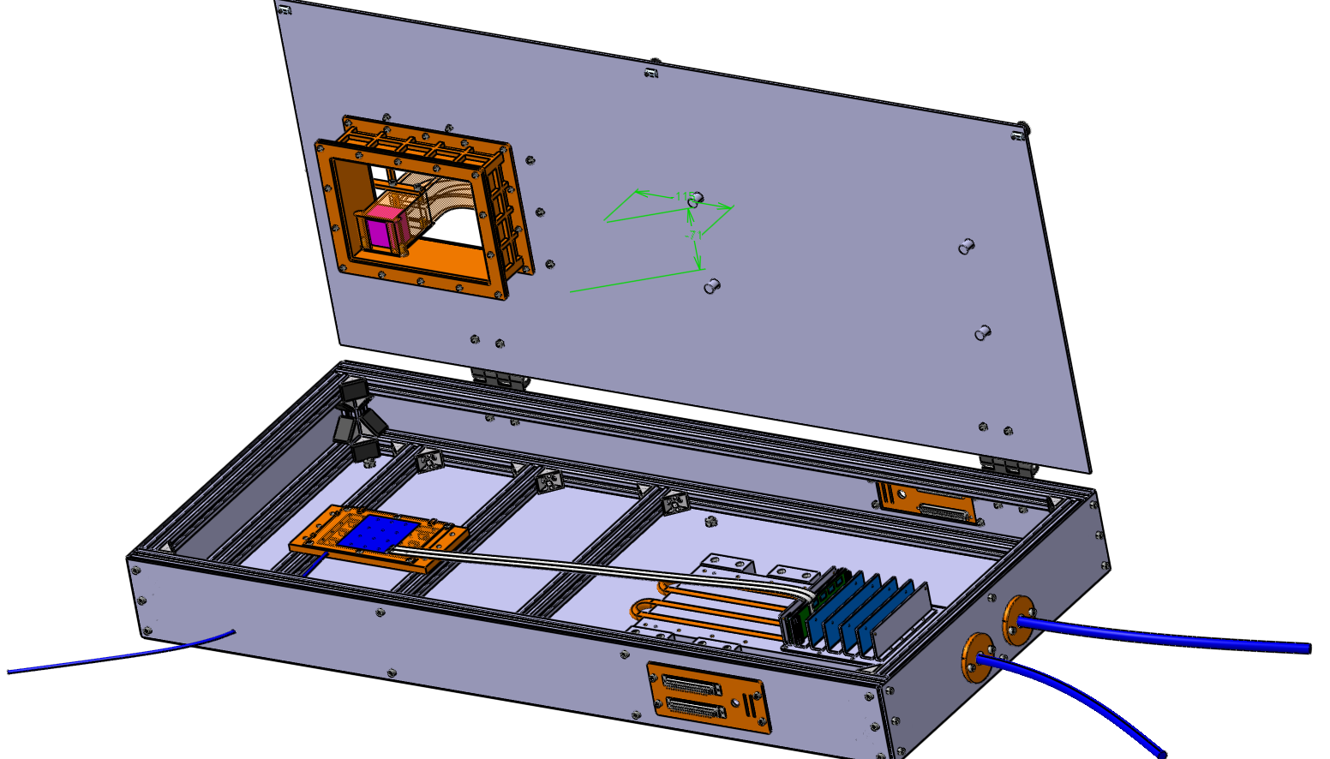
Module Test Box
Several module assembly steps are checked via
additional measurements (e.g. bonding checks via
connectivity tests)
  QA steps during module assembly
  as part of the workflow
After gluing the 2 FEBs onto the L-shape fin
(last module assembly step):
Complete module test in a custom made Module Test Box
O.Vasylyev

Slide 19
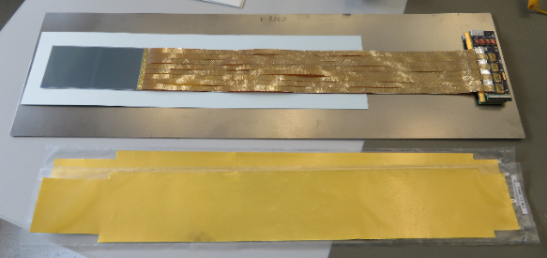
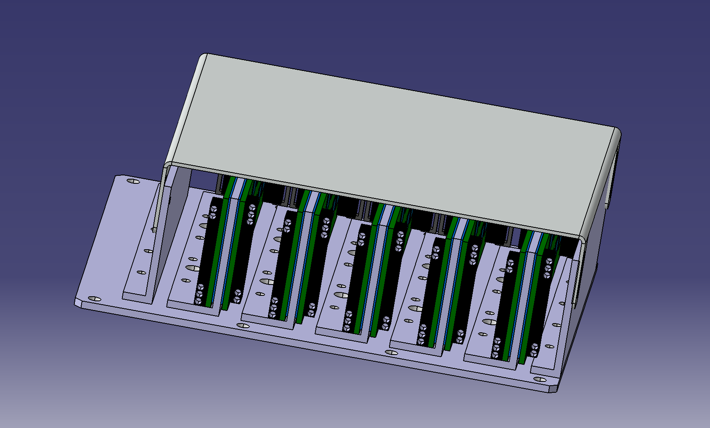
Ladders: Component overview
106 ladders:
  876 Modules
  106 CF-structures
  2 x 106 = 212 Bearings
  2 x 106 = 212 FEB Boxes
Modules
  QA in preparation
  QA protocol in preparation
Ladder Assembly
Carbon fibre structure
  QA already done for samples
Ladder Assembly
FEB Box
Ladder Assembly
Ladder Assembly
Bearings
  EDR taken place June this year

Slide 20
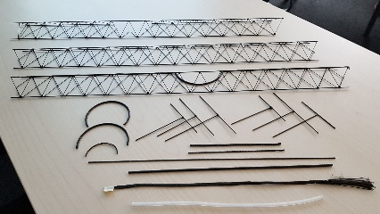
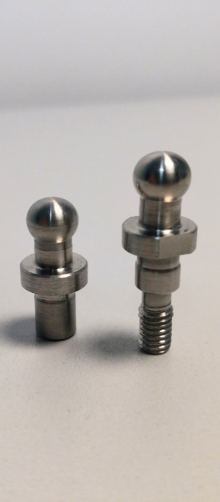
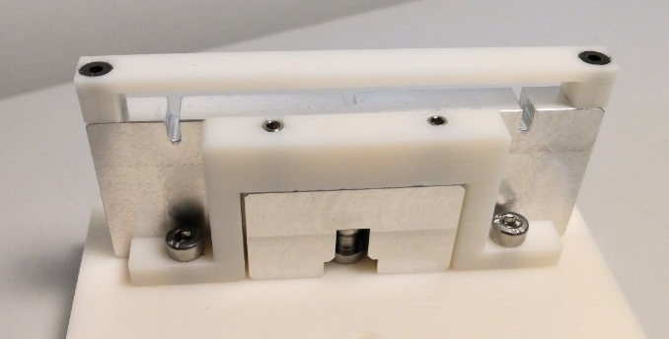
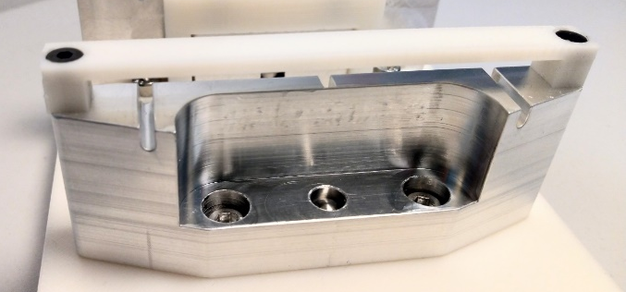
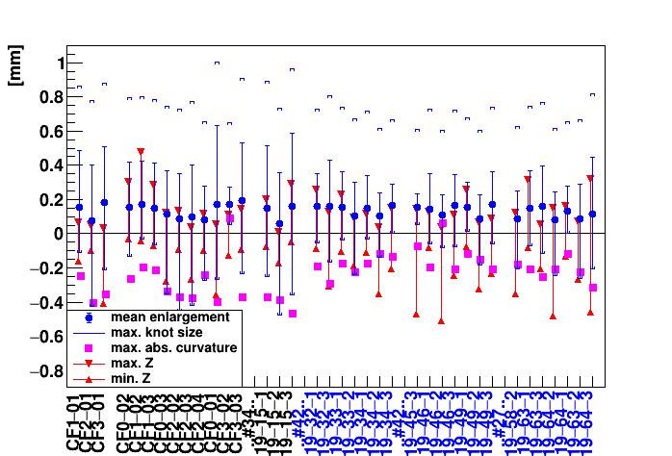
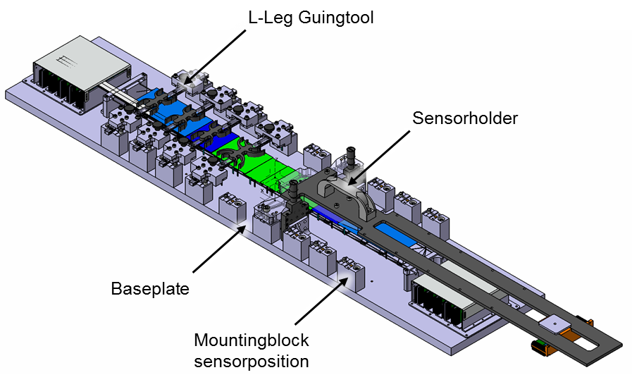
CF Structures & Bearings
Floating Mount
U.Frankenfeld
Ballpins
182 CF structures available already
F.Nickels
Fixed Mount
Ladder Assembly Jig @ GSI
L-Leg gluing tool
U.Frankenfeld
F.Nickels

Slide 21
Summary
STS is in transition from R&D to QA
  most QA issues up to the ladder assembly stage
  are identified and the corresponding QA activities started
QA should be understood as a continuous effort to
  minimize invested resources while being right on target in specs and time
  minimizing sources of errors
Careful documentation will serve solving problems in the future!
Thank you for your attention!

Slide 22
Backup

Slide 23
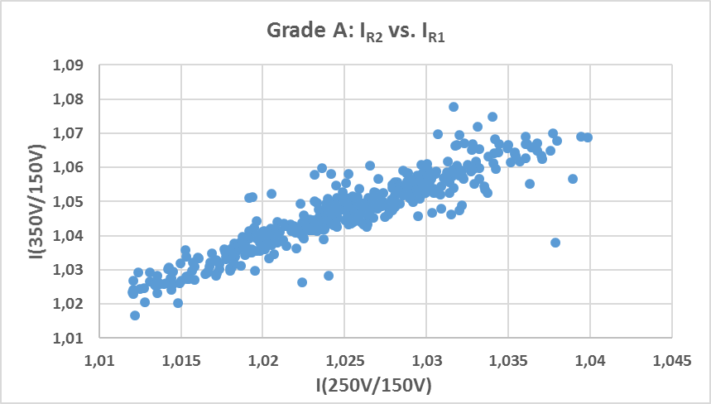
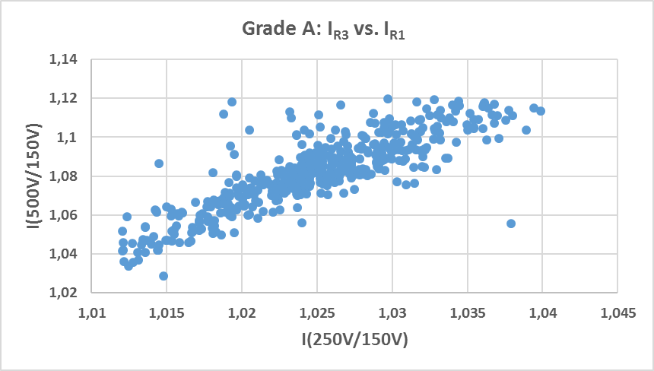
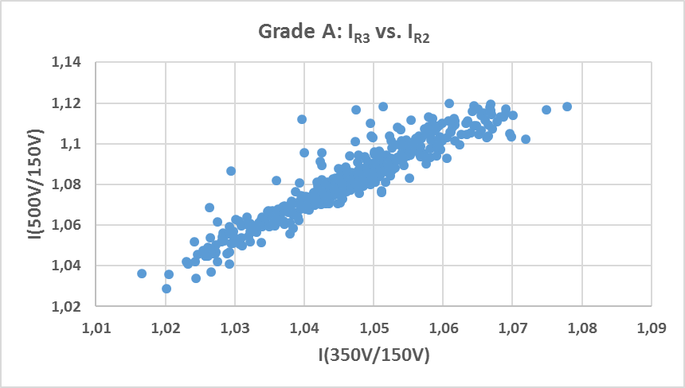
Sensor EI-QA grading
Used QA criteria for basic electrical inspection:
  I_{R1} = I(250 V) / I(150 V)
  I_{R2} = I(350 V) / I(150 V)
  I_{R3} = I(500 V) / I(150 V)
Grade A (Input: ALL sensors):
I_{R1}>1.012 && I_{R1} <1.04
I_{R2}>1.0 && I_{R2}< 1.1
I_{R3}>1.0 && I_{R3}<1.12
Grade B (Input: sensors w/o sensors of Grade A ) :
I_{R1}>1.0 && I_{R1}<1.05
I_{R2}>1.0 && I_{R2}<1.1
I_{R3}<20
Grade C (Input: sensors w/o sensors
of Grade A and Grade B ):
w/o I_{R2}<1.0 and w/o (I_{R1} || I_{R2}|| I_{R3} ) >3.5

