Slide 1
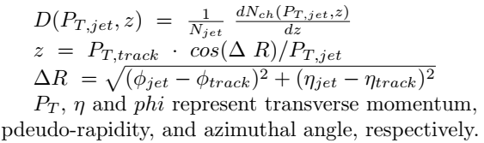
Towards Study of 2-Particle Pt Correlations
A. Galoyan and V. Uzhinsky
PHYSICS REPORTS 107 (1984) 59
e+e- PHYSICS AT PETRA –
THE FIRST FIVE YEARS,
Sau Lan WU and DESY.
Jets in High
Energy Physics
Fragmentation function
It is the well-known procedure!
1/17

Slide 2
Example
19 Aug. 2020 arXiv:2008.08631 [nucl-exp]
Measurement of semi-inclusive jet fragmentation functions in Au+Au collisions at Sqrt(SNN) = 200 GeV in STAR, Saehanseul Oh (for the STAR Collaboration)
In-medium modifications of fragmentation functions have been previously reported by LHC collaborations for inclusive jet populations
[4, 5].
[[4] M. Aaboud et al., “Measurement of jet fragmentation in Pb+Pb and pp collisions at sqrt(sNN) = 2:76 TeV with the ATLAS detector at the LHC”, Eur. Phys. J. C 77, no.6, 379 (2017).
[5] S. Chatrchyan et al., “Measurement of jet fragmen-tation into charged particles in pp and PbPb collisions at sqrt(sNN )= 2:76 TeV”,
JHEP 10, 087 (2012).
Figure 1: Semi-inclusive jet fragmentation functions measured in 40–60% Au+Au collisions for three pT;jet ranges (closed markers), compared to those calculated by PYTHIA 8 for pp collisions (dashed lines). Measured distributions are corrected for detector effects and uncorrelated background effects.
2

Slide 3
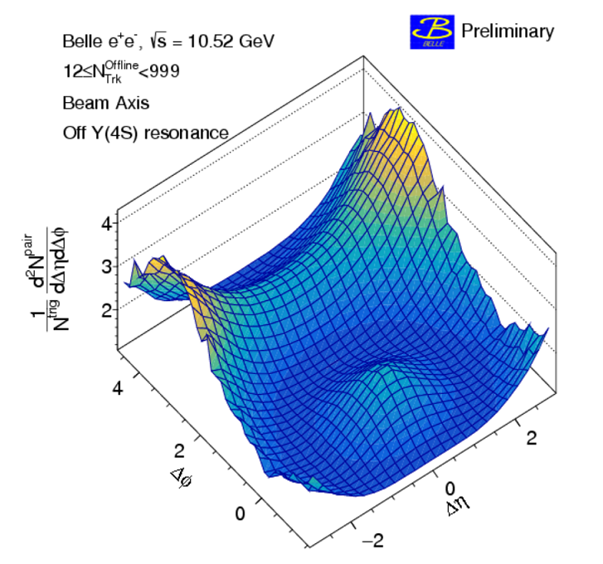
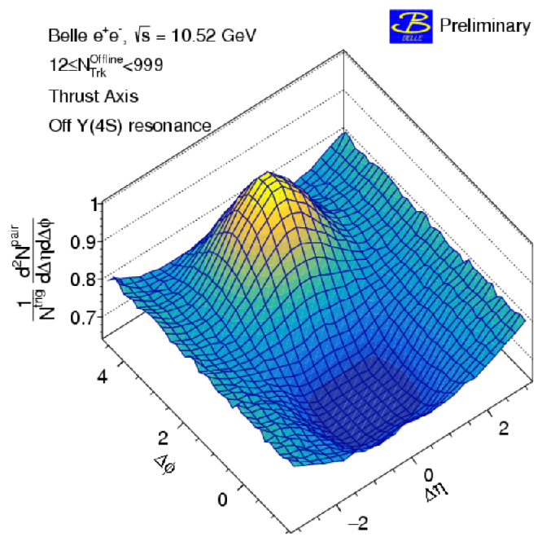
Other exp. method – azimuthal correlations
11 Aug. 2020 2008.04187 [hep-exp]
Measurement of two-particle correlations in hadronic e+e− collisions at Belle, A. Abdesselam et.al.
The “ridge signal”, is a phenomenon widely observed in high multiplicity proton-proton,
proton-ion and deutron-ion collisions, which is not yet fully understood.
Two-particle correlation functions
for beam (left) and thrust (right)
axis analyses with offline multiplicity Noffline Trk ≥ 12.
3

Slide 4
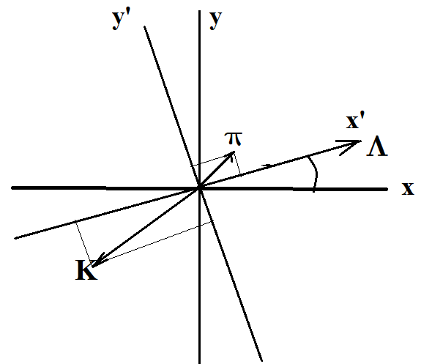





What to do if there is No Jet?
Main idea
2-Particle Pt Correlations
4

Slide 5
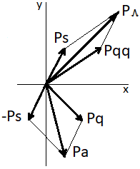

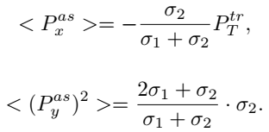
5

Slide 6
Pt-Correlation: calculation method
We calculated 1000000 PbarP-events at Plab=5
and 15 GeV/c using FTF generator in PandaRoot
2. We selected events with Λ –hyperons, and calculated
Cos(φ_Λ) = Px_ Λ / Pt_Λ
Sin( φ_Λ) = Py_Λ / Pt_Λ
3. For these events we transformed Px and Py momenta of
particles associated with Λ –hyperon in the new rotated
coordinate system.
Px’ = Px * Cos(φ_Λ) + Py * Sin(φ_Λ)
Py’ = - Px * Sin(φ_Λ) + Py * Cos(φ_Λ)
(It is obviously, that for Λ –hyperon Px’=Pt; Py’=0)
4. We performed analysis of transformed Px’ and Py’² of particles
produced with Λ –hyperons.
6

Slide 7
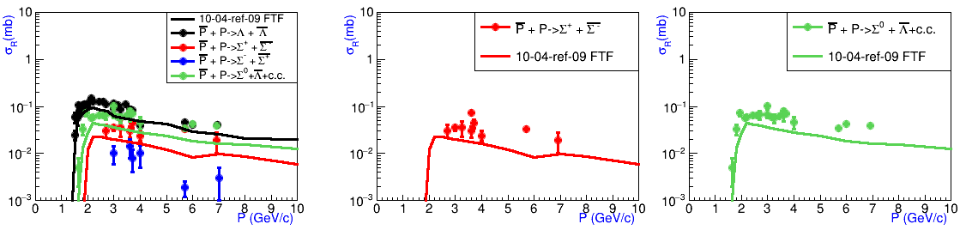
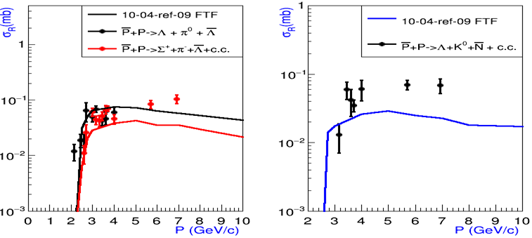
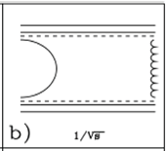
Validation of FTF for Λ production in PbarP events
7

Slide 8
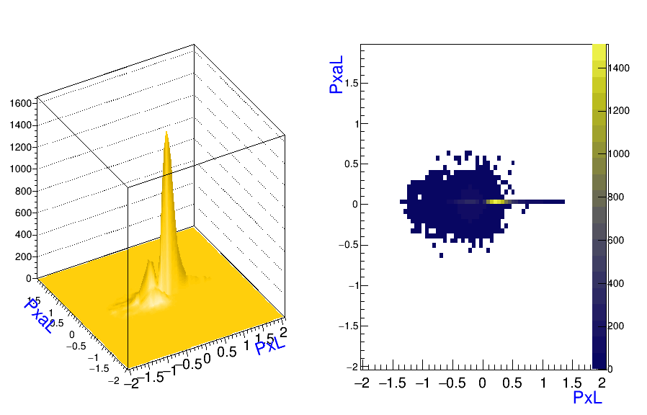
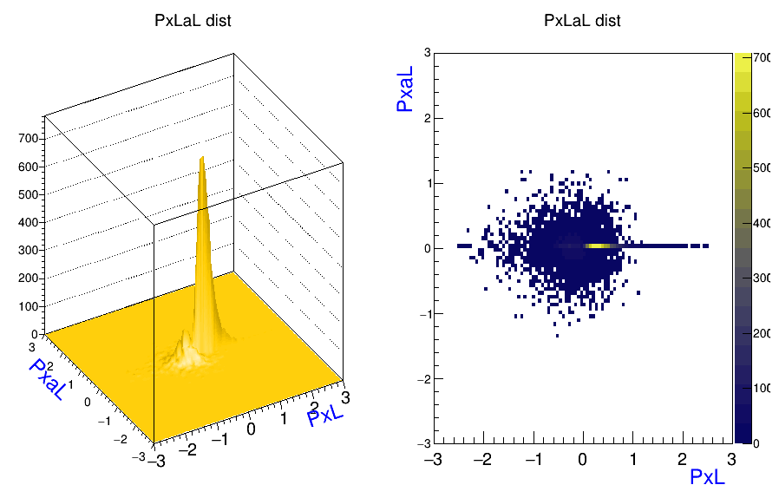
Pt-Correlations of Λ and Λbar : results
Comparison of P_{T}’ of Λ-bar hyperons associated with Λ hyperon in PbarP- events calculated by FTF model
5 GeV/c
15 GeV/c
8

Slide 9
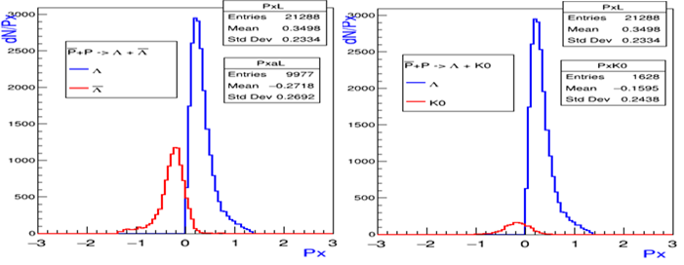
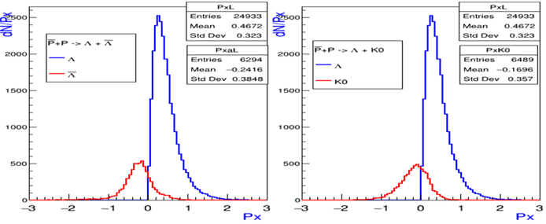
Comparison of Px’ of Λ-bar hyperons and K0-mesons associated with Λ hyperon in PbarP- events
5 GeV/c
N_ Λ = 21288
<Px’_Λ>= 350 MeV/с
N_ Λ bar=9977
<Px’_ Λbar>= -272MeV/c
N_K0=1628
<Px’_K0>= -160 MeV/c
15 GeV/c
N_ Λ = 24933
<Px’_Λ>= 467 MeV/с,
N_ Λ bar=6294
<Px’_ Λbar>= -242 MeV/c
N_K0=6489
<Px’_K0>= -170 MeV/c
9

Slide 10
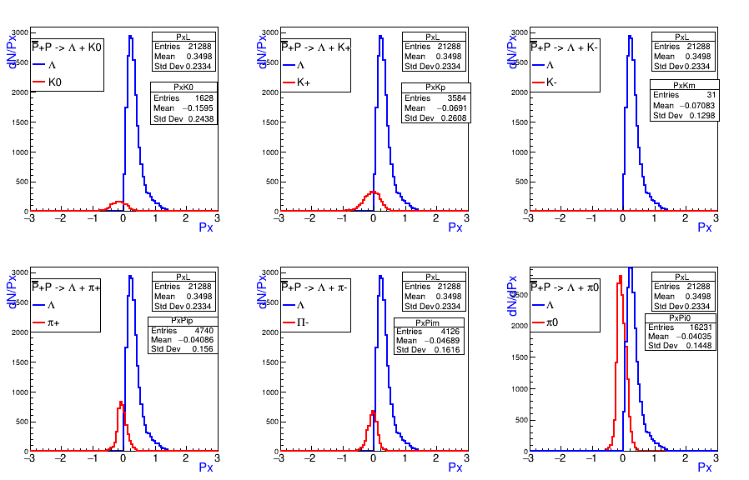
Px’ of particles associated with Λ hyperons
in PbarP-events calculated by FTF at 5 GeV/c
Plab=5 GeV/c <Px’_Λ> = 350 MeV/c
<Px’_K0> = -160 MeV/с , <Px’_K+>=-69 MeV/с, <Px’_K- > = -71 MeV/с
<Px’_π+> = -41 MeV/с, <Px’_π->=-47 MeV/с <Px’_π0 > = -40 MeV/с
Plab=15 GeV/c <Px’_Λ> = 467 MeV/c
<Px’_K0> = -170 MeV/с , <Px’_K+>=-111 MeV/с, <Px’_K- > = -118 MeV/с
<Px’_π+> = -61 MeV/с, <Px’_π->=-65 MeV/с <Px’_π0 > = -42 MeV/с
10

Slide 11
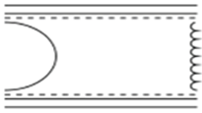
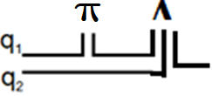
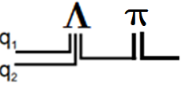
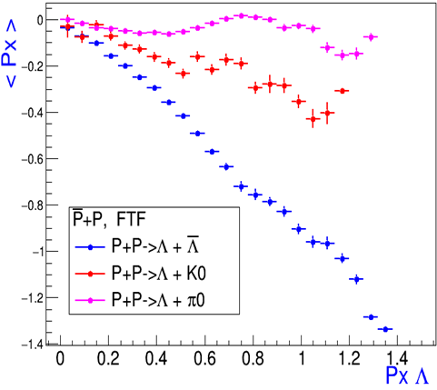
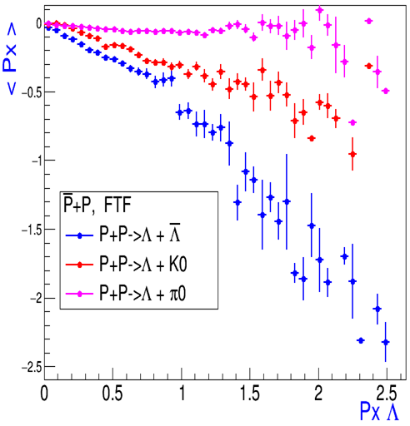
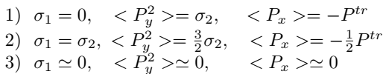
Correlations of mean Px’ of Λ-bar hyperons, K and π mesons with
Λ hyperon Px’ in PbarP-events calculated by FTF
5 GeV/c
15 GeV/c
11

Slide 12
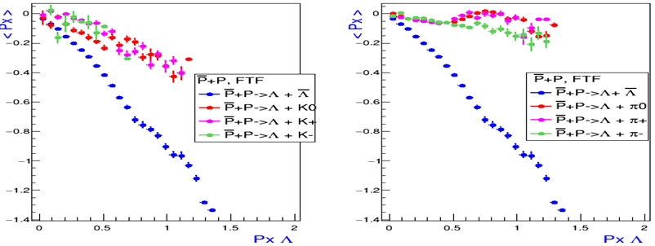
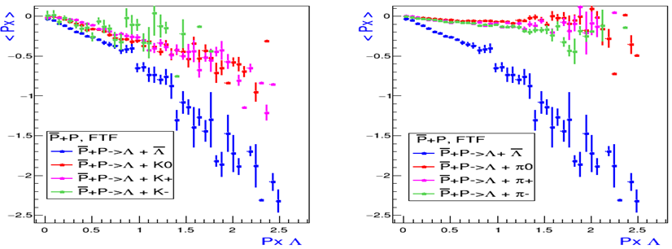
Correlations of mean Px’ of Λ-bar hyperons, K and π mesons with
Λ hyperon Px’ in PbarP-events calculated by FTF
5 GeV/c
15 GeV/c
12

Slide 13
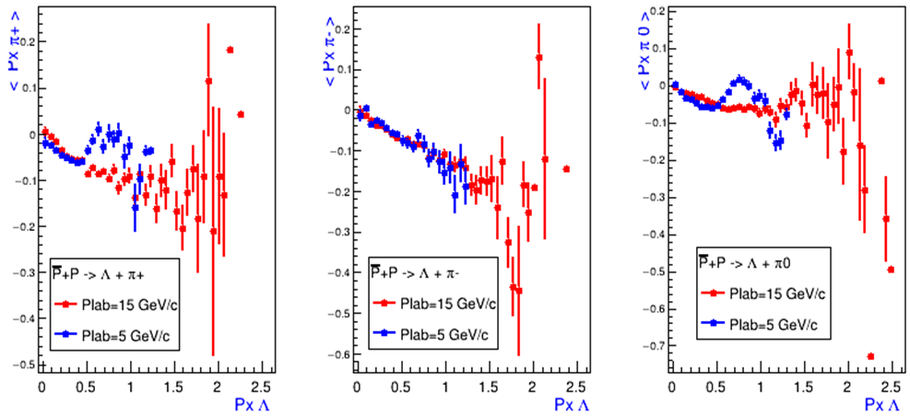
Comparison of correlations of mean Px’ of Λ-bar hyperons and π- mesons with Λ hyperon Px’ in PbarP events at 5 and 15 GeV/c
13

Slide 14
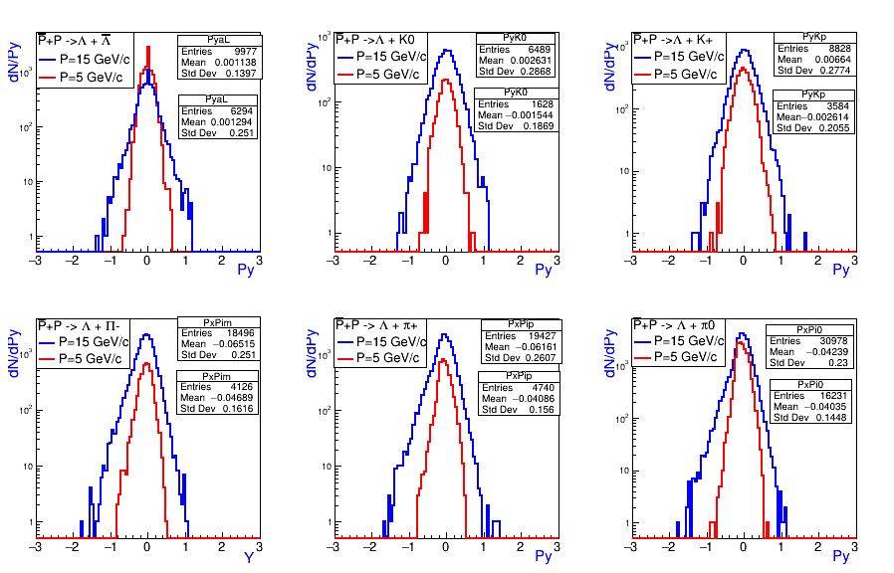
Comparison of Py’ distributions of Λ-bar hyperons, K and π mesons in PbarP-events at 5 and 15 GeV/c calculated by FTF
5 GeV/c
15 GeV/c
14

Slide 15
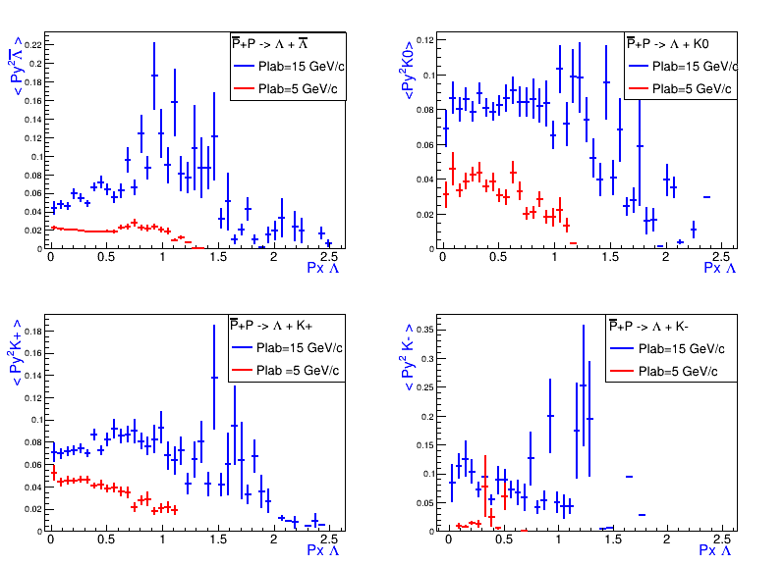
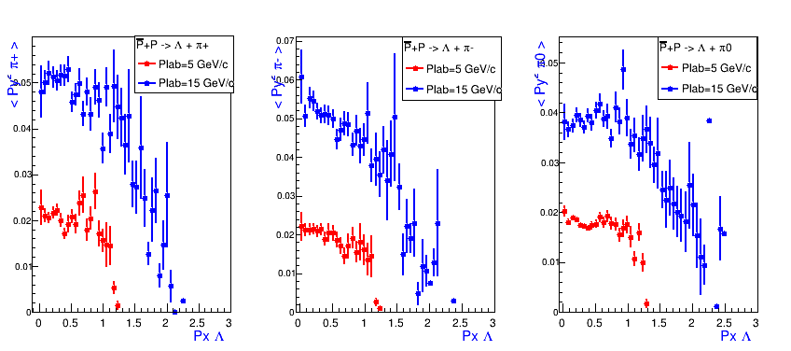
Correlations of mean Py’² of Λ-bar hyperons, K and π mesons
with Λ hyperon Px’ in PbarP-events at 5 and 15 GeV/c
15

Slide 16
Table of Numbers and Mean values of Px’ and Py’² of
Λ-hyperons and particles associated with Λ-hyperon in PbarP-events
Plab GeV/c | Λ | Λbar | K+ | K- | K0 | π+ | π- | π0
5 | N 21288 | N 9977 | N 3584 | N 31 | N 1628 | N 4740 | N 4126 | N 16231
15 | N 24933 | N 6294 | N 8828 | N 661 | N 6489 | N 19427 | N 18496 | N 30978
5 | <Px> 350 | <Px> -272 | <Px> -69 | <Px> -71 | <Px> -160 | <Px> -41 | <Px> -47 | <Px> -40
15 | <Px> 467 | <Px> -242 | <Px> -111 | <Px> -118 | <Px> -170 | <Px> -61 | <Px> -65 | <Px> -42
5 | <Py²> 0 | <Py²> 20 | <Py²> 42 | <Py²> 19 | <Py²> 35 | <Py²> 20 | <Py²> 20 | <Py²> 18
15 | <Py²> 0 | <Py²> 63 | <Py²> 77 | <Py²> 87 | <Py²> 82 | <Py²> 49 | <Py²> 50 | <Py²> 38
16

Slide 17
Summary
We have proposed a New Method of Study of 2-Particle
Pt correlations in soft interactions. The correlations are
sensitive to main assumptions of string model especially
used in Geant4 FTF one.
2. We calculated Pt correlations of Λ -hyperons and associated
particles in PbarP interactions at 5 and 15 GeV/c in FTF model
3. We observe strong 2-particle Pt correlations between anti- Λ
and Λ-hyperons.
4. Pt correlations of Λ -hyperons and K-mesons are more
stronger than correlations of Λ-hyperons and π-mesons.
5. Pt correlations of Λ -hyperons and K-mesons increase
with initial energy growth. The same is true for Pt correlations
of π-mesons and Λ -hyperons.
Detailed study of the Pt - correlations at PANDA will give
a new look on anti-proton − proton interactions
17

Slide 18
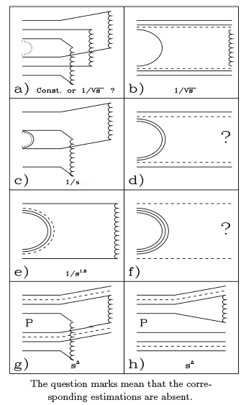


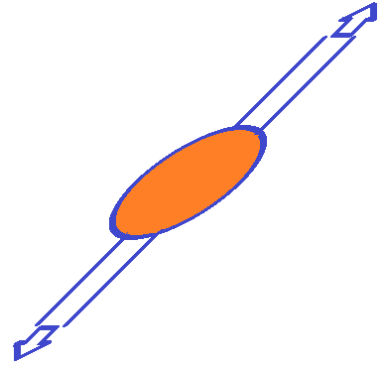
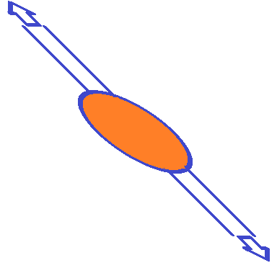

Anti-proton proton annihilation
Randomly izotrophically rotate string!
18

