Slide 1
HESR-PANDA Dipole Status
Collaboration Meeting (via ZOOM)
28 October 2020
Evgeny Antokhin (BINP), Jost Lühning (GSI)

Slide 2
Specification for Dipole magnet
Field integral along beam axis (z-direction) 2.0 T·m
Total length ≤ 2.52 m (without field clamps)
Gap opening (height · width) (0.8-1.01 m) · 3.1 m
Total mass of dipole (yoke, coils, field clamps, support structure) 230 t < m < 240 tons
Steel quality of yoke St-10
Coil Resistive, water cooled
Maximum conductor current ≤ 2.0 kA
Ramping capability (in 60 seconds from 25 % to 100 % of nominal current)
Delay time of field integral vs. current during ramping ≤ 1.0 s
Total dissipated power ≤ 400 kW
Water supply pressure 13 bars
Allowable pressure drop 10 bars
Water temperature rise ≤ 25 K
Proof of sufficient stability in case of seismic events

Slide 3
Status of contracts
Contract about the design of the Forward Spectrometer Dipole Magnet
(“Implementing Addendum No. 1 to the Co-Operation Agreement between BINP, Novosibirsk, and FAIR, Darmstadt”)
The Intermediate Report (stage 1.1 of contract) was finished in March (https://edms.cern.ch/document/2360253/5)
The report was conditionally approved with 3 exceptions (s. following slide)
The Final Report (stage 1.2 of contract) and the Final Design Review (stage 2. of contract) are planned to be finished in December 2020.
Contract about the production of the Dipole Magnet including power supply
An agreement has been reached about the specifications for the power supply
(title “Detailed Specification for the PANDA forward Dipole Magnet Power Converter Power Part and Cabinet”, PSP code 2.11.11.5.1)
An agreement has also been reached about the scope of production, testing, and delivery of the dipole. A document about specifications (title "Detailed Specifications for the HESR-PANDA Spectrometer Dipole", PSP code 2.11.11.1) will soon be finished.

Slide 4
Addendum to the Intermediate Report
The 3 exceptions for the conditional approval of the Intermediate Design Report were:
Repellant forces on the yoke plates
Discrepancies for the stray field on the outside of the yoke
Detailed stress level on support legs for both crucial horizontal directions
Ad 1.:
The BINP colleague entrusted with magnetic field calculations used 2 approaches to determine repellant forces (integration method in a 2D-FEM model, energy difference method in a 3D-FEM model). The bigger one of the 2 resulting force values turned out to be 35 tons (350 kN).
The bolts which are used to connect all the yoke plates are strong enough to bear a force of this magnitude.
An accompanying simulation at FAIR/GSI suggests that repelling forces will mainly act on plate regions which are near to coils (pole shoes). Further away from the coils (flux return region) the magnetic forces among the plates are non-repelling (s. following slides).

Slide 5
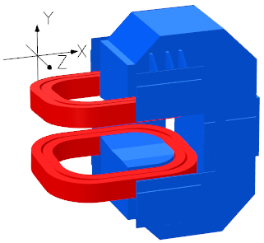
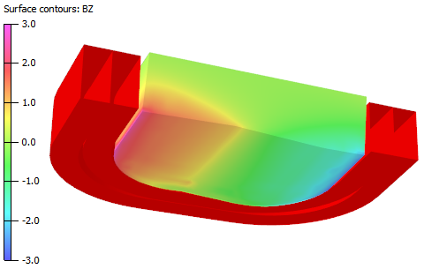
Repelling forces on dipole yoke
Maxwell stress force on these pole sections Fz=-106kN
Lorentz force Fz on western half of upper coil = -59kN
For symmetry reasons, here and in the following only 1 quarter of the dipole (upper western quarter, x=>west, z=>north) is considered.

Slide 6
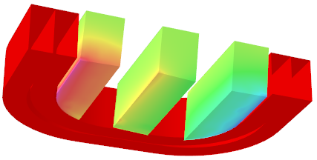
Repelling forces on pole sections
section 1
section 3
section 5
Fz=-133kN
Fz=-29kN
Fz=+110kN
One half of the yoke consists of 5 parallel units (3 plates per unit, 15 plates in total). In the figure above, the upstream (southern) unit is named “section 1”. For clarity, sections 2 and 4 are not shown, the forces on these are:
section 2 Fz=-108kN, section 4 Fz=+54kN.

Slide 7
Addendum to the Intermediate Report (Continuation of slide 4)
Ad 2.:
Plots of the stray field outside of the yoke have been presented. The field magnitude is in the same order as those stray field values calculated at FAIR/GSI, however, in field distribution plots there were some artefacts visible. The BINP colleague in charge of FEM simulations is trying to get rid of these artefacts.
Ad 3.:
FEM simulations concerning the support structure of the dipole have been carried out both at BINP and FAIR/GSI.
One of the most crucial requirements for the dipole magnet is that the support structure can bear a static horizontal acceleration of 0.8 m/s² (8% of earth gravity) in any direction without plastic deformation in any region. This criterion ensures sufficient stability against the severest seismic events to be expected at the FAIR site (s. following pages).

Slide 8
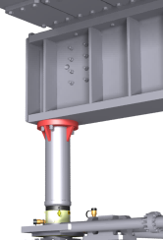
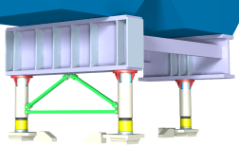
FEM simulation of crucial horizontal acceleration
The most crucial direction of any horizontal force is that one from the center-of-gravity towards the north-western leg (s. figure). The highest stress arises at the top of the leg.
connection of north-western leg and big beam (BINP design)
Simple geometry of FEM model used at GSI. Struts marked green are intended to reduce bending moments on support legs

Slide 9
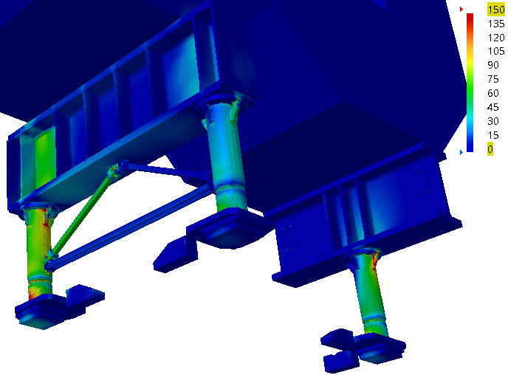
FEM simulation of crucial horizontal acceleration
Von-Mises stress [MPa]
Hydraulic jack for north-western leg
Recent simulations at GSI for the most crucial load case have shown that struts which connect the 2 western legs will considerably reduce the maximum stress at the top of the north-western support leg.

Slide 10
Thank you for your attention!

