Slide 1
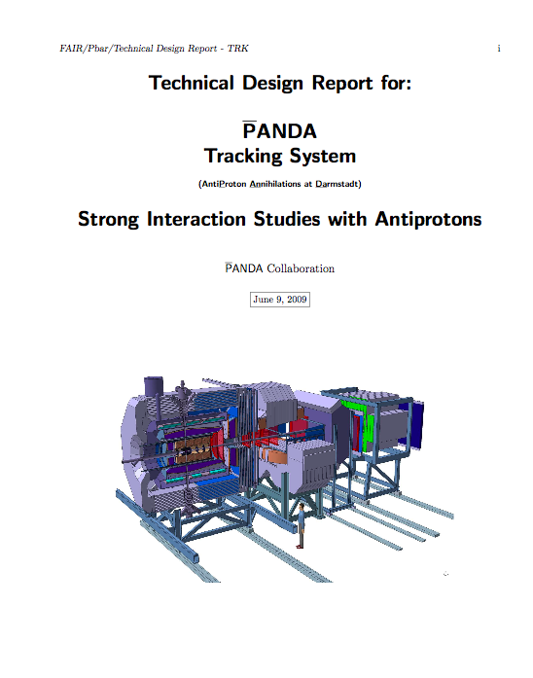
STT Technical Design Report status
Status of the work
Time line
….

Slide 2
The Tracking TDR
The Tracking TDR is a multi-volume document describing the technical solutions chosen for:
Micro Vertex Detector;
Central Tracker;
Forward GEM Chambers
Forward Tracker.
The different volumes have different time scales.

Slide 3
Work done for the STT volume
Concerning the STT volume we have
3 The Straw Tube Tracker
3.1 General overview
3.2 Straw tube description
3.2.1 Straw materials
3.2.2 Pressurized straws
3.2.3 Gas mixture
3.3 The layout of the whole detector
3.3.1 Detector geometry
3.4 Mechanics and detector installation
3.4.1 Support structure of the straw
3.4.2 Installation of the straw tubes
layers on the support structure
3.4.3 Mechanical tests
3.5 Central frame
3.6 The gas system
3.7 The readout electronics
3.8 Calibration and Monitoring
3.9 Simulations
3.9.1 The charge released into the tube
3.9.2 The drift process from GARFIELD
3.9.3 Simulation of the drift process
3.9.4 The electrical signal
3.9.5 Simulation of the self-calibration
procedure
3.9.6 The dE/dx simulation
3.9.7 Full and fast simulation
3.9.8 The Helix fit
3.9.9 The Kalman filter
3.9.10 The simulation environment
3.9.11 Results
3.10 Prototype tests
3.10.1 Spatial resolution
3.10.2 Momentum resolution
3.10.1 Aging tests
3.11 Benchmark channels
3.12 Organization
References

Slide 4
Road map
We still do not have enough about the tracking requirements
My proposal is to skip this for the moment
We have to define referees to enter into the review process of what is already available
The main goal of the TDR is to demonstrate that the detector is ready to be constructed;
The second goal is to have the material to make the choice TPC vs STT
My proposal is to have a first complete draft for March 2011

Slide 5
General Information
Regular meeting will again take place to check the progresses and organize the work, every 3 weeks on Thursday morning starting at 10 A.M
The Tracking WIKI page is the place to go to find information
http://panda-wiki.gsi.de/cgi-bin/view/Tracking
Repository Access
A subversion repository " https://lxfocus14.pv.infn.it/svn/PndTrkTdr " has been created to host the files for the Tracking TDR.
The editing rules are similar to the ones for the TPR and the PB and all others PANDA official documents.
If you have not been contacted and want to be an author with svn access, please send an e-mail to Gianluigi Boca (Gianluigi.Boca@pv.infn.it).

