Slide 1
LNF Straw Tube activity
Mechanics development
Prototype development
Electronics tests

Slide 2
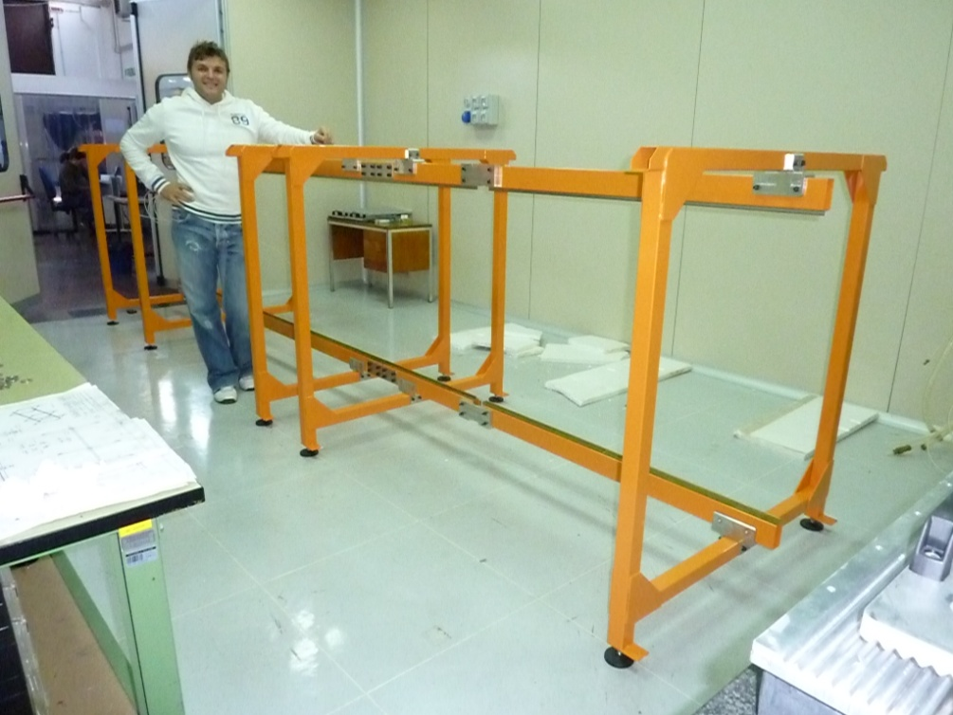
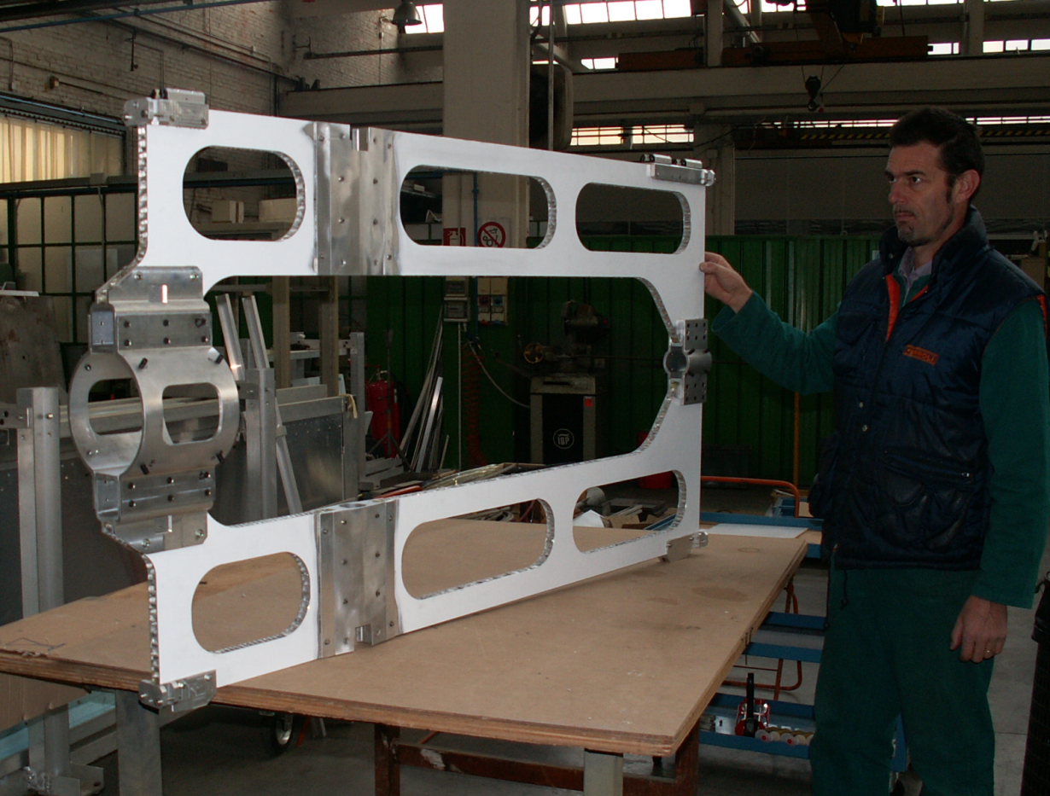
Mechanics development
After the design of the
STT support structure,
we moved to
the inserting system design,
and finally to
the cable routing design.
Presently prototypes of the STT main mechanics components have been realized and tests of mounting procedure will be carried out
Details have been presented by Dario Orecchini in the Mechanical session

Slide 3
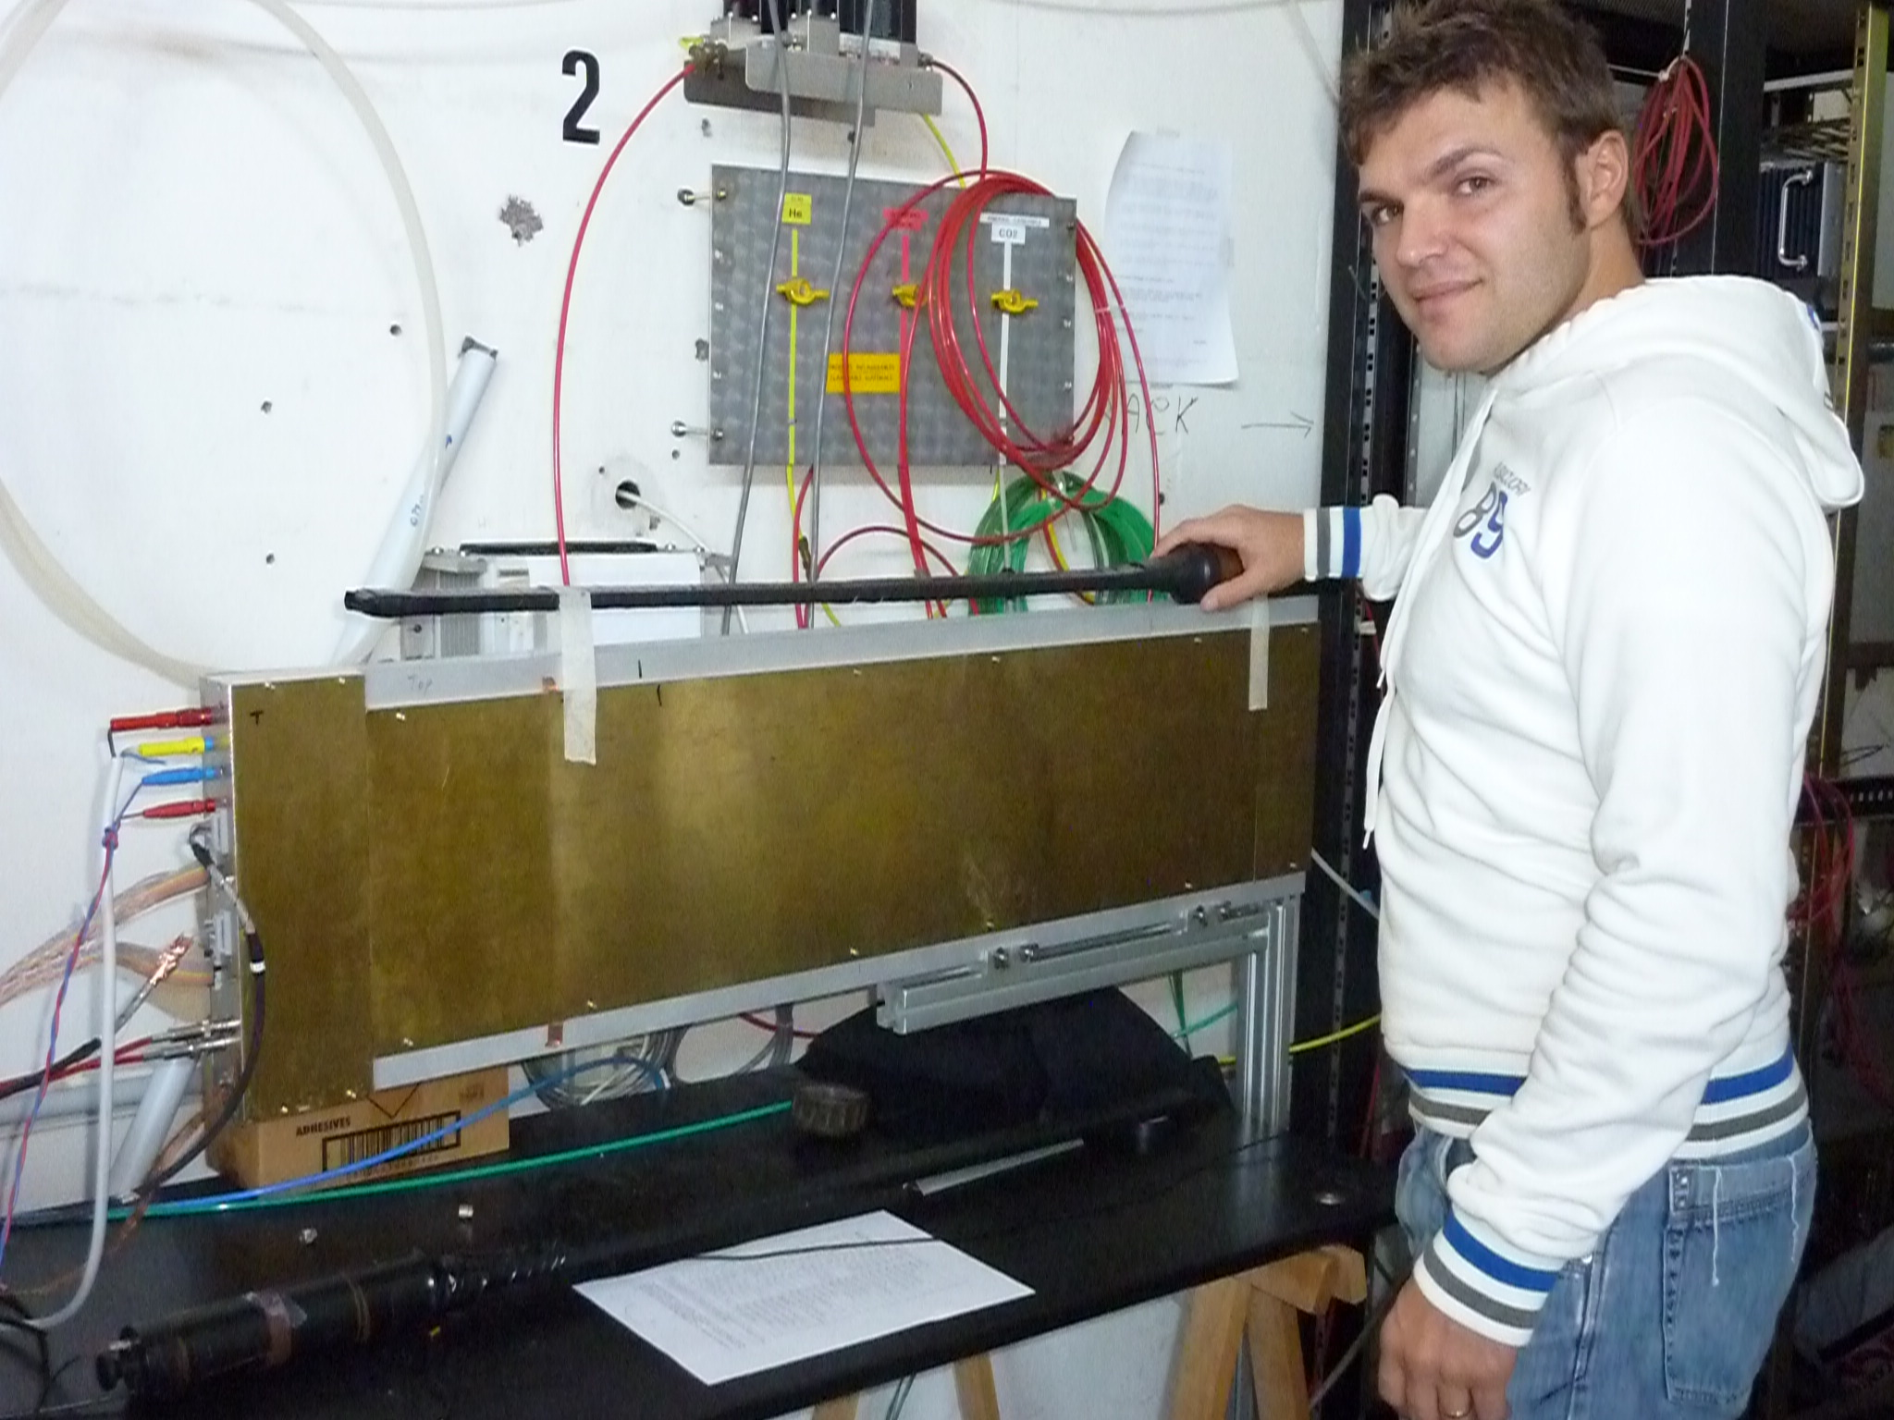
Prototype tests
A 32 channels double layer prototype has been realized by Ferrara and brought to LNF for a test beam.
The module is equipped with electronics boards mounting CARIOCA chips developped for LHCb muon tracker
Presently the detector is under test with cosmic ray triggered by a scintillator hodoscope.

Slide 4
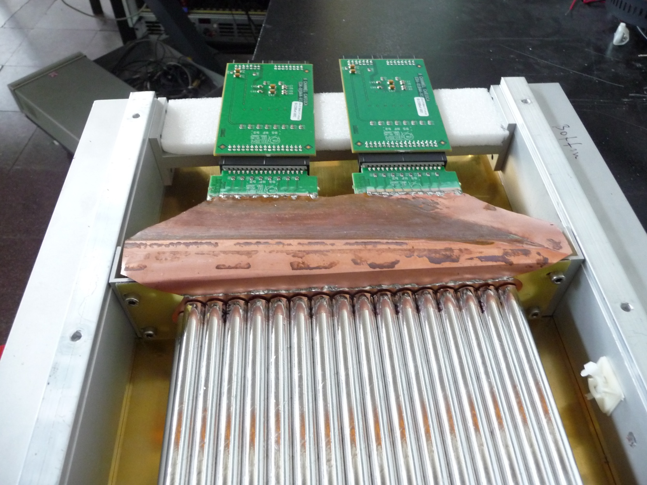
Connection FEE-straw (2x16-channels)
CARIOCA _ hot
CARIOCA _ hot

Slide 5
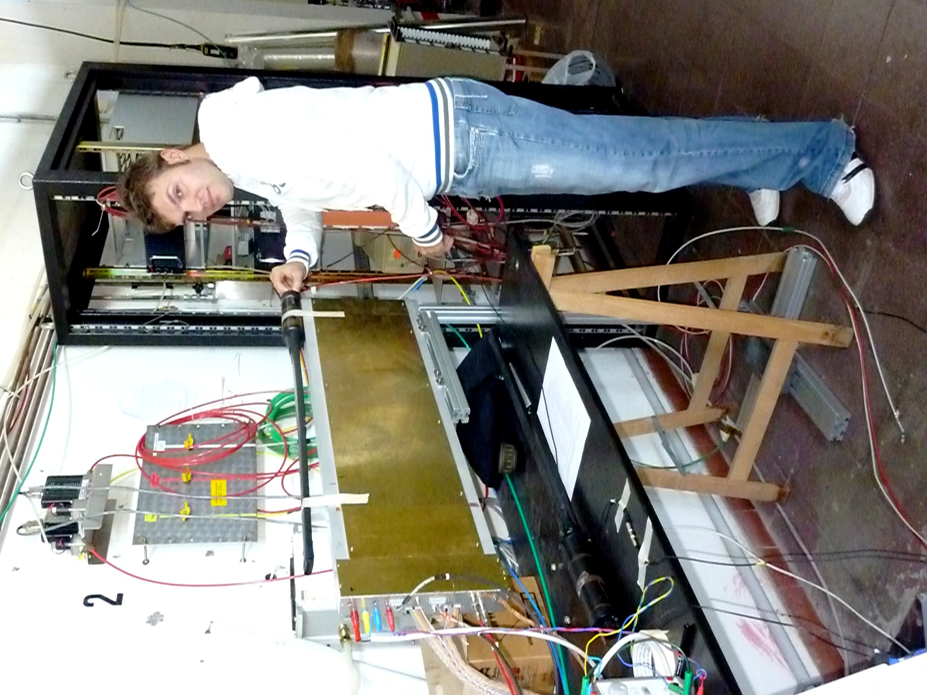
Hodoscope layout
STs are operated with a gas mixture Ar+CO₂ (90+10) with an overpressure of 1000 mbar
We use two plastic scintillators to trigger on cosmic rays all along the tubes length.
ST signals are processed with CARIOCA chips.
Drift times are read out using a LeCroy digital TDC 3377 with 0.5ns/ch resolution.

Slide 6
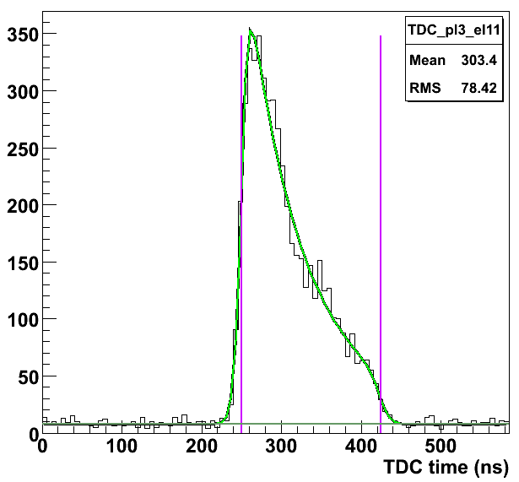
TDC spectra ch 1÷16
TH. 1.01 V
HV 1700 V
165 ns

Slide 7
TDC spectra ch 17÷32
TH. 1.01 V
HV 1700 V

Slide 8
MC simulations

Slide 9
TDC spectra ch 1÷16
TH. 1.01 V
HV 1800 V

Slide 10
TDC spectra ch 17÷32
TH. 1.01 V
HV 1800 V

Slide 11
Conclusions
CARIOCA chip seems to provide good time response with ST. A test beam will be performed soon;
CARIOCA chip does not have analog output ➔ no dE/dx;
A new chip is under development.

