Slide 1
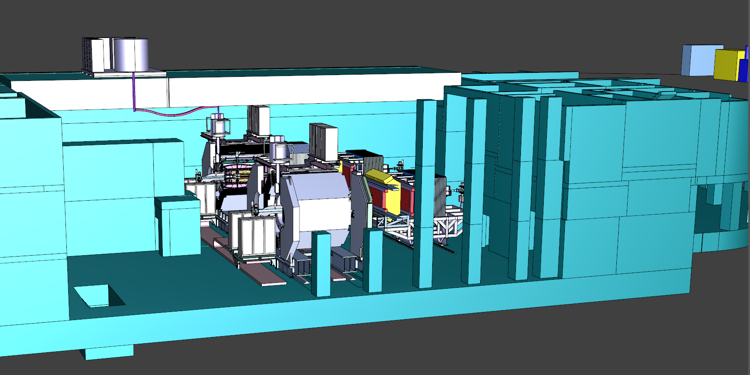
PANDA magnet in the experimental building (in-beam and in-parking positions)
LHe transfer line
Cold box of the liquefier and Buffer Dewar
Helium compressor
Radiation shield

Slide 4
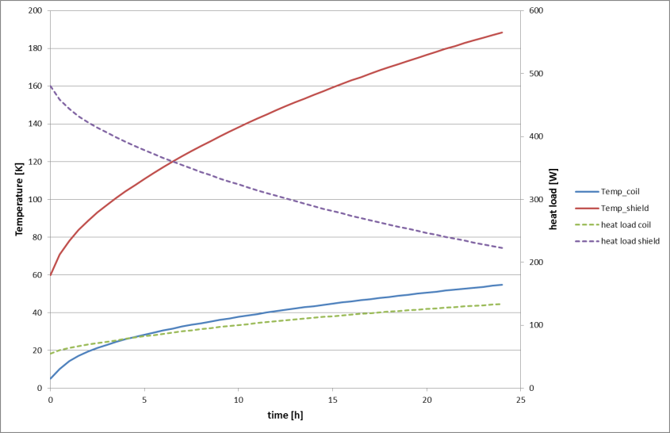
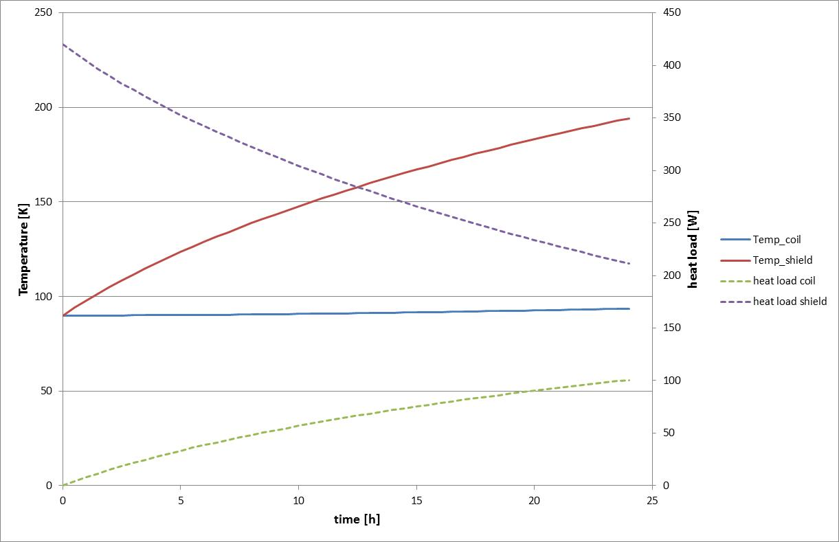
1. Emptying the magnet (no liquid helium in the magnet/or control dewar during travel.
Why?
The movement of the liquid helium causes several safety risks (where do you send the boil-off helium; if you damage the vacuum vessel during travel, you blow off all helium within seconds)
As the magnet will rest for 6 month in the parking position, the temperature of the final magnet before re-cooling is not influenced by a “cooling reserve“ in the first hours.
Here the temperature profile for the travel out and the travel into operation position are shown. (These profiles represent a trend, as they depend on a lot of assumptions.)
2. Lower the pressure to approx. 1.3 bar in the full magnet
Why?
Even if the liquid helium is removed from the magnet, the density will drop with rising temperature. Therefore helium from the system has to be removed. This helium may be still brought back to the helium storage connected to the refrigerator. (Later this will be difficult as the refrigerator is not equipped with a purifier)

Slide 5
3. Close the valves: CV1,CV2,CV4,CV8,CV9
4. Open two hand valves (HV1, HV2) towards a passive pressure relief valve. This guarantees a pressure below 1.4 bar in the moving magnet.
Why?
Therefore the magnet can be treated as a “mobile dewar”, this pressure relief valve can be chosen with the correct size for this operation mode. The safety valve (for normal operation at 18 bar) would be operated in a very stressful mode out of specification and it may not close properly any more.

Slide 6

5. Start heating up the valves and the process pipes between valves and couplings to ambient by electrical heaters.
Why?
  The condensation of moisture from the ambient air has to be avoided. As the temperature profile follows the natural behaviour (warm on top) and the pipe length between valves and cold mass is much longer than towards the coupling, the heat load to the cold mass should be low. (Cross check)
6. Disconnect all warm pipings (CL)
7. When ambient temperatures at the coupling and valves are reached, break the vacuum at the connection section, open the sliding sleeve and the couplings
8. Close the lines with lids, in such a way, that no dirt can fall into the lines.

