Slide 1
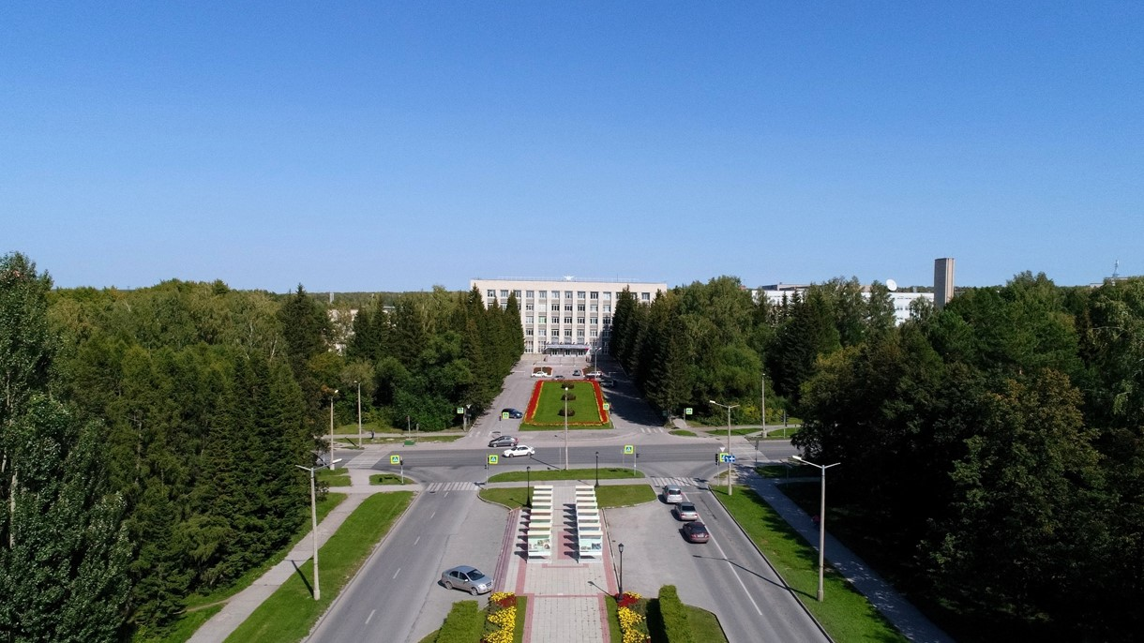
5th BINP-FAIR Collaboration Coordination Workshop Status production PANDA solenoid
E.Pyata, S.Pivovarov, M.Kholopov, M.Azimbaev BINP, Novosibirsk

Slide 2
The main milestones of production of the PANDA solenoid magnet
The scope of delivery includes:
Magnetic and engineering design of the magnet including tools and support;
Production and delivery of the magnet (consisting of yoke, cold mass and cryostat, alignment components, proximity cryogenics, support frame and platform beams) and all tools;
Power converter and quench protection and instrumentation.
Item | Date
Start contract | 03/2017
Control assembling of the Yoke of solenoid at the BINP site | 09/2020
Magnetic tests of the PANDA solenoid including safety system and electrical components at BINP (additional contract) | 12/2021 - 05/2022
Assembling and tests at the FAIR site
Assembling of the magnet at Darmstadt | 06/2024
Acceptant tests at FAIR | 11/2024
Installation of the PANDA solenoid magnet at worked position and final acceptance tests | 01-05/2025

Slide 3
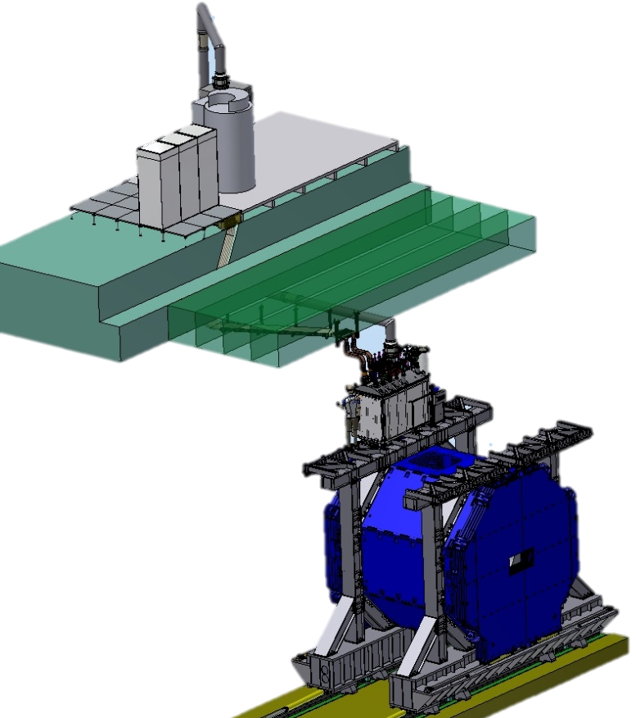
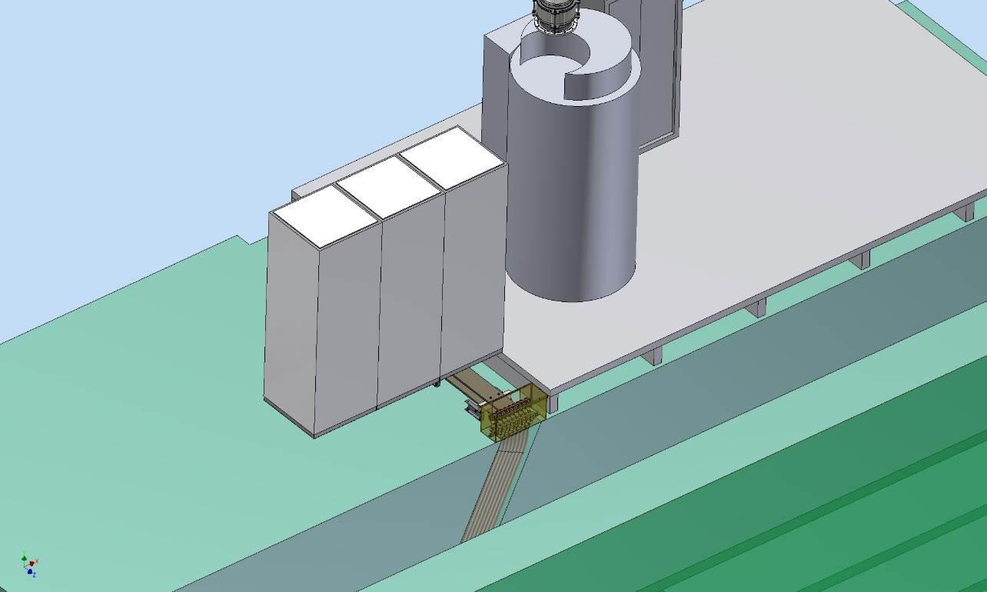
PANDA solenoid magnet, BINP responsibility
Power supply and energy extraction system
Control Dewar box
Cable channel
Solenoid and yoke
Power Supply
Energy Extraction Rack
Dump resistor
Frame of Yoke

Slide 4
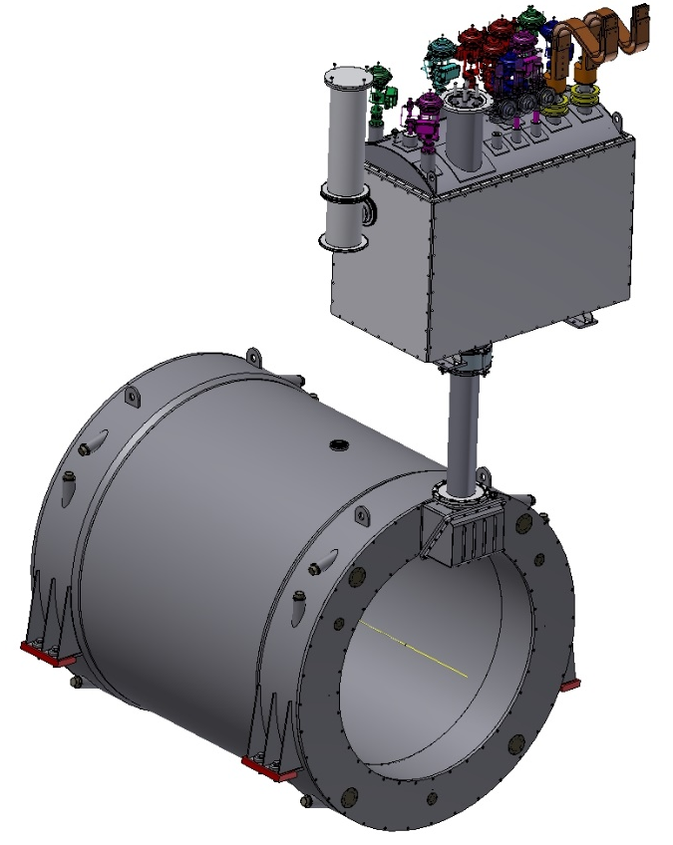
3D model of the Magnet and Control Dewar.
Control Dewar box
Cryostat and Coil

Slide 5
Development of the PANDA solenoid magnet
Name of item | Status of work
Yoke and frame | Final machining 5 July 2020 Start control assembling July 2020
Cryostat of solenoid & Cold mass | Design is ready, technological development, purchasing raw materials Contract production 01.09.2020
Conductor purchasing | Development work, Contract production 18.08.2020
Control Dewar box | Preliminary design October 2020 - OK
PANDA solenoid power cabling | Design is ready, production
Power supply and energy extraction system | Detail design is ready, purchasing power convertors & components. Production
Magnet safety system | in process

Slide 6
Status of the PANDA cryostat and cold mass production

Slide 7
The main milestones of the Cryostat production
Name of milestone |  | Date 2017/10
FDR of the Cryostat |  | 08/02/2019
FDR of the Cold Mass |  | 17/04/2019
Status production
Cryostat stands for assembling solenoid and magnet Cold Mass | Contract production 18.08.2020
 | Purchasing raw material 10/2020 – 95% Delivery raw material to subcontractor – 12/2020
 | Manufacturing Technical documentation 11/2021
 | Contract: delivery to BINP 09/2021

Slide 8
Status of the PANDA yoke production

Slide 9
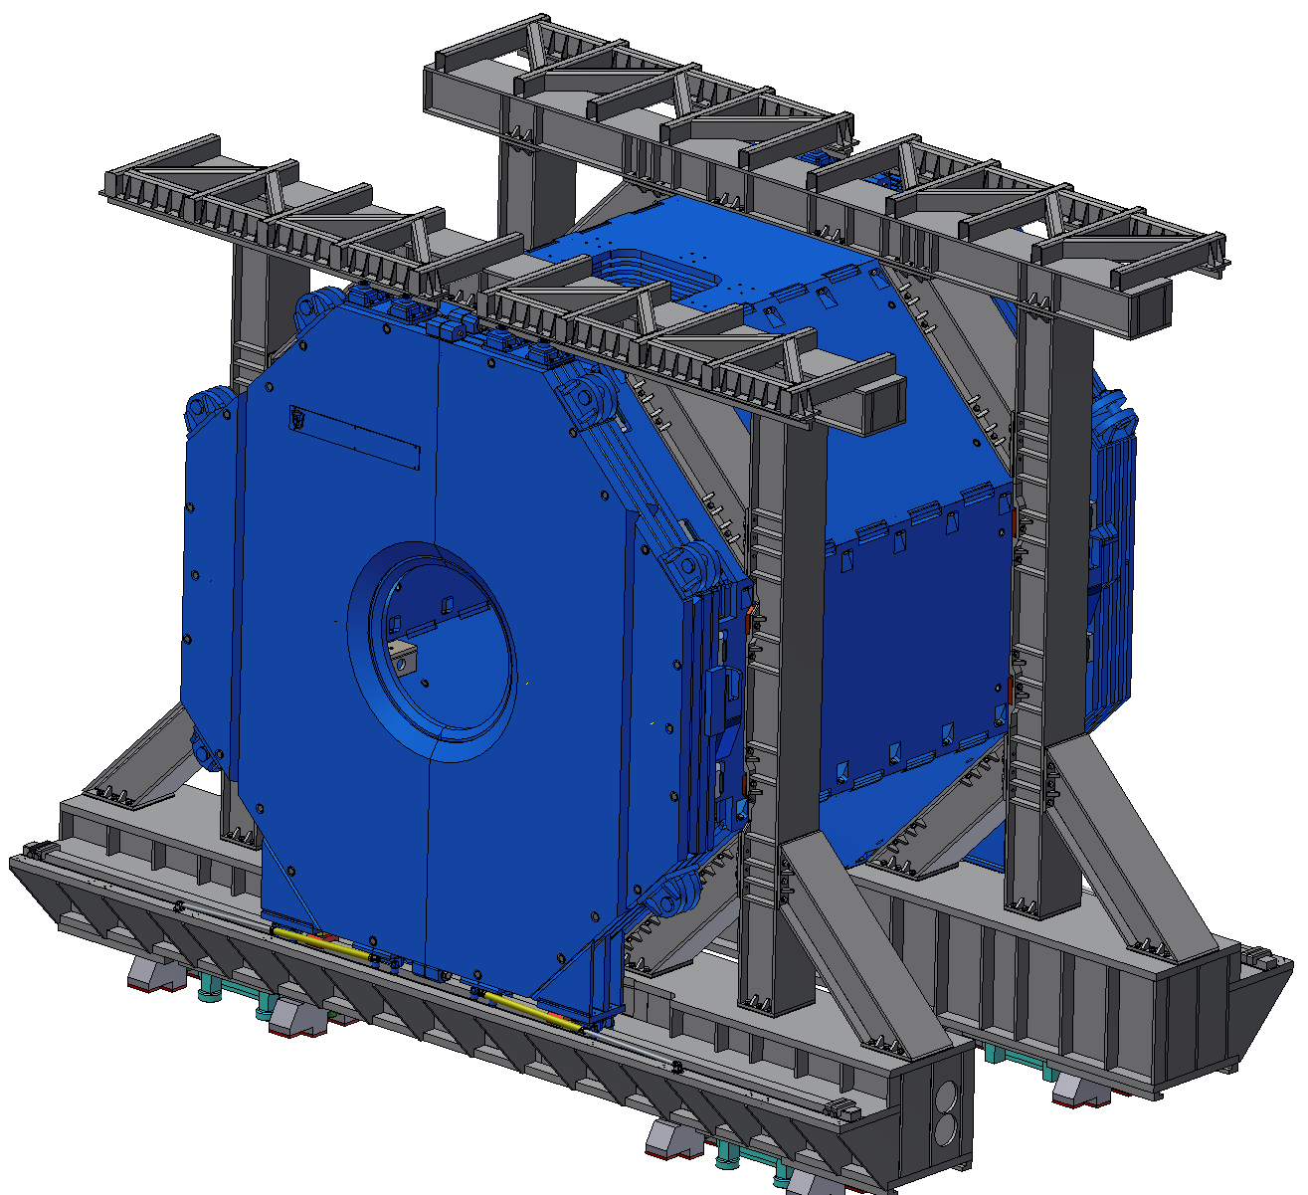
3D model of the Yoke and Frame.
Frame
Yoke
Control assembling
1st - 09/2020
2nd - 11/2020

Slide 10
The main milestones of the yoke production
Name of milestone |  | Date 2017/10 | Comments
Production of the all barrel octants |  | 04/2020 | Ready
Production of the frame and beams |  | 04/2020 | Ready
Production of the doors | Upstream | 05/2020 | Ready
 | Downstream | 06/2020 | Ready
Control assembling at SET |  | 07– 09/2020 | Ready
Finalization of the parts |  | 08 - 10/2020 | Ready
Control assembling at SET second |  | 11– 12/2020 | In progress
Assembling of the Yoke at BINP |  | ?

Slide 11
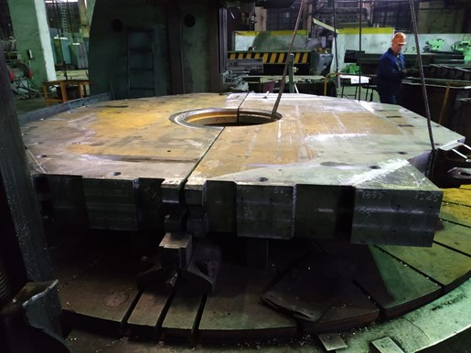
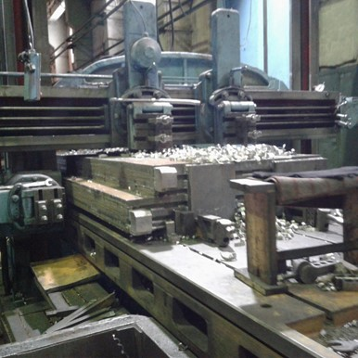
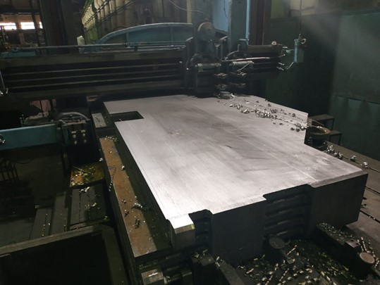
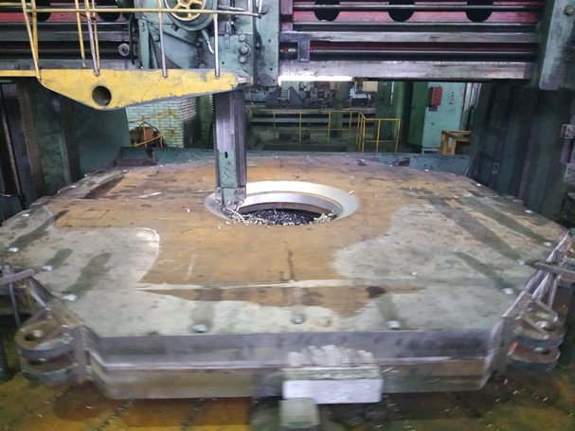
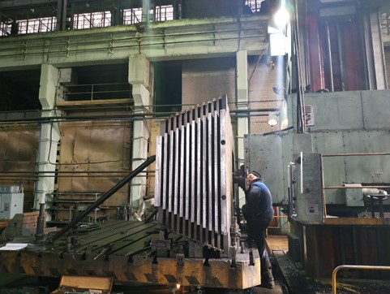
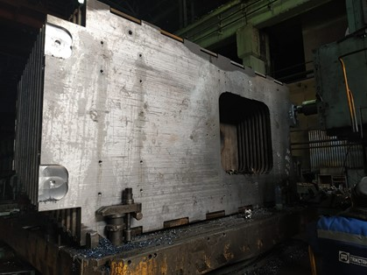
Production of the parts of the Yoke

Slide 12
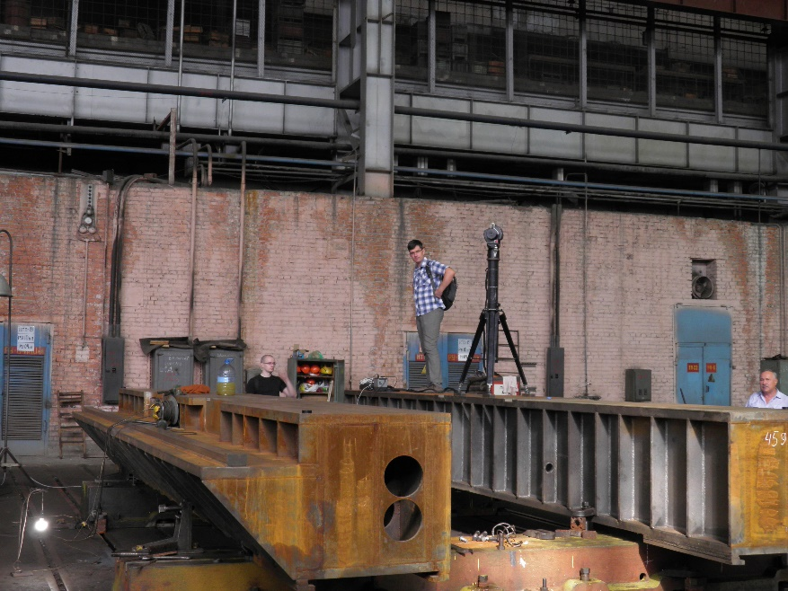
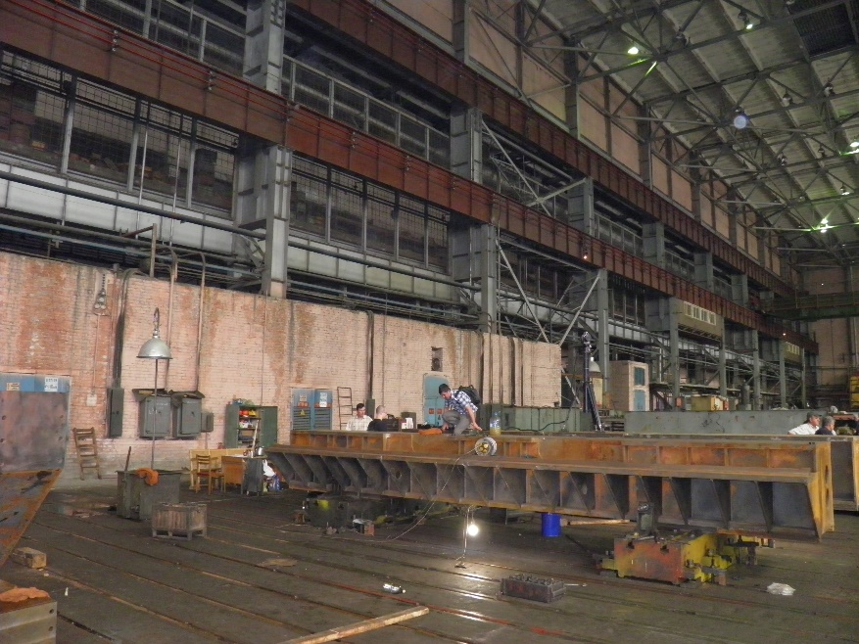
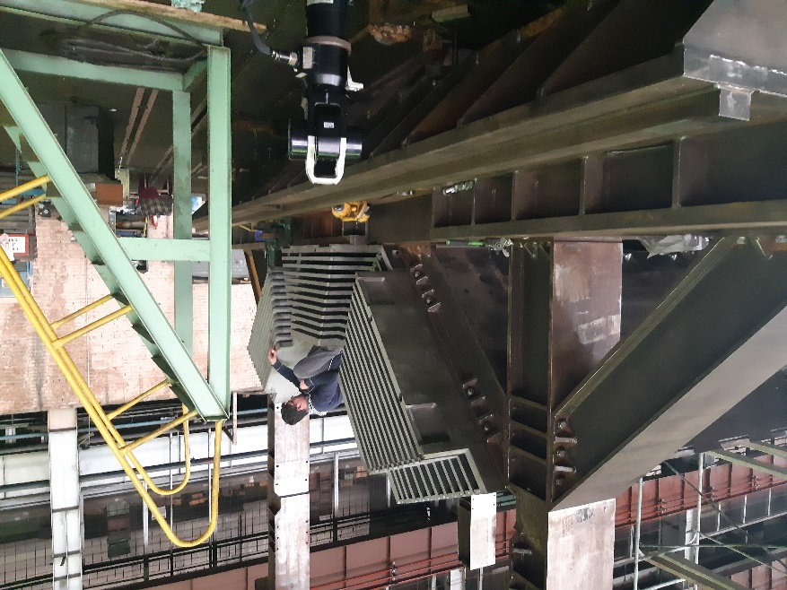
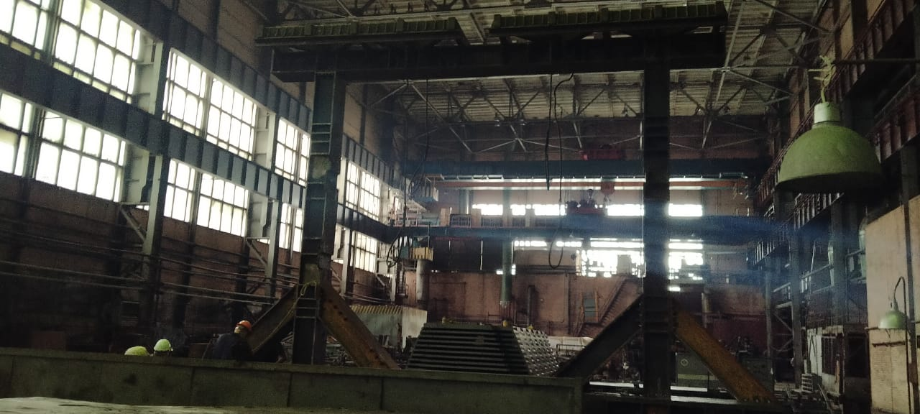
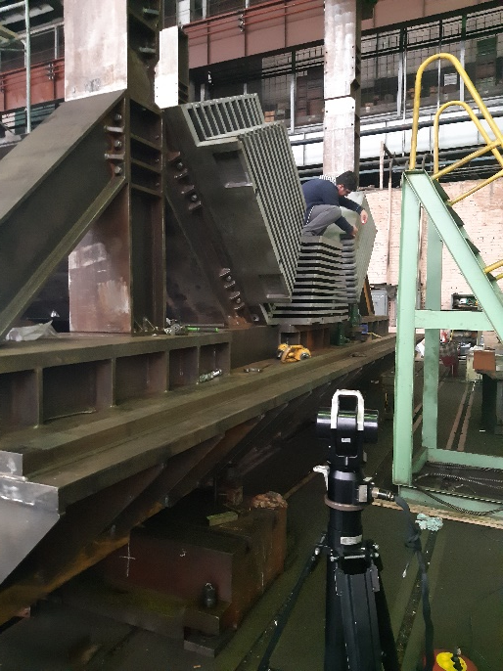
Assembling of the Yoke

Slide 13
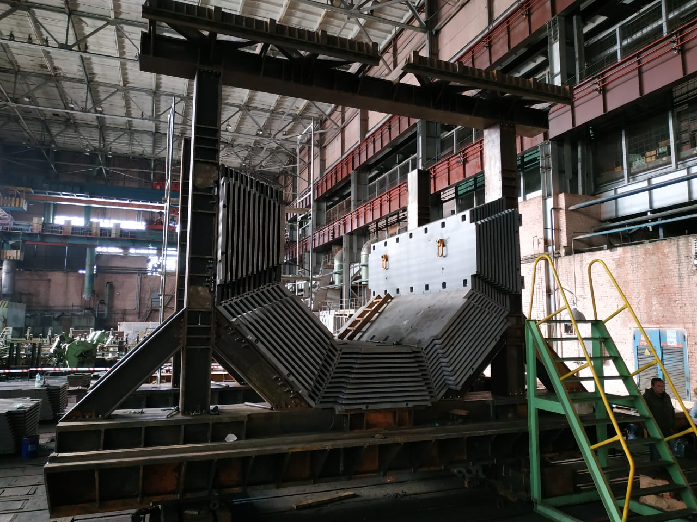
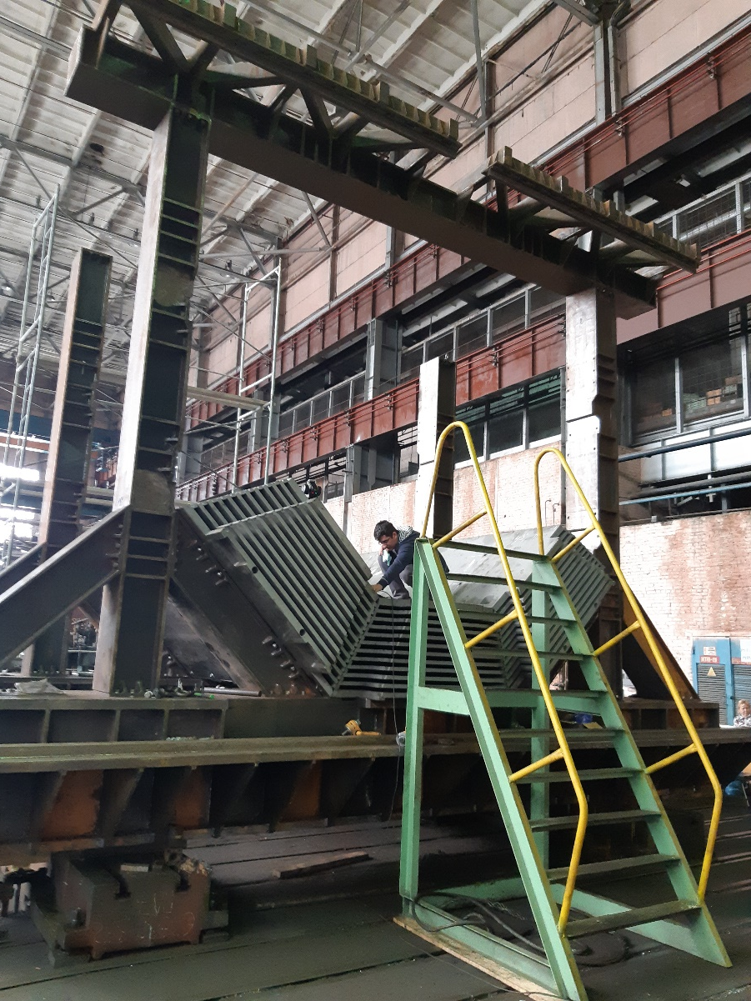
Assembling of the Yoke

Slide 14
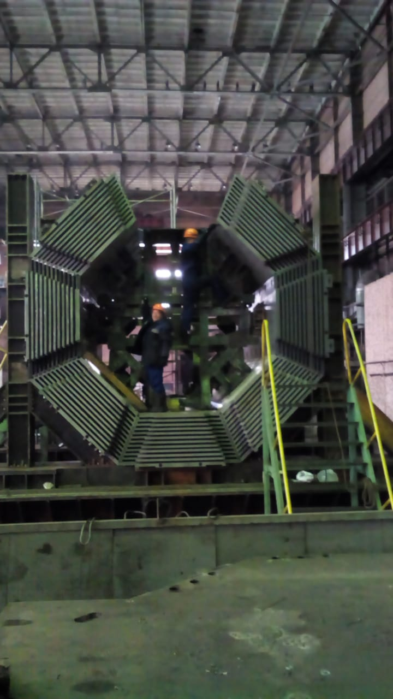
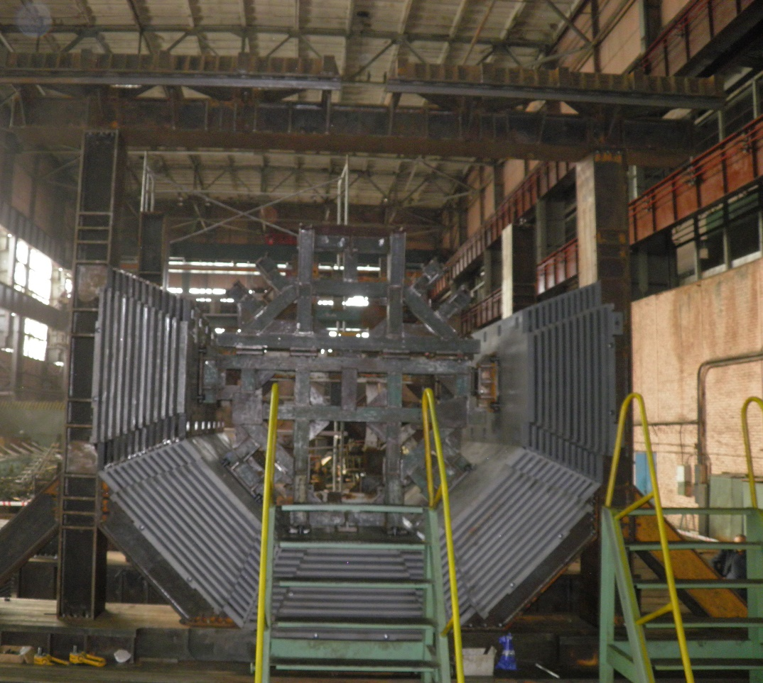
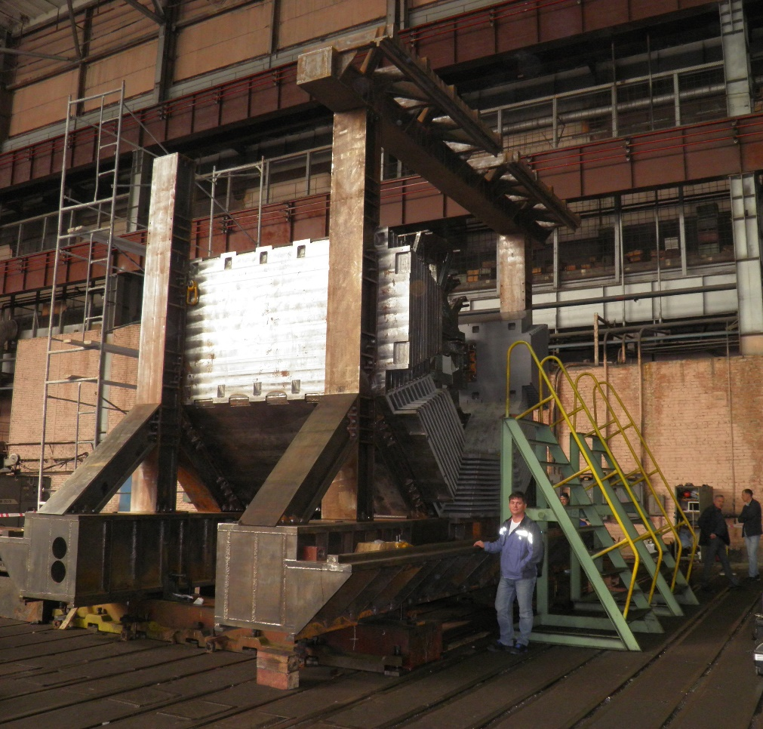
Assembling of the Yoke

Slide 15
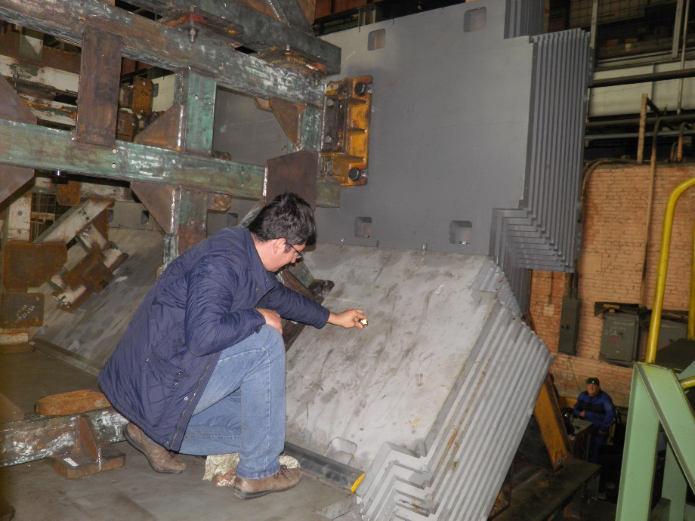
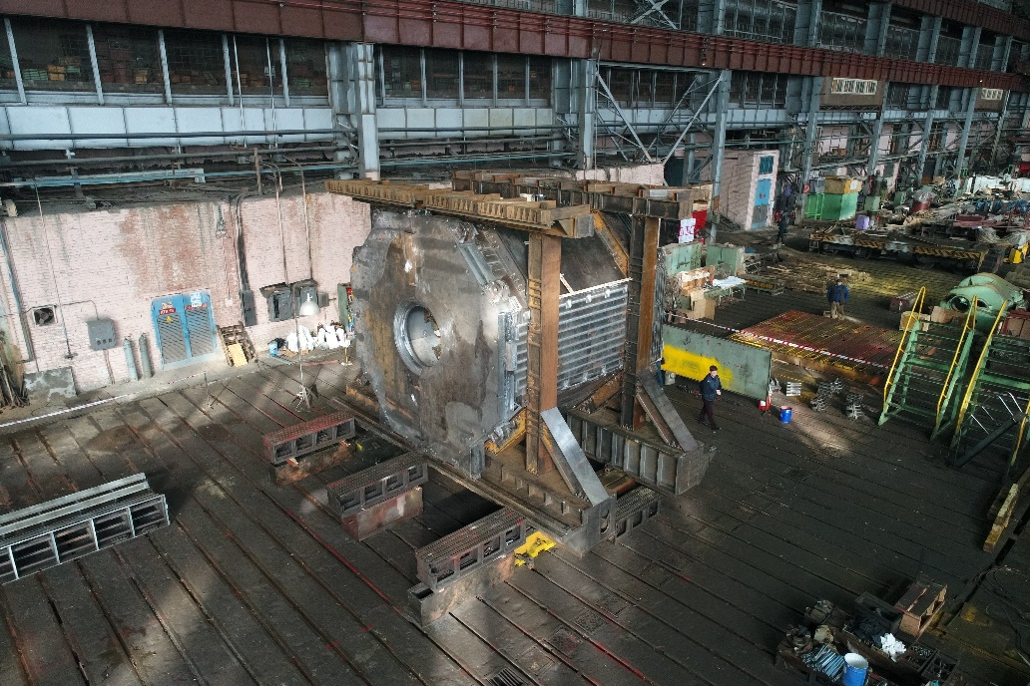
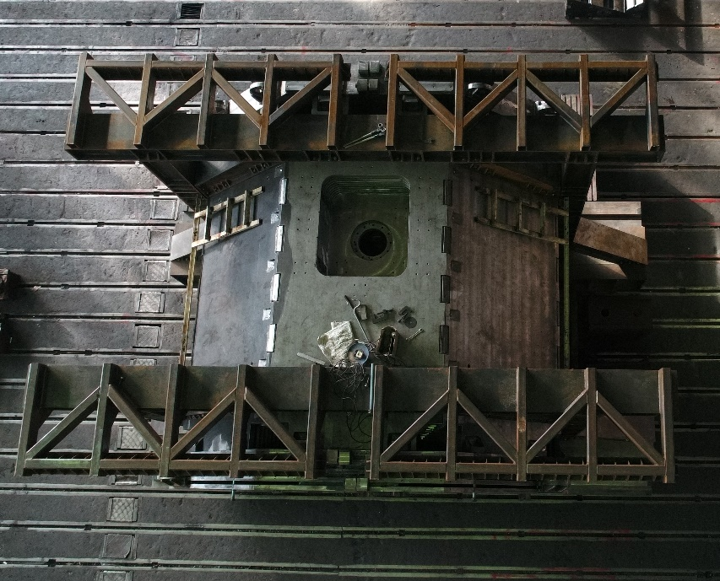
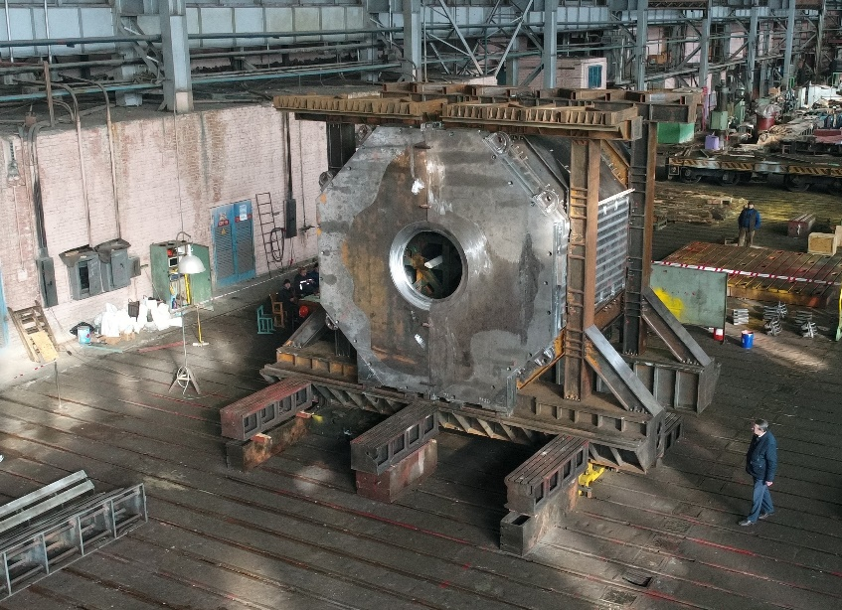
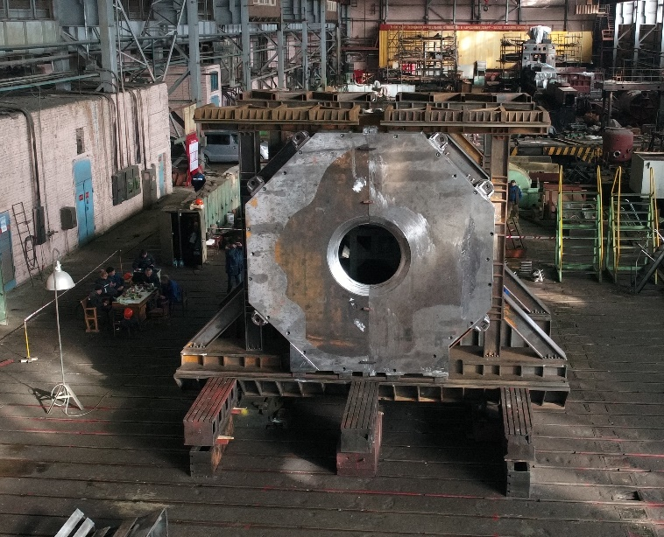
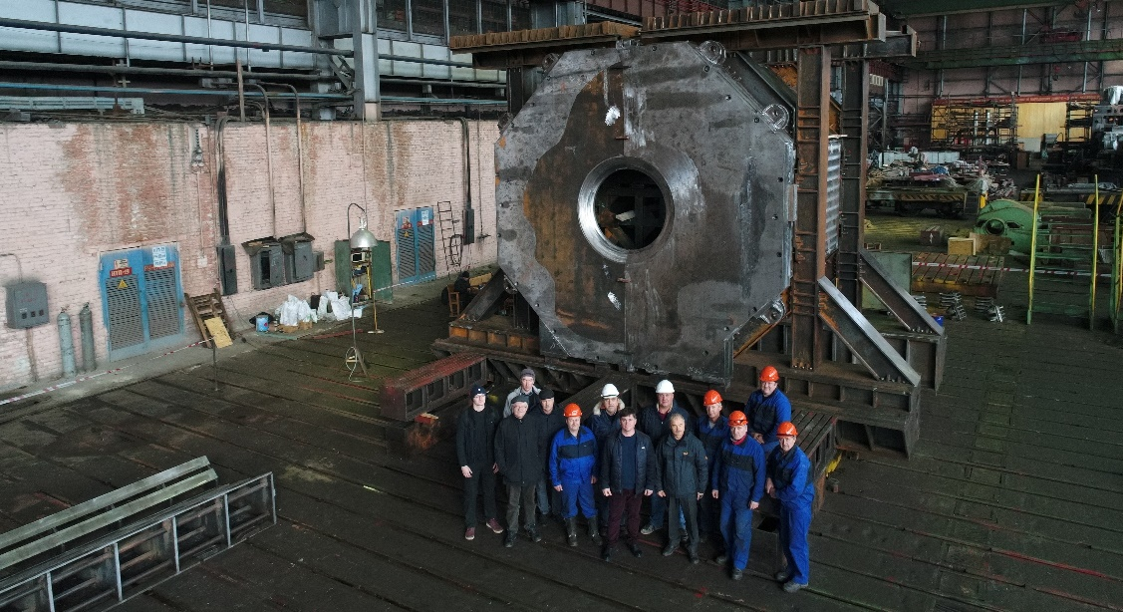
Assembling of the Yoke

Slide 16
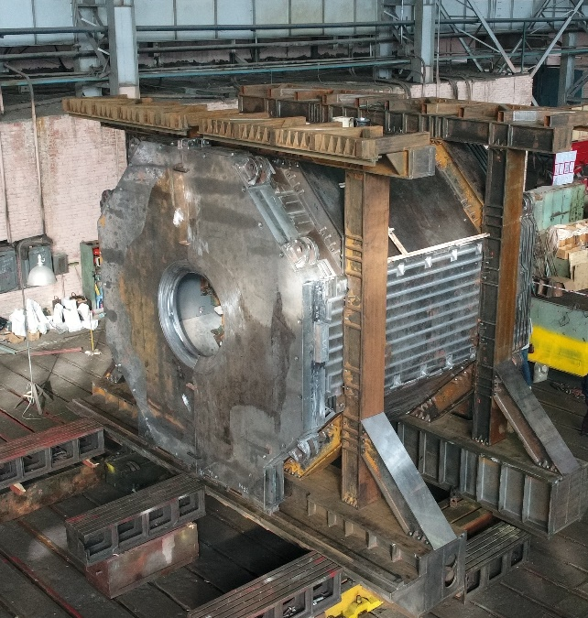
Assembling of the Yoke
Installed 10 support for detectors of a laser tracker.
Built an axis of the yoke and 3D map of elements by a laser tracker.
Measuring surfaces of the octants and wings we can do correction each part of the frames and barrel part of the yoke.
We plan to install about 30 the same support to do assembly of the yoke more quickly and suitable/

Slide 17
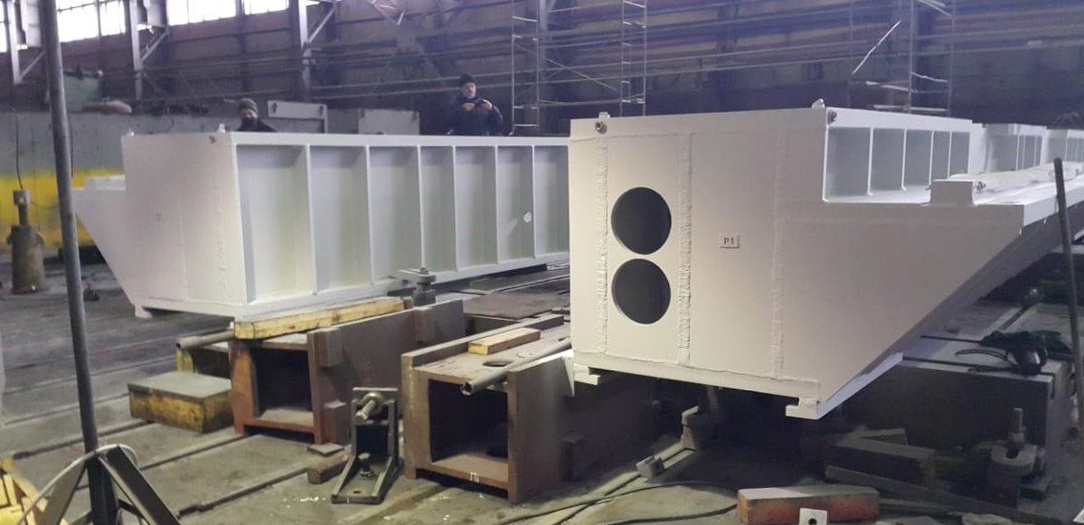
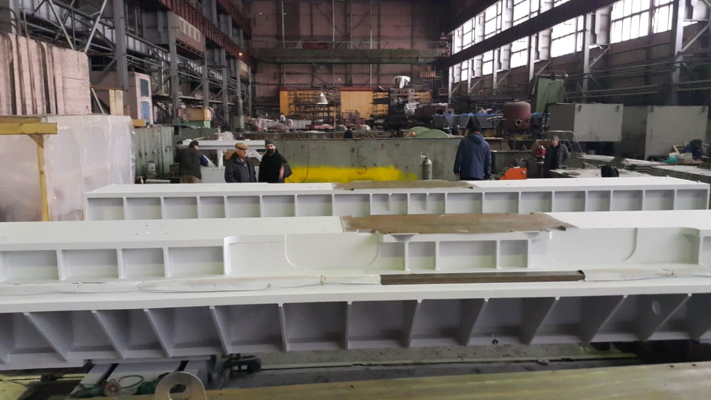
Assembling of the Yoke
The external and internal surfaces of the yoke with the exception of the polish surface, the junction and reference surfaces are painting. The color is according to RAL color code 5015.
The frame was painted according to RAL color code 7035.
Built an axis of the yoke and 3D map of elements by a laser tracker during second control assembling.

Slide 18
Status of the PANDA conductor development/ procurement

Slide 19
Conductor.
Status of the PANDA conductor development/ procurement
BINP/ VNIINM Bochvar/ VNIIKP/ Saransk cable optic (SarKO)
Rutherford cable co-extrusion/ conklad in a pure Al
Production1000m Cu Rutherford cable for tests in SARKO - 03-04/ 2020 (in BINP)
Tests in SARKO, 1000m Cu Rutherford cable - 09-12/ 2020
Preparation contracts for PANDA NbTi strands production, VNIINM - 03/ 2020
Production strands VNIINM for central coil - 02/2021
Production strands VNIINM for up/downstream coils - 09/2021
PANDA Rutherford cables production, VNIIKP - 03-10/ 2021
Production PANDA conductor BINP/SARKO - 03 - 11/ 2021

Slide 20
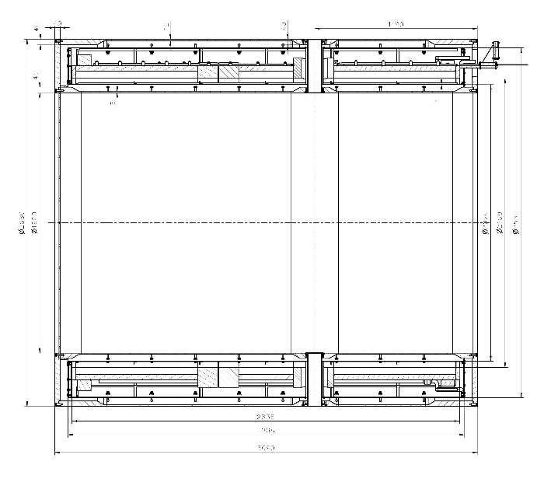
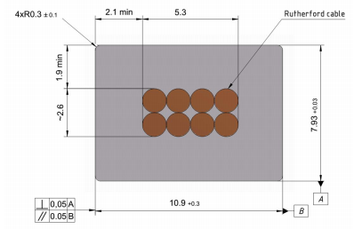
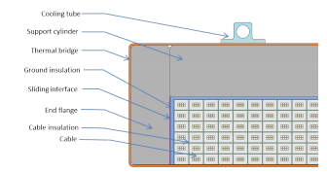
Main risks
Purchasing super conductive conductor - lack of a manufacturers
Rutherford cable, 8 strands, extruded in Al matrix
Thickness (after cold work) at 300 K | mm | 7.93 | ± 0.03
Width (after cold work) at 300 K | mm | 10.95 | ± 0.03
Critical current (at 4.2 K, 5 T) | A | > 14690
Critical current (at 4.5 K, 3 T) | A | > 16750
Overall Al/Cu/sc ratio |  | 10.5/1.0/1.0
Aluminum RRR (at 4.2 K, 0 T) |  | > 1000
Al 0.2% yield strength at 300 K | MPa | > 30
Longitudinal section of the cryostat with cold mass.
Conductor mechanical and electrical parameters.
Cold mass cross-section.
Cross-section of the conductor.

Slide 21
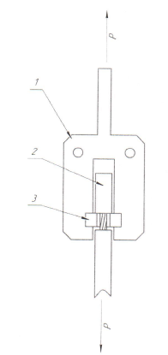
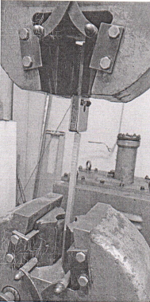
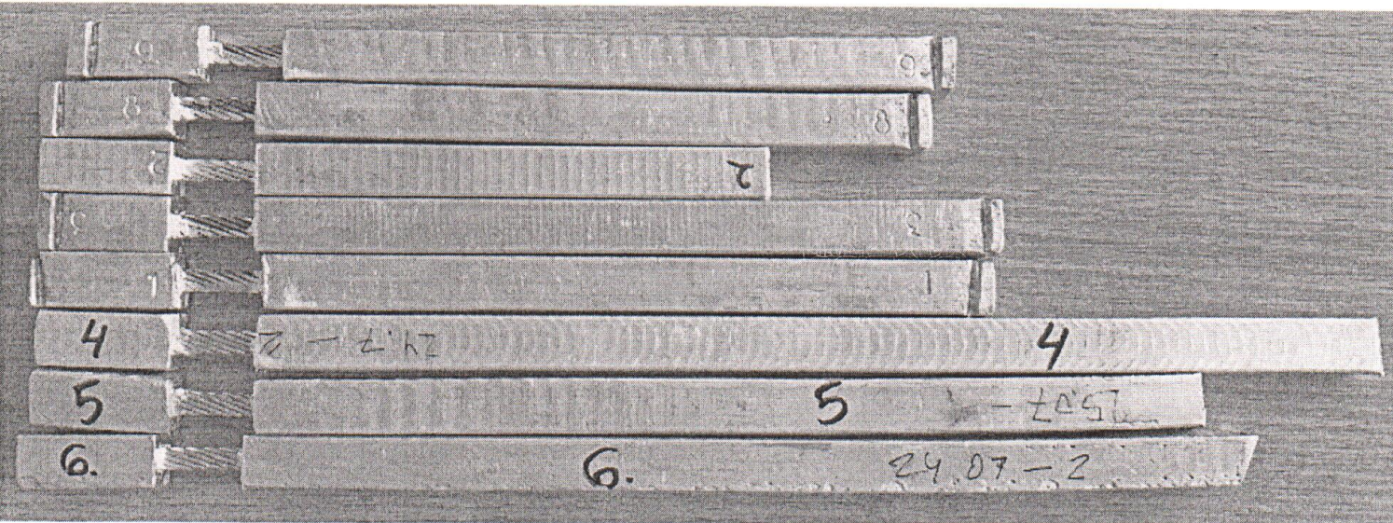
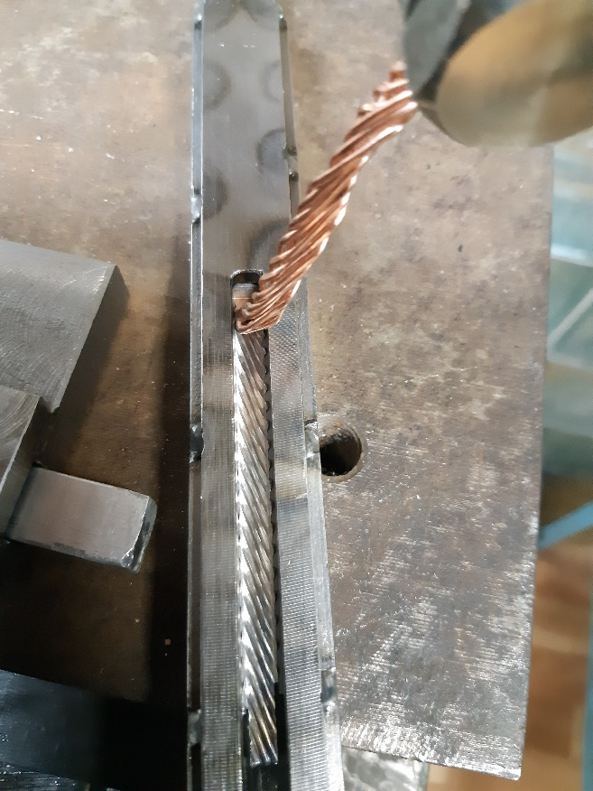
Status of the PANDA conductor development/ procurement
8 pieces of the samples of PANDA conductor produced with different tools were tested for a shear strength. Results are 62,5 – 85,3 MPa. Specified value of a shear strength is ≥20 Mpa.
Photo of the samples of PANDA conductor
Scheme of shear strength measurement

Slide 22
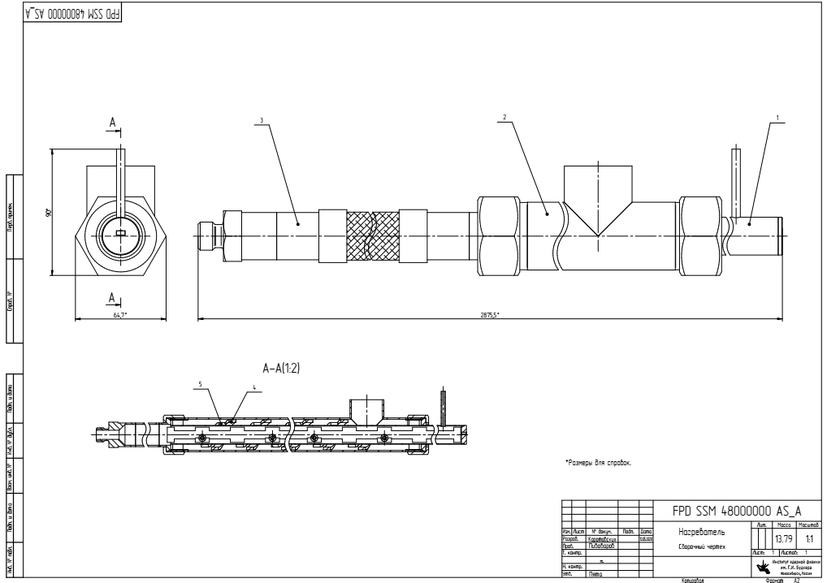
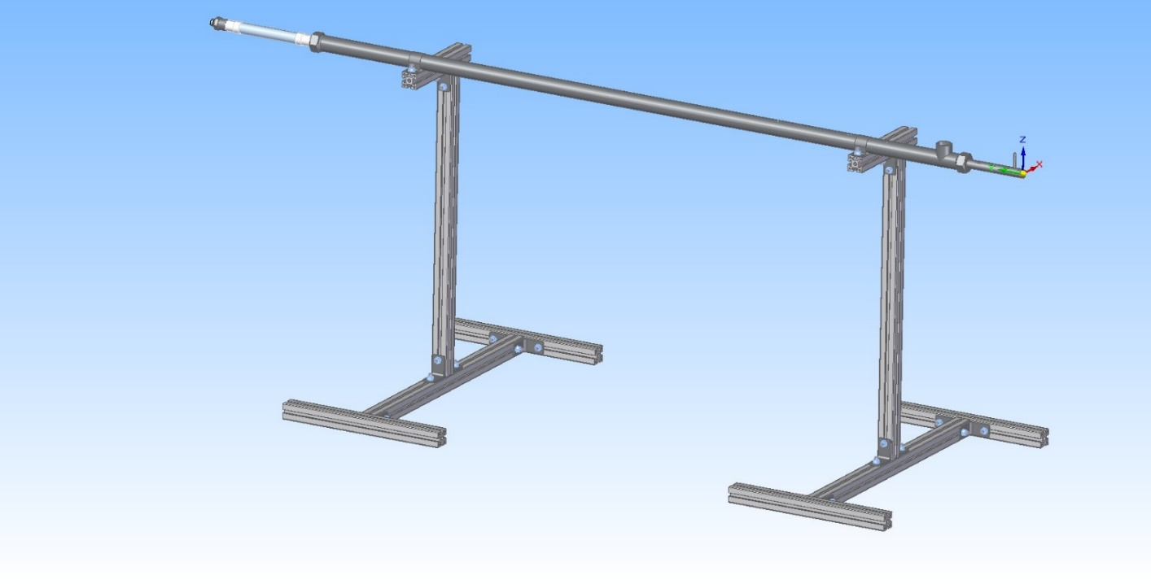
Status of the PANDA conductor development/ procurement
Development works with a prototype Rutherford cable (Cu or NbTi) to co-extrusion/ conklad in a pure Al 995 and Aluminum A95
Oven for preheating a Rutherford cable.
Temperature - 200 ÷ 450°C;
Shielding gas – N₂
Preparation a contract BINP/SARKO to development a technology production a conductor with preheating and creating intermetallic connection Al/Cu.

Slide 23
Status of the PANDA coils production

Slide 24
The main milestones of the coils production
Status production
Cryostat and stands for assembling solenoid and magnet | Design is ready, technological development, Call for tender
Cold Mass | Design is ready, technological development, Call for tender
First Prototype of the Coil | 11/2019
Second Prototype of the Coil | 03/2020
Third Prototype of the Coil | 08/2020
Tooling for winding Coil (and Prototype) | 11/2019
Tooling for impregnation of Coil (and Prototype)/modified | 11.2019/03.2020
Prepress prototype coil into cold mass | 10/2020
Tooling for winding and impregnation of PANDA Coil | Design is ready, technological development, Call for tender

Slide 25
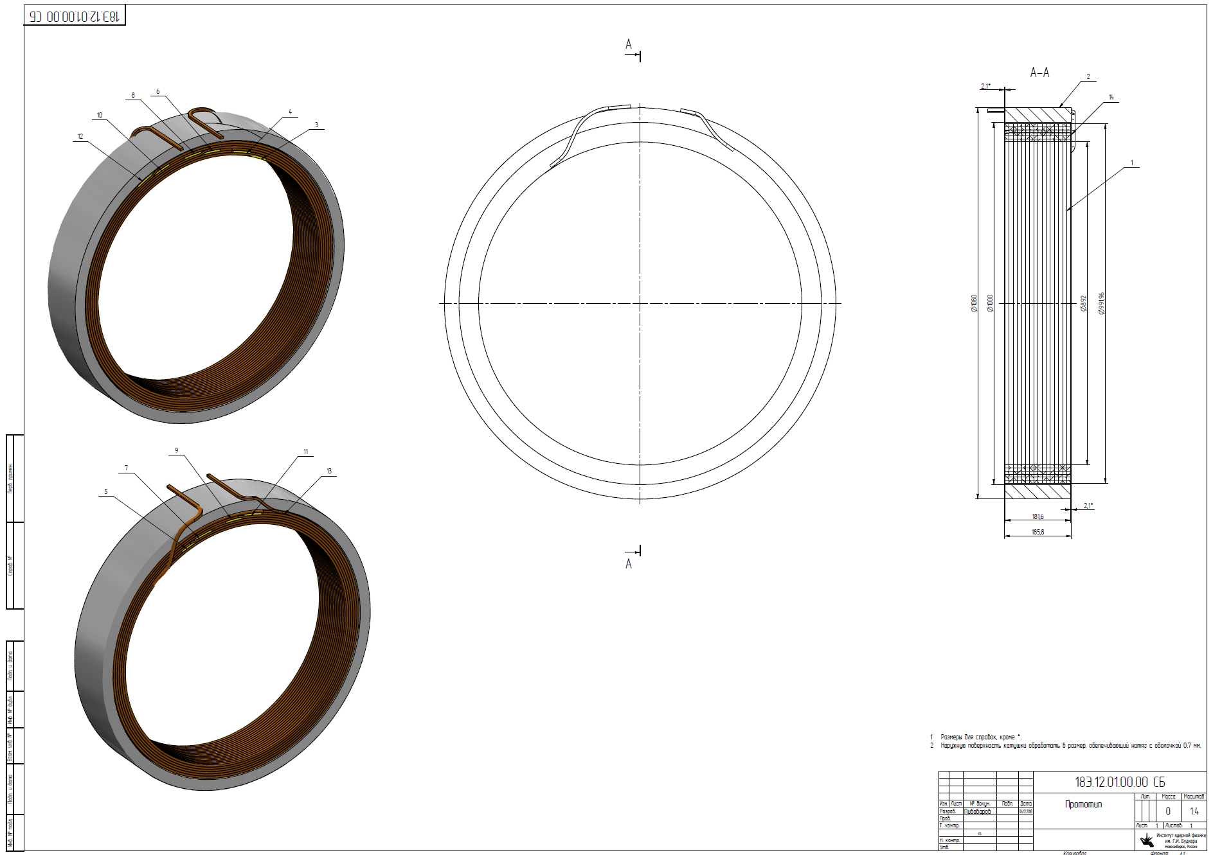
The Prototype of the Coil (3pcs.)
OD = 1m,
h=180 mm
Conductor:Al
10,85 мм x 7.93 мм,
6 layers
16 turns
Design is ready, 2 prototype produced

Slide 26
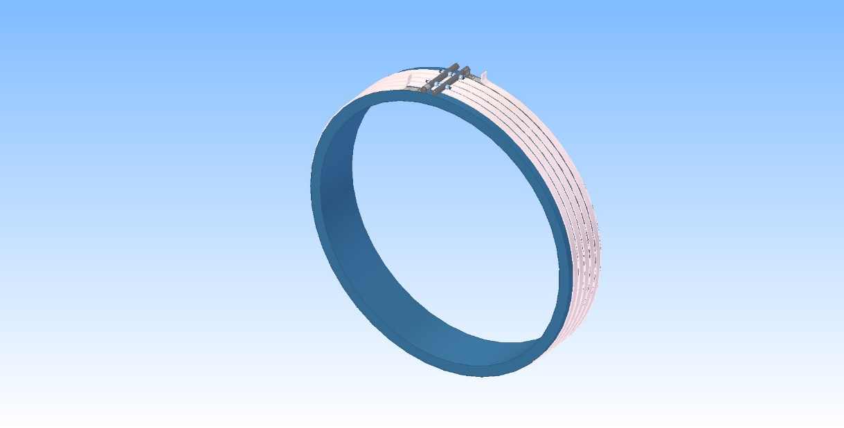
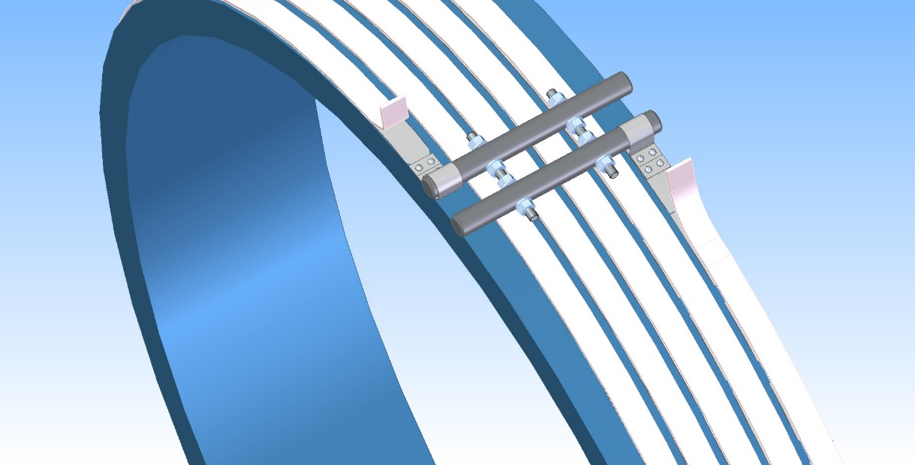
The Prototype of the Coil (3pcs.)
Preparation prestress procedure of coil
to an aluminum shell
For prototype heater:
Length - 17m;
Power - 3,5 kW;
Cross section - 24 x 3 mm;
Quantity - 1 pc.
For PANDA coil
Length - 36m;
Power - 3,0 kW;
Cross section - 24 x 3 mm;
Quantity - 8-9 pc.
Design is ready, preparation heat system

Slide 27
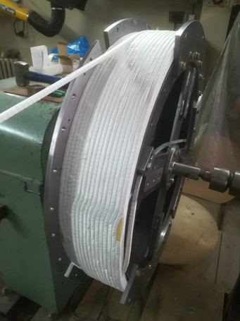
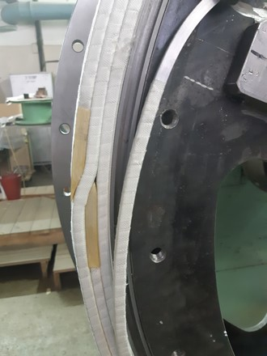
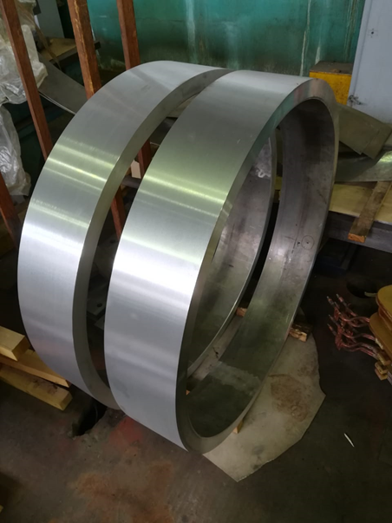
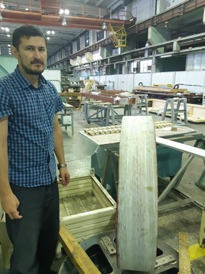
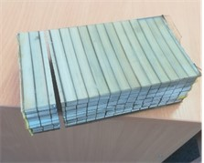
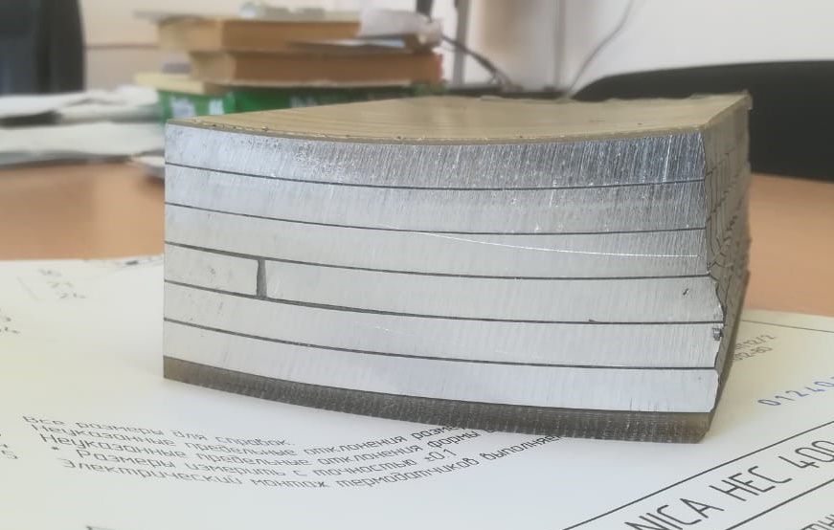
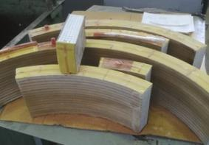
Production of the coil prototype

Slide 28
Status of the PANDA coil development/ production
Development works with a prototype Rutherford conductor.
Material is Aluminum A95
Third prototype
Electrical tests 3rd prototype - OK;
Procedure heating Al shell with control uniformity distribution of temperature, temperature rate, shell expansion measurement - OK;
Assembling coil and Al shell with prestress - OK;
Mechanical test coil assembling – OK, ≥2500 kg shear strength;
Destroy tests;
Thermal shock tests LN₂;
Checking quality of an epoxy penetration, mechanical tests;
Analysis of the manufacturing quality of the third prototype;
Preparation production of the 4th prototype

Slide 29
Status of the PANDA coil development/ production
Номер катушки/ Coil | Дата/Date | R изм кат/ R coil | t катушки, ^{о}С / Temperature of coil | R привед. кат/ R at 20^{о}С | Индуктивность / Inductance of the coil | кз виток 1000/ Short circuit | Rиз 10000/ R insulation to shell
 |  |  |  |  | 100/1000Гц/Hz |  | 10kV
 |  | мОм/mOhm |  | мОм/mOhm | мГн/mH
3 | 25.09.2020 | 98,39 | 20,0 | 98,39 | 12,60/11,93 | нет/No | >100Мом/MOhm
Results of measurements 3rd coil.
No. испытаний / test | No. катушки / coil | Дата/ Date | Импульсное напряжение/ Pulse voltage, V | КЗ виток / Short circuit interturn insulation
1 | 3 | 25.09.2020 | 1000 | нет/No
2 | 3 | 28.09.2020 | 500 | нет/No
3 | 3 | 28.09.2020 | 1000 | нет/No
4 | 3 | 28.09.2020 | 1500 | нет/No
5 | 3 | 28.09.2020 | 2000 | нет/No
Tests interturn insulation of the coil.

Slide 30
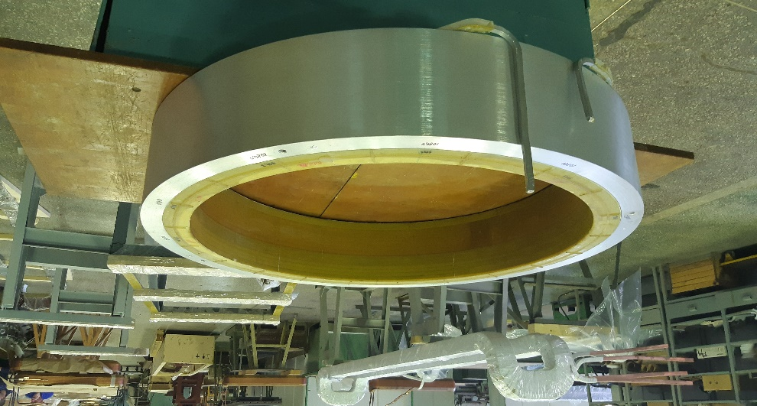

Status of the PANDA coil development/ production
No. испытаний / test | No. катушки / coil | Дата/ Date | Время выдержки/ Time | Постоянное напряжение/ Constant voltage, V | Rиз 10000/ R insulation to shell
1 | 3 | 15.10.2020 | 1 min | 1000 | нет/No
2 | 3 | 15.10.2020 | 1 min | 2000 | нет/No
3 | 3 | 15.10.2020 | 1 min | 3000 | нет/No
4 | 3 | 15.10.2020 | 1 min | 4000 | нет/No
5 | 3 | 15.10.2020 | 6 sec | 5000 | да/Yes
Results of measurements 3rd coil with Al shell up to limited conditions.
Prepress 3rd coil to Al shell – 1mm per diameter.

Slide 31

Drawing of the Devices for winding coil (scheme).
Design is ready, production until 06/2021

Slide 32
Status Control Dewar and Transfer Line production

Slide 33


3D model of Control Dewar
Vacuum barrier
The PANDA control Dewar is designed to ensure helium delivery to the user in accordance with the flow scheme.
Technologic volume
- transfer line (Chimney) connecting the vacuum vessels of cryostat and control Dewar
Pamp station
Chimney

Slide 34







3D model of Control Dewar

Slide 35






Flexible bus bar between cable way and current leads

Slide 36
Power supply and energy extraction system

Slide 37
Power Supply (Current Source – TDK-Lambda, Genesys+, 10V, 1500A)
New power supply

Slide 38



Dump resistor sections assembling

Slide 39


Dump resistor sections assembling
R insulation 2,5kV - ≥ 100 MOhm;
∑ R - 0, 09 Ohm;
Weight - 1020 kg.

Slide 40
Preparation tests in BINP

Slide 41

PANDA magnet, bld. 13. Area for cryogenic and coils tests and measurements of a magnetic field

Slide 42

Thank you for your attention

