Slide 1
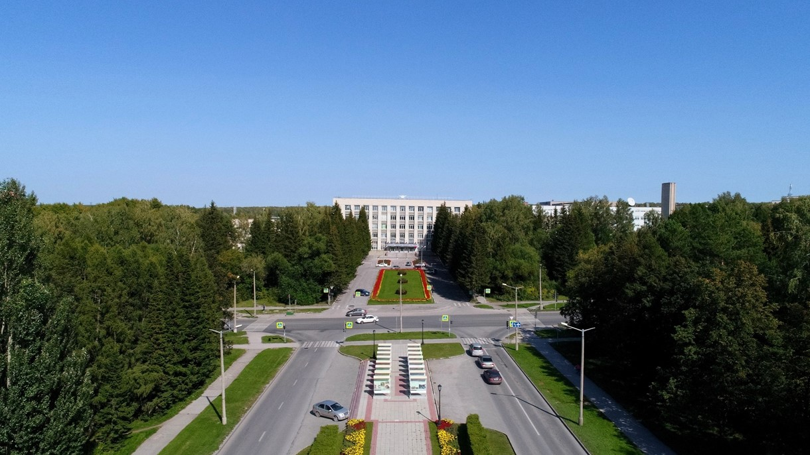
5th BINP-FAIR Collaboration Coordination Workshop SFRS local cryogenic

Slide 2
design of the BRANCH BOX (BB)
Accelerator Implementing Agreement No. 2 to the ACCELERATOR CO-OPERATION Agreement of dated by October 2, 2019. The scope of cooperation of this work includes, first of all, the technological design of the branch box (BB), which distribute helium supply to four SFRS experimental branches. Conceptual design and preparation for the introduction of devices will be performed by both organizations GSI and BINP SB RAS. BINP SB RAS will perform technological design. The GSI will provide scientific support.
BINP developed sub-cooler of the BB. 1000 l LHe vessel, 105 g/sec flow; BINP defined a design of vacuum shell. Conceptual 3D model is ready; For next design works, BINP needs a Detail specification of BB. It should be ready 2020/01.
According to our agreements 27 November 2019, GSI will prepare a contract FAIR-BINP for development and production of Transfer lines, part of Feed/End boxes and BB

Slide 3
Flowscheme of the Branch Box (September 2020).
design of the BRANCH BOX (BB)

Slide 4
3D model of the Branch Box.
3D model of the Branch Box without Warm piping. The weight is ~14t

Slide 5
Dimensions of the Branch Box.
Branch M
Branch R
MPL
CWU
Branch H
Branch L
Outer diameter is 2060 mm (2220 mm flanges), length is 5500 mm

Slide 6
Interface of the Branch Box.
design of the BRANCH BOX (BB)
The interface of all ports is agreed. The process tubes of the CWU port were rotated 90 degrees according to BINP request!

Slide 7
Vacuum shell of the Branch Box
design of the BRANCH BOX (BB)
Cup
Flange
Blank cap
Leg
Shell
Outer diameter of the shell is 2060 mm, thickness is 12 mm, thickness of the blank cap is 45 mm, length of the BB is 5500 mm. Material is stainless steel 1,4307/01. The weight is about 7,3 t.

Slide 8
Results of calculation of the vacuum shell BB. Operation condition (p=0.1 MPa) vs vacuum Stress
design of the BRANCH BOX (BB)
The maximum equivalent stress is 78 MPa.

Slide 9
Results of calculation of the vacuum shell BB. Deformation
design of the BRANCH BOX (BB)
The maximum deformation is 2 mm in centre of blank cap 45mm thickness.

Slide 10
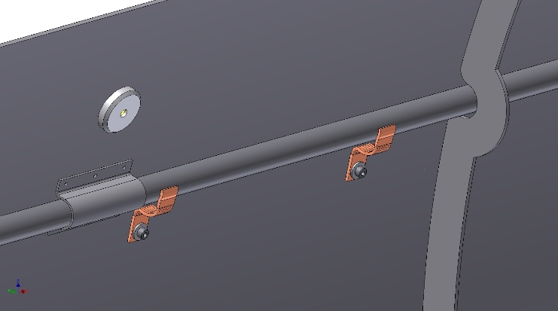
Thermal shield of the Branch Box
design of the BRANCH BOX (BB)
Pipeline
Support
Thermal bridges
Shell
Cover
Flange
Outer diameter is 1956 mm, length is 5340 mm, thickness of the shell is 4 mm, Material is Aluminum alloy. The weight is about 0,54 t. The shield is cooled using thermal bridges.

Slide 11
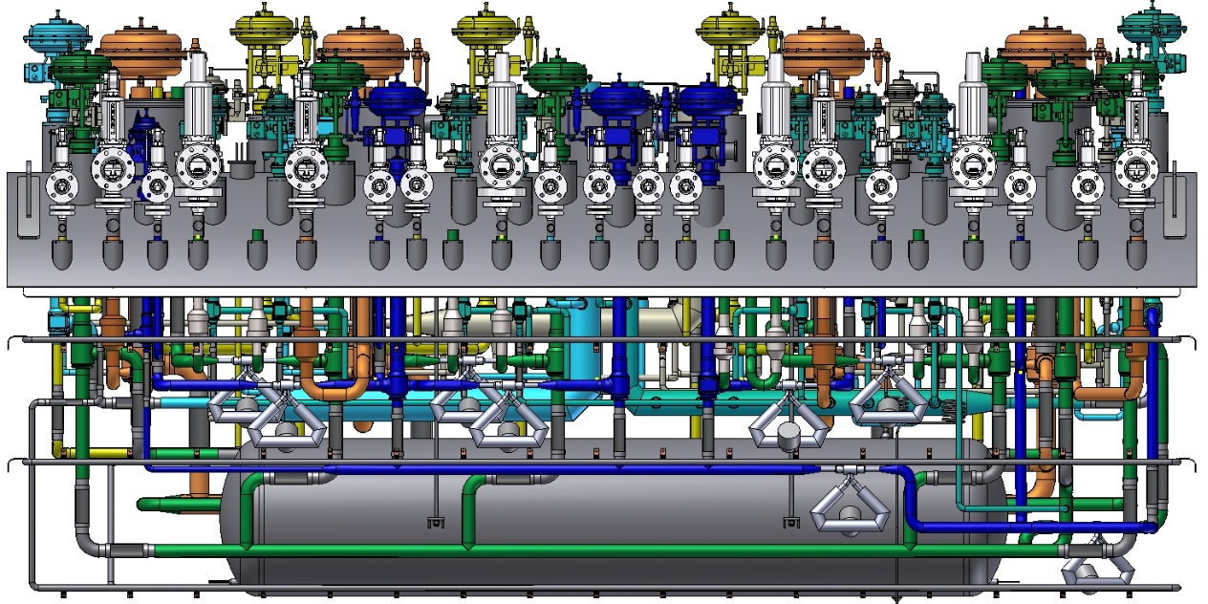
Pipelines of the Branch Box.
design of the BRANCH BOX (BB)

Slide 12
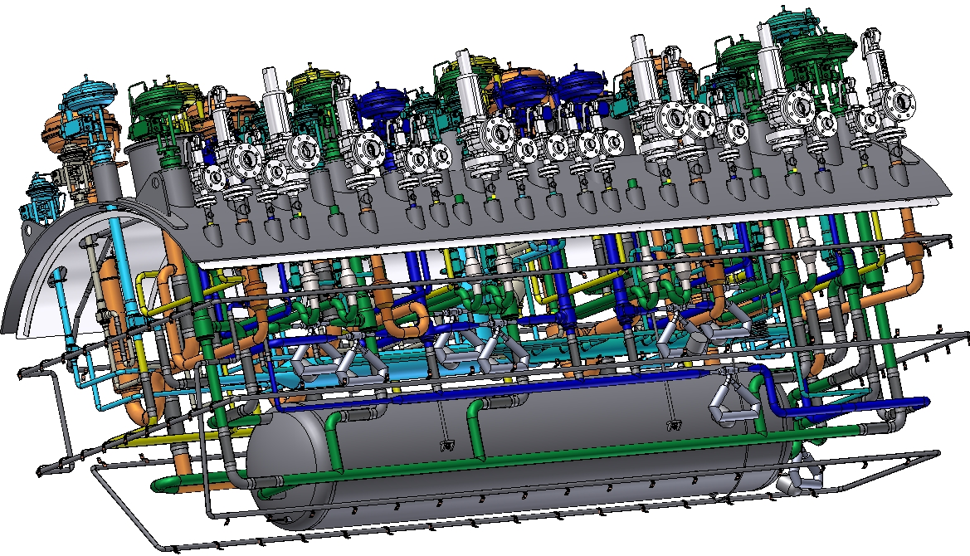
Pipelines of the Branch Box.
design of the BRANCH BOX (BB)
80K return
CWU return
5K return
CWU supply
MPL
4.5K supply
50K supply

Slide 13
Vacuum shell, thermal shield and subcooler of the Branch Box
design of the BRANCH BOX (BB)/ subcooler
Vacuum shell
Heat exchanger
Thermal shield
Location of the Heat exchanger/subcooler into the BB

Slide 14
design of the BRANCH BOX (BB)/ subcooler
Heat exchanger
suspension rods
Subcooler shell:
Outer diameter – 711 mm; length - 3550 mm;
barrel length - 3150 mm; thickness - 8 mm; weight - 0,56 t;
material - stainless steel 1.4541;
Process pipes:
Diameter - 12 mm;
Thickness - 1 mm;
Length one pipe - 9 m;
Quantity pipes - 8 pc.
Pipes

Slide 15
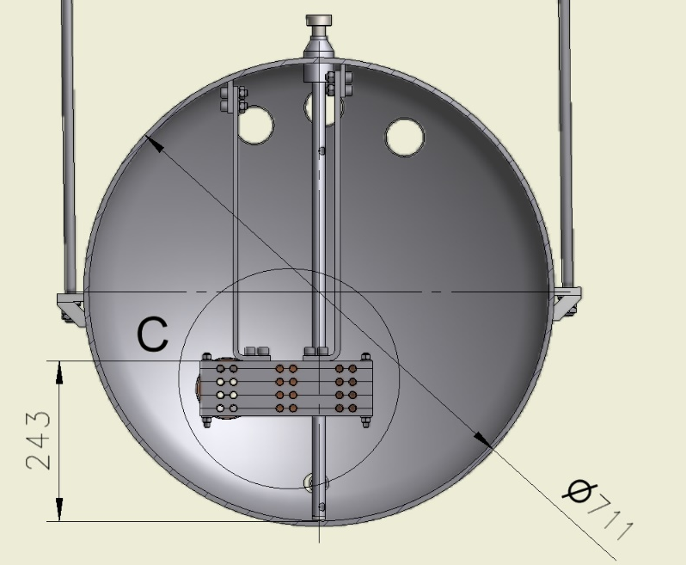
design of the BRANCH BOX (BB)/ subcooler
Position of the tubes into the subcooler.
The LHe volume
in maximum (530 mm) -1000 liters.
The maximum LHe level
The minimum LHe level

Slide 16
Results of calculation of subcooler. Operation condition (p=2.0 MPa) Stress
design of the BRANCH BOX (BB)/ subcooler
The maximum equivalent stress is 115 MPa.

Slide 17
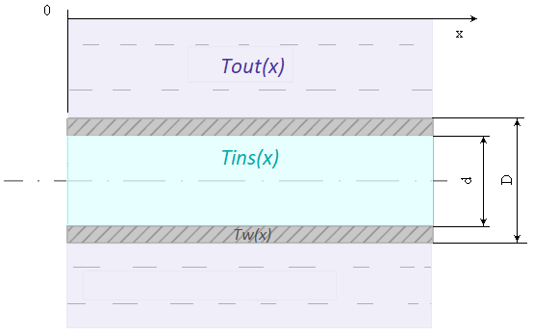
Calculations of the subcooler properties Initial data/ requirements
design of the BRANCH BOX (BB)/ subcooler
Inlet pressure, bar | 3.5
Maximum pressure drop,bar | 0.05
Input temperature,K | 5
Output temperature,K | 4.6
Mass flow rate,g/s | 145
Pressure outside the tube, bar | 1.3
Temperature outside the tube, K | 4.5
Length of the tube,m | 9
Cu process pipe
To calculate the parameters of liquid helium cooling in a heat exchanger, a program was written in the MatLab environment. The heat exchanger consists of N parallel tubes. To calculate the thermal characteristics along one tube, we take a linear coordinate system and divide the tube into equal sections 1 cm long.

Slide 18
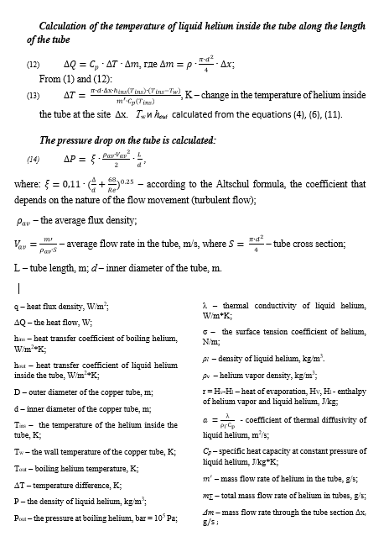
Formulas and abbreviations
design of the BRANCH BOX (BB)/ subcooler

Slide 19
design of the BRANCH BOX (BB)/ subcooler
Results for 7 tubes 12*1
Results for 8 tubes 12*1
32 mbar;
50 mbar specified
25 mbar;
50 mbar specified

Slide 20
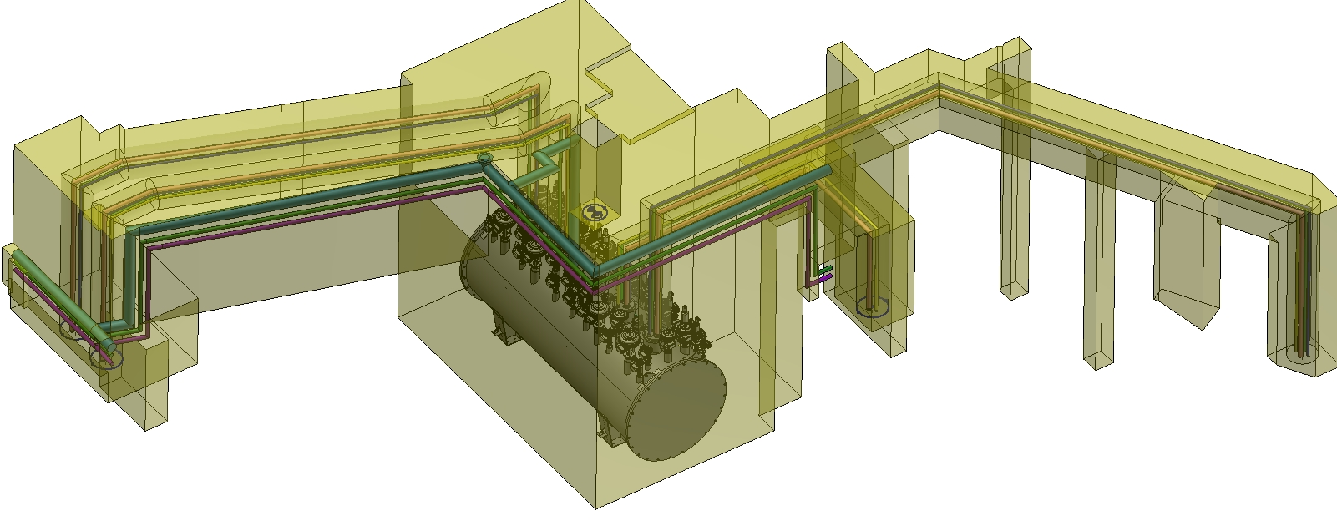
Installation of the Branch Box.
design of the BRANCH BOX (BB)

Slide 21
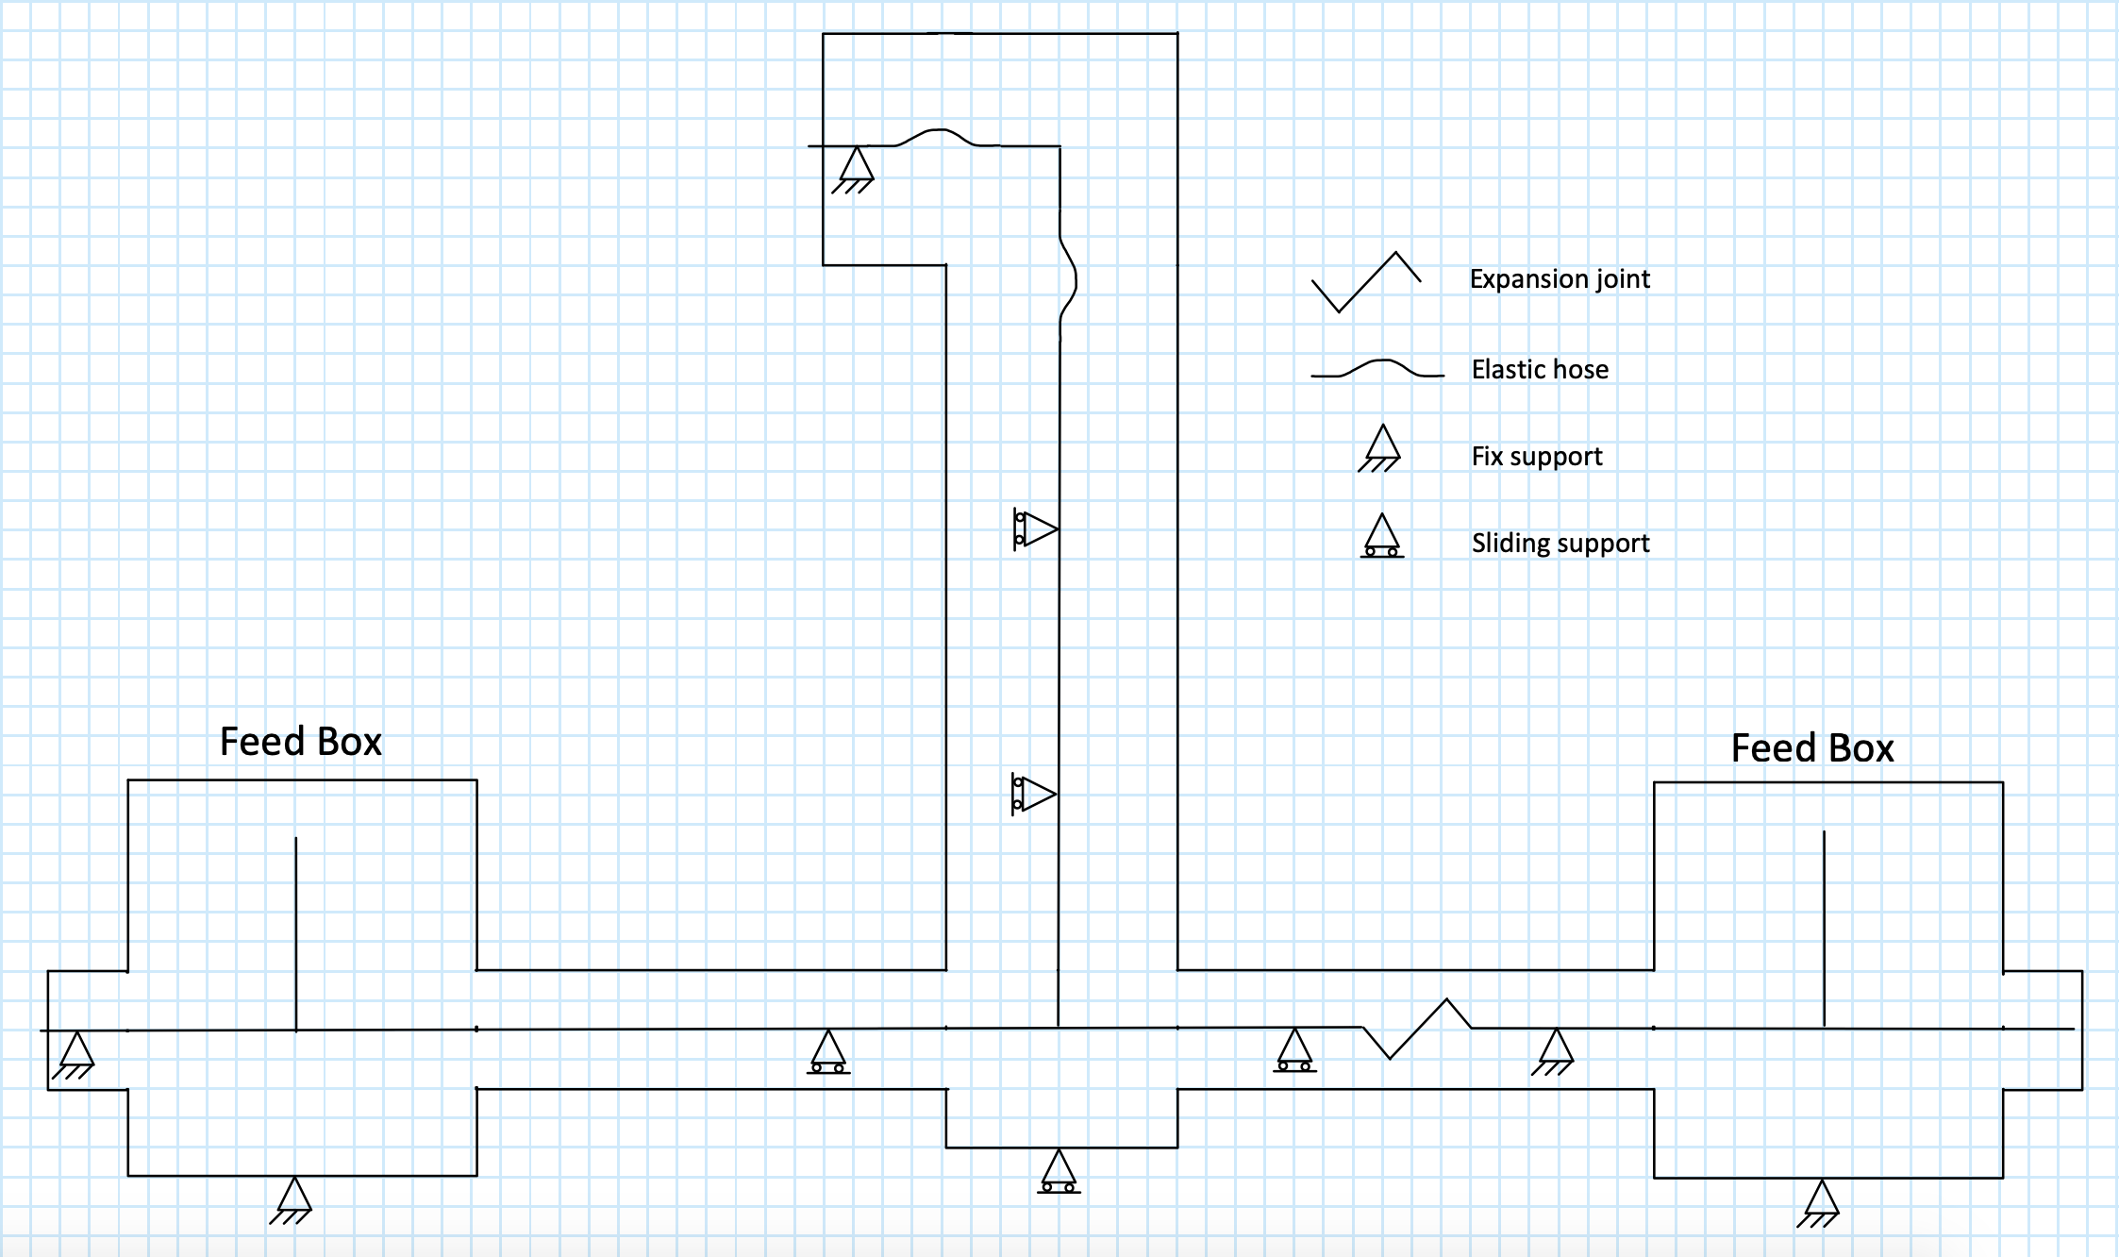
design of the BRANCH BOX (BB)/ transfer lines
Scheme of types of supports process piping for Tee connections

Slide 22
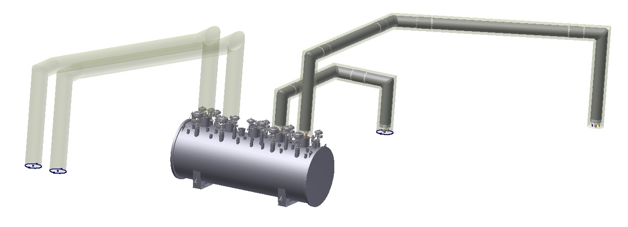
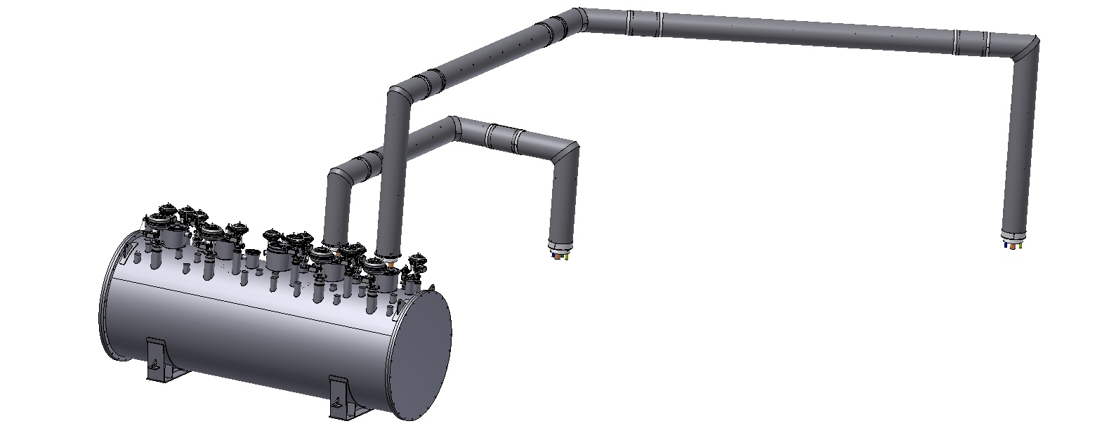
design of the BRANCH BOX (BB)/ transfer lines
Branch L;
TL_06
to Tee connection
Branch B;
TL_05
to Tee connection

Slide 23
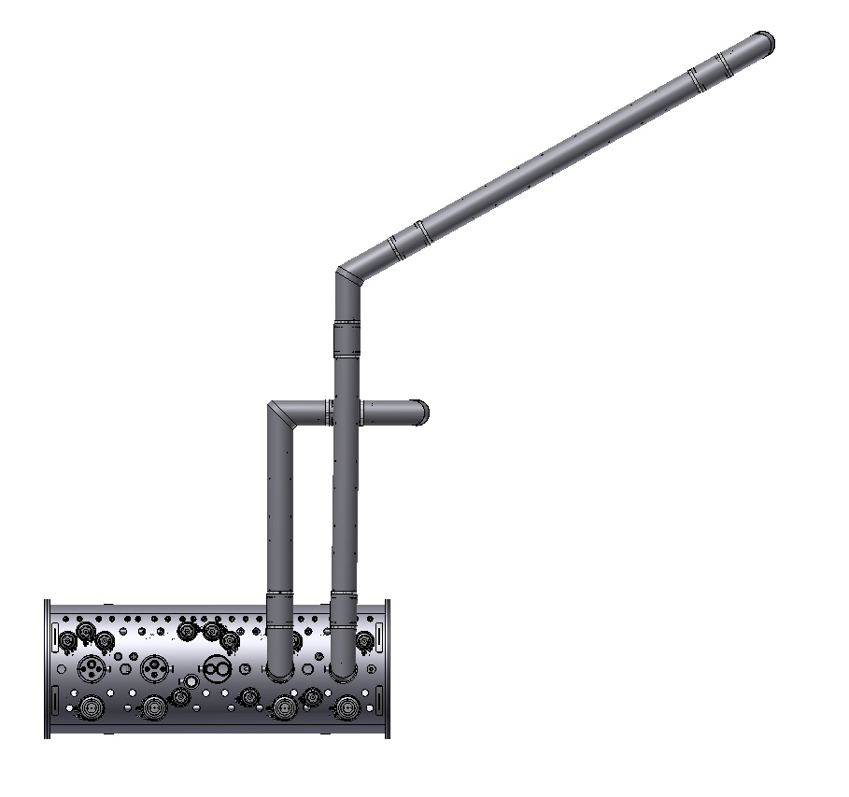
design of the BRANCH BOX (BB)/ transfer lines
Branch L;
TL_06
to Tee connection
 | TL_05 | TL_06
DN | 400 | 400
Total length, m | 9,5 | 19,6
Length, x m | 4,1 | 9,9
Length, y m | 2,2 | 6,4
Height, m | 1,34/ 1,9 | 2,9/ 3,5
Process pipes | 4 | 4
Weight, kg | 540 | 1140
Branch B;
TL_05
to Tee connection

Slide 24
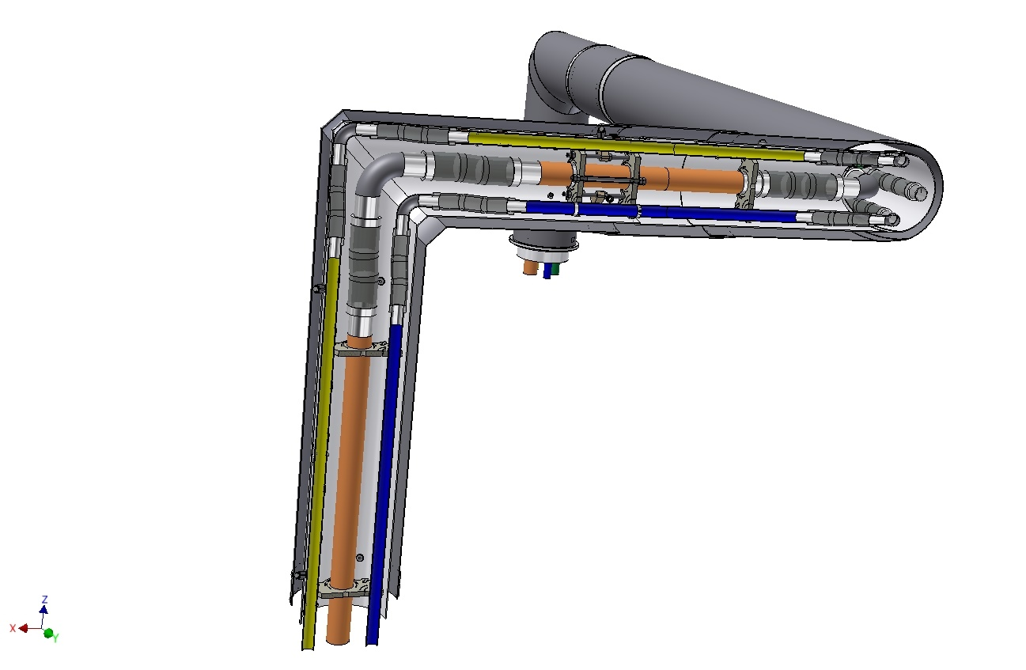
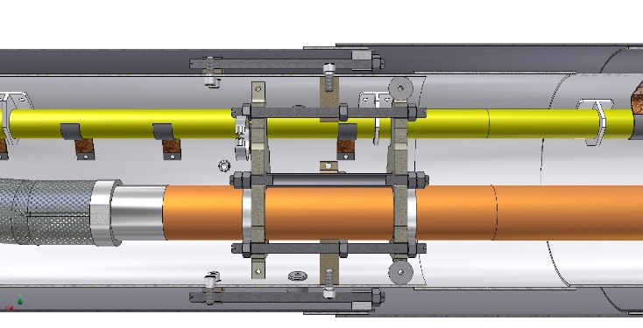
design of the BRANCH BOX (BB)/ transfer lines
Fix point
Branch B;
TL_05
to Tee connection

Slide 25
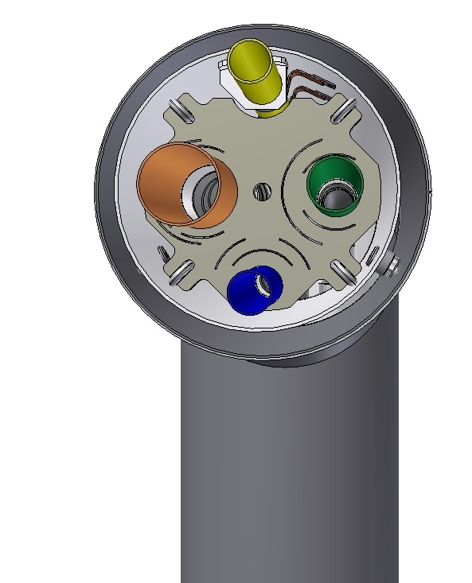
design of the BRANCH BOX (BB)/ transfer lines
Cross section:
Outer diameter – 406 mm;
Process pipes:
Yellow - DN40/ 80K return;
Brown - DN80/ 5,5K return;
Green - DN50/ 4,5K forward;
Blue - DN40/ 50K forward;
material - stainless steel 1.4541;

Slide 26
Plan
design of the BRANCH BOX (BB)
1. Placement the temperature sensors and other instruments.
2. Placement layout outside pipelines.
Calculate the pipelines of BB using the Caesar-II program.
Assembling drawings.
3D design TL_03, TL04_ TL_05 and TL_06.
Calculation loads of the piping, shell of TLs, supports, vacuum barriers and etc. using the Caesar-II program.

Slide 27
Thank you for your attention

