Slide 1
Radiation resistant SFRS dipoles status.
D. Gurov, A.Utkin for SFRS team
BINP, Novosibirsk
12.11.2020
FAIR-BINP, Novosibirsk, RUSSIA

Slide 2
Contents
Radiation resistant dipole magnet
Status of 3D model
Remote water connections 2 types
Remote current power connections 3 types
Water and current layout
Some minor exceptions
Grounding (option 1)
Grounding (option 2)
Layout of conductors for thermal monitoring in coils
Changes in coil construction
Status of 2D drawings

Slide 3
Radiation resistant dipole magnet
CC 2.4.2.1.1.2 (03.2019 – 10.22)
Parameter | Value
Lamination thickness | 130 mm
Number of RRDM dipole magnets | 3
Overall weight | 95 t
Coil current | 640 A
Number of coil turns | 192
Coil resistance | 343 mΩ
Coil inductance | 2200 mH
Maximum DC power loss | 140 kW

Slide 4
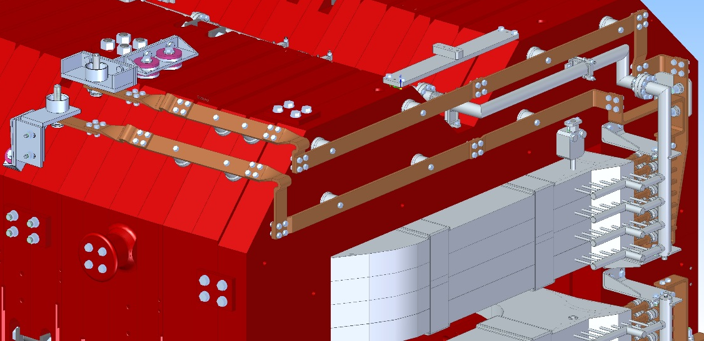
Status of 3D model
Mostly 3D Model is finished (including remote water connections, remote current power connections, remote connections for thermal monitoring, current and water layout on the yoke)

Slide 5
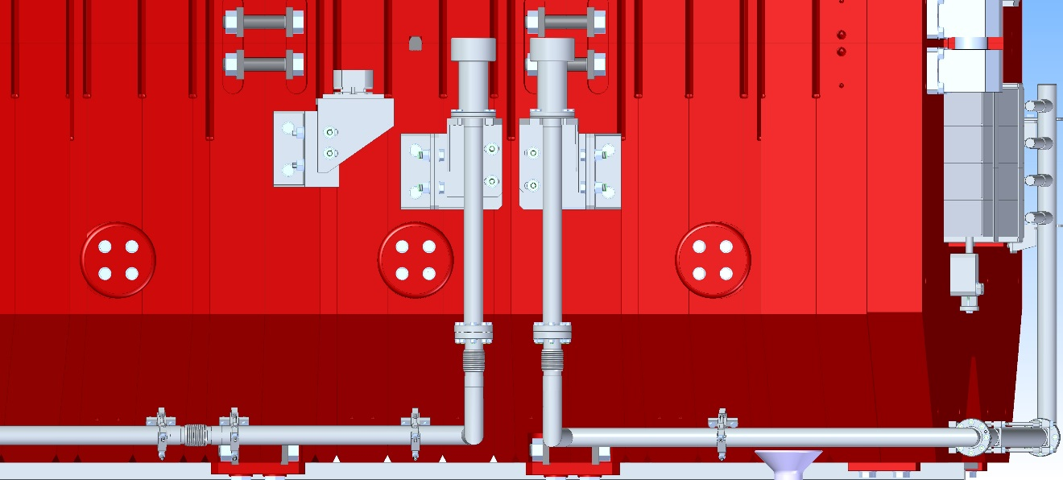
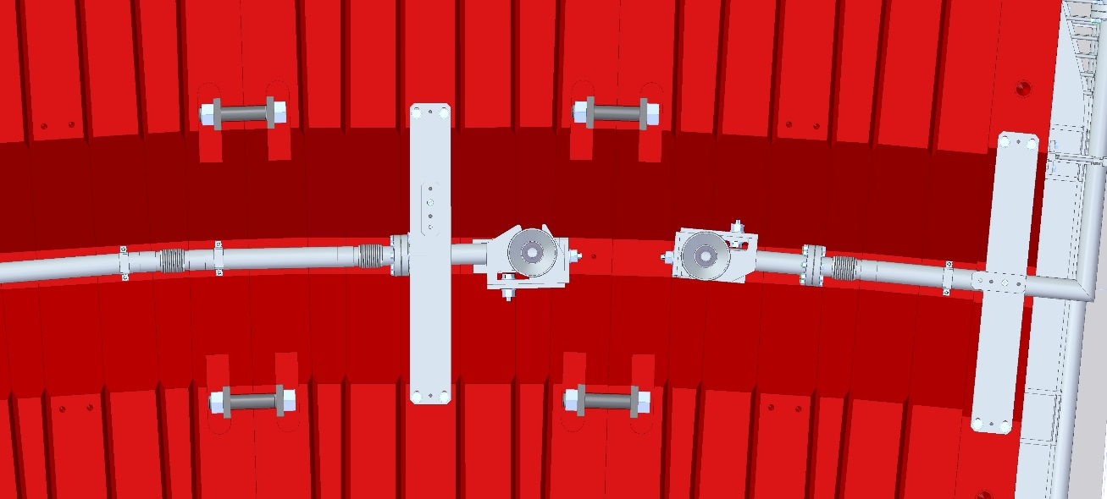
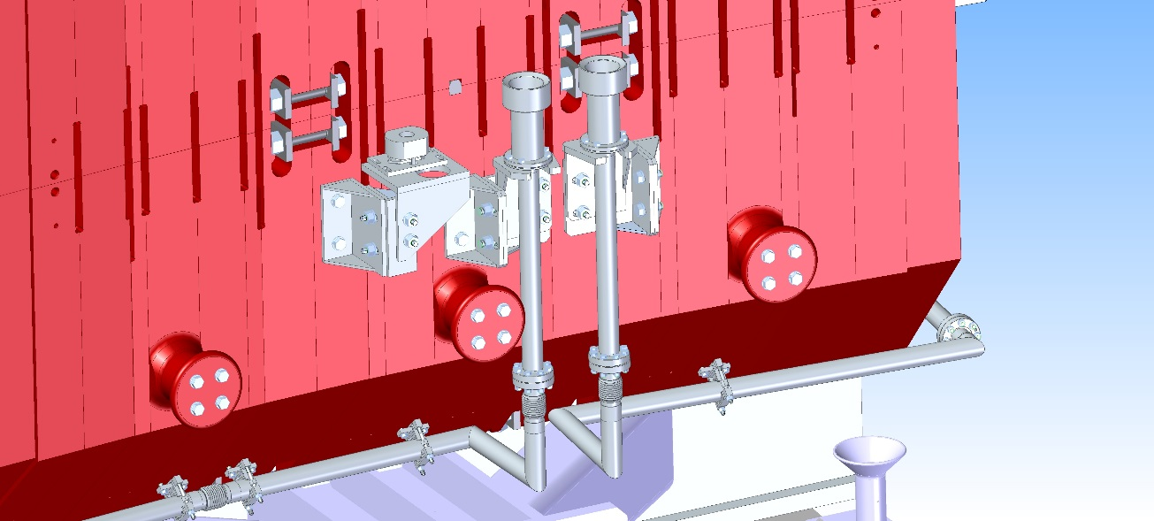
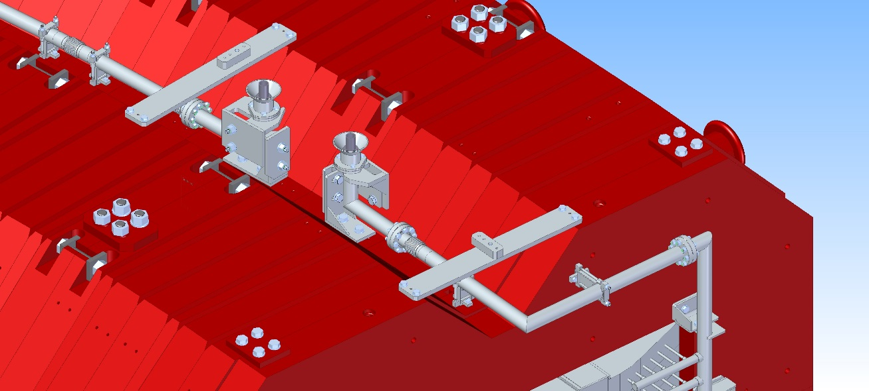
Remote water connections 2 types
Water connections for lower half
Water connections for upper half

Slide 6
Remote current power connections 3 types

Slide 7
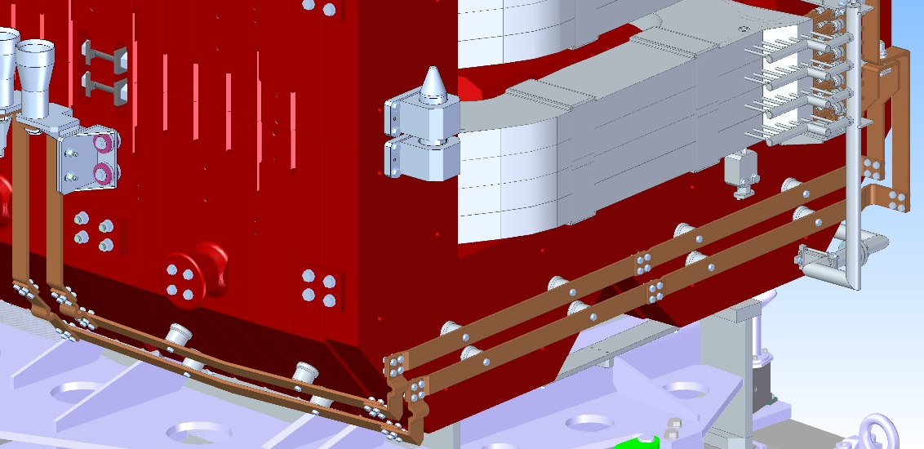
Water and current layout
Commutation allow to
Disassemble half of
yoke into 3 pieces

Slide 8
Some minor exceptions
grounding of magnet
layout of conductors for thermal monitoring in coils

Slide 9
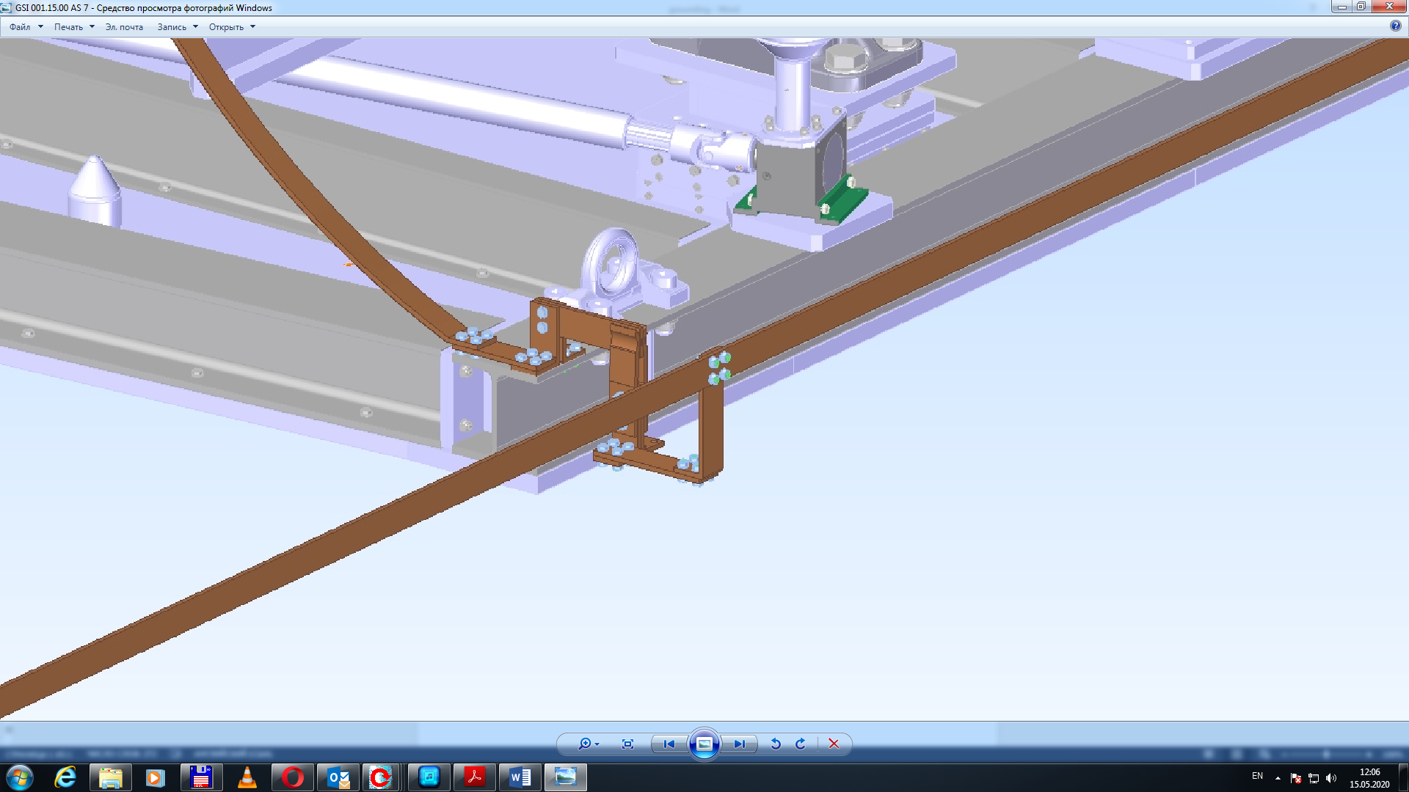
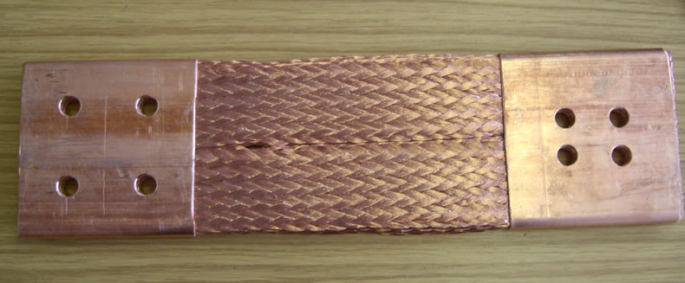
Grounding (option 1)

Slide 10
Grounding (option 2)
Grounding through remote connection for thermal control (side pins)
Cross section area
Insulation
Type of wire (solid or braided)

Slide 11
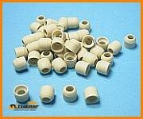
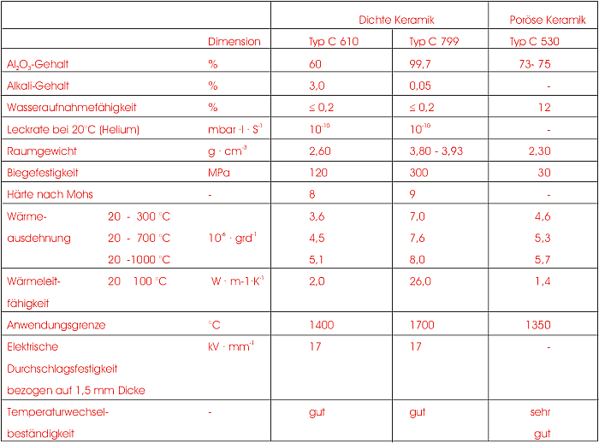
Layout of conductors for thermal monitoring in coils
Ceramic beads

Slide 12
Changes in coil construction
Based on the 3D model currently produced 2D drawings for the coils
Water collector in current construction ->

Slide 13
Status of 2D drawings
In December 2020, the end of producing of 2D drawings for the coils
In the end of February 2021, the end of producing of 2D drawings for yoke and stand

