Slide 1
Status of SFRS vacuum components design and production at BINP
BINP
A.Krasnov, Alexander Dranitchnikov, Alexey Semenov, Alexander Zhukov, Aigerim Baynazarova, Tatiana Bedareva, Svetlana Glukhovchenko, Georgy Gusev, Vyacheslav Borodich
5th BINP-FAIR Collaboration Coordination Workshop

Slide 2
FAIR vacuum components producing at BINP
Name | Signed | End (expected) | Cost M€ | Status
AFAA1 SFRS Diagnostic chambers | 03.2019 | 12.2021 (12.2022) | 1.11 | FoS is produced. All documents for FDR are uploaded into EDMS. Waiting vacuum equipment for FAT. 2D drawings – 20%, CDR – 75%. All CF flanges are ordered.
AFAA3 SFRS Vacuum chambers inside SC dipoles | 10.2019 | 06.2022 (11.2022) | 0.87 | 3D model of combined chamber with pumping port is created. Waiting corrected 3D DMU from FAIR/GSI. Conception of assembly into SC magnet is accepted (details are under consideration). FEM analysis for NC dipole wide chamber is going on.
AFAA5 SFRS vacuum components |  |  | 1.5 | Time schedule is agreed. Cost is fixed. Contract can be signed before detailed specification finalization.
SFRS branching chambers inside SC dipoles |  |  | 0.31 0.1 | The cost is too low for production the complex chambers
Alexander Krasnov / SFRS vacuum 5th BINP-FAIR Collaboration Coordination Workshop

Slide 3
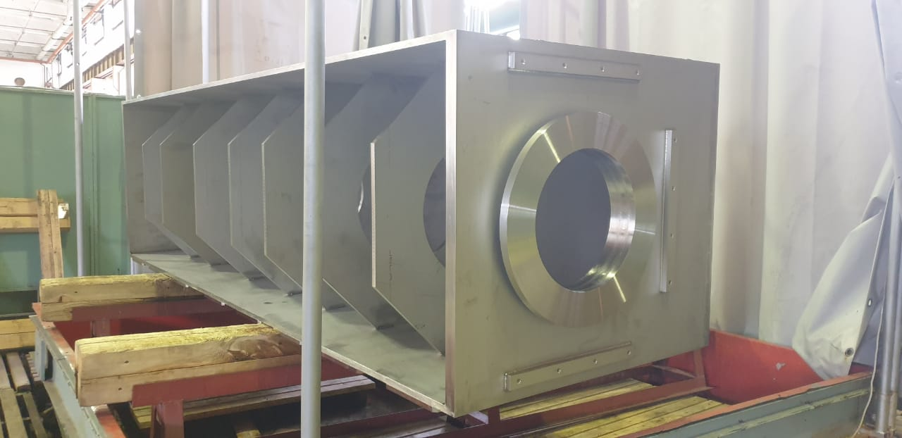
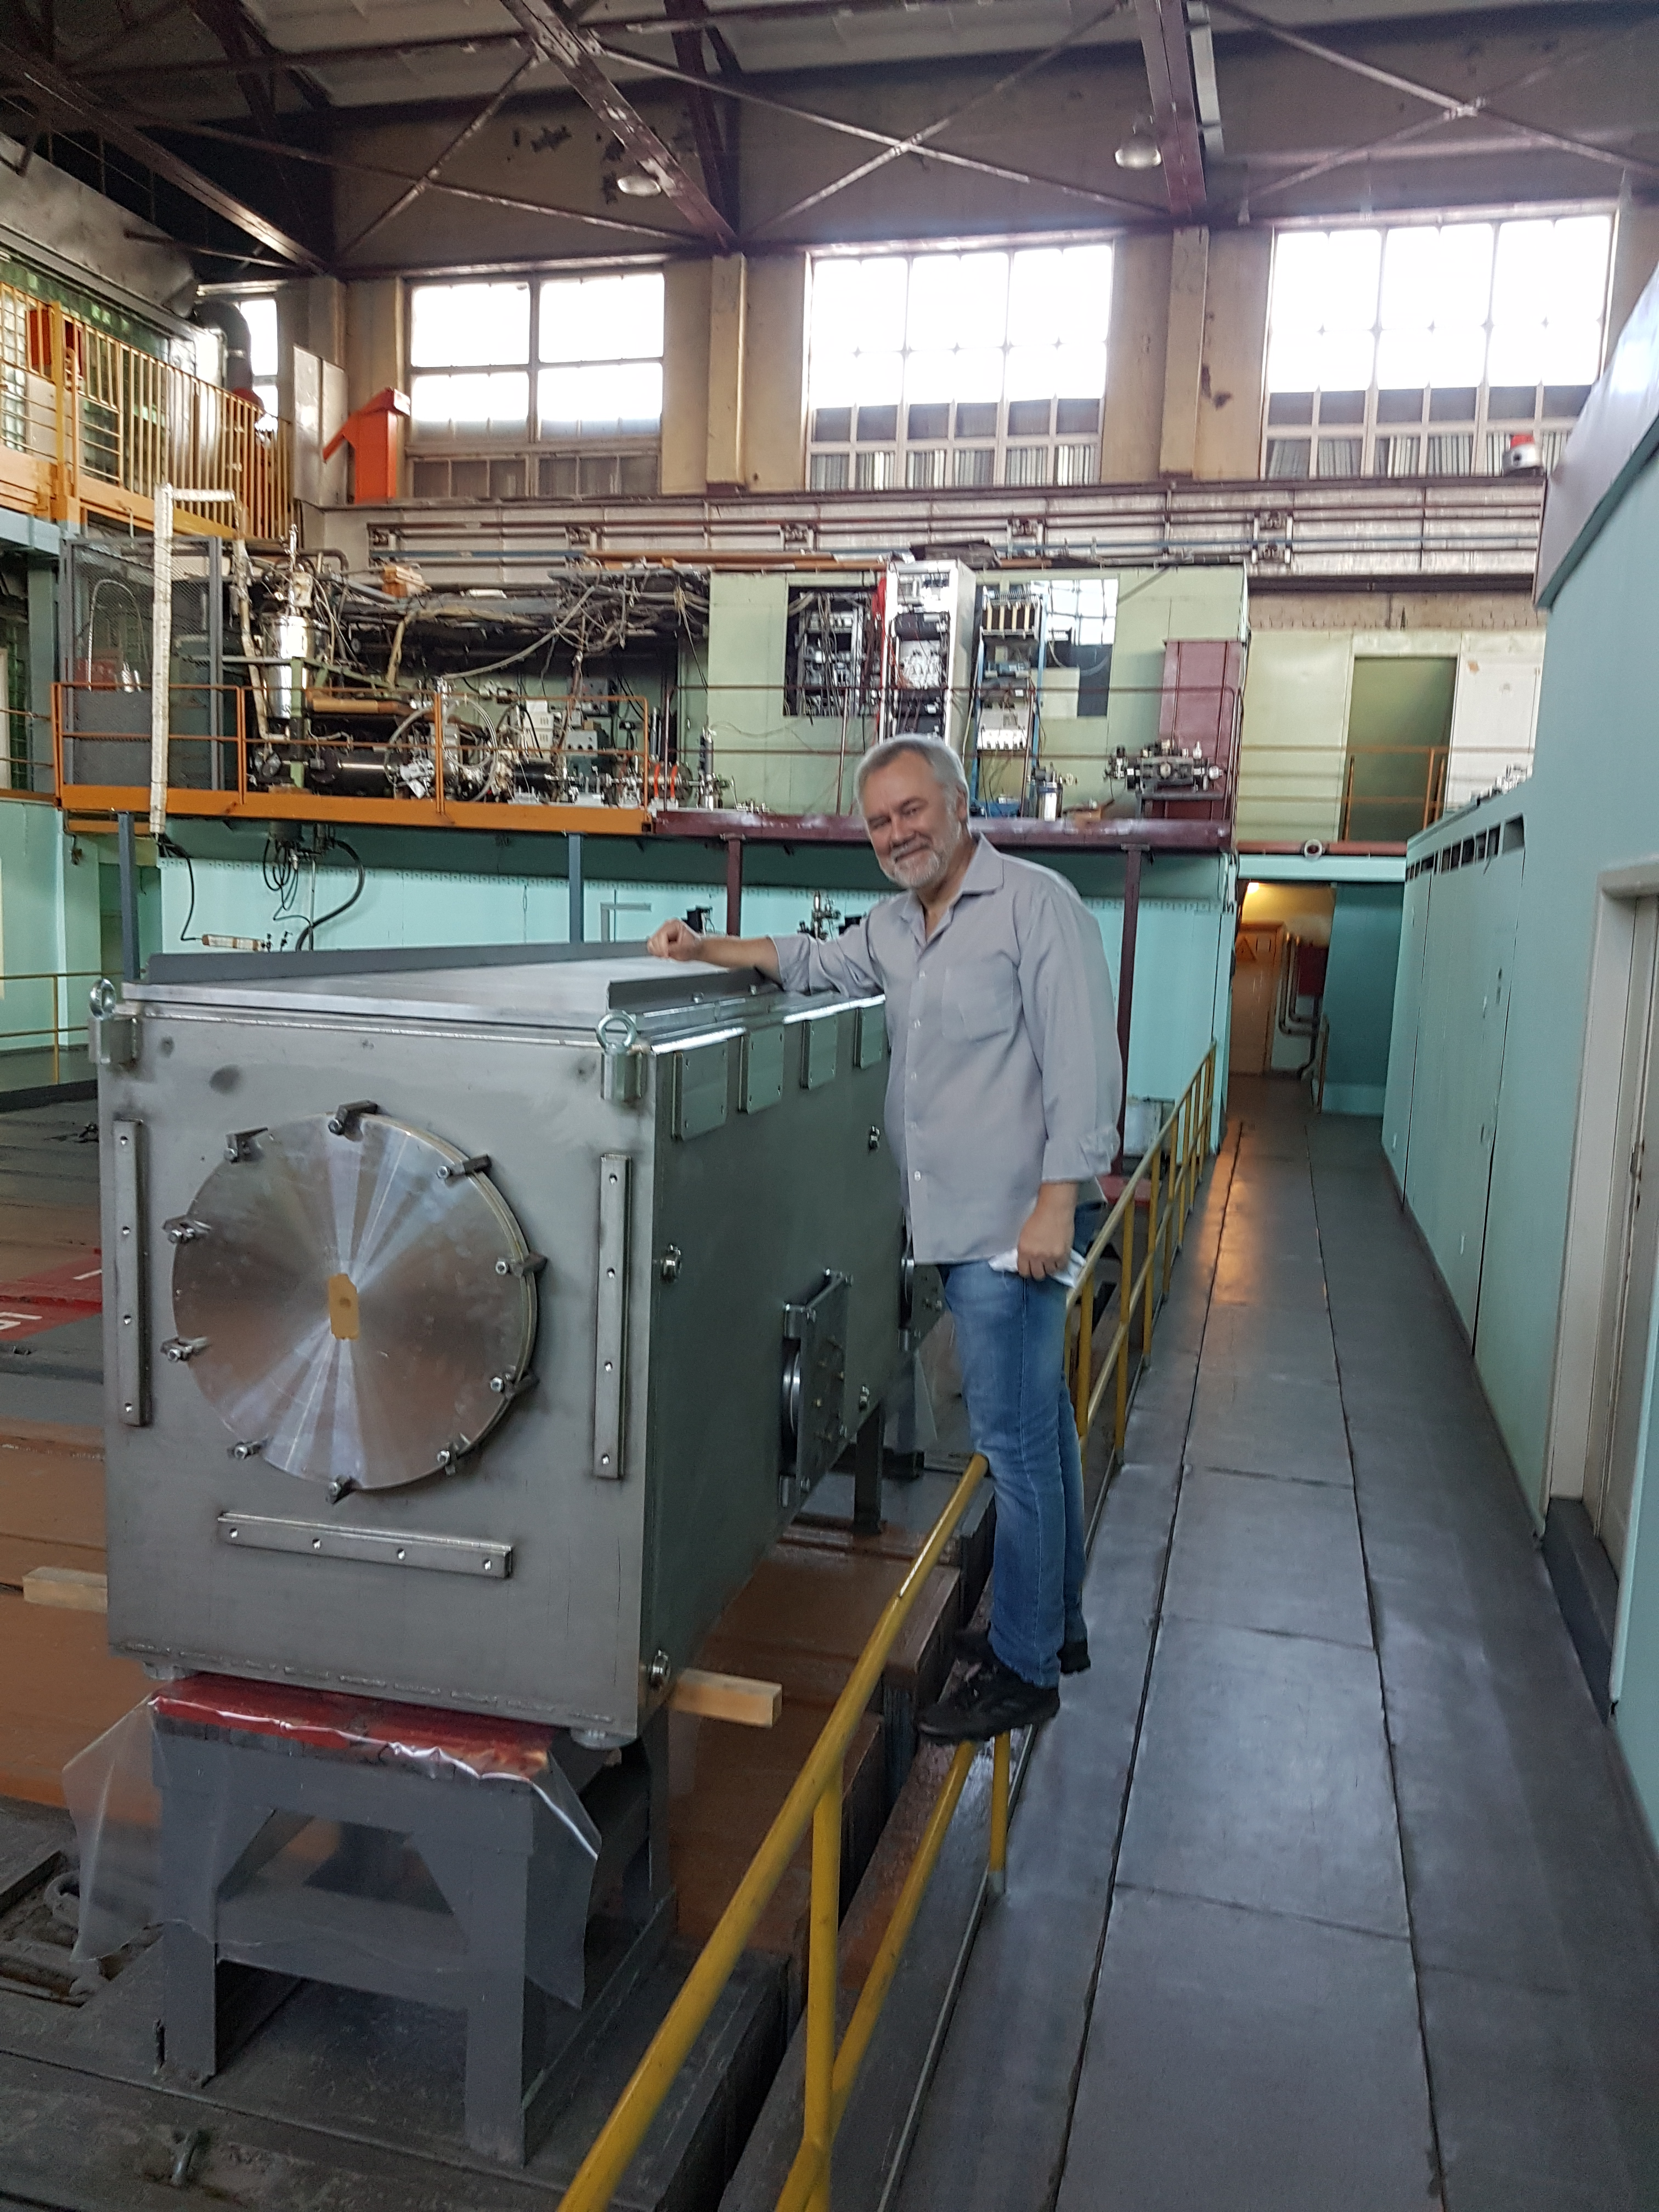
SFRS diagnostic chambers
FoS is produced!
All documents for FDR are uploaded into EDMS.
Waiting vacuum equipment for FAT.
2D drawings – 20%,
CDR – 75%
All CF flanges are ordered.
Alexander Krasnov / SFRS vacuum 5th BINP-FAIR Collaboration Coordination Workshop

Slide 4
SFRS diagnostic chambers
Sequence | Nomenclature | PSP | Designation (short name) | possible earliest FAT date (MVRicciardi) | Contracted FAT date [target date] | Contracted delivery date [target date] | Forecast FAT date [actual date] | Forecast delivery date [actual date] | 3D/ CDR | 2D/ FDR | alignment feets | flanges
1 | FPF2DK1_FoS | 2.4.7.1.12.1 and 2.4.7.2.2 | DC_02 FoS | 21/02/2020 | 21/02/2020 | 28/02/2020 | November-20 | January-20 | 3 | 2 | 2 | 3
 | FTF1DK1 | 2.4.7.1.12.1 and 2.4.7.2.2 | DC_01 | 23/07/2020 | latest Aug-2021 | latest Oct-2021 |  |  |  |  | 1 | 2
4 | FPF2DK1 | 2.4.7.1.12.1 and 2.4.7.2.2 | DC_02 | 13/08/2020 | latest Aug-2021 | latest Oct-2021 | August-21 | November-21 | 75% |  | 1 | 2
5 | FPF3DK1 | 2.4.7.1.12.1 and 2.4.7.2.2 | DC_03 | 03/09/2020 | latest Aug-2021 | latest Oct-2021 | September-21 | November-21 | 75% |  | 1 | 2
6 | FPF4DK1 | 2.4.7.1.12.1 and 2.4.7.2.2 | DC_04 | 24/09/2020 | latest Aug-2021 | latest Oct-2021 | October-21 | November-21 | 75% |  | 1 | 2
3 | FMF1DK1 | 2.4.7.1.12.1 and 2.4.7.2.2 | DC_05 | 15/10/2020 | latest Aug-2021 | latest Oct-2021 | May-21 | June-21 | 75% |  | 1 | 2
7 | FMF2DK1 | 2.4.7.1.12.1 and 2.4.7.2.2 | DC_06 | 05/11/2020 | latest Aug-2021 | latest Oct-2021 | November-21 | November-21 | 75% |  | 1 | 2
8 | FMF2DK2 | 2.4.7.1.12.1 and 2.4.7.2.2 | DC_07 | 26/11/2020 | latest Aug-2021 | latest Oct-2021 | December-21 | May-22 | 75% |  | 1 | 2
9 | FMF2DK3 | 2.4.7.1.12.1 and 2.4.7.2.2 | DC_08 | 17/12/2020 | latest Aug-2021 | latest Oct-2021 | January-22 | May-22 | 75% |  | 1 | 2
10 | FMF3DK1 | 2.4.7.1.12.1 and 2.4.7.2.2 | DC_09 | 07/01/2021 | latest Aug-2021 | latest Oct-2021 | February-22 | May-22 | 75% |  | 1 | 2
11 | FHF1DK1 | 2.4.7.1.12.1 and 2.4.7.2.2 | DC_10 | 28/01/2021 | latest Aug-2021 | latest Oct-2021 | March-22 | May-22 | 75% |  | 1 | 2
12 | FHF1DK2 | 2.4.7.1.12.1 and 2.4.7.2.2 | DC_11 | 18/02/2021 | latest Aug-2021 | latest Oct-2021 | April-22 | May-22 | 75% |  | 1 | 2
13 | FLF1DK1 | 2.4.7.1.12.1 and 2.4.7.2.2 | DC_12 | 11/03/2021 | latest Aug-2021 | latest Oct-2021 | May-22 | October-22 | 75% |  | 1 | 2
14 | FLF2DK1 | 2.4.7.1.12.1 and 2.4.7.2.2 | DC_13 | 01/04/2021 | latest Aug-2021 | latest Oct-2021 | June-22 | October-22 | 75% |  | 1 | 2
15 | FLF3DK1 | 2.4.7.1.12.1 and 2.4.7.2.2 | DC_14 | 22/04/2021 | latest Aug-2021 | latest Oct-2021 | July-22 | October-22 | 75% |  | 1 | 2
16 | FLF4DK1 | 2.4.7.1.12.1 and 2.4.7.2.2 | DC_15 | 13/05/2021 | latest Aug-2021 | latest Oct-2021 | August-22 | October-22 | 75% |  | 1 | 2
17 | FLF5DK1 | 2.4.7.1.12.1 and 2.4.7.2.2 | DC_16 | 03/06/2021 | latest Aug-2021 | latest Oct-2021 | September-22 | October-22 | 75% |  | 1 | 2
2 | FLF6DK1 | 2.4.7.1.12.1 and 2.4.7.2.2 | DC_17 | 24/06/2021 | latest Aug-2021 | latest Oct-2021 | April-21 | June-21 | 75% |  | 1 | 2
18 | FRF1DK1 | 2.4.7.1.12.1 and 2.4.7.2.2 | DC_18 | 15/07/2021 | latest Aug-2021 | latest Oct-2021 | October-22 | December-22 | 75% |  | 1 | 2
19 | FRF2DK1 | 2.4.7.1.12.1 and 2.4.7.2.2 | DC_19 | 05/08/2021 | latest Aug-2021 | latest Oct-2021 | November-22 | December-22 | 75% |  | 1 | 2
20 | FRF3DK1 | 2.4.7.1.12.1 and 2.4.7.2.2 | DC_20 | 26/08/2021 | latest Aug-2021 | latest Oct-2021 | December-22 | December-22 | 75% |  | 1 | 2
CDR for all chambers is 75% complete, an amendment needed ASAP to proceed it officially
Alexander Krasnov / SFRS vacuum 5th BINP-FAIR Collaboration Coordination Workshop

Slide 5
SFRS SC dipole chamber
3D model of combined chamber with pumping port is created.
Waiting corrected 3D DMU from FAIR/GSI.
Conception of assembly into SC magnet is accepted (details are under consideration).
QA documents are under preparation

Slide 6
SFRS SC dipole chamber
Materials and bellows for Pre-serial production are ordered

Slide 7
SFRS SC dipole chamber
Nomenclature | PSP vacuum chamber | Designation | Contracted FAT date [target date] | Contracted delivery date [target date] | Forecast FAT date [actual date] | Forecast delivery date [actual date] | 3D/ CDR | 2D/ FDR | stainless steel plates | flanges | bellows
FPF4 xxx | 2.4.7.1.2.1.1 | 01 - St. dip. 2 chamber, curved exit | Jan-21 |  | Sep-21 | 01/10/2021 |  |  | 1 | 1 | 1
FPF4 xxx | 2.4.7.1.2.1.1 | 02 - St. dip. 2 chamber, curved exit | Feb-21 |  | Nov-21 | 01/12/2021 |  |  | 1 | 1 | 1
FPF4 xxx | 2.4.7.1.2.1.1 | 03 - St. dip. 2 chamber, curved exit | Feb-21 |  | Jan-22 | 01/03/2022 |  |  | 1 | 1 | 1
spare xxx | 2.4.7.1.2.1.1 | 26 - St. dip. 2 chamber, curved exit | Mar-22 |  | Feb-22 | 01/03/2022 |  |  | 1 | 1 | 1
FMF1 xxx | 2.4.7.1.2.2.1.1 | 04 - St. dip. 3 chamber, curved exit | Mar-21 |  | 01/04/2021 | 01/05/2021 | 2 | 1 | 1 | 1 | 2
FMF1 xxx | 2.4.7.1.2.2.1.1 | 05 - St. dip. 3 chamber, curved exit | Mar-21 |  | Jun-21 | 01/10/2021 | 2 | 1 | 1 | 1 | 2
FMF1 xxx | 2.4.7.1.2.2.1.1 | 06 - St. dip. 3 chamber, curved exit | Apr-21 |  | Sep-21 | 01/10/2021 | 2 | 1 | 1 | 1 | 2
FMF2 xxx | 2.4.7.1.2.2.1.1 | 07 - St. dip. 3 chamber, curved exit | May-21 |  | Oct-21 | 01/12/2021 | 2 | 1 | 1 | 1 | 2
FMF2 xxx | 2.4.7.1.2.2.1.1 | 08 - St. dip. 3 chamber, curved exit | May-21 |  | Nov-21 | 01/12/2021 | 2 | 1 | 1 | 1 | 2
FMF2 xxx | 2.4.7.1.2.2.1.1 | 09 - St. dip. 3 chamber, curved exit | Jun-21 |  | Dec-21 | 01/03/2022 | 2 | 1 | 1 | 1 | 2
FMF3 xxx | 2.4.7.1.2.2.1.1 | 12 - St. dip. 3 chamber, curved exit | Jul-21 |  | Jan-22 | 01/03/2022 | 2 | 1 | 1 | 1 | 2
FHF1 xxx | 2.4.7.1.2.2.1.1 | 15 - St. dip. 3 chamber, curved exit | Sep-21 |  | Feb-22 | 01/03/2022 | 2 | 1 | 1 | 1 | 2
FLF2 xxx | 2.4.7.1.2.2.1.1 | 16 - St. dip. 3 chamber, curved exit | Oct-21 |  | Mar-22 | 01/06/2022 | 2 | 1 | 1 | 1 | 2
FLF2 xxx | 2.4.7.1.2.2.1.1 | 17 - St. dip. 3 chamber, curved exit | Oct-21 |  | Apr-22 | 01/06/2022 | 2 | 1 | 1 | 1 | 2
FLF2 xxx | 2.4.7.1.2.2.1.1 | 18 - St. dip. 3 chamber, curved exit | Nov-21 |  | May-22 | 01/06/2022 | 2 | 1 | 1 | 1 | 2
FRF2 xxx | 2.4.7.1.2.2.1.1 | 19 - St. dip. 3 chamber, curved exit | Nov-21 |  | Jun-22 | 01/06/2022 | 2 | 1 | 1 | 1 | 2
FRF2 xxx | 2.4.7.1.2.2.1.1 | 20 - St. dip. 3 chamber, curved exit | Dec-21 |  | Jul-22 | 01/11/2022 | 2 | 1 | 1 | 1 | 2
FRF2 xxx | 2.4.7.1.2.2.1.1 | 21 - St. dip. 3 chamber, curved exit | Jan-22 |  | Aug-22 | 01/11/2022 | 2 | 1 | 1 | 1 | 2
FRF3 xxx | 2.4.7.1.2.2.1.1 | 22 - St. dip. 3 chamber, curved exit | Jan-22 |  | Sep-22 | 01/11/2022 | 2 | 1 | 1 | 1 | 2
spare xxx | 2.4.7.1.2.2.1.1 | 25 - St. dip. 3 chamber, curved exit | Mar-22 |  | Oct-22 | 01/11/2022 | 2 | 1 | 1 | 1 | 2
FMF3 xxx | 2.4.7.1.2.2.2 | 10 - St. dip. 3 chamber, curved exit, 9,75° | Jun-21 |  | Oct-21 | 01/12/2022 |  |  | 1 | 1 | 1
FHF1 xxx | 2.4.7.1.2.2.2 | 13 - St. dip. 3 chamber, curved exit, 9,75° | Aug-21 |  | Dec-21 | 01/03/2022 |  |  | 1 | 1 | 1
FRF3 xxx | 2.4.7.1.2.2.2 | 24 - St. dip. 3 chamber, curved exit, 9,75° | Feb-22 |  | Mar-22 | 01/06/2022 |  |  | 1 | 1 | 1
FMF3 xxx | 2.4.7.1.2.3 | 11 - Br. dip. 3 chamber, curved exit, 9,75° | not yet available | not yet available
FHF1 xxx | 2.4.7.1.2.3 | 14 - Br. dip. 3 chamber, curved exit, 9,75° | not yet available | not yet available
FRF3 xxx | 2.4.7.1.2.3 | 23 - Br. dip. 3 chamber, curved exit, 9,75° | not yet available | not yet available
Bellows for Pre-serial production are ordered (will be received in this year)
Waiting offers for low mu stainless steel

Slide 8
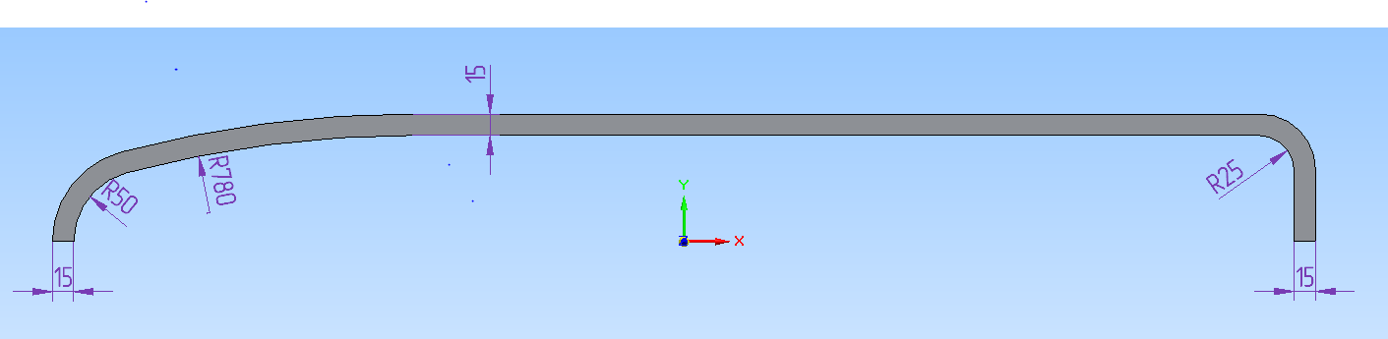
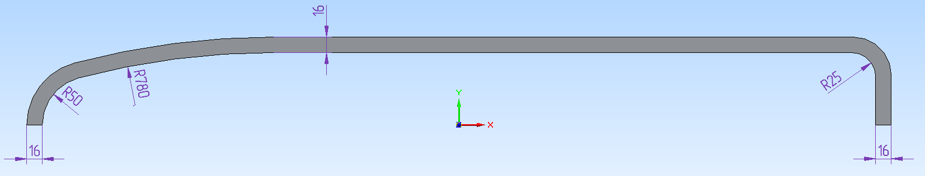
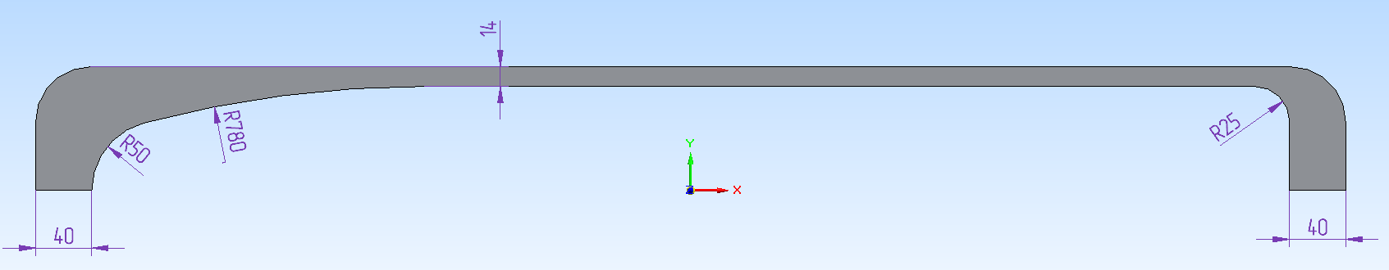
R&D for SFRS NC dipole chamber
Vertical size can be decreased at left side of the chamber
FEM analysis for wide chamber (inside SFRS NC RR dipoles) is going on.
Results show that the chamber can be made of Ti or Ti alloy

Slide 9
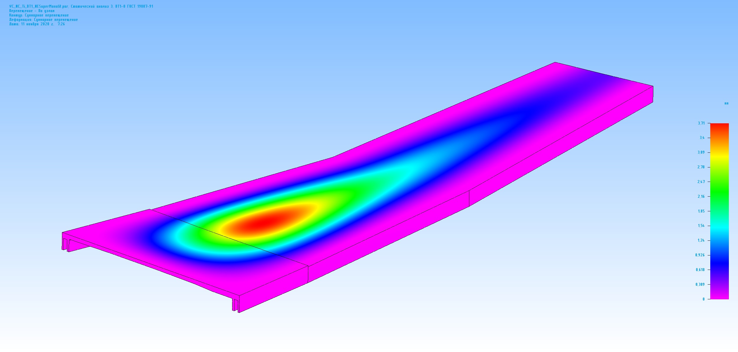
R&D for SFRS NC dipole chamber
Possible reliable solutions
Deflection: 2 x 3.7 mm – acceptable, made of Ti6Al4V (Grade5)

Slide 10
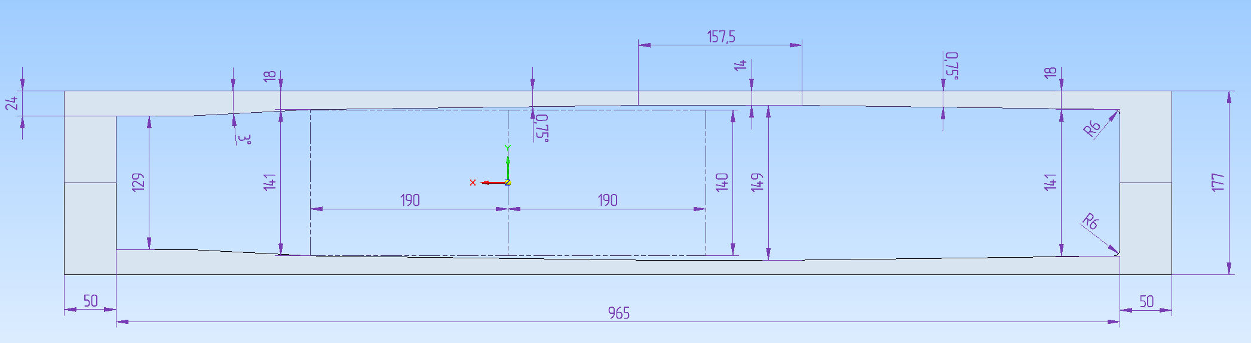
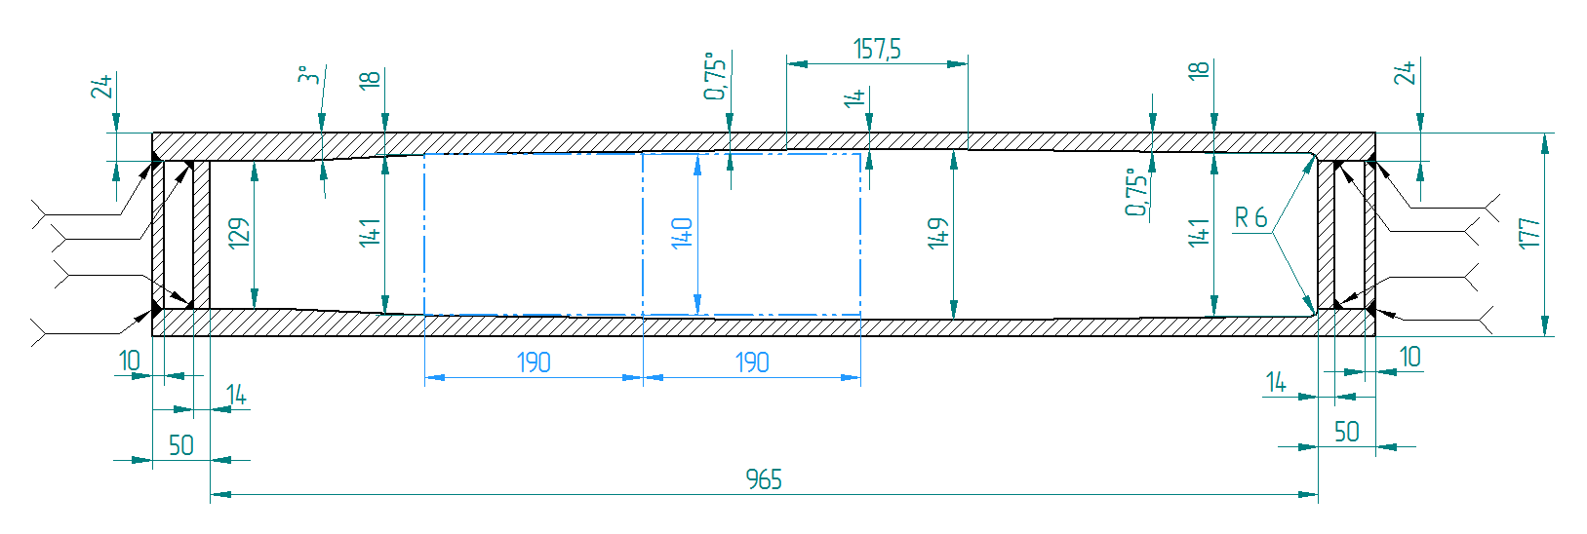
R&D for SFRS NC dipole chamber
Possible reliable solutions
Deflection: 2 x 3.7 mm – acceptable, made of Ti6Al4V (Grade5)

Slide 11
SFRS NC dipole chamber
Temperature jump and maximum stress
P = 3 W/cm^2, Energy 4.5 J per pulse, repetition 1.5 c
Radiation length 20.4 g/cm^2 (2.6cm for stainless steel) 1500 MeV U
Incident angle 15 mrad
13%
 | Ro g/cm^3 | R length cm | Cm J/g/K | Cv J/cm^3/K | deltaT | J/g | E GPa | σ₋₁ Mpa | a 1/K | DeltaT max
BT1 | 4,54 | 6,7E-02 | 0,53 | 2,41 | 27,75 | 14,71 | 103,00 | 280,00 | 8,2E-06 | 464,13
BT3-1 | 4,54 | 6,7E-02 | 0,53 | 2,41 | 27,75 | 14,71 | 115,00 | 450,00 | 8,2E-06 | 668,08
BT6 | 4,43 | 6,9E-02 | 0,53 | 2,35 | 27,75 | 14,71 | 113,00 | 450,00 | 8,2E-06 | 679,91
Stainless steel | 7,90 | 3,9E-02 | 0,46 | 3,63 | 31,97 | 14,71 | 200,00 | 280,00 | 1,6E-05 | 122,50
Inconel 718 | 8,20 | 3,7E-02 | 0,50 | 4,10 | 29,41 | 14,71 | 210,00 | 700,00 | 1,30E-05 | 358,97
AMg5 | 2,70 | 1,1E-01 | 0,92 | 2,48 | 15,98 | 14,71 | 70,00 | 125,00 | 2,3E-05 | 108,70

Slide 12
Thank you for attention and stay healthy!

