Slide 1
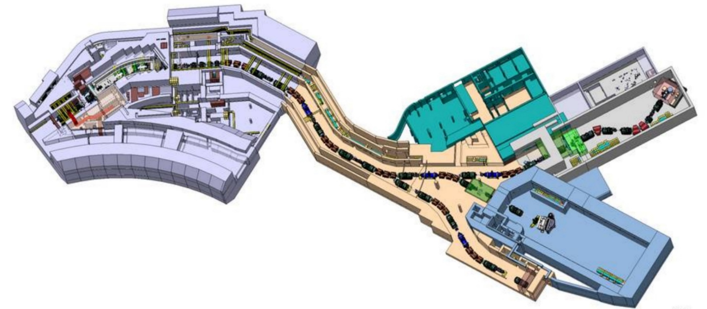
WUST In-Kind scope to Super-FRS
J. Polinski, A. Iluk, L. Pachnik, M. Chorowski

Slide 2
WUST In-Kind scope to Super-FRS
Contents
S-FRS Local Cryogenics General Layout
Project scope and its potential division between WUST and BINP
Project schedule
WUST works summary

Slide 3
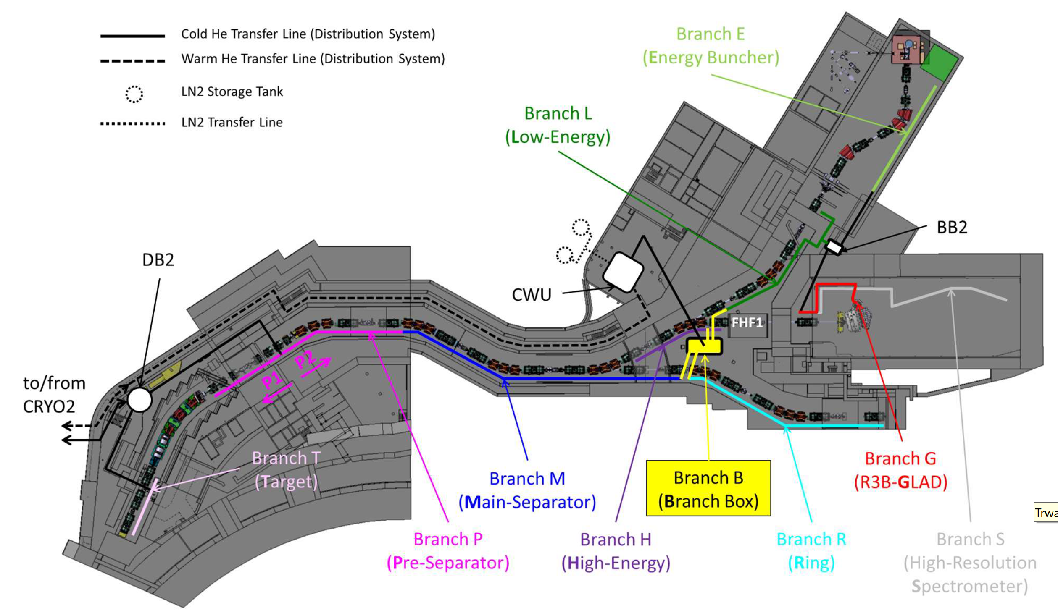
WUST In-Kind scope to Super-FRS
S-FRS Local Cryogenics General Layout

Slide 4
WUST In-Kind scope to Super-FRS
S-FRS Local Cryo conceptual design
Branch T
Branch B (Branch Box)

Slide 5
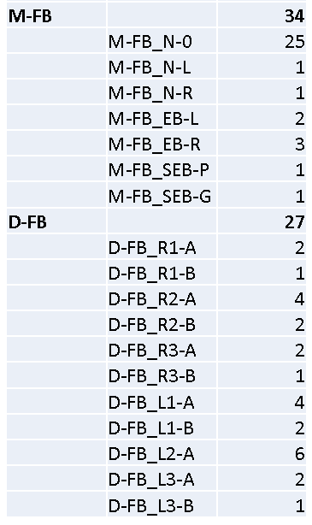
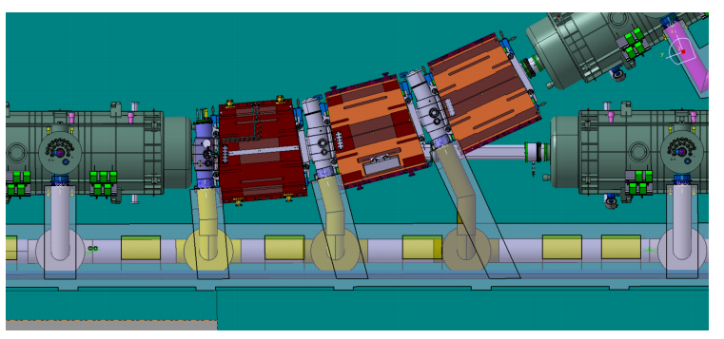
WUST In-Kind scope to Super-FRS
The project scope
General structure of Super-FRS Local Cryogenics has been reviewed by WUST.
Modifications of Jumper Connections routing and some Feed Boxes locations have been proposed to have single general type of Feed Box design and single End Box design instead of many types.
The GSI has implemented of the new concept of jumper connections and Feed Boxes locations in the building mockup and confirmed the available space for it.
Original list of different feedboxes
Example of branch of SFRS local cryogenics – original design

Slide 6
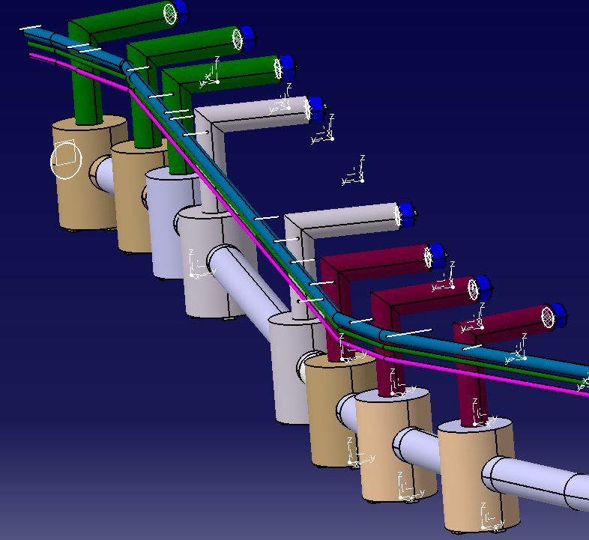
WUST In-Kind scope to Super-FRS
Potential division between WUST and BINP:
Super-FRS local cryogenics design and construction is proposed to be divided between WUST and BINP
Proposal of an interfaces division:
WUST – all branches of the SFRS local cryogenics with Feed Boxes, End Boxes
and Jumper Connections to the magnets
BINP – Branch Box (valve box distributing helium to the branches of SFRS) and
warm gas piping with MPL (VIP) line in all the branches.

Slide 7
WUST In-Kind scope to Super-FRS
The project scope/ potential division:
Description | SFRS | Design | Production
Branch Box (5 interfaces, 40 valves, etc.) including 4 TL to the branches- pcs | 1 | BINP | BINP
Feed Boxes - pcs | 62+1* | WUST | WUST/BINP
End Boxes - pcs | 7 | WUST | WUST
Jumper Connections- pcs | 62 | WUST | WUST
4-channel transfer lines – meters | 313 | WUST | WUST
Single channel transfer lines (MPL) - meters | 543 | BINP | BINP
Warm-GHe pipes- meters | 1154 | BINP | BINP
* Special FB for GLAD magnet

Slide 8
WUST In-Kind scope to Super-FRS
Project schedule (proposal on Sept 2020)

Slide 9
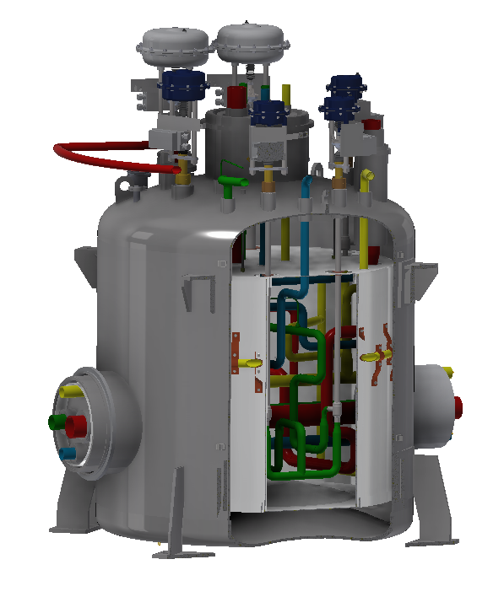
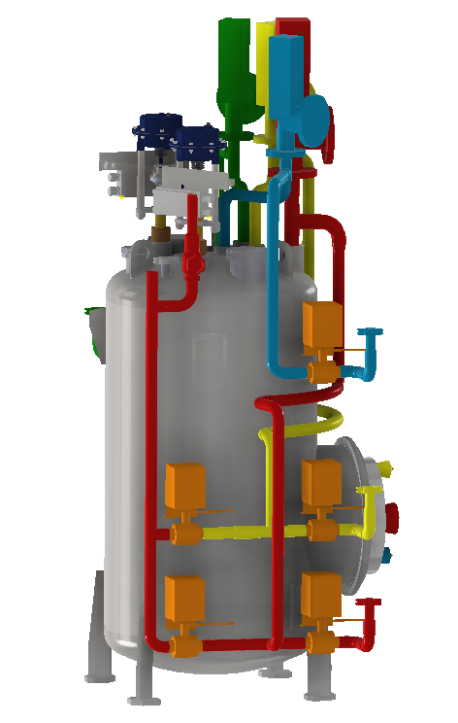
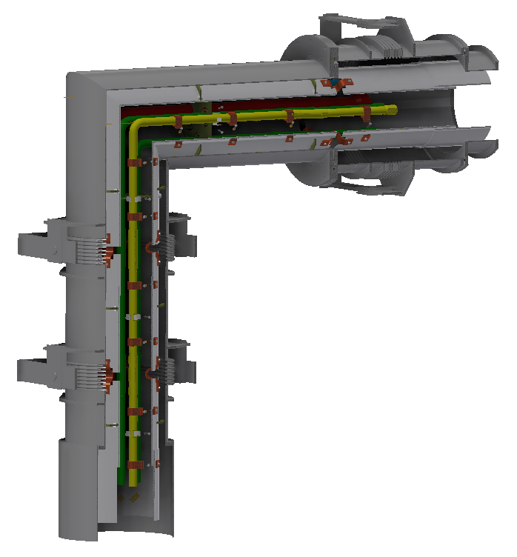
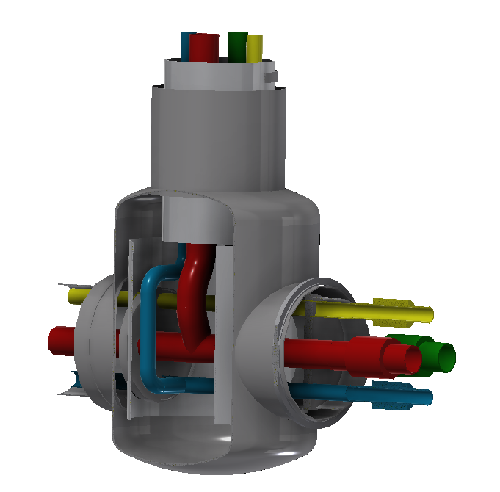
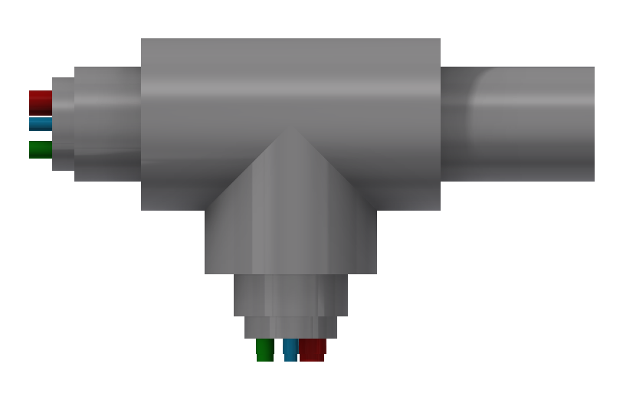
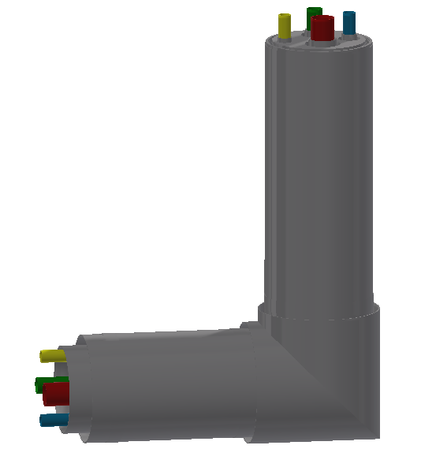
WUST In-Kind scope to Super-FRS
WUST works summary
Conceptual design of Local Cryo components
Multiplet/Dipole Feed Box
11º Dipole Feed Box
End Box
Jumper Connection
Up- and downward T-connection
L-connection

Slide 10
WUST In-Kind scope to Super-FRS
WUST works summary
Conceptual design of Local Cryo components
 | Amount | Types | Space agreed? | Conceptual design status
Feed Boxes | 63* | 7 (TBC) | YES | Designed (standard + 11º)
End Boxes | 6 | 2 (TBC) | YES | Designed
T-connections | 4 | 2 | YES | Designed
L-connections | 3 | 1 | YES | Designed
Jumper Connections | 62 | 15 (TBC) | YES | 1 of 15 is designed**
Transfer Lines | NA | NA | YES | Under design
*includes one special FB for GLAD, for which specification is still unknown
**standard type (Type 1)

Slide 11
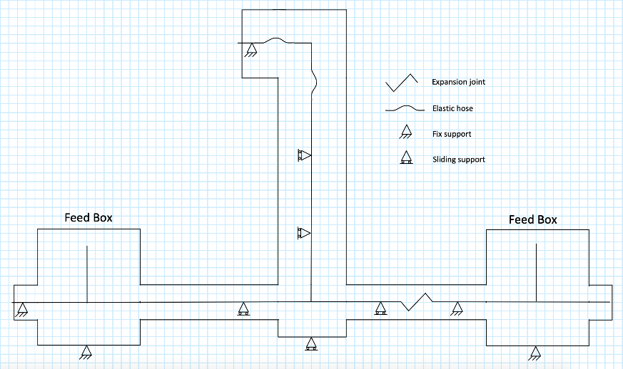
WUST In-Kind scope to Super-FRS
WUST works summary
Works on the WUST-BINP interfaces
Tee-Interfaces TL_05 and TL_06:
WUST-BINP interfaces in Branch Box area

Slide 12
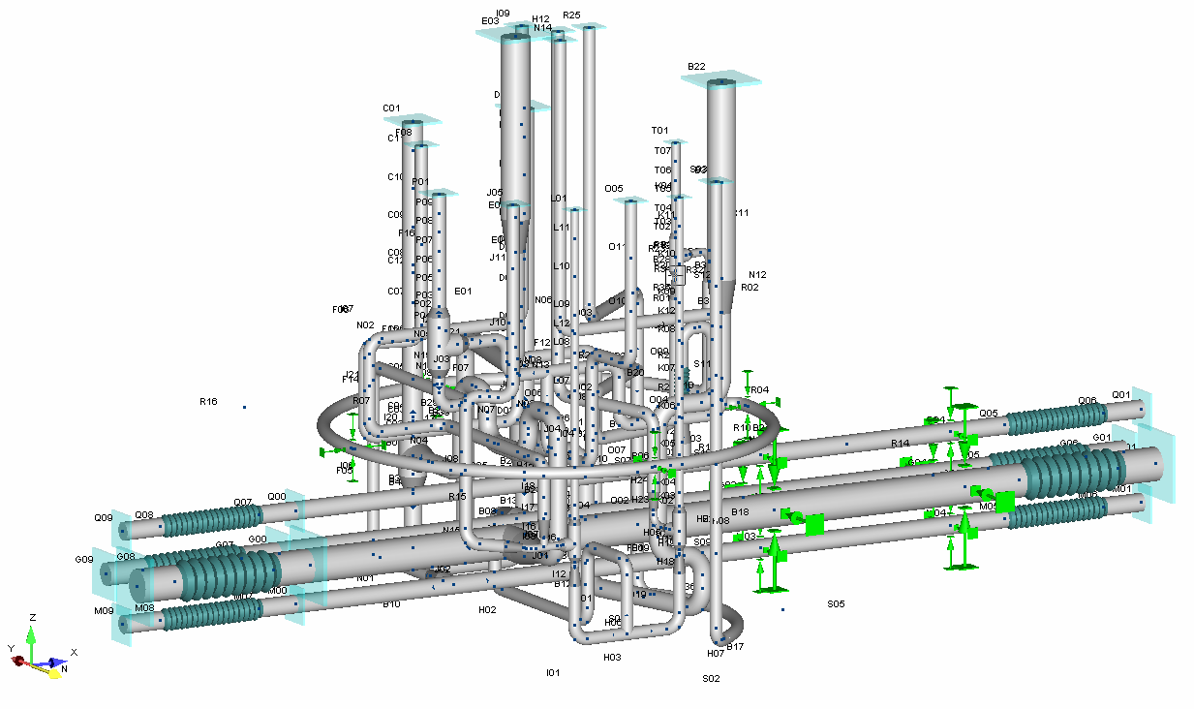
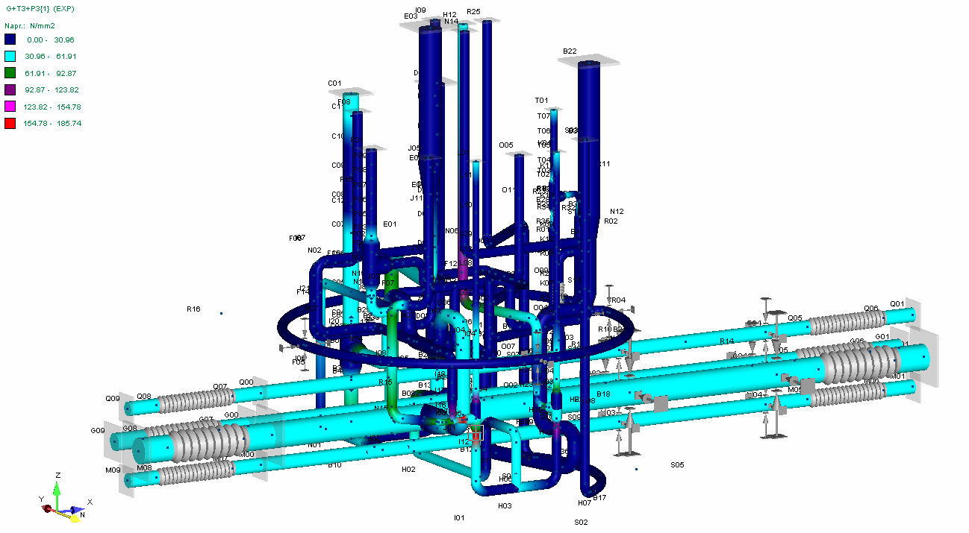
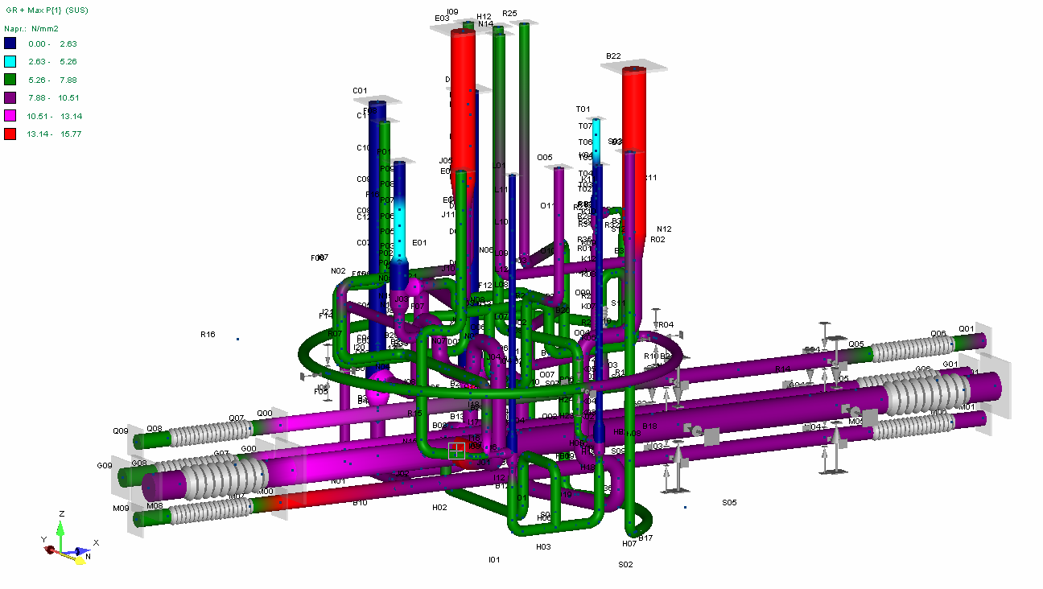
WUST In-Kind scope to Super-FRS
WUST works summary
Works on FB flexible analysis
Model
Expansion loads
Sustained loads
Pressure test

Slide 13
WUST In-Kind scope to Super-FRS
Summary
First elements of the SFRS Local Cryo are conceptually designed
The works on the WUST-BINP interfaces definition are undergoing,
The WUST works are focused on the unification of the SFRS Local Cryo elements design,
First flexible analysis shows that FB internal pipework creates self-compensation structure with small (<2.6 mm) thus acceptable displacement of the cryo valve heads,
The SFRS Local Cryo design, production and installation schedule seems to be tight but possible if SFRS element will be uniform in the design and if the production will be divided between at least 2 manufacturer

