Slide 1
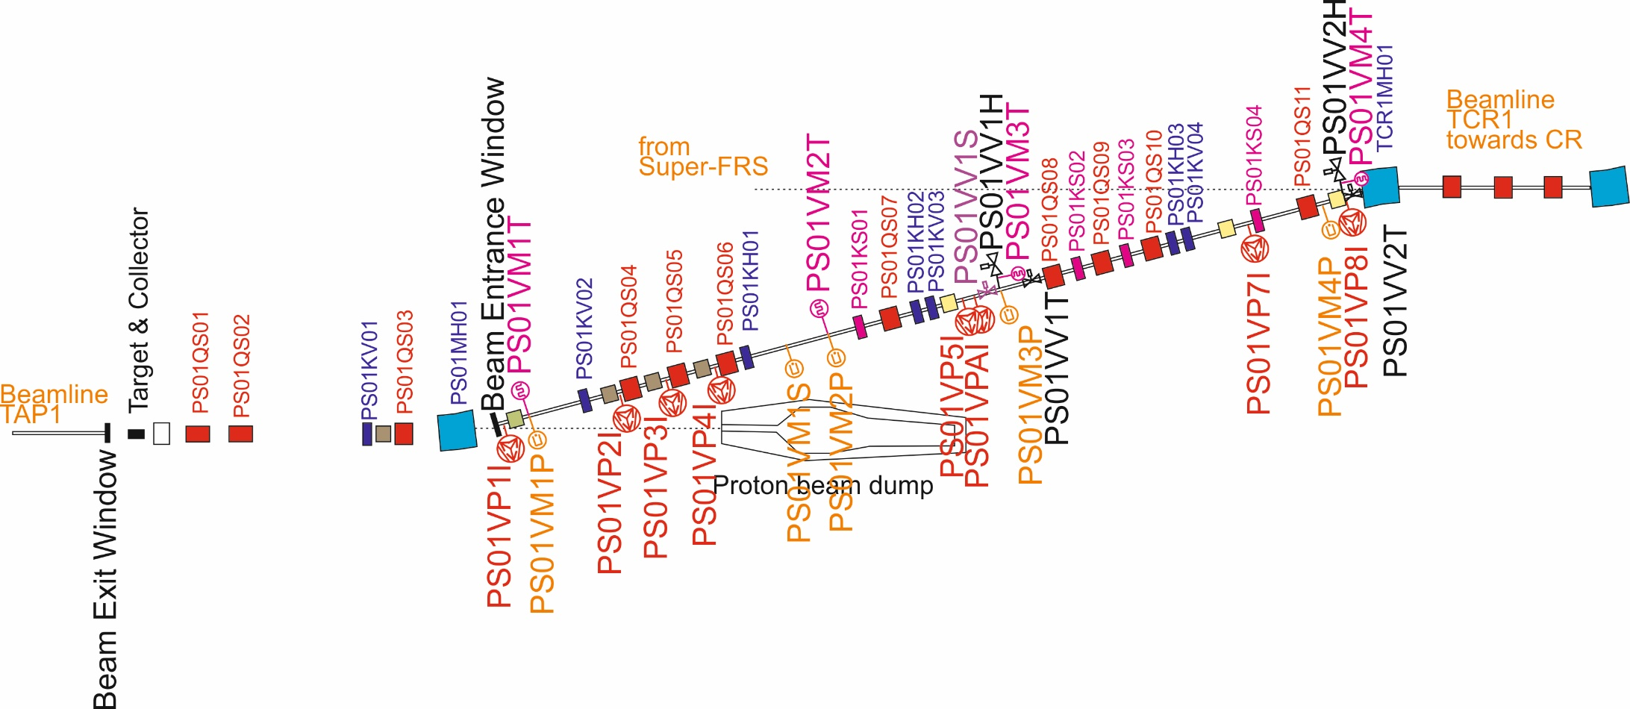
Vacuum System of the pbar-Separator
Pbar-target is in air. Vacuum System ends with an exit window in HEBT and starts with entrance window after first dipole behind target.
Vacuum chambers to be produced by Budker Institute of Nuclear Physics BINP.
Wide quad chambers already contracted.

Slide 2
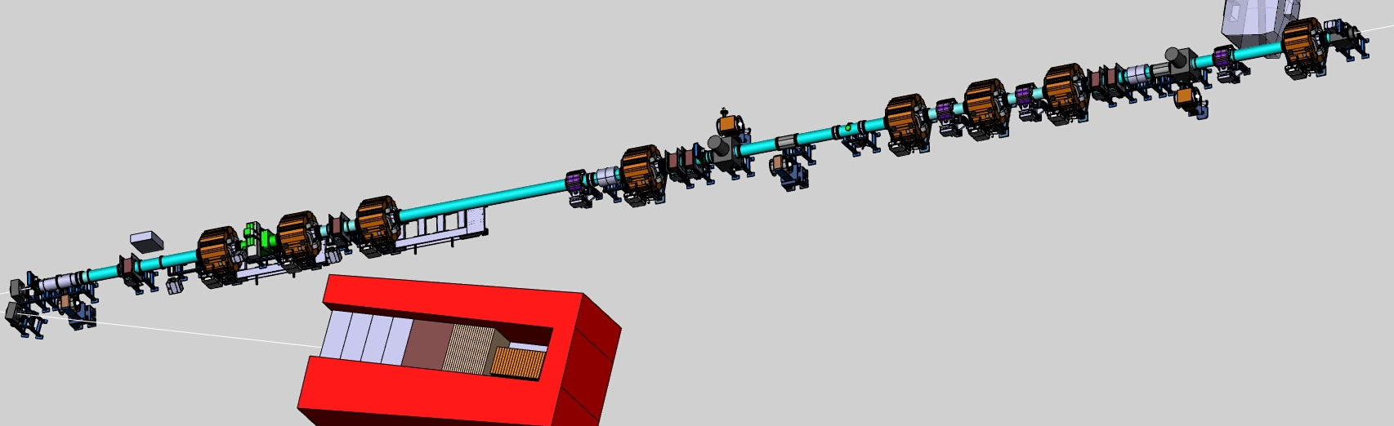
pbar-Separator: Draft 3D Model
Target Station
Beam
Entance
Window
PS01QS04&05&06
PS01MH01
He bag
PS01QS08&09&10
PS01QS04&05&06
PS01VV1T
Momentum Collimator
PS01VV2T
Beam
Entance
Window

Slide 3
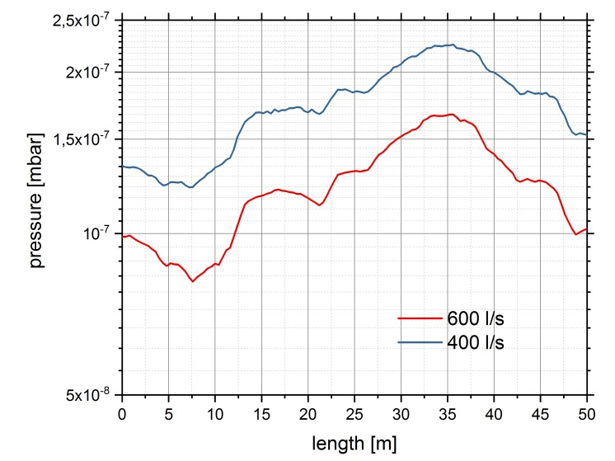
pbar-Separator Pressure Profile Calculations (MOLFLOW+)

Slide 4
Vacuum components pbar Separator
Vacuum system design not yet finalized
Components | Quantity | Remarks
Roughing Stations | 1 | Mobile (TMP&forepump 700l/s&30m3/h)
Ion Getter Pumps | 8 | Pumping Speed 500l/s
Sector Gate Valve | 2 | all-metal, DN400
Angle Valves | 2 | DN160CF for roughing stations
Fast Valves | 1
Cold Cathode Gauges | 4
Pirani Gauges | 4
Fast Valve Sensor | 1
Status Standard Vacuum Components:
Ion Getter Pumps: call for tender under process ongoing, to be signed within this year.
Specifications for gauges, valves and controllers under preparation. Call for tender to be started Q1/2021.

Slide 5
Technical properties of vacuum chambers
Vacuum properties | Non-bakeable
Integral leak rate | ≤ 1x 10⁻¹⁰ $\frac{\text{mbar} \text{l}}{\text{s}}$
Outgassing rate (after 10h of pumping) | ≤ 5x 10⁻¹⁰ $\frac{\text{mbar} \text{l}}{\text{s} \text{cm}\text{2}}$
Residual gas analyse (after 24h of pumping) | All peaks between mass 18 and 45 must be 100 times lower than mass 18, except mass 28 and 44. All peaks higher mass 45 must be 1000 lower than mass 18.
Mechanical requirements:
Check of welding seam according to DIN EN ISO 9712, quality class DIN EN ISO 5817 B
Surface quality R_{z}=25
Magnetic permeability:
Parts of the body of vacuum chamber that are located at a distance less than the magnetic gap from the yoke edge → $μ_{rel}$ ≤ 1.01
Parts of the body of vacuum chamber that are located at a distance greater than the magnetic gap from the yoke edge → $μ_{rel}$ ≤ 1.05
Components of the vacuum chamber such as flanges, bellows, and other fixed elements such as supports, bolts, nuts, washers, etc. → $μ_{rel}$≤ 1.05
Chamber material according DIN EN 10088: 1.4306, 1.4307, 1.4404, 1.4429 or 1.4435
Flange Material according DIN EN10088: 1.4306, 14307 or higher quality

Slide 6
Vacuum Chambers pbar-Separator
Large aperture beam pipe DN400/450,
Mainly round and straight chambers
Vacuum chambers not designed in detail
Chamber Type | Pieces | Shape | Dimensions
Bellows | ~31 | round | L= , d=400mm
Round Chambers | ~18 |  | ~1000< L<6000mm, d=400mm
Pumping/roughing Chamber | ~3
Wide Quadrupole Chamber | 8 | Octagonal (to be discussed) | L=1300mm, 400x180mm2, flange DN400
Vert./Horiz. Collimator Chamber | ~3

Slide 7
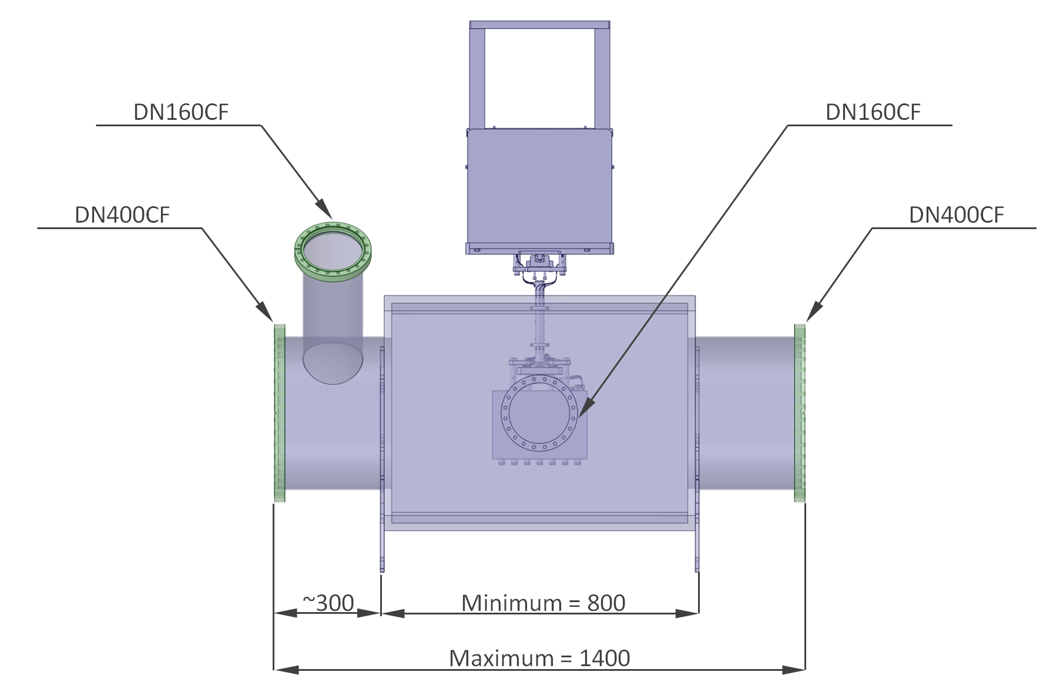
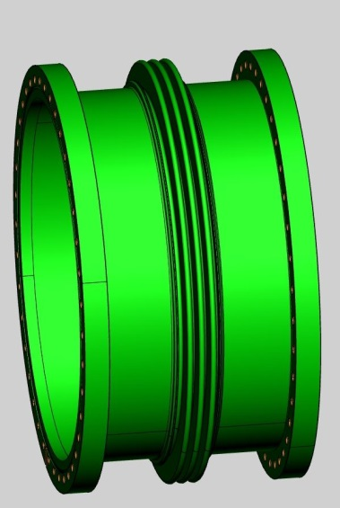
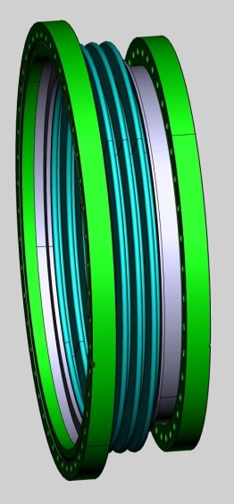
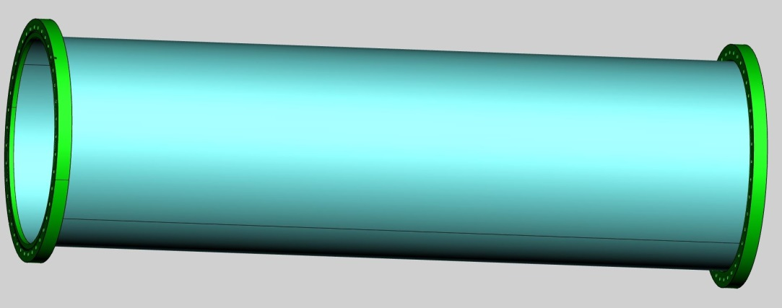
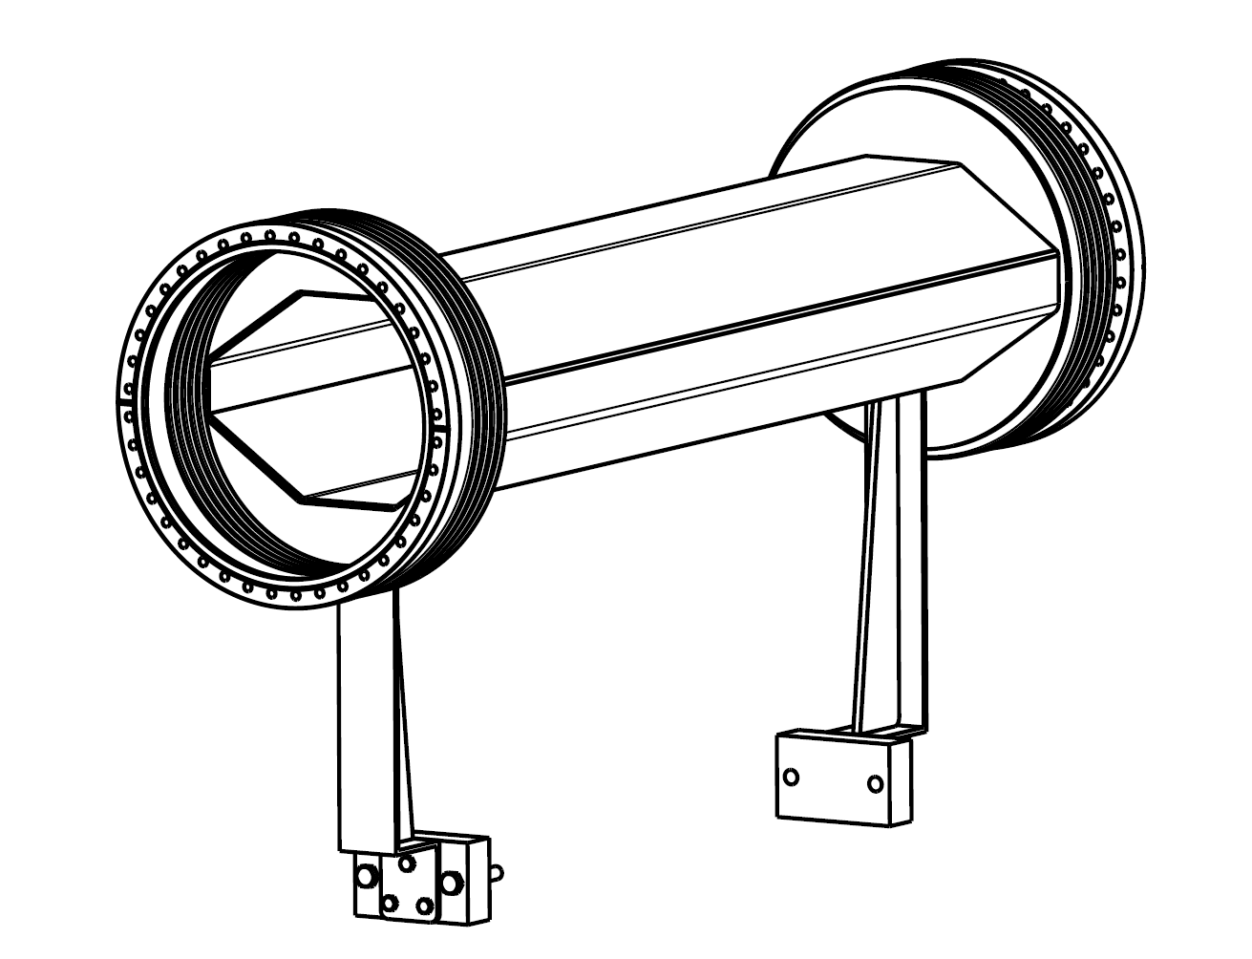
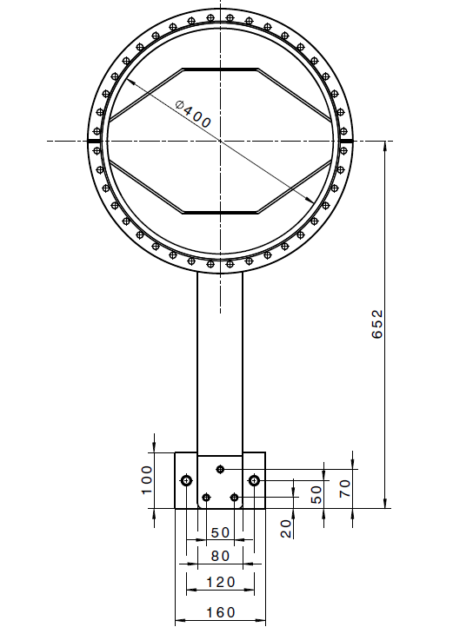
Draft 3D Model of Chambers
Collimator Chamber
Bellows
Wide Quadrupole Chamber
(shape to be discussed again)
Round Chamber

