Slide 1
New CR-Building Plan
Status May 2020
by Thorsten Ziglasch

Slide 2
New CR-Building Plan
Overview of Building
Explanation of Changes
Layout of inner rooms
Errors
New room numbers and database

Slide 3
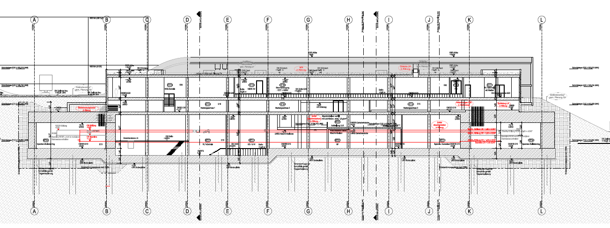
Cut through the CR-building

Slide 4
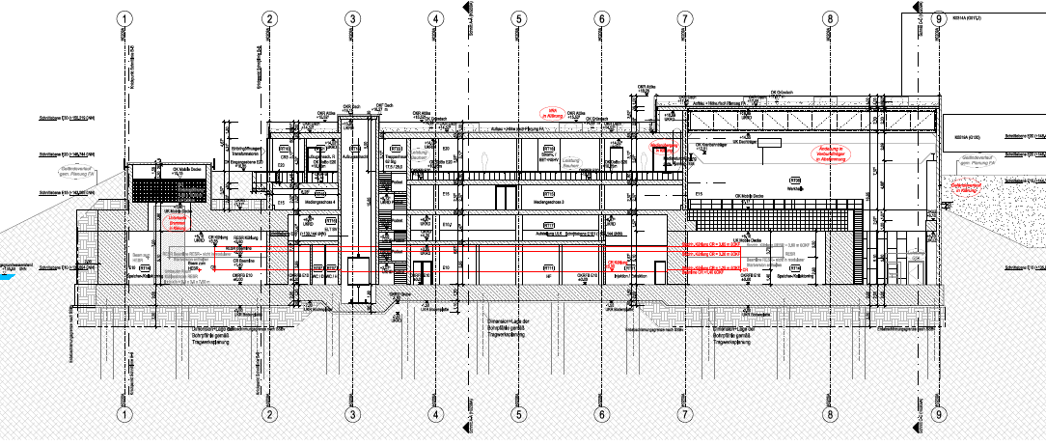
Cut through the building

Slide 5
New CR-Building Plan
New level E.15 only for cable trays, cooling water and cooling air distibution
No component placement in E.15
Level E.15 and E.20 now extend over the tunnel southward
Cables are fed to the tunnel from the top with an exception at the crane opening (injection side)
New layout of the levels E.10 and E.20
Extra shielding against radiation applied

Slide 6
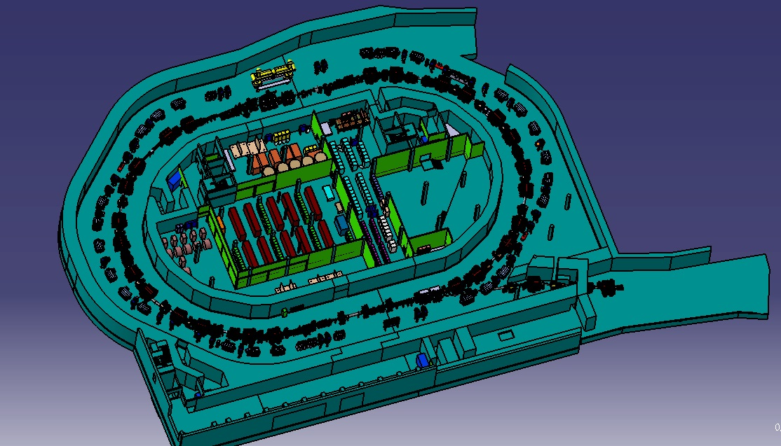
H0209A.E.010
Northern part lowered by 1.3m
Covered BCO-signal pipes
Larger RF-floor
CR-kicker room move to the south (arrangement of kicker control units preliminary)
Heavy concrete wall near injection septum

Slide 7
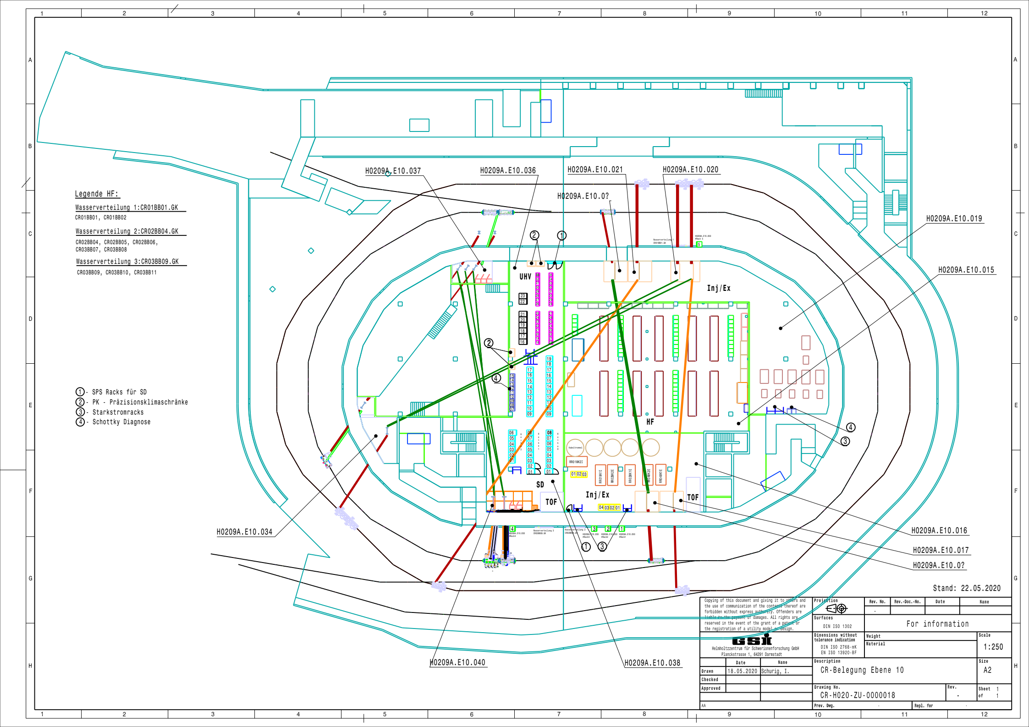
Layout E.010

Slide 8
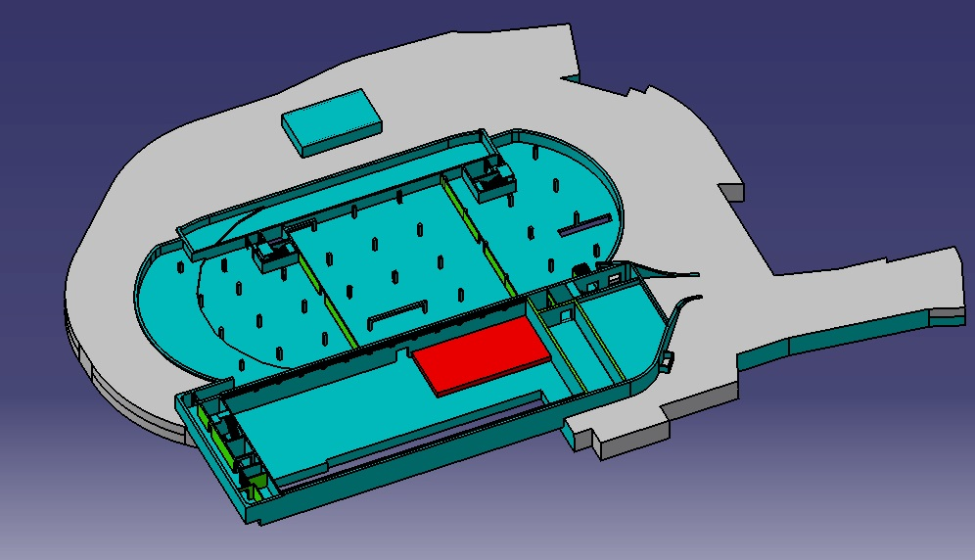
H0209A.E.015
Level E.015 only for cable trays, water- and air-cooling pipes
Concrete slabs added for radiation protection above injection septum
Access for cables to the tunnel to be determined by M&B

Slide 9
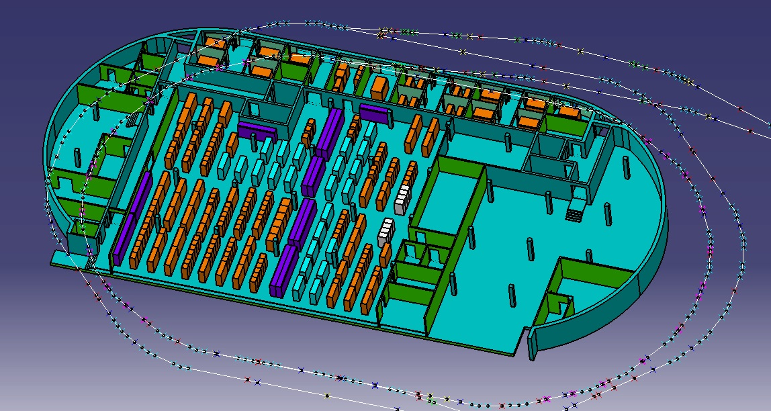
H0209A.E.020
Level E.020 extends 10 southward over tunnel
More room for transformer and dipole power supply
raised floor at level with outside street for easy transport/installation

Slide 10
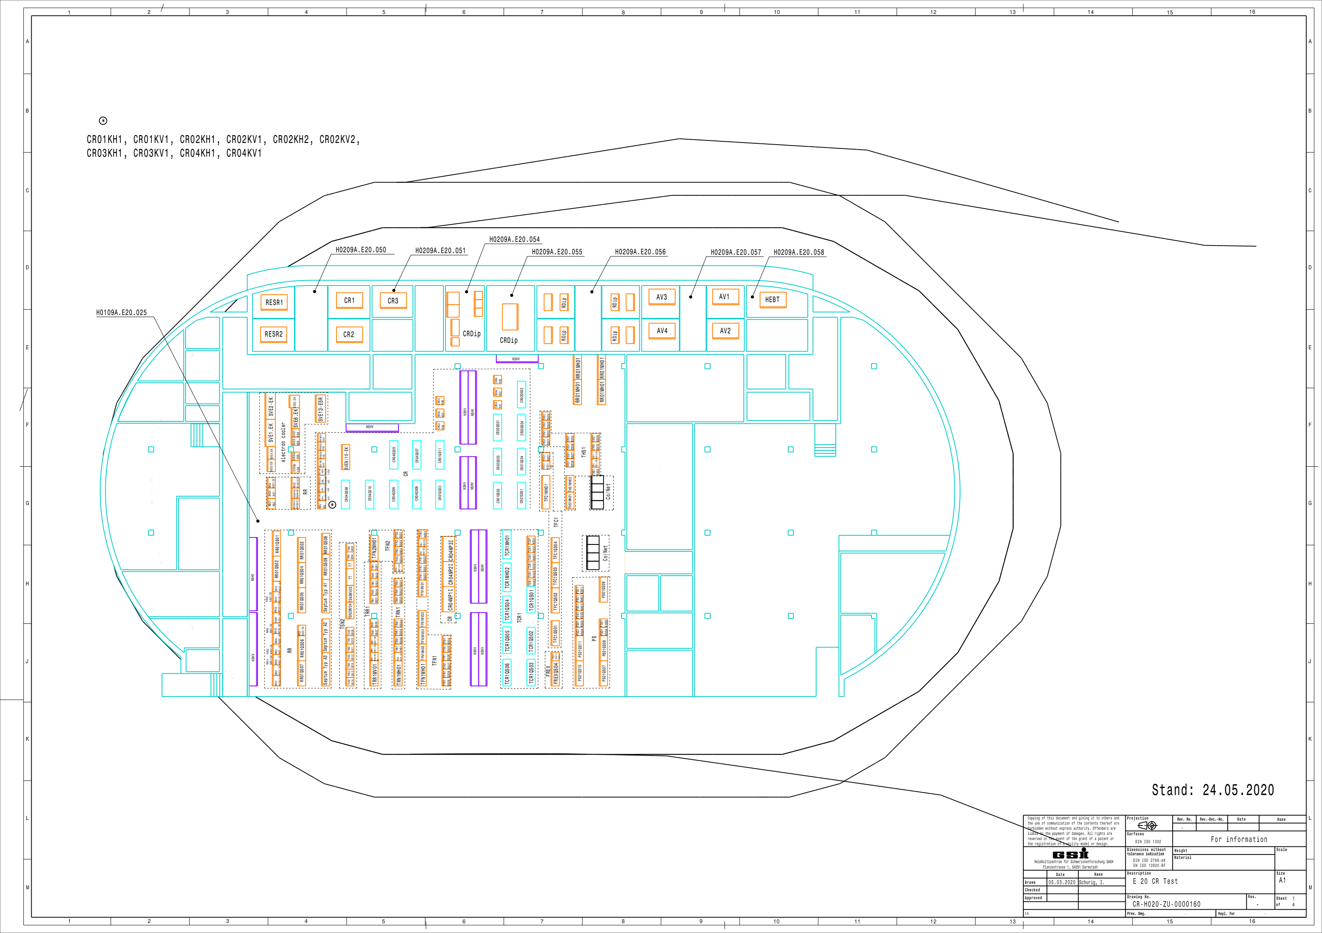
Layout E.020

Slide 11
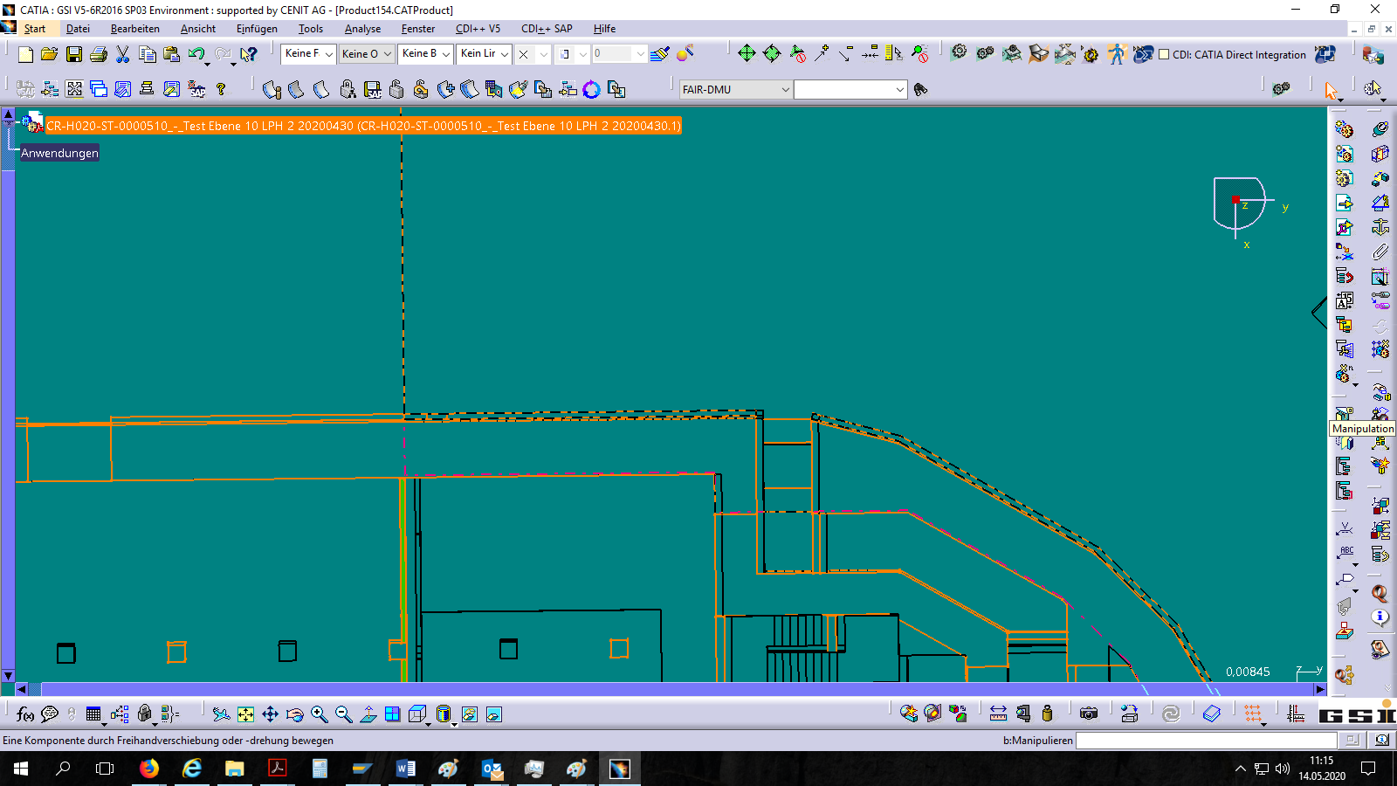
Errors
Critical: Wall moved 25cm southward leading to collision with stochastic cooling platform and its signal pipes
Minor: 3D-model lacks some doors which are shown in the 2D-drawings

Slide 12
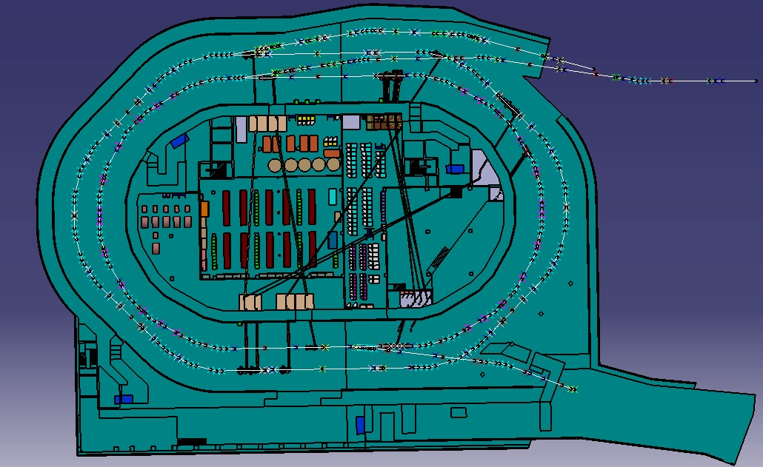
Critical errors

Slide 13
New list of room numbers
A conversion list from the old room numbers to the new room numbers was entered into the cable database and the component database
WPLs should check again if data is correct

Slide 14
New CR-Building Plan
I thank you for your attention
Thorsten Ziglasch
T.Ziglasch@gsi.de

