Slide 1
Status of CR vacuum system
BINP
A.Krasnov, A.Semenov, A. Sukhanov, S.Glukhovchenko, G.Gusev
5th BINP-FAIR Collaboration Coordination Workshop

Slide 2
CR & TCR1
Status of works for CR
 | Q-ty | Types |  | Specification | CDR | FDR | FAT | SAT Ab | October 2020, general info
WP7 | 24 | 2 | CR dipole chambers | done | done | 12/2020 | 03/2021 12/2022 | 10/2021 02/2023 | design, production of prototype
WP7 | 29 | 6 | CR wide quad+sext chambers | done | done | 04/2021 | 11/2021 03/2024 | 01/2022 03/2024 | design, production of prototype
WP7 | 18 | 3 | CR wide straight tubes | done | 02/2021 | 11/2021 | 01/2022 | 02/2022 | design
WP7 | 18 | 18 | CR narrow straight tubes | done | 02/2021 | 12/2021 | 06/2022 | 07/2022 | design, material ordering
WP7 | 6 | 3 | CR adapters | done | 11/2020 | 01/2022 | 09/2022 | 10/2022 | design
WP7 | 12 | 5 | CR bellows assemblies | done | 12/2020 | 02/2022 | 07/2022 | 08/2022 | design, material ordering
WP7 | 2 | 1 | CR roughing chambers | done | 02/2021 | 09/2021 | 05/2022 | 06/2022 | design
WP7 | 53 | 9 | CR supports | done | 06/2021 | 06/2022 | 06/2022 | 07/2022 | design
WP7 | - | - | CR valves | no spec | - | - | ??? | ??? | Purchase by FAIR/GSI ??
WP7 | 75 | 1 | CR NEXTorr pumps | done | - | - | 06/2022?? | 06/2022?? | Purchase by FAIR/GSI is going on
WP7 | 2 | 1 | Roughing stations | no spec | - | - | ??? | ??? | Purchase by FAIR/GSI ??
WP7 | - | - | Nuts, bolts, gaskets | done | - | - | ??? | ???

Slide 3
CR & TCR1
Status of works for TCR1
WP7 | 2 | 2 | TCR1 dipole chambers | no spec | ??? | ??? | ??? | ???
WP7 | - | - | TCR1 quad & sext chambers | no spec | ??? | ??? | ??? | ???
WP7 | - | - | TCR1 straight chambers | no spec | ??? | ??? | ??? | ???
WP7 | - | - | TCR1 bellows assemblies | no spec | ??? | ??? | ??? | ???
WP7 | - | - | TCR1 adapters | no spec | ??? | ??? | ??? | ???
WP7 | 21 | 6 | TCR1 supports | done | 06/2021 | 06/2022 | 06/2022 | 07/2022
WP7 | 1 | 1 | TCR1 roughing chambers | done | 02/2021 | 09/2021 | 05/2022 | 06/2022
WP7 | - | - | TCR1 valves | no spec | - | - | - | -
WP7 | 7 | 1 | TCR1 ion pumps | no spec | - | - | - | -
WP7 | 1 | 1 | Roughing stations | no spec | - | - | - | -
WP7 | - | - | Nuts, bolts, gaskets | done | - | - | ??? | ???
Design
Design
Design
Design
Design
To be discussed. How to proceed as fast as possible

Slide 4
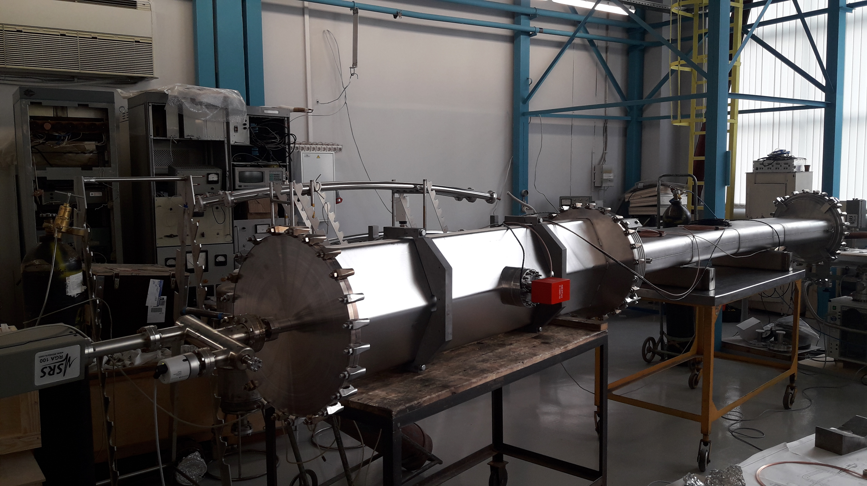
Mock-up installation
2 pumps for dipole + quadruple chambers – average pumping ‘density’ per meter in CR
Pressure level 2.3E-9 mbar after 1 month pumping and 3 getter activation
Both type of HTMS sealing rings are working well. But SnBi is better because it needs less number of clamps – 24 (we will use 36 to be in safe side).

Slide 5
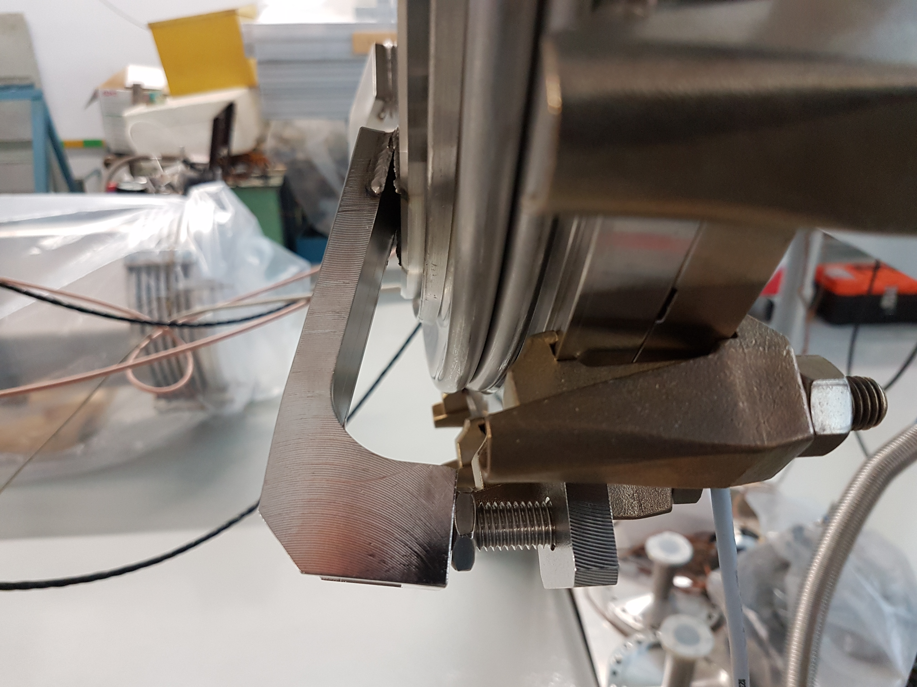
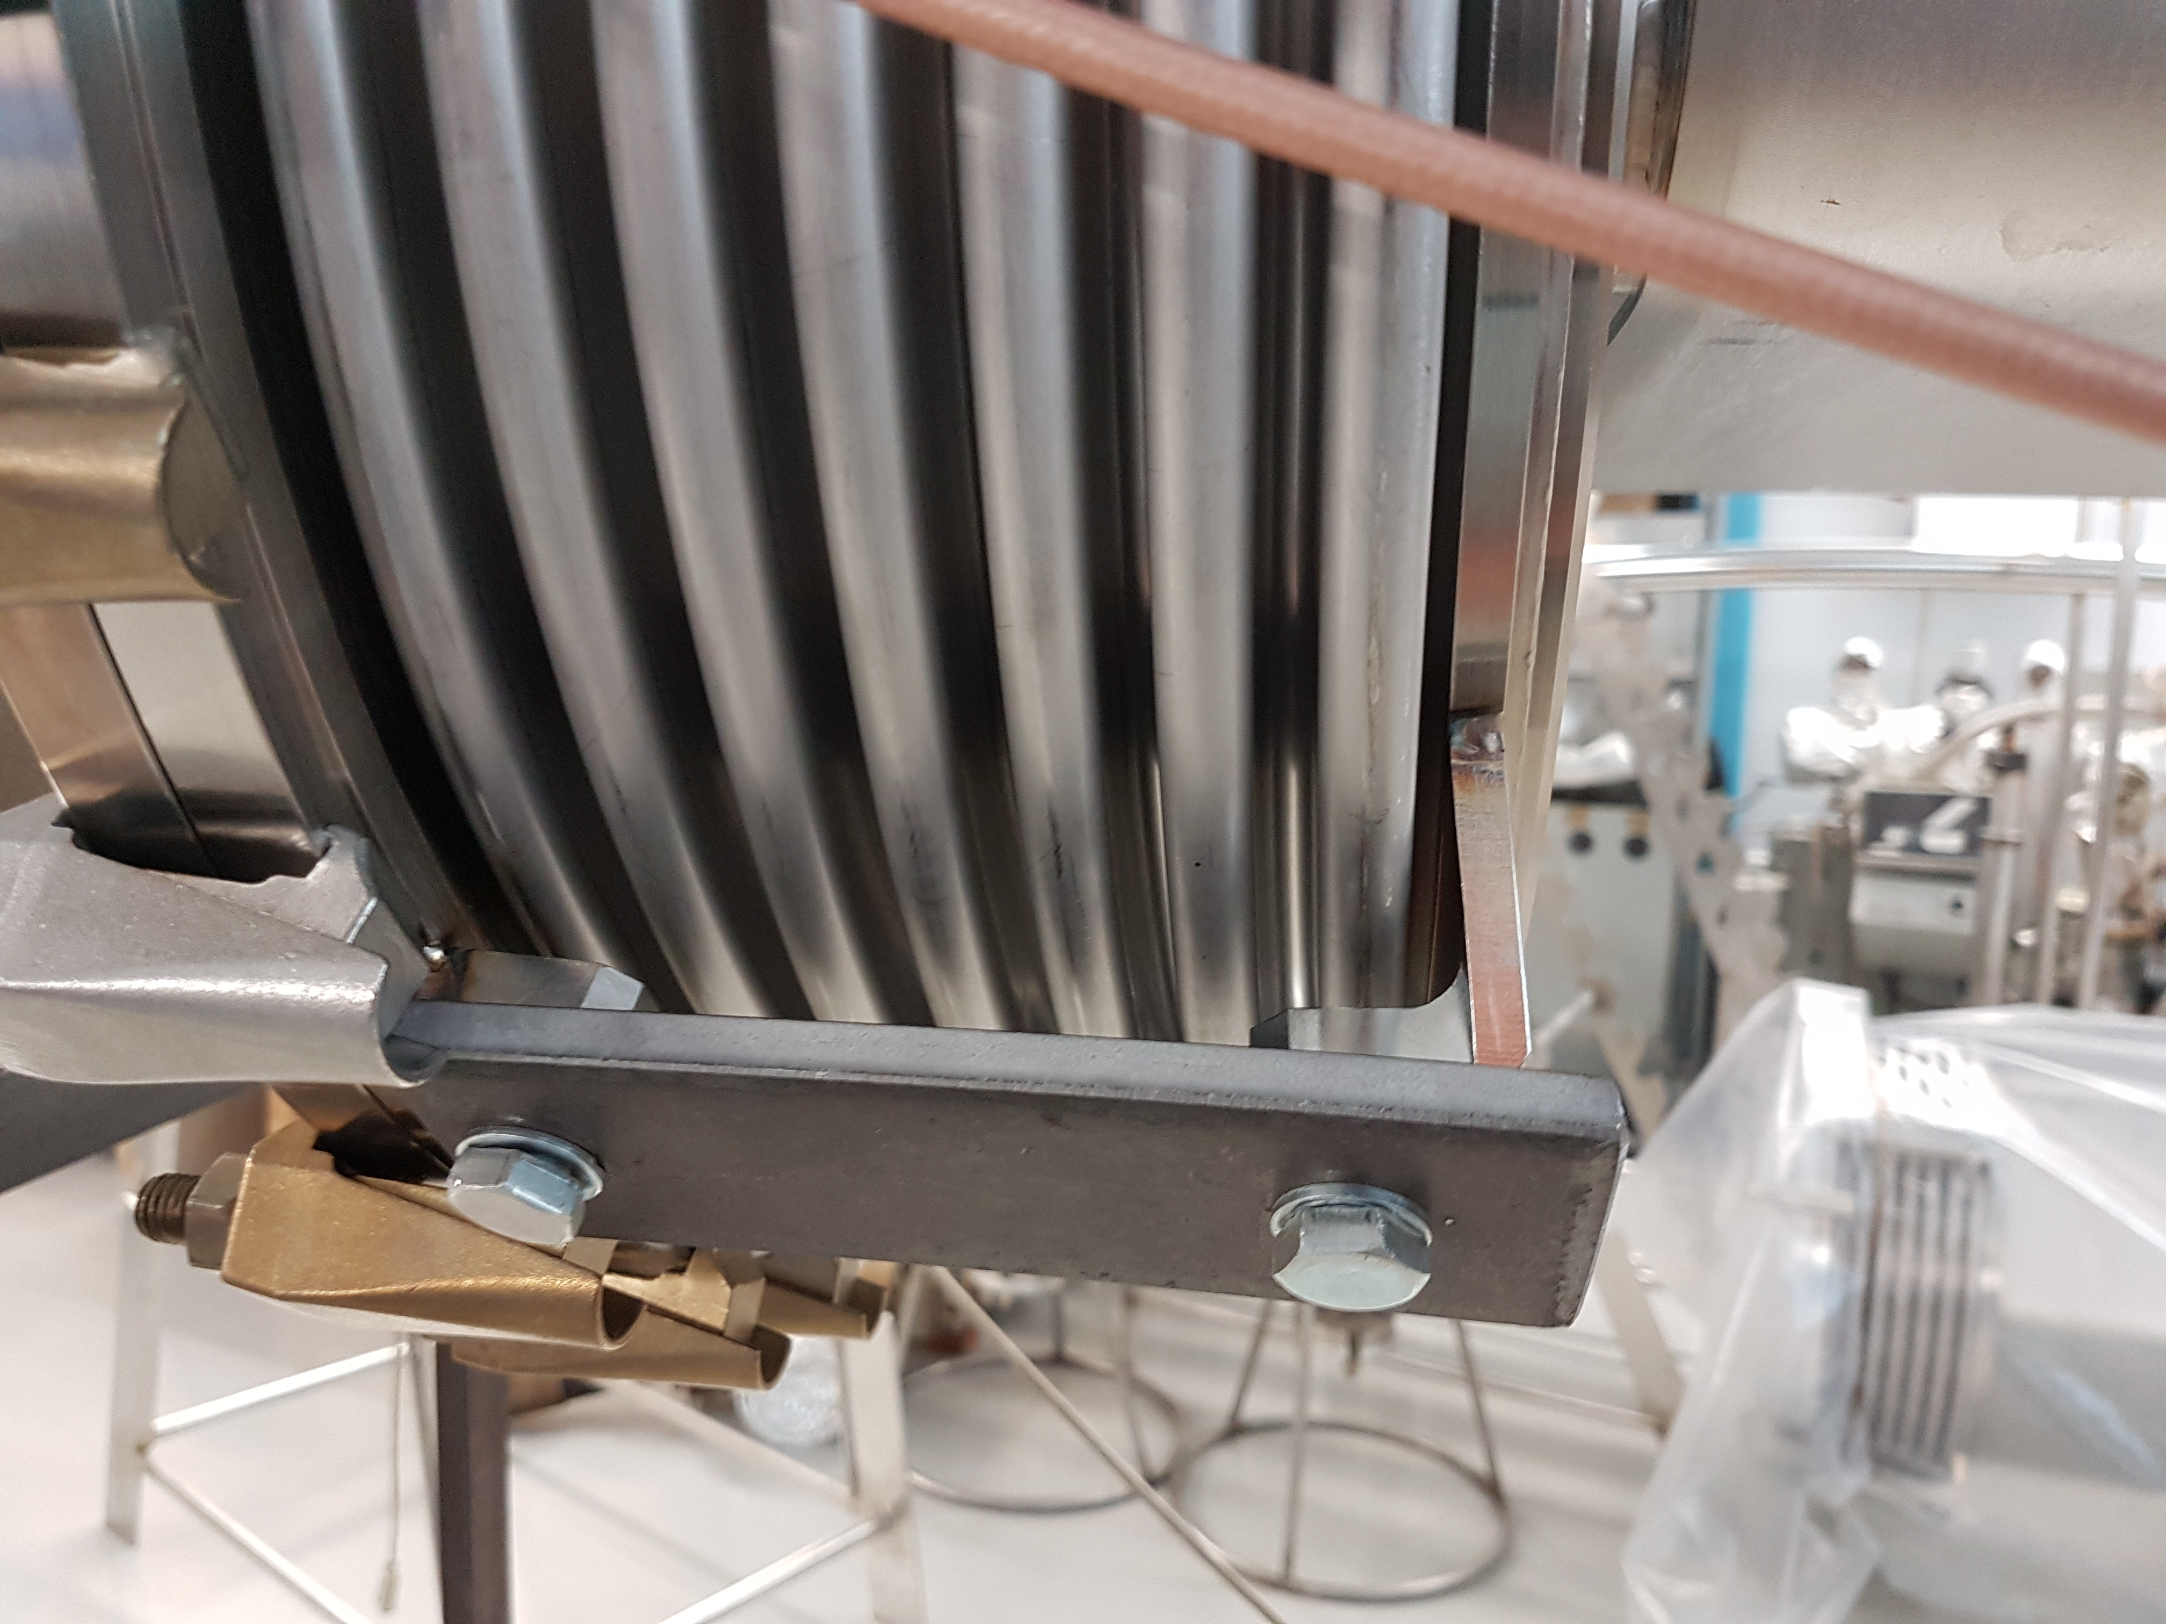
Mock-up installation
Problems
Supports of the bellows were deformed. The chamber for ceramic tubes installation will be send after solving the problem.

Slide 6
CR & TCR1
Needed info to complete design of CR vacuum
CR/TCR1
GSI is responsible:
gauges: Flange (DN 40 or DN63), DMU model?
RGA: Flange (DN 40 or DN63), DMU model?
BINP is responsible but purchase by FAIR:
Angle valves: DMU model, pneumatic or manual? BINP suggests the manual angle valve.
Gate valve: DMU model, interface, cables and connectors? Functional specification is uploaded long time ago but not released (?).
Most important:
Ion pumps: flange (DN 100, DN150 or other), DMU model, interface, cables & connectors. Functional specification with minimum required parameters is uploaded into EDMS

Slide 7
CR & TCR1
Materials purchase
Tubes: CR – 100% delivered. TCR – 0%
Bellows: CR and TCR1 – DN175 & DN200 -100% delivered, DN450 – 15% delivered
All CF flanges are ordered
Stainless steel with low magnetic susceptibility – under purchasing

Slide 8
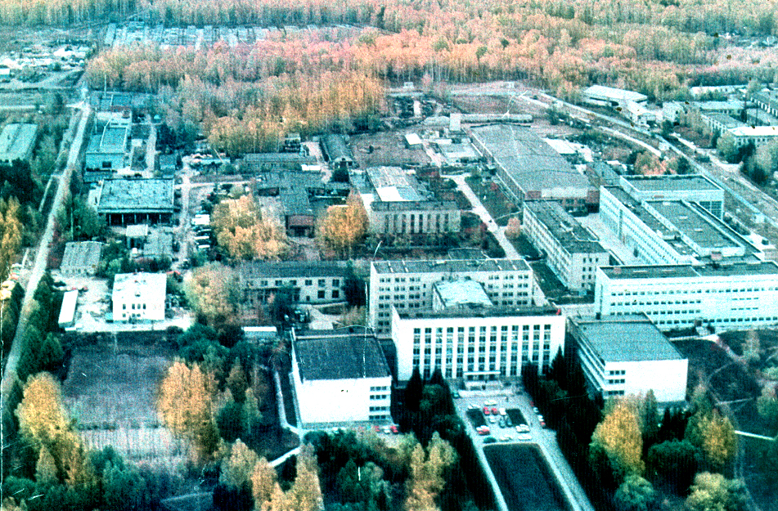
Thank you for your attention

