Slide 1

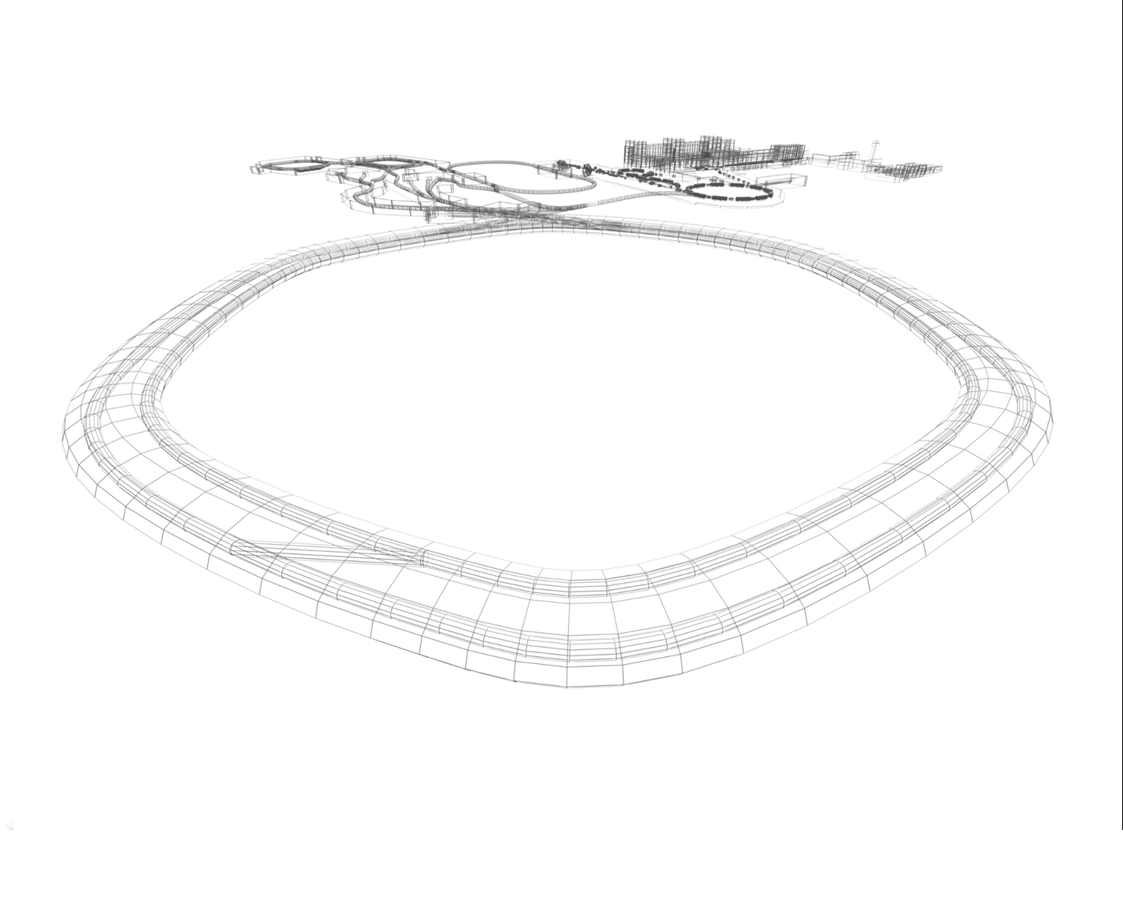
CR Power Converters
5th Joint BINP-FAIR CC Workshop
09.11 - 12.11.2020
Status

Slide 2
CR+TCR1 Power Converters
5th Joint BINP-FAIR CC Workshop
09.11 - 12.11.2020
CR DPC type
CR QPC Type
CR SPC Type
CR OPC Type
CR CPC Type
1 CR Dipole magnets Power
Converter
15 CR Quad magnets Power
Converters
6 CR Sext magnets Power
Converters
12 CR Octupol magnets Power
Converters
48 CR Steer. magnets Power
Converters
2 TCR1 Dipole magnets Power
Converters
2 TCR1 Sext magnets Power
Converters
7 TCR1 Steer. magnets Power
Converters
6 TCR1 Quad magnets Power
Converters
1 PC
23 PCs
8 PCs
12 PCs
55 PCs

Slide 3
CR magnets types
5th Joint BINP-FAIR CC Workshop
09.11 - 12.11.2020
TYPE | SUB | Qty | Imax A | Lm mHn | Rm mOm | Vm V | Deviat
DIPOLES | - | 24 | 1450 | 377 | 62.45 | 91 | 10ppm
QUADRUPOLES | EWQ | 3 | 1500 | 49.8 | 26.31 | 38 | 100ppm
 | WQ | 14 | 1500 | 59 | 26.31 | 38 | 100ppm
 | SWQ | 12 | 1500 | 44 | 21.67 | 31 | 100ppm
 | NQ | 11 | 1450 | 11 | 10.1 | 15 | 100ppm
SEXTUPOLES | - | 24 | 500 | 6 | 35 | 18 | 0.1%
OCTUPOLES | - | 12 | 30 | 86 | 2450 | 74 | 1%
CORRECTORS | H | 24 | 6 | 182 | 9560 | 58 | 1%
 | V | 16 | 14 | 158 | 4200 | 59 | 1%
 | H/V | 8 | 20 | 90 | 760 | 16 | 1%

Slide 4
5th Joint BINP-FAIR CC Workshop
09.11 - 12.11.2020
CR MAGNETS POWER CONVERTERS PARAMETERS
PARAMETER | DPC | QPCTYPE1 | QPCTYPE2 | QPCTYPE3 | SPC | OPC | CPC
MAINS | AC 20kV 50Hz T | AC 400 V 50Hz TN-S
IOUT MAX | 1450 A | 1500 A |  |  | 500 A | 30A | 6/14/20 A
VOUTMAX | 2750 | 200 V | 100 V | 50 V | 100 V | 90V | 75/75/40 V
ΔIOUT/IOUT | 10ppm | 100ppm |  |  | 0.1% | 1% | 1%
LONG TERM STABILITY | 10ppm | 100ppm |  |  | 0.1% | 1% | 1%
CONTROL | GSI CONTROL UNIT
DCCT | GSI CONTROL UNIT |  |  |  | Built In | Built In
MAX POWER | 4MW | 300kW | 150kW | 75kW | 50kW | 2.7kW | < 1kW

Slide 5
DIP MAGNETS POWER CONVERTER DIAGRAM
5th Joint BINP-FAIR CC Workshop
09.11 - 12.11.2020
1.5kA 2750V
20kVAC
MAINS
5.2 MVA
Step-Down
TRANSFORMER
+ POLARITY
12 pulse SCR RECTIFIER
POLARITY
12 pulse SCR
RECTIFIER
OUTPUT
FILTER
DCCT
DIP
MAGNETS
1.5kA

Slide 6
DIP MAGNETS POWER CONVERTER DIAGRAM
5th Joint BINP-FAIR CC Workshop
09.11 - 12.11.2020
1.5kA 2750V
FAIR
CKD
FAIR/
BINP
20kVAC
MAINS
5.2 MVA
Step-Down
TRANSFORMER
+ POLARITY
12 pulse SCR RECTIFIER
POLARITY
12 pulse SCR
RECTIFIER
OUTPUT
FILTER
DCCT
DIP
MAGNETS
1.5kA

Slide 7
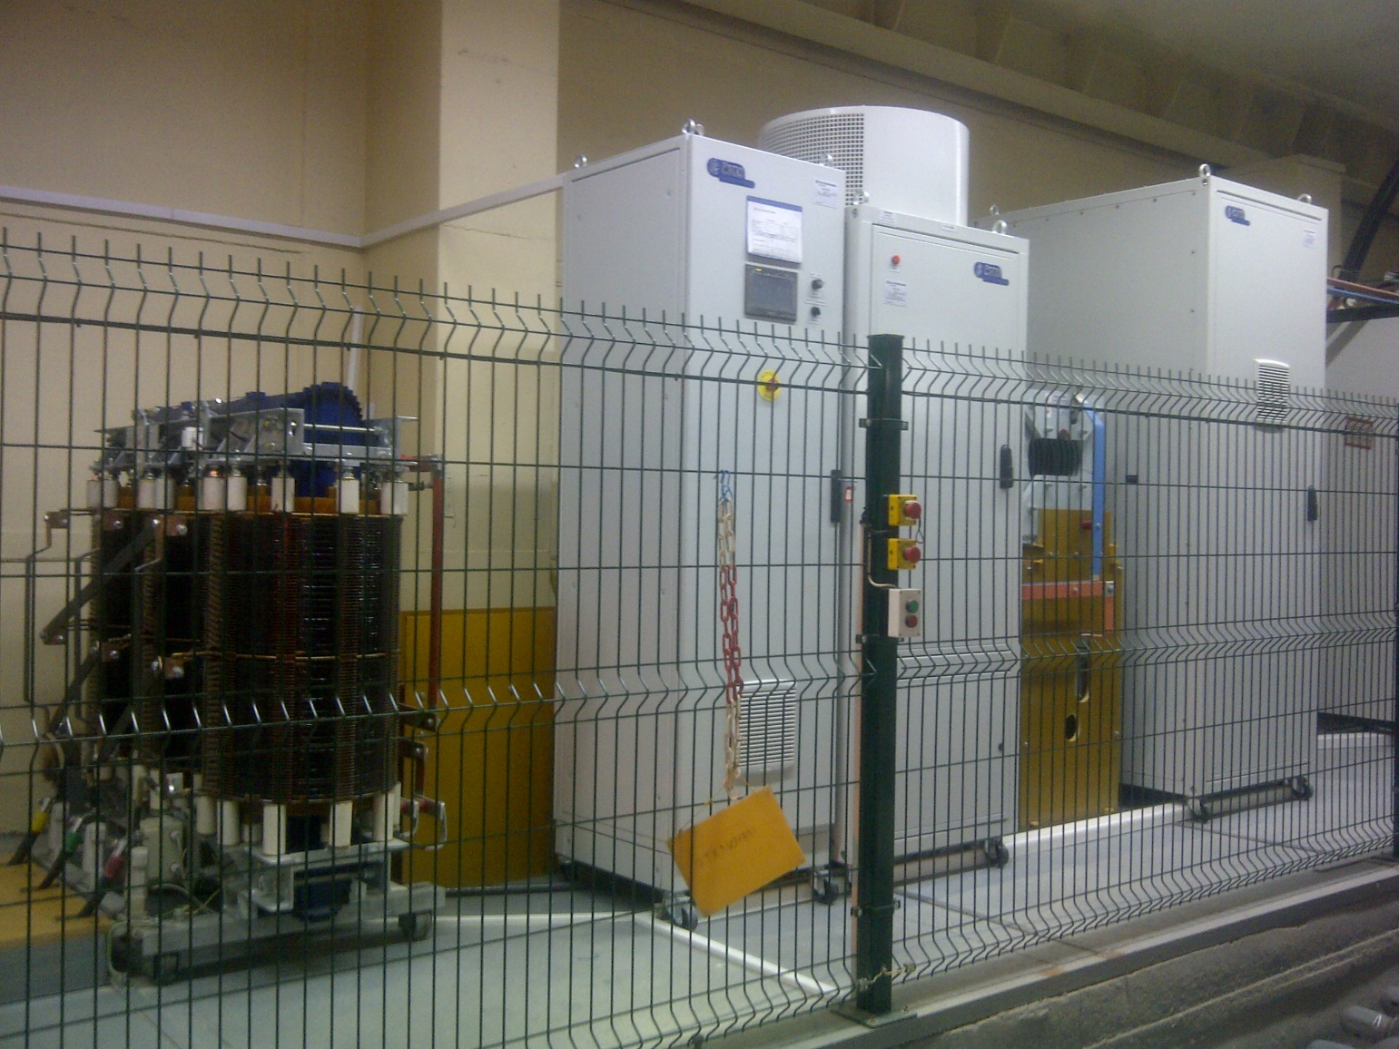
3MVA (1kA 3kV) ČKD DC SOURCE (BINP PLASMA)
5th Joint BINP-FAIR CC Workshop
09.11 - 12.11.2020

Slide 8
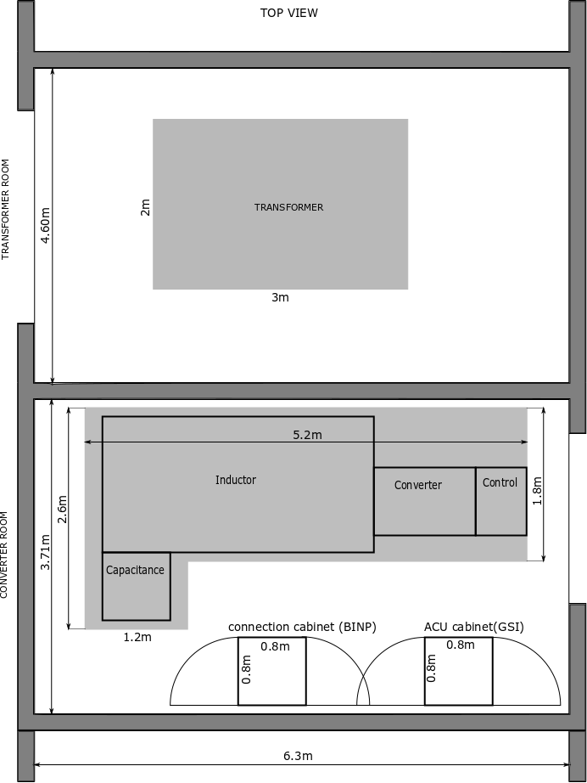
5th Joint BINP-FAIR CC Workshop
09.11 - 12.11.2020
POWER CONVERTERS LOCATION

Slide 9
DPC Current status
5th Joint BINP-FAIR CC Workshop
09.11 - 12.11.2020
Concept
Discussed and agreed
Specifications
Released
Tender process for DPC Power source (CKD) awaiting
CDR
preparing

Slide 10
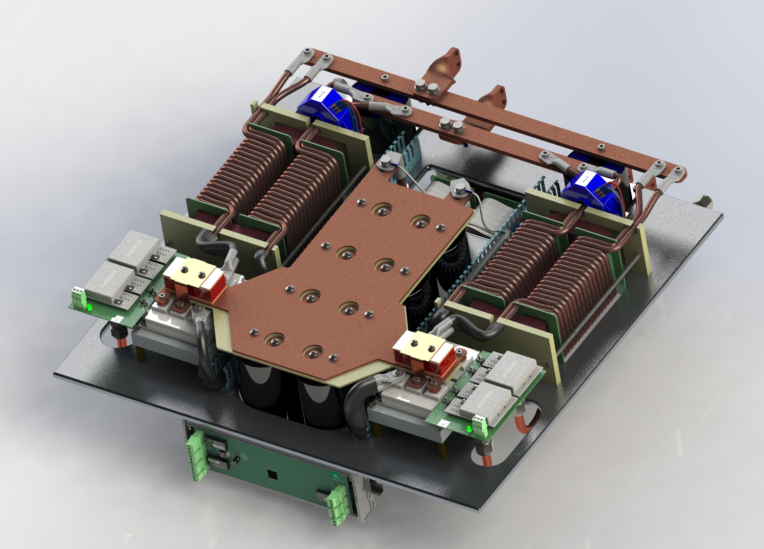
QUAD MAGNETS POWER CONVERTER DIAGRAM
5th Joint BINP-FAIR CC Workshop
09.11 - 12.11.2020
TYPE1
TYPE2
TYPE3
1.5kA 200V
1.5kA 100V
1.5kA 50V
IGBT
H-BRIDGE
1.5kA 600V
20kHz
OUTPUT
FILTER
400VAC
MAINS
Step-Down
TRANSFORMER
RECTIFIER
IGBT
H-BRIDGE
1.5kA 600V
20kHz
OUTPUT
FILTER
IGBT
H-BRIDGE
6x250A 600V
20kHz
OUTPUT
FILTER
DCCT
QUAD
MAGNETS
1.5kA

Slide 11
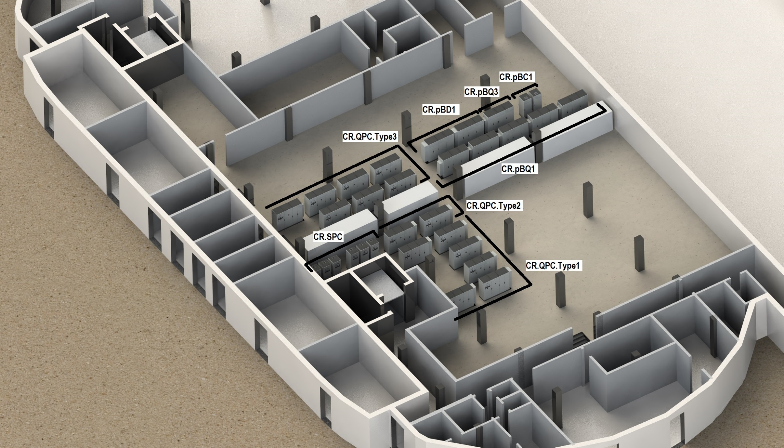
5th Joint BINP-FAIR CC Workshop
09.11 - 12.11.2020
POWER CONVERTERS LOCATION

Slide 12
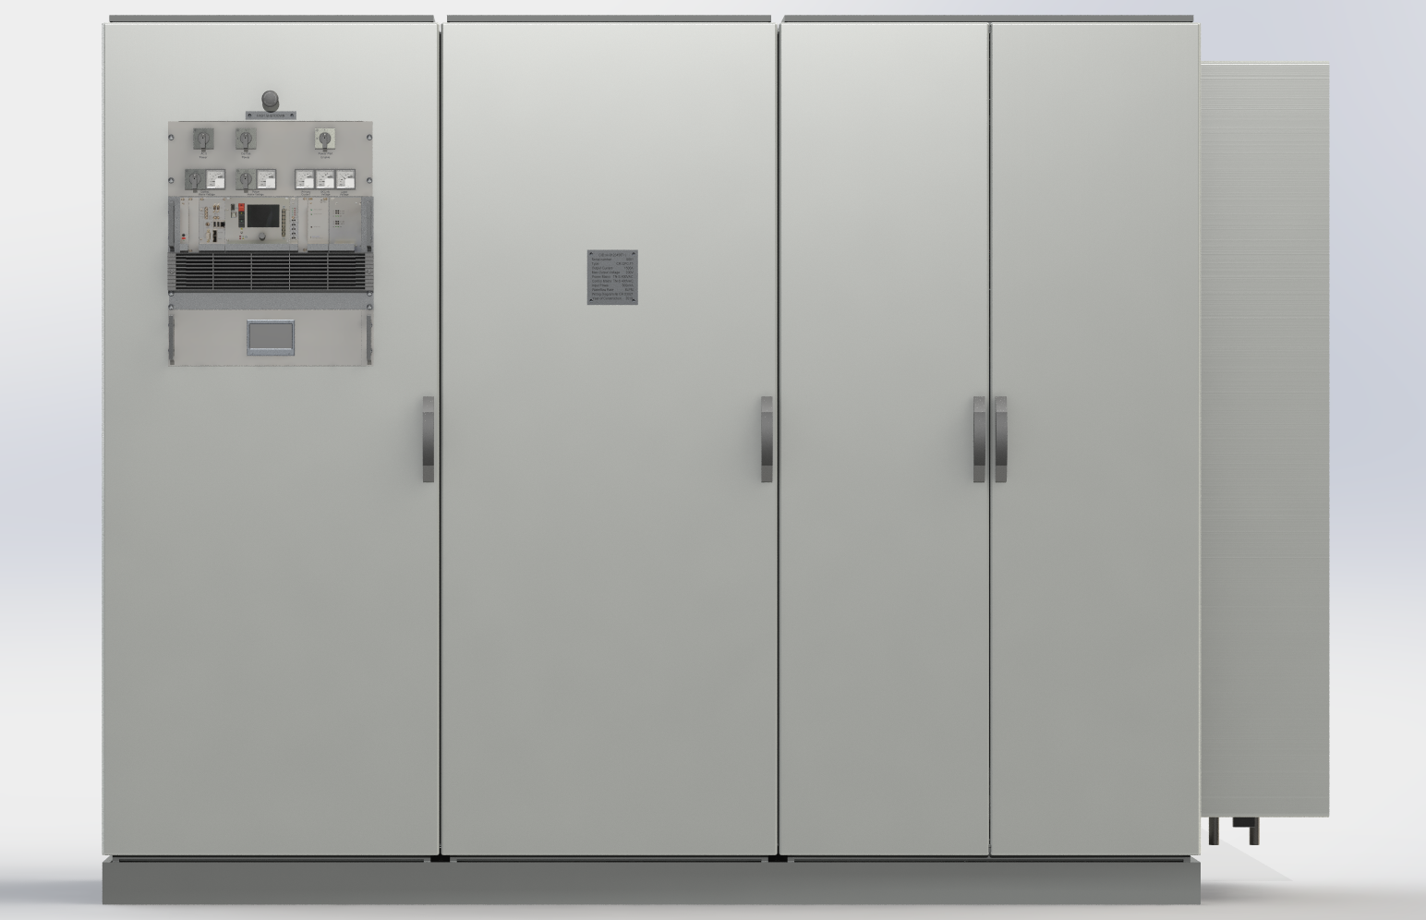
QUAD POWER APPEARANCE (300kW)
5th Joint BINP-FAIR CC Workshop
09.11 - 12.11.2020

Slide 13
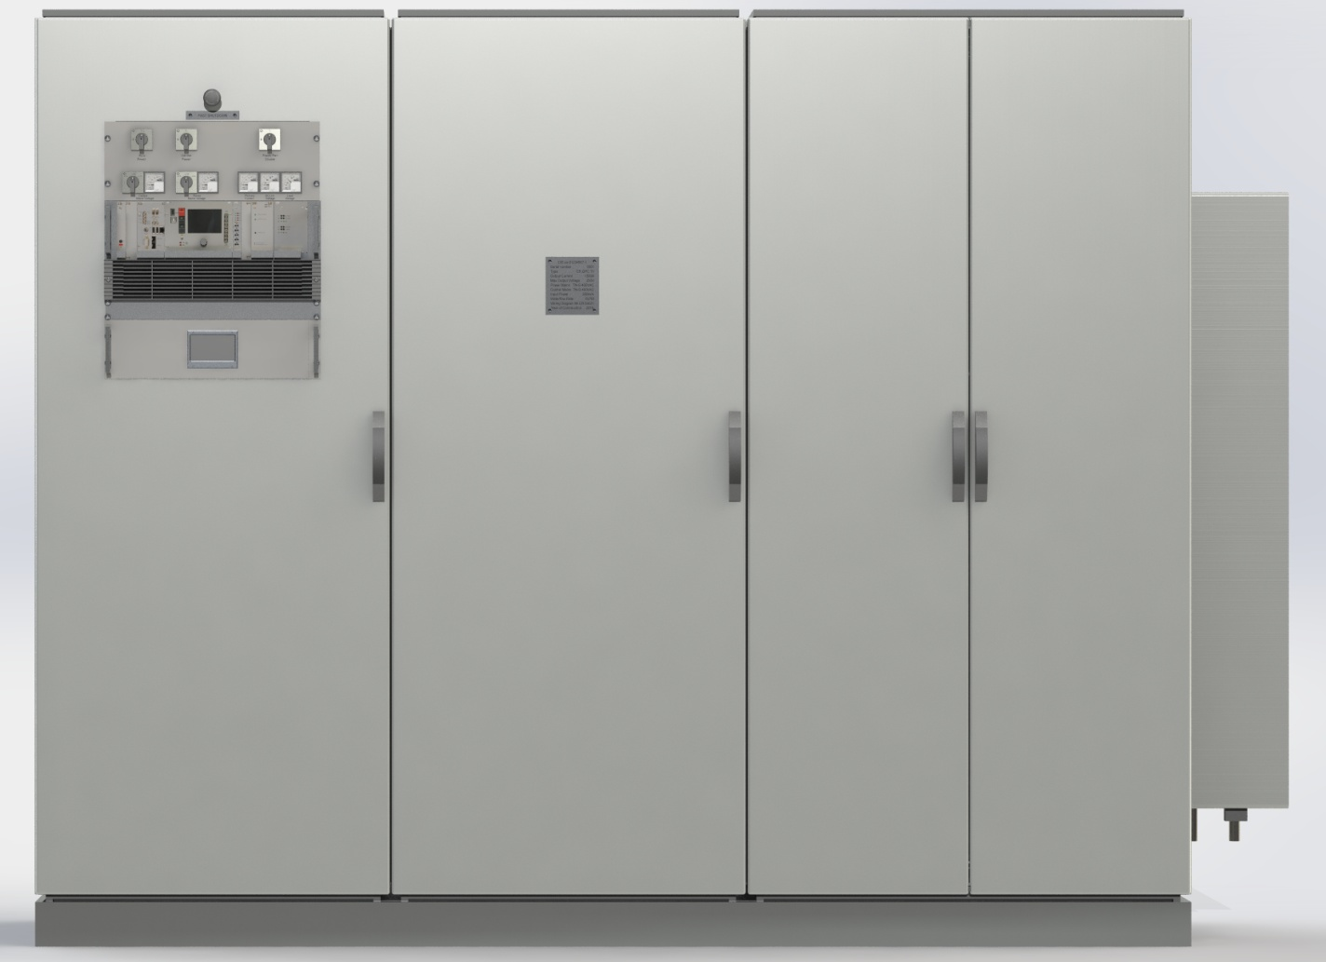
QUAD POWER APPEARANCE (150, 75 kW)
5th Joint BINP-FAIR CC Workshop
09.11 - 12.11.2020

Slide 14
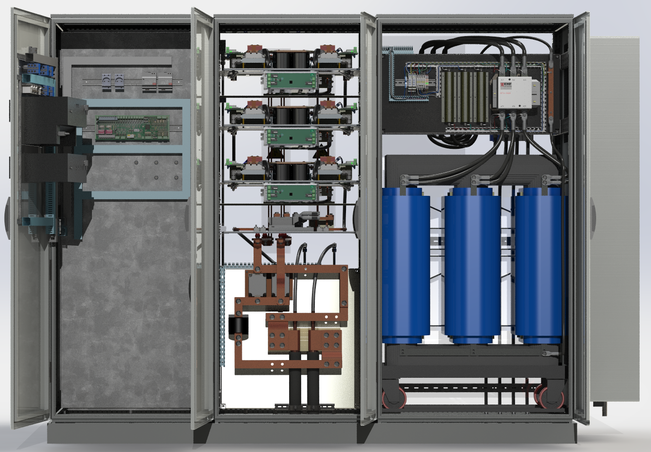
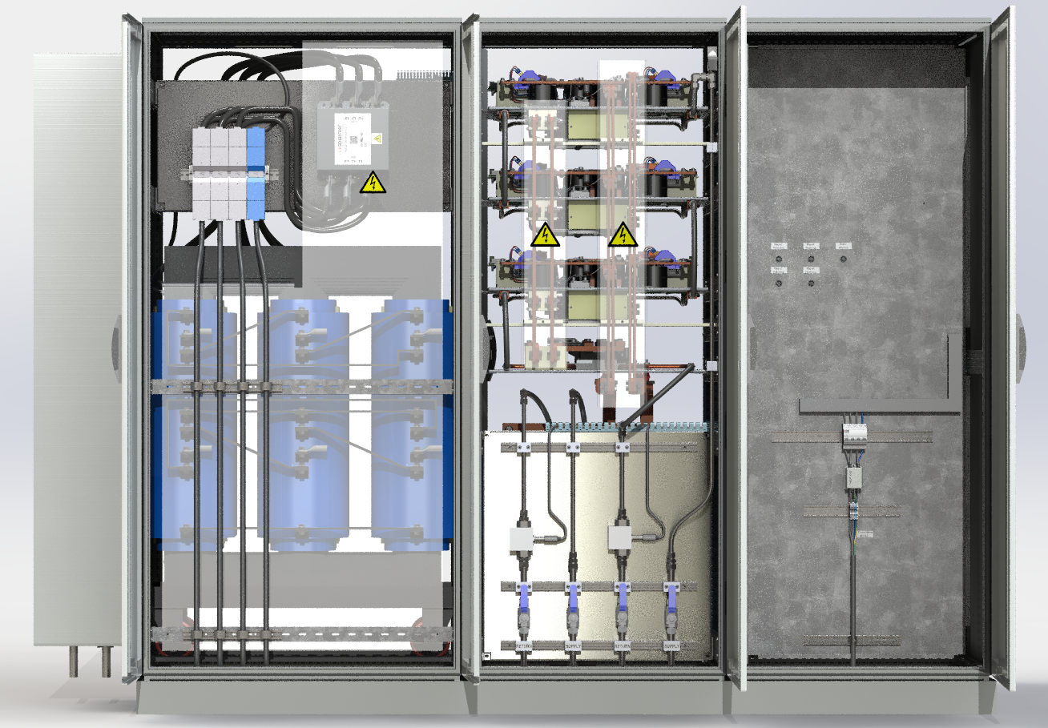
5th Joint BINP-FAIR CC Workshop
09.11 - 12.11.2020
POWER CONVERTERS CONNECTIONS
Connection to electrical power : TN-S
Connection to load: watercooled cables
Open doors Front view:
Open doors Rear view:

Slide 15
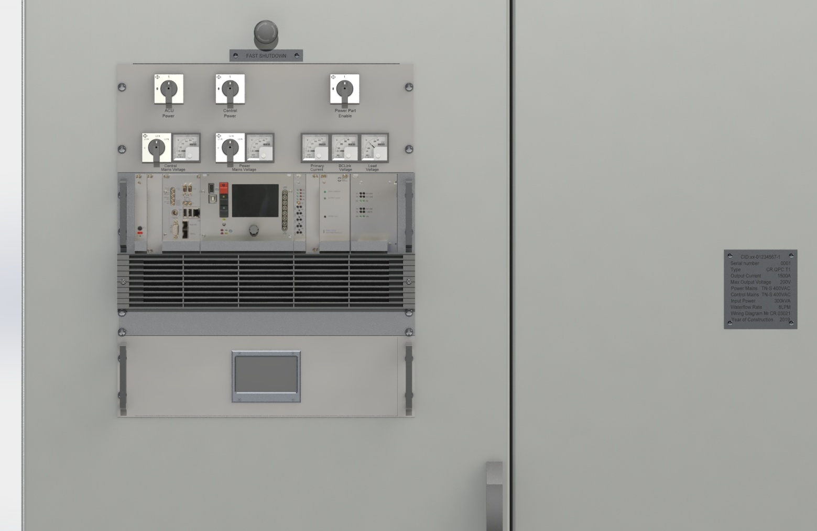
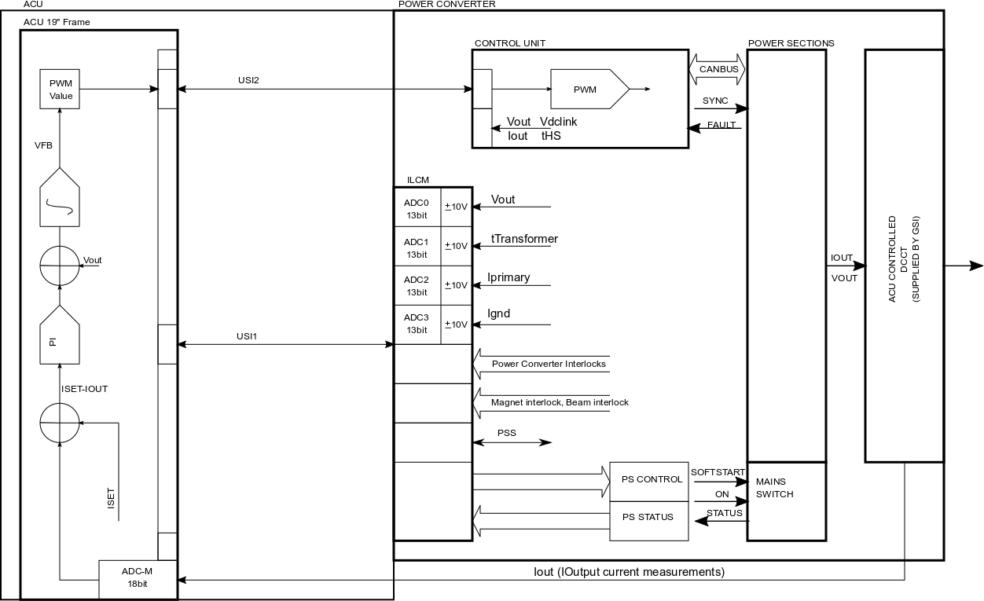
QUAD POWER CONVERTER CONTROL
5th Joint BINP-FAIR CC Workshop
09.11 - 12.11.2020

Slide 16
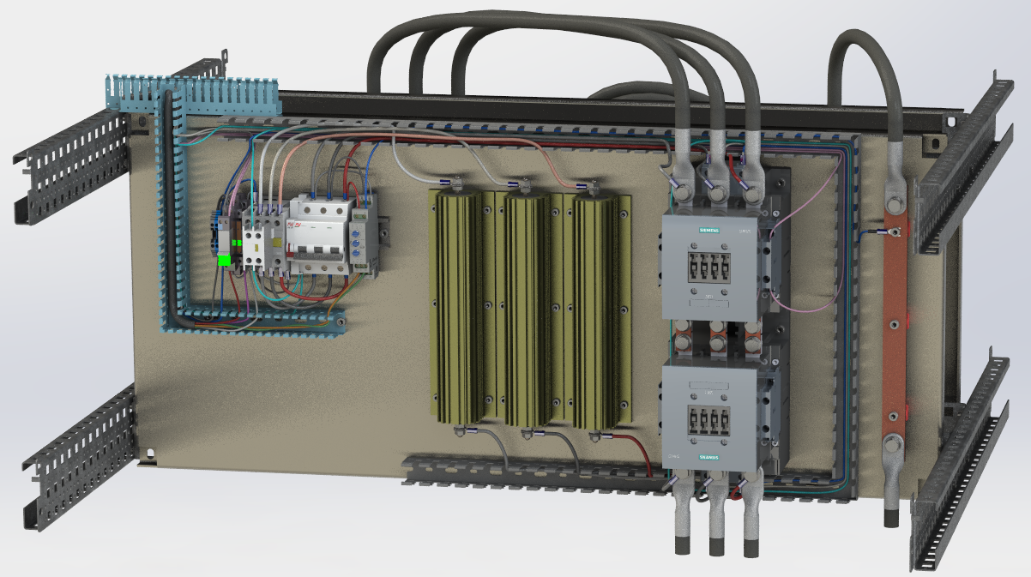
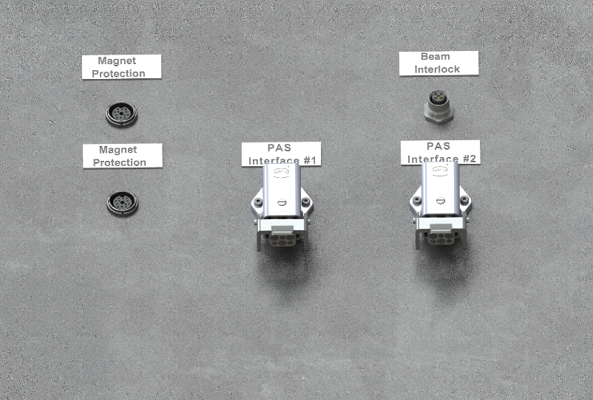
5th Joint BINP-FAIR CC Workshop
09.11 - 12.11.2020
PAS SYSTEM

Slide 17
Current status
5th Joint BINP-FAIR CC Workshop
09.11 - 12.11.2020
Concept
Discussed and agreed
Specifications
Released
Design
Prototyped
CDR
Released
FDR
planned to 09.2020 – 12.2020
4 QPC is produced as prototype/Magnetic stands PC/FOS
(One for FAIR CR DIP MMS, One 300kW, One 150kW, One 75kW with PAS)

Slide 18
SEXTUPOLE MAGNETS POWER CONVERTER DIAGRAM
5th Joint BINP-FAIR CC Workshop
09.11 - 12.11.2020
500A 100V
400VAC
MAINS
Step-Down
TRANSFORMER
RECTIFIER
IGBT
H-BRIDGE
1.5kA 600V
20kHz
OUTPUT
FILTER
IGBT
H-BRIDGE
2x250A 600V
20kHz
OUTPUT
FILTER
DCCT
SEXT
MAGNETS
500A

Slide 19
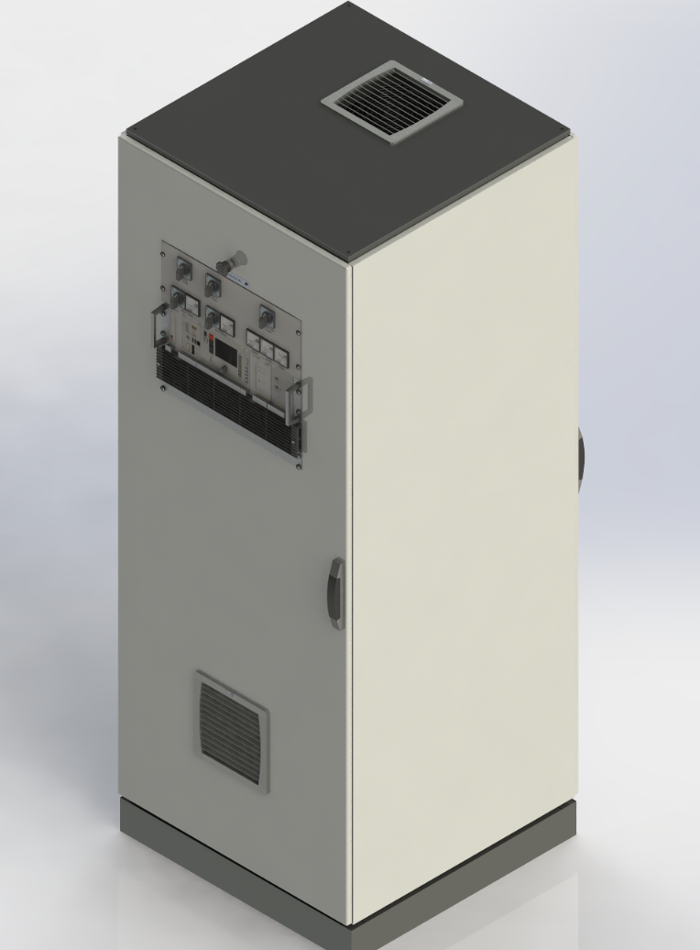
SEXTUPOLES POWER CONVERTER RACK LAYOUT
5th Joint BINP-FAIR CC Workshop
09.11 - 12.11.2020
500A
Power Section

Slide 20
Current status
5th Joint BINP-FAIR CC Workshop
09.11 - 12.11.2020
Concept
Discussed and agreed
Specifications
Released
Design
prototyping will start in 2021
CDR
planned to 09.2020 – 12.2020
FDR
planned to 03.2021 – 05.2021

Slide 21
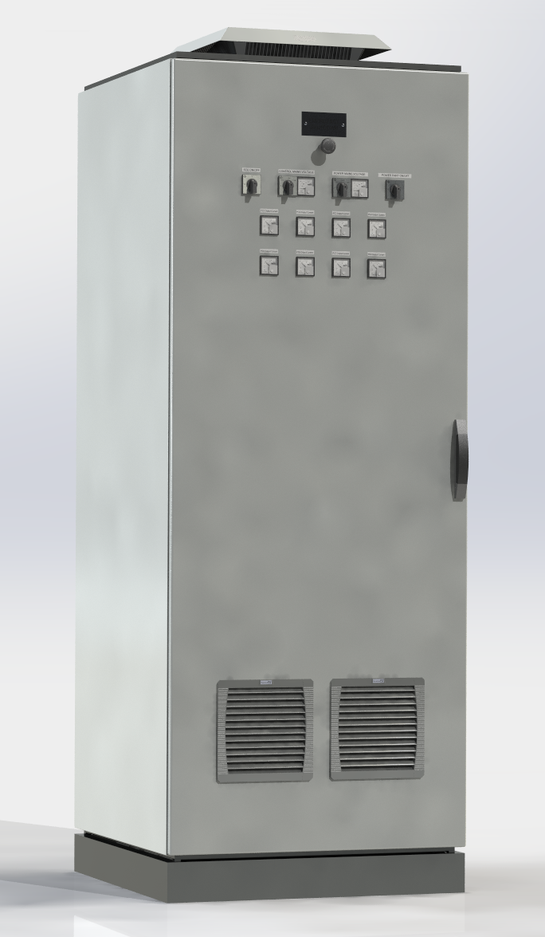
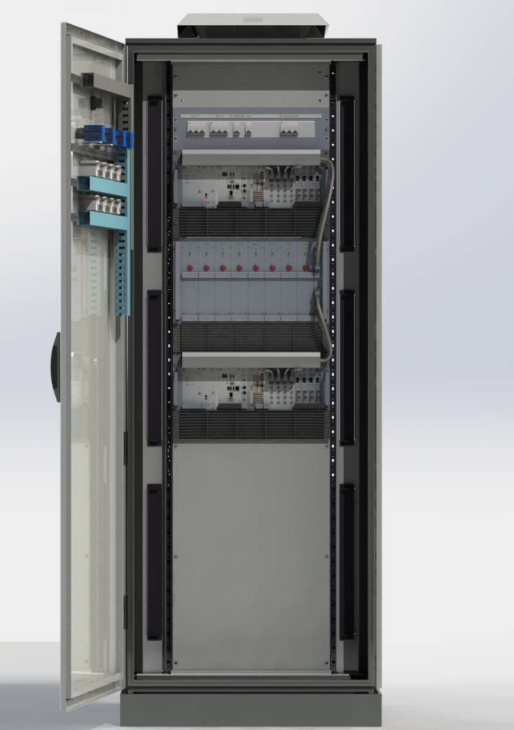
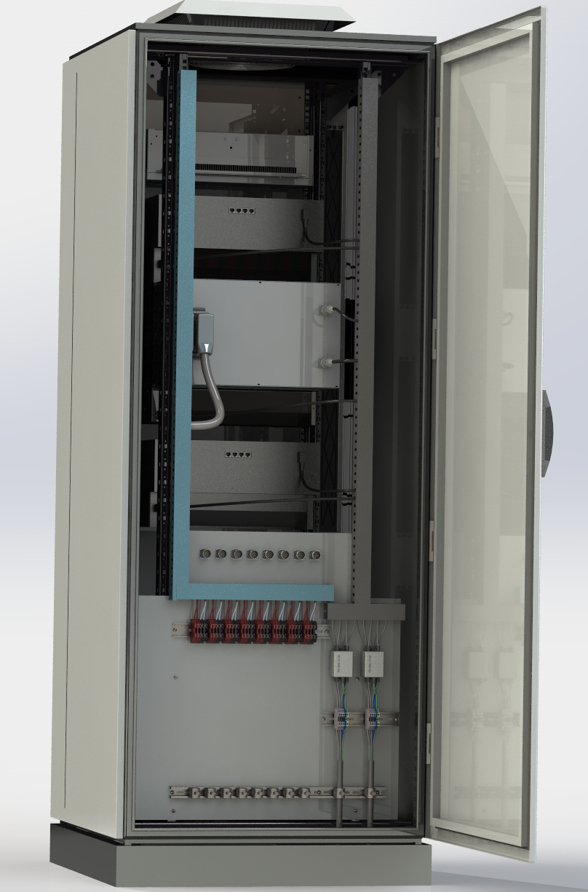
OCTUPOLE & STEERER POWER CONVERTERS
RACK LAYOUT
5th Joint BINP-FAIR CC Workshop
09.11 - 12.11.2020

Slide 22
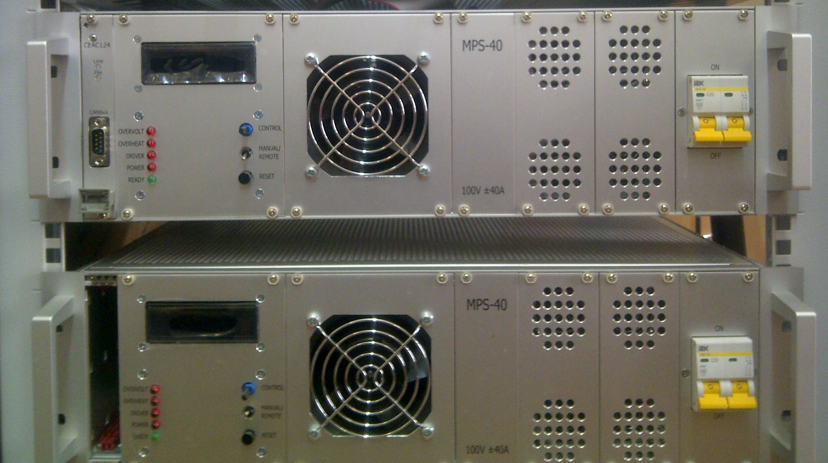
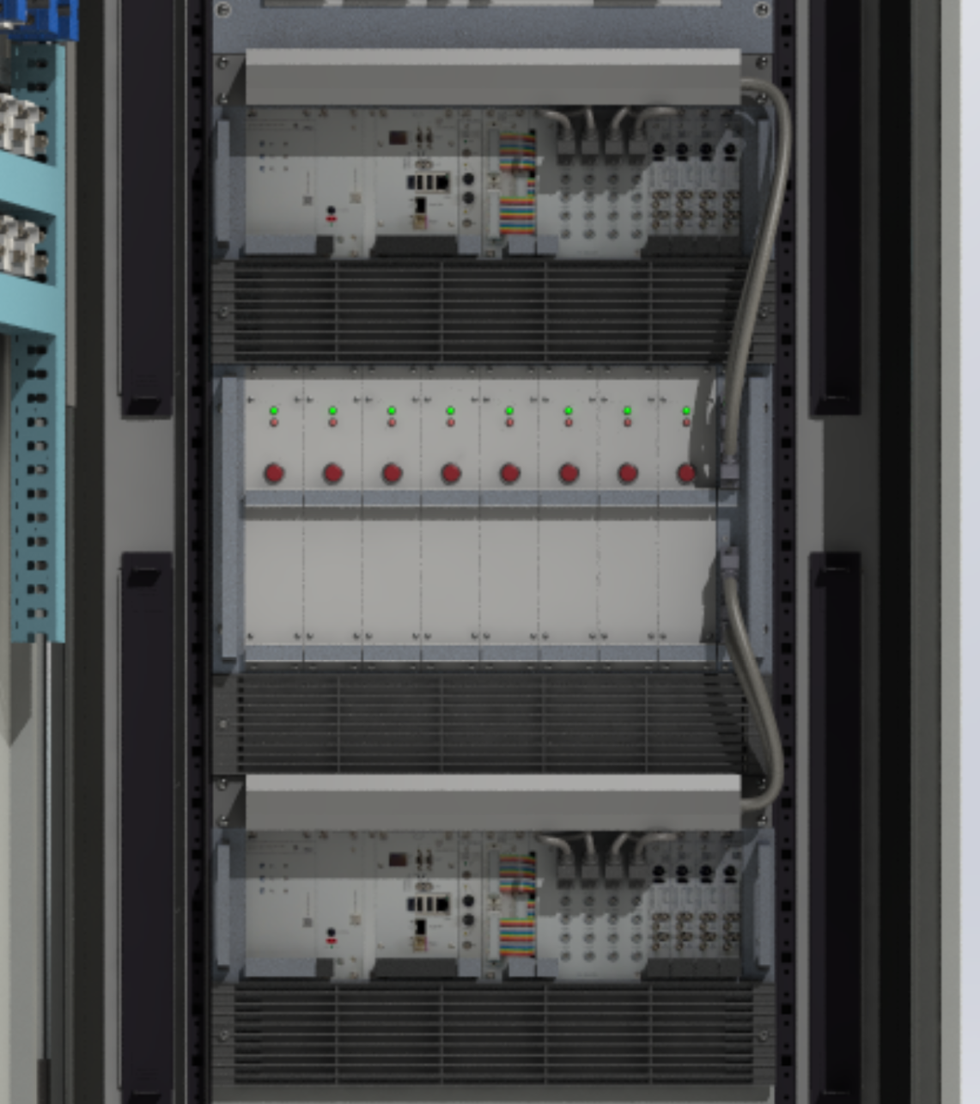
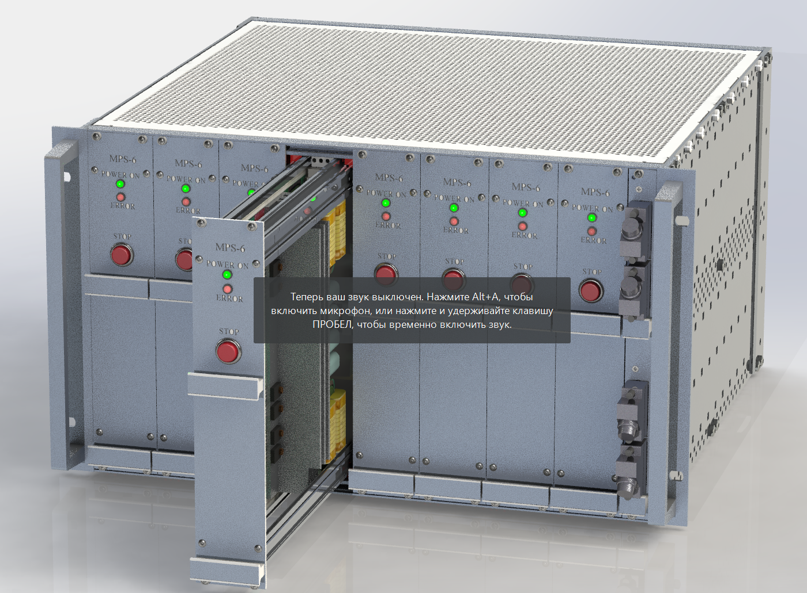
OCT. & CORR. POWER BLOCKS
5th Joint BINP-FAIR CC Workshop
09.11 - 12.11.2020

Slide 23
Current status
5th Joint BINP-FAIR CC Workshop
09.11 - 12.11.2020
Concept
Discussed and agreed
Specifications
Released
Design
Prototyped
CDR
planned to 2021
FDR
planned to 2021

Slide 24
Dipole Magnet Magnetic stand PC current status
5th Joint BINP-FAIR CC Workshop
09.11 - 12.11.2020
Concept
QPC
Control
BINP – MODBUS TCP (QPC control block)
GSI – MODBUS TCP (QPC control block) at start
– ACU as quick as be ready for QPC control block
DCCT
BINP – LEM ULTRASTAB
GSI – LEM IN-2000-S at start

Slide 25
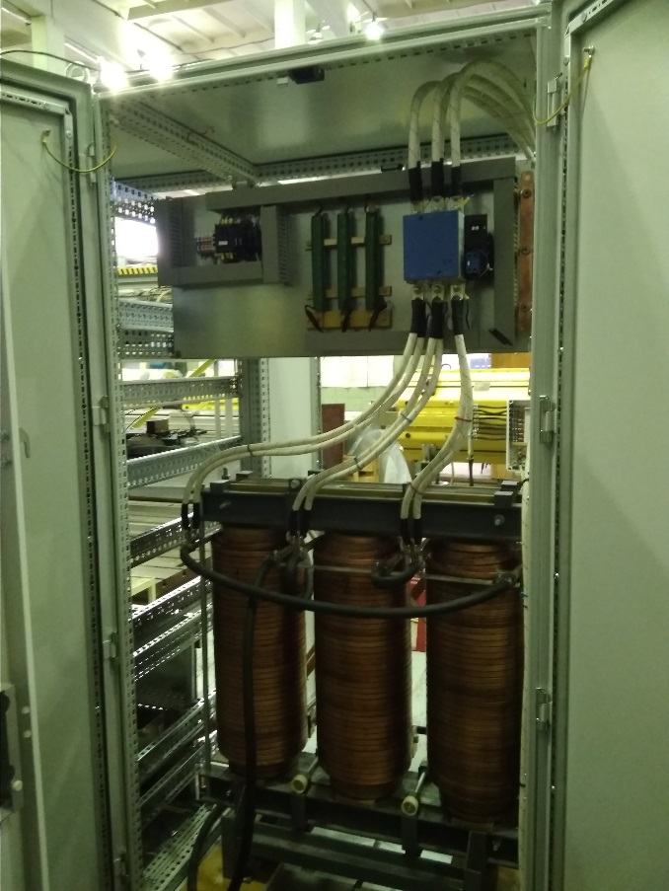
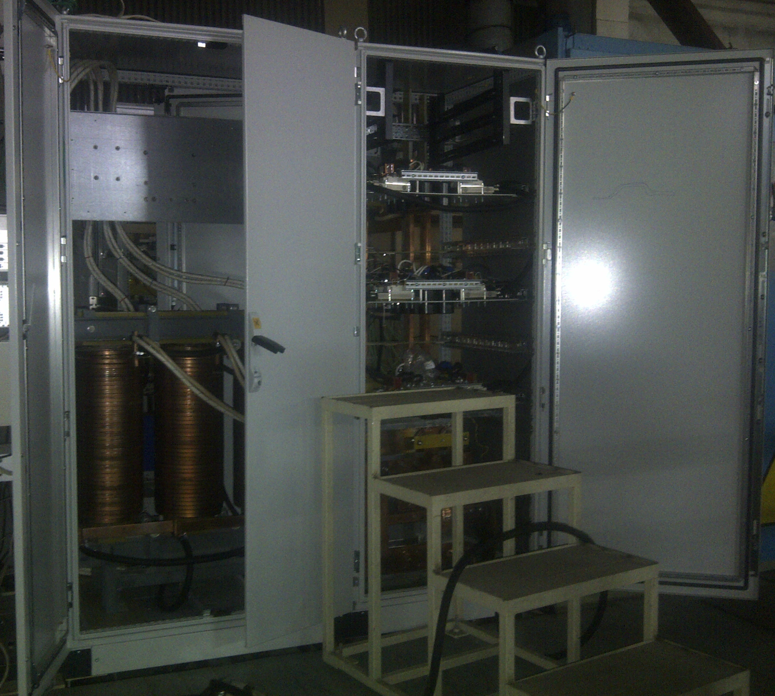
Current status
5th Joint BINP-FAIR CC Workshop
09.11 - 12.11.2020
Prototype for BINP magnetic measurements stand:

Slide 26
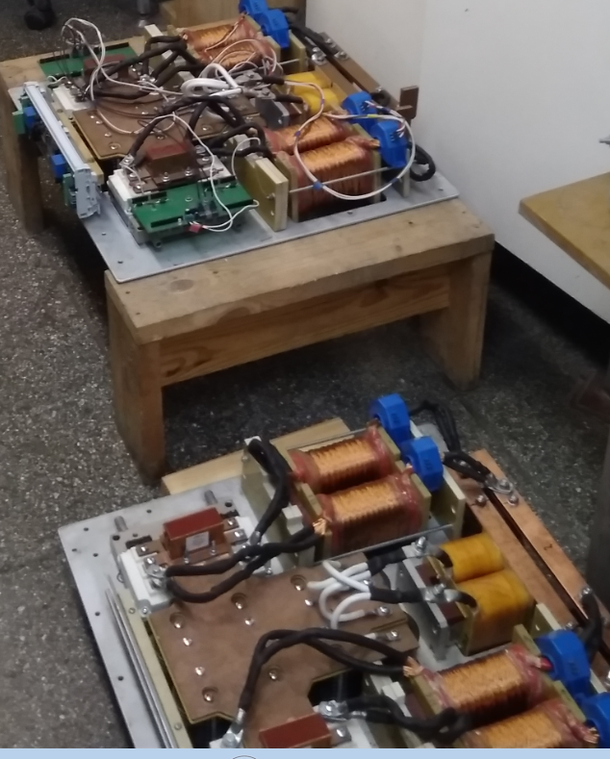
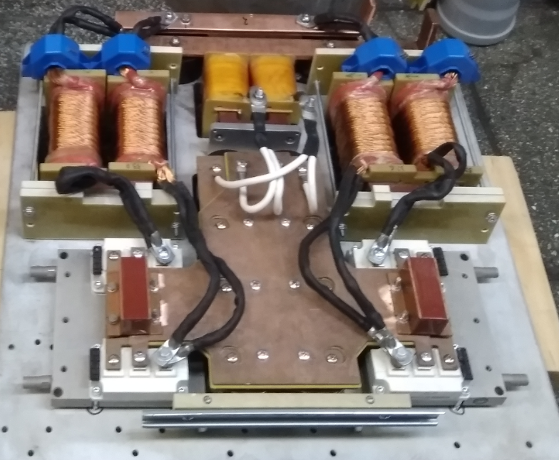
Sections under wiring
5th Joint BINP-FAIR CC Workshop
09.11 - 12.11.2020

Slide 27
Thank you for attention
5th Joint BINP-FAIR CC Workshop
09.11 - 12.11.2020

