Slide 1
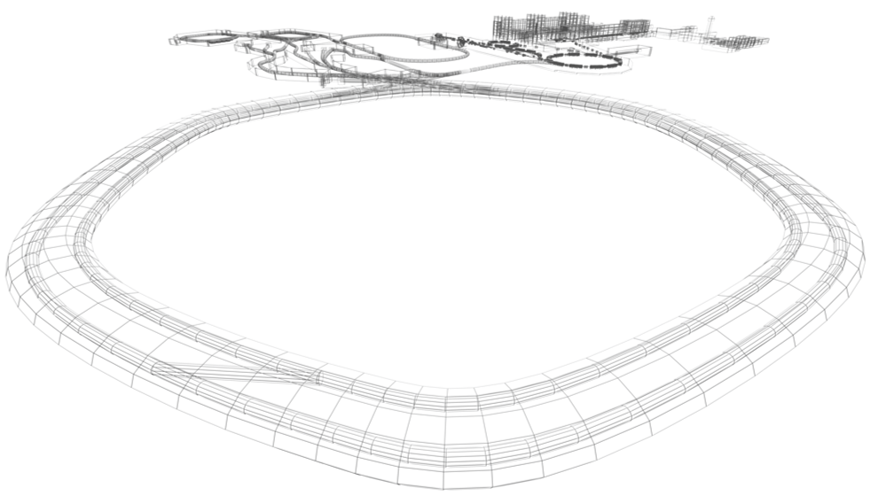
SAT CR dipole

Slide 2
Action steps: (draft)
FAT FoS dipole magnet at BINP : November – December 2020
Documentation: FAT of protocol measurements; final drawings; instructions for assembly; acceptance protocol : December 2020– January 2021
Delivery to FAIR site : February 2021
Preparation of TBI for SAT (H.Hagelskamp/H.Reich)): (transportation tools, crane, PS connection,…others)
Assembly at GSI by FAIR SMG (H.Hagelskamp/H.Reich)): March 2021
Preparation of stand for magnet measurements (to be clarified by C.Muehle)
Magnet measurements (C.Muehle/H.Leibrock) March-April 2021
Protocol of SAT measurements; April 2021
acceptance protocol (WPL, SPL at FAIR and BINP); April 2021.
Transportation to storage place (H.Reich) April-May 2021.

