Slide 1
5th BINP Workshop Video-Conference 09. – 12.11.2020 Quality, FAT, Documentation
C Will, H Reich, H Hagelskamp

Slide 2
Site Management
Agenda:
Workshop – Quality Improvement
Third Party FAT or On-Line FAT
Components with preliminary FAT
FAT – Documentation Requirements
Documentation – Language Requirements
CR – Dipole Pre-Assembly and Testing

Slide 3
Quality Improvement – Magnets 1/4
Category: Main Components
Group | Description of the technical problem | criticality for function 1 low-10 high | Incidence 1 low-10 high | correction effort at GSI 1 low-10 high
Coils | Coil ends are not sufficiently insulated | 8 | 7 | 7
Coils | Defective design of the bobbin holder | 10 | 3 | 10
Coils | Damage in coil potting | 8 | 3 | 10
Coils | Mechanical contact between coil and yoke | 7 | 2 | 10
Fiducials | Spring washers in the fiducial target seats are missing | 2 | 7 | 3
Fiducials | Fiducial Taget seat broken | 8 | 2 | 10
Support Frames | Underframes Steerer not according to drawing | 6 | 5 | 10
Support Frames | Missing frame bracing | 8 | 4 | 6
Yokes | Gap between the yoke halves too large | 10 | 3 | 10
Yokes | Centring aids of the yokes are faulty | 10 | 2 | 10
low to medium rate of incidents = high effort to correct = must be avoided
high impact on functionality = high effort to correct = must be avoided

Slide 4
Quality Improvement – Magnets 2/4
Category: Media Connections
Group | Description of the technical problem | criticality for function 1 low-10 high | Incidence 1 low-10 high | correction effort at GSI 1 low-10 high
Cooling Water | Cooling hoses incorrectly connected or poorly mounted (rubbing on the housing or busbars) | 7 | 6 | 7
Cooling Water | Hose clamps not correctly attached | 4 | 5 | 7
Cooling Water | Water distributor not correctly mounted | 4 | 3 | 5
Electrical & Cabling | Faulty execution of busbars | 10 | 7 | 10
Electrical & Cabling | Poor crimping in interlock cabling | 8 | 5 | 7
Electrical & Cabling | Interlock test | 10 | 1 | 5
high impact on functionality = high effort to correct = must be avoided high impact on functionality = medium effort to correct = easy to avoid

Slide 5
Quality Improvement– Magnets 3/4
Category: General Workmanship – Mechanical Connections
Group | Description of the technical problem | criticality for function 1 low-10 high | Incidence 1 low-10 high | correction effort at GSI 1 low-10 high
Bolting and threads | Use of incorrect screws | 8 | 3 | 5
Bolting and threads | Threads are not cut correctly | 2 | 2 | 8
Welding & Soldering | Poorly executed welding seams | 10 | 10 | 10
Welding & Soldering | Annealing colours on welding seams | 2 | 10 | 10
Welding & Soldering | Poor soldering points on coils and busbars | 10 | 3 | 10
high rate of incidents = high effort to correct = must be avoided
high impact on functionality = high effort to correct = must be avoided

Slide 6
Quality Improvement– Magnets 4/4
Category: Final Care at production end
Group | Description of the technical problem | criticality for function 1 low-10 high | Incidence 1 low-10 high | correction effort at GSI 1 low-10 high
Clean-up & Finishing | Not deburred drill holes | 4 | 8 | 3
Clean-up & Finishing | Missing Labelling (earthing, water connection etc.) | 3 | 7 | 5
Clean-up & Finishing | Oil spills | 1 | 2 | 5
Clean-up & Finishing | Fitting holes in the yoke | 10 | 1 | 10
Coating & Conservation | zinc dust paint on the poles is missing or damaged | 2 | 9 | 2
Coating & Conservation | Reference surfaces not greased | 2 | 8 | 2
Coating & Conservation | Contact surfaces of earthing connections wrongly painted | 5 | 3 | 5
Coating & Conservation | Rust on reference surfaces | 2 | 3 | 5
Coating & Conservation | Contact surfaces on frame and adjustable feet wrongly painted | 5 | 2 | 10
Coating & Conservation | Rust on crane eyes | 10 | 1 | 10
high rate of incidents = low effort to correct = easy to avoid
high impact on functionality = high effort to correct = must be avoided

Slide 7
Quality Improvement– Vacuum 1/3
Category: Main Components
Group | Description of the technical problem | criticality for function 1 low-10 high | Incidence 1 low-10 high | correction effort at GSI 1 low-10 high
Daignostic Chambers | Diagnostic chamber: port in wrong position | 8 | 2 | 10
Support Frames | Stand wrong | 1 | 2 | 5
Vacuum Chambers | Gap in the chamber (pumping takes a very long time!) | 3 | 8 | 2
Vacuum Chambers | Permeability not achieved | 10 | 5 | 10
Vacuum Chambers | Hall probe groove not as specified | 2 | 2 | 5
Vacuum Chambers | Chamber not according to drawing | 10 | 1 | 10
Vacuum Chambers | Holes in the chamber not degassed | 4 | 6 | 1
high rate of incidents = low effort to correct = easy to avoid
high impact on functionality = high effort to correct = must be avoided

Slide 8
Quality Improvement – Vacuum 2/3
Category: General Workmanship – Mechanical Connections
Group | Description of the technical problem | criticality for function 1 low-10 high | Incidence 1 low-10 high | correction effort at GSI 1 low-10 high
Errors & Missing Parts | Flange in wrong position | 8 | 5 | 10
Errors & Missing Parts | References forgotten | 10 | 3 | 10
Errors & Missing Parts | Hall sound groove not as specified (wrong position) | 2 | 1 | 10
Welding | Tempering colours not removed | 3 | 10 | 10
high rate of incidents = high effort to correct = must be avoided
high impact on functionality = high effort to correct = must be avoided

Slide 9
Quality Improvement– Vacuum 3/3
Category: Final Care at production end
Group | Description of the technical problem | criticality for function 1 low-10 high | Incidence 1 low-10 high | correction effort at GSI 1 low-10 high
Clean-up & Finishing | Chamber not cleaned | 10 | 10 | 2
Flanges | Sealing surface damaged (for example cavities) | 10 | 9 | 1
Flanges | CF flange: sealing surface damaged rework possible | 10 | 5 | 2
Flanges | CF flange: sealing surface damaged rework not possible | 10 | 3 | 8
References | References damaged | 8 | 2 | 10
high rate of incidents = high impact on functionality = easy to avoid
high impact on functionality = high effort to correct = must be avoided

Slide 10
Third Party FAT and On-Line FAT
The purpose of the FAT is to check that the components produced match the design agreed during the FDR – no change to existing process.
The central role of the WPL remains unchanged.
Alternative 1: Third Party FAT is performed by hired personnel from a notified inspection authority such as TUV. The Inspector represents the inspection interests on behalf of GSI.
Alternative 2: An empowered QA representative within the Supplier Organization mandated to represent the acceptance interests of GSI and to perform an on site FAT on behalf of GSI. Acting like the Third Party.
Alternative 3: On-Line FAT is performed in the workshop at the component during a video conference by the supplier where the GSI WPL has virtual access and can witness to the process.
All alternatives will be preformed according to the established procedures and FAT Documents: TG7.1; TG7.2, TG7.11-TG7.15, TG7.44.

Slide 11
FAT Process - Definitions
Preliminary FAT – observation (Damage to painting) / defects (Dimensional deviations)
a preliminary FAT will be issued as in the past, when rework is required due to observations that can be remedied with no further on site inspection.
substantial defects will disqualify the component for FAT.
it will be performed at factory according to Alternative 1, 2 or 3.
Rework is to be done before delivery by factory to FAIR.
Conditional FAT – will be confirmed when rework is completed and accepted.
This is followed by a release for delivery.
Final FAT – will be performed at GSI after receiving inspection.
This is followed by release for invoice and payment.

Slide 12
FAT Process – Steps before FAT
Supplier declares readiness for FAT.
Supplier sends the FAT documentation with
declaration to the WPL.
The WPL checks the documentation and confirms readiness for FAT
WPL decides on FAT Process
WPL instructs Third Party Inspector
to witness FAT at supplier factory
2. Supplier’s mandated QA inspector performs
Conditional FAT
3. WPL witness remote FAT
by Video Conferencing

Slide 13
FAT Process – Steps to Conditional FAT before Delivery
Third Party confirms
Conditional FAT
by completing witness protocol
Supplier’s mandated QA inspector confirms Conditional FAT
by completing witness protocol
WPL confirms
Conditional FAT
by completing witness protocol
1)
1)
Third Party sends
signed witness protocol to WPL
Supplier’s mandated QA inspector sends
Conditional FAT protocols to WPL
WPL releases component for delivery to FAIR
Supplier delivers
component to FAIR
1)
Where rework is required a Preliminary FAT is confirmed.
After successful
completion of rework a
Conditional FAT is confirmed.

Slide 14
FAT Process – Steps to Final FAT after Delivery
After Arrival of component,
WPL performs
SAT aa and Final FAT
WPL informs Supplier about deviations
deviations
no deviations
Component
accepted and released for SAT ab
Supplier proposes a procedure to remedy the deviation.
FAIR checks the scheduling and financial aspects of the necessary work and informs the supplier about the calculations.
Supplier performs remedy
FAIR performs remedy work according to supplier’s order.
WPL confirms Final FAT

Slide 15
Components with Preliminary FAT
Quadrupole 10 | 3 | QP | FT-BEQS-ZU-0000217 | FHTQS217AS | 18-0000202-1-8
Quadrupole 10 | 2 | QP | FT-BEQS-ZU-0000217 | FHTQS217AS | 18-0000202-2-5
Quadrupole 10 | 2 | QP | FT-BEQS-ZU-0000217 | FHTQS217AS | 18-0000202-3-2
Quadrupole 10 | 2 | QP | FT-BEQS-ZU-0000217 | FHTQS217AS | 18-0000202-4-9
Quadrupole 11 | 3 | QP | FT-BEQS-ZU-0000028 | FHTQS028AS | 18-000036-10-3
Quadrupole 11 | 3 | QP | FT-BEQS-ZU-0000028 | FHTQS028AS | 18-000036-26-4
Quadrupole 11 | 3 | QP | FT-BEQS-ZU-0000200 | FHTQS028AS | 18-000036-68-4
Quadrupole 2 |  | QP | FT-BEQS-ZU-0000206 | FHTQS109AS | 18-00004-046-9
Steering Magnet HEBT18 |  | ST | FT-BEKH-ZU-0000053 | FHTKH146AS | 18-000034-21-5
Steering Magnet HEBT18 |  | ST | FT-BEKH-ZU-0000053 | FHTKH146AS | 18-000034-22-2
Steering Magnet HEBT18 |  | ST | FT-BEKH-ZU-0000057 | FHTKH057AS | 18-000034-23-9
Steering Magnet HEBT18 |  | ST | FT-BEKH-ZU-0000057 | FHTKH057AS | 18-000034-24-6
Steering Magnet HEBT18 |  | ST | FT-BEKH-ZU-0000146 | FHTKH146AS | 18-000034-40-6
Steering Magnet HEBT18 |  | ST | FT-BEKH-ZU-0000146 | FHTKH146AS | 18-000034-41-3
Preliminary FAT was issued in Feb. 2020
Delivery can take place upon issue of complete documentation
and finalisation of all rework

Slide 16
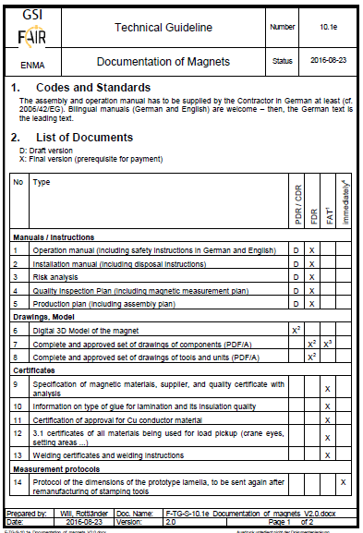
FAT Documentation Requirements
Drawings and Model
Complete and approved set of drawings of components.
Certificates
Specification of magnetic materials, supplier, and quality certificate with analysis.
Information on type of glue for lamination and
its insulation quality.
Certification of approval for Cu conductor material.
3.1Certificate of all materials being used for load pick-up
(crane eyes, setting areas).
Welding certificates and welding instructions.

Slide 17
FAT Documentation Requirements
Measurement Protocols
Results of Epstein or ring probe measurements.
Details about bounding pressure and the heating cycle of yoke bonding.
Measeurement report of the dimensional data required in TG3.12e, TG3.18, or TG3.29, or similar.
Measurement report of the data required in TG7.5e, and either TG7.6e or TG7.7e, as applicable
Report on resistance of the yokes before welding.
Acceptance report for the leak test of the conducting material.
Mechanical Measurements.
Leakage tests.
Electrical Tests.

Slide 18
FAT Documentation Requirements
Language Requirements
English is the contractually agreed langauge.
This applies to all documentation listed and required for CDR, FDR, FAT and other milestones
EU regulations require documentation in the language of the ultimate user of the equipment.
This applies to Operating Manuals, Service and Maintenance Manuals and all CE Declaration Documentation.
An agreement is required on how to ensure the translation to German.

Slide 19
CR Magnets – Pre-Assembly and Testing
CR Workshop and Storage Facility
Groundworks have started
Storage facility expected to be installed in Dec. 2020
Ready for use in Feb 2021

Slide 20
CR Magnets – Pre-Assembly and Testing
Alternative to BINP Personnell for Pre-Assembly
Due to the CORONA pendamic travelling between Russia and Germany is restricted.
Deliveries will commence in Feb 2021.
Pre-assembly and testing has to proceed immediately to avoid backlog in the GSI Facilities.
AN agreement is required to regulate the deployment of FAIR/GSI personnell to perform pre-assembly and testing works on behalf of BINP and with supervision by BINP.
Work Instructions and testing procedures are required.

Slide 21
Next Steps
Eliminate backlog of component deliveries from BINP
Take definitive Measures to improve quality –common approach.
Set-up Video conferencing in the workshops to enable remote FAT.
Finalise agreement on which side will perform the translation of critical documentation.
Agree a process to perform CR Magnet Assemblies and testing without BINP presonnel present at FAIR Facility.

Slide 22
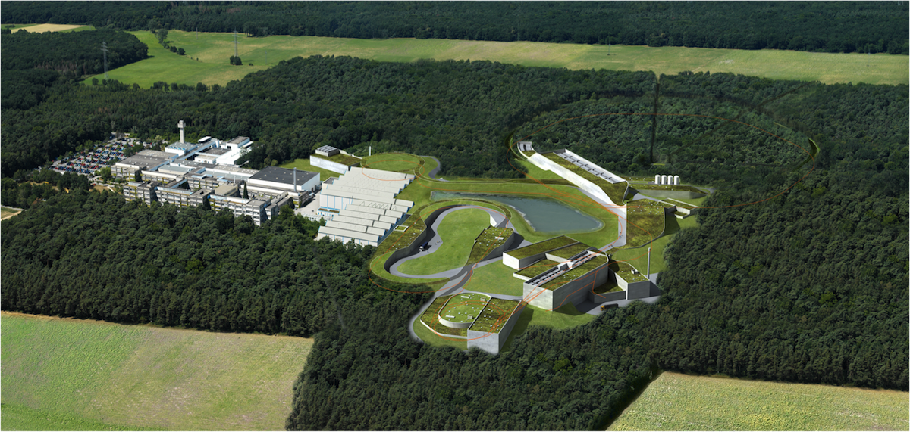
Thank you very much !

