Slide 1
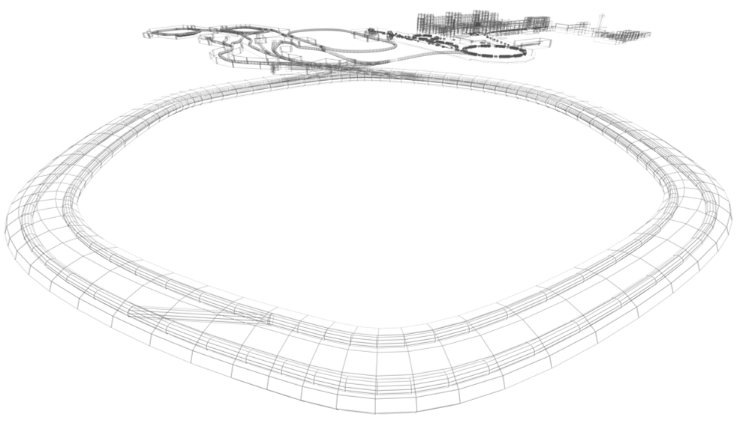
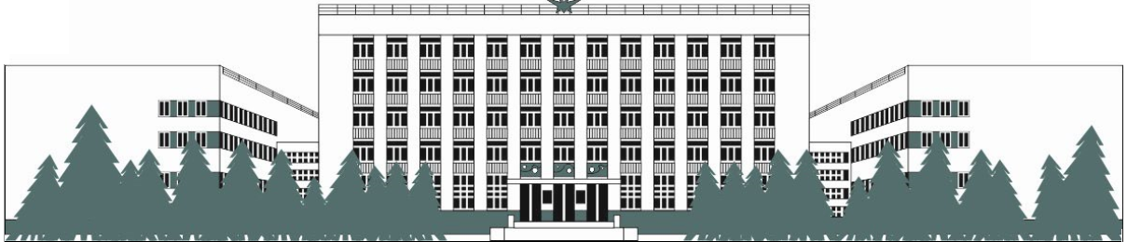


WELCOME to 5th BINP-FAIR WORSHOP

Slide 2
The actual Agenda in Indico: https://indico.gsi.de/event/11347/
One ZOOM link to all sessions: https://gsi-fair.zoom.us/j/93645773502 pwd: 799915 (except of two steering meetings)
Host of ZOOM connection done by Sonia Utermann. But each chair is also Moderator of connection for corresponding session
The chairs or responsible person for protocol are kindly asked to send brief highlights of sessions to Oleksiy Dolinskyy just after finishing of session
Please upload the session minutes and presentations to Indico or send directly to Petr Shatunov or Sonia Utermann
Next 6th BINP-FAIR Workshop. Please visit Doodle:
https://doodle.com/poll/geh799d3swcac9tq and check the preferable data

Slide 3
Time table for Monday
https://gsi-fair.zoom.us/j/93645773502 Passcode: 799915
Session 1: Opening and general questions. Zoom SU, Chair: O. Dolinskyy, Protocol: O.Gorda
08:45 | Connection to ZOOM (registration) | S.Utermann
09:00 | Opening. Technical administration. | O.Dolinskyy
09:05 | FAIR overall status | J.Blaurock
09:20 | Status of BINP collaboration with FAIR | P.Logachev/E.Levichev
09:40 | End of session
Session 1.1: BINP-FAIR PMO-PMO Сurrent QA issues Chair: Andrey Shoshin, Protocol: Katja Petrowa
09:50 | PMO subjects :FAIR 2021 Re-Baselining
10:10 | Transport, Pre-montage and Quality-improvement, Collaboration with the third Party |  | H.Hagelskamp
11:00 | SAT of FoS CR dipole |  | O.Dolinskyy
11:30 | Break
11:40 | BINP QMS Service, General information |  | A.Shoshin, K.Petrowa
12:00 | CE conformity & Final Acceptance required documentation |  | R.Fuchs
13:00 | End of session

