Slide 1
  Tests at manufacturer workshops

Slide 2
  Leak tests on components
Leak tests must be carried out with a helium leak detector on all critical components like process valves, prefabricated sections of pipes, bellows, corrugated tubes, etc. before assembly. This test applies especially to welding seams. Additional tests are to be done on sub-assemblies to avoid situations where location of leaks and repair becomes difficult due to limited access. In order to minimize risks, the contractor may also make spot shock tests with liquid nitrogen before the He-leakage tests. The found leaks must comply with the specified ones.
Rough leakage test of the welding seams
After each pressure test the helium pressure in the process pipes shall be reduced to the design pressure. Then, all welding seams shall be controlled each for rough leakage. For this purpose the welding seams shall be covered from outside with the help of an adhesive foil and submitted to a sampling probe test. The detection sensitivity for the helium sampling probe shall be appropriate for detection of leaks specified in the present specification.
Protocol of the vacuum test XLVB distribution box as sample.

Slide 3
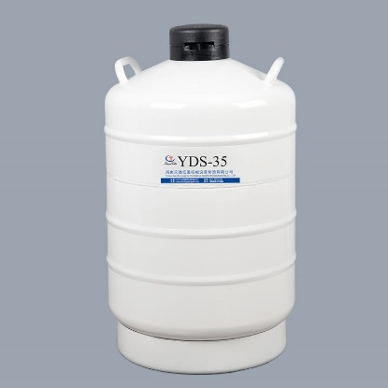
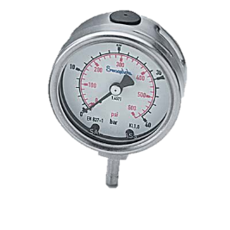
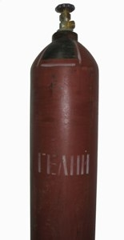
Connections of the pressure pipes are by Swagelok fittings
LN₂
reducer
P(GHe)=28bar
V1
TMP DN63
60 l/s
V2
Full range gauge
Pirani
Leak Detector
Gas helium vessel 150 bar
V3
Pt1000 thermosensor
Welded connections
Dry
Preliminary pump
1 l/s
Vacuum volume
Scheme of a vacuum system for metal hoses/ bellows/ insulators leakage tests with test pressure P_{design} × 1,45 and liquid nitrogen.

Slide 4
  Leak tests on components
      Leakage test across the valve seats
The tube system of the Contro Dewar must be evacuated from one side, all valves must be closed and each tube strand, separated through the valves, shall be supplied one by one with helium at the design pressure. At the other end of the tube strand, a leakage detector shall test whether the valve seats are leak tight. The leakage rate across the valve seats must comply with the specified ones in the present specification.
      Valve functioning
All valves shall be submitted to operation several times within the "open" and "close" range. The valves must move softly within the whole range of mechanical operation, without any visible, audible and noticeable signs of jerks.
Protocol of the vacuum test XLVB distribution box as sample.

Slide 5
  Leak tests on components
Leakage test of the Contro Dewar vacuum tank
The Contro Dewar vacuum tank shall undergo a leakage test. The tank shall be evacuated inside to a pressure of 5•10^{‑5} mbar and then submitted to a He-leakage test by spraying the welding seams, flanges, feedthroughs, etc. from outside with helium. All process pipes and other concerned internal components shall be evacuated to a reasonable pressure. The leak detector shall be connected to the isolation vacuum pump port of the vacuum tank. The found leaks must comply with the specified ones.
1.1.2.6 Leakage test of the internal piping and transfer line to the cryostat
Prefabricated sections of the transfer line of the transportation length. Each side of the vacuum vessel of the section shall be closed by a blind cap. The go and return pipes at one side of the section shall be short circuited. At the other side the process pipes shall protrude through the face side of the cap and shall be welded to the latter. One cap shall be provided with a pump port.
The internal piping of the Contro Dewar vacuum tank shall be submitted to the design pressure. The leak detector at the isolation vacuum pump port shall test leak tightness of the piping. The found leaks must comply with the specified ones.
Protocol of the vacuum test XLVB distribution box as sample.

Slide 6
  Pressure tests on components
Prior to the application of the super insulation, a gas pressure test with helium is required for those assembled parts of the Contro Dewar for which location of leaks and repair after the final assembly may become difficult due to limited access.
The pressure test shall also be carried out after the final assembly of the Branch Box. The test time must be at least 20 minutes unless otherwise defined by authorized inspectors.
      Cool-down tests
For realisation of the cool down and warm up tests and possibly the tests described in the present specification, the cold terminals of the cryostat shall be prepared as follows. For each circuit, the go and return pipe protruding from the vacuum barrier of the cold terminal shall be connected with each other. The thermal shield cylinder shall be closed by a dismountable front cap. The thermal shield and the process pipes shall be covered by MLI. The vacuum shell of the cold terminal shall be closed by a welded blind cap. Vacuum space of each cold terminal shall be pumped down to a pressure necessary for accomplishing the tests.
All Branch Box’s internal circuits one after the other shall be cooled down to 80 K with liquid nitrogen. During and after the cooling process operativeness of the valves shall be tested as described in the previous chapter.
Each circuit after being cooled to LN₂ temperature shall be evacuated and filled with helium at the design pressure. The strand shall then undergo an additional leakage test.
Warm-up tests
During and after the warming-up process operativeness of the valves shall again be tested. With the system warmed-up to room temperatures another leakage test of the internal piping under helium pressure shall be carried out.
During cool-down and warm-up tests the instrumentation must be controlled in the best possible way.

Slide 7
  Pressure tests on components

Slide 8
  Pressure tests on components

Slide 9
  MLI
      Visual control of the MLI
After application of the MLI, a careful inspection must ensure that the MLI has been applied according to the best possible protection from heat radiation and the lowest possible heat transfer.
  Temperature sensors tests
      Testing the temperature sensors
Operativeness of temperatures sensors must be controlled before and after each important step as the thermal shock, application of MLI, etc. The tests shall include verification of the leakage current to the ground and measurements of the resistance between each pair of connecting wires.

Slide 10
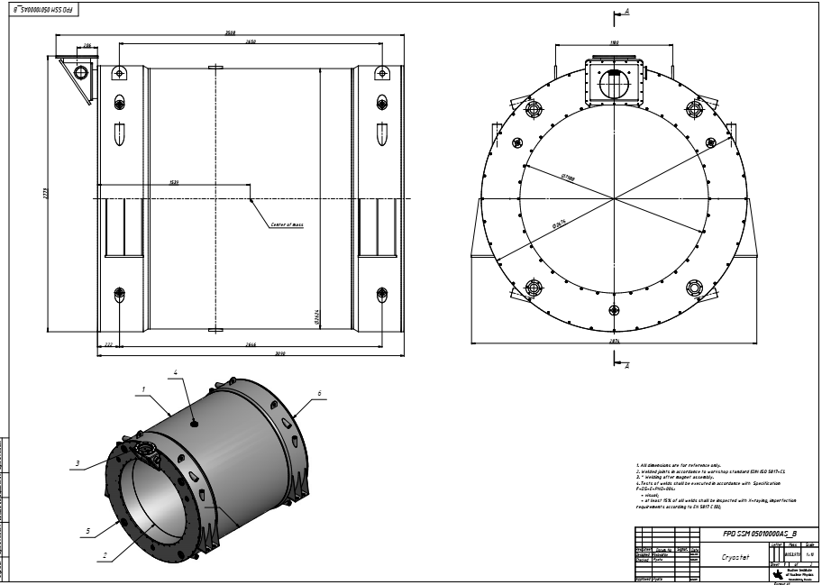
    X-ray tests of welds
The degree of X-ray of welded joints shall be as laid down in AD-HP5/3. Crack detecting with penetrant dye methods must be avoided whenever admissible and possible. If such test is necessary, it must be done after helium leak tests.

Slide 11
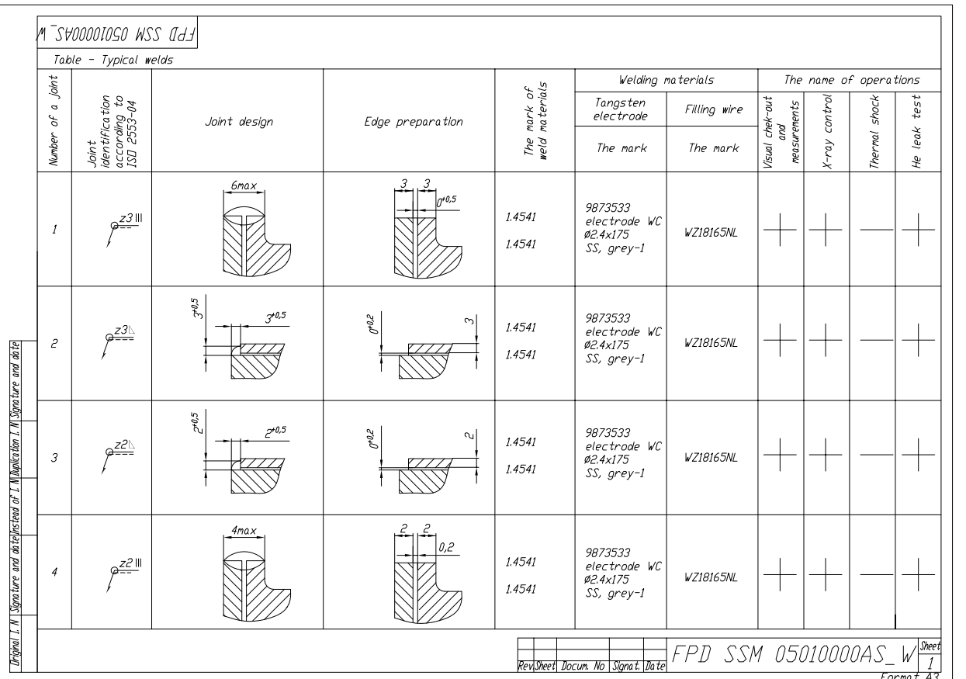
    X-ray tests of welds

Slide 12
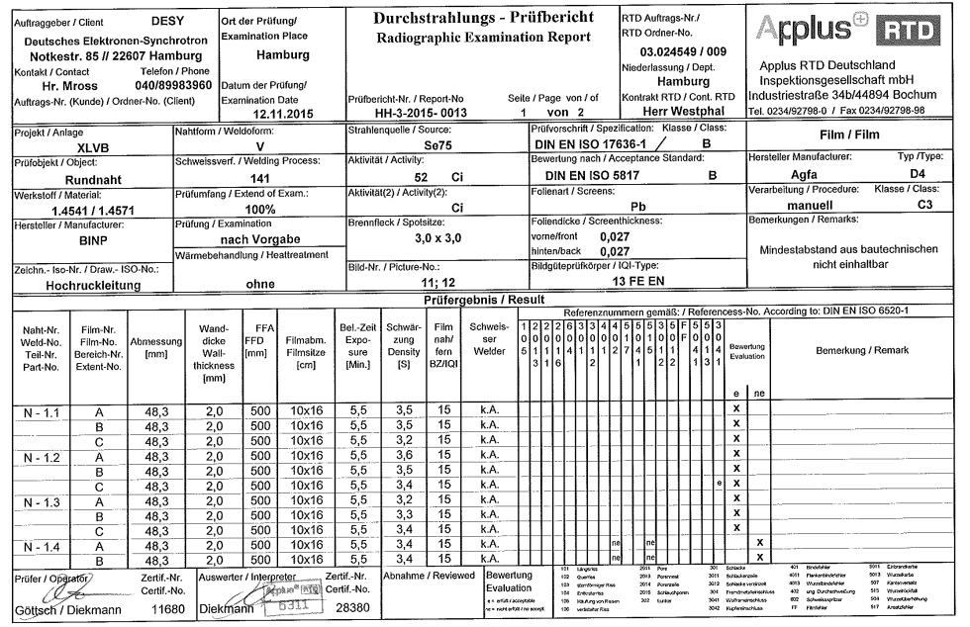
    X-ray tests of welds
Conclusion of the XLVB distribution box X-ray tests on DESY site as sample.

Slide 13
  Tests at the orderer’s site (SAT)

Slide 14
  Leak tests on components
    Leakage test of the piping/ Integral
All piping mounted at the orderer’s site shall undergo a leakage test. The piping has to be filled with helium at a pressure defined as the set pressure of the relevant safety valve. The leakage of the piping inside vacuum volumes shall be verified by a leak detector connected to the corresponding vacuum port.
All welding seams and connections in the warm piping are to be submitted to a sampling probe test. The detection sensitivity for the helium sampling probe shall be appropriate for detection of leaks specified the present specification.
Leakage test of the Contro Dewar vacuum tank
The Contro Dewar vacuum tank shall be evacuated to a pressure of 5•10 5 mbar and then submitted to a He-leakage test by spraying the welding seams, flanges, feedthroughs, etc. from outside with helium. The internal process pipes shall be evacuated to a reasonable pressure. The leak detector shall be connected to the isolation vacuum pump port.

Slide 15
Control Dewar
  Pressure tests on components
Pressure tests must be carried out for all components of the Control Dewar. The concerned relief valves shall be blocked for the period of the tests.

Slide 16
  MLI
      Visual control of the MLI
After application of the MLI, a careful inspection must ensure that the MLI has been applied according to the best possible protection from heat radiation and the lowest possible heat transfer.
    Testing the instrumentation
All instrumentation must be controlled in the best possible way.
  Temperature sensors tests
      Testing the temperature sensors
Operativeness of temperatures sensors must be controlled before and after each important step as the thermal shock, application of MLI, etc. The tests shall include verification of the leakage current to the ground and measurements of the resistance between each pair of connecting wires.

Slide 17
    X-ray tests of welds
All welds on the process pipes done by the contractor at the orderer’s site shall be X-rayed 100%.

Slide 18
    X-ray tests of welds
Conclusion of the XLVB distribution box X-ray tests on DESY site as sample.

Slide 19
  Acceptance tests of the Control Dewar
The acceptance tests of Contro Dewar and transfer line to the cryostat at the orderer’s site will be carried out by the orderer. For informative purposes: the following tests will be performed:
    Preliminary acceptance
Preliminary acceptance tests include operational tests and thermodynamic measurements.
      Operational tests
After purching, all Contro Dewar cooling circuits will be cooled-down to their operating temperatures. During cool-down, steady state operation and the warm-up the insulation vacuum will be registered as well as the helium leak rate. The registered leaks must comply with the specified ones.
Operativeness of all process valves will be remotely tested. The same applies for the functioning of the instrumentation.
      Thermodynamic measurements
The thermodynamic measurements will include heat load measurements and checking the performance of the sub cooler. As soon as the compliance of the measured characteristics of the Contro Dewar with those specified in the present specification will be established, the Contro Dewar will be deemed preliminary accepted. This means that the Contro Dewar can now be used by the orderer without any restrictions.

Slide 20
    Final acceptance
Contro Dewar and transfer line to the cryostat will be deemed finally accepted when the previously described acceptance tests met the requirements of the specifications and when 5 complete operating cycles in sequence have been made without damage afterwards. The operating cycles comprise the complete cooling down and warming up of all the process tubes and installations, between room temperature and the corresponding operating temperatures.
The Orderer requires at least 12 months to carry out the 5 operating cycles for the final acceptance. Final acceptance may proceed after completion of the preliminary acceptance. In case it is not possible to keep to the final acceptance schedule because of reasons beyond the Contractor’s responsibility, final acceptance is considered to have taken place after 12 month. After successful final acceptance tests the warranty shall become effective.
In case it is not possible to keep to the final acceptance schedule because of reasons the Contractor’s responsibility, the final acceptance is considered to have taken place after 12 month. After successful final acceptance tests the warranty shall become effective.

