Slide 1

PANDA
CDR2 of the control
Dewar for solenoid magnet

Slide 2
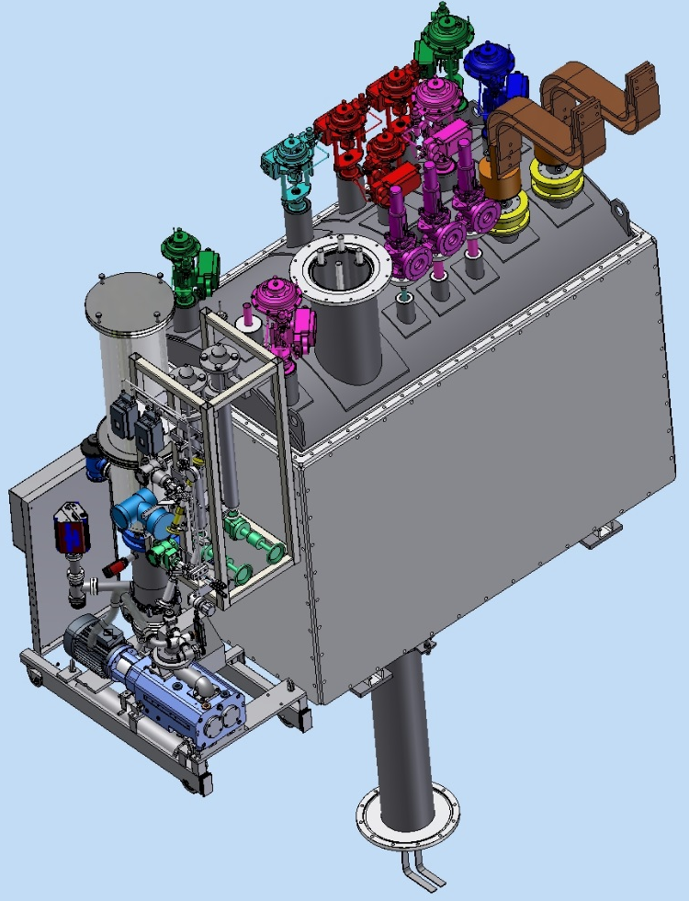
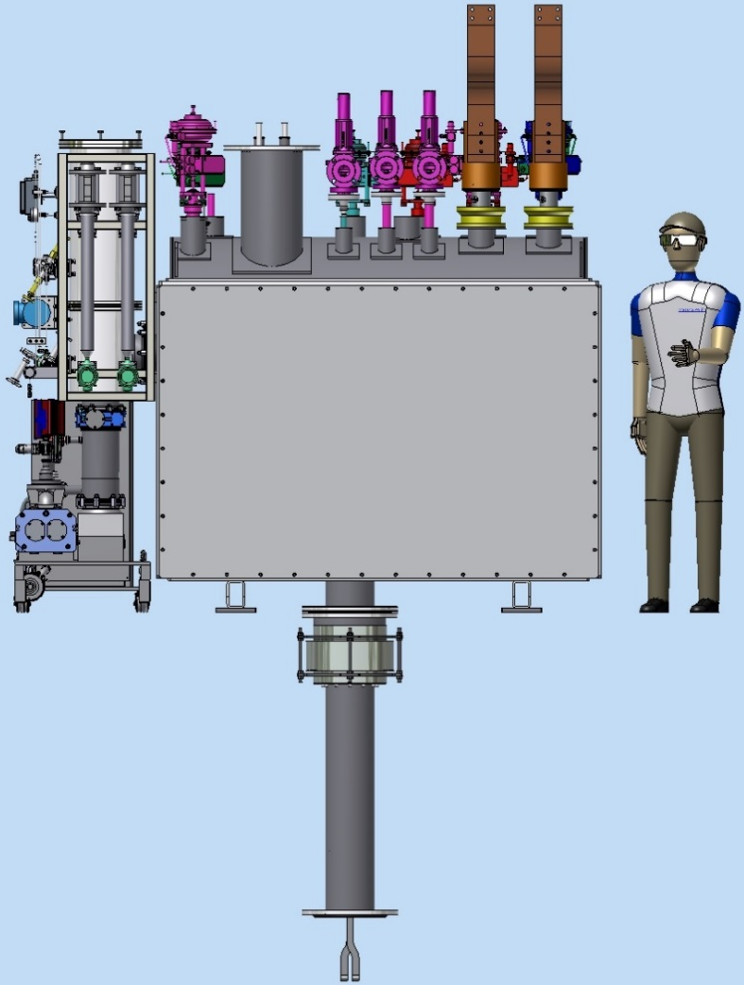
PANDA control Dewar and equipment
The PANDA control Dewar is designed to ensure helium delivery to the user in accordance with the flow scheme.
Vacuum barrier
Technologic volume
- transfer lines (TL) connecting refrigerator and the control Dewar through a vacuum barrier
- transfer line (Chimney) connecting the vacuum vessels of cryostat and control Dewar
Control Dewar
Pamp station
Instrumentation frame
Chimney

Slide 3
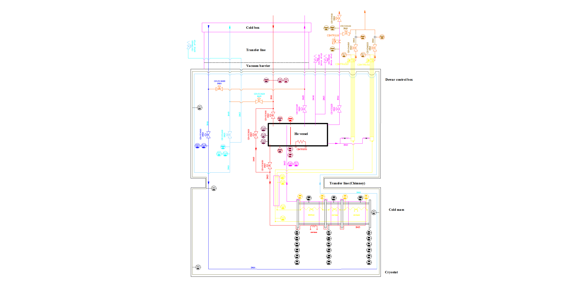
PANDA solenoid 2020, Flowscheme

Slide 4
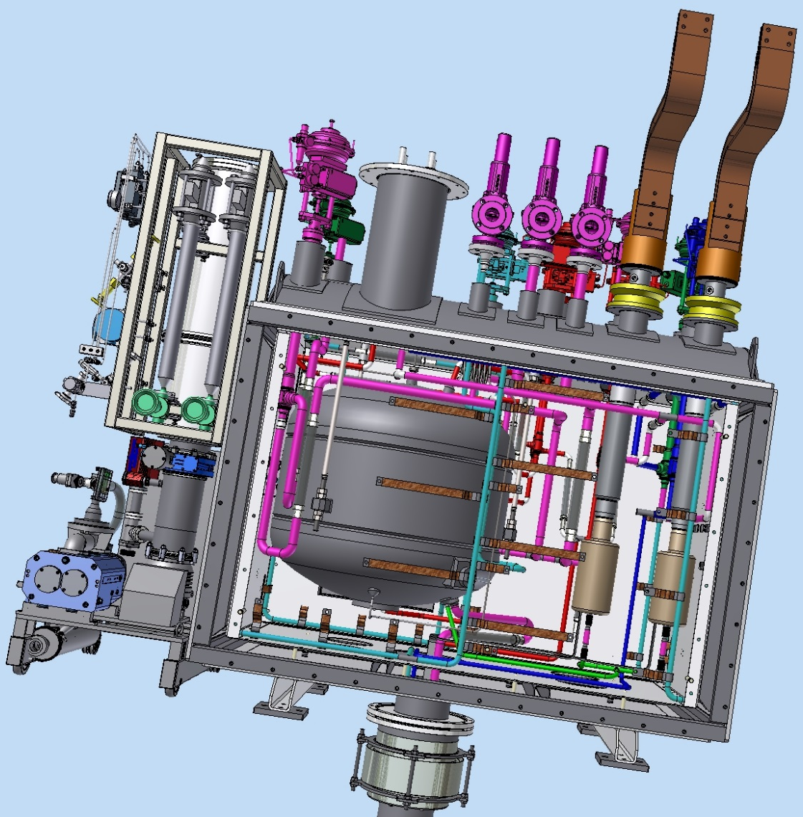
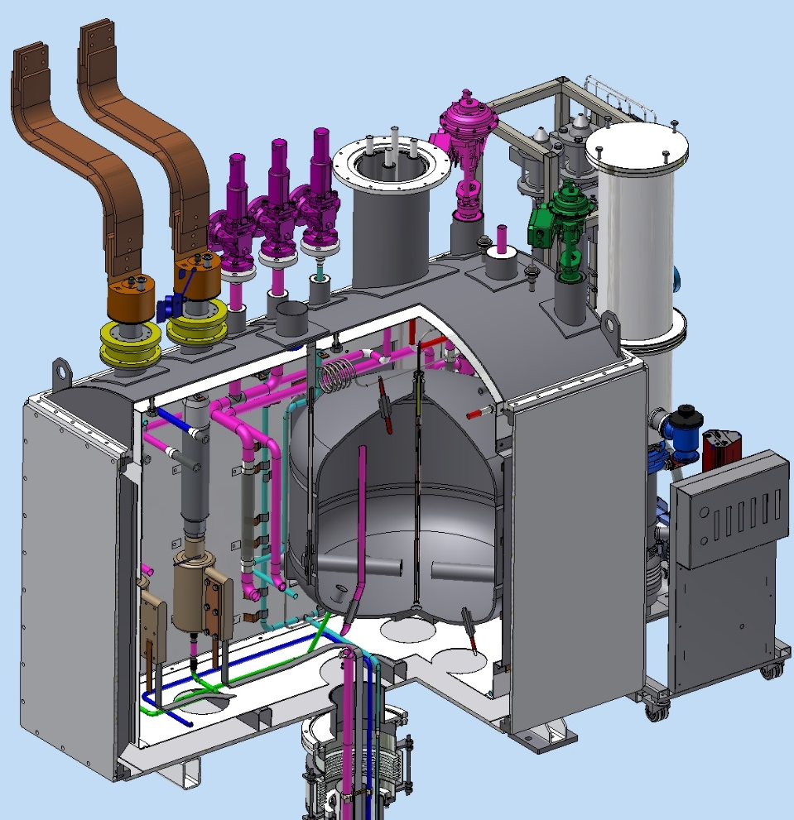
Control Dewar consists of:
a vessel for liquid helium (~450L);
valves, gauges;
current leads;
AL thermal shields cooled by gaseous helium;
vacuum shell.
1
2
3
5
4

Slide 5
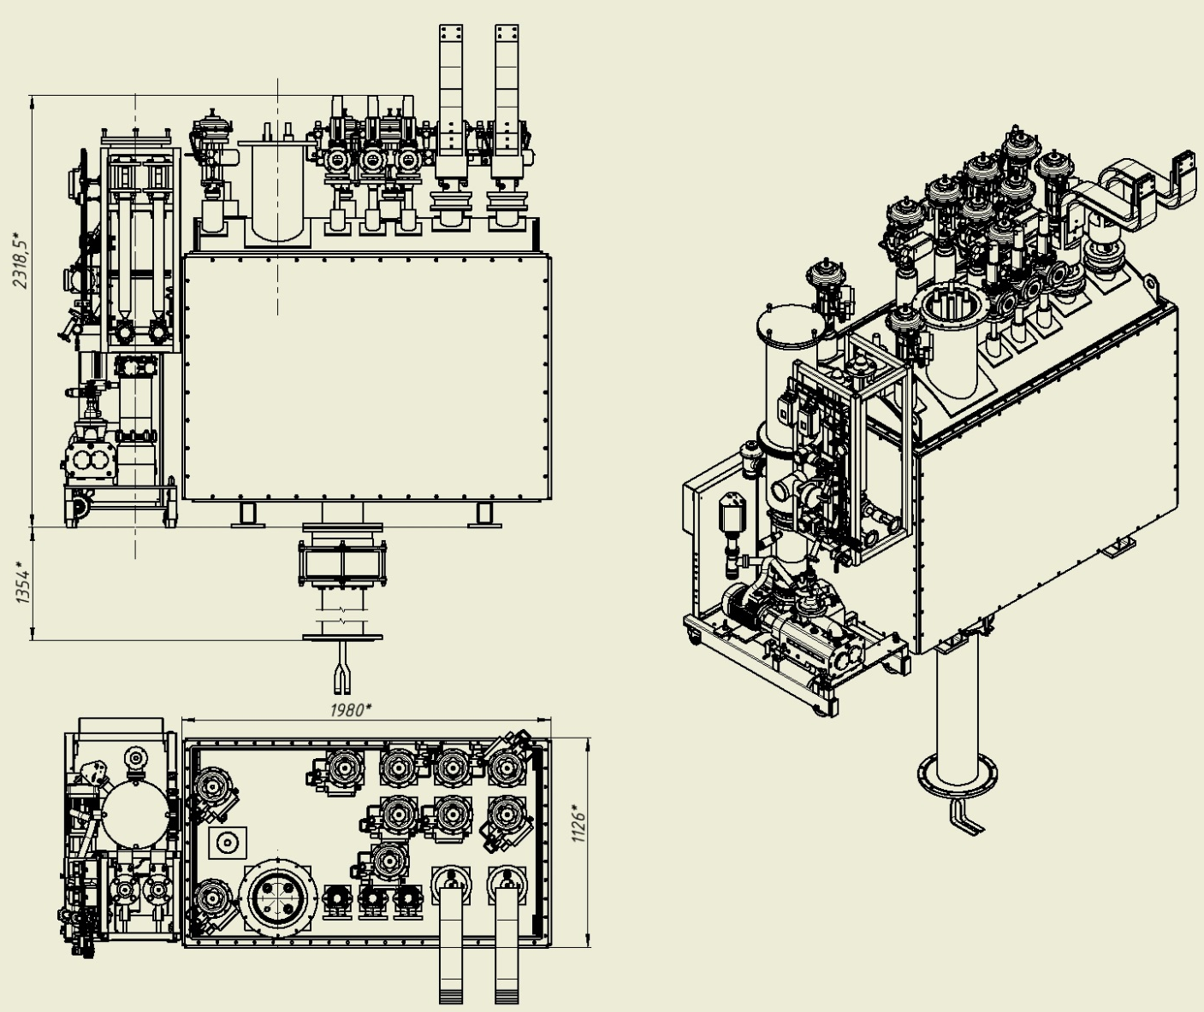
Dimensions and weight of the control Dewar with equipment.
2318.5mm
Flexible contact
The surface of the common platform.
Weight control Dewar about 3120 kg. with vacuum post ~3500 kg.

Slide 6
PANDA solenoid 2020, Vacuum scheme control Dewar and cryostat
Safety valve Flange DN350
Vacuum stand
The PANDA Control Dewar and the Cryostat are a single vacuum volume
Full range gauge
V1
DN150
Technologic
volume
RGA
V4
Control Dewar
S
V5
DN63
TMP 680 l/sec
Primary pump
3-4 l/sec
V3
Pirani
Leak Detector
Cryostat

Slide 7
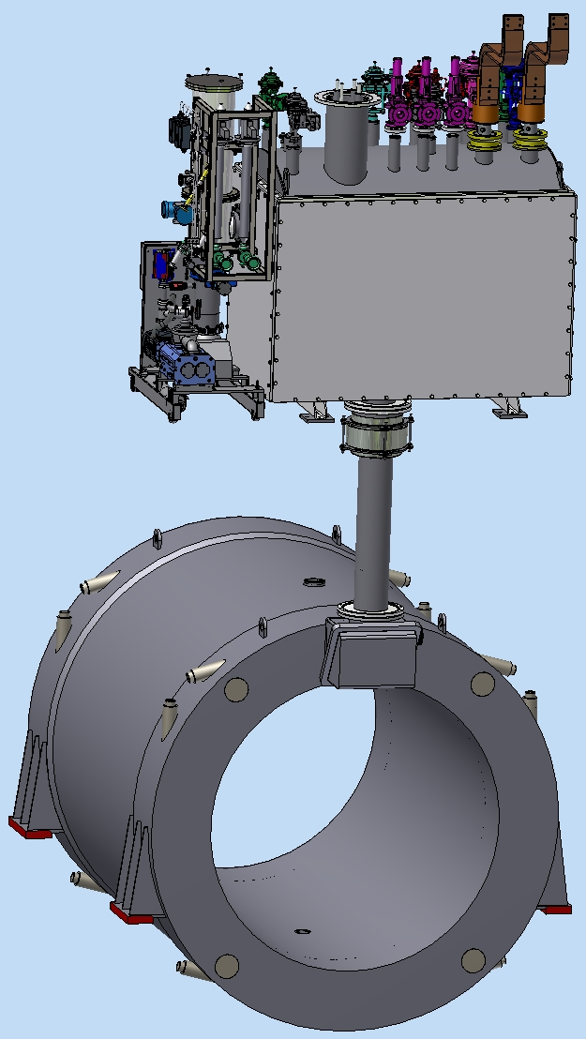
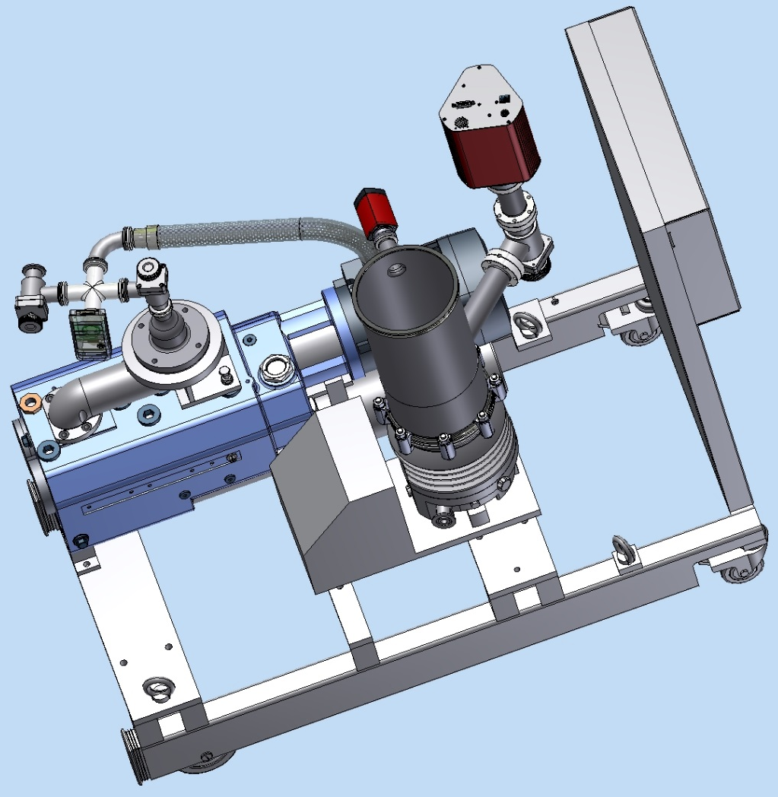
PANDA control Dewars and cryostats vacuum
Technologic
volume
Flange Kf25 for leak detector
Full range guage
RGA
Pirani
Pump station
Control Dewar
Chimney
Pump (680 l/s)
Cryostat
Primary pump

Slide 8
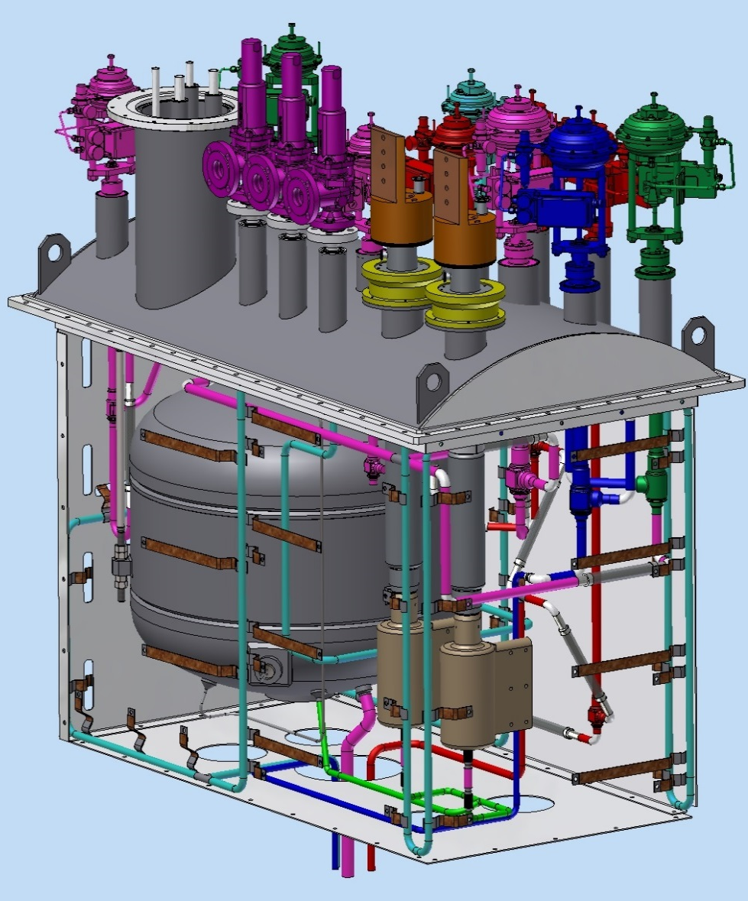
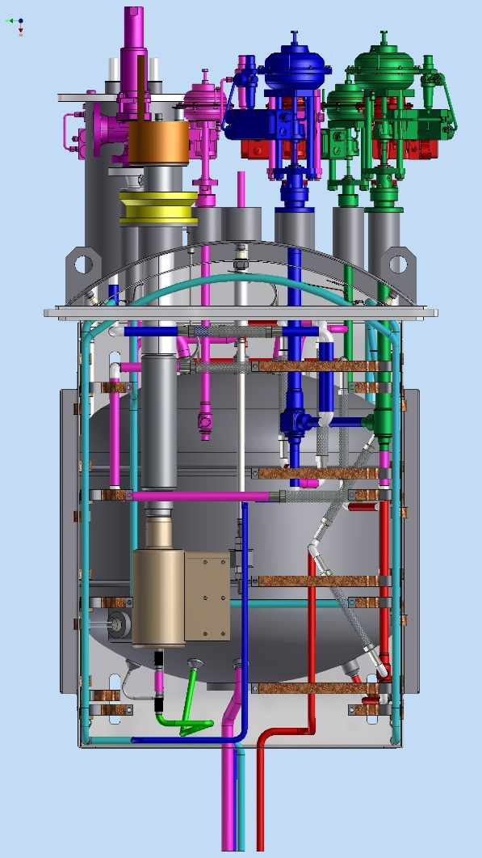
The stages of Assembly of the PANDA control Dewar:
1. Installation of pipelines on the lid of the control Dewar
Valves
Supporting top cover
Thermal shield
Pipelines
He vessel
Current
leads

Slide 9
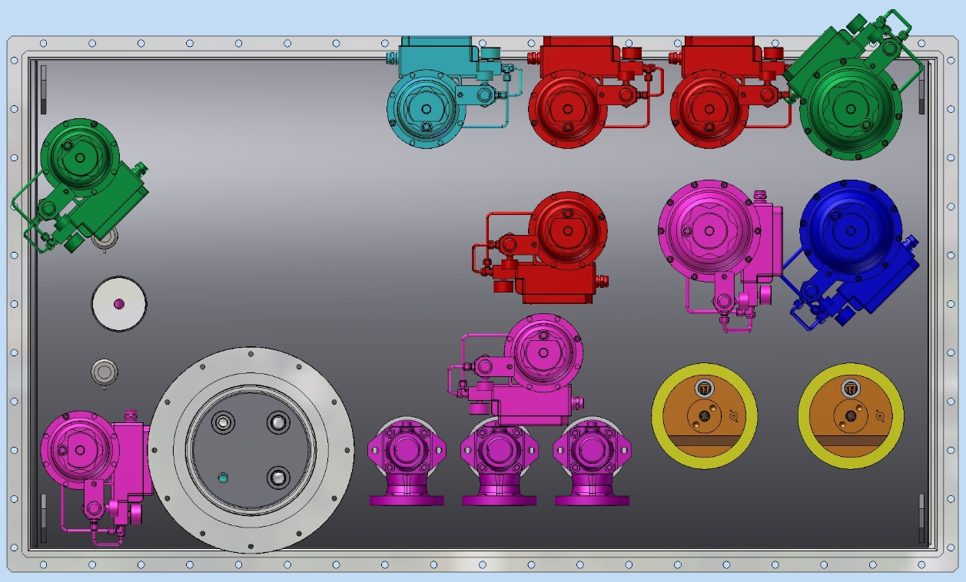
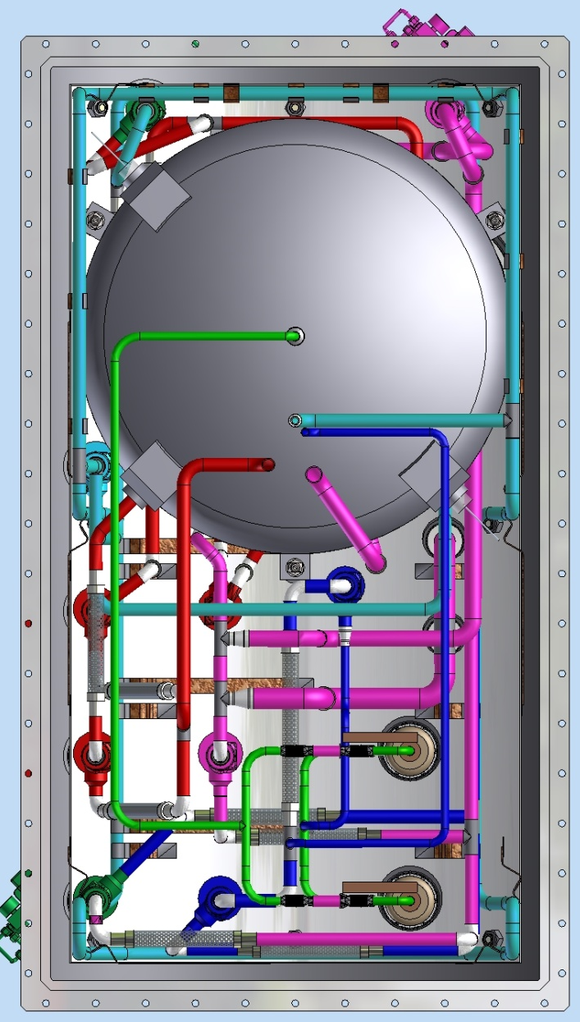
The stages of Assembly of the PANDA control Dewar:
1. Installation of pipelines on the lid of the control Dewar
1100
80KR
4,2KF
1950
5KR
The input of the Vacuum barrier
40KF

Slide 10
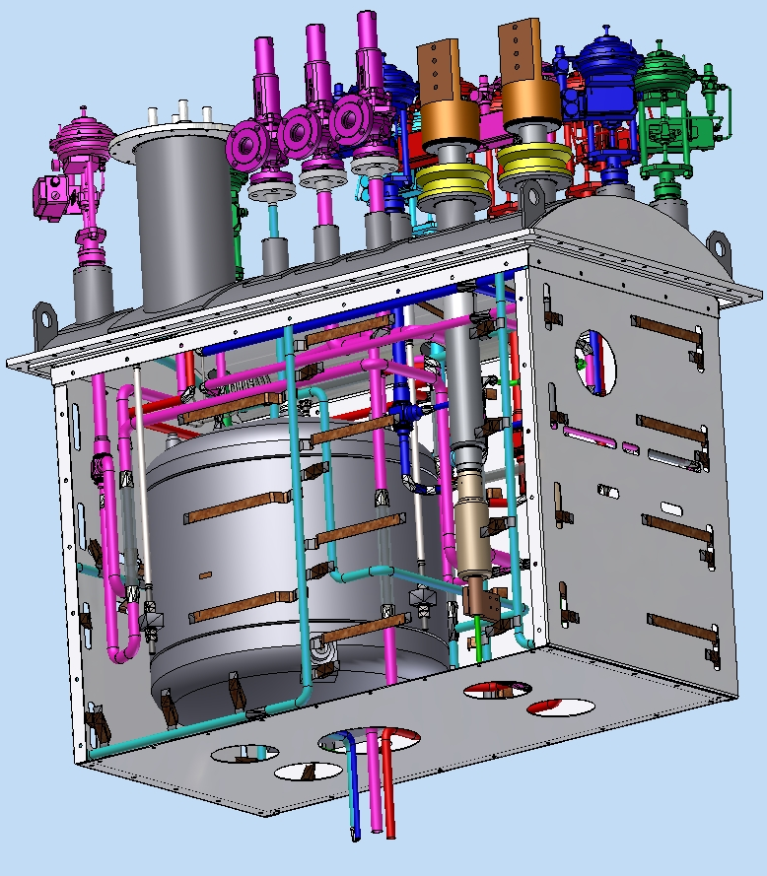
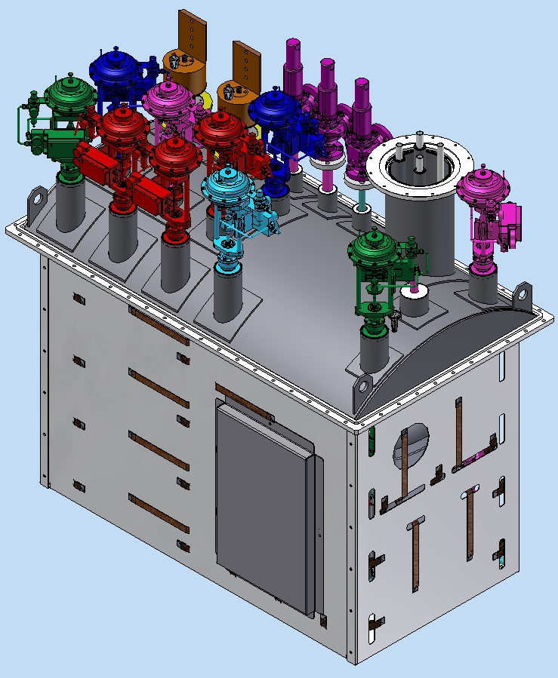
The stages of Assembly of the PANDA control Dewar:
2. Installation of the thermal shields at the Pipelines assembly, and attached the thermal bridges
Thermal bridge
AL Thermal
shield
Pipeline 50K
m=1230 kg.

Slide 11
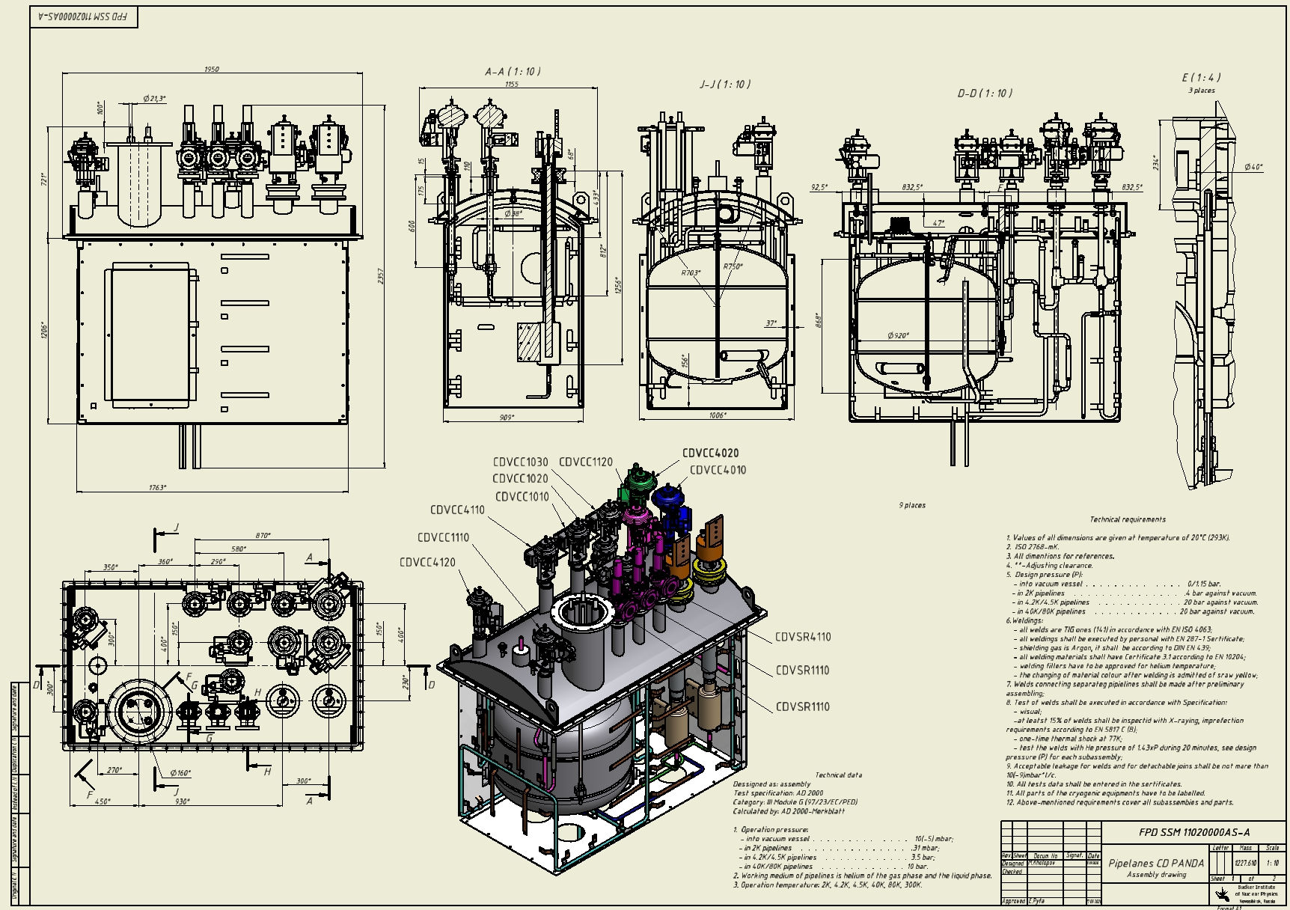
The drawing of the Pipelines PANDA control Dewar:
m=1230 kg.

Slide 12
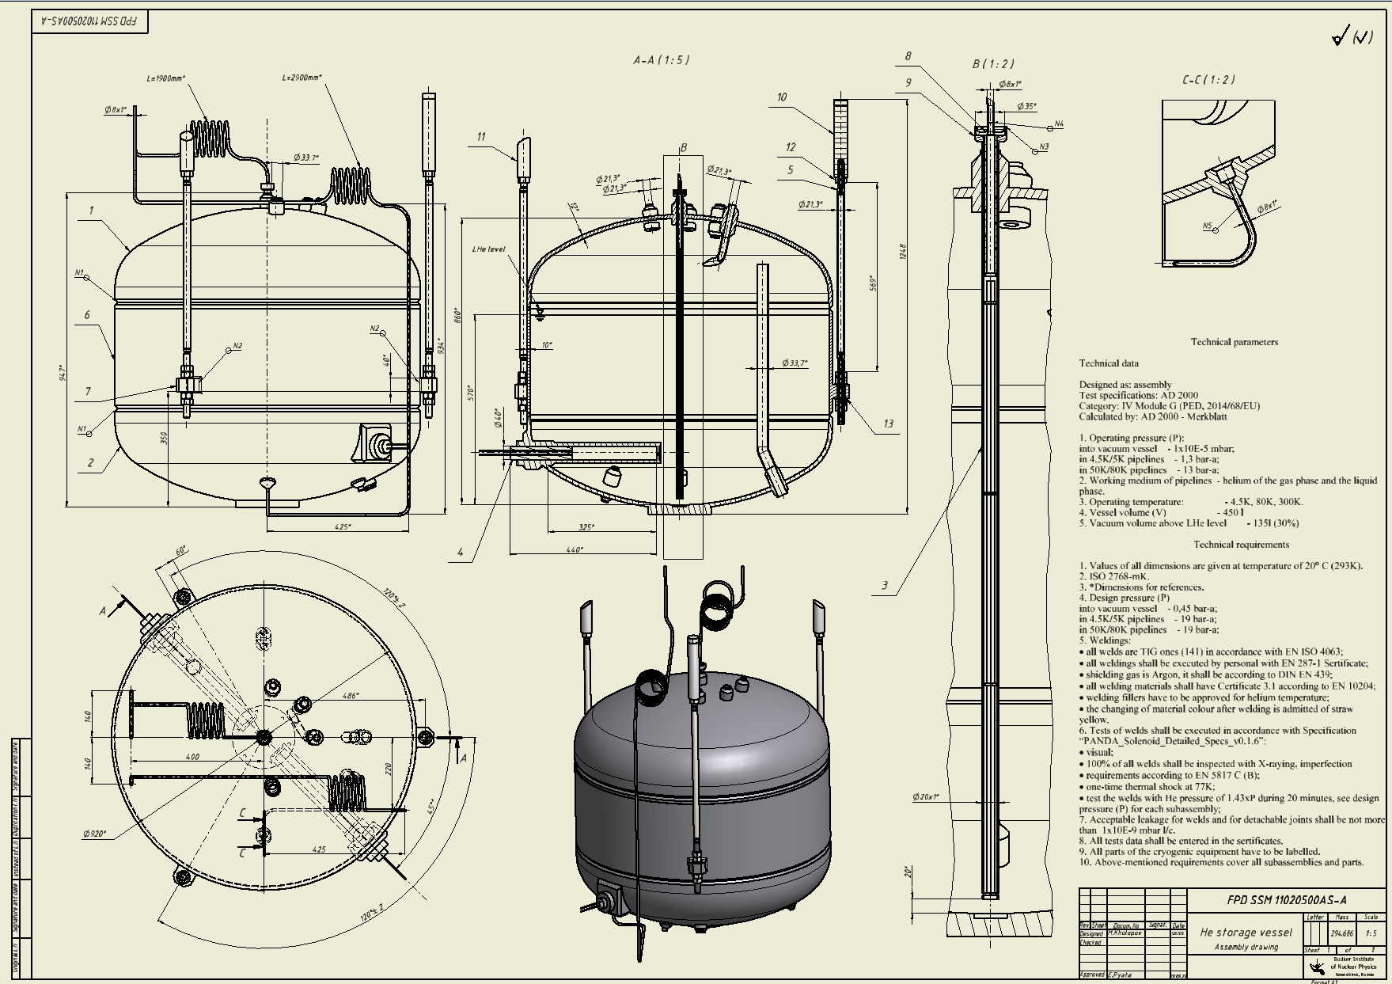
He storage vessel drawing
m=295 kg.

Slide 13
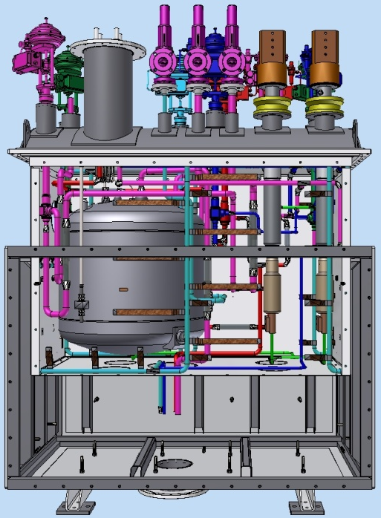
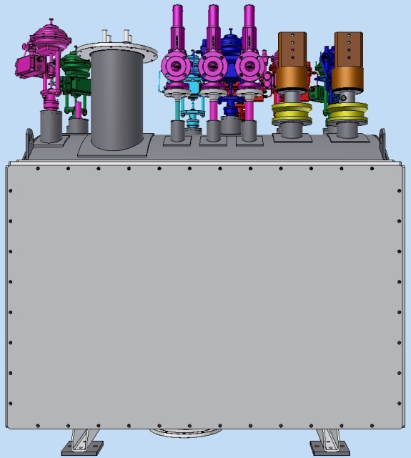
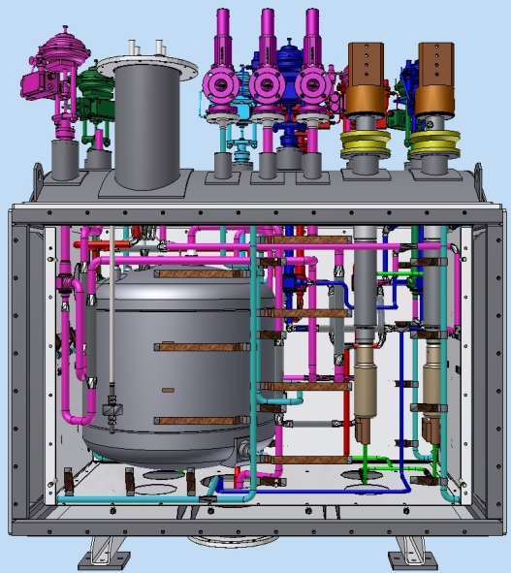
The stages of Assembly of the PANDA control Dewar:
3. Installation pipelines on the lid and thermal shields to the vacuum shell

Slide 14
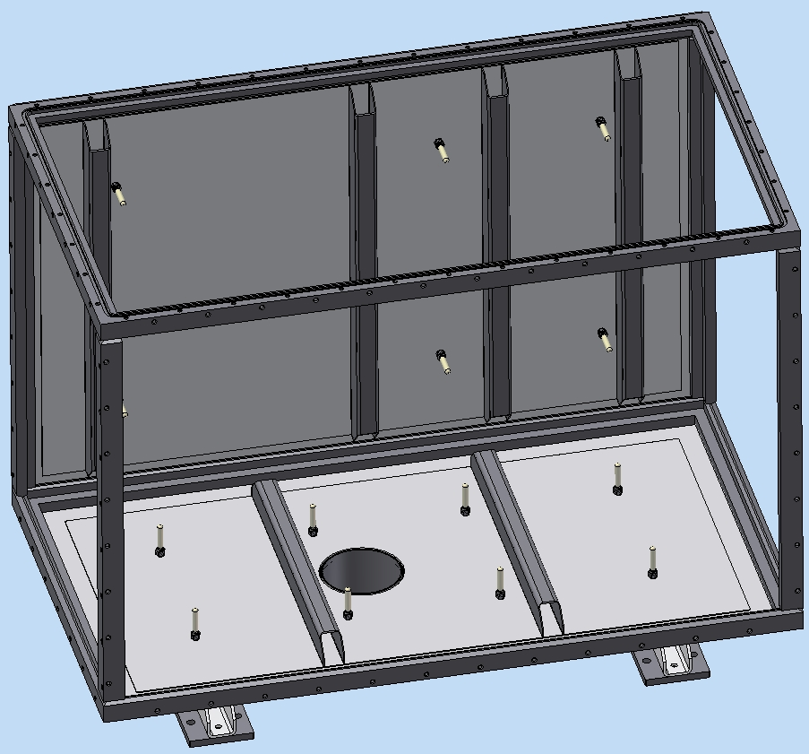
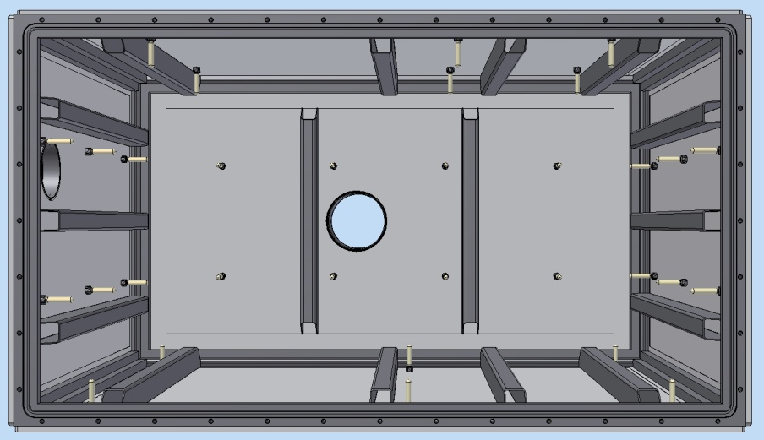
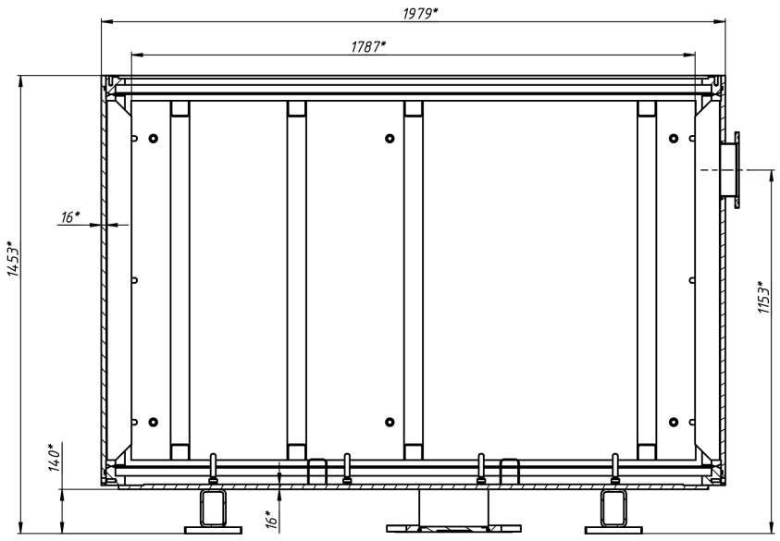
Design of the Vacuum shell
Vacuum shell Assembly, top view.
The Frame
Removable wall
The material of the frame and walls of the Vacuum shell is low alloy steel. m=1670 kg.
G10 supports

Slide 15
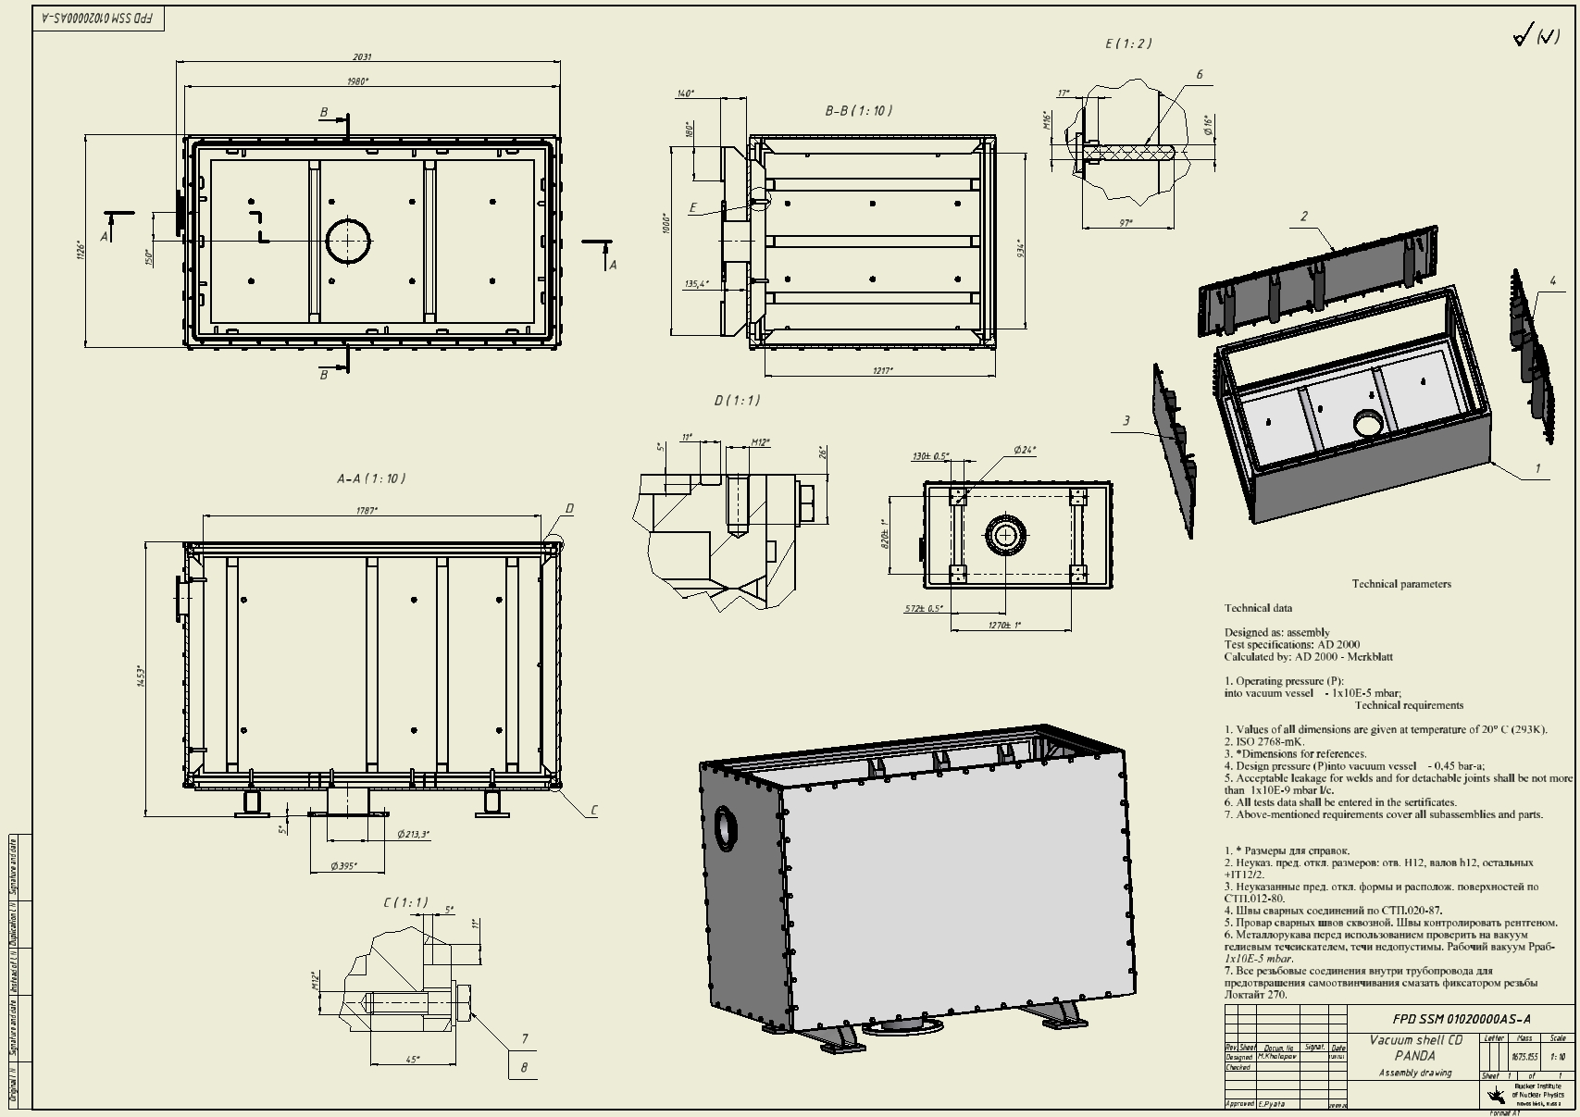
Vacuum shell drawing
m=1675 kg.

Slide 16
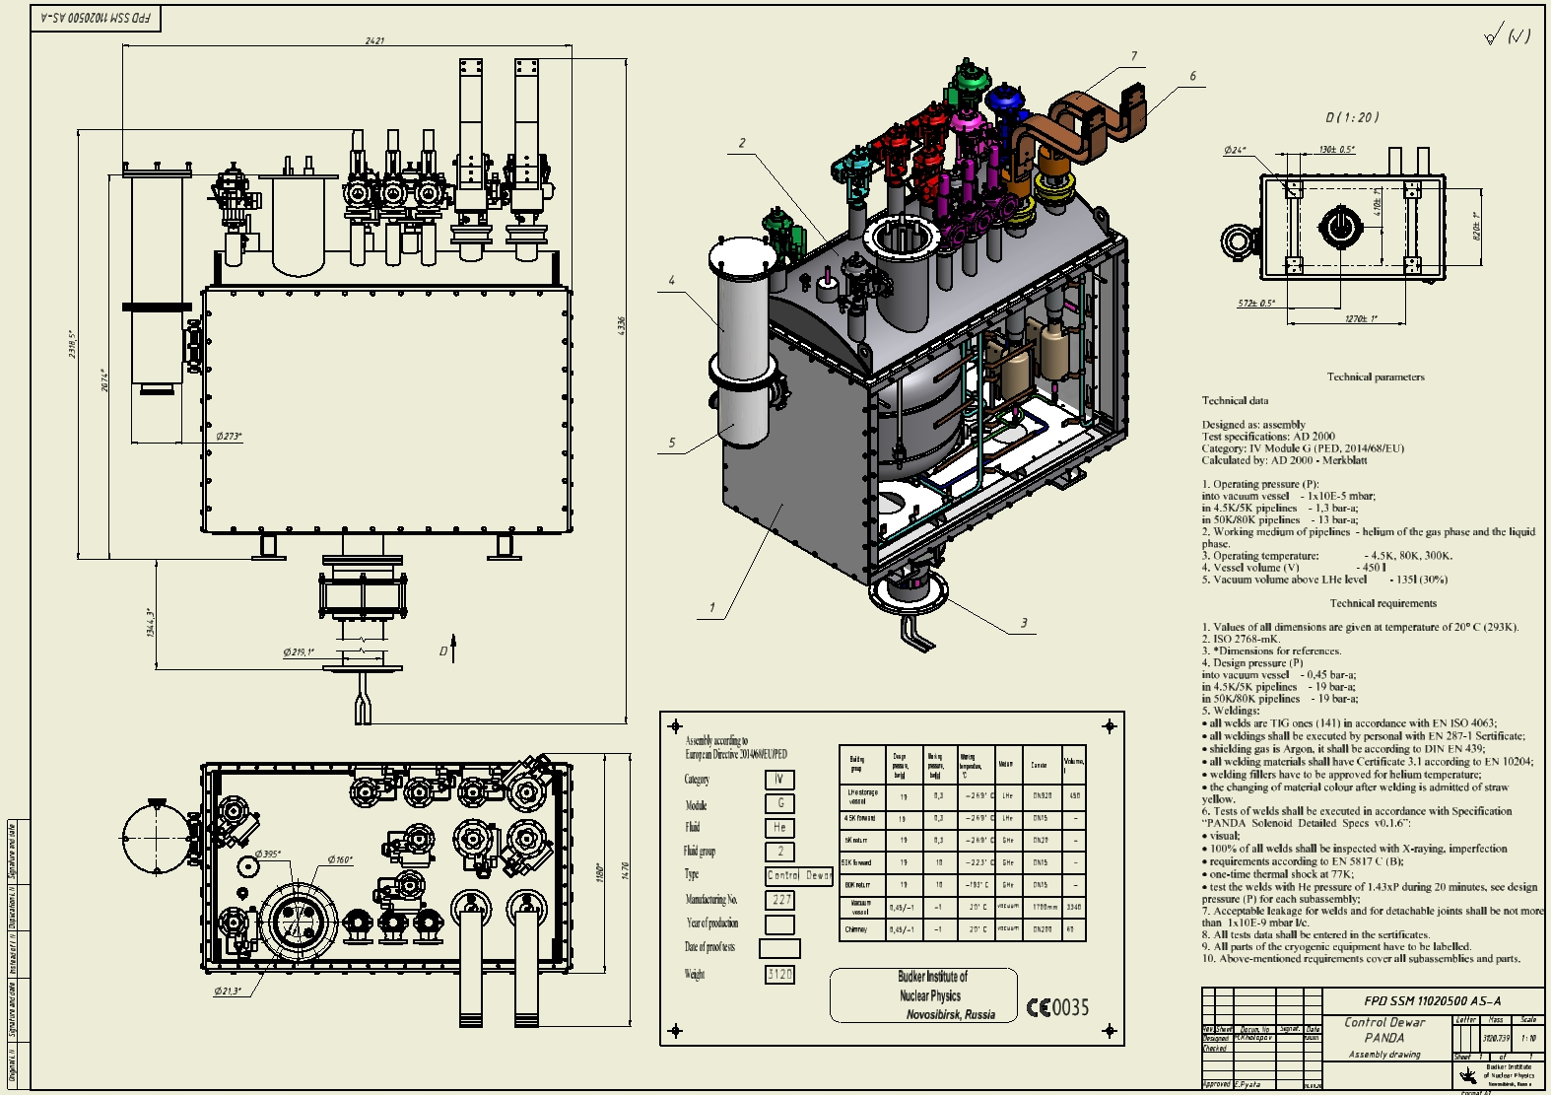
The drawing of the control Dewar PANDA :
m=3120 kg.

Slide 17
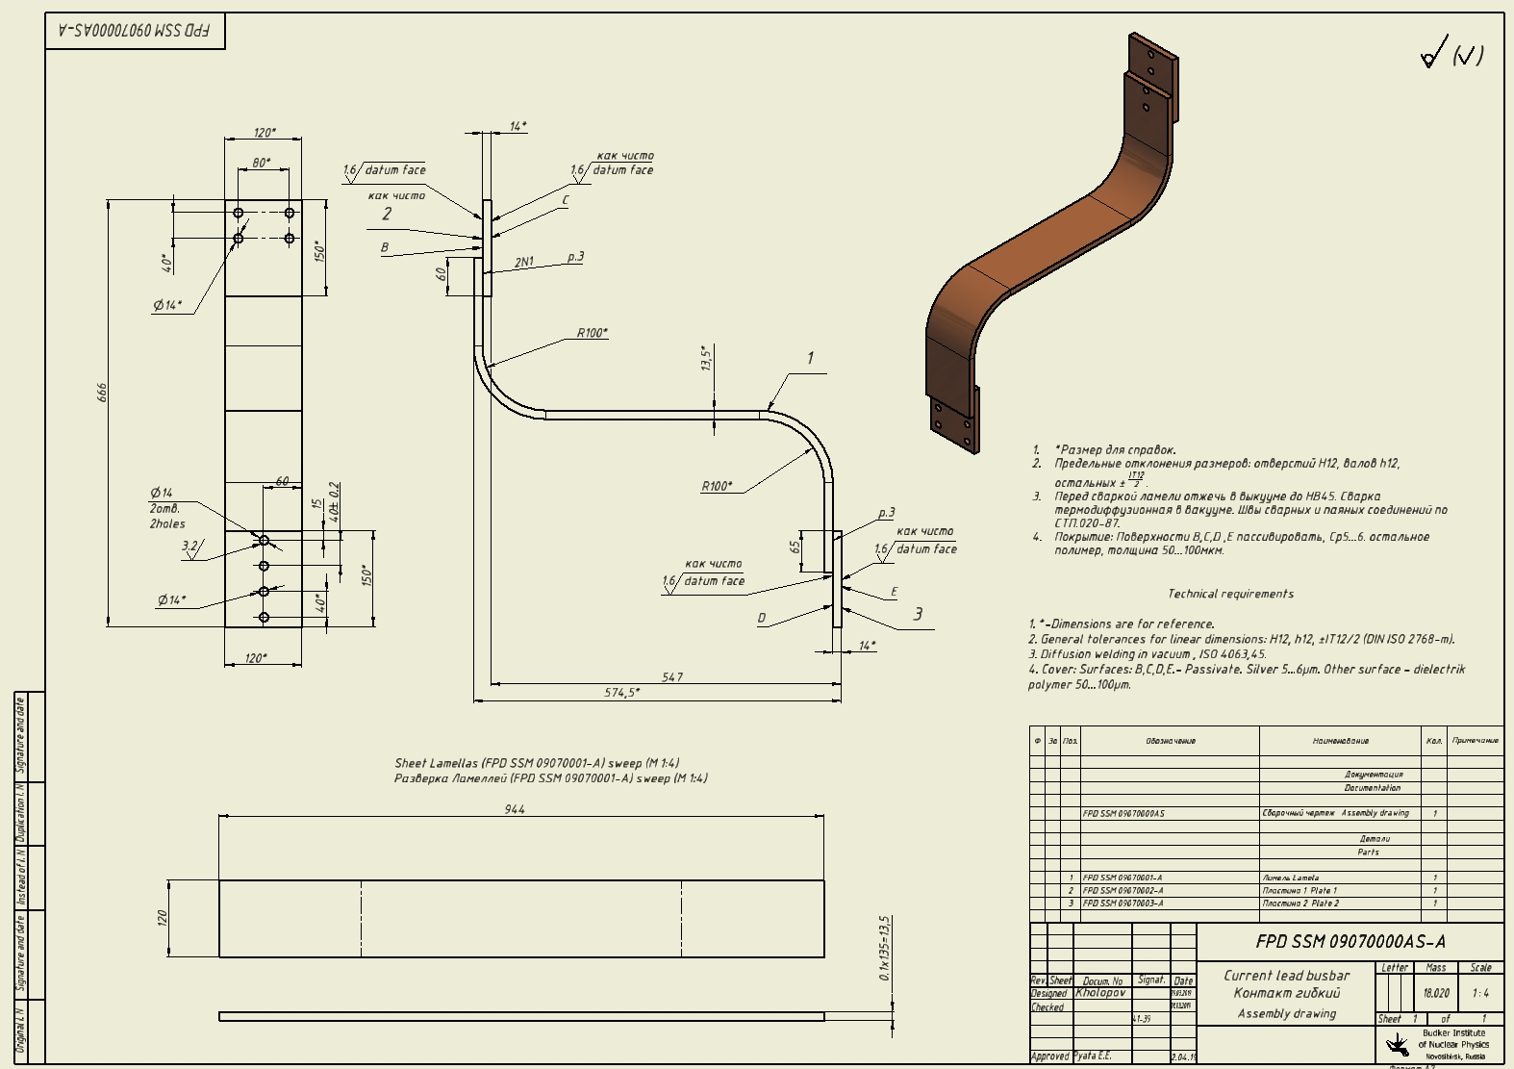
The drawing of the Current lead busbar:
m=18 kg.

Slide 18
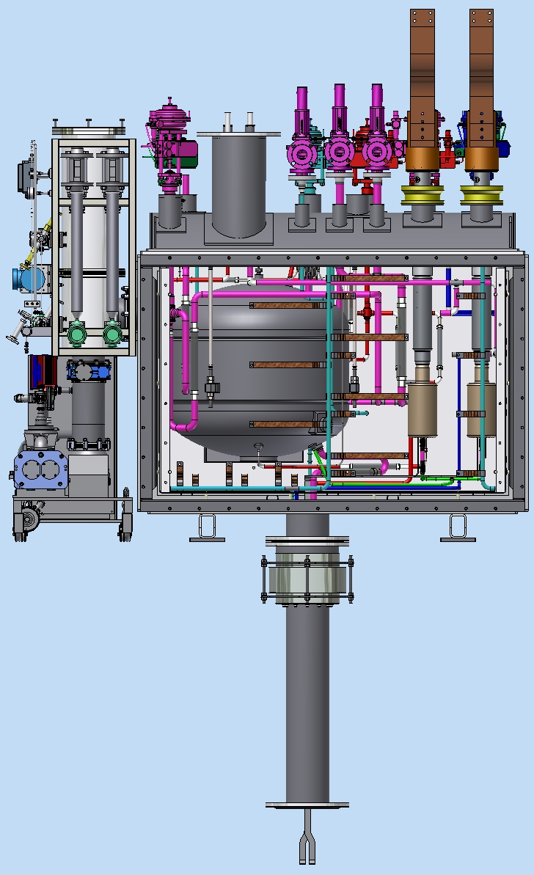
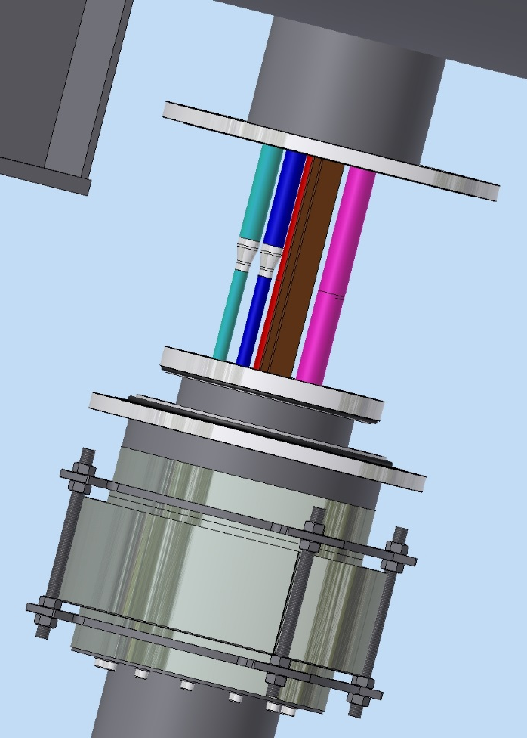
The interface of the PANDA control Dewar:
Control Dewar
Shift the bellows unit
Combine the pipies in
accordance with the
flow scheme
-Carry out the connection of
the superconductor
-Carry out pipes connection
by welding
Install super insulation
Install the bellows unit in place
Install the front wall of the
thermal shield, fix the thermal bridges
Install the front wall of the Vacuum shell
Chimney

Slide 19
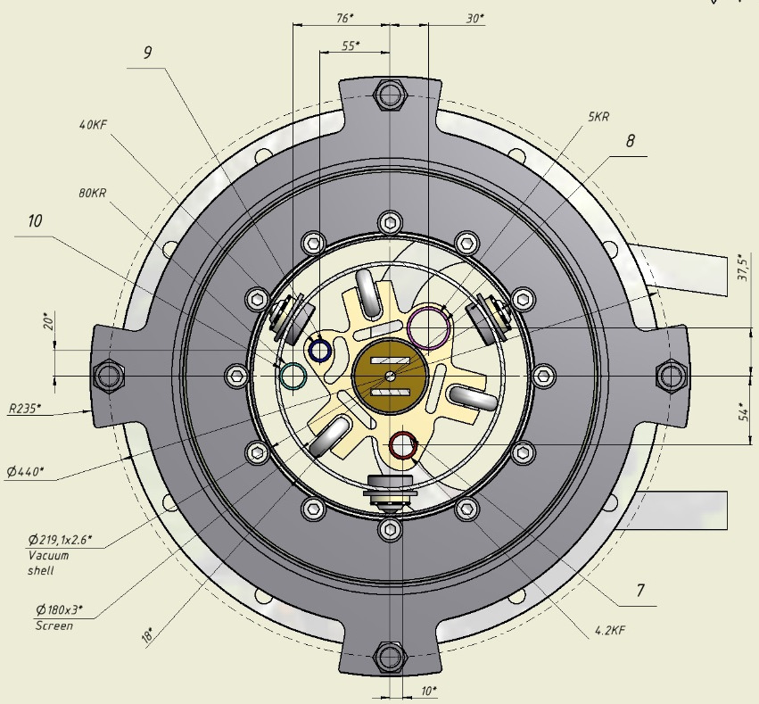
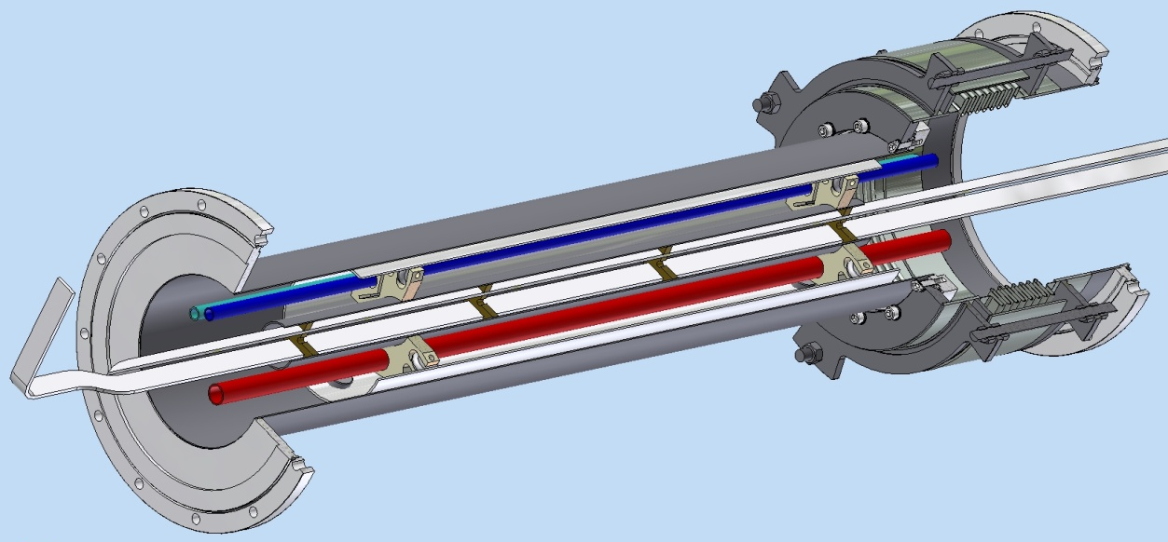
The Chimney design:
Vacuum shell
Bellows unit
Thermal shield
Spacer
Superconductor
Flange ISO320RBR
Flange ISO320RBR
Pipelines
m=84 kg.

Slide 20
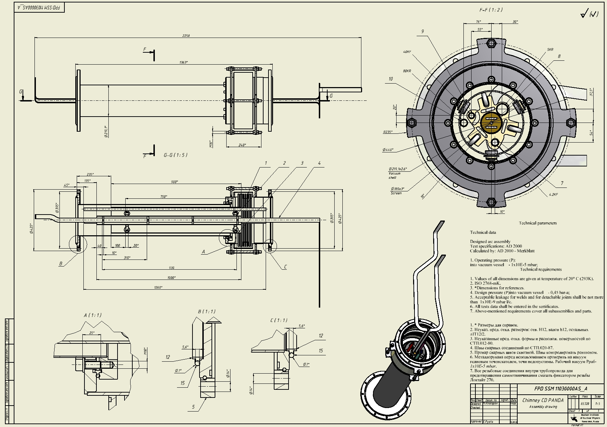
The Chimney drawing
m=84 kg.

Slide 21
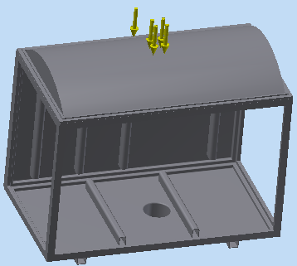
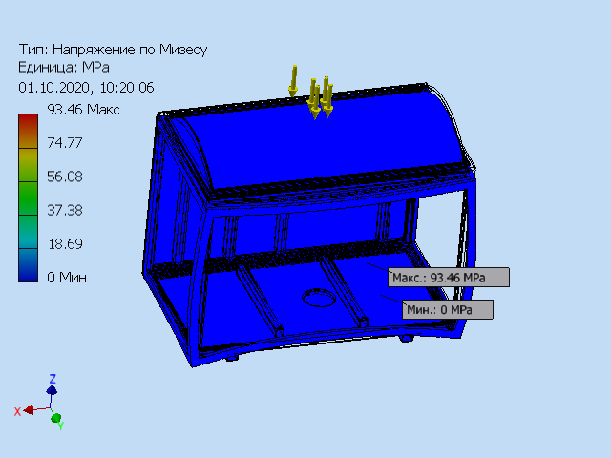
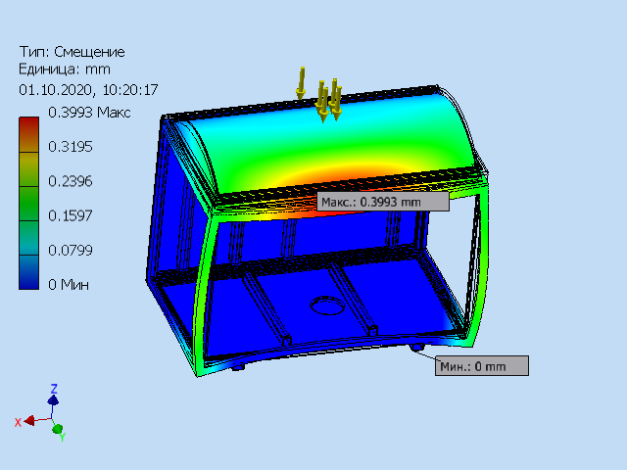
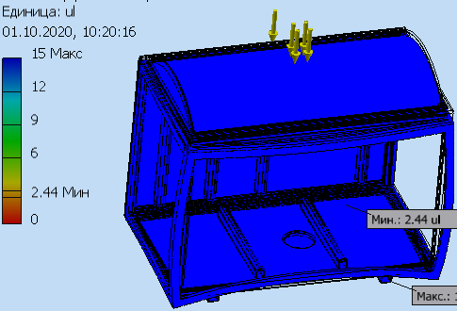
Vacuum shell without removable walls calculation
G
P=1300kg
The von Mises stress
Deformation
Margin

Slide 22
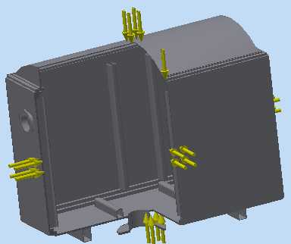
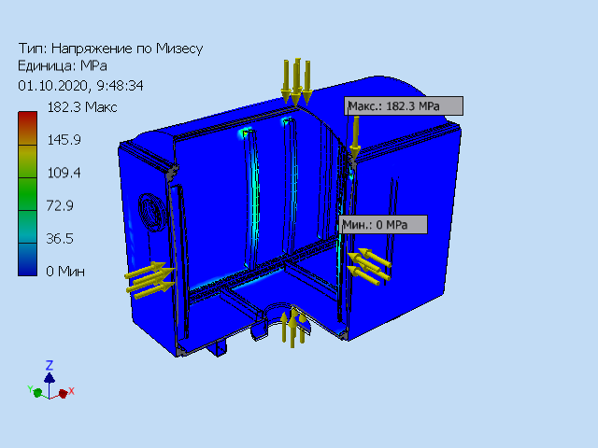
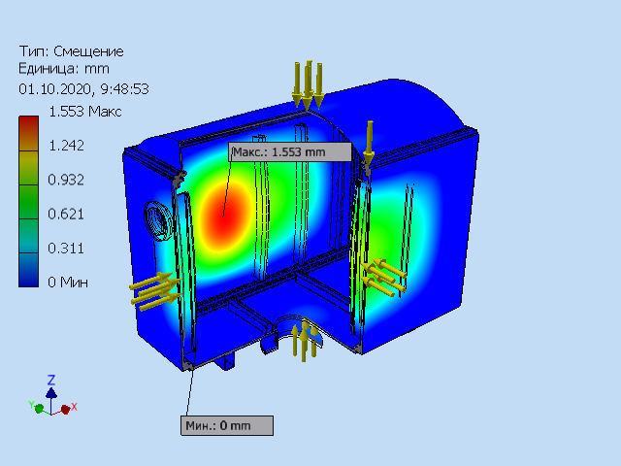
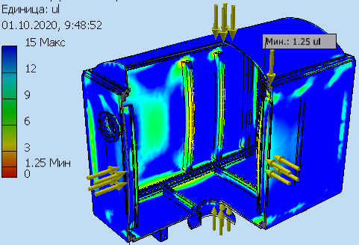
Full Vacuum shell calculation
The von Mises stress
P=0.1MPa
Deformation
Margin

Slide 23
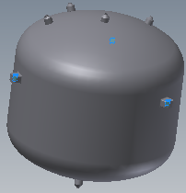
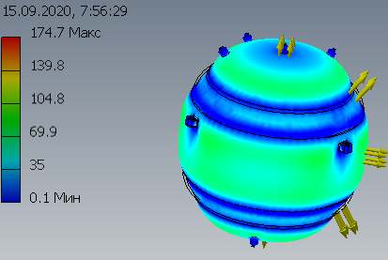
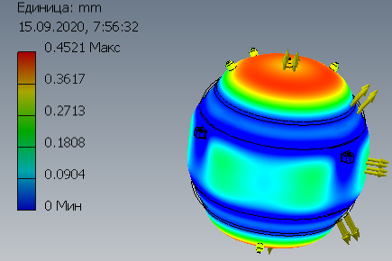
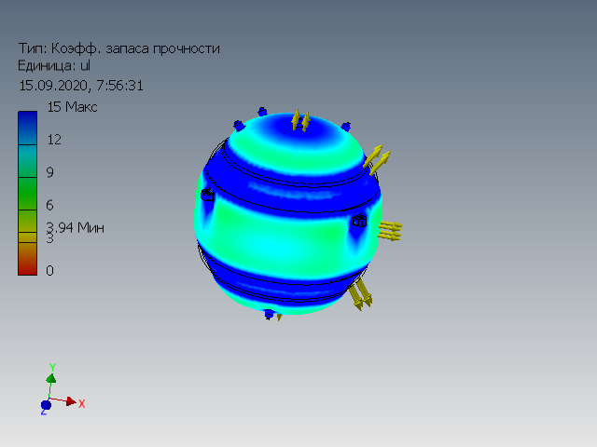
He storage vessel calculatioin
The von Mises stress
P=2.000 MПа
Deformation
Margin

Slide 24
Thank you for your attention

