Slide 1
Resonance Photoproduction of Pionic Atoms @
Joint THEIA-STRONG2020 and JAEA/Mainz REIMEI Web-Seminar, February 17, 2020
Victor V. Flambaum
Based on: V. V. Flambaum, J. Jin, and D. Budker, arXiv:2010.06912

Slide 2
Outline
Pionic atoms
Photoproduction cross-sections
Production rates expected at GF

Slide 3
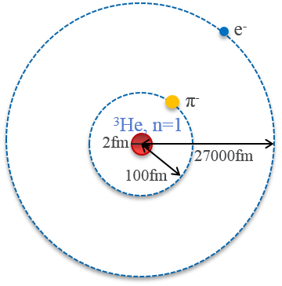
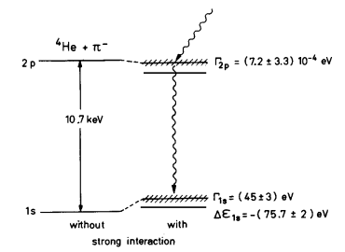
Pionic atoms
A negative pion orbiting the nucleus
hydrogen-like system
m_{π} c² ≈ 140 MeV≈ 270 m_{e} c²
Strong interaction effects
pion absorption width broadening
energy shift vs. Coulomb
Spin =0. Critical charge for point nucleus Z=68! 1s orbital radius is close to nuclear radius for Z=40
J. Hüfner, Pions interact with nuclei, Physics Reports 21, 1 (1975)

Slide 4
Pionic atoms
Physics Motivation
GF photons bound pions
$E_{γ}$, $Γ_{ph}$ vs. $Γ_{tot}$, flux (tunable energy, narrow band, high flux)
deeply bound pionic atoms
strong interaction, nuclear structure, nuclear forces forming the structure…

Slide 5
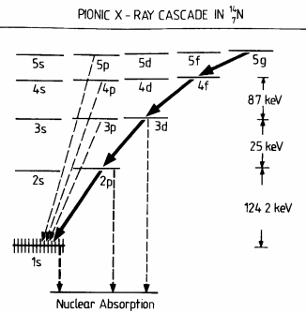
Methods for producing pionic atoms
Stopping free $π^{−}$ in a pion beam
produce ~10⁵ pionic atoms per sec
X-ray cascade between “circular” states
deeply bound states cannot be produced
population of higher ns states is suppressed
M. Hori, et al, Nature 581, 37 (2020); T. Ericson and W. Weise, Pions and Nuclei (Clarendon Press, 1988)

Slide 6
Methods for producing pionic atoms
Our proposal
resonance photoproduction of bound pions from the nucleus
$γ+n→p+π^{−}, γ+_{Z_{i}}^{A}X{→(}_{Z}^{A}X^{′}+π^{−})nl$, $Z=Z_{i}+1$
$E_{γ}≈140$ MeV (final nucleus in its ground state)
$Γ_{ph}$ vs. $Γ_{tot}$

Slide 7
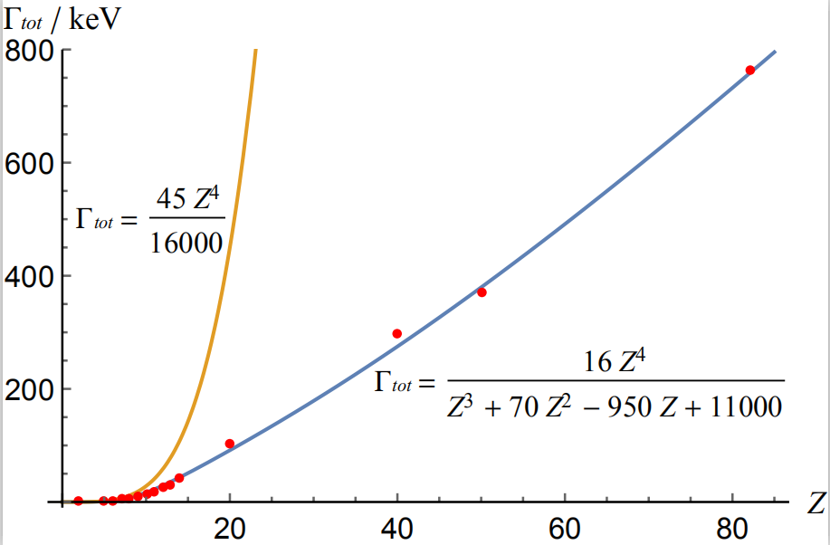
Methods for producing pionic atoms
Total width of ns pionic states
width: pion absorption, X-ray radiation, Auger electron emission
fitting 1s width data
$$Γ_{tot}(Z,1)$$
$Γ_{tot}\left(Z,n\right)≈Γ_{tot}(Z,1)\frac{1}{n^{3}}$
for pionic atoms with 1s orbital radius larger than nuclear radius
E. Friedman and A. Gal, Physics Reports 452, 89 (2007); J. Konijn, et al, Nuclear Physics A 519, 773 (1990)

Slide 8
Photoproduction cross-sections
Cross-section for monochromatic photons
$σ_{0}=2π\frac{2I_{f}+1}{2I_{i}+1}{\left(\frac{ℏc}{E_{γ}}\right)}^{2}\frac{Γ_{γ}}{Γ_{tot}}$
$E_{γ}≈140$ MeV
$Γ_{tot}$: dominated by pion absorption
$Γ_{γ}$ : radiative capture of the pion by nuclei, with final nuclei in the ground state
$\frac{Γ_{γ}}{Γ_{tot}}$: $α$ ($σ_{0}$ ~ 1mb, valid for light nuclei)
2% (radiative capture probability, upper estimate of $\frac{Γ_{γ}}{Γ_{tot}}$)
J. Delorme and T. Ericson, Physics Letters 21, 98 (1966)

Slide 9
Photoproduction cross-sections
bound pion vs. free pion
Integrated cross-section: $∫σ\left(E\right)dE=\frac{π}{2} σ_{0} Γ_{tot}$ (bound pion)
$∫σ\left(E\right)dE={\left(Zα\right)}^{2}mc^{2}Kσ_{p}$, $K=1−exp(−2πZαmc/p)$ (near threshold)
$σ_{p=0}$
measurements of $σ_{p=0}$ (using quasi-monochromatic photons) are limited.
light nuclei:
heavy nuclei: $σ_{p=0}\sim 1μ$b
C. Tzara, Nuclear Physics B 18, 246 (1970); M. Singham and F. Tabakin, Annals of Physics 135, 71 (1981)

Slide 10
Photoproduction cross-sections
$σ_{p=0}$
yields for $(γ,π^{−})$ are A-independent for targets with $A≥40$ ($A≈2Z$)
$γ+$¹⁹⁷Au $→$ ¹⁹⁷Hg_{g.s.}+ $π^{−}$, $σ_{p=0}\sim 1μ$b
$σ_{p=0}\sim 1μ$b for nuclei with $9≤Z≤92$ (rough estimate)
K. Sakamoto, et al, Phys. Rev. C 59, 1497 (1999); I. Blomqvist, et al, Z Physik A 288, 313 (1978)

Slide 11
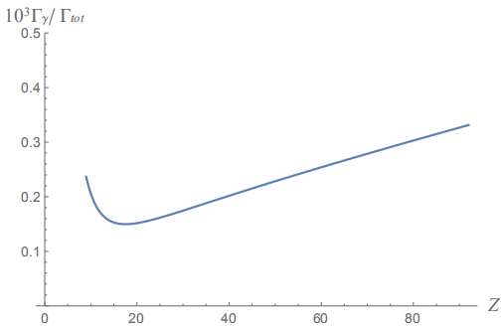
Photoproduction cross-sections
bound pion vs. free pion
$σ_{p}$ $Γ_{γ}/Γ_{tot}$, $σ_{0}$ , production rates
light nuclei:
$Z≥9:σ_{p}≈1μ$b
$$Γ_{γ}/Γ_{tot}≈0.25×{10}^{−3}$$

Slide 12
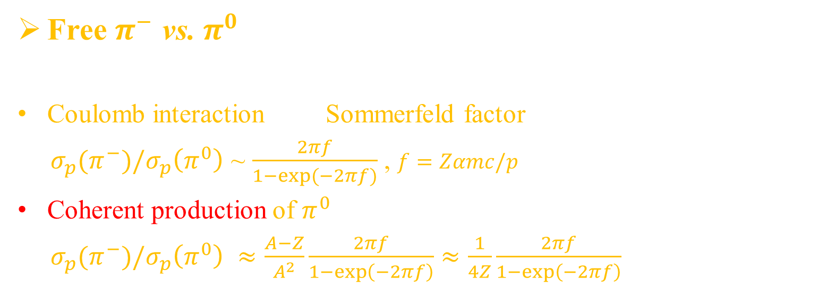
Photoproduction cross-sections
Free $π^{−}$ vs. $π^{0}$
Coulomb interaction Sommerfeld factor
$σ_{p}(π^{−})/σ_{p}\left(π^{0}\right)$ ~ $\frac{2πf}{1−exp⁡(−2πf)}$ , $f=Zαmc/p$
Coherent production of $π^{0}$
$σ_{p}(π^{−})/σ_{p}\left(π^{0}\right)$ $≈\frac{A−Z}{A^{2}}\frac{2πf}{1−\exp\left(−2πf\right)}≈\frac{1}{4Z}\frac{2πf}{1−\exp\left(−2πf\right)}$
B. Krusche, et al, Physics Letters B 526, 287 (2002); B. Krusche, Eur. Phys. J. Special Topics 198, 199 (2011)

Slide 13
Photoproduction cross-sections
Background photon attenuation
For 140 MeV photon:
pair production & Compton scattering
$σ_{tot}\left(Z_{i}\right)≈σ_{pp}+σ_{scat}≈0.6×{10}^{−26}(Z_{i}^{2}+Z_{i})$ cm² >> $σ_{0}$
Particle Data Group, Progress of Theoretical and Experimental Physics 2020, 083C01 (2020)

Slide 14
Production rates at the GF
GF photons: nearly uniformly distributed up to the maximal energy
Proper collimation: suppress the background
$j={10}^{17}$ph/s $j_{eff}=j\frac{Γ_{ph}}{E_{γ}}$
$Γ_{ph}$: $Γ_{ph}=Γ_{tot}$ or $Γ_{ph}=E_{1s}$ (1s binding energy)
$σ_{eff}\left(Z,n\right)$, $σ\left(E\right)=σ_{0}\frac{{\left(Γ_{tot}/2\right)}^{2}}{{{\left(E−E_{γ}\right)}^{2}+\left(Γ_{tot}/2\right)}^{2}}$
$σ_{eff}\left(Z,n\right)≈σ_{0} \frac{Γ_{tot}}{Γ_{ph}}$
collimation

Slide 15
Production rates at the GF
Maximal production rates
$p\left(Z,n\right)=j_{eff}\frac{σ_{eff}\left(Z,n\right)}{σ_{tot}\left(Z_{i}\right)}=5.6×{10}^{8}\frac{σ_{p=0}(Z)/1μb}{n^{3}}$ s⁻¹
light nuclei:
$Z≥9:σ_{p}≈1μ$b
$p\left(Z,1\right)≈5.6×{10}^{8}$s⁻¹

Slide 16
Kaonic atoms
Strangeness conservation
$γ+n→p+K^{−}$
($K^{−}$: $\overline{u}s$. Require $\overline{s}$.)
Possible methods
$γ→K^{−}+K^{+}$ $γ+_{Z}^{A}X{→(}_{Z}^{A}X^{′}+K^{−})nl+K^{+}$
threshold energy, $E_{γ}≈1$GeV, beyond current scope of the GF
nonresonance (free $K^{+}$)

Slide 17
Summary
High production rates
Deeply bound states
Higher ns states and nl states
light nuclei:
$Z≥9:σ_{p}≈1μ$b
$p\left(Z,1\right)≈5.6×{10}^{8}$s⁻¹
Thank you!

