Slide 1
Physics beamtime scheduling 2021+22 machine meeting 29.09.20

Slide 2
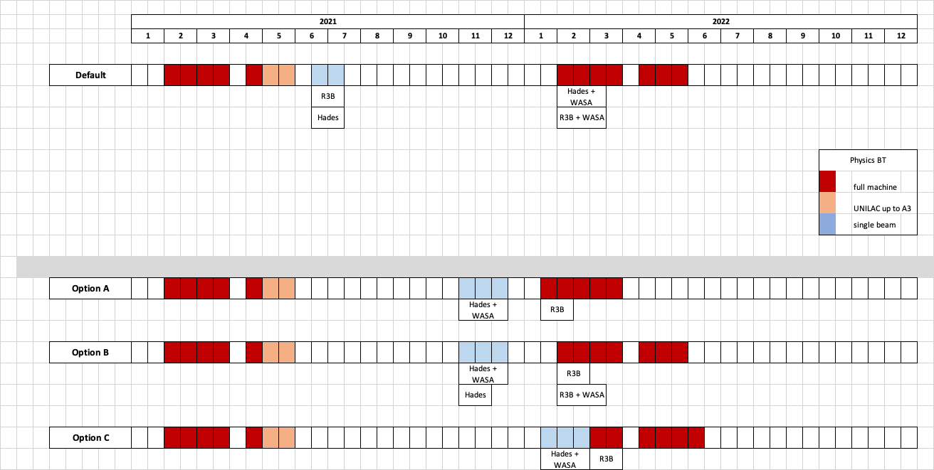
Overall timeline
DRAFT - for internal use only

Slide 3
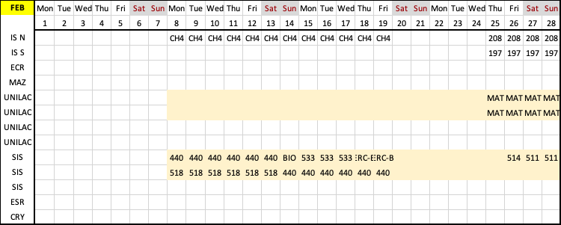
BTS 2021/02
DRAFT - for internal use only

Slide 4
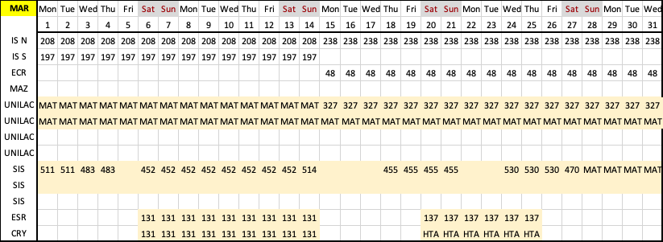
BTS 2021/03
DRAFT - for internal use only

Slide 5
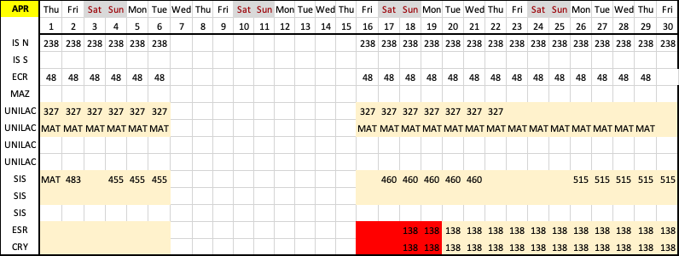
BTS 2021/04
DRAFT - for internal use only

Slide 6
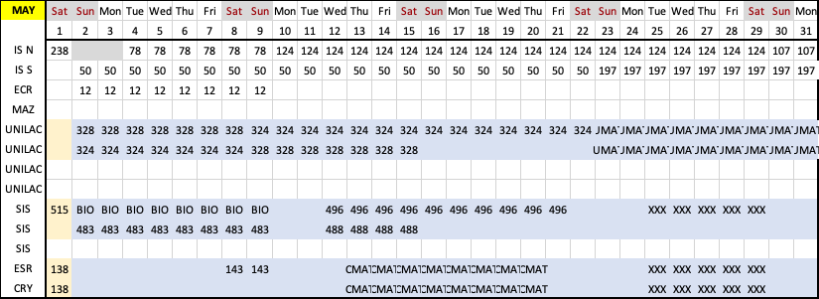
BTS 2021/05
DRAFT - for internal use only

Slide 7
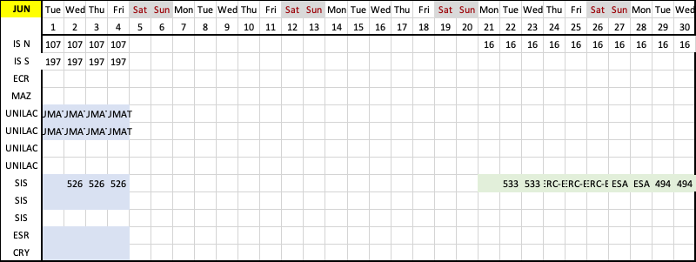
BTS 2021/06
DRAFT - for internal use only

Slide 8
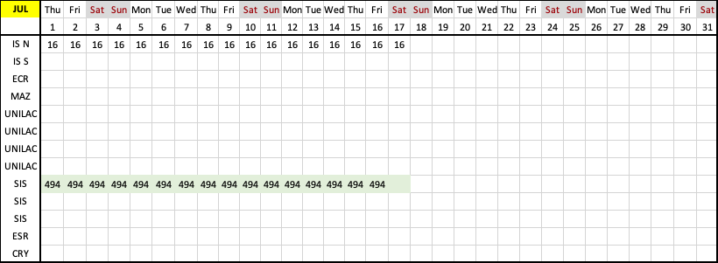
BTS 2021/07
DRAFT - for internal use only

Slide 9
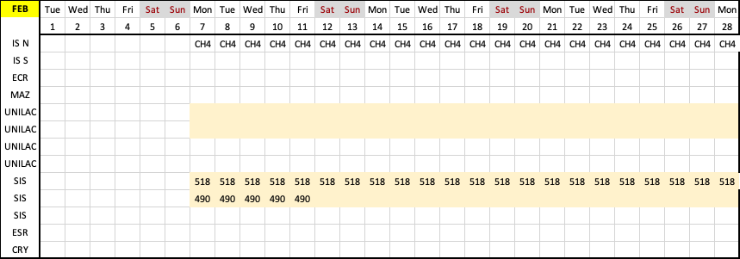
BTS 2022/02
DRAFT - for internal use only

Slide 10
BTS 2022/03
DRAFT - for internal use only

Slide 11
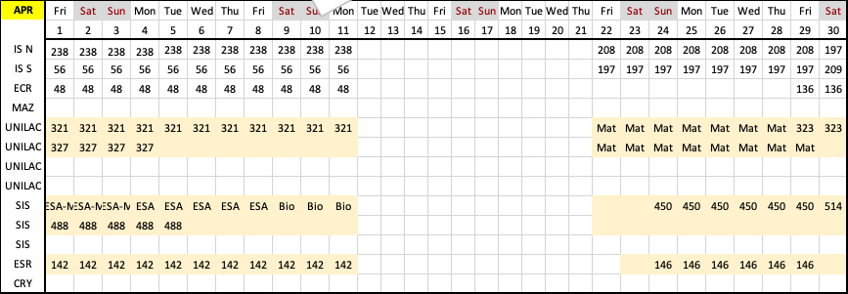
BTS 2022/04
DRAFT - for internal use only

Slide 12
BTS 2022/05
DRAFT - for internal use only

