Slide 1
Specific UNILAC requirements to Controls
U. Scheeler GSI Darmstadt
Workshop on 'Controls Developments for FAIR Commissioning and the Operation of the existing Accelerator Complex"

Slide 2
Outline
operation regime
challenges of high current operation
upgrades and new projects
conclusion

Slide 3
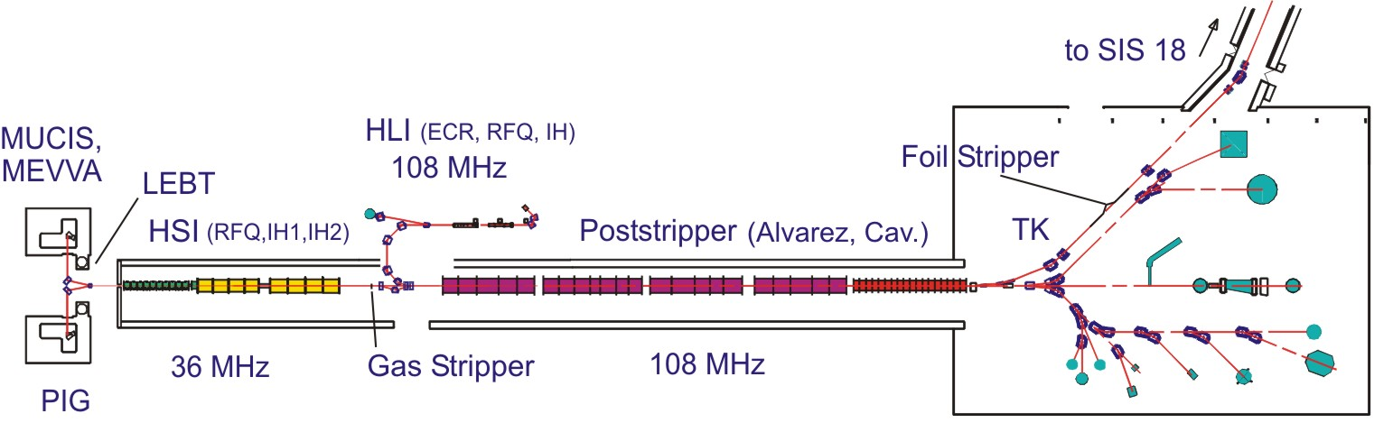
time sharing operation regime
repetition rate: up to 50 Hz at present -> 10 Hz for FAIR injection in future
for rf conditioning may be more

Slide 4
FAIR high current operation
upgrade of beam diagnostics systems (online survey of intensity, transmission, beam position) -> upgrade/exchange of present HW systems
reliable machine protection based on beam loss/ beam transmission measurements is needed
maximum repetition rate for access to the devices and measurement of beam parameters is essential
beam tuning at acceptance limit (feed back loop: operator <=> accelerator)

Slide 5
new projects at UNILAC
pulsed gas stripper
PRIDE (Terminal West)
18 Ghz ECR source and cw Linac

Slide 6
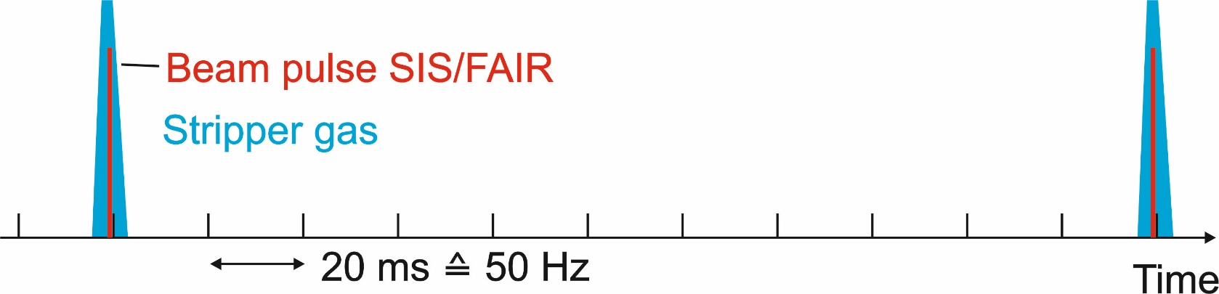
pulsed gas stripper
see contribution of P. Gerhard
beam pulse 2
stripper gas 2
beam pulse 1
stripper gas 1
arbitrary units
gas-stripper features:
mixed pulse operation (different targets)
pulse to pulse variation (pulse length up to 5ms), repetition frequency (up to 50 Hz)
beam intensity attenuation

Slide 7
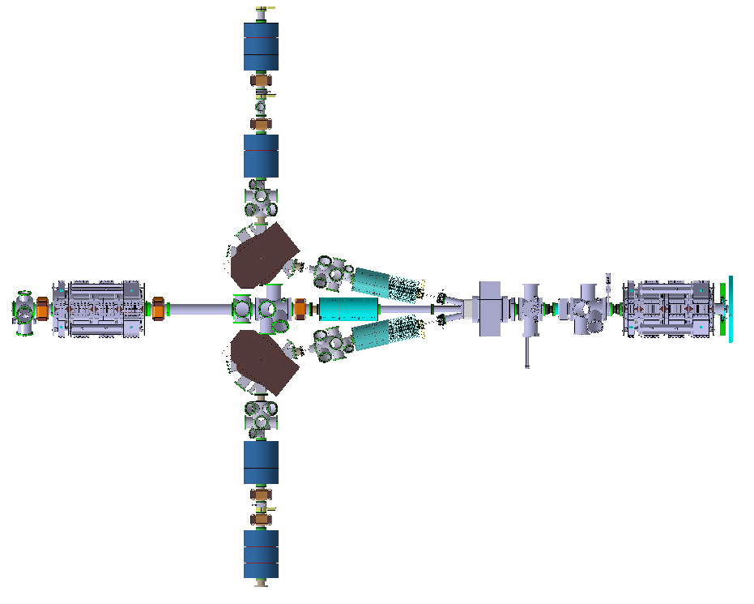
PRIDE
Terminal Nord
(MUCIS, VARIS)
²³⁸U⁴⁺ only
at 2.2 ^{keV}/_{u}
Terminal West:
same hardware and software for ion source as for Terminal Nord
Compact-LEBT:
new beamline has to be established and implemented into the control system
Terminal
West
High Current Injector
Terminal Süd
(PIG)

Slide 8
cw Linac with new injector and ECR
cw operation:
beam chopper for shared beam lines with UNILAC (time sharing)
beam diagnostics for cw and pulsed beam operation
beam loss detection/survey in cw operation
cryogenic infrastructure
time line: commissioning of cw start configuration (new cw injector+CM1+CM2 ) in 2025
SIS 18
SIS 18
18 GHz
EZR
cw-Linac
beam dump
14 GHz EZR
Advanced cw-LINAC test area
HLI
North
HSI
IH
RFQ
HSI
U⁴⁺
SHE
HE
-
LINAC2
UNILAC
HSI
HSI
ALVAREZ LINAC 1 - 5
EH
(Poststripper)
Exp.
South

Slide 9
Conclusion
time sharing operation is still the keyword, cw-operation is a new feature
not all upgrade measures are connected to a complex controls development
the upgrade of HW systems for machine protection and beam diagnostics control have to be handled carefully
Thank you!

