Slide 1
Specific Controls Requirements for pLinac Workshop on Controls Developments for FAIR Commissioning and the Operation of the existing Accelerator Complex 17 Sep 2020 C. Kleffner PLI

Slide 2
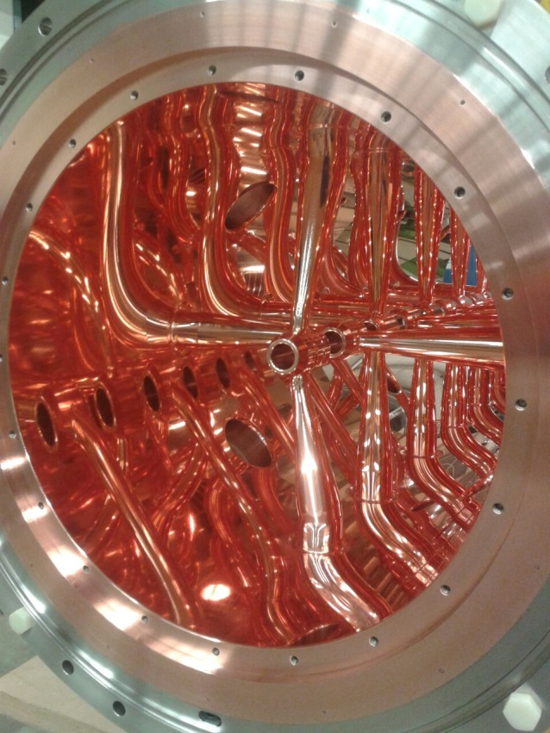
Overview
Beam Energy (MeV) | 70 → 68
Design Current (mA) | 70
Beam Pulse (µs) | 36
Repetition Rate (Hz) | 4 → 2,7
Frequency (MHz) | 325.224
Beam Loading (peak) (MW) | 4.9
RF Power (peak) (MW) | 2.2
Klystron (3 MW Peak Power) | 7
Solid State Amplifier | 3
Total Length (RFQ + CH) | ≈ 27 m

Slide 3
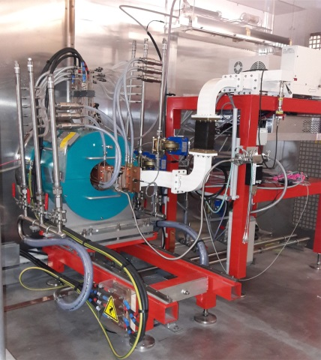
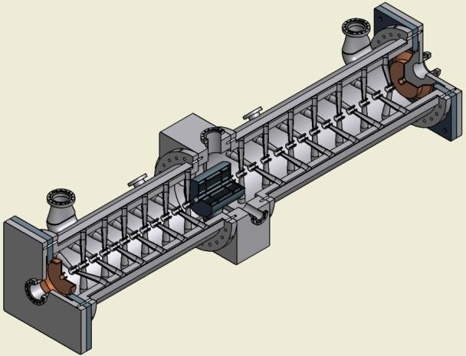
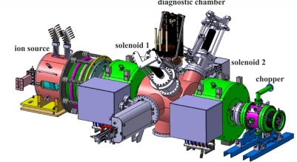
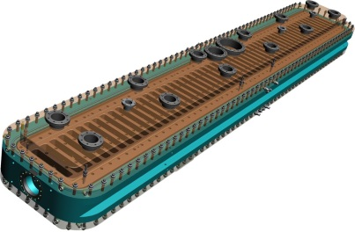
overall design
2.45 GHz ECR source generating 100 mA of 95 keV protons
LEBT & diagnostics chamber: faraday cup / allison scanner / wien filter
ladder 4-Rod RFQ with chopper and a beam dump in front
Six normal conducting crossbar cavities of CCH and CH type aranged in two sections with intermediate diagnostic section
CEA
IAP

Slide 4
pLinac: main devices
Control System Standard Devices
RF: 7 klystrons & modulators / 3 transitor amlipifiers
vacuum devices / pulsed power supplies / movable dev.
GSI (FAIR) beam instrumation devices
Non-Standard Standard Devices
CEA Ion Source, LEBT, BI, Chopper: Labview → LSA
mobile testbench with special BI devices during construction / set-up phase in the accelerator tunnel
CEA
IAP

Slide 5
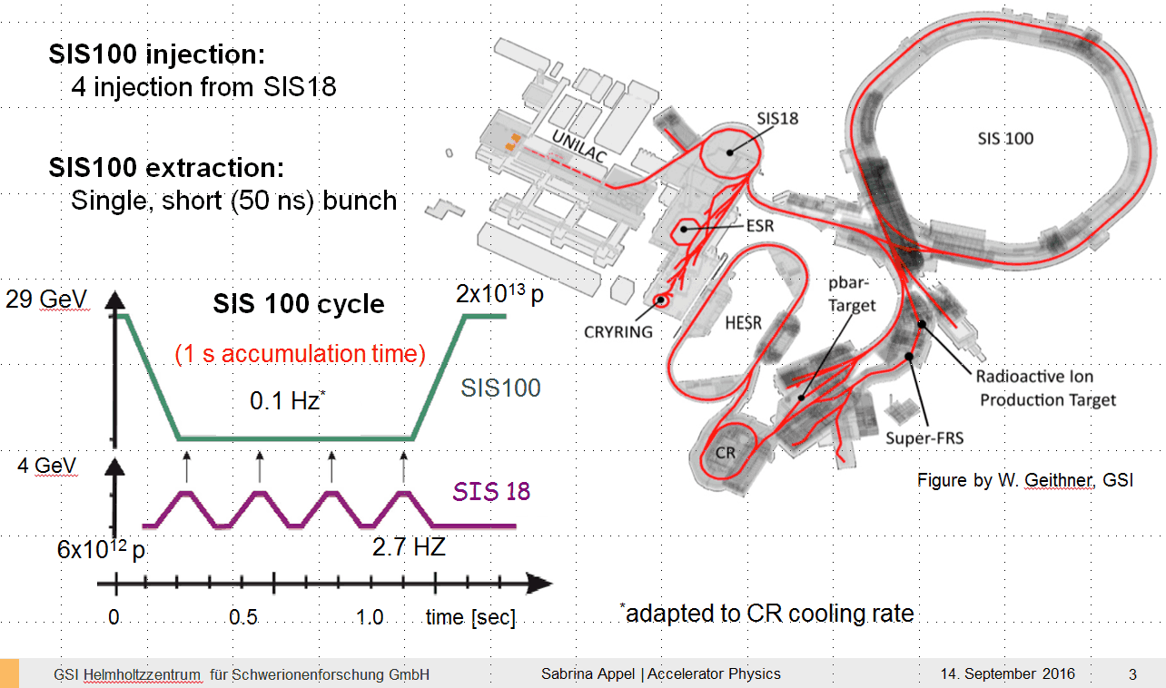
FAIR primary beam chain: Protons
pLinac

Slide 6
FAIR booster operation: Protons
anitiproton production chain in a periodic pattern

Slide 7
FAIR parallel operation
parallel operation
example pattern with periodic antiproton chain
parallel operation of Unilac and pLinac the TK !

Slide 8
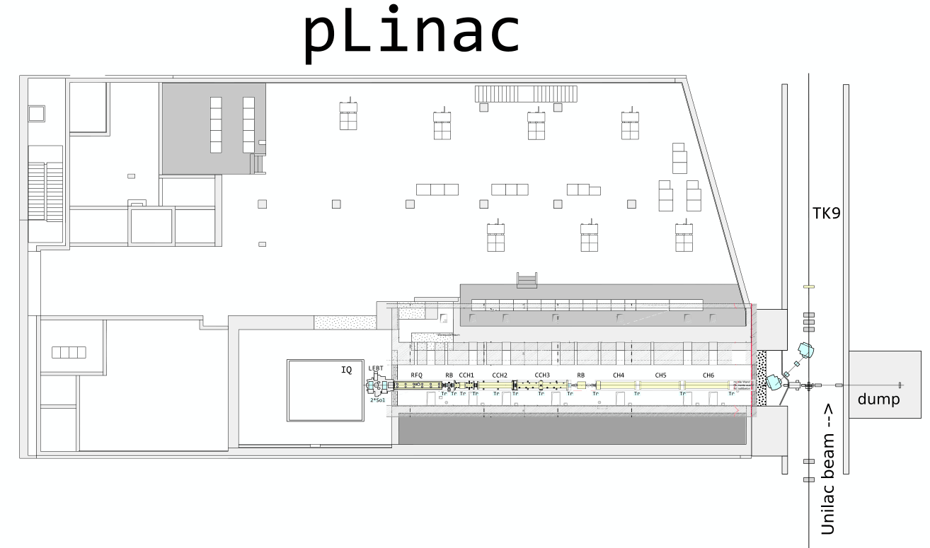
pLinac booster mode
SIS18
pLinac / Unilac parallel operation mode

Slide 9
pLinac machine-test beam-dump
periodic operation mode (i.e. 0,5 Hz)
independent to Unilac operation mode

Slide 10
pLinac machine-test with TK
TK9 Cup
periodic operation mode (i.e. 0,5 Hz)
exclusive pLinac

Slide 11
pLinac step-by-step installation
step-by-step cavity installation
and commissioning with beam
periodic operation mode (i.e. 0,5 Hz)
independent to Unilac operation mode
support of mobil testbench (spektrometer, beamshape monitor, emittance measurement …..
Start 2023 after ion source installation

Slide 12
pLinac demands
support of all devices including mobile testbench
parallel / indepent operation: timing / sequencer
stability pulses for RF systems (2,7 Hz ?)
parameter scans (orchestrated operation) of parameters should be possible
(spektrometer, amplitude/phase scans,…)
support for machine dependant applications?

Slide 13
thank you for your attention

