Slide 1
Commissioning of Power Converters
H. Welker/EPS
17.09.2020

Slide 2
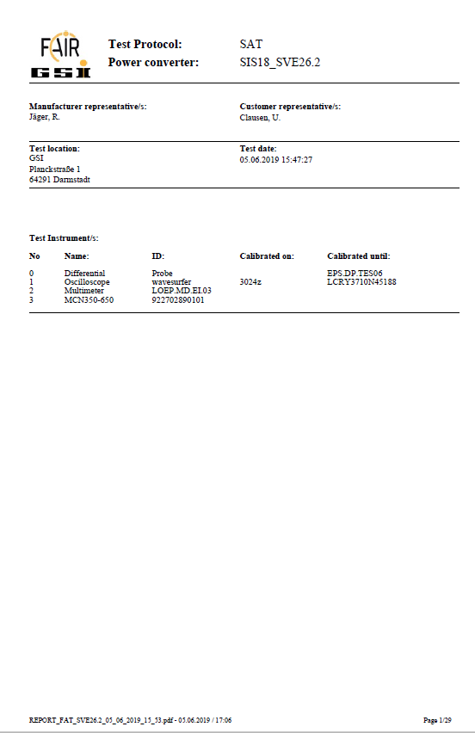
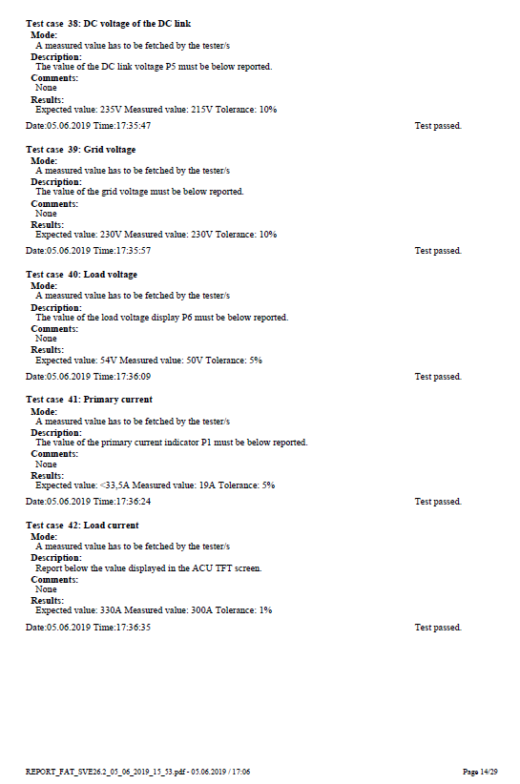
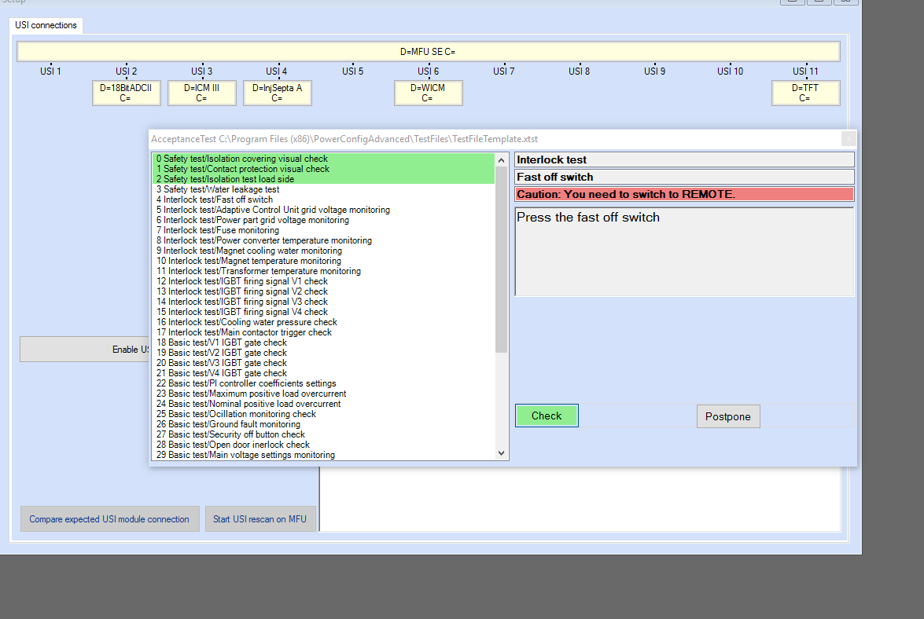
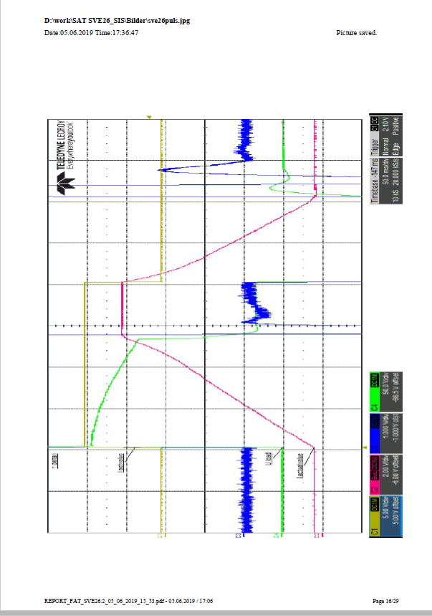
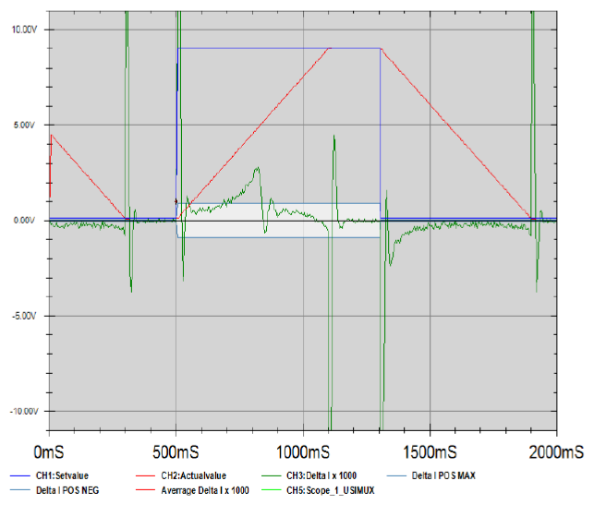
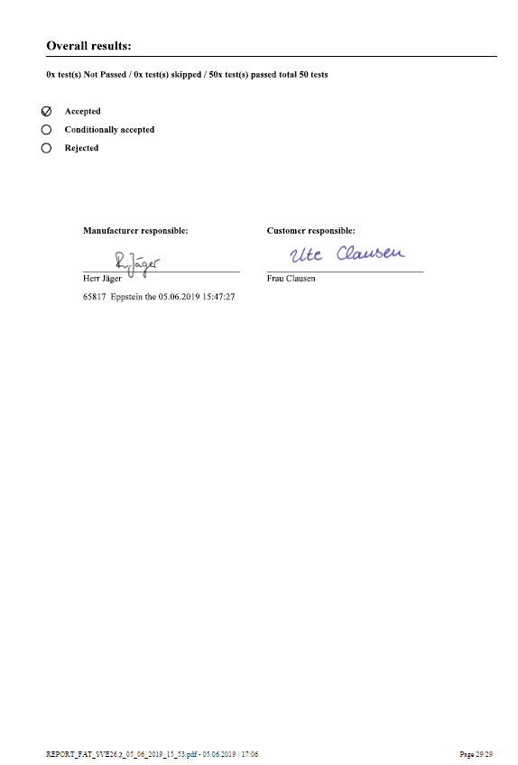
Commissioning of Power Converters
Acceptance of Power Converters FAT + SAT (Aa-Ba)
Acceptance tests will be performed with the power converter configuration software PCA as stand alone system. Generally no ACO hardware required or control system has to be available
PCA includes:
Semi automatic test procedure
Generation of set values
Generation of test reports
Generation of configuration files

Slide 3
Commissioning of Power Converters
Commissioning of Power Converters after Acceptance
New FESA-classes for new power converter topologies/functionalities required
Testing of control interface (preferably by automatized procedure)
On/off/reset
Supply of set values (I/U)
Read back of actual values/status
Testing of interfaces to MPS (ΔI monitoring) and PAS
Synchronous operation of large power converters for power tests (i.e. SIS 100 main systems together with SIS 18 main systems). Partially in SAT Ab, Ba required.
Uploading of parameter files to central storage place (via the control system)

Slide 4
Commissioning of Power Converters
Power converter data management / data exchange via control system
Write/read files to/from ACUs
Firmware, parameter files & configuration files
On demand to a single ACU
Via broadcast to a list of ACUs
Set internal ACU clock (time) once per day
Central storage of those files or interface to storage (database)
Compare files stored in ACU with files stored on database
In case of mismatch, actions to be taken have to be discussed in detail
Accessible for EPS
Post mortem analysis

